Slide 1
CMPE 152: Compiler Design March 2 Class Meeting
Department of Computer Engineering San Jose State University Spring 2021 Instructor: Ron Mak
www.cs.sjsu.edu/~mak

Slide 2
Scope and the Symbol Table Stack
The scope of an identifier is the part of the source program where that identifier can be used.
Everywhere in the program where the definition of the identifier is in effect.
A program creates a scope whenever it has identifiers that can only be used in a certain part of the program.
Example: Local variables of a function.
Scope is closely related to nesting levels and the symbol table stack.

Slide 3
Scope and the Symbol Table Stack, cont’d
Global scope
Nesting level 0: At the bottom of the symbol table stack.
All predefined global identifiers such as integer, real, boolean, char.
Program scope
Nesting level 1: One up from the bottom of the stack.
All identifiers declared at the “top level” of a program (not in a procedure or function).

Slide 4
Scope and the Symbol Table Stack, cont’d
Procedures, functions, and record definitions each has a scope.
Scopes in a Pascal program are nested.
An identifier can be redefined within a nested scope.
Within the nested scope, the definition in the nested scope overrides the definition in an outer scope.
Example: A function can have a local variable x which overrides a program variable x.
Each scope must have its own symbol table.

Slide 5
Scope and the Symbol Table Stack, cont’d
As the parser parses a program from top to bottom, it enters and exits nested scopes.
Whenever the parser enters a scope, it must push that scope’s symbol table onto the symbol table stack.
Whenever the parser exits a scope, it must pop that scope’s symbol table off the stack.

Slide 6
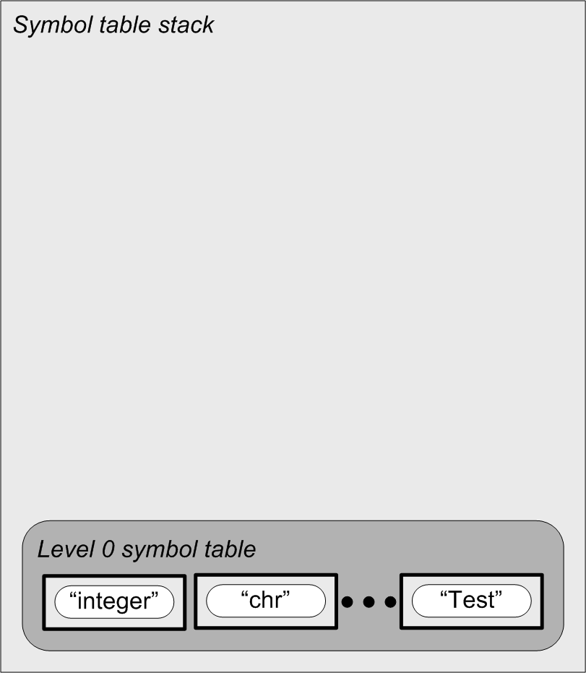
Nested Scopes and the Symbol Table Stack
PROGRAM Test;
VAR i, j, k, n : integer;
PROCEDURE p(j : real);
VAR k : char;
FUNCTION f(x : real) : real;
VAR i:real;
BEGIN {f}
f := i + j + n + x;
END {f};
BEGIN {p}
k := chr(i + trunc(f(n)));
END {p};
BEGIN {test}
p(j + k + n)
END {test}.
Note that the program name
Test is defined in the global
scope at level 0.

Slide 7
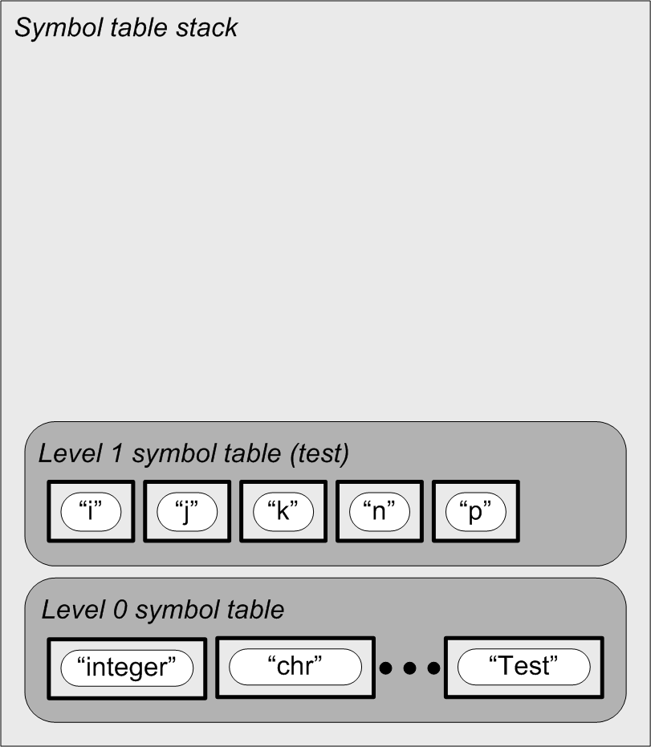
Nested Scopes and the Symbol Table Stack
PROGRAM Test;
VAR i, j, k, n : integer;
PROCEDURE p(j : real);
VAR k : char;
FUNCTION f(x : real) : real;
VAR i:real;
BEGIN {f}
f := i + j + n + x;
END {f};
BEGIN {p}
k := chr(i + trunc(f(n)));
END {p};
BEGIN {test}
p(j + k + n)
END {test}.

Slide 8
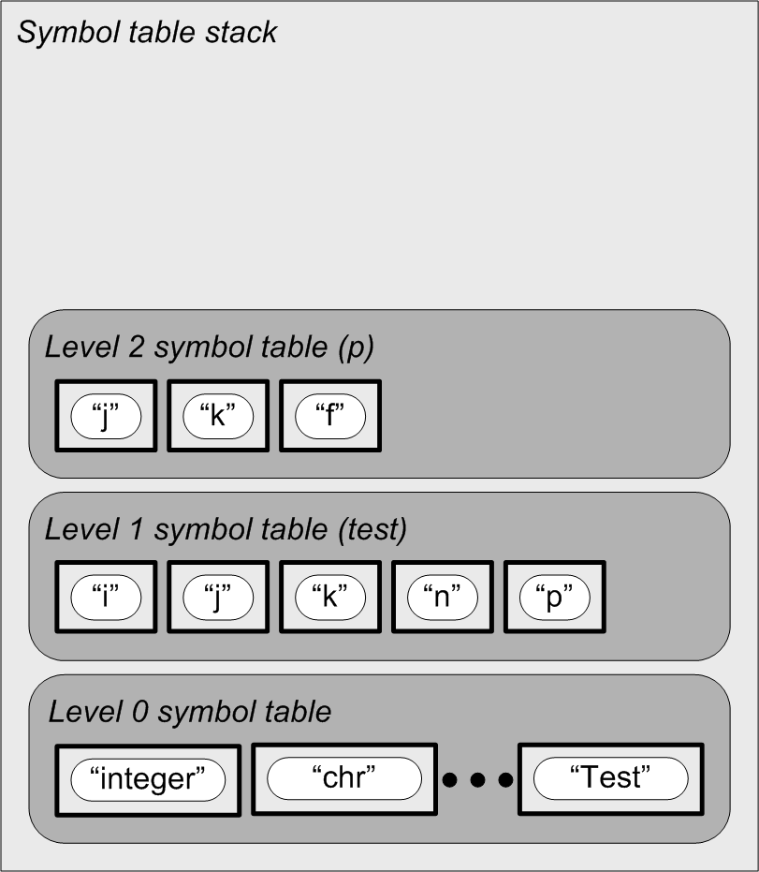
Nested Scopes and the Symbol Table Stack
PROGRAM Test;
VAR i, j, k, n : integer;
PROCEDURE p(j : real);
VAR k : char;
FUNCTION f(x : real) : real;
VAR i:real;
BEGIN {f}
f := i + j + n + x;
END {f};
BEGIN {p}
k := chr(i + trunc(f(n)));
END {p};
BEGIN {test}
p(j + k + n)
END {test}.

Slide 9
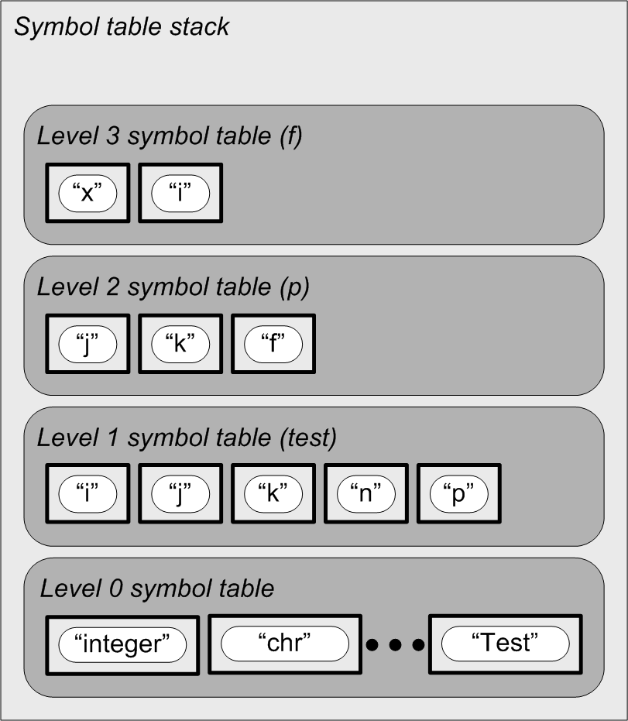
Nested Scopes and the Symbol Table Stack
PROGRAM Test;
VAR i, j, k, n : integer;
PROCEDURE p(j : real);
VAR k : char;
FUNCTION f(x : real) : real;
VAR i:real;
BEGIN {f}
f := i + j + n + x;
END {f};
BEGIN {p}
k := chr(i + trunc(f(n)));
END {p};
BEGIN {test}
p(j + k + n)
END {test}.

Slide 10
Nested Scopes and the Symbol Table Stack
PROGRAM Test;
VAR i, j, k, n : integer;
PROCEDURE p(j : real);
VAR k : char;
FUNCTION f(x : real) : real;
VAR i:real;
BEGIN {f}
f := i + j + n + x;
END {f};
BEGIN {p}
k := chr(i + trunc(f(n)));
END {p};
BEGIN {test}
p(j + k + n)
END {test}.

Slide 11
Nested Scopes and the Symbol Table Stack
PROGRAM Test;
VAR i, j, k, n : integer;
PROCEDURE p(j : real);
VAR k : char;
FUNCTION f(x : real) : real;
VAR i:real;
BEGIN {f}
f := i + j + n + x;
END {f};
BEGIN {p}
k := chr(i + trunc(f(n)));
END {p};
BEGIN {test}
p(j + k + n)
END {test}.

Slide 12
Nested Scopes and the Symbol Table Stack
PROGRAM Test;
VAR i, j, k, n : integer;
PROCEDURE p(j : real);
VAR k : char;
FUNCTION f(x : real) : real;
VAR i:real;
BEGIN {f}
f := i + j + n + x;
END {f};
BEGIN {p}
k := chr(i + trunc(f(n)));
END {p};
BEGIN {test}
p(j + k + n)
END {test}.

Slide 13
Nested Scopes and the Symbol Table Stack
PROGRAM Test;
VAR i, j, k, n : integer;
PROCEDURE p(j : real);
VAR k : char;
FUNCTION f(x : real) : real;
VAR i:real;
BEGIN {f}
f := i + j + n + x;
END {f};
BEGIN {p}
k := chr(i + trunc(f(n)));
END {p};
BEGIN {test}
p(j + k + n)
END {test}.
Each routine’s local
names are defined
in that routine’s scope.
Each routine’s name
is defined in the
parent’s scope.

Slide 14
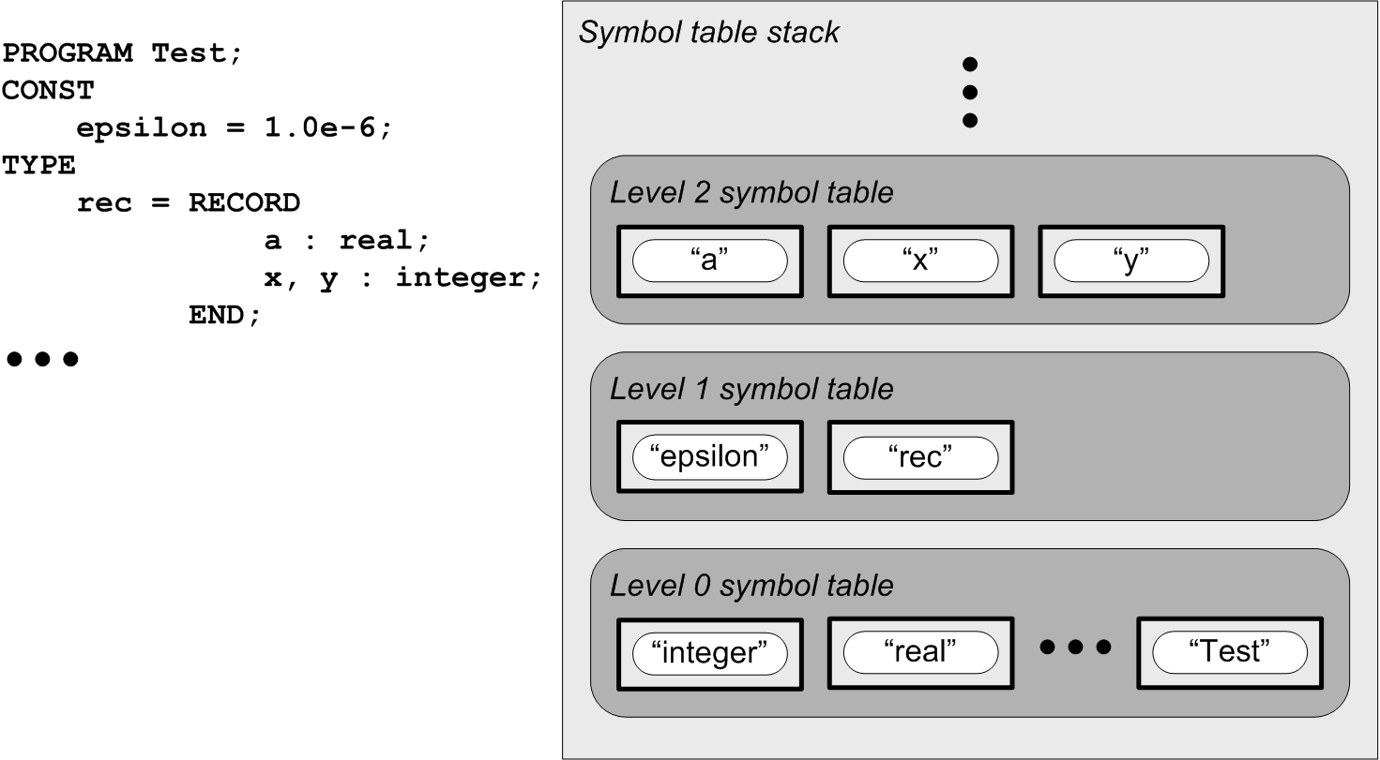
The Scope of Record Fields
Each record type has a symbol table:
Program symbol table
Note that the program name
Test is defined in the global
scope at level 0.
Global symbol table

Slide 15
Class SymtabEntry
SymtabEntry.h
enum class Kind
{
CONSTANT, ENUMERATION_CONSTANT, TYPE, VARIABLE, RECORD_FIELD,
VALUE_PARAMETER, REFERENCE_PARAMETER, PROGRAM_PARAMETER,
PROGRAM, PROCEDURE, FUNCTION,
UNDEFINED
};
class SymtabEntry
{
private:
/**
* Information for each kind of identifier.
*/
union EntryInfo
{
struct
{
Object *value;
} data;
};
There will be more structs
in this union later.

Slide 16
Class SymtabEntry, cont’d
SymtabEntry.h
string name; // identifier name
Kind kind; // what kind of identifier
Symtab *symtab; // parent symbol table
Typespec *typespec; // type specification
vector<int> lineNumbers; // source line numbers
EntryInfo info; // entry information
public:
SymtabEntry(const string name, const Kind kind, Symtab *symtab)
: name(name), kind(kind), symtab(symtab), typespec(nullptr)
{
switch (kind)
{
case Kind::CONSTANT:
case Kind::ENUMERATION_CONSTANT:
case Kind::VARIABLE:
case Kind::RECORD_FIELD:
case Kind::VALUE_PARAMETER:
info.data.value = nullptr;
break;
default: break;
}
}
virtual ~SymtabEntry() {}

Slide 17
Class SymtabEntry, cont’d
SymtabEntry.h
string getName() const { return name; }
Kind getKind() const { return kind; }
void setKind(Kind kind) { this->kind = kind; }
Symtab *getSymtab() const { return symtab; }
Typespec *getType() const { return typespec; }
void setType(Typespec *typespec) { this->typespec = typespec; }
vector<int> *getLineNumbers() { return &lineNumbers; }
void appendLineNumber(const int _number)
{
lineNumbers.push_back(_number);
}
Object getValue() const { return *(info.data.value); }
void setValue(Object value) { info.data.value = new Object(value); }

Slide 18
Class Symtab
Symtab.h
class Symtab
{
private:
int nestingLevel; // scope nesting level
SymtabEntry *ownerId; // symbol table entry of the owner
map<string, SymtabEntry *> contents; // entries
static int unnamedIndex; // index for unnamed type names
public:
Symtab(const int nestingLevel)
: nestingLevel(nestingLevel), ownerId(nullptr) {}
virtual ~Symtab() {}
int getNestingLevel() const { return nestingLevel; }
static string generateUnnamedName()
{
unnamedIndex++;
return UNNAMED_PREFIX + to_string(unnamedIndex);
}

Slide 19
Class Symtab, cont’d
Symtab.h
SymtabEntry *getOwner() { return ownerId; }
void setOwner(SymtabEntry *ownerId) { this->ownerId = ownerId; }
SymtabEntry *enter(const string name, const Kind kind)
{
SymtabEntry *entry = new SymtabEntry(name, kind, this);
contents[name] = entry;
return entry;
}
SymtabEntry *lookup(const string name)
{
return (contents.find(name) != contents.end()) ? contents[name]
: nullptr;
}

Slide 20
Class Symtab, cont’d
vector<SymtabEntry *> sortedEntries()
{
vector<SymtabEntry *> list;
map<string, SymtabEntry *>::iterator it;
// Iterate over the sorted entries and append them to the list.
for (it = contents.begin(); it != contents.end(); it++)
{
list.push_back(it->second);
}
return list; // sorted list of entries
}
void resetVariables(Kind kind)
{
vector<SymtabEntry *> list;
map<string, SymtabEntry *>::iterator it;
// Iterate over the entries and reset their kind.
for (it = contents.begin(); it != contents.end(); it++)
{
SymtabEntry *entry = it->second;
if (entry->getKind() == VARIABLE) entry->setKind(kind);
}
}
};
Symtab.h

Slide 21
Class SymtabStack
class SymtabStack
{
private:
int current_nesting_level; // current scope nesting level
SymtabEntry *program_id; // entry for the main program id
vector<Symtab *> stack;
public:
SymtabStack() : current_nesting_level(0), program_id(nullptr)
{
stack.push_back(new Symtab(0));
}
virtual ~SymtabStack()
{
for (Symtab *symtab : stack) if (symtab != nullptr) delete symtab;
}
int getCurrentNestingLevel() const { return current_nesting_level; }
SymtabEntry *getProgramId() const { return program_id; }
void setProgramId(SymtabEntry *id) { program_id = id; }
Symtab *getLocalSymtab() const { return stack[current_nesting_level]; }
SymtabStack.h

Slide 22
Class SymtabStack, cont’d
SymtabStack.h
Symtab *push()
{
Symtab *symtab = new Symtab(++current_nesting_level);
stack.push_back(symtab);
return symtab;
}
Symtab *push(Symtab *symtab)
{
++current_nesting_level;
stack.push_back(symtab);
return symtab;
}
Symtab *pop()
{
Symtab *symtab = stack[current_nesting_level];
stack.erase(stack.begin() + current_nesting_level);
current_nesting_level--;
return symtab;
}

Slide 23
Class SymtabStack, cont’d
SymtabEntry *enterLocal(const string name, const Kind kind)
{
return stack[current_nesting_level]->enter(name, kind);
}
SymtabEntry *lookupLocal(const string name) const
{
return stack[current_nesting_level]->lookup(name);
}
SymtabEntry *lookup(const string name) const
{
SymtabEntry *found_entry = nullptr;
// Search the current and enclosing scopes.
for (int i = current_nesting_level;
(i >= 0) && (found_entry == nullptr); --i)
{
found_entry = stack[i]->lookup(name);
}
return found_entry;
}
};
SymtabEntry.h

Slide 24
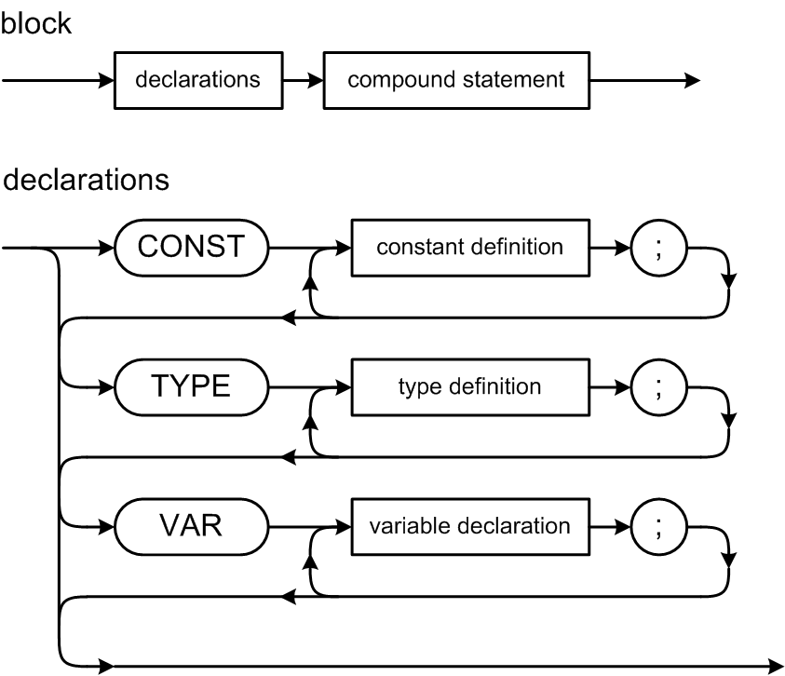
Pascal Declarations
The CONST, TYPE, and VAR parts are optional, but they must come in this order.
Note that constants and types are defined, but variables are declared.
Collectively, you refer to all of them as declarations.

Slide 25
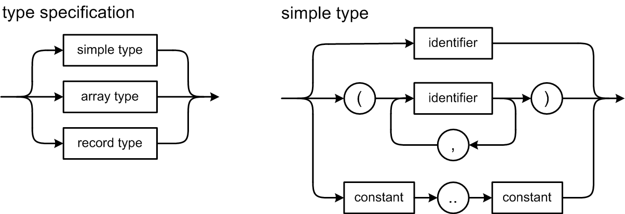
Pascal Declarations, cont’d

Slide 26
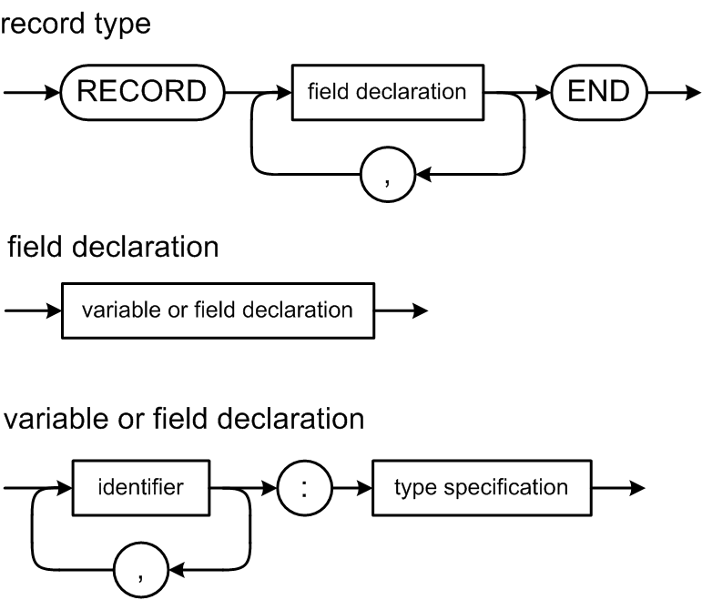
Pascal Declarations, cont’d

Slide 27
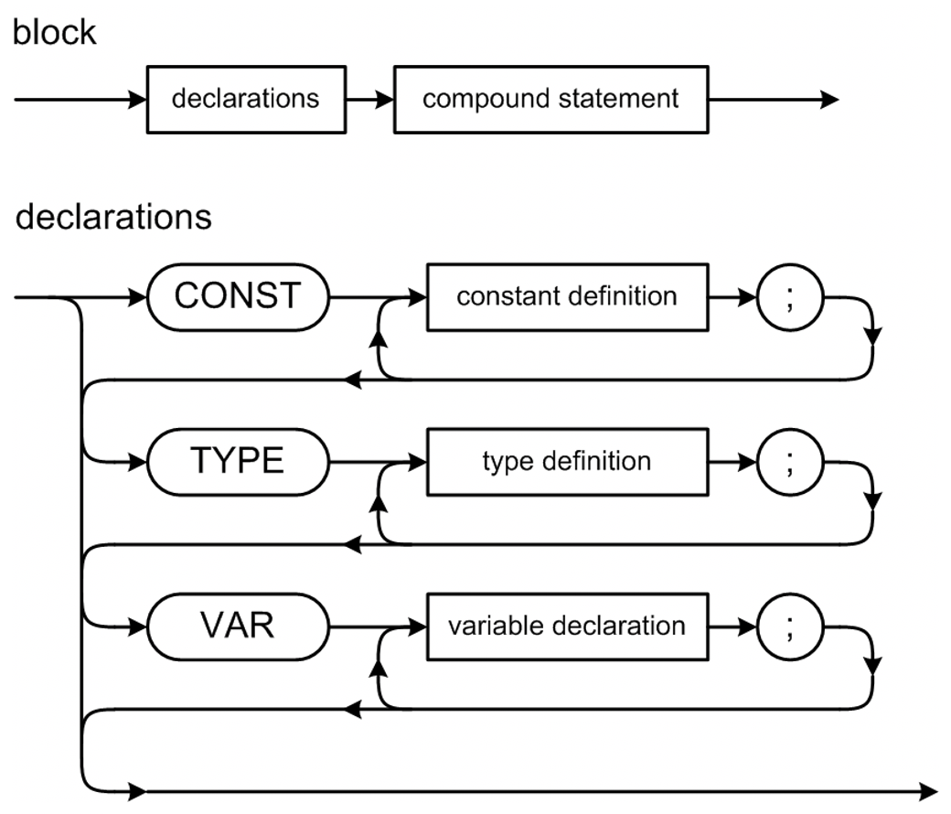
Grammar File Pcl5.g4
grammar Pcl5;
program : programHeader block '.' ;
programHeader : PROGRAM IDENTIFIER programParameters? ';' ;
programParameters : '(' IDENTIFIER ( ',' IDENTIFIER )* ')' ;
block : declarations compoundStatement ;
declarations : ( constantsPart ';' )? ( typesPart ';' )?
( variablesPart ';' )? ( routinesPart ';')? ;
constantsPart : CONST constantDefinitionsList ;
constantDefinitionsList : constantDefinition ( ';' constantDefinition )* ;
constantDefinition : constantIdentifier '=' constant ;
constantIdentifier : IDENTIFIER ;
constant
: sign? ( IDENTIFIER | unsignedNumber )
| characterConstant
| stringConstant
;
Pcl5.g4

Slide 28
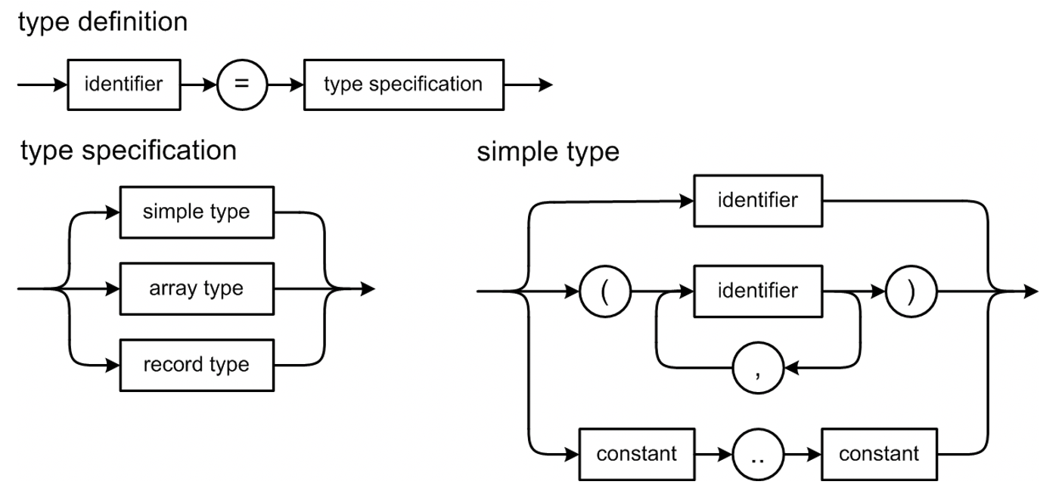
Grammar File Pcl5.g4, cont’d
typesPart : TYPE typeDefinitionsList ;
typeDefinitionsList : typeDefinition ( ';' typeDefinition )* ;
typeDefinition : typeIdentifier '=' typeSpecification ;
typeIdentifier : IDENTIFIER ;
typeSpecification
: simpleType # simpleTypespec
| arrayType # arrayTypespec
| recordType # recordTypespec
;
simpleType
: typeIdentifier # typeIdentifierTypespec
| enumerationType # enumerationTypespec
| subrangeType # subrangeTypespec
;
Pcl5.g4

Slide 29
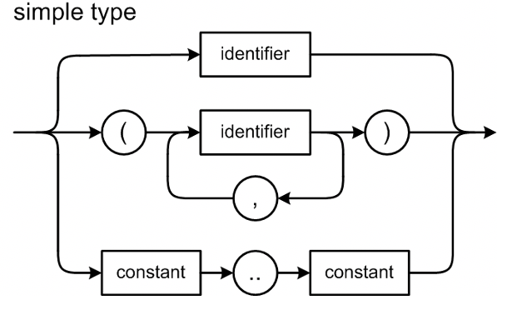
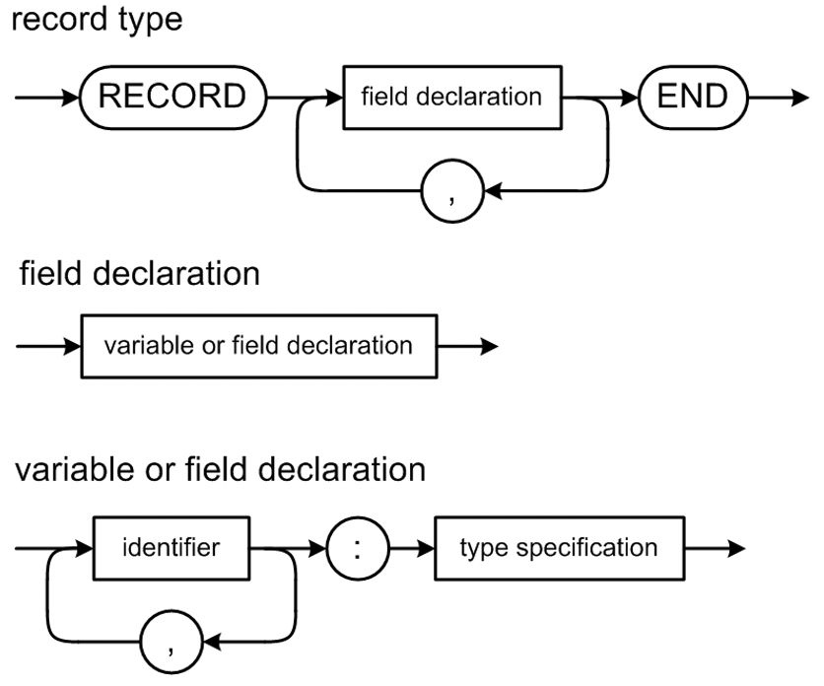
Grammar File Pcl5.g4, cont’d
enumerationType : '(' enumerationConstant ( ',' enumerationConstant )* ')' ;
enumerationConstant : constantIdentifier ;
subrangeType : constant '..' constant ;
arrayType
: ARRAY '[' arrayDimensionList ']' OF typeSpecification ;
arrayDimensionList : simpleType ( ',' simpleType )* ;
recordType : RECORD recordFields ';'? END ;
recordFields : variableDeclarationsList ;
variablesPart : VAR variableDeclarationsList ;
variableDeclarationsList : variableDeclarations ( ';' variableDeclarations )* ;
variableDeclarations : variableIdentifierList ':' typeSpecification ;
variableIdentifierList : variableIdentifier ( ',' variableIdentifier )* ;
variableIdentifier : IDENTIFIER ;
routinesPart : ;
Pcl5.g4

Slide 30
Declarations and the Symbol Table
Identifiers from Pascal declarations that we will enter into a symbol table, names of:
constants
types
enumeration values
record fields
variables
Information from parsing type specifications:
simple types
array types
record types
Notes:
START HERE.

Slide 31
Type Specification Attributes
Each type specification has certain attributes depending on its form.
Type form
Type specification attributes
Scalar
None
Enumeration
List of enumeration constant identifiers
Subrange
Base type
Minimum value
Maximum value
Array
Index type
Element type
Element count
Record
A separate symbol table for the field identifiers

Slide 32
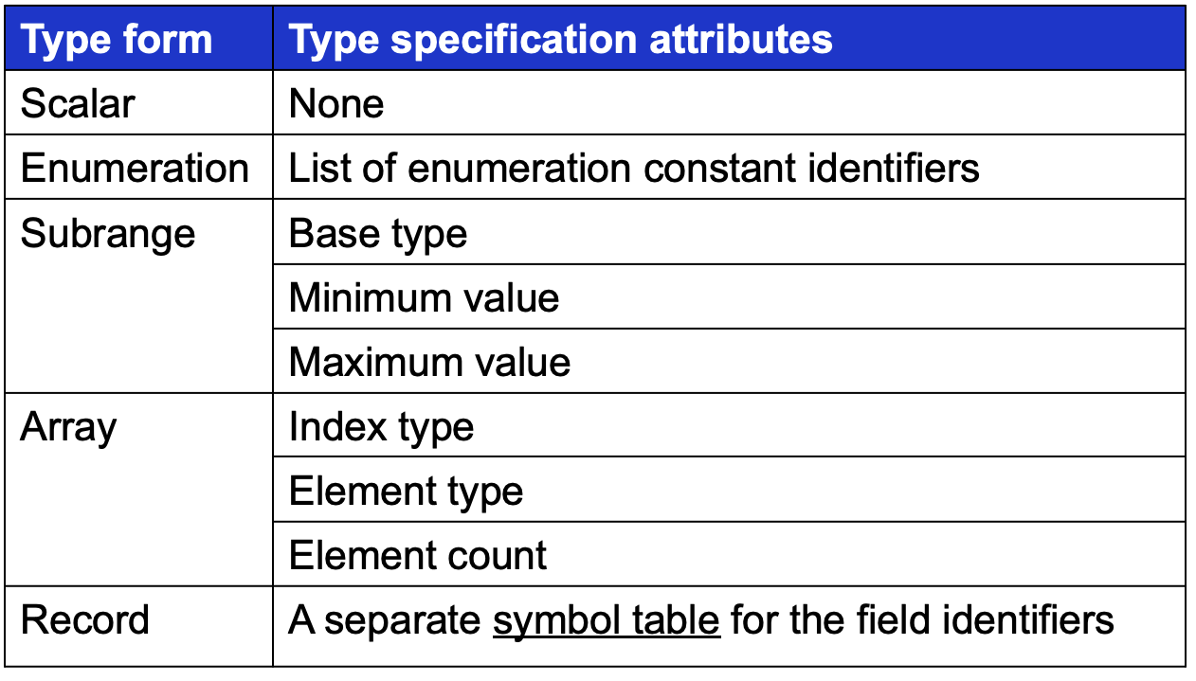
Class Typespec
Typespec.h
enum class Form
{
SCALAR, ENUMERATION, SUBRANGE, ARRAY, RECORD,
};
class Typespec
{
private:
/**
* Information for each type form.
*/
union TypeInfo
{
struct
{
vector<SymtabEntry *> *constants;
} enumeration;
struct
{
Typespec *baseType;
int minValue;
int maxValue;
} subrange;

Slide 33
Class Typespec, cont’d
struct
{
Typespec *indexType;
Typespec *elementType;
int elementCount;
} array;
struct
{
string *typePath;
Symtab *symtab;
} record;
};
Form form;
SymtabEntry *identifier; // type identifier
TypeInfo info;
public:
Typespec() : form((Form) -1), identifier(nullptr) {}
Typespec.h

Slide 34
Class Typespec, cont’d
Typespec.h
Typespec(Form form) : form(form), identifier(nullptr)
{
switch (form)
{
case Form::ENUMERATION:
info.enumeration.constants = new vector<SymtabEntry *>();
break;
case Form::SUBRANGE:
info.subrange.minValue = 0;
info.subrange.maxValue = 0;
info.subrange.baseType = nullptr;
break;
case Form::ARRAY:
info.array.indexType = nullptr;
info.array.elementType = nullptr;
info.array.elementCount = 0;
break;

Slide 35
Class Typespec, cont’d
Typespec.h
case Form::RECORD:
info.record.typePath = nullptr;
info.record.symtab = nullptr;
break;
default: break;
}
}
virtual ~Typespec() {}
bool isStructured() const
{
return (form == ARRAY) || (form == RECORD);
}
Form getForm() const { return form; }
SymtabEntry *getIdentifier() const { return identifier; }
void setIdentifier(SymtabEntry *identifier) { this->identifier = identifier; }
Typespec *baseType()
{
return form == Form::SUBRANGE ? info.subrange.baseType : this;
}

Slide 36
Class Typespec, cont’d
Typespec.h
Typespec *getSubrangeBaseType()
{
return info.subrange.baseType;
}
void setSubrangeBaseType(Typespec *baseType)
{
info.subrange.baseType = baseType;
}
int getSubrangeMinValue() const { return info.subrange.minValue; }
void setSubrangeMinValue(const int min_value)
{
info.subrange.minValue = min_value;
}
int getSubrangeMaxValue() const { return info.subrange.maxValue; }
void setSubrangeMaxValue(const int max_value)
{
info.subrange.maxValue = max_value;
}

Slide 37
Class Typespec, cont’d
vector<SymtabEntry *> *getEnumerationConstants() const
{
return info.enumeration.constants;
}
void setEnumerationConstants(vector<SymtabEntry *> *constants)
{
info.enumeration.constants = constants;
}
Typespec.h

Slide 38
Class Typespec, cont’d
Typespec *getArrayIndexType() const { return info.array.indexType; }
void setArrayIndexType(Typespec *index_type)
{
info.array.indexType = index_type;
}
Typespec *getArrayElementType() const { return info.array.elementType; }
void setArrayElementType(Typespec *elmt_type)
{
info.array.elementType = elmt_type;
}
int getArrayElementCount() const { return info.array.elementCount; }
void setArrayElementCount(const int elmt_count)
{
info.array.elementCount = elmt_count;
}
Typespec.h

Slide 39
Class Typespec, cont’d
public int getArrayElementCount() { return ((ArrayInfo) info).elementCount; }
public void setArrayElementCount(int elementCount)
{
((ArrayInfo) info).elementCount = elementCount;
}
public Typespec getArrayBaseType()
{
Typespec elmtType = this;
while (elmtType.form == Form.ARRAY)
{
elmtType = elmtType.getArrayElementType();
}
return elmtType.baseType();
}
Typespec.h

Slide 40
Class Typespec, cont’d
Symtab *getRecordSymtab() const { return info.record.symtab; }
void setRecordSymtab(Symtab *symtab)
{
info.record.symtab = symtab;
}
Typespec.h

