Slide 1


CMPE 152: Compiler Design
February 23 Class Meeting
Department of Computer Engineering
San Jose State University
Spring 2021
Instructor: Ron Mak
www.cs.sjsu.edu/~mak

Slide 2
Example ANTLR Grammar File
Expr.g4
grammar Expr;
program: statement+ ;
statement : expr NEWLINE
| IDENTIFER '=' expr NEWLINE
| NEWLINE
;
expr: expr ('*'|'/') expr
| expr ('+'|'-') expr
| INTEGER
| IDENTIFER
| '(' expr ')'
;
IDENTIFER : [a-zA-Z]+ ;
INTEGER : [0-9]+ ;
NEWLINE : '\r'? '\n' ;
WS : [ \t]+ -> skip ;
One or more statements.
input.txt
193
a = 5
b = 6
a+b*2
(1+2)*3
One or more lower- or upper-case letters.
One or more digits.
The line-feed character optionally preceded by the carriage-return character.
Skip whitespace characters.

Slide 3
A C++ Main Program for ANTLR
#include <iostream>
#include <fstream>
#include "antlr4-runtime.h"
#include "ExprLexer.h"
#include "ExprParser.h"
using namespace antlrcpp;
using namespace antlr4;
using namespace std;
int main(int argc, const char *args[])
{
ifstream source;
// Create the input stream.
source.open(args[1]);
ANTLRInputStream input(source);
// Create a lexer which scans the input stream
// to create a token stream.
ExprLexer lexer(&input);
CommonTokenStream tokens(&lexer);
ExprMain.cpp

Slide 4
A C++ Main Program for ANTLR, cont’d
// Print the token stream.
cout << "Tokens:" << endl;
tokens.fill();
for (Token *token : tokens.getTokens())
{
std::cout << token->toString() << std::endl;
}
// Create a parser which parses the token stream
// to create a parse tree.
ExprParser parser(&tokens);
tree::ParseTree *tree = parser.program();
// Print the parse tree in Lisp format.
cout << endl << "Parse tree (Lisp format):" << endl;
std::cout << tree->toStringTree(&parser) << endl;
return 0;
}

Slide 5
Environment Setup
First set up your environment,
or create equivalent shell scripts.
  Use your own file paths, of course.
export ANTLR_JAR="$HOME/ANTLR-4.8/antlr-4.8-complete.jar"
export CLASSPATH="$CLASSPATH:$ANTLR_JAR"
alias antlr4="java -jar $ANTLR_JAR"
alias grun='java org.antlr.v4.gui.TestRig'
The latest version of ANTLR 4 is 4.9.1
Demo
Notes:
START HERE

Slide 6
On the Command Line
ANTLR-ExprTestCpp: ls
Expr.g4 ExprMain.cpp input.txt
ANTLR-ExprTestCpp: antlr4 -Dlanguage=Cpp Expr.g4
ANTLR-ExprTestCpp: ls
Expr.g4 ExprBaseListener.cpp ExprLexer.h ExprListener.cpp ExprParser.cpp
Expr.interp ExprBaseListener.h ExprLexer.interp ExprListener.h ExprParser.h
Expr.tokens ExprLexer.cpp ExprLexer.tokens ExprMain.cpp input.txt
ANTLR-ExprTestCpp: g++ -std=c++0x -I/Users/rmak/ANTLR-4.8/antlr4-runtime \
-L/Users/rmak/ANTLR-4.8/lib -lantlr4-runtime -o Expr Expr*.cpp

Slide 7
On the Command Line, cont’d
ANTLR-ExprTestCpp: ./Expr input.txt
Tokens:
[@0,0:2='193',<9>,1:0]
[@1,3:3='\n',<10>,1:3]
[@2,4:4='a',<8>,2:0]
[@3,6:6='=',<1>,2:2]
[@4,8:8='5',<9>,2:4]
[@5,9:9='\n',<10>,2:5]
[@6,10:10='b',<8>,3:0]
[@7,12:12='=',<1>,3:2]
[@8,14:14='6',<9>,3:4]
[@9,15:15='\n',<10>,3:5]
[@10,16:16='a',<8>,4:0]
[@11,17:17='+',<4>,4:1]
[@12,18:18='b',<8>,4:2]
[@13,19:19='*',<2>,4:3]
[@14,20:20='2',<9>,4:4]
[@15,21:21='\n',<10>,4:5]
[@16,22:22='(',<6>,5:0]
[@17,23:23='1',<9>,5:1]
[@18,24:24='+',<4>,5:2]
[@19,25:25='2',<9>,5:3]
[@20,26:26=')',<7>,5:4]
[@21,27:27='*',<2>,5:5]
[@22,28:28='3',<9>,5:6]
[@23,29:29='\n',<10>,5:7]
[@24,30:29='<EOF>',<-1>,6:0]
Parse tree (Lisp format):
(program (statement (expr 193) \n) (statement a = (expr 5) \n) (statement b = (expr 6) \n)
(statement (expr (expr a) + (expr (expr b) * (expr 2))) \n)
(statement (expr (expr ( (expr (expr 1) + (expr 2)) )) * (expr 3)) \n))
input.txt
193
a = 5
b = 6
a+b*2
(1+2)*3

Slide 8
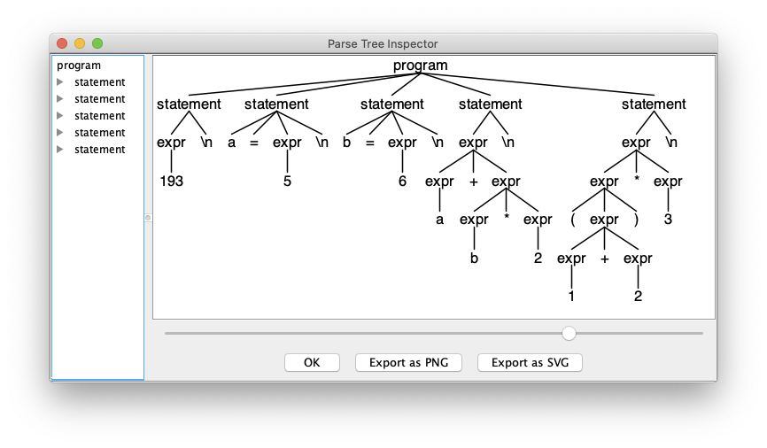
The Java grun Tool
ANTLR-ExprTestCpp: antlr4 Expr.g4
ANTLR-ExprTestCpp: ls
Expr ExprBaseListener.cpp ExprLexer.h ExprListener.cpp ExprParser.cpp
Expr.g4 ExprBaseListener.h ExprLexer.interp ExprListener.h ExprParser.h
Expr.interp ExprBaseListener.java ExprLexer.java ExprListener.java ExprParser.java
Expr.tokens ExprLexer.cpp ExprLexer.tokens ExprMain.cpp input.txt
ANTLR-ExprTestCpp: javac Expr*.java
ANTLR-ExprTestCpp: grun Expr program -gui input.txt
input.txt
193
a = 5
b = 6
a+b*2
(1+2)*3
grun is a Java program that
provides a main for the
generated lexer and parser.

Slide 9
What Does ANTLR Do for Us?
Generate a lexer (scanner) based on the token specifications (regular expressions) in the grammar file.
Generate a parser based on the production rules in the grammar file.
Generate visit interfaces and default visit methods for the back end.
Create graphical syntax diagrams and parse trees from the grammar and source files.
Expr.g4
ExprLexer
Expr.g4
ExprParser
ExprVisitor
ExprBaseVisitor

Slide 10
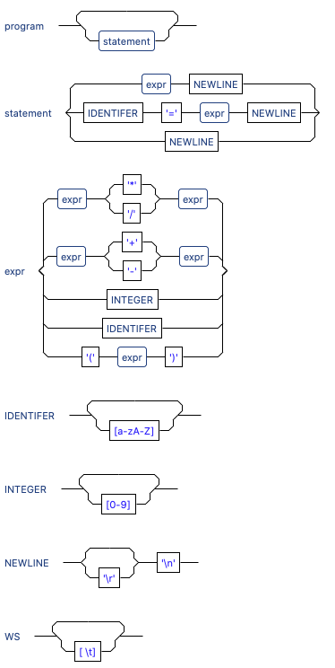
Syntax Diagrams (Eclipse Plugin)
Expr.g4
grammar Expr;
program: statement+ ; // at least one statement
statement : expr NEWLINE
| IDENTIFER '=' expr NEWLINE
| NEWLINE
;
expr: expr ('*'|'/') expr
| expr ('+'|'-') expr
| INTEGER
| IDENTIFER
| '(' expr ')'
;
IDENTIFER : [a-zA-Z]+ ;
INTEGER : [0-9]+ ;
NEWLINE : '\r'? '\n' ;
WS : [ \t]+ -> skip ; // skip whitespace
ANTLR 4 plug-in
for Eclipse.

Slide 11
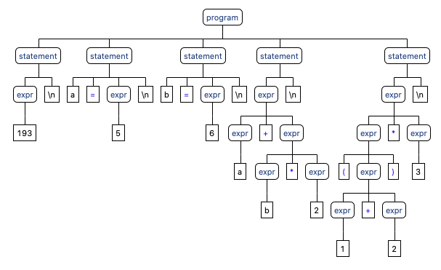
Parse Tree (Eclipse Plugin)
input.txt
193
a = 5
b = 6
a+b*2
(1+2)*3
ANTLR 4 plug-in
for Eclipse.

Slide 12
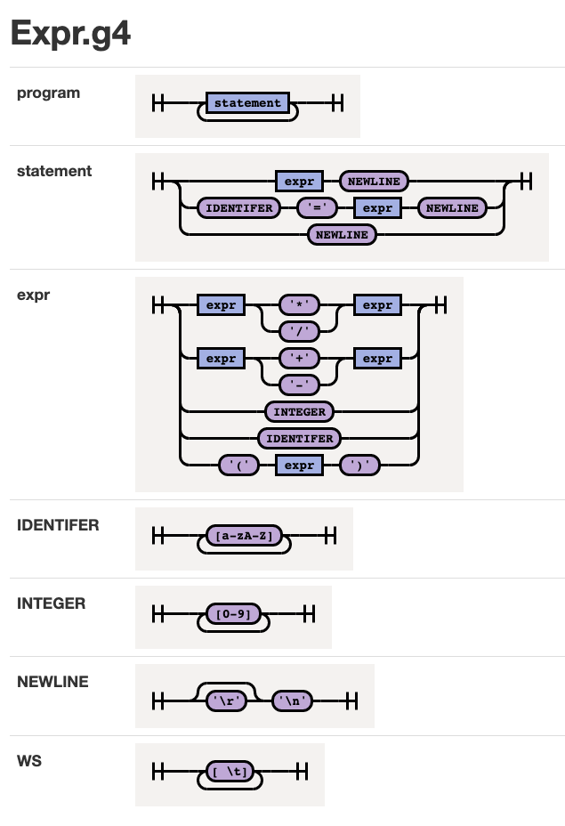
Syntax Diagram (Command Line)
Expr.g4
java -jar rrd-antlr4-0.1.2.jar Expr.g4
grammar Expr;
program: statement+ ; // at least one statement
statement : expr NEWLINE
| IDENTIFER '=' expr NEWLINE
| NEWLINE
;
expr: expr ('*'|'/') expr
| expr ('+'|'-') expr
| INTEGER
| IDENTIFER
| '(' expr ')'
;
IDENTIFER : [a-zA-Z]+ ;
INTEGER : [0-9]+ ;
NEWLINE : '\r'? '\n' ;
WS : [ \t]+ -> skip ; // skip whitespace
https://github.com/bkiers/rrd-antlr4

Slide 13
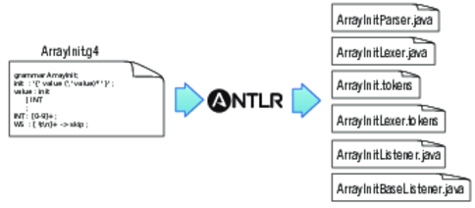
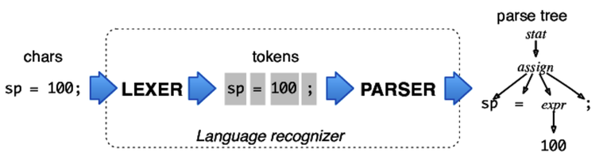
ANTLR Workflow
Generate compiler components based on the .g4 grammar file:
Use the generated components on a source file:
The Definitive ANTLR 4 Reference
by Terence Parr
The Pragmatic Programmers, 2012

Slide 14
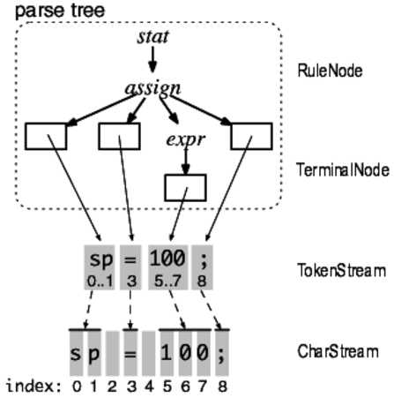
ANTLR Parse Trees
A token stream is the “pipe”
between the lexer and the parser.
Each token object records the start and stop character indexes in the character stream.
The Definitive ANTLR 4 Reference
by Terence Parr
The Pragmatic Programmers, 2012

Slide 15
ANTLR Parse Trees, cont’d
ANTLR generates a RuleNode subclass for each grammar rule.
They are called
context objects
because they record everything about the recognition phase
of a rule.
The Definitive ANTLR 4 Reference
by Terence Parr
The Pragmatic Programmers, 2012

Slide 16
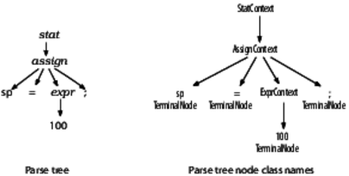
ANTLR Parse Trees, cont’d
The ANTLR-generated parser has corresponding parse tree node class names.
The Definitive ANTLR 4 Reference
by Terence Parr
The Pragmatic Programmers, 2012

Slide 17
Syntax Error Handling
An ANTLR-generated parser has
basic syntax error handling and recovery.
  You can improve the error handling.
193
a = 5
b = 6
(a+b*2
(1+2)*3
Parse tree (Lisp format):
(prog
(stat (expr 193) \n)
(stat a = (expr 5) \n)
(stat b = (expr 6) \n)
(stat (expr ( (expr (expr a) + (expr (expr b) * (expr 2))) <missing ')'>) \n)
(stat (expr (expr ( (expr (expr 1) + (expr 2)) )) * (expr 3)) \n))
line 4:6 missing ')' at '\n'

Slide 18
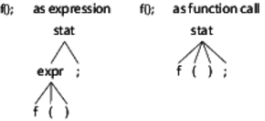
Resolving Ambiguities
Is f() a function call as a standalone statement, or a function call in an expression?
stat: expr ';'
| ID '(' ')' ';'
;
expr: ID '(' ')'
| INT
;
The Definitive ANTLR 4 Reference
by Terence Parr
The Pragmatic Programmers, 2012

Slide 19
Resolving Ambiguities, cont’d
Is begin a reserved word or an identifier?
ANTLR resolves an ambiguity by choosing
the first alternative in the grammar.
BEGIN : 'begin' ;
ID : [a-z]+ ;

Slide 20
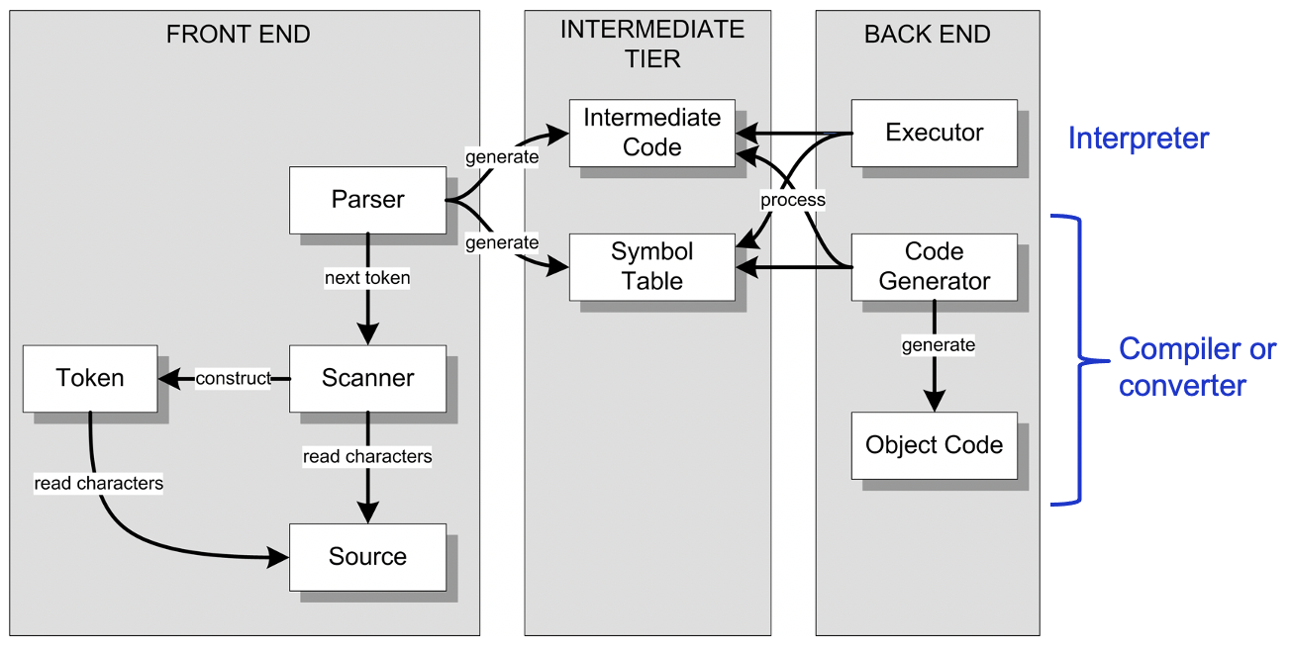
The Visitor Interface
We want ANTLR to generate the
visitor interface for our back end.
  By default, it generates the listener interface
  which we won’t use in this class.

Slide 21
The Visitor Interface, cont’d
Specify “visitor” and “no listener” when you run ANTLR to generate components.
  Command line:
alias antlr4='java -jar /Users/rmak/ANTLR-4.8/antlr-4.8-complete.jar'
ANTLR-ExprTestJava: antlr4 -no-listener -visitor -Dlanguage=Cpp Expr.g4
ANTLR-ExprTestJava: ls
Expr.g4 ExprBaseVisitor.cpp ExprLexer.h ExprMain.cpp ExprVisitor.cpp
Expr.interp ExprBaseVisitor.h ExprLexer.interp ExprParser.cpp ExprVisitor.h
Expr.tokens ExprLexer.cpp ExprLexer.tokens ExprParser.h input.txt

Slide 22
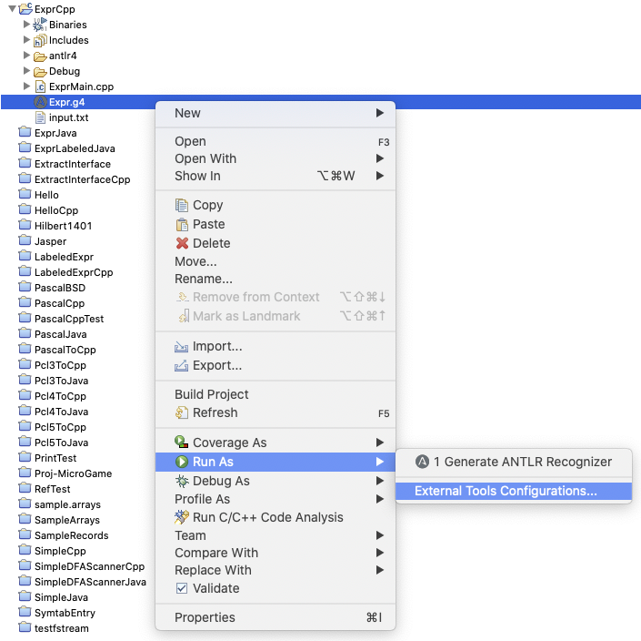
The Visitor Interface, cont’d
  Eclipse plug-in: You must first create an External Tool Configuration for your ANTLR grammar file:

Slide 23
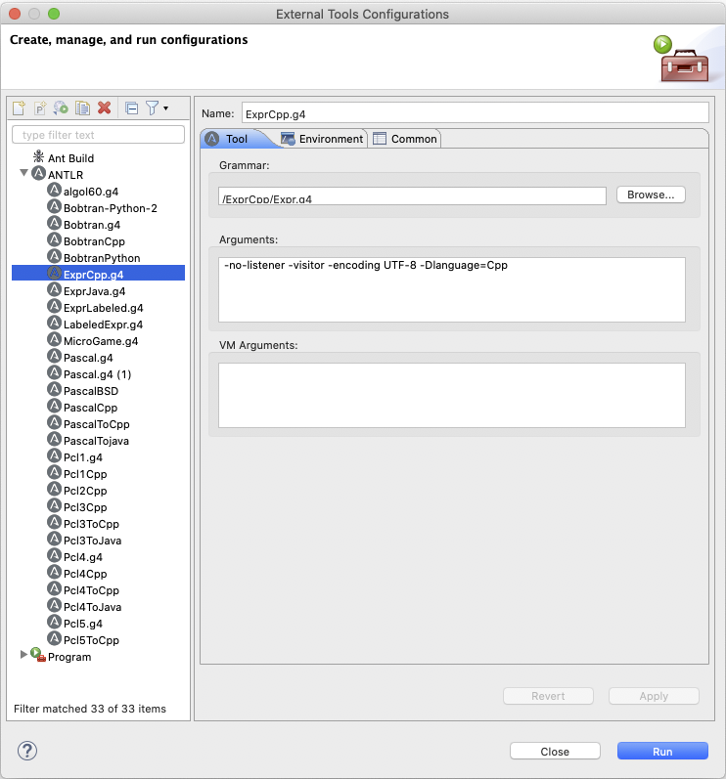
The Visitor Interface, cont’d
  Specify:
-no-listener -visitor -encoding UTF-8 -Dlanguage=Cpp

Slide 24
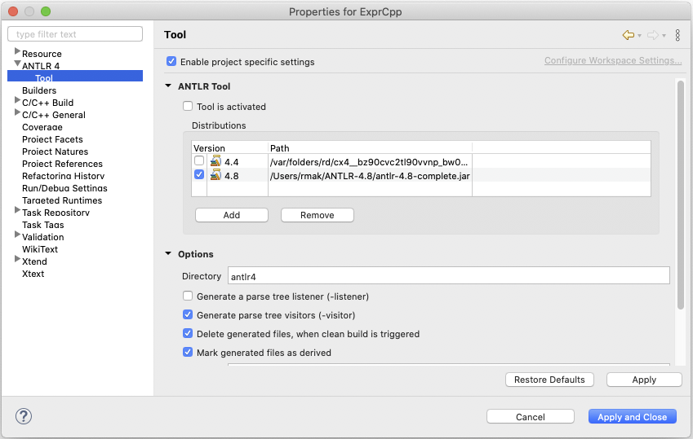
The Visitor Interface, cont’d
  Then set the project’s ANTLR properties:

Slide 25
Interface ExprVisitor
ExprVisitor.h
#include "antlr4-runtime.h"
#include "ExprParser.h"
/**
* This class defines an abstract visitor for a parse tree
* produced by ExprParser.
*/
class ExprVisitor : public antlr4::tree::AbstractParseTreeVisitor
{
public:
virtual antlrcpp::Any visitProgram(ExprParser::ProgramContext *context) = 0;
virtual antlrcpp::Any visitStatement(ExprParser::StatementContext *context) = 0;
virtual antlrcpp::Any visitExpr(ExprParser::ExprContext *context) = 0;
};
You can think of each context
as a pointer to a parse tree node.
grammar Expr;
program: statement+ ; // at least one statement
statement : expr NEWLINE
| IDENTIFER '=' expr NEWLINE
| NEWLINE
;
expr: expr ('*'|'/') expr
| expr ('+'|'-') expr
| INTEGER
| IDENTIFER
| '(' expr ')'
;
IDENTIFER : [a-zA-Z]+ ;
INTEGER : [0-9]+ ;
NEWLINE : '\r'? '\n' ;
WS : [ \t]+ -> skip ; // skip whitespace

Slide 26
The Base Visitor Class ExprBaseVisitor
ExprVisitor.h
#include "antlr4-runtime.h"
#include "ExprVisitor.h"
/**
* This class provides an empty implementation of ExprVisitor, which can be
* extended to create a visitor which only needs to handle a subset of the available methods.
*/
class ExprBaseVisitor : public ExprVisitor
{
public:
virtual antlrcpp::Any visitProgram(ExprParser::ProgramContext *ctx) override
{
return visitChildren(ctx);
}
virtual antlrcpp::Any visitStatement(ExprParser::StatementContext *ctx) override
{
return visitChildren(ctx);
}
virtual antlrcpp::Any visitExpr(ExprParser::ExprContext *ctx) override
{
return visitChildren(ctx);
}
};

Slide 27
The Base Visitor Class, cont’d
Each default visit implementation in the base visitor class ExprBaseVisitor simply visits
the parse tree node’s children.
  If the node has no children, then nothing happens.
  Therefore, all the default methods accomplish
  is to visit each node of the tree and nothing else.
Therefore, to do real work in the back end, we must create a subclass of ExprBaseVisitor where we override the default visit methods.
  ANTLR has created a framework for our back end.

Slide 28
The Base Visitor Class, cont’d
ANTLR generated a separate visit method
for each production rule:
  visitProgram
  visitStatement
  visitExpr
But that’s too “course” since some rules have multiple options:
statement : expr NEWLINE
| IDENTIFER '=' expr NEWLINE
| NEWLINE
;
expr : expr ('*'|'/') expr
| expr ('+'|'-') expr
| INTEGER
| IDENTIFER
| '(' expr ')'
;
Expr.g4

Slide 29
Labeled Production Rules
Add a # label to each rule option and
rerun ANTLR to generate a new parser:
grammar ExprLabeled;
program: statement+ ;
statement : expr NEWLINE # print
| IDENTIFER '=' expr NEWLINE # assign
| NEWLINE # empty
;
expr : expr ('*'|'/') expr # mulDiv
| expr ('+'|'-') expr # addSub
| INTEGER # int
| IDENTIFER # id
| '(' expr ')' # parens
;
These are labels,
not comments!
ExprLabeled.g4

Slide 30
Interface ExprLabeledVisitor
ExprLabeledVisitor.h
// Generated from ExprLabeled.g4 by ANTLR 4.8
#include "antlr4-runtime.h"
#include "ExprLabeledParser.h"
class ExprLabeledVisitor
: public antlr4::tree::AbstractParseTreeVisitor
{
public:
virtual antlrcpp::Any visitProgram(ExprLabeledParser::ProgramContext *context) = 0;
virtual antlrcpp::Any visitPrint(ExprLabeledParser::PrintContext *context) = 0;
virtual antlrcpp::Any visitAssign(ExprLabeledParser::AssignContext *context) = 0;
virtual antlrcpp::Any visitEmpty(ExprLabeledParser::EmptyContext *context) = 0;
virtual antlrcpp::Any visitParens(ExprLabeledParser::ParensContext *context) = 0;
virtual antlrcpp::Any visitAddSub(ExprLabeledParser::AddSubContext *context) = 0;
virtual antlrcpp::Any visitId(ExprLabeledParser::IdContext *context) = 0;
virtual antlrcpp::Any visitInt(ExprLabeledParser::IntContext *context) = 0;
virtual antlrcpp::Any visitMulDiv(ExprLabeledParser::MulDivContext *context) = 0;
};
program: statement+ ;
statement : expr NEWLINE # print
| IDENTIFER '=' expr NEWLINE # assign
| NEWLINE # empty
;
expr : expr ('*'|'/') expr # mulDiv
| expr ('+'|'-') expr # addSub
| INTEGER # int
| IDENTIFER # id
| '(' expr ')' # parens
;

Slide 31
Base Class ExprLabeledBaseVisitor
As before, the default implementation of
each method is to visit the node’s children.
#include "antlr4-runtime.h"
#include "ExprLabeledVisitor.h"
class ExprLabeledBaseVisitor : public ExprLabeledVisitor
{
public:
virtual antlrcpp::Any visitProgram(ExprLabeledParser::ProgramContext *ctx) override
{
return visitChildren(ctx);
}
virtual antlrcpp::Any visitPrint(ExprLabeledParser::PrintContext *ctx) override
{
return visitChildren(ctx);
}
...
}
ExprLabeledBaseVisitor.cpp

Slide 32
Class Executor
#include <string>
#include <map>
#include "antlr4-runtime.h"
#include "ExprLabeledBaseVisitor.h"
using namespace std;
typedef antlrcpp::Any Object;
class Executor : public ExprLabeledBaseVisitor
{
private:
map<string, Object> symtab;
public:
Executor() {}
virtual ~Executor() {}
Object visitAssign(ExprLabeledParser::AssignContext *ctx);
Object visitPrint(ExprLabeledParser::PrintContext *ctx);
Object visitInt(ExprLabeledParser::IntContext *ctx);
Object visitId(ExprLabeledParser::IdContext *ctx);
Object visitMulDiv(ExprLabeledParser::MulDivContext *ctx);
Object visitAddSub(ExprLabeledParser::AddSubContext *ctx);
Object visitParens(ExprLabeledParser::ParensContext *ctx);
};
Executor.h

Slide 33
Class Executor, cont’d
statement : expr NEWLINE # print
| IDENTIFIER '=' expr NEWLINE # assign
| NEWLINE # empty
;
ExprLabeled.g4
Object Executor::visitAssign(ExprLabeledParser::AssignContext *ctx)
{
string idName = ctx->IDENTIFIER()->getText();
Object value = visit(ctx->expr()); // compute the expression value
symtab[idName] = value; // store it into the symbol table
return value;
}
Executor.cpp

Slide 34
Class Executor, cont’d
statement : expr NEWLINE # print
| IDENTIFIER '=' expr NEWLINE # assign
| NEWLINE # empty
;
ExprLabeled.g4
Object Executor::visitPrint(ExprLabeledParser::PrintContext *ctx)
{
Object value = visit(ctx->expr()); // evaluate the expression
cout << value.as<int>() << endl; // print the result
return Object();
}
Executor.cpp

Slide 35
Class Executor, cont’d
expr : expr op=('*'|'/') expr # mulDiv
| expr op=('+'|'-') expr # addSub
| INTEGER # int
| IDENTIFIER # id
| '(' expr ')' # parens
;
ExprLabeled.g4
Object Executor::visitInt(ExprLabeledParser::IntContext *ctx)
{
return stoi(ctx->INTEGER()->getText()); // integer value
}
Object Executor::visitId(ExprLabeledParser::IdContext *ctx)
{
string id = ctx->IDENTIFIER()->getText();
if (symtab.find(id) != symtab.end())
{
return symtab[id]; // value from symbol table
}
else return 0; // dummy value
}
Executor.cpp

Slide 36
Class Executor, cont’d
expr : expr op=('*'|'/') expr # mulDiv
| expr op=('+'|'-') expr # addSub
| INTEGER # int
| IDENTIFIER # id
| '(' expr ')' # parens
;
MUL : '*' ;
DIV : '/' ;
ADD : '+' ;
SUB : '-' ;
ExprLabeled.g4
Object Executor::visitMulDiv(ExprLabeledParser::MulDivContext *ctx)
{
int left = visit(ctx->expr(0)).as<int>(); // left child expression
int right = visit(ctx->expr(1)).as<int>(); // right child expression
if (ctx->op->getType() == ExprLabeledParser::MUL) return left*right;
else return left/right;
}
Executor.cpp

Slide 37
Class Executor, cont’d
expr : expr op=('*'|'/') expr # mulDiv
| expr op=('+'|'-') expr # addSub
| INTEGER # int
| IDENTIFIER # id
| '(' expr ')' # parens
;
MUL : '*' ;
DIV : '/' ;
ADD : '+' ;
SUB : '-' ;
ExprLabeled.g4
Object Executor::visitAddSub(ExprLabeledParser::AddSubContext *ctx)
{
int left = visit(ctx->expr(0)).as<int>(); // left child expression
int right = visit(ctx->expr(1)).as<int>(); // right child expression
if (ctx->op->getType() == ExprLabeledParser::ADD) return left + right;
else return left - right;
}
Executor.cpp

Slide 38
Class Executor, cont’d
expr : expr op=('*'|'/') expr # mulDiv
| expr op=('+'|'-') expr # addSub
| INTEGER # int
| IDENTIFIER # id
| '(' expr ')' # parens
;
MUL : '*' ;
DIV : '/' ;
ADD : '+' ;
SUB : '-' ;
ExprLabeled.g4
Object Executor::visitParens(ExprLabeledParser::ParensContext *ctx)
{
return visit(ctx->expr()); // return parenthesized expression value
}
Executor.cpp

Slide 39
The Main
ExprLabeledMain.cpp
#include <iostream>
#include <fstream>
#include "antlr4-runtime.h"
#include "ExprLabeledLexer.h"
#include "ExprLabeledParser.h"
#include "Executor.h"
using namespace antlrcpp;
using namespace antlr4;
using namespace std;
int main(int argc, const char *args[])
{
...
// Create a parser which parses the token stream
// to create a parse tree.
ExprLabeledParser parser(&tokens);
tree::ParseTree *tree = parser.program();
// Execution.
cout << "Execution:" << endl;
Executor executor;
executor.visit(tree);
return 0;
}

