Slide 1
CMPE 142 Operating Systems May 14 Class Meeting
Department of Computer Engineering San Jose State University Spring 2021 Instructor: Ron Mak
www.cs.sjsu.edu/~mak

Slide 2
Case Study: The Linux Operating System
Linux as a case study of operating systems should be like a semester review.
We’ve pretty much been looking at Linux all along.
Designed by programmers for programmers, to be:
Simple
Elegant
Consistent
Powerful
Flexible

Slide 3
Booting Linux
The Master Boot Record (MBR) in the first sector of the boot disk contains the boot program.
GRUB (Grand Unified Bootloader) can be configured to boot a selected OS from a list of choices (dual booting or multi-booting).

Slide 4
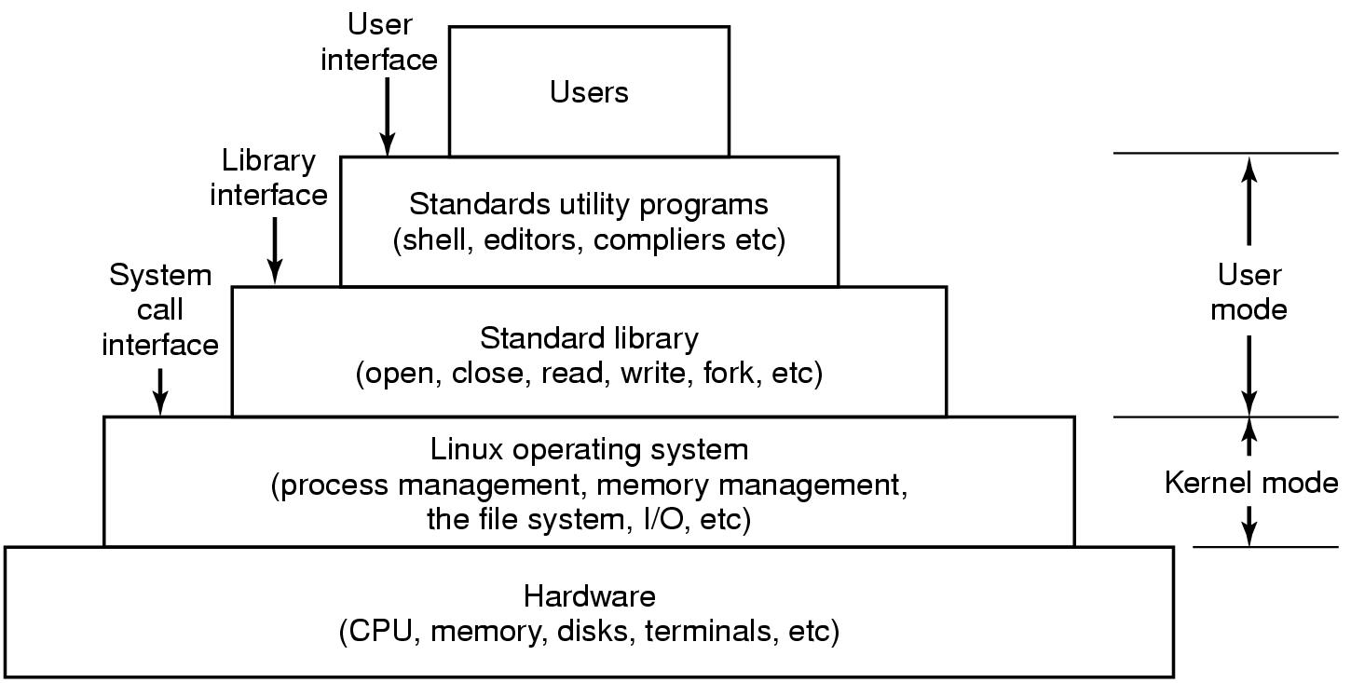
The Layers in a Linux System
Modern Operating Systems, 4th edition
by Andrew Tanenbaum & Herbert Bos
Pearson, 2014, ISBN 978-0133591620

Slide 5
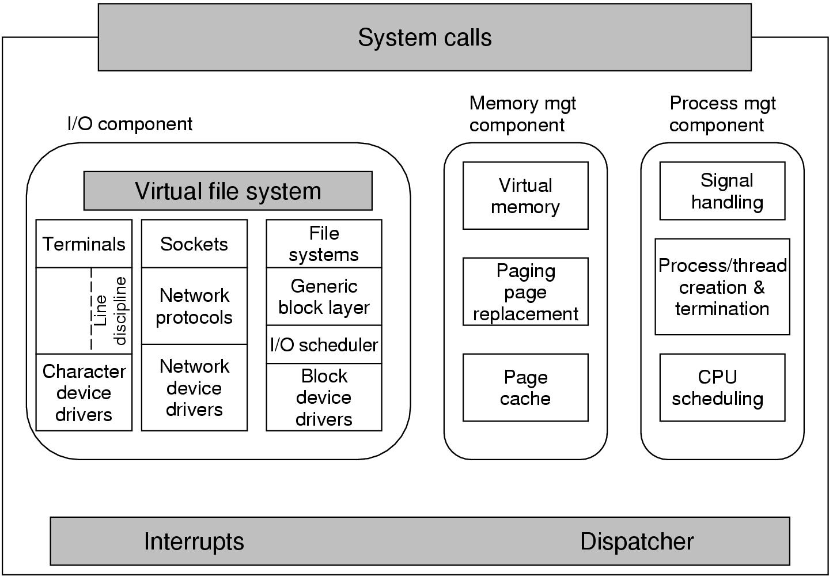
Structure of the Linux Kernel
Modern Operating Systems, 3rd ed.
Andrew Tanenbaum
(c) 2008 Prentice-Hall, Inc.. 0-13-600663-9
All rights reserved

Slide 6
Linux Processes and Threads
Linux tasks represent processes and threads.
Same internal process descriptor:
Scheduling parameters
Memory image
Signals
Machine registers
System call state
File descriptor table
Accounting
Kernel stack
Miscellaneous

Slide 7
Linux Scheduler
Real-time
Priority-based and preemptive.
Priority ranges 0-99.
FCFS and round-robin, as required by POSIX.
Timesharing
Pre-emptive Completely Fair Scheduler (CFS).
CFS always schedules the task which has the least amount of time left on the CPU.
nice command and system call can adjust a process’s priority up or down.

Slide 8
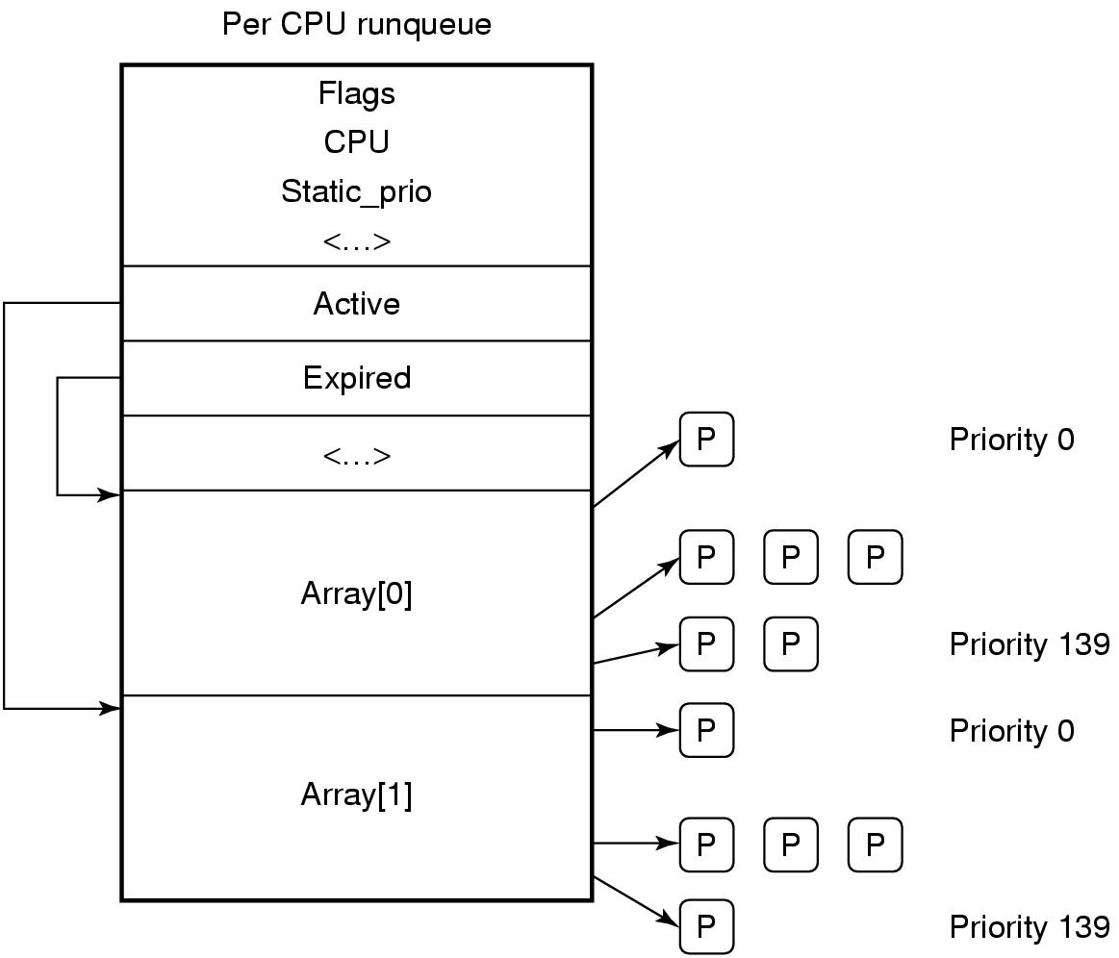
Linux Scheduler, cont’d
The runqueue is associated with each CPU.
Two arrays, active and expired.
Each contains 140 list heads, one per priority level.
Each list head points to a list of processes at that priority level.
Modern Operating Systems, 4th edition
by Andrew Tanenbaum & Herbert Bos
Pearson, 2014, ISBN 978-0133591620

Slide 9
Linux ext3 File System
Default block size is a function of the total size of the file system.
Block sizes of 1, 2, 4, and 8 KB supported.
To maintain high performance, cluster physically adjacent I/O requests.
Journaling file system
Transactions are logged to a journal.
Journal entries are replayed to the actual file system.
Journaling may improve file system performance.

Slide 10
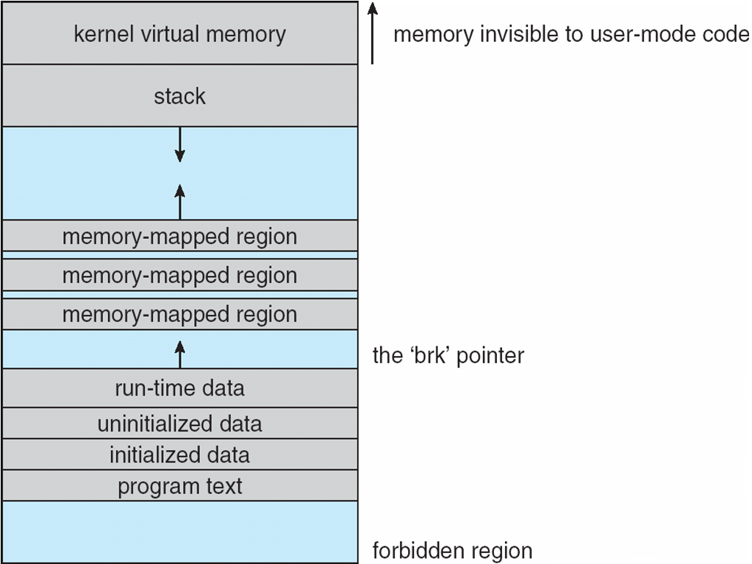
Linux Executable Files
Old format: a.out
New format: ELF
Memory layout:
Operating System Concepts, 10th edition
by Abraham Silberschatz, Greg Gagne, and Peter B. Galvin
Wiley, 2018, ISBN 978-1119456339

Slide 11
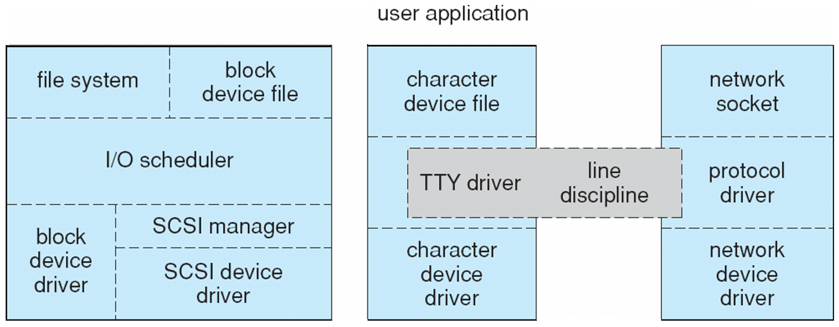
Linux I/O
Device-driver overall structure.
Block devices
Character devices
Network devices
Operating System Concepts, 10th edition
by Abraham Silberschatz, Greg Gagne, and Peter B. Galvin
Wiley, 2018, ISBN 978-1119456339

Slide 12
Linux I/O, cont’d
Block devices
Traditionally used C-SCAN disk scheduling across all processes.
New algorithm: Completely Fair Queuing (CFQ)
One request list per process.
Each lists maintained according to C-SCAN.
Lists are serviced round-robin.
Character devices
Line discipline interprets terminal device data.
Network devices

Slide 13
Linux Networking
Supports standard Internet protocols
UNIX-to-UNIX.
Non-UNIX operating systems.
Three networking layers:
Socket interface
Protocol drivers
Network-device drivers
User applications perform all networking requests through the socket interface.

Slide 14
TCP/IP Protocol Suite
IP protocol implements routing between hosts.
UDP, TCP, and ICMP protocols implemented on top of the routing protocol.
UDP
Arbitrary individual datagrams between hosts.
TCP
Reliable connections between hosts.
Guaranteed delivery of packets in order.
Automatic retransmissions of lost packets.
ICMP
Carry error and status messages between hosts.

Slide 15
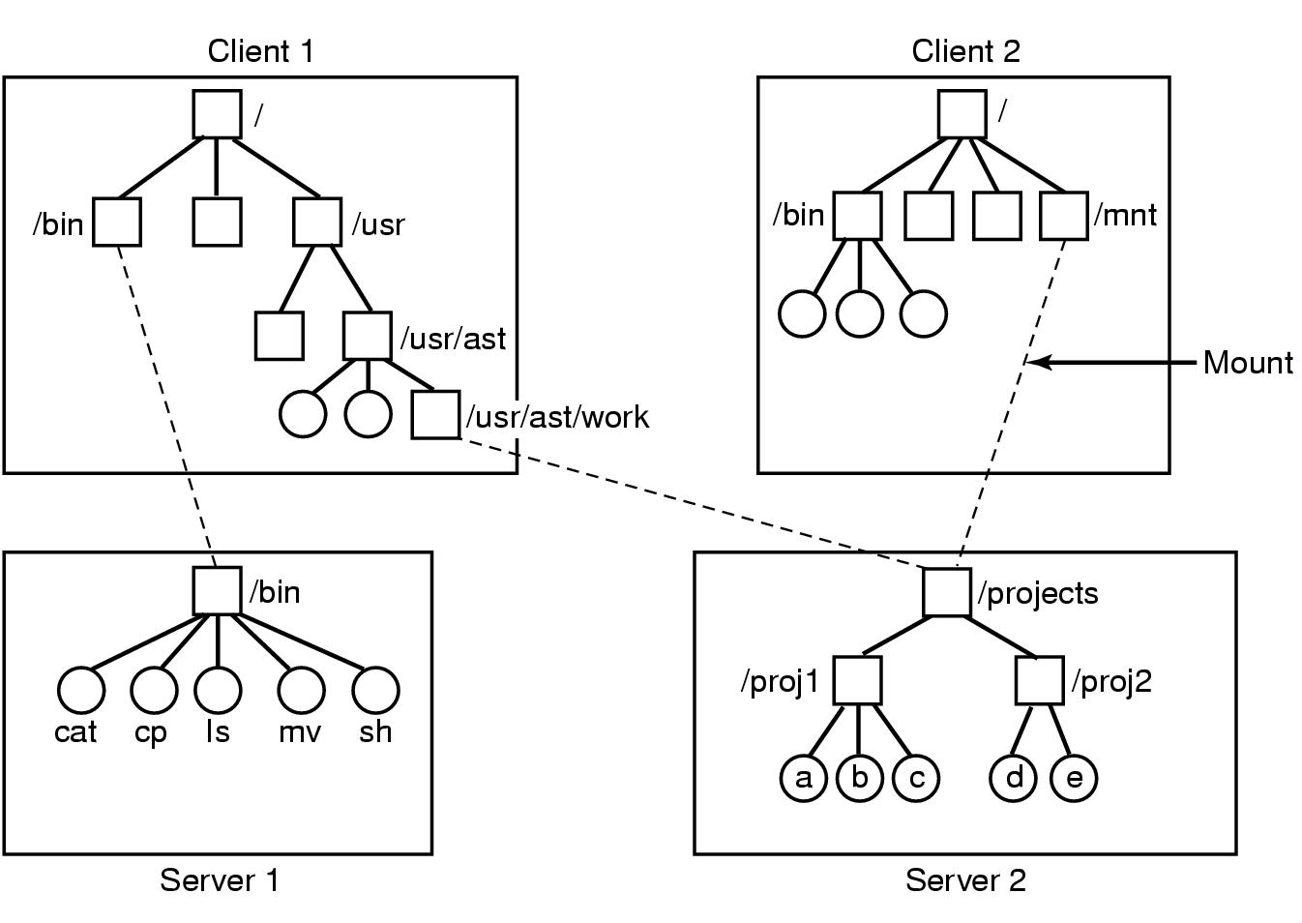
NFS Mounting
Modern Operating Systems, 4th edition
by Andrew Tanenbaum & Herbert Bos
Pearson, 2014, ISBN 978-0133591620

Slide 16
Microsoft Windows 10
Extensible and portable operating system.
Kernel objects provide basic services.
Virtual memory, caching, preemptive scheduling.
Elaborate security mechanisms to protect user data and to guarantee program integrity.
Internationalization features.
Sophisticated scheduling and memory management features.
Feature-rich and expansive API programming environment for developers.

Slide 17
Windows vs. Unix
Unix
Simple OS functions
Few parameters
Few examples of multiple ways to do something.
Kernel panic for a fatal error.
Windows
Comprehensive APIs with many parameters.
Several ways to do the same thing.
Mixed low-level and high-level functions.
Blue Screen of Death for a fatal error.

Slide 18
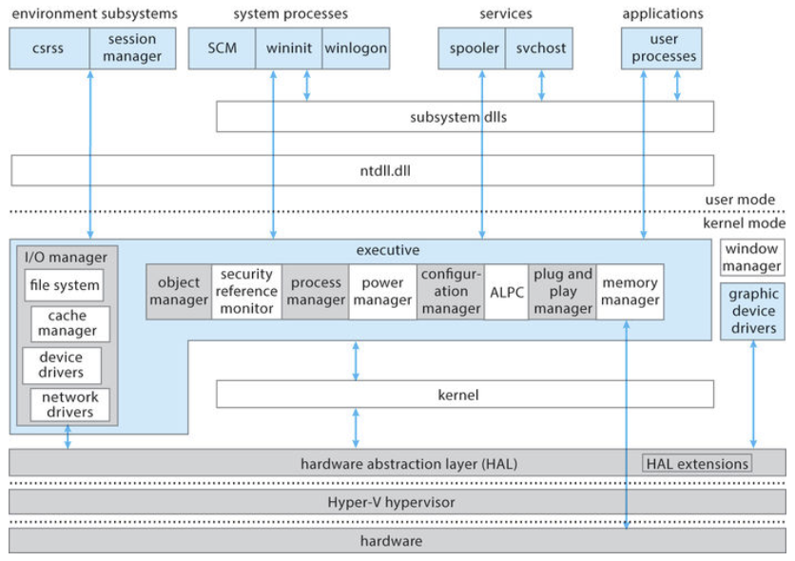
Windows 10 Architecture
Operating System Concepts, 10th edition
by Abraham Silberschatz, Greg Gagne, and Peter B. Galvin
Wiley, 2018, ISBN 978-1119456339

Slide 19
Windows 10 Dispatcher Objects
Dispatcher objects control dispatching and synchronization in the system:
event: records an event occurrence and synchronizes the event with some action
mutex: enforces mutual exclusion
semaphore: synchronizes threads
thread: scheduled by the kernel dispatcher
timer: keeps track of time and signals timeouts

Slide 20
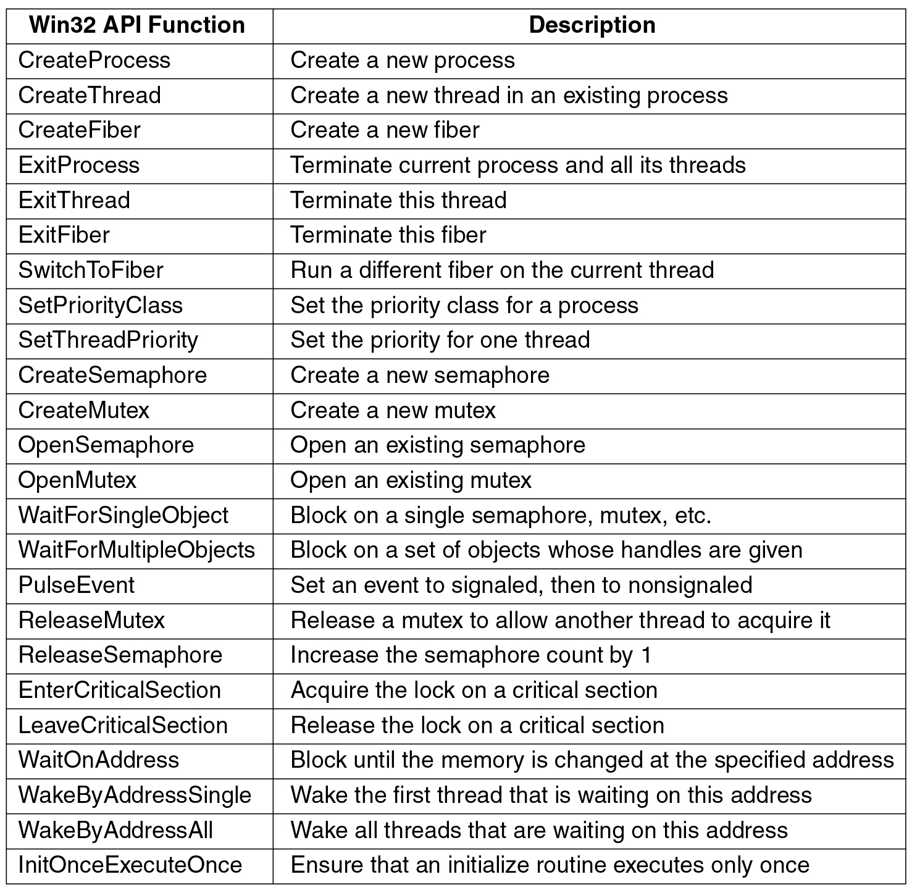
Processes and Threads, cont’d
Modern Operating Systems, 4th edition
by Andrew Tanenbaum & Herbert Bos
Pearson, 2014, ISBN 978-0133591620

Slide 21
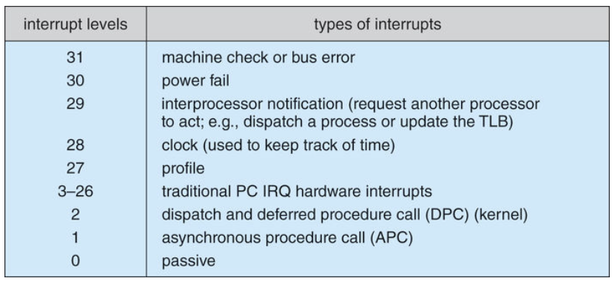
Interrupt Request Levels (IRQLs)
Operating System Concepts, 10th edition
by Abraham Silberschatz, Greg Gagne, and Peter B. Galvin
Wiley, 2018, ISBN 978-1119456339

Slide 22
Exceptions and Interrupts
The kernel dispatcher provides trap handling for exceptions and interrupts generated by hardware or software.
Integer or floating-point overflow
Integer or floating-point divide by zero
Illegal instruction
Data misalignment
Privileged instruction
Access violation
Paging file quota exceeded
Debugger breakpoint

Slide 23
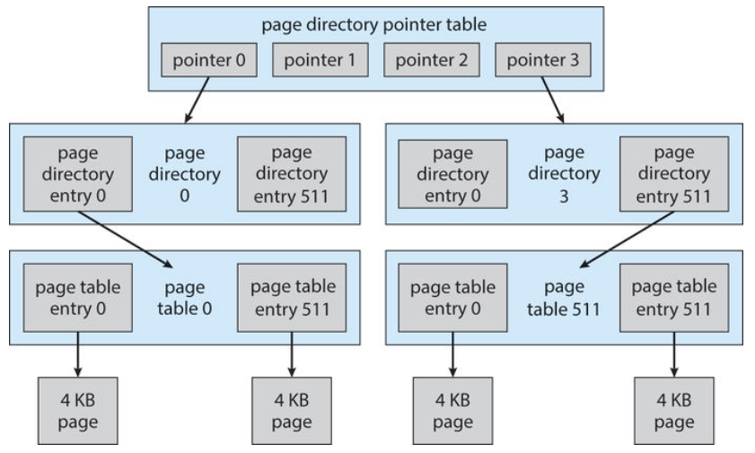
Virtual Memory
The page table layout can be expanded to manage ever larger physical memory sizes.
Operating System Concepts, 10th edition
by Abraham Silberschatz, Greg Gagne, and Peter B. Galvin
Wiley, 2018, ISBN 978-1119456339

Slide 24
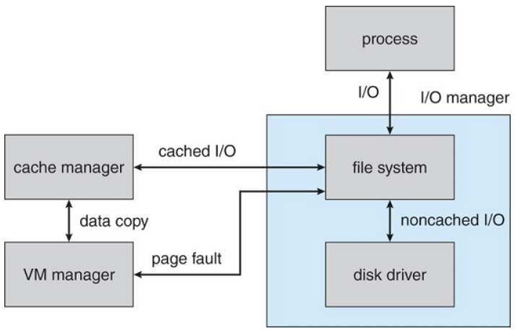
Cache Manager
A centralized caching facility that works operates at the logical/virtual file level.
Works closely with the memory manager to provide cache services for all components under the control of the I/O manager.
Operating System Concepts, 10th edition
by Abraham Silberschatz, Greg Gagne, and Peter B. Galvin
Wiley, 2018, ISBN 978-1119456339

Slide 25
Break

Slide 26
Android
Designed by Google to run on mobile devices.
NASA uses Android for its “cubesats”.
Based on the Linux kernel and facilities.
Much written in Java.
Combines open-source code with closed-source third-party applications.
Supports a wide variety of proprietary cloud services.
Google Play online store for Android apps.

Slide 27
Android Design Goals
Open-source platform for mobile devices
Support 3rd party apps with robust, stable API
3rd party apps compete on level playing field
Users need not deeply trust 3rd party apps
Support mobile user interaction
Manage app processes for users
Encourage apps to interoperate, collaborate
Full general-purpose OS

Slide 28
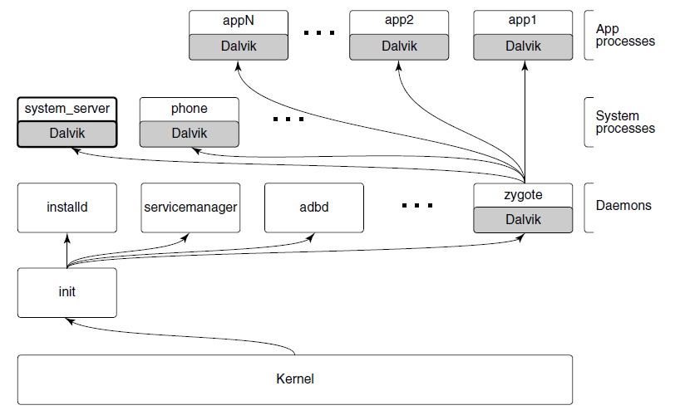
Android Architecture
Modern Operating Systems, 4th edition
by Andrew Tanenbaum & Herbert Bos
Pearson, 2014, ISBN 978-0133591620

Slide 29
Android Architecture, cont'd
The init process starts Android daemons.
Focused on low-level functions such as managing file systems and hardware access.
Additional layer of processes that run Dalvik’s Java language environment.
Dalvik is a managed runtime environment.
Brought up by the zygote native daemon.
JVM bytecode is translated to Dalvik bytecode.

Slide 30
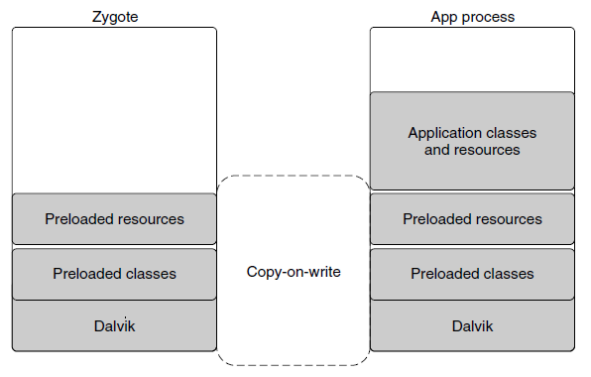
Dalvik
Modern Operating Systems, 4th edition
by Andrew Tanenbaum & Herbert Bos
Pearson, 2014, ISBN 978-0133591620

Slide 31
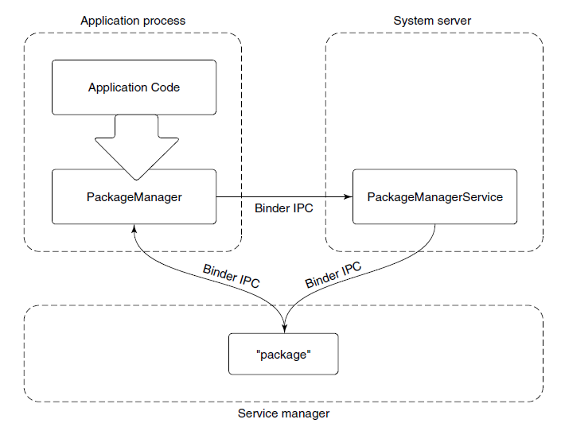
Android Application Framework
Typical design for Android framework APIs that interact with system services, such as the PackageManager class.
Modern Operating Systems, 4th edition
by Andrew Tanenbaum & Herbert Bos
Pearson, 2014, ISBN 978-0133591620

Slide 32
Package Manager Example
The package manager provides a framework API for apps to call in their local process.
The PackageManager class connects to the corresponding service in the system server.
The PackageManager makes calls on the service.
Calls are implemented as interprocess communication.
Android Binder IPC mechanism.

Slide 33
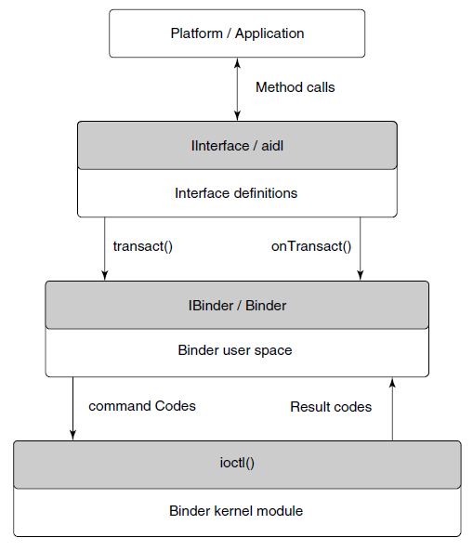
Binder IPC
Relies on remote procedure calls (RPC).
Modern Operating Systems, 4th edition
by Andrew Tanenbaum & Herbert Bos
Pearson, 2014, ISBN 978-0133591620

Slide 34
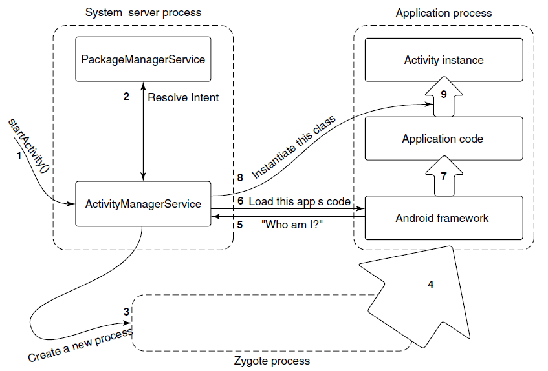
Launching a New Application Process
Modern Operating Systems, 4th edition
by Andrew Tanenbaum & Herbert Bos
Pearson, 2014, ISBN 978-0133591620

Slide 35
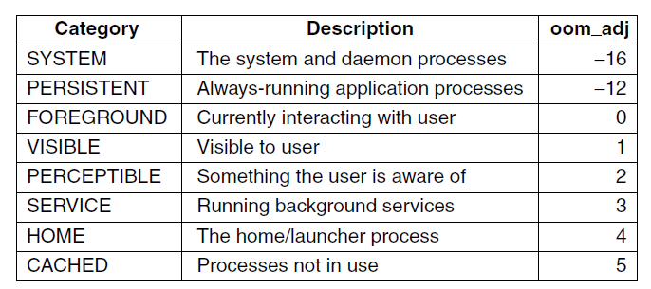
Process Lifecycle
Process importance categories.
oom_adj: a strict ordering to determine which processes to kill first in an out-of-memory situation.
Modern Operating Systems, 4th edition
by Andrew Tanenbaum & Herbert Bos
Pearson, 2014, ISBN 978-0133591620

Slide 36
Postmortem Reports
Due Monday, May 17 at 11:59 PM
A few paragraphs into Canvas.
Individual and private.
What did you learn in this class?
What were your contributions to your project team?
How well did each of your teammates do?

Slide 37
Final Exam
Thursday, May 20 at 9:45 AM – noon
A Canvas “quiz”.
Covers the entire semester.
More emphasis on the second half.
Multiple-choice + short-answer questions.
Open book, notes, and internet.
No communication with anyone else.
Turn on your video cameras for proctoring.

Slide 38
Disk Storage
Industry standard I/O bus
Host-attached storage
Network-attached storage (NAS)
Storage-area network (SAN)

Slide 39
Disk Storage, cont'd
Disk scheduling algorithms
FCFS: first-come first-served
SSTF: shortest seek time first
SCAN: elevator scheduling
C-SCAN: circular scan
LOOK and C-LOOK
Hierarchical storage management (HSM)
RAID

Slide 40
File Systems
File types
File attributes
File operations
File tables
File locking
File structure
Sequential access
Direct (random) access

Slide 41
File Systems, cont'd
Disk structure
Partitions
Directories
Operations
Single- and two-level
Tree-structured
Acyclic graphs

Slide 42
File Systems, cont'd
File path names
Mounting a file system
File protection
Unix

Slide 43
File Systems, cont'd
Implementation
Layered architecture
Master boot record
Superblock
File-control blocks (inodes)
File allocation algorithms
Contiguous
Linked
File allocation table (FAT)
Indexed

Slide 44
File Systems, cont'd
UNIX directories
Disk block size
Free space management
Reliability
Consistency

Slide 45
File Systems, cont'd
Performance
Caching
Read ahead
Disk arm motion
Log-structured
Virtual
Networked file system (NFS)
NFS mounting

Slide 46
I/O
Device controllers
Polling
I/O interrupts
Priority levels
Application-level interrupt handlers
Sockets
select()
Clocks and timers

Slide 47
Virtualization
Virtual machine manager
Types
Implementation

Slide 48
Distributed Systems
Advantages
Network operating systems
Distributed operating systems
Network structure
LAN and WAN

Slide 49
Distributed Systems, cont'd
Communication structure
Naming
Domain name service (DNS)
Routing
Fixed, virtual, dynamic
Contention
CSMA/CD

Slide 50
Distributed Systems, cont'd
Connection strategies
Circuit, message, packet switching
Communications protocols
ISO 7-layer model
TCP/IP protocol layers
Ethernet
Failure detection
Reconfiguration
Network design issues

Slide 51
Distributed Systems, cont'd
Distributed file system
Structure
Naming and transparency
Naming schemes
Remote file access
Caching
Location
Update policy
Consistency

Slide 52
Protection
Principle of least privilege
Granularity
Domains
UNIX domains
Domain switching

Slide 53
Protection, cont'd
Access matrix
Access control list
Role-based access control
Covert channels
Program-level protection

Slide 54
Security
Violations
Methods
Man in the middle
Trojan horse
Trap door
Logic bomb
Stack and buffer overflow

Slide 55
Security, cont'd
Levels
Viruses
Ransomware
Port scanning
Denial of service
User authentication
Firewalls
Public key cryptography

Slide 56
Case Studies
Linux
Windows 10
Android

Slide 57
IBM Manual, 1925
All parts should go together without forcing.
You must remember that the parts you are reassembling were disassembled by you.
Therefore, if you can’t get them together again,
there must be a reason.
By all means, do not use a hammer.

