Slide 1
CMPE 142 Operating Systems April 30 Class Meeting
Department of Computer Engineering San Jose State University Spring 2021 Instructor: Ron Mak
www.cs.sjsu.edu/~mak

Slide 2
Virtual Machines
Abstract the hardware of a single computer system.
Create several different execution environments.
Each environment can have its own operating system.
Each environment believes it has the entire physical system.
Processes
Processes
Processes
Kernel
Kernel
Kernel
VM1
VM2
VM3
Virtual Machine Manager
Host Operating System
Physical Machine

Slide 3
Virtual Machines, cont’d
The virtual machine manager (VMM) creates and controls the virtual machines.
AKA hypervisor
Example:
VirtualBox

Slide 4
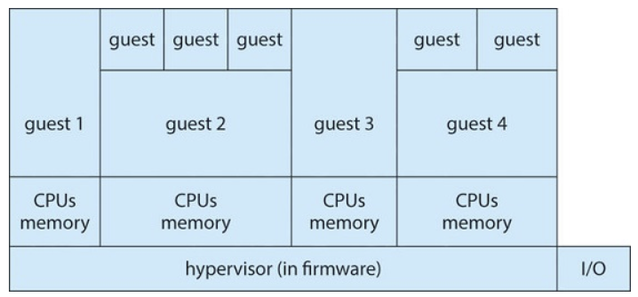
Types of Virtual Machine Managers
Type 0
Hardware-based solution
Commonly found in mainframe computers.
Examples: IBM LPARs, Oracle LDOMs
Operating System Concepts, 10th edition
by Abraham Silberschatz, Greg Gagne, and Peter B. Galvin
Wiley, 2018, ISBN 978-1119456339

Slide 5
Types of Virtual Machine Managers, cont’d
Type 1
Operating-system-like software provides virtualization
Examples: VMware ESX, Joyent SmartOS, Citrix XenServer
General-purpose OSes that provide VMM functions
Examples: Microsoft Windows Server with HyperV, Red Hat Linux with KVM feature

Slide 6
Types of Virtual Machine Managers, cont’d
Type 2
Applications that run on standard OSes to provide VMM functionality to guest operating systems.
Examples:
VMware Workstation and Fusion, Parallels Desktop, Oracle Virtual Box.

Slide 7
Types of Virtual Machine Managers, cont’d
Paravirtualization
Modify a guest operating system to work with a VMM.
Programming-environment virtualization
VMMs create an optimized virtual system.
Examples:
Java Virtual Machine (JVM), Microsoft .Net

Slide 8
Types of Virtual Machine Managers, cont’d
Emulators
Applications written for one hardware environment (one type of CPU) can run on a very different hardware environment (another type of CPU).
Application containment
Not really virtualization, but segregate applications from the host operating system.
Examples: Oracle Solaris Zones, BSD Jails, IBM AIX WPARs

Slide 9
Host vs. Guest Operating Systems
Host operating system
The OS running on the physical machine that supports (among its other tasks) a VMM
Examples:
Linux, Windows, Mac OS X

Slide 10
Host vs. Guest Operating Systems, cont’d
Guest operating system
An OS running in a virtual machine under control of a VMM.
Example:
Debian running under VirtualBox on a Mac
If there is enough physical memory and disk space, it is possible to run several guest OSes (and their applications) simultaneously on a single physical machine.

Slide 11
Virtualization Requirements
Fidelity
A VMM provides an environment for programs that is essentially identical to the original machine.
Performance
Programs running within that environment have only minor performance degradation.
Safety
The VMM is in complete control of system resources required by the guest operating systems.

Slide 12
Brief History of Virtual Machines
1972: Virtual machines first appeared commercially.
IBM VM370 on IBM mainframes.
Late 1990s: Intel 80x86 CPU become popular.
Xen and VMware created VMM technologies for that CPU.

Slide 13
Brief History of Virtual Machines, cont’d
Today: Commercial and open-source VMMs run on all common operating systems.
Example VMM: VirtualBox runs on Intel x86 and AMD64 CPUs on Windows, Linux, Mac OS X, and Solaris.
Example guest OSes: Versions of Windows, Linux, Solaris, BSD, MS-DOS, IBM OS/2

Slide 14
Benefits of Virtual Machines
Sharing
Different execution environments can share the same physical hardware resources.
Security
A virus that infects a guest OS is unlikely to affect other guest OSes or the host OS.

Slide 15
Benefits of Virtual Machines, cont’d
Suspend the running of a guest OS.
Create a snapshot the state of a suspended guest OS.
Resume the execution from the snapshot, possibly on different hardware.
Live migration: Move a guest from one physical machine to another without interrupting its operations.

Slide 16
Benefits of Virtual Machines, cont’d
Create a network of virtual machines.
Communicate over the virtual communications network.
Operating system research and development.
Rapid application porting and testing on different environments.

Slide 17
Benefits of Virtual Machines, cont’d
Resource optimization
An organization can support multiple environments without the hardware investment.
Cloud computing
Made possible by virtualization.

Slide 18
Implementation of Virtual Machines
Virtual CPU (VCPU) implementation
Does not execute code.
Represents the state of the CPU as the guest believes it to be.

Slide 19
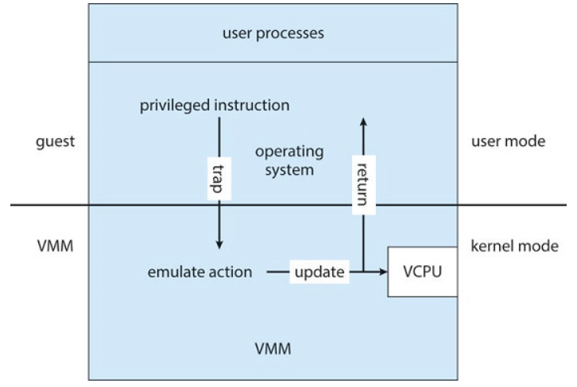
Implementation of Virtual Machines, cont’d
Trap-and-emulate
The guest kernel attempts to execute a privileged instruction, such as to do I/O.
Causes a trap to the VMM in the real machine.
The VMM emulates the privileged operation.
Therefore, privileged instructions create extra overhead.
The guest will run more slowly.
Operating System Concepts, 10th edition
by Abraham Silberschatz, Greg Gagne, and Peter B. Galvin
Wiley, 2018, ISBN 978-1119456339

Slide 20
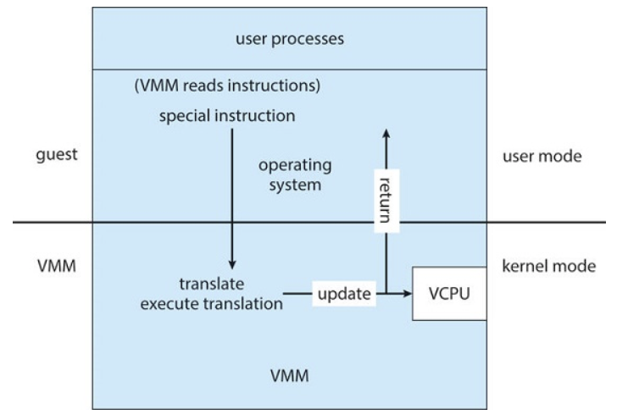
Implementation of Virtual Machines, cont’d
Binary translation
Some x86 instructions (“special instructions”) behave differently in user mode vs. kernel mode.
The VMM translates special instructions in the guest kernel into a new set of native instructions that accomplish the operations.
Operating System Concepts, 10th edition
by Abraham Silberschatz, Greg Gagne, and Peter B. Galvin
Wiley, 2018, ISBN 978-1119456339

Slide 21
Implementation of Virtual Machines, cont’d
Binary translation, cont’d
The new set of instructions can be cached to improve performance.
The VMM must also intercept memory paging requests by the guest kernel.
The VMM maintains nested page tables (NPTs) to map guest paging operations to physical page table operations.

Slide 22
Implementation of Virtual Machines, cont’d
Hardware assistance
Newest CPU chips provide more support for virtualization.
2005: Intel x86 CPU family add VT-x instructions.
Binary translation and NPTs no longer needed.
2006: AMD processors support AMD-V technology.
CPUs with virtualization hardware assistance can automatically deliver an interrupt destined for a guest to a core that is running a thread of the guest.

Slide 23
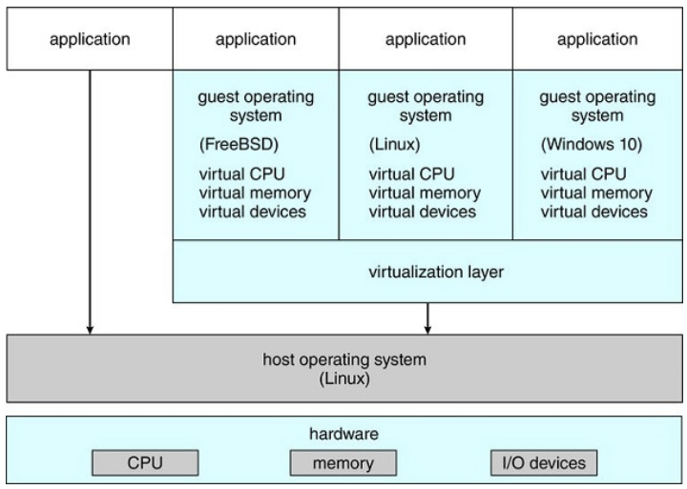
Type 2 Hypervisor
The VMM is just another process running on the host.
Examples: VMware, VirtualBox
The host OS doesn’t know that virtualization is taking place.
Operating System Concepts, 10th edition
by Abraham Silberschatz, Greg Gagne, and Peter B. Galvin
Wiley, 2018, ISBN 978-1119456339

Slide 24
Type 2 Hypervisor, cont’d
The VMM may run as a user application.
It might not have the administrative privileges to access the hardware assistance features of modern CPUs.
Therefore, type 2 hypervisors can have poorer performance than type 0 or type 1.
No changes are required to the host operating system.
Any student can run VirtualBox to experiment and learn from different guest operating systems.

Slide 25
Virtualization Components
CPU scheduling
There may be more virtual CPUs than physical CPUs.
Overcommitment
The VMM must share the available physical CPUs among the guests.

Slide 26
Virtualization Components, cont’d
Memory management
The VMM may overcommit memory among the guests.
The VMM determines how much real memory each guest can use.
Each guest has the illusion that it has all the memory it wants.
The VMM does its own memory page allocation.
It works with the host system’s memory management.

Slide 27
Virtualization Components, cont’d
I/O management
The VMM can dedicate physical I/O devices to guests.
Example: Assign a physical CD ROM drive to a guest.
The VMM can provide idealized device drivers to guests.
The VMM maps guest I/O requests to a device to the actual device driver.

Slide 28
Virtualization Components, cont’d
Storage management
The VMM ensures that each guest can only access the disk blocks allocated to it.
Networking
The VMM provides each guest with at least one IP address.
The VMM provides routing between the guest and the network.
The VMM provides network address translation (NAT).

Slide 29
Assignment #10: Virtual Machine Manager
Work together as a team, but each team member must show individual results on his or her own machine.
Install a virtual machine manager, either VirtualBox or VMware on each team member’s machine.
VirtualBox: https://www.virtualbox.org
Windows, Mac, or Linux
VMware Workstation Player: https://www.vmware.com/in/products/workstation-player/workstation-player-evaluation.html
Windows or Linux

Slide 30
Assignment #10, cont’d
Choose a Linux distribution (“distro”).
Google “Linux distros”
Each team member must choose a different distro.
Download the .iso file which is the image of the installation CD ROM for the distro.
Install the Linux distro with the virtual machine manager using the .iso file.
Create a screen shot that clearly shows the distro running in the virtual machine manager running on the host OS.

Slide 31
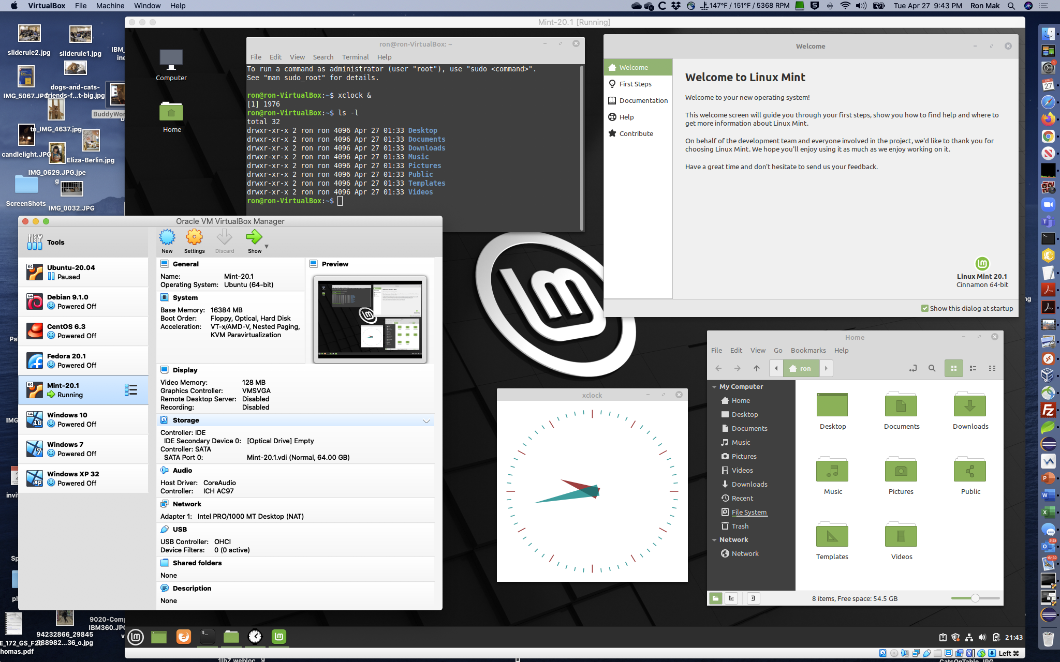
Linux Mint on VirtualBox on Mac OS

Slide 32
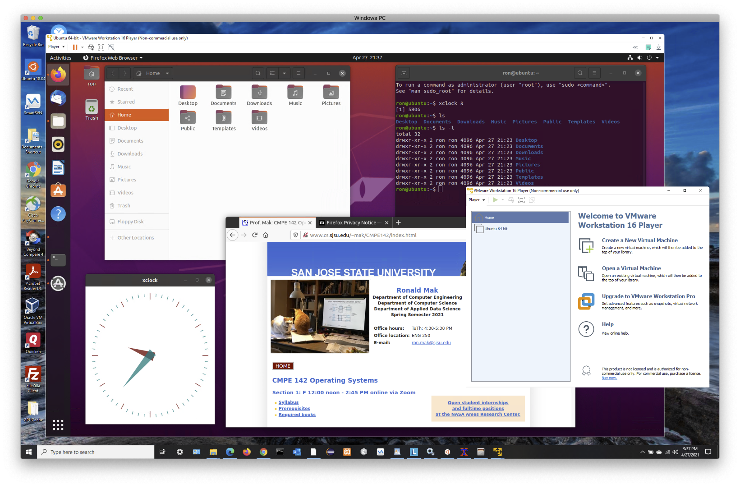
Ubuntu on VMware on Windows 10

Slide 33
Break

Slide 34
Distributed Systems
A distributed system is
A collection of loosely coupled processors
Interconnected by a communications network
Site: The physical location of a machine.
Node: The machine or system located at a site.
AKA: host
Server: A node that provides resources to other nodes.
Client: A node that consumes resources from a server.

Slide 35
Advantages of Distributed Systems
Resource sharing
Share and print files at remote sites.
Process information in a distributed database.
Use remote specialized hardware devices.
Load sharing
Computation speedup.
Load balancing.

Slide 36
Advantages of Distributed Systems, cont’d
Reliability
Detect and recover from a site failure.
Transfer functions from a failed site.
Reintegrate a failed site.
Communication
Message passing.
Flexibility
Replace mainframes with networks of workstations.
More cost effective.

Slide 37
Network Operating Systems
Users are aware of the network and its multiplicity of machines.
Users issue commands to log into remote machines
telnet
ssh
Remote desktop
Users get a virtual view of a remote machine’s desktop on their local workstation screens.

Slide 38
Network Operating Systems, cont’d
Remote file transfer
File transfer protocol (FTP)
Secure FTP (SFTP)
get: Transfer a file from a remote to the local machine.
put: Transfer a file from the local to a remote machine.

Slide 39
Network Operating Systems, cont’d
All general-purpose operating systems today are network operating systems.
Linux
Mac OS
Android

Slide 40
Distributed Operating Systems
Users are not aware that they are on a network.
Access to remote resources is similar to access to local resources.

Slide 41
Distributed Operating Systems, cont’d
Data migration
When a user wants to access a file at a remote site, the file is transferred to the user’s local machine.
From then on, all file accesses are local.
After the user closes the file, it is transferred back to the remote site.
Another approach: Only transfer portions of the file that the user needs to perform a task.

Slide 42
Distributed Operating Systems, cont’d
Computation migration
Instead of running a job locally, run it on a remote machine.
Then the program can access the files locally on the remote machine.

Slide 43
Distributed Operating Systems, cont’d
Process migration
Execute an entire process, or parts of it, at a remote site.
Load balancing
Distribute processes across network to even the workload.
Computation speedup
Child processes can run concurrently on different sites.

Slide 44
Distributed Operating Systems, cont’d
Process migration, cont’d
Hardware preference
Process execution may require specialized processor.
Software preference
Required software may be available at only a particular site.
Data access
Run process remotely, rather than transfer all data locally.

Slide 45
Network Structure
Local area network (LAN)
Network nodes are distributed over a small area
one building
adjacent buildings
Wide area network (WAN)
Network node distributed over a large area
entire country
internationally

Slide 46
Local Area Network (LAN)
Covers a small geographical area.
Bus, ring, or star network.
Speeds
1 megabit/second: AppleTalk, infrared, Bluetooth
10 megabits/second: 10BaseT Ethernet
100 megabits/second: 100BaseT Ethernet

Slide 47
Local Area Network (LAN), cont’d
Broadcast is fast and cheap.
Including wifi.
Nodes:
Usually workstations and/or personal computers
A few (usually one or two) mainframes
Gateway: a node that connects to other networks

Slide 48
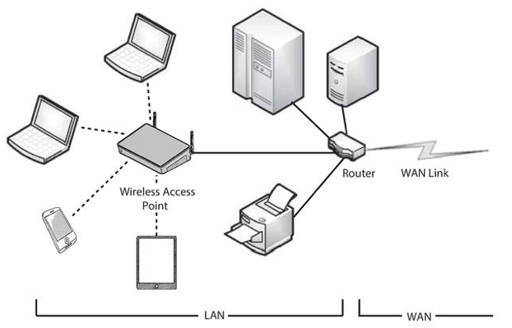
Local Area Network (LAN)
Operating System Concepts, 10th edition
by Abraham Silberschatz, Greg Gagne, and Peter B. Galvin
Wiley, 2018, ISBN 978-1119456339

Slide 49
Wide Area Network (WAN)
Links geographically separated sites.
Point-to-point connections over long-haul lines.
Often leased from a phone company.
Communication processors control communication links.

Slide 50
Wide Area Network (WAN)
Speeds
1.544 megabits/second: T1 service
45 megabits/second: T3 service
40 gigabits/second: intercity backbone connections
Broadcast usually requires multiple messages.
Nodes:
Usually a high percentage of mainframes.

Slide 51
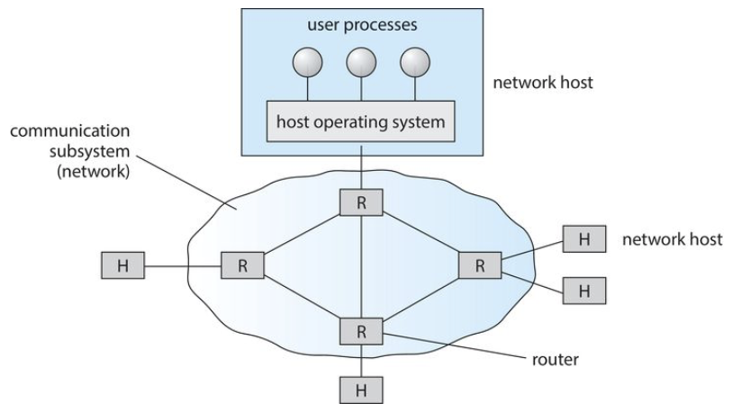
Wide Area Network (WAN)
Operating System Concepts, 10th edition
by Abraham Silberschatz, Greg Gagne, and Peter B. Galvin
Wiley, 2018, ISBN 978-1119456339

Slide 52
Communication Structure
Naming and name resolution
How do two processes locate each other to communicate?
Routing strategies
How are messages sent through the network?
Connection strategies
How do two processes send a sequence of messages?

Slide 53
Communication Structure, cont’d
Contention
The network is a shared resource.
How do we resolve conflicting demands for its use?

Slide 54
Naming and Name Resolution
Systems on the network need to be named.
Locally, each process has an id.
A host on the network has no knowledge about processes on other hosts.
Identify processes on remote systems by a <host-name, identifier> pair.

Slide 55
Domain Name Service (DNS)
Specifies the naming structure of the hosts.
Name to address resolution on the Internet.
Hosts on the Internet are logically addressed with multipart names known as an IP (Internet protocol) address.
Example: 172.7.57.62
Map domain names such as sjsu.edu to their IP addresses.

Slide 56
Routing Strategies
How does a process at Site A communicate with a process at Site B?
How is the message routed?

Slide 57
Fixed Routing
A path from A to B is specified in advance.
The path changes only if a hardware failure disables it.
Since the shortest path is usually chosen, communication costs are minimized.
Fixed routing cannot adapt to load changes.
Ensures that messages will be delivered in the order in which they were sent.

Slide 58
Virtual Routing
A path from A to B is fixed for the duration of one session.
Different sessions involving messages from A to B may have different paths.
Partial remedy to adapting to load changes.
Ensures that messages will be delivered in the order in which they were sent.

Slide 59
Dynamic Routing
The path used to send a message from site A to site B is chosen only when a message is sent.
Usually, a site sends a message to another site on the link least used at that particular time.
Adapts to load changes by avoiding routing messages on heavily used paths.

Slide 60
Dynamic Routing, cont’d
Messages may arrive out of order.
How to remedy this problem?
Append a sequence number to each message.

Slide 61
Connection Strategies
Once routing has been established, messages can reach their destinations.
Processes at different sites that want to communicate with each other must choose a connection strategy.

Slide 62
Connection Strategies, cont’d
Circuit switching
A permanent physical link is established for the duration of the communication.
Example: telephone system
Message switching
A temporary link is established for the duration of one message transfer.
Example: post-office mailing system

Slide 63
Connection Strategies, cont’d
Packet switching
Messages of variable length are divided into fixed-length packets which are sent to the destination.
Each packet may take a different path through the network.
The packets must be reassembled into messages as they arrive.

Slide 64
Connection Strategies, cont’d
Circuit switching requires setup time, but incurs less overhead for shipping each message.
May waste network bandwidth.
Message and packet switching require less setup time, but incur more overhead per message.

Slide 65
Contention
Several sites may want to transmit information over a link simultaneously, causing collisions.
CSMA/CD
Carrier sense with multiple access (CSMA)
Collision detection (CD)
A site determines whether another message is currently being transmitted over that link.
If two or more sites begin transmitting at exactly the same time, they register a CD and will stop transmitting.

Slide 66
Contention, cont’d
CSMA/CD, cont’d
When the system is very busy, many collisions may occur.
Performance may be degraded.
CSMA/CD is used successfully in the Ethernet system, the most common network system.

Slide 67
Communications Protocols
The ISO (International Standards Organization) 7-layer model.
Layer 1: Physical layer
Handle the mechanical and electrical details of the physical transmission of a bit stream.
Layer 2: Data-link layer
Handle the frames, or fixed-length parts of packets.
Error detection and recovery that occurred in the physical layer.

Slide 68
The ISO Network Model
Layer 3: Network layer
Connect and route packets in the communication network.
Handle the address of outgoing packets.
Decode the address of incoming packets.
Maintain routing information for proper response to changing load levels.
Routers work at this level.

Slide 69
The ISO Network Model, cont’d
Layer 4: Transport layer
Low-level network access and for message transfer between clients.
Partition messages into packets.
Maintain packet order.
Control flow.
Generate physical addresses.

Slide 70
The ISO Network Model, cont’d
Layer 5: Session layer
Implement sessions, or process-to-process communications protocols.
Layer 6: Presentation layer
Resolve the differences in formats among the various sites in the network
Character conversions
Half duplex/full duplex (echoing)

Slide 71
The ISO Network Model, cont’d
Layer 7: Application layer
Interact directly with the users
File transfer
Remote-login protocols
Electronic mail
Schemas for distributed databases

Slide 72
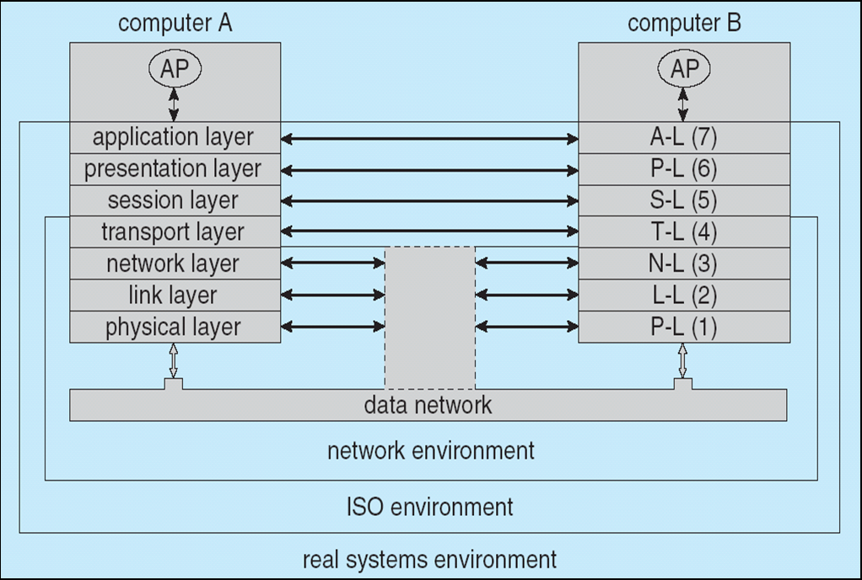
The ISO Network Model, cont’d
Operating System Concepts, 10th edition
by Abraham Silberschatz, Greg Gagne, and Peter B. Galvin
Wiley, 2018, ISBN 978-1119456339

Slide 73
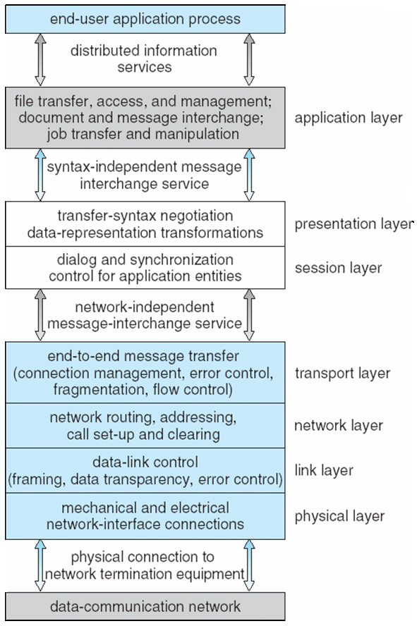
The ISO Protocol Stack
Operating System Concepts, 10th edition
by Abraham Silberschatz, Greg Gagne, and Peter B. Galvin
Wiley, 2018, ISBN 978-1119456339

Slide 74
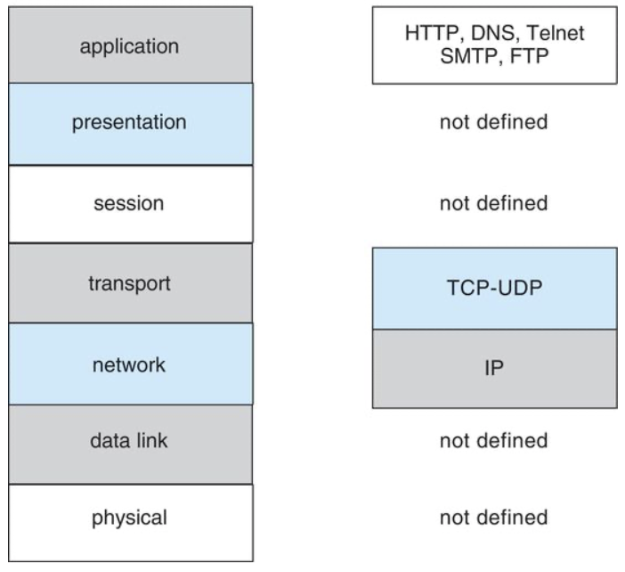
TCP/IP Protocol Layers
ISO
TCP/IP
TCP (Transmission Control Protocol): reliable and connection-oriented
IP (Internet Protocol): routes internet packets
Operating System Concepts, 10th edition
by Abraham Silberschatz, Greg Gagne, and Peter B. Galvin
Wiley, 2018, ISBN 978-1119456339

Slide 75
Ethernet Packet Transmission
Every host has a unique IP address.
Host: a computer connected to the network.
The Domain Name Service (DNS) can be used to acquire IP addresses.
Every Ethernet device has a unique medium access control (MAC) address.
Two devices on a LAN communicate using only their MAC addresses.

Slide 76
Ethernet Packet Transmission, cont’d
Address Resolution Protocol (ARP) is used to send data to another system.
If the hosts are on the same network, ARP can be used.
If the hosts are on different networks, the sending host will send the packet to a router, a device which routes the packet to the destination network.

Slide 77
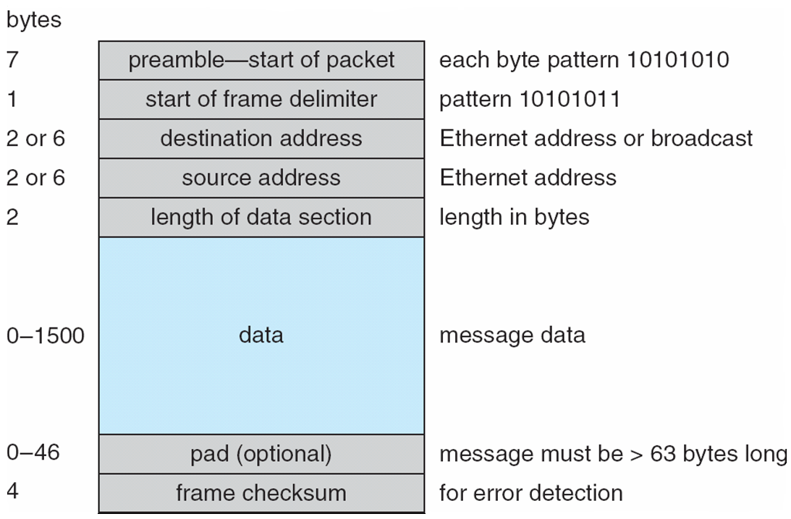
An Ethernet Packet
Operating System Concepts, 10th edition
by Abraham Silberschatz, Greg Gagne, and Peter B. Galvin
Wiley, 2018, ISBN 978-1119456339

Slide 78
Failure Detection
Detecting hardware failure is difficult.
Use a handshaking protocol to detect link failure.
Assume Site A and Site B have established a link.
At fixed intervals, sites exchange I-am-up messages to indicate that they are up and running.

Slide 79
Failure Detection, cont’d
If Site A does not receive a message within the fixed interval, it assumes either
The other site is not up, or
The message was lost.
Site A sends an Are-you-up? message to Site B.
If Site A does not receive a reply, it can repeat the message or try an alternate route to Site B.

Slide 80
Failure Detection, cont’d
If Site A does not ultimately receive a reply from Site B, it concludes some type of failure has occurred.
Types of failures:
Site B is down
The direct link between A and B is down
The alternate link from A to B is down
The message has been lost
However, Site A cannot determine exactly why the failure has occurred.

Slide 81
Reconfiguration
When Site A determines a failure has occurred, it must reconfigure the system.
If the link has failed from A to B, this must be broadcast to every site in the system.
If a site has failed, every other site must also be notified that the services offered by the failed site are no longer available.

Slide 82
Reconfiguration, cont’d
When the link or the site becomes available again, this information must be broadcast to all other sites.

Slide 83
Network Design Issues
Transparency
The distributed system should appear as a conventional, centralized system to the user.
Fault tolerance
The distributed system continues to function after a failure.

Slide 84
Network Design Issues, cont’d
Scalability
As demands increase, the system easily accepts the addition of new resources to accommodate the increased demand.
Clusters
A collection of semi-autonomous machines acts as a single system.

