Slide 1
CMPE 142 Operating Systems April 23 Class Meeting
Department of Computer Engineering San Jose State University Spring 2021 Instructor: Ron Mak
www.cs.sjsu.edu/~mak

Slide 2
Virtual File System (VFS)
A UNIX Virtual File System (VFS) provides an object-oriented way to implement file systems.
VFS allows the same system call interface (the API) to be used for different types of file systems.
Examples: ext2, ext3, ReiserFS, ISO 9660 CD ROM
Separate generic file system operations from implementation details.
Notes:
start here.

Slide 3
Virtual File System (VFS), cont’d
The implementation can be one of many file systems types, or a network file system.
Implement vnodes which hold inodes or network file details.
The API is to the VFS interface, rather than any specific type of file system.
Dispatch an operation to the appropriate file system implementation routines.

Slide 4
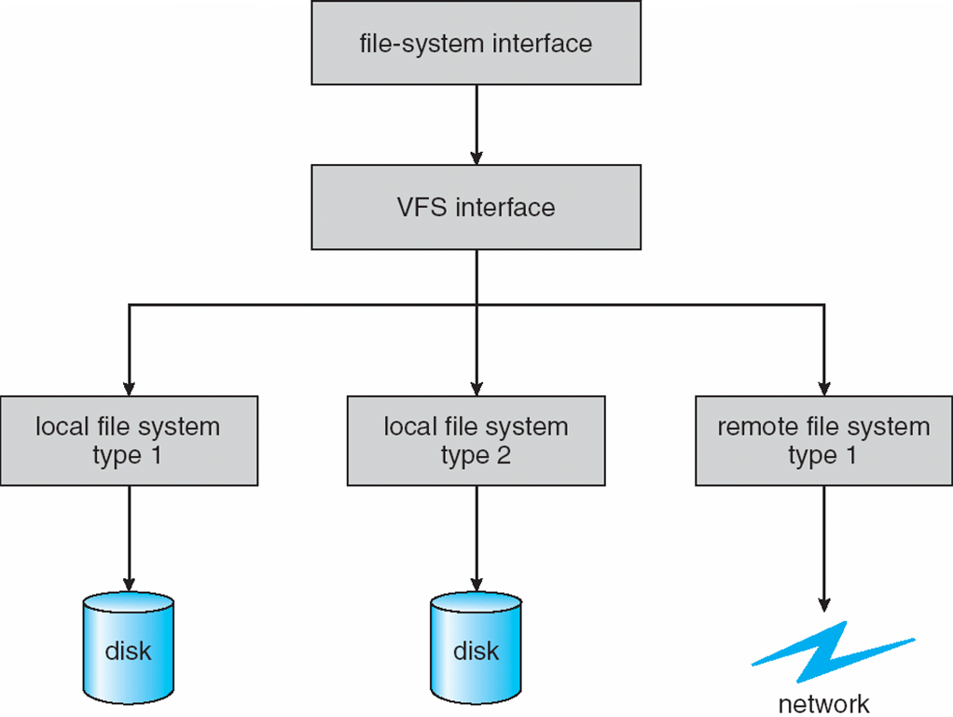
Virtual File System (VFS)
POSIX function calls
Schematic view of a virtual file system.
Operating System Concepts, 10th edition
by Abraham Silberschatz, Greg Gagne, and Peter B. Galvin
Wiley, 2018, ISBN 978-1119456339

Slide 5
Network File System (NFS)
Commonplace implementation of a client-server file system.
Access remote files across local-area networks (LANs) or wide-area networks (WANs).
Use the TCP/IP or UDP/IP protocol.
Operate in a heterogeneous environment of different machines, operating systems, and network architectures.

Slide 6
Network File System (NFS), cont’d
Provide file sharing across a set of independent machines and independent file systems.
Mount a remote file system onto a local mount point.
Transparent sharing.

Slide 7
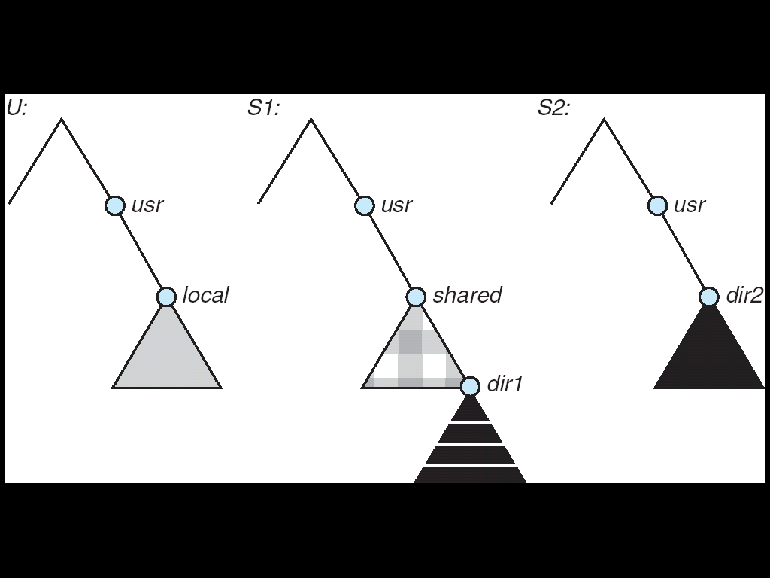
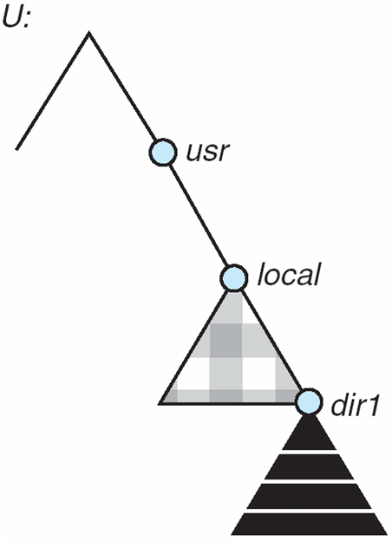
NFS Mounting
(a)
(b)
A local file system U and two remote file systems S1 and S2.
The result of mounting the remote /usr/shared from S1 onto /usr/local
Operating System Concepts, 10th edition
by Abraham Silberschatz, Greg Gagne, and Peter B. Galvin
Wiley, 2018, ISBN 978-1119456339

Slide 8
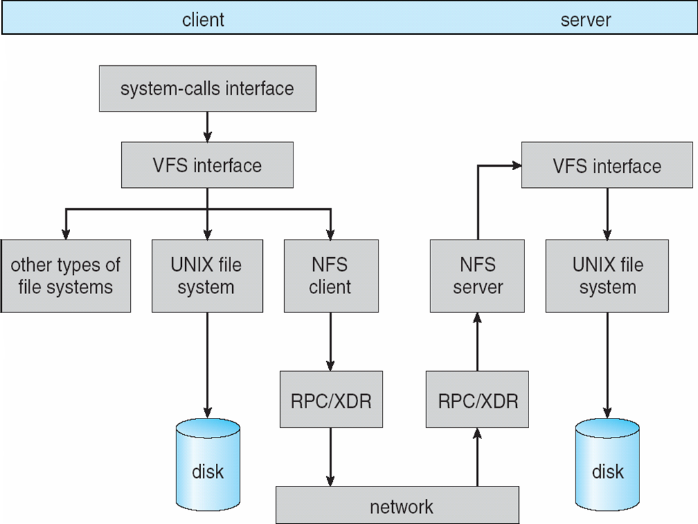
NFS Architecture
RPC: remote procedure call
XDR: external data representation
Operating System Concepts, 10th edition
by Abraham Silberschatz, Greg Gagne, and Peter B. Galvin
Wiley, 2018, ISBN 978-1119456339

Slide 9
Types of I/O Devices
Block
Store data in fixed-sized blocks.
Each block has a separate address.
Common block sizes are 512 bytes to 32K bytes.
Each block can be read or written independently.
Example system calls: read(), write(), seek().
Example
disk drive

Slide 10
Types of I/O Devices, cont’d
Character
Accept a stream of characters.
No block structure.
Example system calls: get(), put()
Higher-level routines implement line-oriented I/O.
Examples
keyboards, printers, mice, etc.

Slide 11
Types of I/O Devices, cont’d
Sequential access
Transfer data from storage in a fixed order as determined by the device.
Examples
tape drive, serial and parallel ports
Random access
Seek to any storage address to read or write data.
Example
disk drive

Slide 12
Types of I/O Devices, cont’d
Shared
Multiple processes can use the device concurrently.
Example
disk drive
Dedicated
Only one process at a time can use the device.
Example
keyboard, mouse, tape drive

Slide 13
Types of I/O Devices, cont’d
Read only
Processes can only read from the device.
Example
scanner
Write only
Processes can only write to the device.
Example
printer

Slide 14
Types of I/O Devices, cont’d
Read-write
Processes can both read from and write to the device.
Examples
disk drive, tape drive

Slide 15
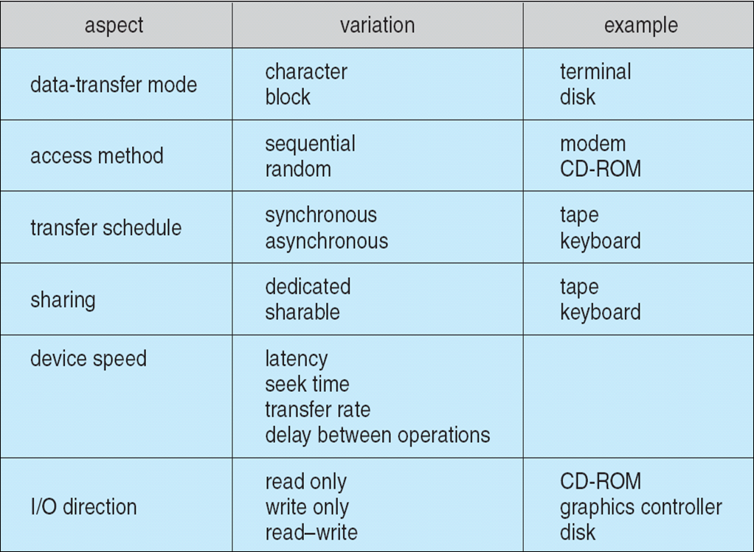
Types of I/O Devices, cont’d
Operating System Concepts, 10th edition
by Abraham Silberschatz, Greg Gagne, and Peter B. Galvin
Wiley, 2018, ISBN 978-1119456339

Slide 16
Hardware to Support I/O
Port
A connection point in the machine where a device or device cable plugs in.
Usually uses an industry-standard communications protocol.
Example: USB port
Bus
A set of wires shared by multiple different devices.
Uses a rigidly defined protocol.
An expansion bus handles slow devices.
Example: PCI, SCSI

Slide 17
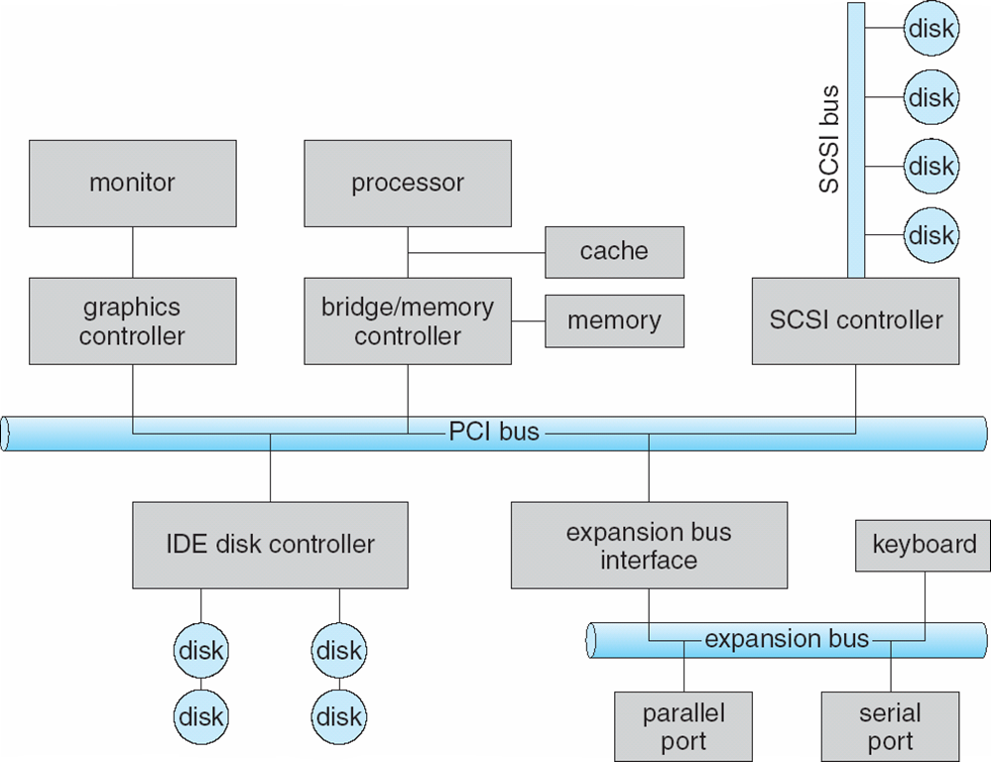
Typical Computer Bus Architecture
Operating System Concepts, 10th edition
by Abraham Silberschatz, Greg Gagne, and Peter B. Galvin
Wiley, 2018, ISBN 978-1119456339

Slide 18
Device Controllers
A separate hardware unit that interfaces with an I/O device.
A more modular and general machine design.
AKA device adapter
Typically, a separate printed circuit card plugged into the system mother board.
A cable leads from the card to the device.
One controller can handle multiple identical devices.

Slide 19
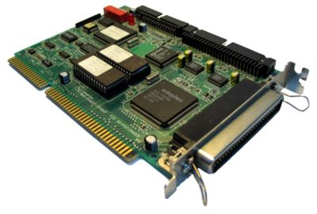
Device Controllers, cont’d
Often uses an industry standard interface.
ANSI, IEEE, or ISO standard.
Example: Disk controllers use the IDE (Integrated Drive Electronics) or SCSI (Small Computer System Interface) standards.
SCSI device controller
https://simple.wikipedia.org/wiki/Device_controller#/media/File:Kontroler_scsi_isa.jpg

Slide 20
Device Controllers, cont’d
Device controllers typically have built-in control registers and data buffers to use during I/O operations.
Each control register has a port number.
Special I/O instructions can read from such a port: or write to such a port:
IN REG,PORT
OUT PORT,REG

Slide 21
Memory-Mapped I/O
A device controller’s I/O registers can be part of the address space for main memory.
Each register is assigned a unique memory address.
Such addresses are not used by normal memory operations.
Whenever a process wants to read from memory, it puts the memory address out onto the system bus.
If the address is that of an I/O register, the corresponding device goes to get the data.
Otherwise, it’s a normal read from main memory.

Slide 22
Direct Memory Access (DMA)
Requires a DMA controller.
The DMA controller can be used by multiple I/O devices.
Regulates concurrent data transfers.
The controller accesses the system bus independently of the CPU.

Slide 23
Direct Memory Access (DMA), cont’d
The CPU can access the controller’s registers.
memory address register
byte count register
control registers
The DMA controller handles I/O upon instruction from the CPU.
Works in parallel with the CPU.

Slide 24
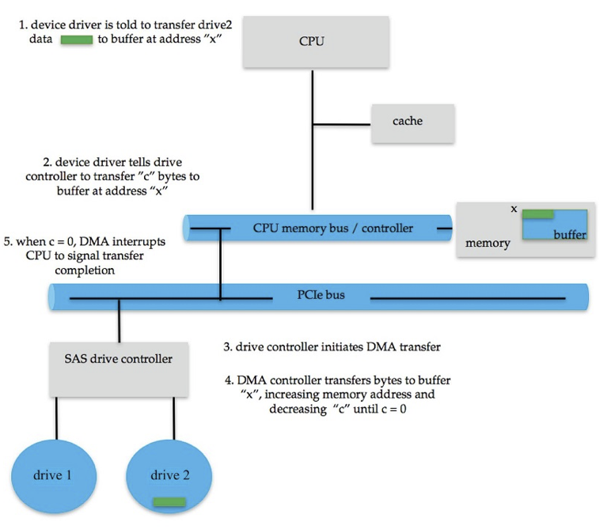
DMA Example: Data Read
Operating System Concepts, 10th edition
by Abraham Silberschatz, Greg Gagne, and Peter B. Galvin
Wiley, 2018, ISBN 978-1119456339

Slide 25
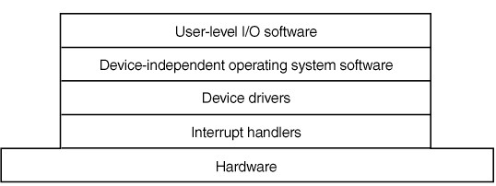
I/O Software Layers
Layers of the I/O software system:
Modern Operating Systems, 4th edition
by Andrew Tanenbaum & Herbert Bos
Pearson, 2014, ISBN 978-0133591620

Slide 26
Device Drivers
Device drivers are lower-level system software.
File systems deal with abstract block devices.
Provide uniform device access by the OS kernel to the I/O subsystem.
New devices are being invented all the time.
No hope of using these devices without standard device driver interfaces.
Analogous to the OS system calls which provide a standard interface between applications and the OS.

Slide 27
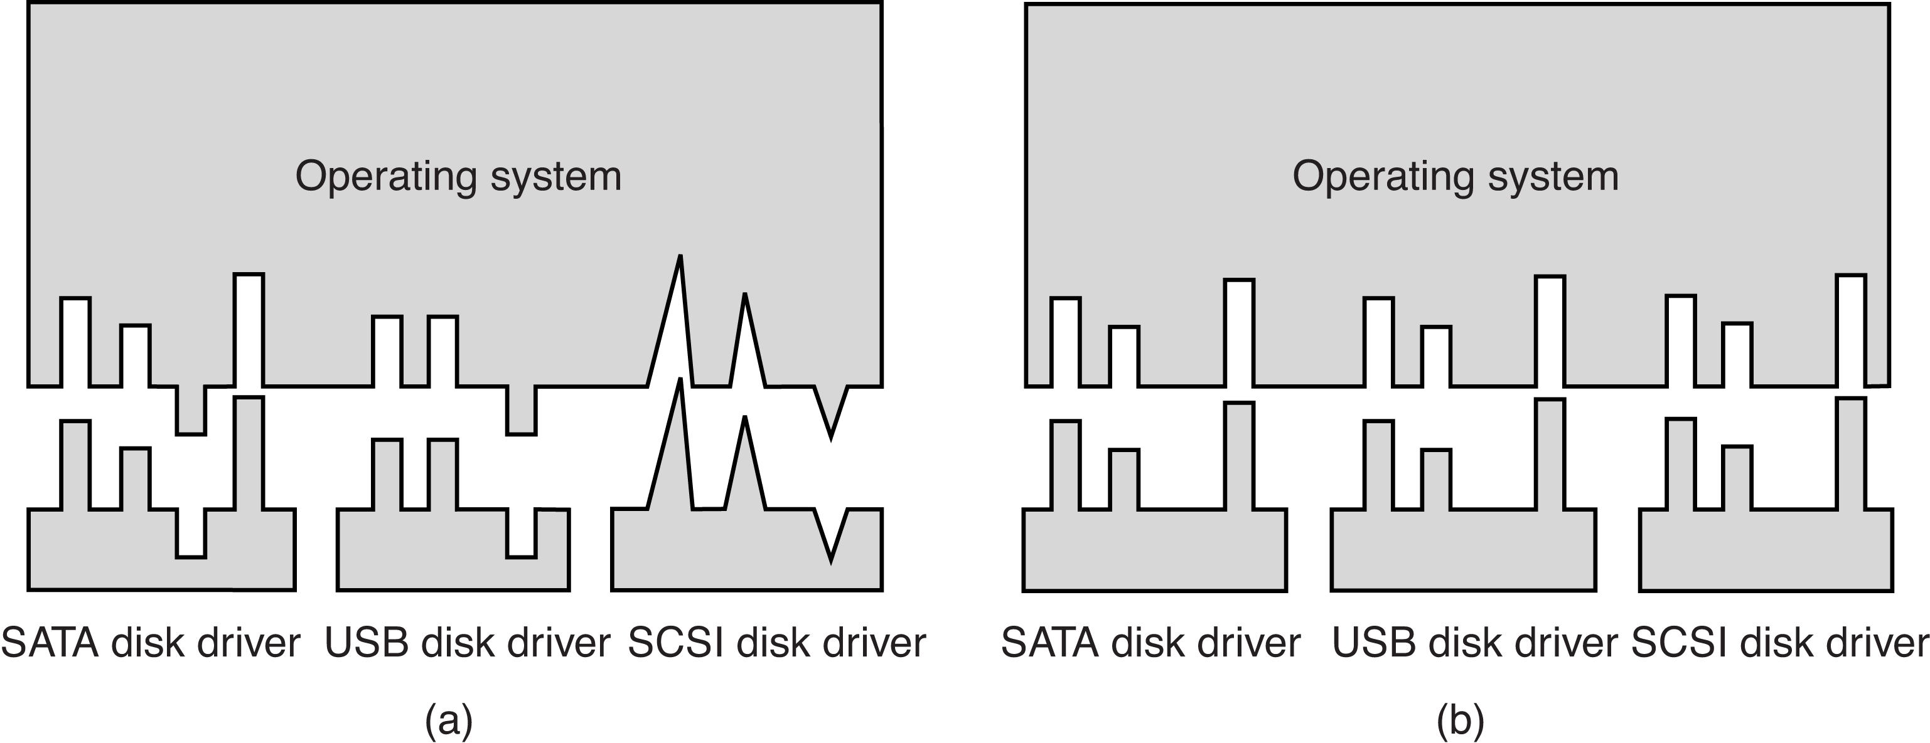
Device Drivers, cont’d
Without a standard driver interface.
With a standard driver interface.
Modern Operating Systems, 4th edition
by Andrew Tanenbaum & Herbert Bos
Pearson, 2014, ISBN 978-0133591620

Slide 28
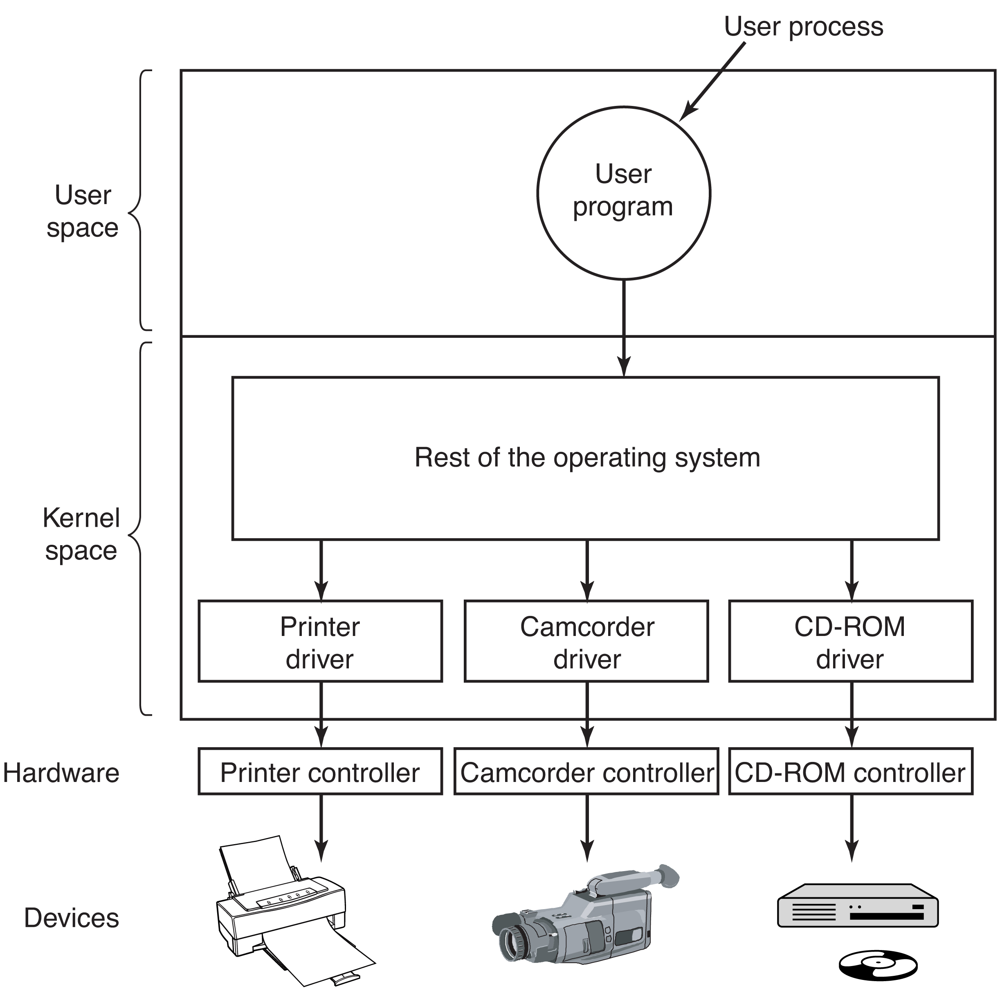
Device Drivers, cont’d
Modern Operating Systems, 4th edition
by Andrew Tanenbaum & Herbert Bos
Pearson, 2014, ISBN 978-0133591620

Slide 29
Device-Independent Software
Most I/O software is device-independent.
The remaining is device-specific.
Perform I/O operations that are common to all devices.
Provide a uniform interface to user-level applications software.

Slide 30
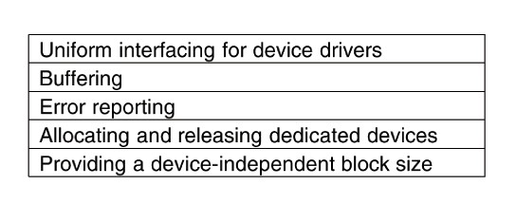
Device-Independent Software, cont’d
Functions of the device-independent I/O software.
Modern Operating Systems, 4th edition
by Andrew Tanenbaum & Herbert Bos
Pearson, 2014, ISBN 978-0133591620

Slide 31
Synchronous I/O Operations
Synchronous (AKA blocking)
Perform I/O synchronized with the process.
The process waits for the I/O operation to complete.
Predictable response times.
Insufficient for some needs.

Slide 32
Asynchronous I/O Operations
Asynchronous (AKA nonblocking)
Requires multithreading.
Perform I/O not synchronized with the process.
After initiating an I/O operation, a process continues without waiting for completion.
The process receives an interrupt at an unpredictable time when the I/O operation completes.
Irregular or unpredictable response times.

Slide 33
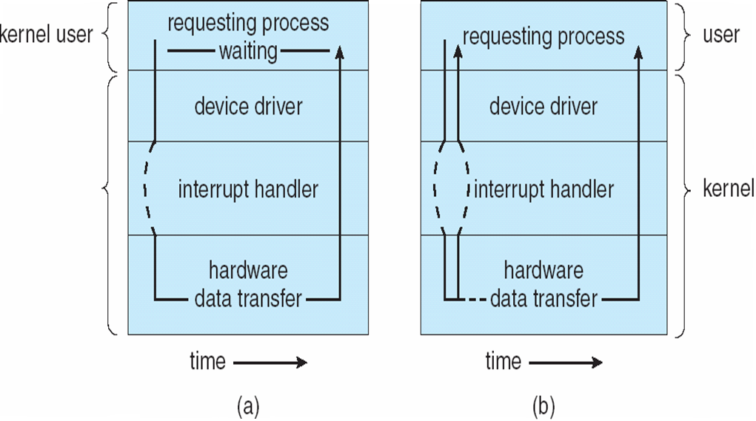
Types of I/O Operations
Synchronous
Asynchronous
Operating System Concepts, 10th edition
by Abraham Silberschatz, Greg Gagne, and Peter B. Galvin
Wiley, 2018, ISBN 978-1119456339

Slide 34
Break

Slide 35
Kernel I/O Subsystem
Scheduling
Some I/O request ordering via per-device queues.
The OS attempts fairness.
Buffering
Store data in memory while transferring between devices.
Cope with device speed mismatch.
Cope with device transfer size mismatch.

Slide 36
Kernel I/O Subsystem, cont’d
Caching
Fast memory holding copy of data.
Always just a copy.
Key to performance.
Spooling
Hold output for a device if the device can serve only one request at a time.
Example: printing

Slide 37
Kernel I/O Subsystem, cont’d
Device reservation
Provide exclusive access to a device.
System calls for allocation and deallocation.
Watch out for deadlocks!

Slide 38
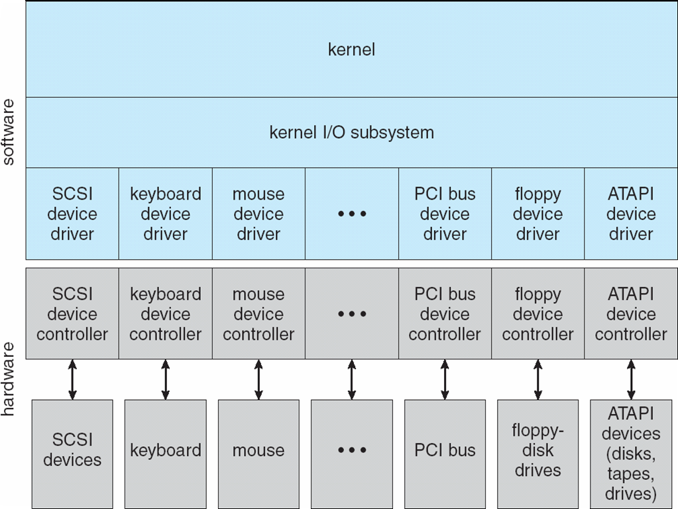
Kernel I/O Subsystem
Operating System Concepts, 10th edition
by Abraham Silberschatz, Greg Gagne, and Peter B. Galvin
Wiley, 2018, ISBN 978-1119456339

Slide 39
Polling
Producer-consumer relationship.
The OS and the device controller share a handshaking protocol.
The controller sets a busy bit in its status register to indicate that it’s busy working.
The OS sets a command-ready bit in the controller’s command register to indicate that it has a command for the controller to execute.

Slide 40
The Polling Cycle
The OS repeatedly checks the busy bit.
Polling (busy waiting)
The OS sets the write bit in the command register and writes a byte into the data-out register.
The OS sets the command-ready bit.
The controller sees the command-ready bit is set and sets the busy bit.

Slide 41
The Polling Cycle, cont’d
The controller sees the write bit is set in the command register, reads the byte in the data-out register, and performs the I/O operation.
The controller clears the command-ready bit, clears the error bit in the status register, clears the write bit, and clears the busy bit.

Slide 42
I/O Interrupts
An I/O device triggers the CPU’s interrupt-request line.
An interrupt handler receives interrupts.
Some interrupts are maskable to ignore or delay the interrupts.
Other interrupts are nonmaskable.
An interrupt vector dispatches the interrupt to the correct interrupt handler.
Based on priority.

Slide 43
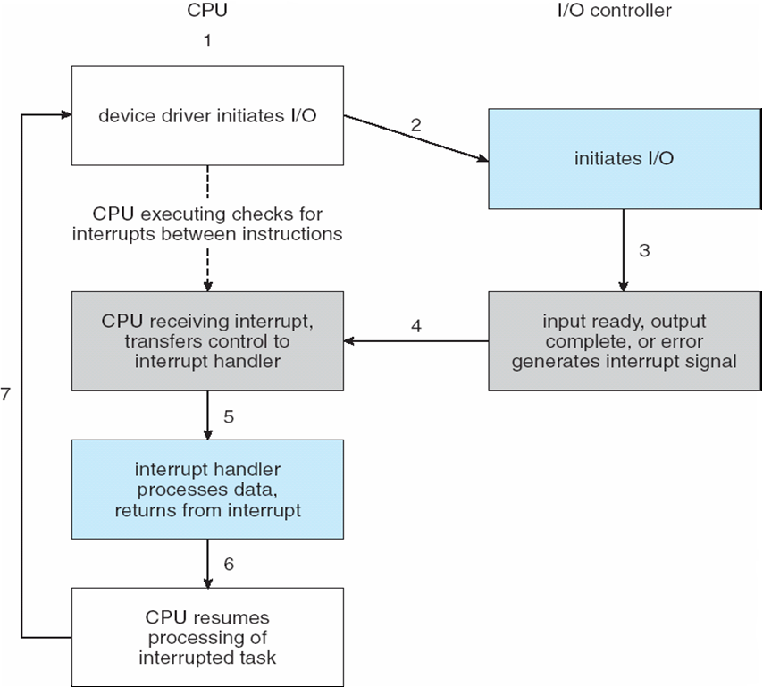
I/O Interrupts
Operating System Concepts, 10th edition
by Abraham Silberschatz, Greg Gagne, and Peter B. Galvin
Wiley, 2018, ISBN 978-1119456339

Slide 44
OS-Level Interrupt Handlers
Interrupt priority levels
A high-priority interrupt can preempt a low-priority interrupt.
Used to handle system exceptions (errors).
Examples
divide by zero
accessing a protected or nonexistent memory address
executing a privileged instruction in user mode

Slide 45
Application-Level Interrupt Handlers
Software interrupt (AKA trap)
A special instruction executed by a system call from a user application to request a kernel service.
User programs can include application-level interrupt handlers.

Slide 46
Signal Handler
#include <stdio.h>
#include <stdlib.h>
#include <signal.h>
#include <unistd.h>
void INThandler(int);
int main(void)
{
signal(SIGINT, INThandler);
for (int i = 1; i <= 20; i++)
{
printf("Sleep #%d\n", i);
sleep(1);
}
printf("\nDone!\n");
return 0;
}
signal.c
Handle control-C

Slide 47
Signal Handler, cont’d
signal.c
void INThandler(int sig)
{
signal(sig, SIG_IGN);
printf("\nDo you really want to quit? [y/n] ");
int ch = getchar();
if (ch == 'y' || ch == 'Y')
{
printf("\nProgram killed.\n");
exit(0);
}
else
{
signal(SIGINT, INThandler);
getchar();
}
}

Slide 48
Clocks and Timers
Provide current time and elapsed time.
Programmable interval timer
Provide a timer to trigger operation X at time T.
Used for timings
Generate periodic interrupts
The UNIX ioctl() system call
Covers odd aspects of I/O such as clocks and timers.

Slide 49
Timer Example
timer.c
#include <stdio.h>
#include <stdlib.h>
#include <signal.h>
#include <stdbool.h>
#include <sys/time.h>
#define COUNT 10
int right = 0;
int wrong = 0;
bool timed_out;
void SIGALRM_handler(int sig);
int main(void)
{
struct itimerval tval;
char string[BUFSIZ];
timerclear(&tval.it_interval);
timerclear(&tval.it_value);
tval.it_value.tv_sec = 2; // 2 second timeout
signal(SIGALRM, SIGALRM_handler);
Set the SIGALRM handler.

Slide 50
Timer Example, cont’d
for (int k = 1; k <= COUNT; k++)
{
int i = rand()%10;
int j = rand()%10;
printf("Problem #%d: Solve %d+%d=", k, i, j);
timed_out = false;
setitimer(ITIMER_REAL, &tval, NULL);
if (fgets(string, sizeof string, stdin) != NULL)
{
if (!timed_out)
{
setitimer(ITIMER_REAL, NULL, NULL);
if (atoi(string) == i + j)
{
right++;
printf("Correct!\n");
}
else
{
wrong++;
printf("Wrong!\n");
}
}
}
}
printf("\nRight: %d, wrong: %d\n", right, wrong);
return 0;
}
timer.c
Generate an addition problem.
Set the timer.
Turn off the timer.

Slide 51
Timer Example, cont’d
timer.c
void SIGALRM_handler(int sig)
{
printf("\nTime's up!\nPress return for another problem.\n");
wrong++;
timed_out = true;
}
Also see the timer in the Office Hour program
that signals the end of the professor’s office hour.

Slide 52
Sockets
Network socket interface.
An application creates a software socket.
Connect a local socket to a remote address.
The socket plugs the application into a socket created by another application.
Listen for data packets over the connection.
Ports below 1024 are considered well-known.
Example: SSH listens on port 22.
Example: Web server listens on port 80.

Slide 53
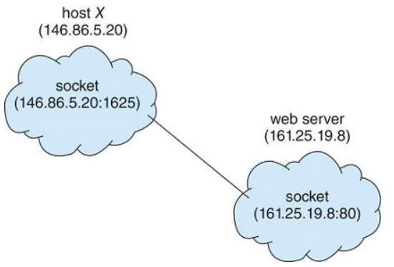
Sockets, cont’d
When a client process initiates a request for a connection, it is assigned a port number > 1024 by its host computer.
Operating System Concepts, 10th edition
by Abraham Silberschatz, Greg Gagne, and Peter B. Galvin
Wiley, 2018, ISBN 978-1119456339

Slide 54
Socket Example: Server
server.c
#include <stdio.h>
#include <stdlib.h>
#include <unistd.h>
#include <string.h>
#include <time.h>
#include <sys/types.h>
#include <sys/socket.h>
#include <arpa/inet.h>
#include <netinet/in.h>
#include "globals.h"
int main(int argc, char *argv[])
{
struct sockaddr_in server_address;
memset(&server_address, '0', sizeof(server_address));
int socket_fd = socket(AF_INET, SOCK_STREAM, 0);
if (socket_fd < 0)
{
perror("*** Error: socket()");
return -1;
}
globals.h
#define BUFFER_SIZE 1024
#define SERVER_PORT 5000
#define MAX_CONNECTIONS 10
Create a socket:
AF_INET: family for IPv4 addresses
SOCK_STREAM: use reliable transport protocol
0: let the kernel decide the default protocol

Slide 55
Socket Example: Server, cont’d
server.c
htonl and htons convert long and short values, respectively, from host byte order
to network byte order.
INADDR_ANY: accept
incoming connections
across any network
interface configured on
the local host.
server_address.sin_family = AF_INET;
server_address.sin_addr.s_addr = htonl(INADDR_ANY);
server_address.sin_port = htons(SERVER_PORT);
if (bind(socket_fd, (struct sockaddr*)&server_address,
sizeof(server_address)) < 0)
{
perror("*** Error: bind()");
return -2;
}
if (listen(socket_fd, MAX_CONNECTIONS) < 0)
{
perror("*** Error: listen()");
return -3;
}
After the call to listen(),
this socket becomes a fully
functional listening socket.

Slide 56
Socket Example: Server, cont’d
server.c
char buffer[BUFFER_SIZE];
memset(buffer, '0', sizeof(buffer));
while (1)
{
printf("Server waiting to connect ... "); fflush(stdout);
int connection_fd = accept(socket_fd, (struct sockaddr*)NULL, NULL);
if (connection_fd < 0)
{
perror("*** Error: accept()");
return -4;
}
time_t ticks = time(NULL);
sprintf(buffer, "%s", ctime(&ticks));
write(connection_fd, buffer, strlen(buffer));
printf("sent %s", buffer);
close(connection_fd);
}
}
Accept a connection on a socket.
Generate and send
the time message
over the connection.

Slide 57
Socket Example: Client
client.c
#include <netdb.h>
#include <stdio.h>
#include <string.h>
#include <unistd.h>
#include <sys/types.h>
#include <sys/socket.h>
#include <arpa/inet.h>
#include <netinet/in.h>
#include "globals.h"
int main(int argc, char *argv[])
{
if (argc != 2)
{
printf("*** Usage: <IP address of server>\n");
return -1;
}
int socket_fd = socket(AF_INET, SOCK_STREAM, 0);
if (socket_fd < 0)
{
perror("*** Error: socket()");
return -2;
}
globals.h
#define BUFFER_SIZE 1024
#define SERVER_PORT 5000
#define MAX_CONNECTIONS 10

Slide 58
Socket Example: Client, cont’d
client.c
struct sockaddr_in server_address;
memset(&server_address, '0', sizeof(server_address));
server_address.sin_family = AF_INET;
server_address.sin_port = htons(SERVER_PORT);
char *ip_address = argv[1];
if (inet_pton(AF_INET, ip_address, &server_address.sin_addr) <= 0)
{
perror("*** Error: inet_pton()");
return -3;
}
if (connect(socket_fd,
(struct sockaddr *)&server_address,
sizeof(server_address)) < 0)
{
perror("*** Error: connect()");
return -4;
}
Example client run:
./client 127.0.0.1
Convert an internet address
from text to binary form.
Connect the socket
to the address.

Slide 59
Socket Example: Client, cont’d
client.c
char buffer[BUFFER_SIZE];
memset(buffer, '0', sizeof(buffer));
int n = read(socket_fd, buffer, sizeof(buffer)-1);
if (n > 0)
{
buffer[n] = 0;
printf("Client received %s", buffer);
}
else perror("*** Error: read()");
return 0;
}

Slide 60
The POSIX select() Call
Problem: Your program has several input sources, and you don’t know at run time which one will have input at any moment.
Solution: Use the POSIX select() function to manage a set of file descriptors.
Returns information about the file descriptors:
Which have data waiting to be read.
Which can accept data to be written.
Which have pending errors.

Slide 61
The POSIX select() Call, cont’d
#include <sys/time.h>
#include <sys/select.h>
int select(int nfds, fd_set *readfds, fd_set *writefds,
fd_set *exceptfds, struct timeval *timeout);
Return the number of ready file descriptors, 0 on timeout, or -1 on error.
Block (until timeout) while waiting until at least one file descriptor can be read without blocking, written without blocking, or has a pending error.
Eliminates the need for polling.

Slide 62
The POSIX select() Call, cont’d
Macros FD_ZERO(), FD_SET(), and FD_CLEAR() manipulate file descriptor sets.
Macro FD_ISSET() tests whether a file descriptor is ready for reading or writing, or has a pending error.

Slide 63
The POSIX select() Call, cont’d
TestSelect.c
#include <stdio.h>
#include <stdlib.h>
#include <fcntl.h>
#include <unistd.h>
#include <sys/types.h>
#include <sys/time.h>
#include <sys/ioctl.h>
#define BUFFER_SIZE 128
int main()
{
char buffer[BUFFER_SIZE];
int result, nread;
fd_set read_set;
struct timeval timeout;

Slide 64
The POSIX select() Call, cont’d
TestSelect.c
// Loop to monitor file descriptors.
while (1)
{
// 2.5 seconds.
timeout.tv_sec = 2;
timeout.tv_usec = 500000;
FD_ZERO(&read_set); // initialize to the empty set
FD_SET(0, &read_set); // set file descriptor 0 (stdin) into read_set
result = select(FD_SETSIZE, &read_set, NULL, NULL, &timeout);
switch (result)
{
// Nothing ready.
case 0:
{
printf("@");
fflush(stdout);
break;
}
Set more file descriptors to monitor besides 0.
Must reset the read_set before each call to select().

Slide 65
The POSIX select() Call, cont’d
TestSelect.c
// Error.
case -1:
{
perror("select");
exit(1);
}
// Something is ready.
default:
{
// Is it file descriptor 0 (stdin)?
if (FD_ISSET(0, &read_set))
{
nread = read(0, buffer, BUFFER_SIZE);
buffer[nread] = 0;
printf("Read %d characters from the keyboard: %s",
nread, buffer);
}
break;
}
}
}
}
Test any other file descriptors in read_set.
Demo

Slide 66
Assignment #9: POSIX select()
Write a program that can receive input from several file descriptors.
Use the POSIX select() call to monitor the input file descriptors.
Read data from any file descriptor that is ready and print the data.
Create two pipes and fork two child processes.
Child process 1 writes Message 1, Message 2, etc. to the write end of the first pipe at random intervals of 1, 2, 3, 4, or 5 seconds.

Slide 67
Assignment #9, cont’d
Child 2 prompts the user at the terminal to enter a message. It reads the message and writes it to the write end of the second pipe.
In a loop, the parent process monitors the read ends of the two pipes using a select() call. It also monitors a socket connection (another file descriptor) to a time server program.
Whenever a read file descriptor is ready, the parent process reads the data and prints it.
Label the data with its source: Child 1, Child 2, or time server.

Slide 68
Assignment #9, cont’d
After the parent process reads and prints the time from the time server, it must make a new connection.
Write a separate time server program.
In a loop, it waits for a client to connect.
It sends the current time to the connection.
Then it sleeps randomly for 1, 2, 3, 4, or 5 seconds before waiting for the next connection.

Slide 69
How Fast?
Speed of an electrical signal: ~20 cm/nsec in a copper wire or optical fiber.
Heat dissipation
Faster clock ➔ more heat
Smaller component ➔ harder to dissipate heat
Clock speed | Max distance per cycle
10 GHz | 2 cm
100 GHz | 2 mm
1 THz | 100 microns

Slide 70
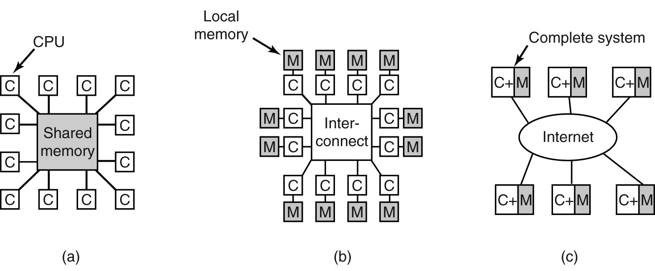
Multiprocessor Systems
Physical limits to how fast and how small it is possible to make the CPU.
Solution: Computers with multiple CPUs.
Massively parallel computers
Shared memory
Message-passing
Distributed
Modern Operating Systems, 4th edition
by Andrew Tanenbaum & Herbert Bos
Pearson, 2014, ISBN 978-0133591620

Slide 71
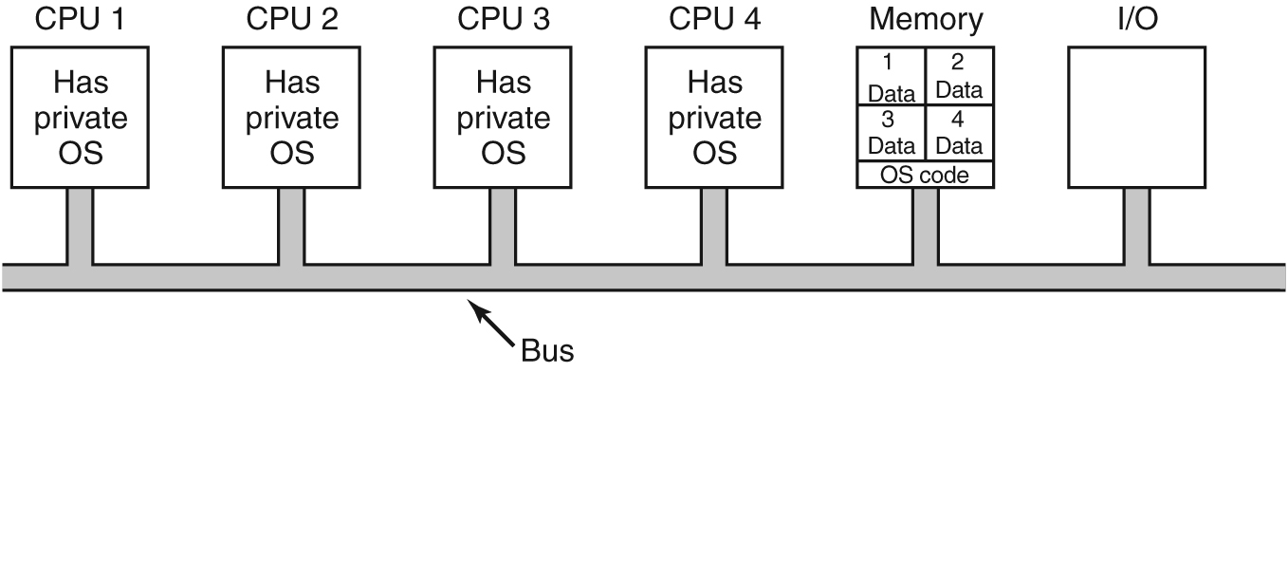
Multiprocessor Operating Systems
Each CPU has its own operating system.
Memory is partitioned.
Modern Operating Systems, 4th edition
by Andrew Tanenbaum & Herbert Bos
Pearson, 2014, ISBN 978-0133591620

Slide 72
Multiprocessor Operating Systems, cont’d
Master-slave multiprocessors
One copy of the OS runs on the master CPU.
Slave CPUs redirect system calls to the master CPU.
Modern Operating Systems, 4th edition
by Andrew Tanenbaum & Herbert Bos
Pearson, 2014, ISBN 978-0133591620

Slide 73
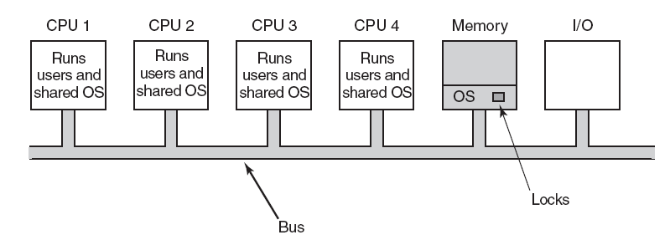
Multiprocessor Operating Systems, cont’d
Symmetric multiprocessor (SMP)
One copy of the OS.
Any CPU can run the OS.
First acquire a mutex lock.
Modern Operating Systems, 4th edition
by Andrew Tanenbaum & Herbert Bos
Pearson, 2014, ISBN 978-0133591620

Slide 74
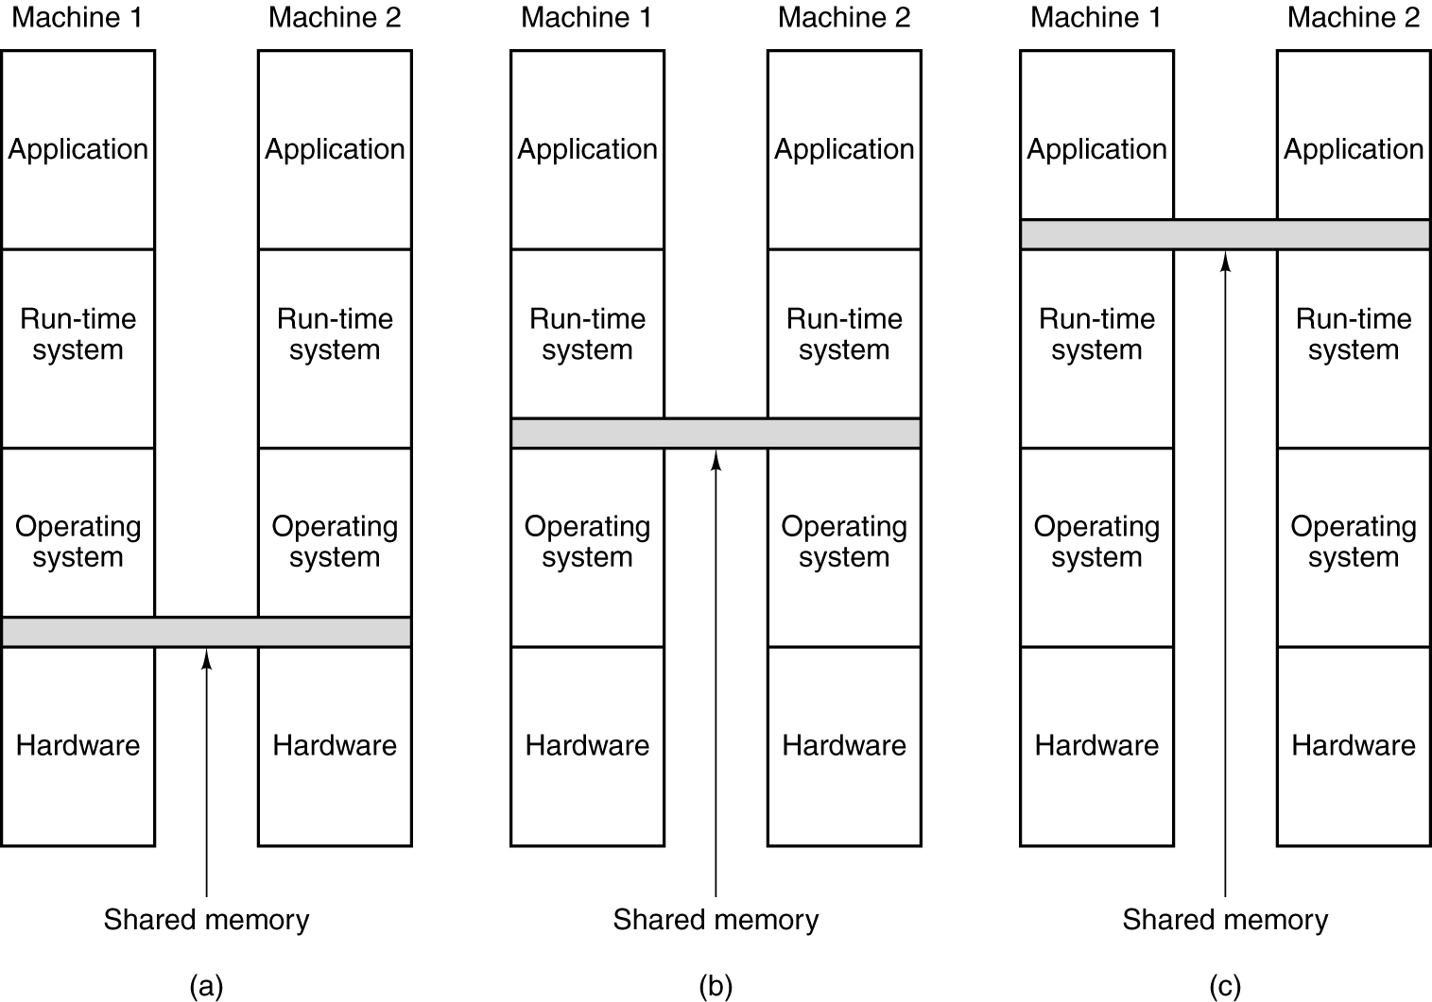
Distributed Shared Memory (DSM)
At which level can memory be shared?
Hardware
Operating system
User-level
Modern Operating Systems, 4th edition
by Andrew Tanenbaum & Herbert Bos
Pearson, 2014, ISBN 978-0133591620

Slide 75
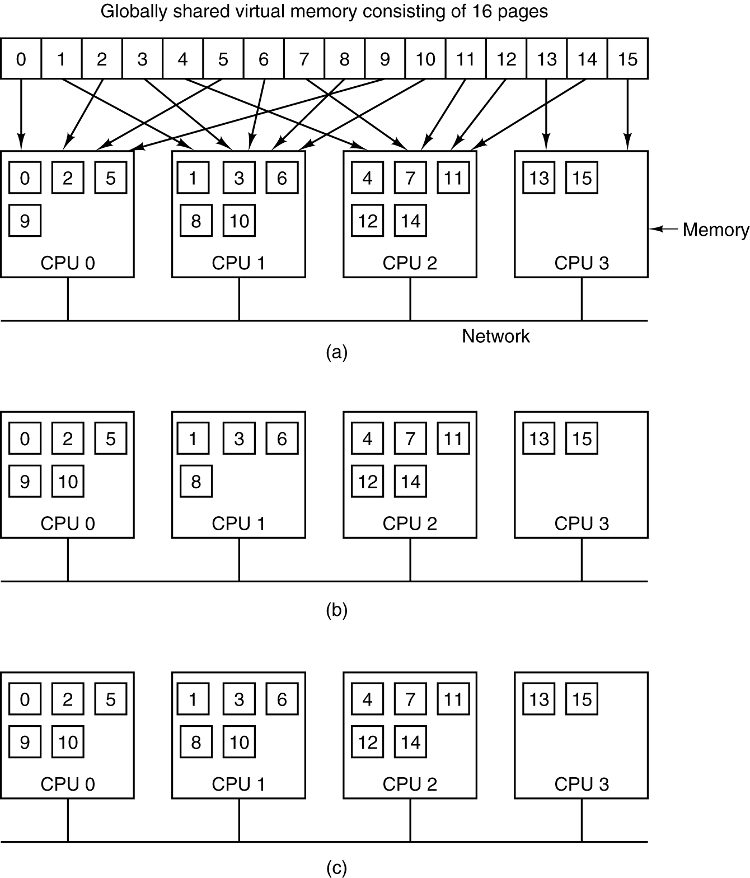
Distributed Shared Memory (DSM), cont’d
Pages of the address space are distributed among four CPUs. Page 10 is mapped to CPU 1.
CPU 0 references Page 10. It must wait for CPU 1 to release the page.
If Page 10 is read-only, it can be mapped to both CPU 0 and CPU 1.
Modern Operating Systems, 4th edition
by Andrew Tanenbaum & Herbert Bos
Pearson, 2014, ISBN 978-0133591620

