Slide 1


CMPE 142
Operating Systems
March 19 Class Meeting
Department of Computer Engineering
San Jose State University
Spring 2021
Instructor: Ron Mak
www.cs.sjsu.edu/~mak

Slide 2
Working Set
The set of pages a process is currently using.
If a process’s working set can fit in memory,
there will be few page faults.

Slide 3
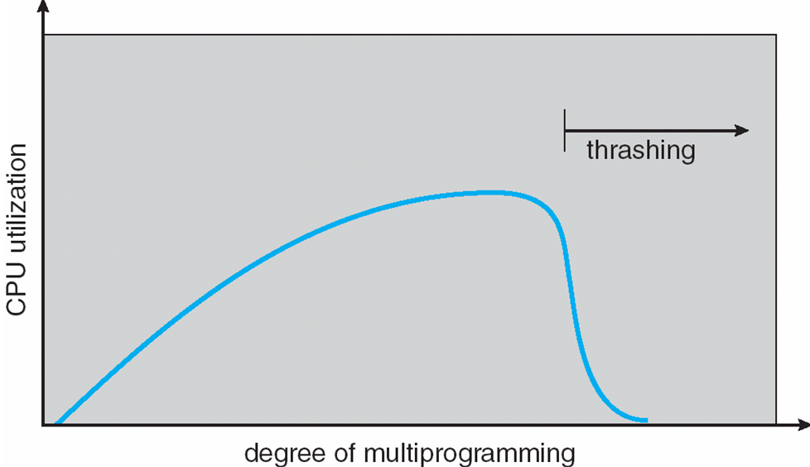
Thrashing
A process’s working set cannot fit
into available memory.
  Many page faults – one every few instructions.
Pages are constantly being
loaded and evicted.
  Disk I/O is very slow
  compared to the speed
  of the CPU.
  The process spends
  more time paging
  than executing.
Operating System Concepts, 10th edition
by Abraham Silberschatz, Greg Gagne, and Peter B. Galvin
Wiley, 2018, ISBN 978-1119456339

Slide 4
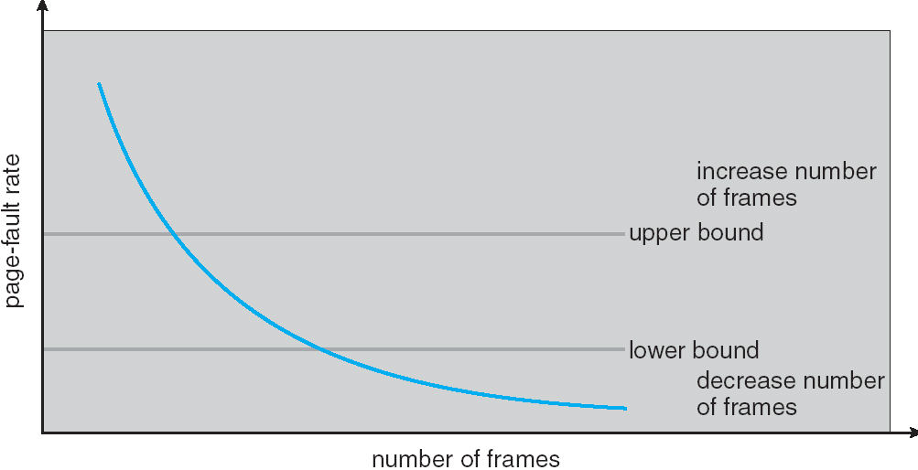
Page Fault Frequency (PFF)
To prevent thrashing, we need to control the
page fault frequency (PFF) of a process.
  Too high: The process needs more page frames,
  or it will thrash.
  Too low: The process has too many page frames.
Operating System Concepts, 10th edition
by Abraham Silberschatz, Greg Gagne, and Peter B. Galvin
Wiley, 2018, ISBN 978-1119456339

Slide 5
Locality Model
Locality is the set of pages that
a process actively uses.
  A program typically has several localities
  which may overlap.
The locality model states that a process
moves from locality to locality as it executes.
Examples:
  Executing the methods of an object
  and accessing its local data.
  Being in a particular phase of a major application,
  such as a compiler.

Slide 6
Locality Model, cont’d
If localities did not exist:
  Data accesses would be completely random.
  Caching and TLBs would not work.
  Demand paging would not work.
If not enough frames can be allocated to accommodate the size of the current locality, the process will thrash.

Slide 7
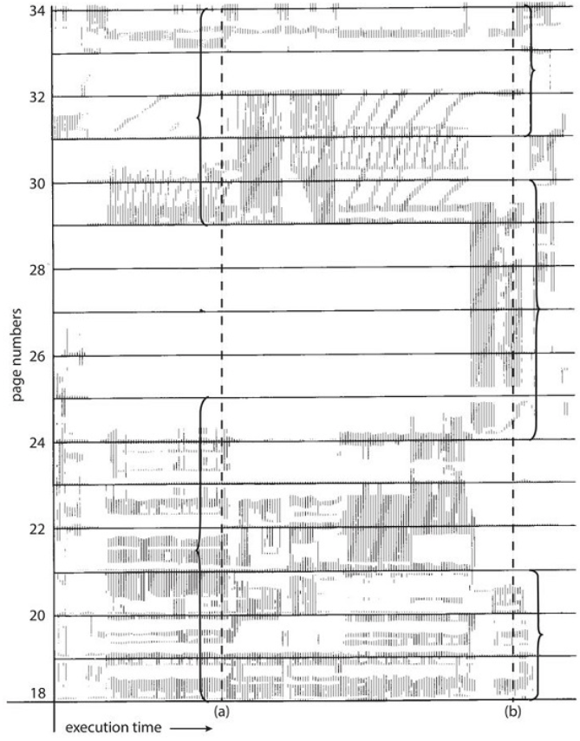
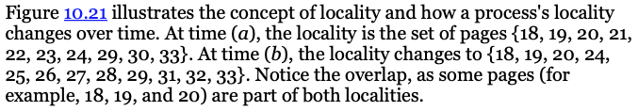
Locality Model
Locality in a memory-reference pattern.
Operating System Concepts, 10th edition
by Abraham Silberschatz, Greg Gagne, and Peter B. Galvin
Wiley, 2018, ISBN 978-1119456339

Slide 8
Working Set Model
Working set is the most recent set
of Δ page references.
  Parameter Δ defines the working set window.
A page actively being used is in the working set.
  If a page is no longer being used,
  it will drop from the working set
  Δ time units after its last reference.
  Based on the assumption of locality.

Slide 9
Working Set Model, cont’d
A working set is an approximation of
a process’s locality.
The accuracy of the working set
depends on the selection of Δ.
  Δ too large: Several localities overlap.
  Δ too small: It will not encompass the entire locality.

Slide 10
Working Set Model, cont’d
The most important property of a working set
is its size.
If WSS_{i} is the working set size for process i, then
is the total demand for page frames.
  If D is greater than the total number
  of available frames, thrashing will occur.
  The operating system selects a process to suspend.

Slide 11
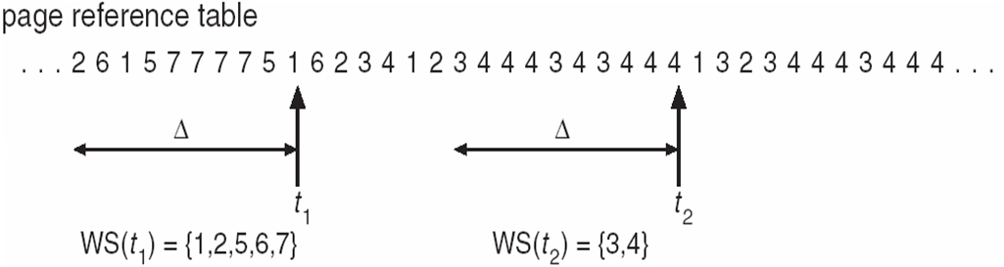
Working Set Model, cont’d
The working set model prevents thrashing
and keeps the degree of multiprogramming
as high as possible.
Operating System Concepts, 10th edition
by Abraham Silberschatz, Greg Gagne, and Peter B. Galvin
Wiley, 2018, ISBN 978-1119456339

Slide 12
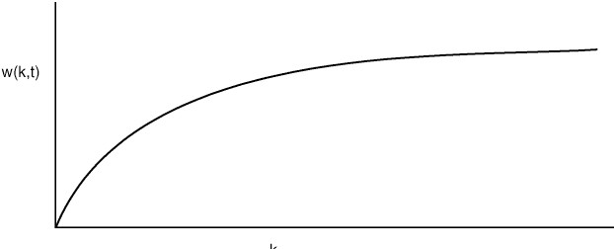
Working Set Model, cont’d
The size of a process’s working set is a
monotonically nondecreasing function of Δ.
  The size is finite because a process
  cannot reference more pages
  than its logical address space contains.
ΣWSS_{i}
Δ
Modern Operating Systems, 3rd ed.
Andrew Tanenbaum
(c) 2008 Prentice-Hall, Inc.. 0-13-600663-9
All rights reserved

Slide 13
Local vs. Global Page Allocation
When a page fault occurs for a process A,
the page replacement algorithm can choose a victim page to evict from memory either locally or globally.
Local page replacement
  Each process has a fixed allocation of page frames.
  The victim page is selected from process A’s pages in memory.

Slide 14
Local vs. Global Page Allocation
Global page replacement
  The victim page is selected
  from all the pages in memory.
In general, global page replacement
works better.
  A process’s working set size varies over time.
  With local page replacement, a process may thrash
  even if there are free page frames.

Slide 15
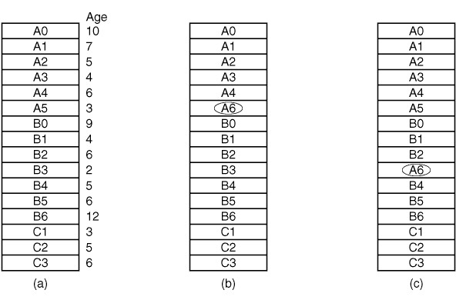
Local vs. Global Page Allocation, cont’d
Local versus global page replacement.
  Original configuration.
  Local page replacement.
  Global page replacement.
Modern Operating Systems, 3rd ed.
Andrew Tanenbaum
(c) 2008 Prentice-Hall, Inc.. 0-13-600663-9
All rights reserved

Slide 16
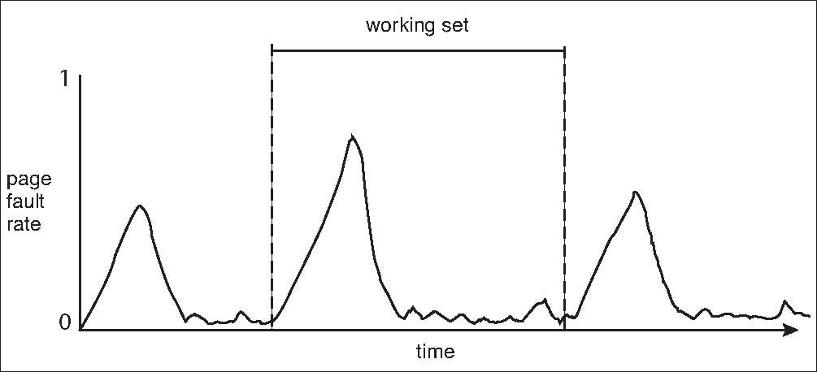
Working Set and Page Fault Rate
There is a direct relationship between
working set and page fault rate.
  As a process moves from one locality to another,
  the number of page faults increases.
  The number of page faults decreases as the new working set
  is paged into memory.
Operating System Concepts, 10th edition
by Abraham Silberschatz, Greg Gagne, and Peter B. Galvin
Wiley, 2018, ISBN 978-1119456339

Slide 17
Prepaging
With demand paging, there is a large number
of page faults when a process first starts or
is resumed after a suspension.
Try to get the initial locality into memory.

Slide 18
Prepaging, cont’d
Prepaging is a strategy to bring into memory
at once all the pages that a process will need.
  Requires knowledge history
  of the process’s working set.
  Record the working set whenever
  a process is suspended.
Must weigh the cost of prepaging
vs. the cost of servicing page faults.

Slide 19
Page Size
There is no single best page size.
  A power of 2, generally 4 KB (2¹²) to 4 MB (2²²).
Larger page size = smaller page table
  Each active process keeps a copy of the page table.
  Fewer page faults.
  Less I/O time per page.
  Reduce latency and seek time.
Historical trend:
Larger page sizes.

Slide 20
Page Size
Smaller page size = better memory utilization.
  Minimize internal fragmentation.
  Less total I/O time.
Each page matches process locality more accurately (better resolution).

Slide 21
Page Size, cont’d
Then
  s/p = the approximate number of pages per process
  p/2 = the average amount of wasted space due to internal fragmentation
Let
  s = average process size
  p = page size
  e = page entry size
Overhead:
  The first term (page table size) is large when p is small.
  The second term (internal fragmentation) is large when p is large.
To find the optimum page size p,
differentiate with respect to p and set to 0:
Therefore:

Slide 22
TLB Reach
Increase the hit ratio of the translation lookaside buffer.
Increase the reach of the TLB.
  reach: number of TLB entries X the page size
Ideally, a process’s working set is stored in the TLB.
  Otherwise, each miss requires accessing the page table.
Increase the number of TLB entries.
  Associative memory is expensive and power hungry.

Slide 23
Program Structure
Consider the following C code to initialize a matrix.
  Assume the matrix is stored by rows (128 words per row)
  and that the page size is 128 words and there is 1 page frame.
int row, col;
int data[128][128];
for (row = 0; row < 128; row++) {
for (col = 0; col < 128; col++) {
data[row][col] = 0;
}
}
How many page faults?
128 page faults
int row, col;
int data[128][128];
for (col = 0; col < 128; col++) {
for (row = 0; row < 128; row++) {
data[row][col] = 0;
}
}
How many page faults?
128x128 =
16,384 page faults

Slide 24
Kernel Memory
Kernel memory is often allocated from
a free-memory pool that is separate from
user-mode allocations.
  The kernel requests memory for structures of varying sizes.
  Some kernel memory needs to be contiguous,
  such as for device I/O
Kernel memory can be allocated using
the buddy system.

Slide 25
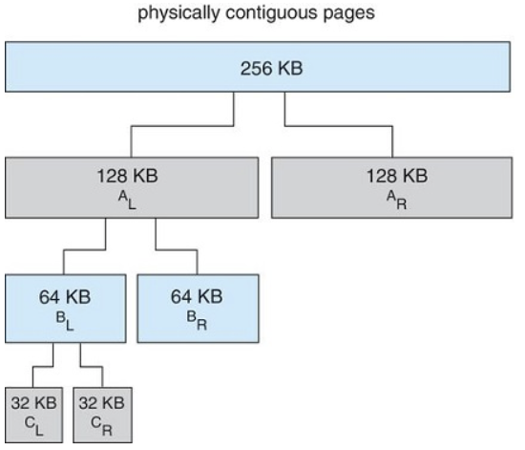
Buddy System
Allocate memory from a fixed-size segment consisting of physically-contiguous pages.
Allocate using a power-of-2 allocator.
  Satisfy requests in units sized as a power of 2.
  Round up a request to the next highest power of 2.
  When a smaller allocation is needed than is available,
  split the current block into two buddies of next-lower power of 2.
Continue until an appropriate-sized block is available.
Operating System Concepts, 10th edition
by Abraham Silberschatz, Greg Gagne, and Peter B. Galvin
Wiley, 2018, ISBN 978-1119456339

Slide 26
Buddy System, cont’d
Example: Assume a 256KB block is available,
and the kernel requests 21KB
  Split into A_{L} and A_{R} into blocks of 128KB each
  Divide A_{L} into B_{L} and B_{R} blocks of 64KB each
  Divide B_{L} into C_{L} and C_{R} blocks of 32KB each
  C_{L} satisfies the request
Advantage: Quickly coalesce unused blocks into larger blocks.
Disadvantage: Internal fragmentation.
Operating System Concepts, 10th edition
by Abraham Silberschatz, Greg Gagne, and Peter B. Galvin
Wiley, 2018, ISBN 978-1119456339

Slide 27
Memory-Mapped Files
Memory-mapped files allows file I/O
to be treated as routine memory access.
  Map a disk block to a page in memory.
A file is initially read using demand paging.
  A page-sized portion of the file is read
  from the file system into a physical page.
  Subsequent file I/O are treated as
  ordinary memory accesses.

Slide 28
Memory-Mapped Files
Simplifies and speeds file access by
driving file I/O through memory rather than read() and write() system calls.
Also allows several processes to map the same file thereby sharing the pages in memory.

Slide 29
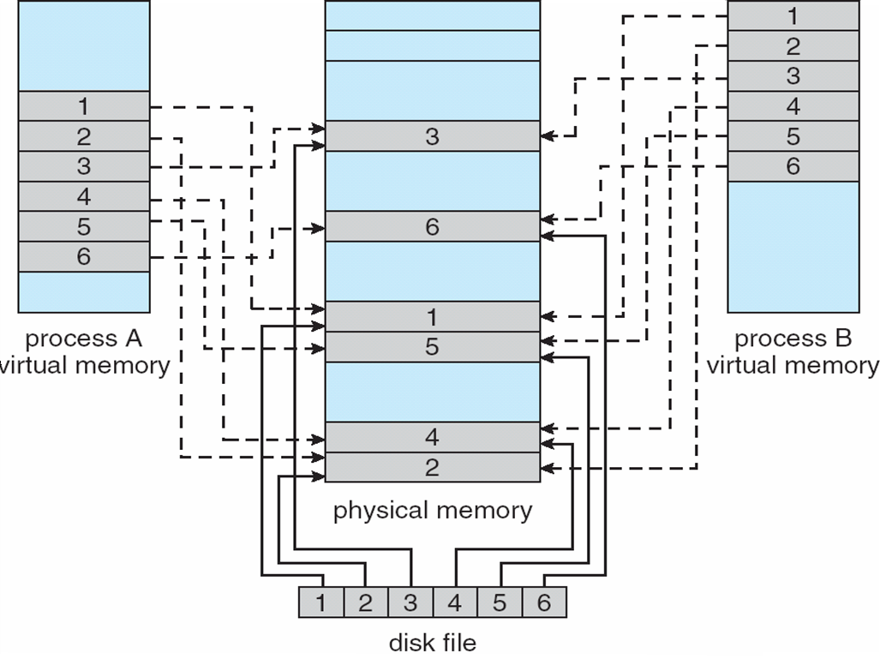
Memory-Mapped Files, cont’d
Operating System Concepts, 10th edition
by Abraham Silberschatz, Greg Gagne, and Peter B. Galvin
Wiley, 2018, ISBN 978-1119456339

Slide 30
Example: Memory-Mapped File
#include <stdio.h>
#include <stdlib.h>
#include <string.h>
#include <fcntl.h>
#include <unistd.h>
#include <sys/mman.h>
#include <sys/stat.h>
#define MAP_SIZE 100
int main(int argc, char *argv[])
{
if (argc < 2)
{
printf("*** Usage: filepath new_contents\n");
return -1;
}
char *filepath = argv[1];
char *new_contents = argv[2];
MapFile.c

Slide 31
Example: Memory-Mapped File, cont’d
int fd = open(filepath, O_RDWR);
if (fd == -1)
{
printf("*** open() failed: %s\n", filepath);
return -2;
}
// Map the file into memory.
char *addr = mmap(NULL, MAP_SIZE, PROT_READ|PROT_WRITE,
MAP_SHARED, fd, 0);
if (addr == MAP_FAILED)
{
printf("*** mmap() failed.\n");
return -3;
}
// File descriptor no longer needed.
if (close(fd) == -1)
{
printf("*** close(fd) failed.\n");
return -4;
}
Demo

Slide 32
Example: Memory-Mapped File, cont’d
printf("Current contents of file %s: \"%.*s\"\n",
filepath, MAP_SIZE, addr);
// Zero out the mapped memory and copy in the new contents.
memset(addr, 0, MAP_SIZE);
strncpy(addr, argv[2], MAP_SIZE-1);
printf("Copied \"%s\" to mapped file.\n", new_contents);
// Flush back out to the disk file.
if (msync(addr, MAP_SIZE, MS_SYNC) == -1)
{
printf("*** msync() failed.\n");
return -5;
}
return 0;
}
POSIX functions mmap and msync:
https://man7.org/linux/man-pages/man2/mmap.2.html
https://man7.org/linux/man-pages/man2/msync.2.html

Slide 33
Break

Slide 34
Intel 32-Bit Architecture
Memory management in Intel’s IA-32 systems consists of segmentation and paging.
  Each segment can be up 4 GB.
  Up to 16 K segments per process.
The logical address space of a process
is divided into two partitions.

Slide 35
Intel 32-Bit Architecture, cont’d
First partition:
Up to 8 K segments private to the process.
  Kept in the local descriptor table (LDT).
Second partition:
Up to 8 K segments shared among all processes
  Kept in the global descriptor table (GDT)

Slide 36

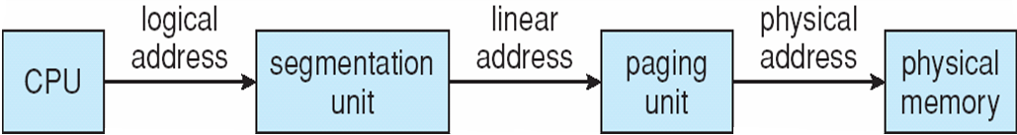
Intel 32-Bit Architecture, cont’d
The CPU generates a 16-bit logical address.
  The selector s is given to segmentation unit
  to produce a linear address.
  The g bit indicates whether the segment
  is in LDT or GDT.
  The linear address is given to paging unit to generate
  a 32-bit physical address.
  The segmentation and paging units form the MMU.
Operating System Concepts, 10th edition
by Abraham Silberschatz, Greg Gagne, and Peter B. Galvin
Wiley, 2018, ISBN 978-1119456339

Slide 37
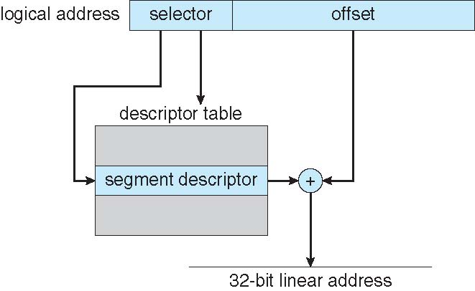
Intel 32-Bit Architecture, cont’d
Operating System Concepts, 10th edition
by Abraham Silberschatz, Greg Gagne, and Peter B. Galvin
Wiley, 2018, ISBN 978-1119456339

Slide 38
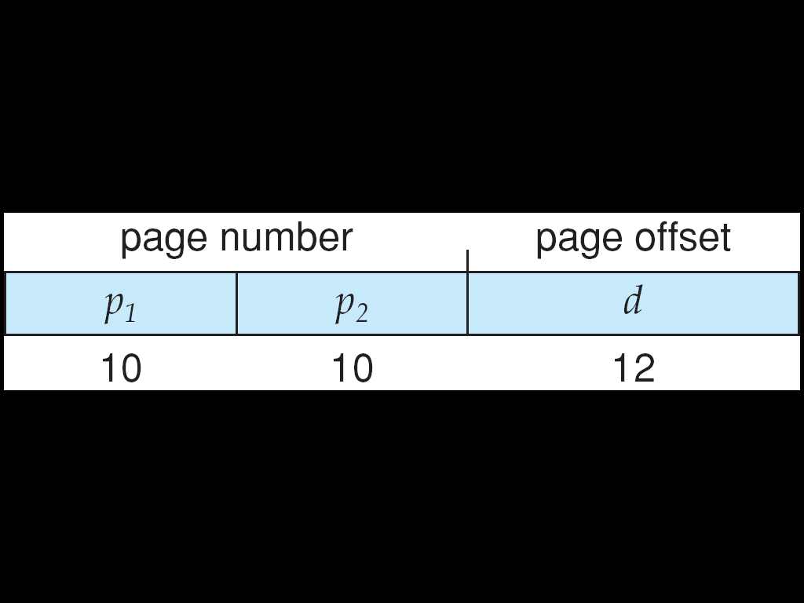
Intel 32-Bit Architecture, cont’d
Pages can be 4 KB or 4 MB.
  4 KB pages use a two-level paging scheme
  with two page numbers in the linear address:
    p₁ references the page directory
    p₂ references the inner page table
  For 4 MB pages, p₁ points directly to the page frame and the lower 22 bits is the page offset.
Operating System Concepts, 10th edition
by Abraham Silberschatz, Greg Gagne, and Peter B. Galvin
Wiley, 2018, ISBN 978-1119456339

Slide 39
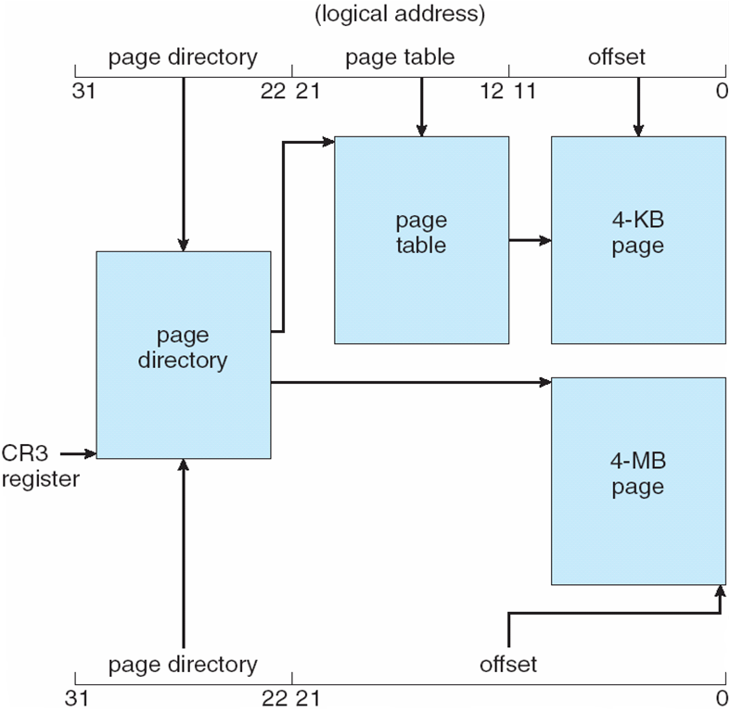
Intel 32-Bit Architecture, cont’d
Operating System Concepts, 10th edition
by Abraham Silberschatz, Greg Gagne, and Peter B. Galvin
Wiley, 2018, ISBN 978-1119456339

Slide 40
Intel 32-Bit Architecture, cont’d
Page address extension (PAE) allows 32-bit processors to address a physical address space larger than 4 GB.
  A three-level scheme.
Operating System Concepts, 10th edition
by Abraham Silberschatz, Greg Gagne, and Peter B. Galvin
Wiley, 2018, ISBN 978-1119456339

Slide 41
Intel 64-Bit Architecture
IA-64 was Intel’s original 64-bit architecture.
  Not commercially successful.
Rival AMD developed a 64-bit architecture, known as x86-64, based on extending the IA-32 instruction set.
  Intel subsequently adopted AMD’s architecture.
A 64-bit address space supports 2⁶⁴ bytes of addressable memory.
  > 16 quintillion bytes (16 exabytes)

Slide 42
Intel 64-Bit Architecture, cont’d
48-bit virtual address
  Page sizes of 4 KB, 2 MB, or 1 GB
  Four levels of paging hierarchy
  PAE can support 52-bit physical addresses (4096 TB)
Operating System Concepts, 10th edition
by Abraham Silberschatz, Greg Gagne, and Peter B. Galvin
Wiley, 2018, ISBN 978-1119456339

Slide 43
ARMv8 Architecture
ARM processors used in most mobile devices
Mostly widely used architecture when measured in the quantity of chips produced.
ARM only designs chips but doesn’t manufacture them.
  Unlike Intel, licenses its architectural designs
  to chip manufacturers.

Slide 44
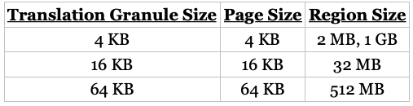

ARMv8 Architecture, cont’d
Three translation granules: 4 KB, 16 KB, 64 KB
  Each granule provides different page sizes and larger sections of contiguous memory called regions.
  4-KB and 16-KB granules: up to four paging levels:
  64-KB granules: up to three paging levels.
Operating System Concepts, 10th edition
by Abraham Silberschatz, Greg Gagne, and Peter B. Galvin
Wiley, 2018, ISBN 978-1119456339

Slide 45
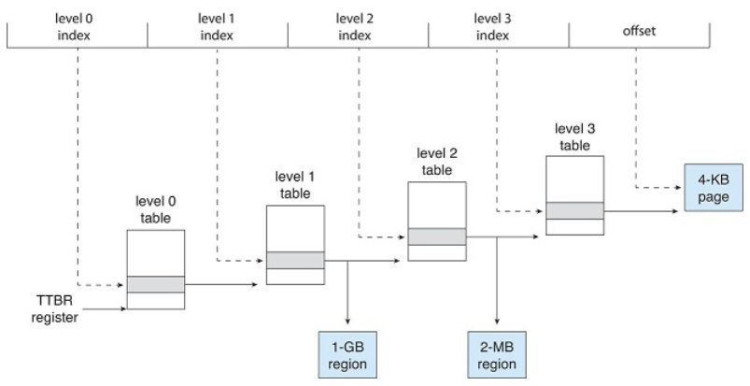
ARMv8 Architecture, cont’d
The four-level hierarchical paging structure for the 4-KB translation granule:
Operating System Concepts, 10th edition
by Abraham Silberschatz, Greg Gagne, and Peter B. Galvin
Wiley, 2018, ISBN 978-1119456339

Slide 46
ARMv8 Architecture, cont’d
Two levels of TLBs
  Outer level: Two micro TLBs,
  one for data and one for code.
  Inner level: Main TLB
  If a micro TLB misses, try the main TLB.
  If the main TLB misses, the hardware checks the page table.

Slide 47
Linux Memory Management
Two main components
  Physical memory
    Allocating and freeing pages, groups of pages,
    small blocks of RAM
  Virtual memory
    Mapping memory into the address space of running processes.

Slide 48
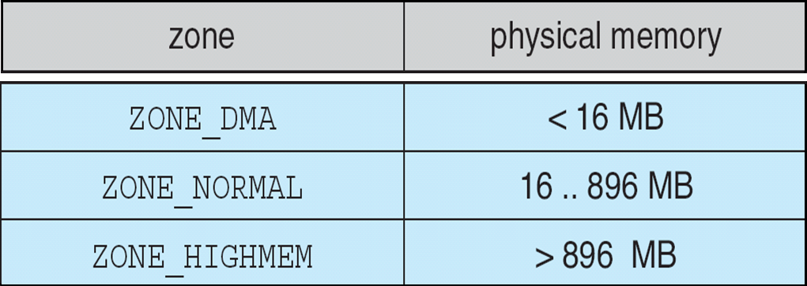
Linux Physical Memory (Intel x86-32)
Physical memory is divided into three zones.
  ZONE_DMA
    Pages that used by legacy devices.
  ZONE_NORMAL
    Normal, regularly mapped pages.
  ZONE_HIGHMEM
    Pages with high memory addresses that are not mapped
    into the kernel address space.
Operating System Concepts, 10th edition
by Abraham Silberschatz, Greg Gagne, and Peter B. Galvin
Wiley, 2018, ISBN 978-1119456339

Slide 49
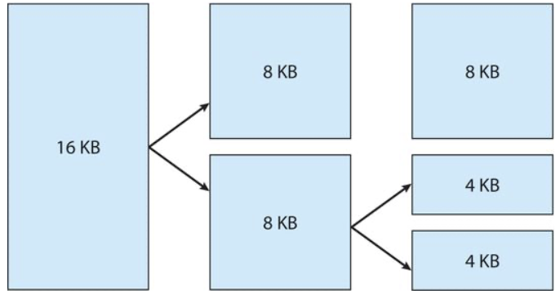
Linux Kernel Memory Allocation
Each zone has its own page allocator.
  Uses the buddy system.

Slide 50
Linux Kernel Memory Allocation, cont’d
The buddy algorithm causes
internal fragmentation.
Linux uses a slab allocator to carve
smaller allocations from what is
allocated by the buddy algorithm.
Since the kernel frequently allocates
certain types of objects, slabs are cached
by object size.

Slide 51
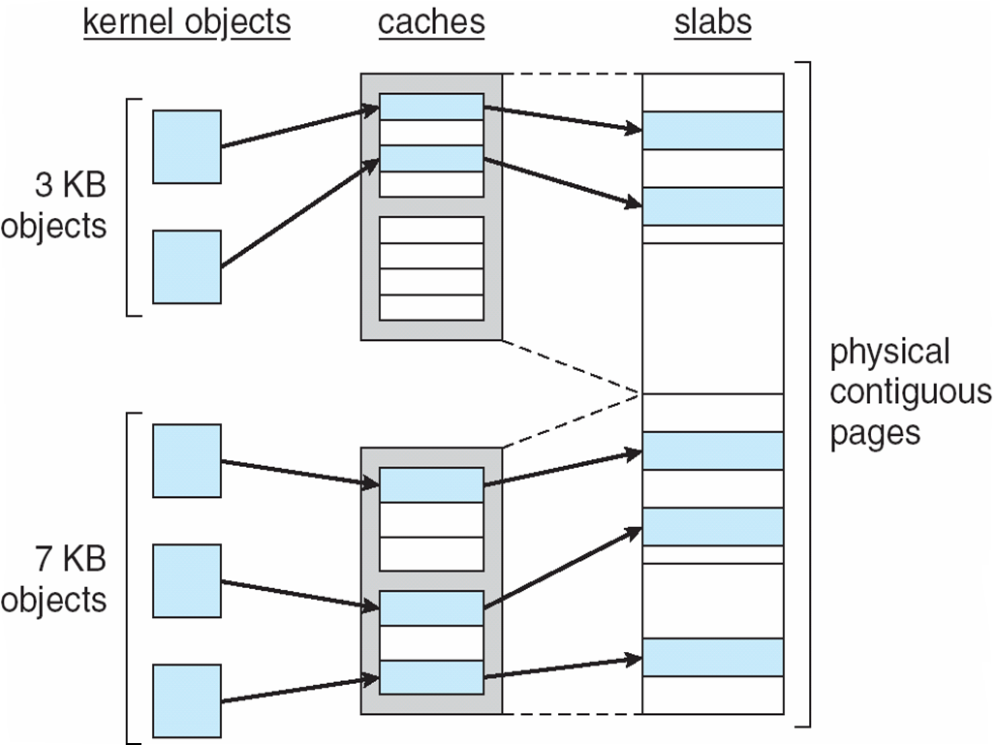
Linux Kernel Memory Allocation, cont’d

Slide 52
Linux Virtual Memory
The virtual memory manager maintains two separate views of a process’s address space:
  as a set of separate regions
  as a set of pages
A region backed by a file acts as a viewport onto a section of that file.
  Multiple process can map the file into their address spaces.

Slide 53
Linux Virtual Memory, cont’d
The kernel creates a new virtual address space when:
  A process runs a new program via an exec() call.
  A new process is created by the fork() call.

Slide 54
Review for the Midterm
A test of understanding, not memorization.
Open book, open notes, open laptop,
open Internet.
  But not open neighbor!
  Communication with anyone else in any form
  during the exam is forbidden.
  Join the class Zoom meeting as usual.
  Turn on your cameras for proctoring.
Taken in Canvas as a “quiz” with multiple-choice and short-answer questions.

Slide 55
Review for the Midterm, cont’d
What is an operating system.
  Why study them?
History of operating systems.
  The good old days before your computer had an OS.
  Data processing

Slide 56
Review for the Midterm, cont’d
OS concepts
  Bash shell
    I/O redirection
    pipes
  Processes and threads
  Interprocess communication
  Process scheduling
  Memory management
POSIX functions

Slide 57
Review for the Midterm, cont’d
OS structure
  Kernel mode vs. user mode
  Monolithic vs. layered
  Virtual machines
  Client-server
  Distributed

Slide 58
Review for the Midterm, cont’d
Processes
  Context switching
  Creation and termination
  States
Process scheduling
  Goals
  Process behavior
    compute-bound vs. I/O bound

Slide 59
Review for the Midterm, cont’d
Scheduling algorithms
  Preemptive vs. non-preemptive
  Scheduling criteria
  Algorithms: FCFS, SJF, SRT, RR, HPF, etc.
  Priority queues
  Time quanta (slices)
  Timelines
  Interrupt routines

Slide 60
Review for the Midterm, cont’d
Threads
  Lightweight processes
  Multithreaded systems
  User-level vs. kernel-level
  Thread scheduling
POSIX Pthread library
  create threads
  start threads
  wait for threads

Slide 61
Review for the Midterm, cont’d
Interprocess communication
  shared memory
  named pipes
  remote procedure call (RPC)
  blocking vs nonblocking reads

Slide 62
Review for the Midterm, cont’d
Process synchronization
  race condition
  critical region
Mutual exclusion
  lock variables
  busy waiting
  Peterson’s solution
  sleep and wakeup

Slide 63
Review for the Midterm, cont’d
Producer-consumer problem
Readers-writers problem
Dining philosophers problem
POSIX Pthreads library
  semaphores
    wait and post (signal)
  mutexes
    lock and unlock
  C++ condition variables

Slide 64
Review for the Midterm, cont’d
Deadlocks
Requesting a resource
  preemptable vs non-preemptable
Four deadlock conditions
  mutual exclusion
  hold and wait
  no preemption
  circular wait

Slide 65
Review for the Midterm, cont’d
Deadlock modeling
Strategies
Detection and recovery
Prevention
Banker’s algorithms
Resource trajectories

Slide 66
Review for the Midterm, cont’d
Memory management
System memory design
  Memory manager
Memory hierarchy
  Registers
  Cache
  Main
  Disk storage

Slide 67
Review for the Midterm, cont’d
Monoprogramming systems
Multiprogramming with fixed partitions
Multiprogramming with variable-sized partitions
Process relocation
Process protection

Slide 68
Review for the Midterm, cont’d
Address binding
  Symbolic addresses to relocatable address
  Compile-time, load-time, execution-time
Logical vs. physical address space
Dynamic loading
Dynamic linking
Swapping
  Keep track of memory allocations
  Backing store

Slide 69
Review for the Midterm, cont’d
Memory allocation algorithms
  First fit
  Next fit
  Best fit
Paging
  Pages
  Page frames
Page table
  Multilevel
  Inverted

Slide 70
Review for the Midterm, cont’d
Logical address format
Shared pages
Page replacement algorithms
  FIFO: First-in first-out
    Second chance
  LRU: Least recently used
  LFU: Least frequently used
  MFU: Most frequently used
  Random pick
  Optimal

Slide 71
Review for the Midterm, cont’d
Fragmentation
  Internal and external
Locality of reference
  Translation lookaside buffer (TLB)
  Hit ratio

Slide 72
Review for the Midterm, cont’d
Segmentation
Virtual memory
  Demand paging
  Page fault
  Copy-on-write
Kernel memory
  Buddy system

Slide 73
Review for the Midterm, cont’d
Working set model
  Thrashing
  Page fault frequency (PFF)
Locality model
Prepaging
Page size
TLB reach
Memory-mapped files

Slide 74
Review for the Midterm, cont’d
Memory architectures
  Intel IA-32
  X86-64
  ARMV8
  Linux

