Slide 1


CMPE 135: Object-Oriented Analysis and Design
May 4 Class Meeting
Department of Computer Engineering
San Jose State University
Spring 2021
Instructor: Ron Mak
www.cs.sjsu.edu/~mak

Slide 2
The Standard Template Library (STL)
The Standard Template Library (STL) is a collection of function and class templates
for various data structures, including:
  vector
  stack
  queue
  list (doubly-linked list)
  map (hash table)
  set
Example:
  sort
  random shuffle
  reverse
  find
  binary search
  merge
vector<int> v;

Slide 3
STL Iterators
STL iterators provide a uniform way to
successively access values in a data structure.
  Go through the values of a data structure one after another and perform some operation on each value.
Iterators spare you from having to know
how a data structure is implemented.
An iterator is similar to a pointer.

Slide 4

STL Iterators, cont’d
But STL iterators do not follow
the iterator design pattern.
There is no iterator superclass.
  You cannot use polymorphism for STL iterators
  as you can with the iterator design pattern.
  We can’t write a print function that uses an
  iterator object to sequentially print the values
  of any container.

Slide 5
A Vector Iterator
Declare a vector iterator:
Set the iterator to point to the first value:
Test that the iterator hasn’t gone off the end:
Access a value of the vector:
Point to the next value:
vector<int>::iterator it;
it = v.begin();
it != v.end()
*it
it++

Slide 6
Vector Iterator Example
IteratorVector1.cpp
#include <iostream>
#include <vector>
#include <iterator>
using namespace std;
int main()
{
vector<int> v = {10, 20, 30, 40, 50};
vector<int>::iterator it;
cout << "Test 1:";
for (it = v.begin(); it != v.end(); it++)
{
cout << " " << *it;
}
cout << endl;
...
Test 1: 10 20 30 40 50

Slide 7
Vector Iterator Example, cont’d
...
cout << "Test 2:";
for (it = v.begin(); it == v.end(); it++)
{
cout << " " << *it;
}
cout << endl;
cout << "Test 3:";
for (it = begin(v); it <= end(v); it++)
{
cout << " " << *it;
}
cout << endl;
};
Wrong!
Test 2:
Wrong!
Test 3: 10 20 30 40 50 32767

Slide 8
Kinds of Iterators
Forward iterator
  Use ++ to advance to the next value
  in the data structure.
Bidirectional
  Use ++ and -- to move the iterator to the next
  and to the previous data values, respectively
Random access iterator
  ++, --
  Random access to the n^{th} data value with [n]

Slide 9
Kinds of Iterators, cont’d
Constant iterator
  Example:
  Not allowed to use the iterator to change a value.
  Illegal use of a constant iterator:
Reverse iterator
  Go through the values of a data structure
  in reverse order.
  Example:
vector<char>::const_iterator it;
*it = 'a';
vector<int> v;
vector<int>::reverse_iterator it;
for (it = v.rbegin(); it != v.rend(); it++) ...

Slide 10
Reverse Iterator Example
IteratorVector2.cpp
#include <iostream>
#include <vector>
#include <iterator>
using namespace std;
int main()
{
vector<int> v = {10, 20, 30, 40, 50};
vector<int>::reverse_iterator it;
for (it = v.rbegin(); it != v.rend(); it++)
{
cout << " " << *it;
}
cout << endl;
};
Note: ++
50 40 30 20 10

Slide 11
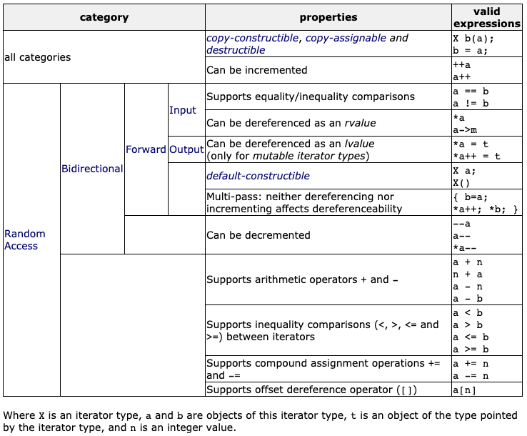
Kinds of Iterators, cont’d
https://www.cplusplus.com/reference/iterator/

Slide 12
Containers
STL container classes are data structures
that hold data.
  Examples: lists, stacks, queues, vectors
Each container class has its own iterator.
  However, all the iterators have the same operators and the member functions begin and end have the same meanings.
Sequential containers arrange their values such that there is a first value, a next value, etc. until the last value.

Slide 13
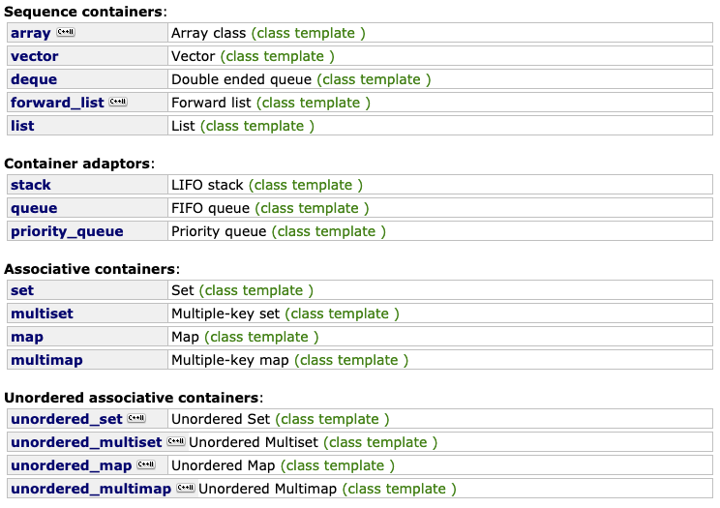
Container Class Templates
https://www.cplusplus.com/reference/stl/

Slide 14
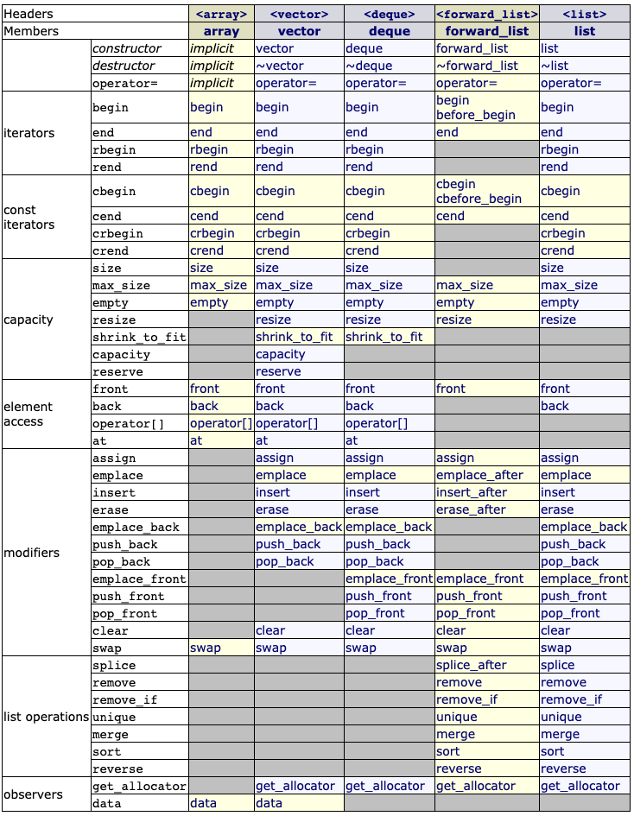
Sequential Containers
https://www.cplusplus.com/reference/stl/

Slide 15
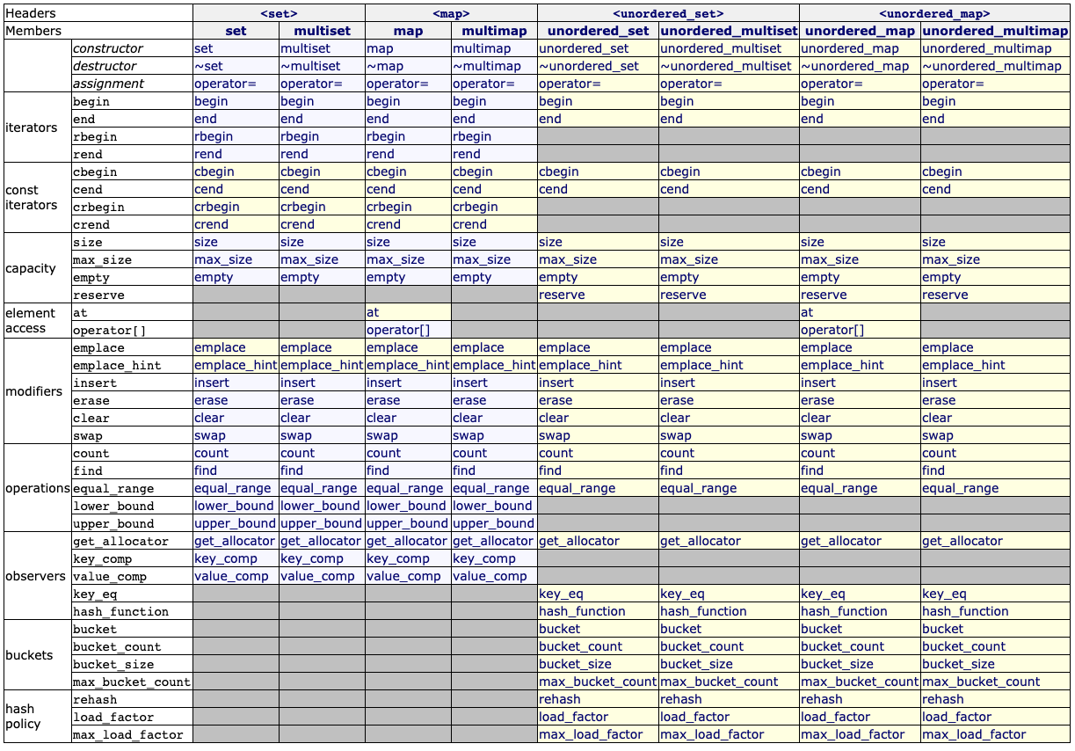
Associative Containers
https://www.cplusplus.com/reference/stl/

Slide 16
The STL list Template Class
The stl::list template class
is a doubly linked list.
  Each element has two hidden pointers.
  One pointer points forward to the next element
  (as in a singly linked list).
  One pointer points back to the previous element.
  You can traverse the list from either direction.
Therefore, there are two pointers to maintain when inserting or deleting an element.
  The STL does this for you.

Slide 17
Linked List vs. Vector
STL list functions are similar to
STL vector functions.
To append to a list: lst.push_back(value)
Forward and reverse iterators.
Insert an element before the position specified by an iterator: lst.insert(pos, value)
Remove the element at the position specified by an iterator : lst.erase(pos)

Slide 18
Linked List vs. Vector, cont’d
A vector has random access iterators.
A linked list only has bidirectional iterators.
To insert into or delete from a vector or list:
  Position an iterator to the insertion/deletion location.
    vector: begin() + index
    list: chase links from one end to the desired location
  Call the container’s insert() or erase() function
    vector: move elements to make room to insert the new element or to close the gap after the deletion
    list: manipulate pointers
Which is more efficient?

Slide 19
Additional List Functions
Remove all the elements with a given value: lst.remove(value)
Merge two sorted lists: lst1.merge(lst2)
  List lst1 is the merged list.
  List lst2 is empty after the merge.
Make the list elements unique: lst.unique()
ListTest.cpp
Demo

Slide 20
The STL forward_list Template Class
If you only need a singly-linked list, use the stl::forward_list template class.
More efficient than stl::list, but you can iterate only forwards through its elements.

Slide 21
Hash Tables
Consider an array or a vector.
  To access a value, you use an integer index.
The array maps the index to a data value
stored in the array.
  The mapping function is very efficient.
  As long as the index value is within range,
  there is a strict one-to-one correspondence
  between an index value and a stored data value.
We can consider the index value to be the key to the corresponding data value.

Slide 22
Hash Tables, cont’d
A hash table also stores data values.
  Use a key to obtain the corresponding data value.
The key does not have to be an integer value.
  For example, the key could be a string.
There might not be a one-to-one correspondence between keys and data values.
The mapping function might not be trivial.

Slide 23
The STL map Template Class
The C++ Standard Template Library (STL) provides the stl::map template class.
  Hides its implementation from programmers.
Two datatype parameters, one for the keys and one for the associated values.
  Example:
  Variable birthdays is a map where the keys are strings (such as persons’ names) and the values
  are Birthday objects.
#include <map>
...
map<string, Birthday> birthdays;

Slide 24
The STL map Template Class, cont’d
An overloaded subscript operator []:
If the subscript operator refers to a nonexistent key ("Jim"), an entry will be made with that key and the value’s default constructor.
MapTest.cpp
birthdays["Ron"] = Birthday(1983, 7, 12);
birthdays["Bob"] = Birthday(1997, 3, 25);
birthdays["Sal"] = Birthday(1985, 8, 10);
cout << "Some birthdays:" << endl;
cout << " Ron's birthday is " << birthdays["Ron"] << endl;
cout << " Jim's birthday is " << birthdays["Jim"] << endl;
cout << " Sal's birthday is " << birthdays["Sal"] << endl;
Some birthdays:
Ron's birthday is 7/12/1983
Jim's birthday is 0/0/0
Sal's birthday is 8/10/1985

Slide 25
The STL map Template Class, cont’d
You can use the at() member function instead of the subscript operator.
  If a key doesn’t exist, at() will throw an out_of_range exception.
try
{
cout << " Bob's birthday is " << birthdays.at("Bob") << endl;
cout << " Tom's birthday is " << birthdays.at("Tom") << endl;
cout << " Sal's birthday is " << birthdays.at("Sal") << endl;
}
catch (const out_of_range& ex)
{
cout << endl << endl << "***** STL map out of range error: "
<< ex.what() << endl << endl;
}
Bob's birthday is 3/25/1997
Tom's birthday is
***** STL map out of range error: map::at: key not found

Slide 26
The STL map Template Class, cont’d
Use the find() member function to check if the map contains a certain key.
  If the key exists, return an iterator to the element with the key.
  If the key does not exist, return map::end.
if (birthdays.find("Bob") == birthdays.end())
{
cout << " Bob's birthday is now unknown." << endl;
}
else
{
cout << " Bob's birthday is " << birthdays["Bob"] << endl;
}

Slide 27
The STL map Template Class, cont’d
You can also use the insert()
member function.
  Entries of a map are pair<key, value> objects.
cout << endl << "Inserting Ada's birthday:" << endl;
auto adas_pair = pair<string, Birthday>("Ada", Birthday(1815, 12, 10));
birthdays.insert(adas_pair);
cout << " Ada's birthday is " << birthdays["Ada"] << endl;
Inserting Ada's birthday:
Ada's birthday is 12/10/1815

Slide 28
The STL map Template Class, cont’d
Member function insert() will not insert an element if the key already exists in the map.
  The existing entry in the map is unaffected.
cout << endl << "Inserting Ron's birthday again:" << endl;
cout << " Ron's birthday is " << birthdays["Ron"] << endl;
Birthday rons_new_bd = Birthday(1900, 12, 18);
auto rons_pair = pair<string, Birthday>("Ron", rons_new_bd);
birthdays.insert(rons_pair);
cout << " Ron's birthday is " << birthdays["Ron"] << endl;
Inserting Ron's birthday again:
Ron's birthday is 7/12/1983
Ron's birthday is 7/12/1983

Slide 29
The STL map Template Class, cont’d
Forward and reverse iterators.
  Iterate over the pairs in the map.
  The pairs are ordered by their keys.
  Use pair member variables first and second.
cout << endl << "Iterating over the birthdays:" << endl;
for (auto it = birthdays.begin(); it != birthdays.end(); it++)
{
cout << " " << it->first << ": " << it->second << endl;
}
cout << "There are " << birthdays.size() << " birthdays." << endl;
Iterating over the birthdays:
Ada: 12/10/1815
Bob: 3/25/1997
Jim: 0/0/0
Ron: 7/12/1983
Sal: 8/10/1985
There are 5 birthdays.

Slide 30
The STL map Template Class, cont’d
Erase an element (remove it from the map).
  Position an iterator to the element.
cout << endl << "Erase Bob's birthday:" << endl;
auto it = birthdays.find("Bob");
birthdays.erase(it);
if (birthdays.find("Bob") == birthdays.end())
{
cout << " Bob's birthday is now unknown." << endl;
}
else
{
cout << " Bob's birthday is " << birthdays["Bob"] << endl;
}
Erase Bob's birthday:
Bob's birthday is now unknown.

Slide 31
The STL map Template Class, cont’d
Count how many entries have a given key.
  Since the entries of a map must have unique keys,
  the count is always either 0 or 1.
For the STL or any other C++ APIs, visit http://www.cplusplus.com/
cout << endl << "How many birthday entries:" << endl;
cout << " Ron: " << birthdays.count("Ron") << endl;
cout << " Bob: " << birthdays.count("Bob") << endl;
How many birthday entries:
Ron: 1
Bob: 0

Slide 32
STL Algorithms
Besides template classes, the STL also contains some useful algorithms.
random_shuffle
AlgorithmsTest.cpp
vector<int> v;
cout << "Original vector:" << endl;
for (int i = 0; i < 10; i++) v.push_back(10*i);
print(v);
cout << endl << "Randomly shuffled vector:" << endl;
random_shuffle(v.begin(), v.end());
print(v);
Original vector:
0 10 20 30 40 50 60 70 80 90
Randomly shuffled vector:
60 0 30 50 70 80 40 10 20 90

Slide 33
STL Algorithms, cont’d
sort
reverse
cout << endl << "Sorted vector:" << endl;
sort(v.begin(), v.end());
print(v);
Sorted vector:
0 10 20 30 40 50 60 70 80 90
cout << endl << "Reversed vector:" << endl;
reverse(v.begin(), v.end());
print(v);
Reversed vector:
90 80 70 60 50 40 30 20 10 0

Slide 34
STL Algorithms
for_each
  The third parameter is a function that operates
  on each element of the container.
  You can pass a lambda expression.
cout << endl << "Use for_each with a lambda expression:" << endl;
for_each(birthdays.begin(), birthdays.end(),
[] (pair<string, Birthday> p)
{
cout << " " << p.first << ": " << p.second << endl;
});
MapTest.cpp
Use for_each with a lambda expression:
Ada: 12/10/1815
Jim: 0/0/0
Ron: 7/12/1983
Sal: 8/10/1985

