Slide 1


CMPE 135: Object-Oriented Analysis and Design
February 16 Class Meeting
Department of Computer Engineering
San Jose State University
Spring 2021
Instructor: Ron Mak
www.cs.sjsu.edu/~mak

Slide 2
On Complexity
A physician, a civil engineer, and a computer scientist were arguing about
what was the oldest profession in the world. The physician remarked,
“Well, in the Bible, it says that God created Eve from a rib taken out of
Adam. This clearly required surgery, and so I can rightly claim that
mine is the oldest profession in the world.”
The civil engineer interrupted, and said, “But even earlier in the book of
Genesis, it states that God created the order of the heavens and the earth
from out of the chaos. This was the first and certainly the most spectacular
application of civil engineering. Therefore, fair doctor, you are wrong:
mine is the oldest profession in the world.”
The computer scientist leaned back in her chair, smiled, and then said
confidently, “Ah, but who do you think created the chaos?”
Object-Oriented Analysis and Design with Applications, 3rd edition
by Bobbi J. Young Ph.D., Kelli A. Houston, Jim Conallen,
Michael W. Engle, Robert A. Maksimchuk, and Grady Booch
Addison-Wesley Professional, 2007
ISBN 9780201895513

Slide 3
Decomposition
One way to deal with complexity is to
divide and conquer.
Decompose a complex system into
smaller and smaller parts.
We only need to comprehend a few small parts rather than all the parts at once.
Algorithmic vs. object-oriented decomposition

Slide 4
Algorithmic Decomposition
Traditional top-down structured design.
Each module is a step in the overall process.
Show the relationships among the various functional elements of the solution.
Update the content
of a master file.
Each module can
call lower-level modules.
Object-Oriented Analysis and Design with Applications, 3rd edition
by Bobbi J. Young Ph.D., Kelli A. Houston, Jim Conallen,
Michael W. Engle, Robert A. Maksimchuk, and Grady Booch
Addison-Wesley Professional, 2007
ISBN 9780201895513

Slide 5
Object-Oriented Decomposition
Decompose according the the key abstractions of the problem domain.
  View the world as a set of autonomous agents.
Object-Oriented Analysis and Design with Applications, 3rd edition
by Bobbi J. Young Ph.D., Kelli A. Houston, Jim Conallen,
Michael W. Engle, Robert A. Maksimchuk, and Grady Booch
Addison-Wesley Professional, 2007
ISBN 9780201895513

Slide 6
Object-Oriented Decomposition, cont’d
Build smaller systems through the
reuse of common mechanisms.
Object-oriented systems are more
resilient to change.
Reduce the risk of building complex systems.
  Evolve incrementally from smaller systems
  in which we already have confidence.
Help make intelligent decisions regarding the separation of concerns in a large system.

Slide 7
Decomposition Perspectives
Algorithmic
  Highlight the ordering of events.
Hierarchical
  The architecture of a complex system is
  function of its components and the hierarchical relationships among these components.
Object-oriented
  Emphasize the agents that either cause action
  or are the subjects that are acted upon.
These perspectives present different views of an application

Slide 8
Class Structure and Object Structure
Class structure
  Defines the structure and behavior within a system.
Object structure
  Describes how different objects collaborate
  with each other and their patterns of interaction during run time.

Slide 9
What is Design?
A disciplined engineering approach
to create a solution for some problem.
Provides a path from requirements to implementation.

Slide 10
The Purpose of Design in Software Engineering
Satisfy a given (perhaps informal)
Functional Specification.
  Meet implicit or explicit requirements.
  Functional: What the application must do or allow users to do.
  Nonfunctional: Requirements on performance and resource usage.
Conform to limitations of the target medium.
“Toward Better Models of the Design Process”
by J. Mostow
AI Magazine vol. 6(1), Spring 1985, p. 44.

Slide 11
The Purpose of Design, cont’d
Satisfy implicit or explicit design criteria
on the architecture of the artifact.
Satisfy restrictions on the design process itself, such as its length or cost, or the tools available for doing the design.
“Toward Better Models of the Design Process”
by J. Mostow
AI Magazine vol. 6(1), Spring 1985, p. 44.

Slide 12
Analysis Precedes Design
Understand the problem.
  The application is no good if it doesn’t
  do what it’s supposed to do.
Gather requirements from the client.
  Create use cases to make sure you and the client agree what the application is supposed to do.
You must understand the application
better than your client.
  Know exactly what the application needs to do.
  Be able to anticipate problems.

Slide 13
The Only Thing that’s Constant ...
... in Analysis and Design is
CHANGE
Clients (and other stakeholders) change
their minds about purpose and requirements.
Market conditions change.
The environment changes.

Slide 14
But Avoid ...
Paralysis by Analysis

Slide 15
Where Do Classes Come From?
Textual analysis
  Look for nouns and verbs in your use cases.
Nouns ➔ classes
  Some nouns are actors.
Verbs ➔ functions
Class names should be nouns in the
singular form, such as Inventory, Instrument, InstrumentSpec.

Slide 16
Where Do Classes Come From? cont’d
How will the classes support the behaviors
that your use cases describe?
Focus on concepts, not implementation.

Slide 17
Categories of Classes
Things
  Examples: Instrument, InstrumentSpec
Agents
  Represent doers of tasks.
  Names often end in “er” or “or”
  Examples: Scanner, Paginator

Slide 18
Categories of Classes, cont’d
Events and transactions
  Activities that describe what happened in the past
  or what needs to be done later.
  Example: MouseEvent remembers when and where the mouse was moved or clicked.
Users and roles
  Stand-in for the actual users of the application.
  Common in systems that are used by more than
  one person or where one person needs to perform distinct tasks.
  Examples: Administrator, User

Slide 19
Categories of Classes, cont’d
System
  A subsystem or the overall system (application) being built.
  Typical functions: initialize, shutdown, read input
System interfaces and devices
  Interfaces to the host operating system,
  file system, etc.
Foundation
  Typically the built-in classes.
  Examples: string, date

Slide 20
Class Responsibilities
Responsibilities correspond to
verbs in the use cases.
Each responsibility should be owned by
one and only one class.
Common mistakes:
  Assigning a responsibility to an inappropriate class.
  Assigning too many responsibilities to a class.
  Ideally, each class should have a
  single primary responsibility.

Slide 21
Class Responsibilities Example
class Automobile
  start()
  stop()
  changeTires()
  drive()
  wash()
  displayOilLevel()
  checkOil()
class Automobile
  start()
  stop()
  displayOilLevel()
class Driver
  drive()
class CarWash
  wash()
class Mechanic
  changeTires()
  checkOil()
What’s wrong with this class?
A cohesive class does
one thing well and does not
try to be something else.

Slide 22
Class Relationships: Dependency
Class A depends on class B.
  An A object requires a B object at run time.
Some function of A manipulates objects of B
  Example: Mailbox objects manipulate
  Message objects.
Dependency is asymmetric.
  The Message class is not aware
  of the existence of the Mailbox class.
  Therefore, Message objects
  do not depend on Mailbox objects.

Slide 23
Class Relationships: Dependency, cont’d
Loose coupling
Minimize the number of
dependency relationships.
A key way for a design to handle change.

Slide 24
Class Relationships: Aggregation
Class C aggregates class B.
  A type of dependency: C depends on B.
The “has-a” relationship.
  A C object “has a” B object.
  Example: An Inventory object “has a”
  list of Instrument objects.
Objects of class C contain objects of class B
over a period of time.
  A C object points to one or more B objects.

Slide 25
Class Relationships: Aggregation, cont’d
Multiplicity
  1:1 – Example: Each Person object “has a”
  single StreetAddress object.
  1:n – Example: Each Inventory object “has a” vector of multiple Instrument objects.

Slide 26
Class Relationships: Inheritance
Class U inherits from class S.
  Another type of dependency: U depends on S.
  Class S is the superclass of class U.
  Class U is a subclass of class S.
The “is-a” relationship.
  A U object “is a” S object.
All class U objects are special cases
of class S objects.
  Example: A ForwardedMessage object “is a” Message object, a special case of message.

Slide 27
Aggregation vs. Inheritance
Aggregation
  A Mailbox “has a” Message object.
Inheritance
  A ForwardedMessage “is a” Message object.

Slide 28
UML Diagrams
A picture is worth a thousand words!
It is much easier to extract information
from a graphical notation than reading
a textual document.
Show your design in graphical UML diagrams.
  UML: Unified Modeling Language

Slide 29
UML Diagrams
There are several different types
of UML diagrams.
For now, we’ll mainly use:
  class diagrams
  sequence diagrams
  statechart diagrams

Slide 30
UML Class Diagram
A class diagram has three compartments:
  Only the class name is mandatory.
  Either or both the member variables or the member functions can be left empty in high-level diagrams.
Class Name
Attributes : types
Methods(parms : types) : return type
member variables
member functions

Slide 31
UML Class Diagram: Attributes and Methods
Specify the key attributes (member variables) and methods (member functions).
If you have too many attributes in a class,
check if you can group them into a new class.
Example:
Mailbox
new_messages : vector<Message> saved_messages : vector<Message>
add(msg : Message) : bool get_current_message() : Message
member variables
member functions

Slide 32
Example: Attributes and Methods
You have attributes that are specific
to your Person class.
But you also have name, street, city, state,
and zip attributes.
Create a new Address class
to contain those attributes.
Then your Person class “has a” Address.

Slide 33
UML Class Diagram: Relationships
Generic relationships:
Aggregations (“has a”):
Inheritances (“is a”):
unspecified association
dependency (generic)
transient dependency
aggregation
composition
inheritance (subclassing)
interface implementation

Slide 34
UML Class Diagram: Multiplicities
Sign | Purpose
* | Zero or more
1..* | One or more
0..1 | Zero or one
1 | Exactly one
Multiplicity in a “has a” relationship.

Slide 35
UML Class Diagram: Dependency
Draw a solid line with an open arrowhead from class A to dependent class B.
Label the line with the name
of the attribute.
  Don’t repeat the attribute inside the class box.
To be more specific, use an aggregation or a composition rather than a dependency.
Mailbox
msgQueue : Message[ ]
Mailbox
Message
The Mailbox class
depends on
the Message class.
Replace the attribute
with the association.
msgQueue
1
*

Slide 36
UML Class Diagram: Transient Dependency
Class A uses class B.
This is generally a transient relationship.
  Example: A method of class A
  is passed a parameter of class B.
  Example: A method of class A
  returns a value of class B.
In UML diagrams, draw a dashed line with an open arrowhead from class A to class B.
A
B

Slide 37
UML Class Diagram: Aggregation
A “has-a” relationship.
The contained object can have an existence
independent of its container.
Example
  A mailbox has a set of messages.
  A message can exist without a mailbox.
  Therefore, a mailbox aggregates messages.
Mailbox
1
*
Message

Slide 38
UML Class Diagram: Composition
A more specific “has-a” relationship.
The contained object can not (logically) have
an existence independent of its container.
Example
  A mailbox has a message queue.
  The message queue cannot exist without a mailbox.
  Therefore, a mailbox composes a message queue.
Mailbox
1
1
MessageQueue

Slide 39
UML Class Diagram: Inheritance
The “is-a” relationship.
  Be sure the open triangle arrowhead
  points at the superclass.
Message
ForwardedMessage

Slide 40
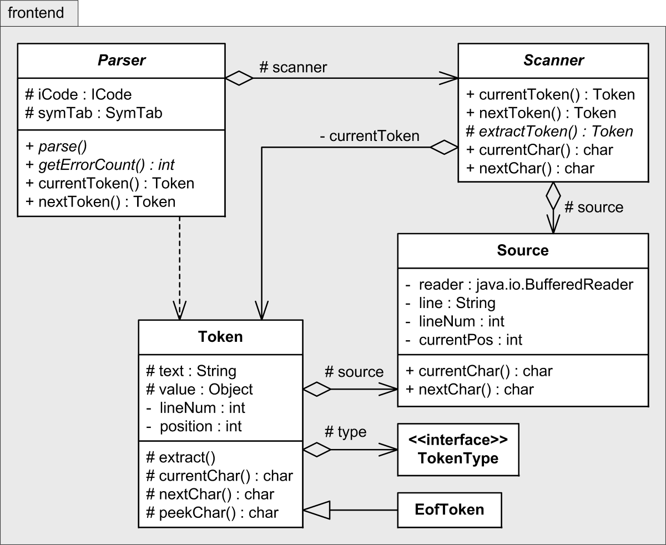
Class Diagram Examples
What’s in the frontend package of a compiler?
UML package diagram
What information can
you learn from these
class diagrams?
Access control
+ public
– private
# protected
~ package
Writing Compilers and Interpreters, 3rd ed.
by Ronald Mak
John Wiley & Sons, 2009.

Slide 41
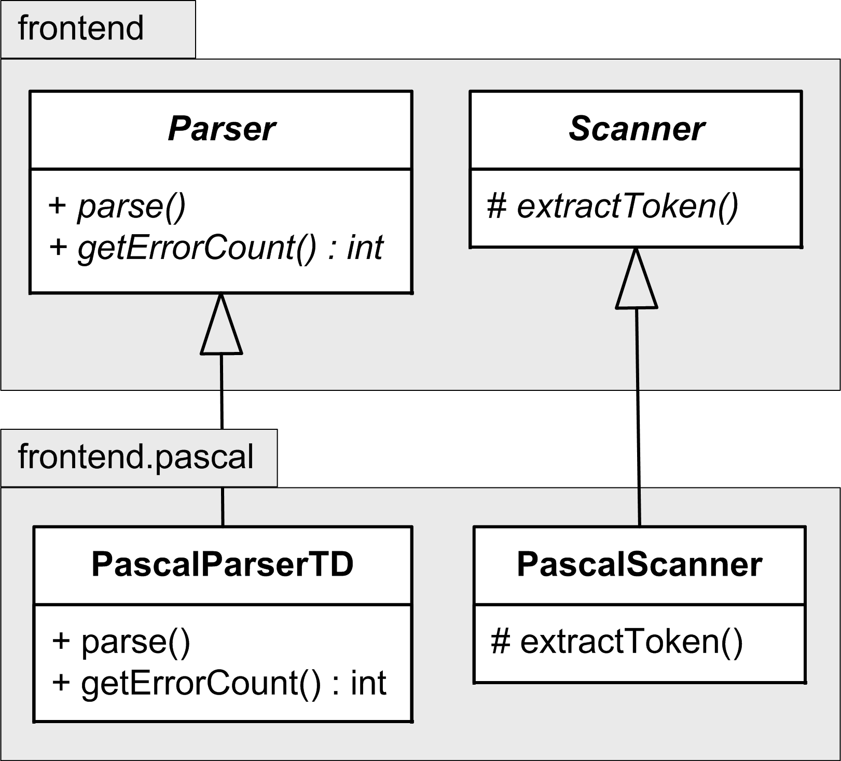
Class Diagram Examples, cont’d
Implement the abstract base classes Parser and Scanner with language-specific subclasses.
Use a slanted font or
italics for the names of
abstract classes and
abstract functions.
Writing Compilers and Interpreters, 3rd ed.
by Ronald Mak
John Wiley & Sons, 2009.

Slide 42
Free UML Design Tools
Violet: http://horstmann.com/violet/
StarUML: http://staruml.sourceforge.net/en/

Slide 43
Design Specification
The Design Specification is a technical document for the developers.
Contains implementation and process details.
  UML class and sequence diagrams
  Data structures and algorithms
  Detailed project schedule (Gantt charts)
Include the following items in the Design Specification, or put into separate documents:
  Test plans
  Deployment and maintenance plans

Slide 44
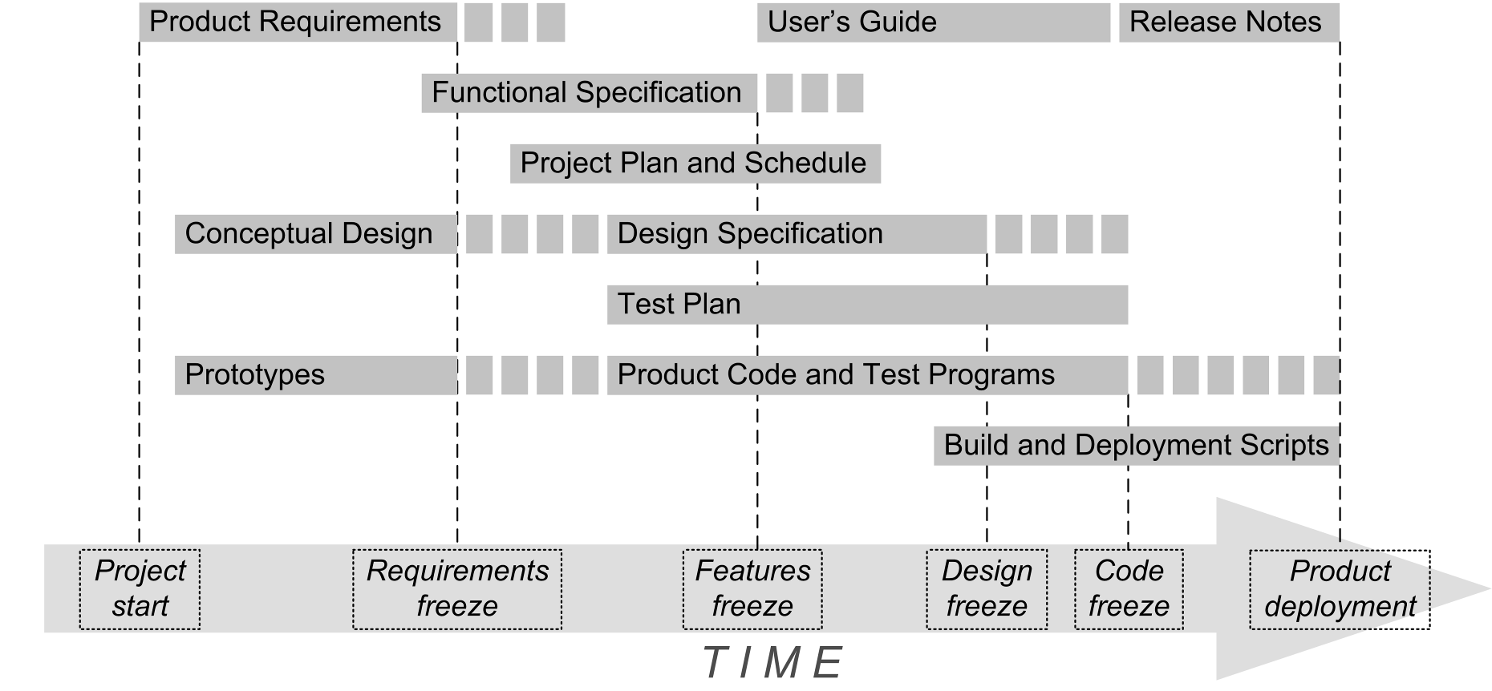
Design Specification, cont’d

Slide 45
Assignment #2: Design Specification
Begin a Design Specification for your semester project.
  Be creative. We won’t hold you to this design when we grade your project at the end of the semester.
To be read and understood by developers.
Identify the important classes (at least four)
and list the set of responsibilities of each class.
  Is each class cohesive with a primary responsibility?
  Are they loosely coupled?

Slide 46
Assignment #2, cont’d
Draw UML class diagrams.
  Show attributes and methods.
  Show the relationships among the classes.
  Are they loosely coupled?
Draw a UML sequence diagram.
  Pick one of your use cases from Assignment #1
  and diagram the interactions of your objects during the execution of the use case.
To be discussed Thursday.

Slide 47
Assignment #2, cont’d
Draw a UML state diagram.
  Pick a class from Assignment #1 and show how one of its objects transitions from state to state during its lifetime at run time.
Create a PDF of your Design Specification
and submit into Canvas:
Assignment #2. Design Specification
Due Friday, February 26 at 11:59 PM.
To be discussed Thursday.

