Slide 1


CMPE/SE 131
Software Engineering
March 23 Class Meeting
Department of Computer Engineering
San José State University
Spring 2017
Instructor: Ron Mak
www.cs.sjsu.edu/~mak

Slide 2
Oral Design Reviews
Present and defend key aspects of your design.
  April 4 and 6, right after the spring break
  12 minutes per team
Use PowerPoint slides
  Submit your slides to Canvas after your presentation.
Briefly discuss the design of your
Ruby on Rails code.
  Show and explain your most important classes.
  UML class diagrams and/or sequence diagrams.
  MVC diagrams

Slide 3
Oral Design Reviews, cont’d
Briefly discuss your database design.
  ER diagram
  Relational schema diagram
Quick demo
Questions and answers at the end
Audience: Very technical
  Other development engineers
  Technical managers
  Expect “deep” questions from the audience!
  The audience will take a Canvas survey.

Slide 4
“Sins of Software Estimation”
Excerpts from
“10 Deadly Sins of Software Estimation”
  by Steve McConnell
  http://www.ewh.ieee.org/r5/central_texas/austin_cs/presentations/2004.08.26.pdf

Slide 5
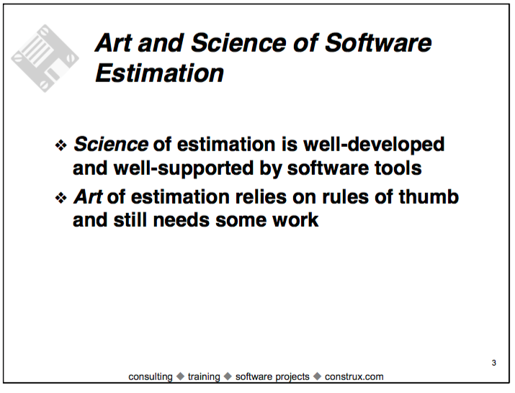
“Sins of Software Estimation”, cont’d

Slide 6

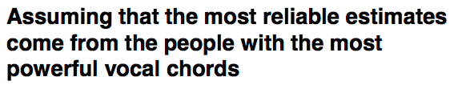
“Sins of Software Estimation”, cont’d

Slide 7
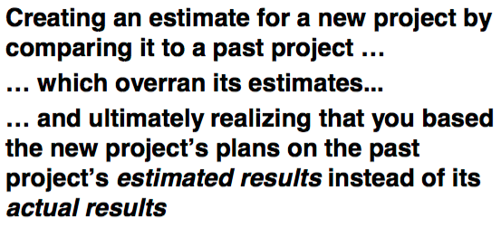
“Sins of Software Estimation”, cont’d

Slide 8
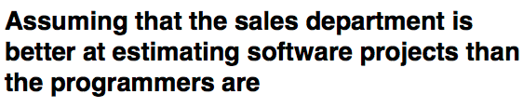
“Sins of Software Estimation”, cont’d

Slide 9
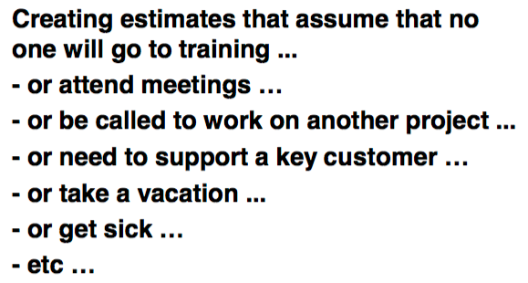
“Sins of Software Estimation”, cont’d

Slide 10
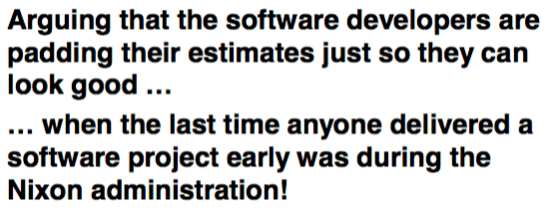
“Sins of Software Estimation”, cont’d

Slide 11
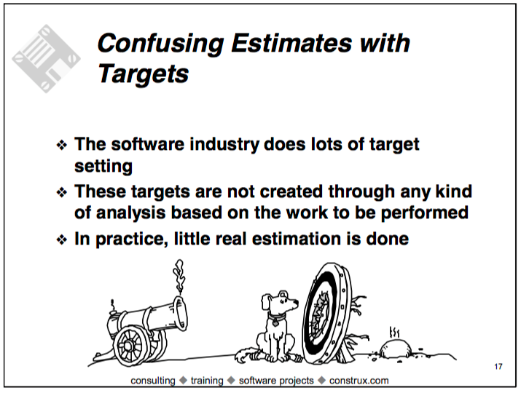
“Sins of Software Estimation”, cont’d

Slide 12
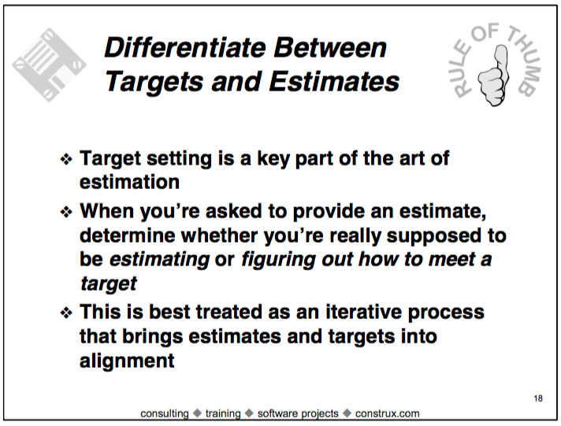
“Sins of Software Estimation”, cont’d

Slide 13
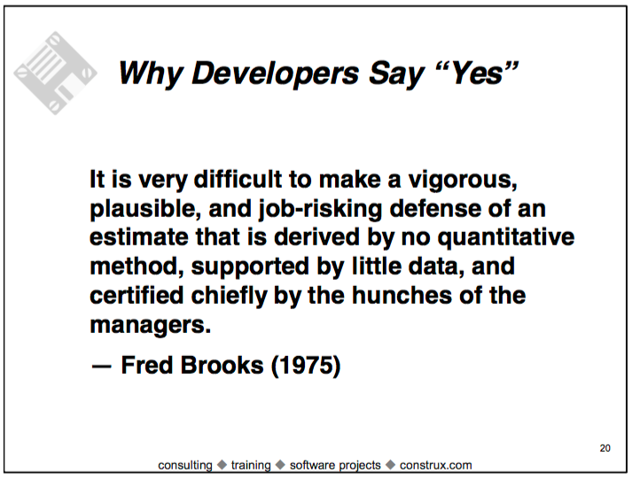
“Sins of Software Estimation”, cont’d

Slide 14
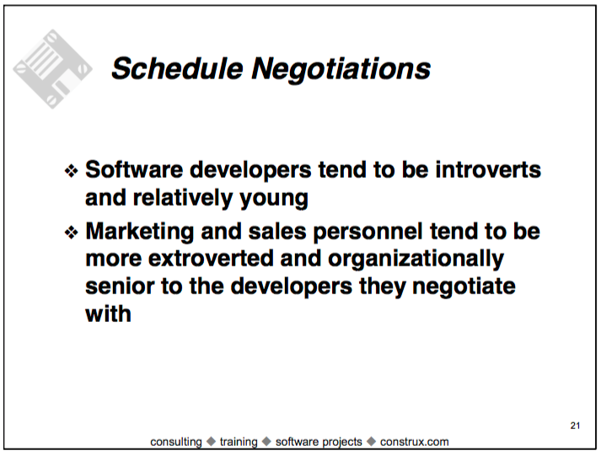
“Sins of Software Estimation”, cont’d

Slide 15
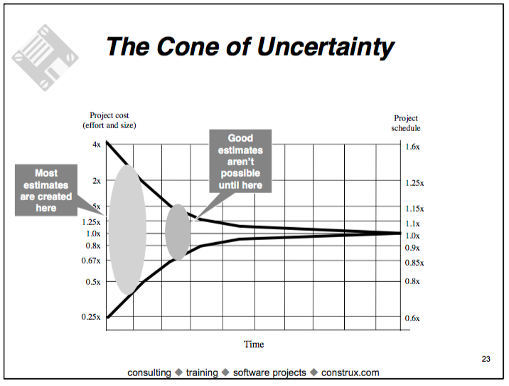
“Sins of Software Estimation”, cont’d

Slide 16
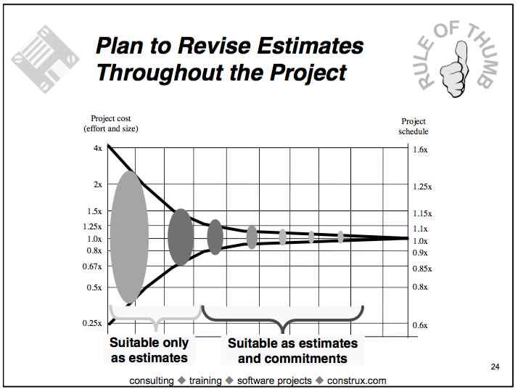
“Sins of Software Estimation”, cont’d

Slide 17
“Sins of Software Estimation”, cont’d
[The common definition of estimate is] ‘An
estimate is the most optimistic prediction that
has a non-zero probability of coming true’ . . .
Accepting this definition leads irrevocably
toward a method called what’s-the-earliest-
date-by-which-you-can’t-prove-you-won’t-be-
finished estimating.
— Tom DeMarco (1982)

Slide 18
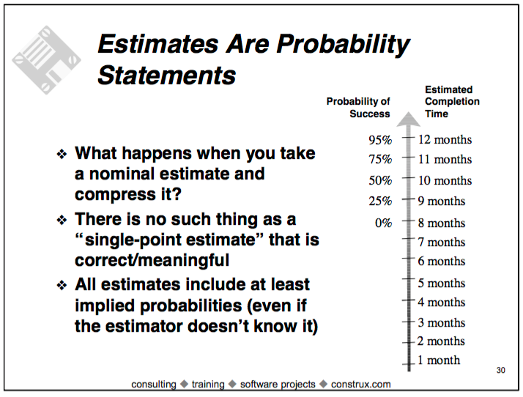
“Sins of Software Estimation”, cont’d

Slide 19
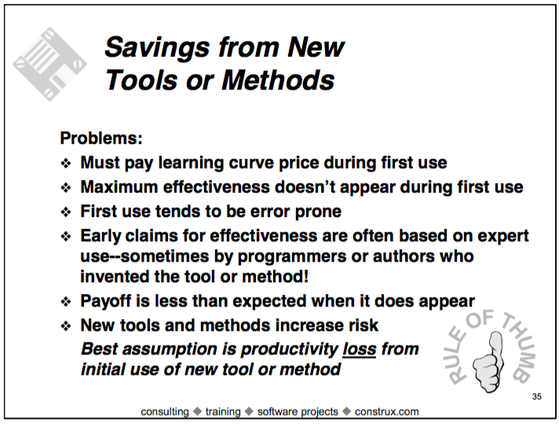
“Sins of Software Estimation”, cont’d

Slide 20
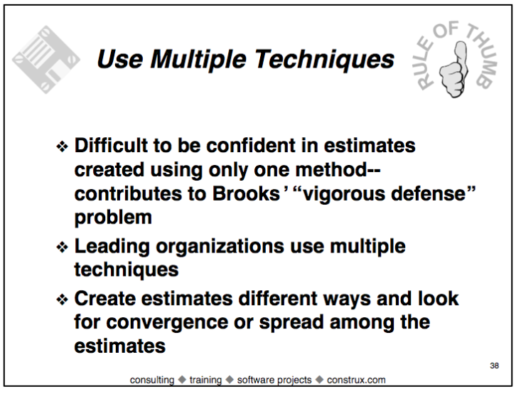
“Sins of Software Estimation”, cont’d

Slide 21
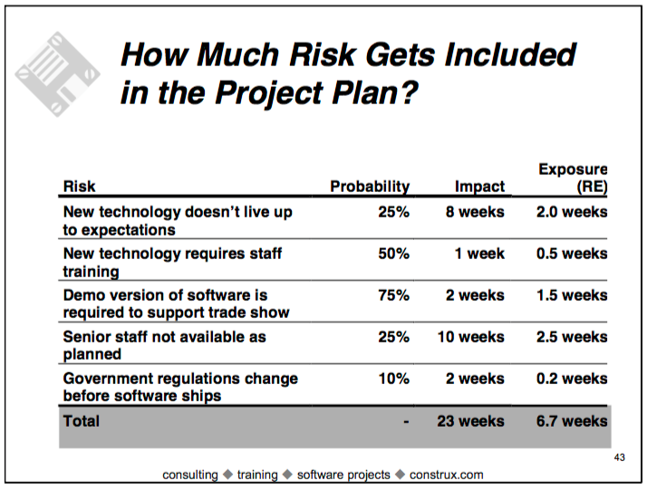
“Sins of Software Estimation”, cont’d

Slide 22
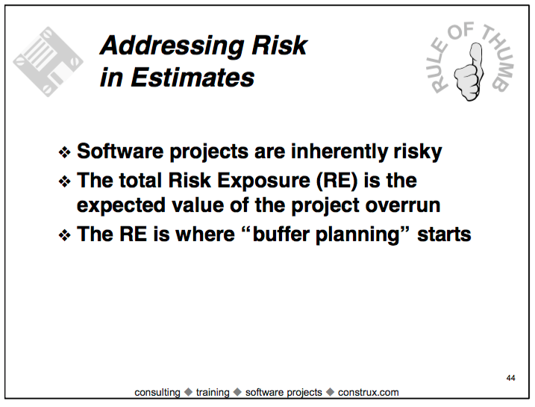
“Sins of Software Estimation”, cont’d

Slide 23
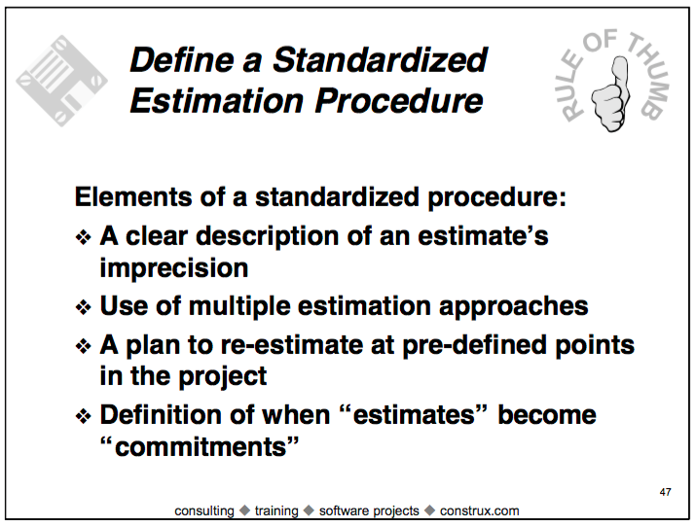
“Sins of Software Estimation”, cont’d

Slide 24
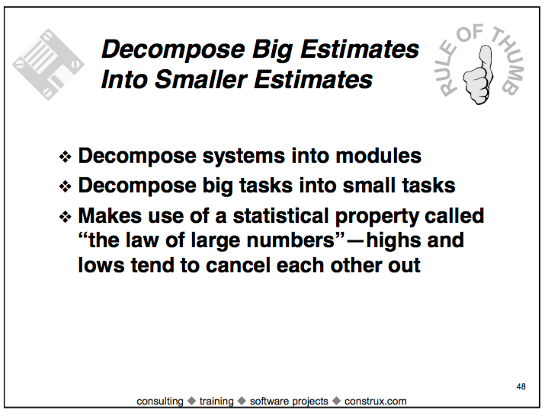
Sins of Software Estimation, cont’d

Slide 25
Work Breakdown Structure (WBS)
A decomposition of a complex project into a hierarchical set of tasks and subtasks.
Can be shown in outline form or as a tree.
Project
Task 1
Task 2
Task 3
Subtask 1.1
Subtask 2.1
Subtask 3.1
Subtask 1.2
Subtask 3.2
Subtask 3.3

Slide 26
WBS Example: Building a House
Architectural design
  Create draft of architecture
  Prepare construction documents
Interior design
  Pre-design
  Select furniture
  Plan equipment
Construction phase
  Build foundation
  Build ground floor
  Build second floor
  Build roof
  Complete wiring and plumbing
Decoration phase
  Walls
  Furniture

Slide 27
Gantt Chart
Project schedules are often represented as Gantt charts.
  Named after Henry Gantt, who developed them
  in 1917.
Enter the work breakdown structure.
Estimate the time requirement for each task
(task duration).
Set task dependencies.
Assign task resources.

Slide 28
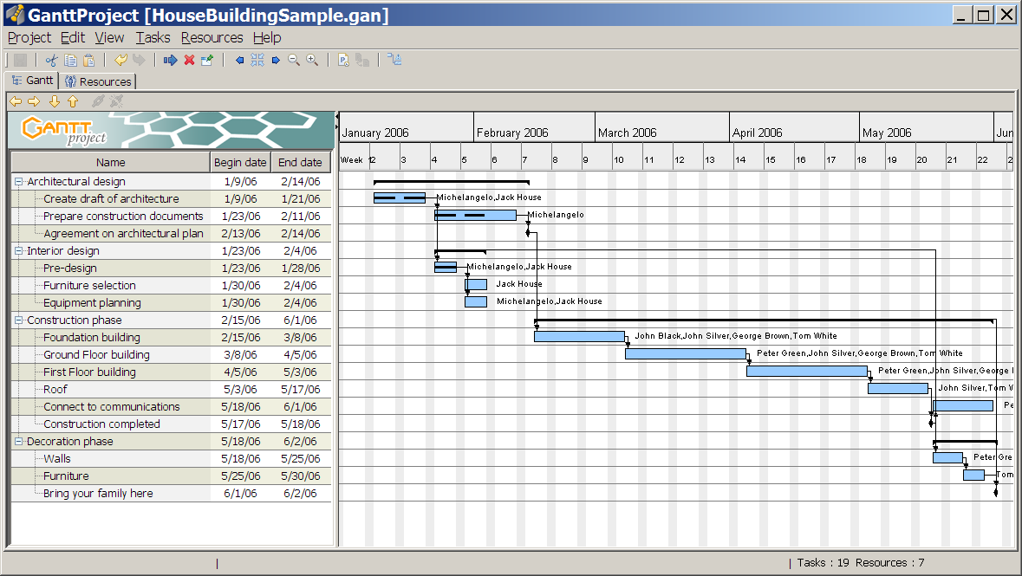
Example Gantt Chart
Progress
Dependencies
Resources
WBS
Time
Time
Milestones

Slide 29
Gantt Chart Demo
Download and install GanttProject from
http://ganttproject.biz/
  Watch the introductory video.
  Similar to (the very expensive) Microsoft Project.
Demo
  Task creation
  Task dependencies
  Resources

Slide 30
Critical Path
Identify the critical path of a schedule.
  The longest path of tasks
  The “long pole in the tent”
The critical path determines
the shortest possible time
to complete the project.
Any delay in the critical path
directly delays the completion
of the overall project.
Demo

Slide 31
Assignment #6
Create a project schedule as a Gantt chart.
Work breakdown structure (WBS)
  Must be hierarchical with tasks and subtasks.
  Backdate to January 26 (first day of class).
  Start with the task of learning Ruby and Rails.
  Include several iterations during code development.

Slide 32
Assignment #6, cont’d
Include these fixed milestones:
  Conceptual design review, February 28
  Design review, April 4
  Code review, April 25
  Application demo, May 9
  Project done, May 17
Show for each task:
  Dependencies
  Progress
  Resources
Tasks other than the first ones
should have their start dates
determined by dependencies.

Slide 33
Assignment #6, cont’d
Resource chart
  Show each team member’s tasks.
  Some greens and reds are OK (but not too many)
Due Friday, April 7

