Slide 1
CMPE/SE 131 Software Engineering March 9 Class Meeting
Department of Computer Engineering San José State University Spring 2017 Instructor: Ron Mak
www.cs.sjsu.edu/~mak

Slide 2
Conceptual Database Model
Visualize the requirements.
Use a conceptual data modeling technique.
Example: Entity-relationship (ER) modeling
Implementation independent: No dependencies on the logic of a particular database management system (DBMS).
Example DBMS: Oracle, MySQL, etc.
Blueprint for the logical model.

Slide 3
Logical Database Model
Create the relational database model as the logical model.
It’s usually straightforward to map an ER model to a relational model.

Slide 4
Physical Database Model
The physical model is the actual database implementation.
Use relational DBMS (RDBMS) software.
Structured Query Language (SQL) commands to create, delete, modify, and query database structures.

Slide 5
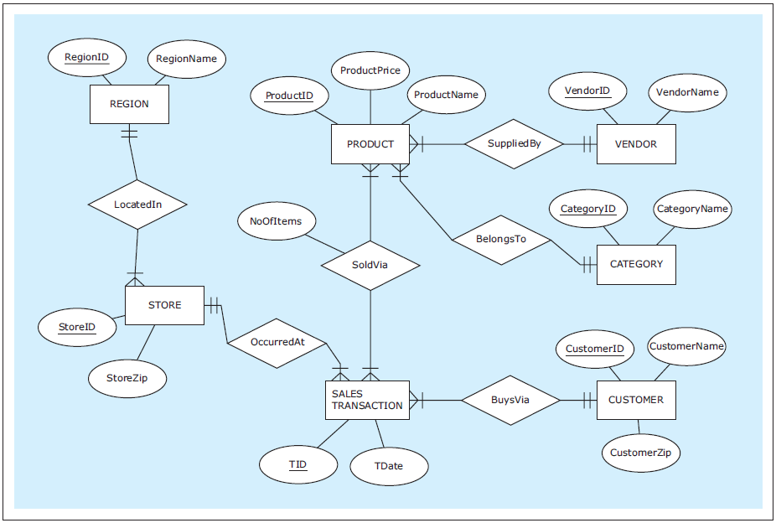
An Example ER Diagram
Conceptual model
Database Systems
by Jukić, Vrbsky, & Nestorov
Pearson 2014
ISBN 978-0-13-257567-6

Slide 6
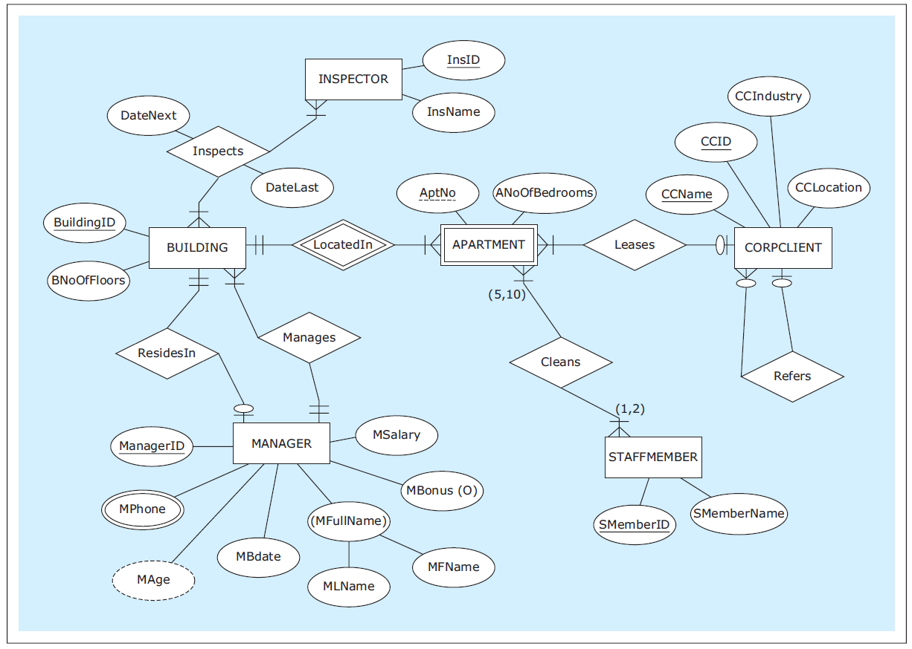
Another Example ER Diagram
Conceptual model
Database Systems
by Jukić, Vrbsky, & Nestorov
Pearson 2014
ISBN 978-0-13-257567-6

Slide 7
Logical Database Model
Map the ER diagram to a logical model represented as a relational schema.
Database Systems
by Jukić, Vrbsky, & Nestorov
Pearson 2014
ISBN 978-0-13-257567-6

Slide 8
Conditions for a Table to be a Relation
Each column must have a name.
Within a table, each column name must be unique.
All values in each column must be from the same (predefined) domain.
Within a table, each row must be unique.
Within each row, each value in each column must be single-valued.
Multiple values of the content represented by the column are not allowed in any rows of the table.

Slide 9
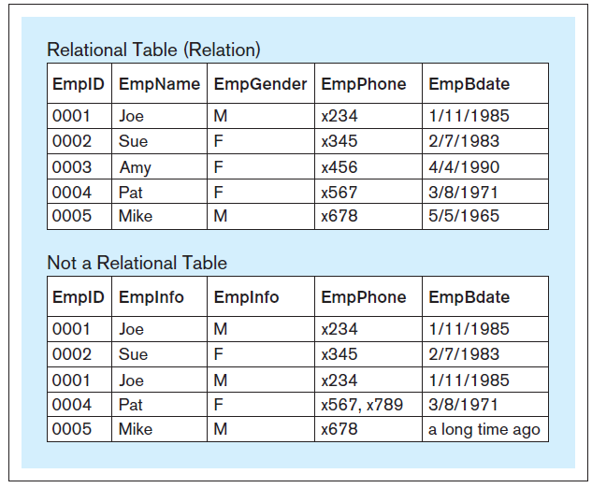
Relational vs. Non-Relational Tables
Database Systems
by Jukić, Vrbsky, & Nestorov
Pearson 2014
ISBN 978-0-13-257567-6

Slide 10
Additional Properties for a Relational Table
The order of columns is irrelevant.
The order of rows is irrelevant.

Slide 11
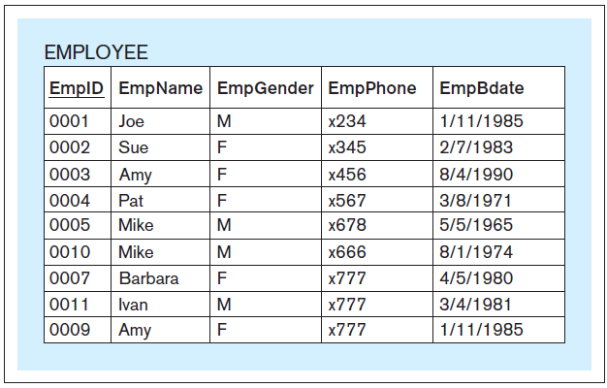
Primary Key
Each relation must have a primary key.
A column or set of columns whose value uniquely identifies each row.
Underline the primary key of the relational table.
Database Systems
by Jukić, Vrbsky, & Nestorov
Pearson 2014
ISBN 978-0-13-257567-6

Slide 12
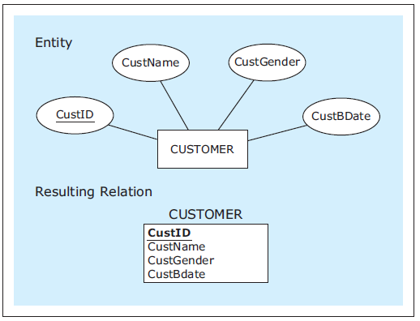
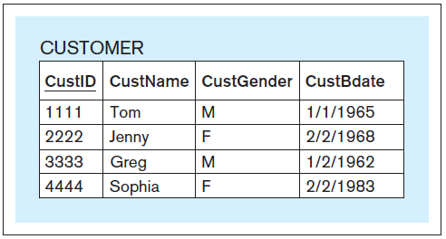
Mapping Entities
Conceptual
Physical
Logical
Database Systems
by Jukić, Vrbsky, & Nestorov
Pearson 2014
ISBN 978-0-13-257567-6

Slide 13
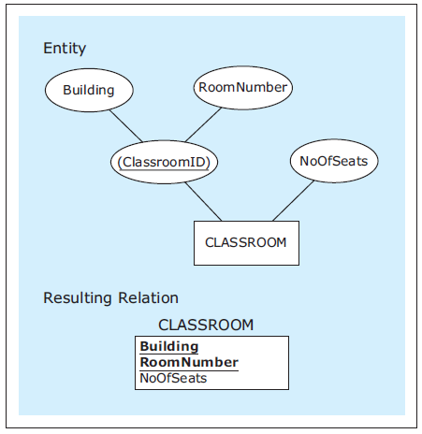
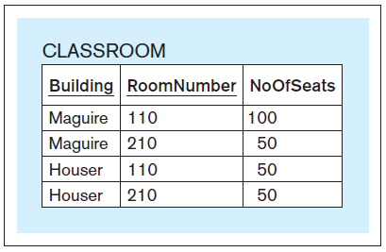
Mapping Entities, cont’d
Conceptual
Physical
Logical
Attribute with a
composite primary key.
Database Systems
by Jukić, Vrbsky, & Nestorov
Pearson 2014
ISBN 978-0-13-257567-6

Slide 14
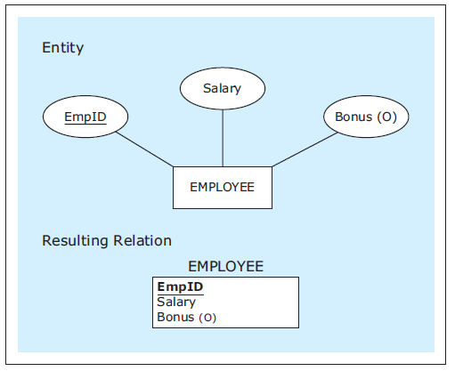
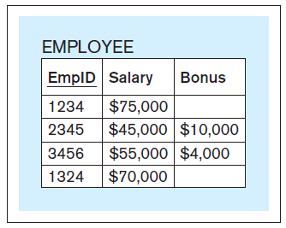
Mapping Entities, cont’d
Conceptual
Physical
Logical
Entity with an optional attribute.
Database Systems
by Jukić, Vrbsky, & Nestorov
Pearson 2014
ISBN 978-0-13-257567-6

Slide 15
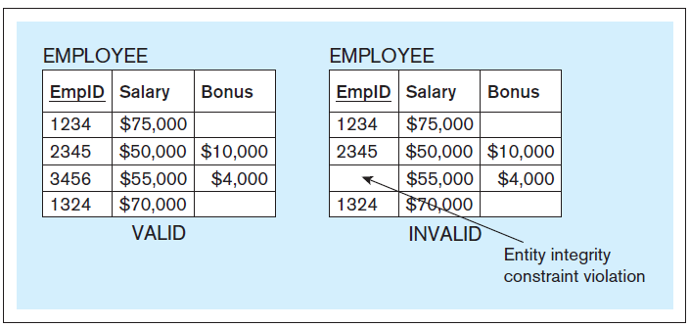
Entity Integrity Constraint
No primary key column of a relational table can have null (empty) values.
Database Systems
by Jukić, Vrbsky, & Nestorov
Pearson 2014
ISBN 978-0-13-257567-6

Slide 16
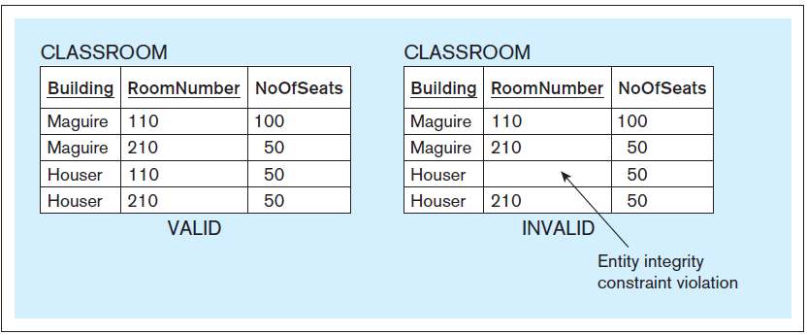
Entity Integrity Constraint, cont’d
Database Systems
by Jukić, Vrbsky, & Nestorov
Pearson 2014
ISBN 978-0-13-257567-6

Slide 17
Foreign Keys
A foreign key is a column in a table that refers to a primary key column in another table.
In a relational schema, draw an arrow from the foreign key to the corresponding primary key.

Slide 18
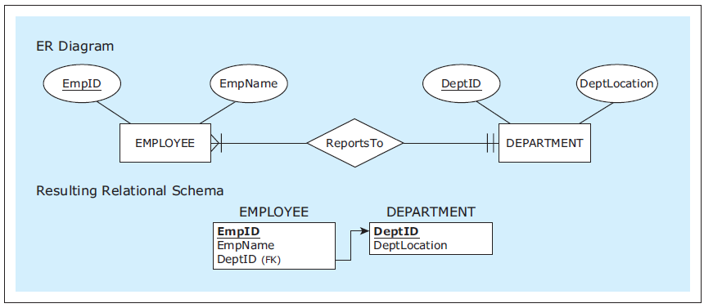
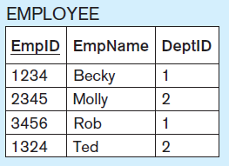
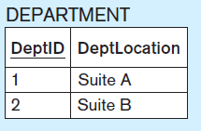
Mapping 1:M Relationships
Conceptual
Mandatory
participation
on both sides.
Logical
The foreign key on the
M side of the 1:M relationship
corresponds to the primary key
on the 1 side.
Physical
Database Systems
by Jukić, Vrbsky, & Nestorov
Pearson 2014
ISBN 978-0-13-257567-6

Slide 19
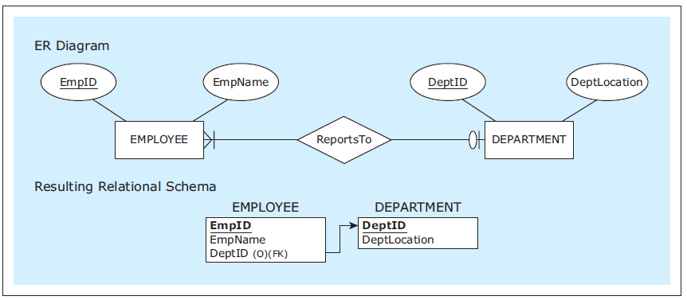
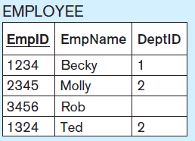
Mapping 1:M Relationships, cont’d
Conceptual
Logical
Optional participation
on the 1 side.
Physical
Database Systems
by Jukić, Vrbsky, & Nestorov
Pearson 2014
ISBN 978-0-13-257567-6

Slide 20
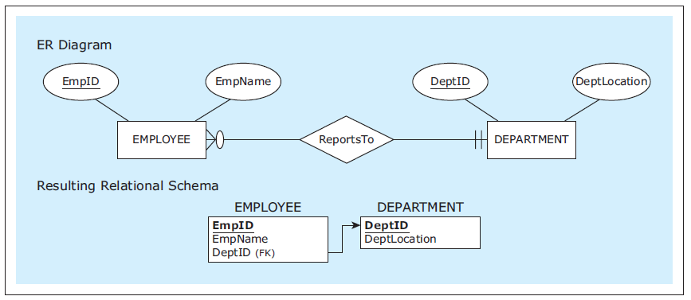
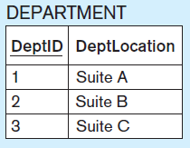
Mapping 1:M Relationships, cont’d
Conceptual
Logical
Optional participation
on the M side.
Physical
Database Systems
by Jukić, Vrbsky, & Nestorov
Pearson 2014
ISBN 978-0-13-257567-6

Slide 21
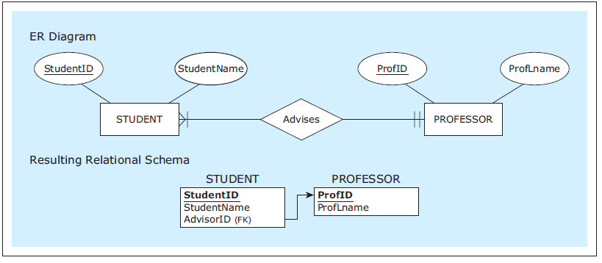
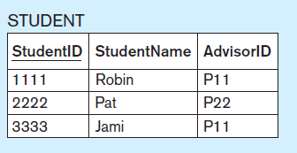
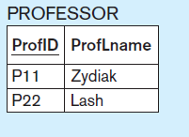
Mapping 1:M Relationships, cont’d
Conceptual
Logical
Rename a foreign key
to better reflect the
role of a relationship.
Physical
Database Systems
by Jukić, Vrbsky, & Nestorov
Pearson 2014
ISBN 978-0-13-257567-6

Slide 22
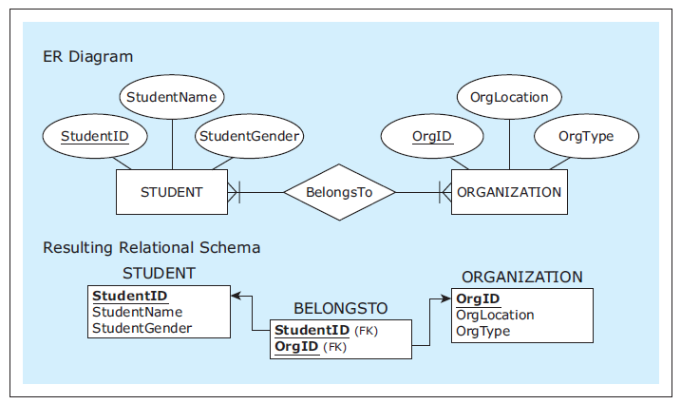
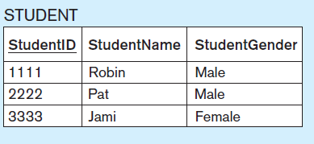
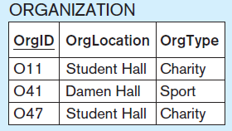
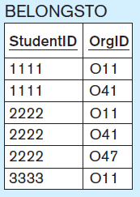
Mapping M:N Relationships
Use the
bridge relation
BELONGSTO
with two
foreign keys.
AKA:
linking table
join table
Conceptual
Logical
Physical
Database Systems
by Jukić, Vrbsky, & Nestorov
Pearson 2014
ISBN 978-0-13-257567-6

Slide 23
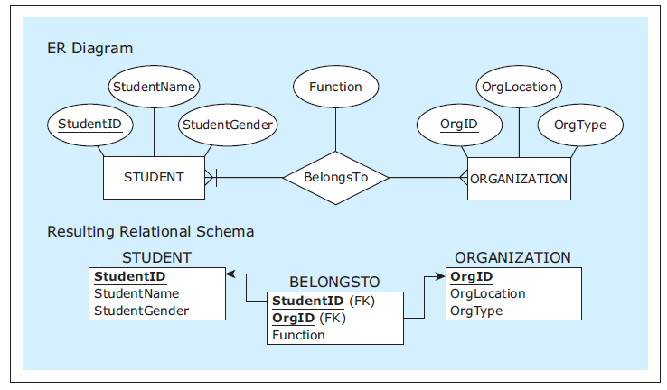
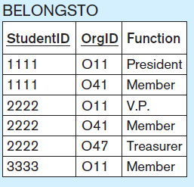
Mapping M:N Relationships, cont’d
Conceptual
Relationship
with an
attribute.
Logical
Physical
Database Systems
by Jukić, Vrbsky, & Nestorov
Pearson 2014
ISBN 978-0-13-257567-6

Slide 24
Mapping 1:1 Relationships
Map 1:1 relationships similarly to 1:M relationships.
One table will have a foreign key pointing to the primary key of the other table.
It can be an arbitrary choice of which table has the foreign key.
Make the choice that is most intuitive or efficient.

Slide 25
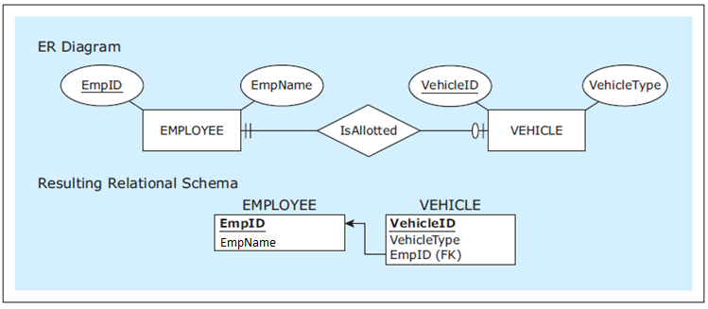
Mapping 1:1 Relationships, cont’d
Conceptual
Logical
Table VEHICLE has the foreign key.
Physical
Database Systems
by Jukić, Vrbsky, & Nestorov
Pearson 2014
ISBN 978-0-13-257567-6

Slide 26
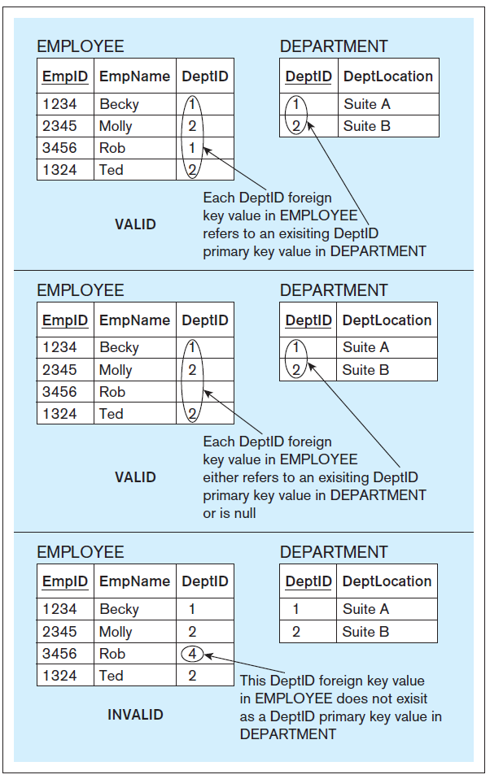
Referential Integrity Constraint
The value of a foreign key must either:
Match one of the values of the primary key in the referred table.
Be null.
Database Systems
by Jukić, Vrbsky, & Nestorov
Pearson 2014
ISBN 978-0-13-257567-6

Slide 27
Mapping Example: ER Diagram
Conceptual
Data Model
Database Systems
by Jukić, Vrbsky, & Nestorov
Pearson 2014
ISBN 978-0-13-257567-6

Slide 28
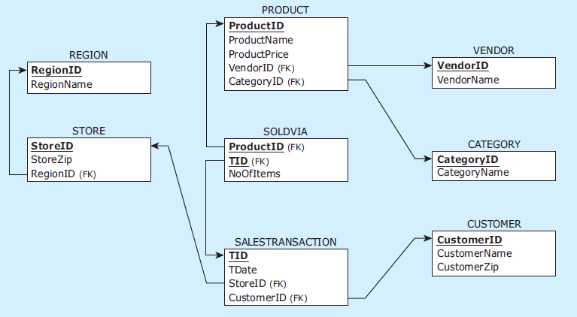
Mapping Example: Relational Schema
Logical
Data Model
Database Systems
by Jukić, Vrbsky, & Nestorov
Pearson 2014
ISBN 978-0-13-257567-6

Slide 29
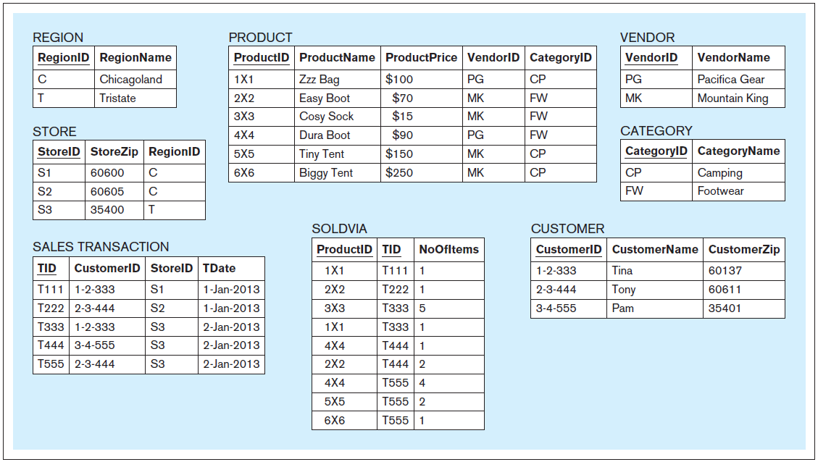
Mapping Example: Sample Data
Physical
Data Model
Database Systems
by Jukić, Vrbsky, & Nestorov
Pearson 2014
ISBN 978-0-13-257567-6

Slide 30
School Database Example
Initial version
Each table has a primary key (PK) field whose value in each record uniquely identifies that record.
Student
Id | Name | Teacher_id_1 | Teacher_id_2 | Teacher_id_3
1001 | Doe, John | 7003 | 7012 | 7008
1005 | Novak, Tim | 7012 | 7008 | null
1009 | Klein, Leslie | null | null | null
1014 | Jane, Mary | 7051 | null | null
1021 | Smith, Kim | 7003 | 7012 | 7051
Student
id
name
which teachers
Teacher
id
name
which classes taught
Class
class code
subject name
class room number
PK
Teacher
Id | Name | Class_code | Subject | Room
7003 | Rogers, Tom | 926 | Java programming | 101
7008 | Thompson, Art | 908 | Data structures | 114
7012 | Lane, John | 951 | Software engineering | 210
7012 | Lane, John | 974 | Operating systems | 109
7051 | Flynn, Mabel | 931 | Compilers | 222
John Lane teaches
two classes.
PK

Slide 31
Normalization
Relational tables need to be normalized.
Improve the stability of the model.
More resilient to change.
Faster record insertions and updates.
Improve data quality.
There are six normal forms, but we will only consider the first two.
Each normal form includes the lower normal forms.
Example: A database in second normal form is also in first normal form.

Slide 32
First Normal Form (1NF)
Separate multi-valued data elements.
Break the name fields into last name and first name fields.
Student
Id | Last | First | Teacher_id_1 | Teacher_id_2 | Teacher_id_3
1001 | Doe | John | 7003 | 7012 | 7008
1005 | Novak | Tim | 7012 | 7008 | null
1009 | Klein | Leslie | null | null | null
1014 | Jane | Mary | 7051 | null | null
1021 | Smith | Kim | 7003 | 7012 | 7051
Id | Name | Teacher_id_1 | Teacher_id_2 | Teacher_id_3
1001 | Doe, John | 7003 | 7012 | 7008
1005 | Novak, Tim | 7012 | 7008 | null
1009 | Klein, Leslie | null | null | null
1014 | Jane, Mary | 7051 | null | null
1021 | Smith, Kim | 7003 | 7012 | 7051
Teacher
Id | Name | Class_code | Subject | Room
7003 | Rogers, Tom | 926 | Java programming | 101
7008 | Thompson, Art | 908 | Data structures | 114
7012 | Lane, John | 951 | Software engineering | 210
7012 | Lane, John | 974 | Operating systems | 109
7051 | Flynn, Mabel | 931 | Compilers | 222
Id | Last | First | Class_code | Subject | Room
7003 | Rogers | Tom | 926 | Java programming | 101
7008 | Thompson | Art | 908 | Data structures | 114
7012 | Lane | John | 951 | Software engineering | 210
7012 | Lane | John | 974 | Operating systems | 109
7051 | Flynn | Mabel | 931 | Compilers | 222

Slide 33
First Normal Form, cont’d
Move repeating data elements to a new table.
Student_Teacher
Student_id | Teacher_id
1001 | 7003
1001 | 7012
1001 | 7008
1005 | 7012
1005 | 7008
1014 | 7051
1021 | 7003
1021 | 7012
1021 | 7051
Student
Id | Last | First | Teacher_id_1 | Teacher_id_2 | Teacher_id_3
1001 | Doe | John | 7003 | 7012 | 7008
1005 | Novak | Tim | 7012 | 7008 | null
1009 | Klein | Leslie | null | null | null
1014 | Jane | Mary | 7051 | null | null
1021 | Smith | Kim | 7003 | 7012 | 7051
Id | Last | First
1001 | Doe | John
1005 | Novak | Tim
1009 | Klein | Leslie
1014 | Jane | Mary
1021 | Smith | Kim
Linking
table
Teacher
Id | Last | First | Class_code | Subject | Room
7003 | Rogers | Tom | 926 | Java programming | 101
7008 | Thompson | Art | 908 | Data structures | 114
7012 | Lane | John | 951 | Software engineering | 210
7012 | Lane | John | 974 | Operating systems | 109
7051 | Flynn | Mabel | 931 | Compilers | 222

Slide 34
Problem!
Suppose Prof. Lane decides he doesn’t want to teach Operating Systems anymore and we delete that row.
What other information do we lose as a result?
We lose the fact that the class is taught in Room 109.
The problem arises because the Teacher table really contains two separate sets of data: teacher data and class data.
Teacher
Id | Last | First | Class_code | Subject | Room
7003 | Rogers | Tom | 926 | Java programming | 101
7008 | Thompson | Art | 908 | Data structures | 114
7012 | Lane | John | 951 | Software engineering | 210
7012 | Lane | John | 974 | Operating systems | 109
7051 | Flynn | Mabel | 931 | Compilers | 222

Slide 35
Second Normal Form (2NF)
Keep related data together (cohesiveness).
Teacher
Class
Id | Last | First
7003 | Rogers | Tom
7008 | Thompson | Art
7012 | Lane | John
7051 | Flynn | Mabel
Class_code | Teacher_id | Subject | Room
908 | 7008 | Data structures | 114
926 | 7003 | Java programming | 101
931 | 7051 | Compilers | 222
951 | 7012 | Software engineering | 210
974 | 7012 | Operating systems | 109
Primary key (PK)
Primary key (PK)
Foreign key (FK)
How would you do this relation with a linking table?

Slide 36
Final Database Structure, cont’d
John Doe takes Java programming, software engineering, and data structures.
Student_Class
Student_id | Class_code
1001 | 926
1001 | 951
1001 | 908
1005 | 974
1005 | 908
1014 | 931
1021 | 926
1021 | 974
1021 | 931
Student
Id | Last | First
1001 | Doe | John
1005 | Novak | Tim
1009 | Klein | Leslie
1014 | Jane | Mary
1021 | Smith | Kim
Class
Teacher
Code | Teacher_id | Subject | Room
908 | 7008 | Data structures | 114
926 | 7003 | Java programming | 101
931 | 7051 | Compilers | 222
951 | 7012 | Software engineering | 210
974 | 7012 | Operating systems | 109
Id | Last | First
7003 | Rogers | Tom
7008 | Thompson | Art
7012 | Lane | John
7051 | Flynn | Mabel

Slide 37
Final Database Structure, cont’d
Student_Class
The Java Programming class has John Doe and Kim Smith.
Student_id | Class_code
1001 | 926
1001 | 951
1001 | 908
1005 | 974
1005 | 908
1014 | 931
1021 | 926
1021 | 974
1021 | 931
Student
Id | Last | First
1001 | Doe | John
1005 | Novak | Tim
1009 | Klein | Leslie
1014 | Jane | Mary
1021 | Smith | Kim
Class
Teacher
Code | Teacher_id | Subject | Room
908 | 7008 | Data structures | 114
926 | 7003 | Java programming | 101
931 | 7051 | Compilers | 222
951 | 7012 | Software engineering | 210
974 | 7012 | Operating systems | 109
Id | Last | First
7003 | Rogers | Tom
7008 | Thompson | Art
7012 | Lane | John
7051 | Flynn | Mabel

Slide 38
Final Database Structure, cont’d
Student_Class
Mabel Flynn teaches compilers.
Student_id | Class_code
1001 | 926
1001 | 951
1001 | 908
1005 | 974
1005 | 908
1014 | 931
1021 | 926
1021 | 974
1021 | 931
Student
Id | Last | First
1001 | Doe | John
1005 | Novak | Tim
1009 | Klein | Leslie
1014 | Jane | Mary
1021 | Smith | Kim
Class
Teacher
Code | Teacher_id | Subject | Room
908 | 7008 | Data structures | 114
926 | 7003 | Java programming | 101
931 | 7051 | Compilers | 222
951 | 7012 | Software engineering | 210
974 | 7012 | Operating systems | 109
Id | Last | First
7003 | Rogers | Tom
7008 | Thompson | Art
7012 | Lane | John
7051 | Flynn | Mabel

Slide 39
Assignment #5
Initial draft of your Design Document.
Document the design of your application.
MVC architecture
UML package and class diagrams
UML sequence diagram
Document the design of your database.
Conceptual model: entity-relationship (ER) diagram
Logical model: relational schema

