Slide 1
DATA 200 Computational Programming for Analytics March 21 Class Meeting
Department of Applied Data Science San Jose State University Spring 2024 Instructor: Ron Mak
www.cs.sjsu.edu/~mak

Slide 2
This Evening
Go over Quiz 0214 and Assignment #7
Python files
Python exception handling
Break
Analysis of Titanic survival data
Quiz

Slide 3
Unofficial Field Trip
Computer History Museum in Mt. View
http://www.computerhistory.org/
Provide your own transportation to the museum.
Saturday, March 23, 11:30 – closing time
Special free admission for my students.
Do a self-guided tour of the Revolution exhibit.
Experience a fully restored IBM 1401 mainframe computer from the early 1960s in operation.

Slide 4
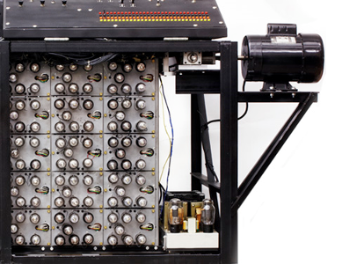
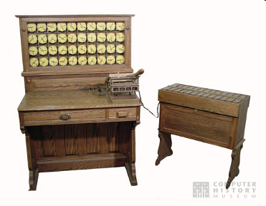
Unofficial Field Trip, cont’d
See the extensive Revolution exhibit!
Walk through a timeline of the First 2000 Years of Computing History.
Historic computer systems, data processing equipment, and other artifacts.
Small theater presentations.
Hollerith
Census
Machine
Atanasoff-Berry
Computer

Slide 5
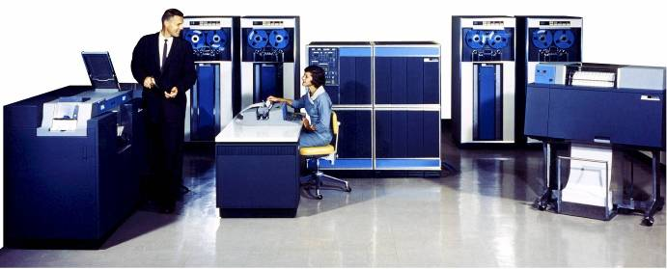
Unofficial Field Trip, cont’d
IBM 1401 computer, fully restored and operational.
A small transistor-based mainframe computer.
Extremely popular with small businesses in the late 1950s through the mid 1960s
Maximum of 16K bytes of memory.
800 card/minute card reader (wire brushes).
600 line/minute line printer (impact).
6 magnetic tape drives, no disk drives.

Slide 6
Unofficial Field Trip, cont’d
Information on the IBM 1401:
General info: http://en.wikipedia.org/wiki/IBM_1401
My summer seminar: http://www.cs.sjsu.edu/~mak/1401/
Restoration: http://ed-thelen.org/1401Project/1401RestorationPage.html

Slide 7
Assignment #7
Abriam-Yago, Katherine - Professor, Nursing (1985)
BS, University of San Francisco
MA, University of San Diego
DED, University of San Francisco
Ackerman, Brian - Marine Operations Manager­, Moss Landing Marine Lab (2016)
BS, Loyola Marymount University
Adams, Ericka - Assistant Professor, Justice Studies (2010)
BA, John Jay College of Criminal Justice
PhD, University of Illinois at Chicago

Slide 8
Assignment #7, cont’d
Only consider lines containing a name and a job title:
Count professors:
if (len(line) > 2) and line[0].isalpha():
if "Professor" in line:
professor_count += 1

Slide 9
Assignment #7, cont’d
Use a regular expression to extract the title:
Agee, Ann - Associate Librarian, University Library (2008)
re.search('.*\s-\s(.*)\s\(', line)

Slide 10
Assignment #7, cont’d
Do some cleaning:
NON_ASCII_SPACE = chr(int('0xa0', 16))
ASCII_SPACE = ' '
DASH = '–'
HYPHEN = '-'
line = line.replace(NON_ASCII_SPACE, ASCII_SPACE)
line = line.replace(DASH, HYPHEN)
# Remove any remaining non-ASCII characters.
for ch in line:
if ord(ch) > 127:
line = line.replace(ch, '')

