Slide 1


CS 153: Concepts of Compiler Design
August 20 Class Meeting
Department of Computer Science
San Jose State University
Fall 2026
Instructor: Ron Mak
www.cs.sjsu.edu/~mak

Slide 2
Basic Info
Office hours
  One hour after each Thursday class
Website
  Faculty webpage: http://www.cs.sjsu.edu/~mak/
  Class webpage:
  http://www.cs.sjsu.edu/~mak/CS153/index.html
  Syllabus
  Assignments
  Lecture notes

Slide 3
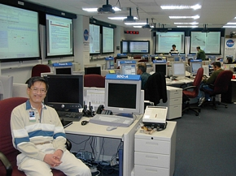
Short Bio
Lecturer at San Jose State University since Spring 2008
  Department of Computer Science
  Department of Applied Data Science
  Department of Computer Engineering
  Engineering Extended Studies
Formerly
  Senior Scientist at the NASA Ames
  Research Center and JPL
  Research Staff Member, IBM Research
  Software Strategist,
  Lawrence Livermore National Lab
  Software developer, project lead,
  engineering manager, etc. at various Silicon Valley companies
http://www.cs.sjsu.edu/~mak/
Mission Control, Jet Propulsion Laboratory (JPL)
NASA Mars Exploration Rover Mission

Slide 4
Goals of the Course
This course will concentrate on the practical aspects of programming language translation and engineering a large, complex software application.
This is a challenging course that will demand much
of your time and effort throughout the semester.

Slide 5
Goals of the Course, cont’d
You will learn programming language translation in various forms (in this order):
  Language conversion. Convert a program written in one
  high-level language to an equivalent program written in another high-level language.
  Interpreter with an interactive symbolic debugger. Execute a program written in a procedural language and be able to set breakpoints, single-step, examine and set variable values, etc.
  Compiler construction and language design. Design and build a working compiler for a programming language that you invented. Write sample programs in your language and compile them into assembly language code that you can then assemble and run.

Slide 6
Goals of the Course, cont’d
Software engineering
  Employ the best practices of object-oriented design and team-based software engineering.
  Programming language translators are large, complex programs!
  Managing the development of such programs requires learning critical job skills that are highly desired by employers.

Slide 7
Course Prerequisites
I must verify that each student has met the course prerequisites:
  A grade of C- or better in each:
    CS 47 or CMPE 102
    CS 146
    CS 154
  Computer Science, Applied and Computational Math, or Software Engineering majors only
Submit in Canvas by Monday, Aug. 24:
Assignments/Miscellaneous/Course prerequisites

Slide 8
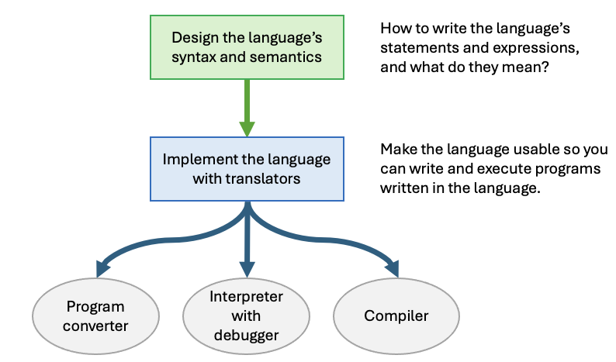
High-Level Course Outline

Slide 9
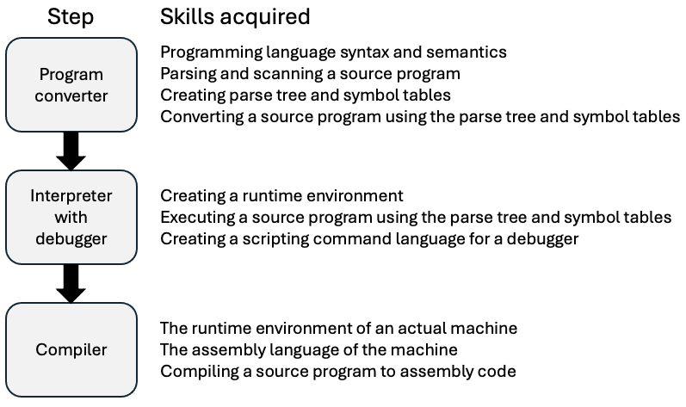
Make Incremental Progress!

Slide 10
Course Timeline
Part 1: Introduction
  What are programming language translators.
  The software architecture of the translators.
  Our source language (the language of the sample test programs) will be Pascal.
  Our implementation language (the language that we’ll use to write our interpreter) will be Java.
  Parsers, scanners, and tokens.
  Parse trees and symbol tables.
  Language grammars and syntax diagrams.
  The ANTLR 4 compiler writing tools.

Slide 11
Course Timeline, cont’d
Part 2: Programming language converters
  ANTLR 4 grammar file for a Pascal subset.
  Convert Pascal program declarations.
  Convert Pascal statements and expressions.
  Scope and the symbol table stack.
  Convert Pascal records.
  Convert Pascal procedures and functions.

Slide 12
Course Timeline, cont’d
Part 3: Interpreters and interactive debuggers
  A Pascal virtual machine
  Runtime memory management
  Stack frames and the runtime stack
  Interpreting Pascal statements and expressions.
  An interactive source-level debugger.
  A debugger command language.
  Debugging Pascal programs.

Slide 13
Course Timeline, cont’d
Part 4: Compilers
  The Java Virtual Machine (JVM) architecture.
  Jasmin assembly language (target language)
  Compile Pascal programs to Jasmin.
  Some advanced concepts.

Slide 14
Required Textbook
The Definitive ANTLR 4 Reference
  Author: Terence Parr
  Publisher: Pragmatic Bookshelf
  ISBN: 978-1934356999
  URL: http://www.antlr.org
Well-written, inexpensive.
Contains necessary information to succeed in this class.
Online material is helpful but not sufficient.

Slide 15
Project Teams
Projects will be done by small project teams.
  Team assignments will help to complete the projects.
Form your own teams of 4 members each.
Choose your team members wisely!
  Be sure you’ll be able to meet and communicate
  with each other and work together well.
  No moving from team to team.
Each team member will receive the same score on each team assignment and team project.

Slide 16
Project Teams, cont’d
Each team member will receive the same score on each team assignment and team project.
Submit your team information into Canvas (under “Assignments/Miscellaneous”)
by Wednesday, August 26:
  Your team name
  A list of team members, student IDs, and email addresses
  Submit to Canvas
Only one student per team
needs to submit team information.

Slide 17
Team Compiler Project
Each project team will complete a compiler at the end of the semester.
  Assignments throughout the semester will help you complete the compiler.
  You can compile a programming language you invented or a (subset of) an existing language.
Each team will present an oral presentation and demo during the last days of the semester.
  The rest of the class will help grade each presentation.
Written report

Slide 18
Individual Responsibilities
  You are personally responsible for participating
  and contributing to your team’s work, and for
  understanding each part of the work for every
  assignment whether or not you worked on that part.

Slide 19
Postmortem Assessment Report
At the end of the semester, each student will individually turn in a short (one page) report:
  A brief description of what you learned in the course.
  An assessment of your personal accomplishments
  for your project team.
  An assessment of the contributions of each of
  your project team members.
This report will be seen only by the instructor.

Slide 20
Your Individual Overall Class Grade
30% assignments*
30% semester project*
20% quizzes and midterm**
20% final**
    * team score
    ** individual score
During the semester, keep track of your progress in Canvas.
At the end of the semester, students with the median score will get the B- grade.
Higher and lower grades will then be assigned based on
how the scores cluster above and below the median.
Therefore, your final class grade will be based primarily on your performance relative to the other students in the class.
Your final class grade will be adjusted up or down depending on your level and quality of participation, as reported by your teammates’ postmortem reports.

Slide 21
Take roll

Slide 22
Design a Programming Language
Each programming team will ultimately develop a compiler as a semester project.
Your compiler can be for a language that you invent, or for a subset of an existing language.
  general-purpose languages
  domain-specific languages
You will be able to write programs in your chosen language, compile them to machine code, and then execute them.

Slide 23
Types of Programming Languages
Category | Examples | Purpose
General-purpose language | Java, Python, C++, C# | These languages have generic statements and expressions for writing programs in a wide variety of application domains. They often come with specialized packages and libraries to support specific types of applications.
Domain-specific language (DSL) | SQL for database applications, HTML + CSS for web applications, HCL for infrastructure configuration, VHDL to simulate the behavior of digital systems | These languages have features tailored for writing programs in a particular application domain. They have built-in statements and expressions to implement operations intrinsic to the domain, such as SQL’s SELECT statement to search and join database tables.

Slide 24
Domain-Specific Languages
A DSL that supports a company’s operations is a valuable asset.
  Example: database programming
  Example: Web page scraping
join tables employee, table salary
display table "pay" by matching column id
use headers "ID", "name", "payment"
columns employee.id, employee.name, salary.hours*salary.rate
on page "Orders"
label invoice_label = find "Invoice"
textbox invoice_box = locate right of invoice_label
string invoice_number = text from invoice_box

Slide 25
It’s All About Translation!
Type | Translator output
Program converter | The output is the result of converting a source program (one written in the source language) to an equivalent program written in the target language, such as converting from a legacy or newly invented language to Java.
Interpreter | An interpreter directly executes a source program code under its full control. Its output is whatever the program writes out during its run time.
Compiler | A compiler translates a source program to low-level executable machine code. The output of compiling a source program is the equivalent program in machine code that can run at full machine speed.

Slide 26
Translator Output
Equivalent program written in the target language
Converter
Convert and generate
Program written in the source language
Interpreter
Execute and produce
Runtime output
Executable machine code
Compiler
Compile and emit

Slide 27
It’s All About Translation! cont’d
Type | When it’s appropriate to use
Program converter | A program converter is the quickest way to get a working compiler for a language, whether the programs are written in a legacy language or in your new language. You take advantage of an existing compiler to do the work.
Interpreter | An interpreter is in full control of executing a program. With an integrated debugger, you can thoroughly test and debug the program. Therefore, an interpreter is most useful while you’re developing your program.
Compiler | A compiler will include a code generator that can produce the best low-level code specifically for the statements and expressions of your language. A compiled program can run orders of magnitude faster than an interpreted program. Therefore, first use an interpreter to develop and debug a program and then compile the program when you’re ready to release it. Some languages are hybrid — for example, Java interprets its bytecode, but it also has a just-in-time (JIT) compiler that compiles bytecode to low-level machine code.

Slide 28
Language Classes During Translation
Class | Relationship to translation
Implementation | Translator components are written in the implementation language. You will write component code in Java, the implementation language. The ANTLR 4 tool will generate code in Java for the components that we won’t have to write.
Source | Source programs to be translated are written in the source language. This is the language you’re designing or modifying, and for which you’re developing the translators. Therefore, you must create a grammar for the source language. The example source language in this course is a subset of Pascal. You are encouraged to design and build either a new language or to modify an existing language.
Target (Object) | A translator transforms source programs written in the source language to the target language. Examples: A program converter transforms a Pascal source program to an equivalent program in a high-level target language such as Java, C++, or Python. The compiler you’ll write in this course will transform a Pascal source program to Jasmin assembly language for the Java Virtual Machine (JVM), a low-level target language that’s human-readable. Most commercial compilers directly generate machine code as its target language. Also called: object language, not to be confused with object-oriented language. Also: object program
Command | You will develop an interactive debugger for the interpreter. While a source program is executing under the interpreter’s control, you can interact with the program using the debugger’s command language to set breakpoints, single-step statement execution, examine variable values, etc.

Slide 29
The Pascal Language
We will use Pascal as the example source language in this class.
  You are encouraged to choose your own language for your semester compiler project.
Pascal was designed to be a simple, clean, and consistent language.
  It’s an excellent source language for developing programming language translators.
  Concentrate on translation issues without becoming entangled in a messy language syntax.

Slide 30
The Pascal Language, cont’d
Pascal is a real programming language.
  It was the teaching language of the 1980s.
  Nevertheless, it has many features that are in current programming languages.
There are online Pascal compilers that you can use to compare their results to the results of the translators that you write.
  https://www.jdoodle.com/execute-pascal-online
  http://rextester.com/l/pascal_online_compiler
  https://www.tutorialspoint.com/compile_pascal_online.php
My favorite!

Slide 31
Example Pascal Program
PROGRAM SquareRoots;
VAR
number : integer;
FUNCTION sqroot(x : real) : real;
VAR
r : real;
diff, prev : real;
BEGIN
r := 1;
prev := 0;
REPEAT
r := (x/r + r)/2;
diff := prev - r;
IF diff < 0 THEN diff := -diff;
prev := r;
UNTIL diff < 1.0e-8;
sqroot := r
END;
BEGIN
FOR number := 1 TO 10 DO
BEGIN
writeln(number:2, sqroot(number):20:16);
END;
END.

Slide 32
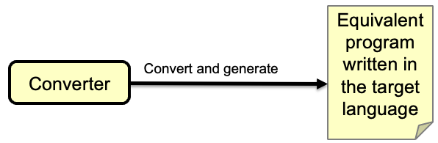
Example Conversion to Java
public class SquareRoots
{
private static int number;
static double sqroot(double x)
{
double root;
double r;
double prev;
double diff;
r = 1;
prev = 0;
do
{
r = (x/r + r)/2;
diff = prev - r;
if (diff < 0) diff = -diff;
prev = r;
}
while (diff >= 1.0e-16);
root = r;
return root;
}
public static void main(String[] args)
{
for (number = 1; number <= 10; number++)
{
System.out.printf("%2d%20.16f\n", number, sqroot(number));
}
}
}

Slide 33

Example Interpreter Execution
PASS 3 Execution:
1 1.0000000000000000
2 1.4142135623730950
3 1.7320508075688772
4 2.0000000000000000
5 2.2360679774997900
6 2.4494897427831780
7 2.6457513110645907
8 2.8284271247461900
9 3.0000000000000000
10 3.1622776601683790
397 statements executed.
0 runtime errors.
7 milliseconds execution time.

Slide 34
Example Interpreter Debugger
PASS 3 Debugger:
At line 025
Command? break 19
Command? go
1
At line 019
Command? show r
r :: 1.0
Command? stack
FUNCTION sqroot:
r :: 1.0
prev :: 0.0
x :: 1.0
diff :: 1.0
sqroot :: null
PROCEDURE SquareRoots:
number :: 1
sqroot :: null
Command? go
At line 019
Command? unbreak 19
Command? watch r
Command? break 22
Command? go
At line 019: r :: 1.0
At line 022
Command? go
At line 022: r :: 1.0
1.0000000000000000
2At line 012: r <= 1
At line 016: r :: 1.0
At line 016: r :: 1.0
At line 016: r <= 1.5
...

Slide 35
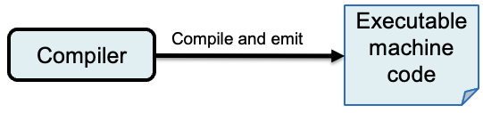
Example Compilation to Jasmin
;
; FUNCTION sqroot
;
.method private static sqroot(D)D
.var 4 is diff D
.var 6 is prev D
.var 2 is r D
.var 8 is sqroot D
.var 0 is x D
;
; 012 r:=1
;
iconst_1
i2d
dstore_2
;
; 013 prev:=0
;
iconst_0
i2d
dstore 6
;
...

Slide 36
Example Compilation to Jasmin, cont’d
~/CS153/Pascal: jasmin SquareRoots.j
Generated: SquareRoots.class
~/CS153/Pascal: java SquareRoots
1 1.0000000000000000
2 1.4142135623730950
3 1.7320508075688772
4 2.0000000000000000
5 2.2360679774997900
6 2.4494897427831780
7 2.6457513110645907
8 2.8284271247461900
9 3.0000000000000000
10 3.1622776601683790
[1 milliseconds execution time.]

Slide 37
Overview of the Compilation Process
What’s in this box?
Hello.pas
Hello.java
Translation:
Pascal compiler
(you will write this in Java)
Java compiler
javac Hello.java ...
assembly language
object program
Hello.j
Translation:
Jasmin assembler
(provided for you)
binary
object program
Hello.class
Hello.class
Java linker & loader
(provided for you)
Java linker & loader
java Hello ...
Execution:
Java Virtual Machine
(provided for you)
Java Virtual Machine

Slide 38
Reminder #1: By Monday, August 24
Submit your prerequisites in Canvas:
Assignments/Miscellaneous/Course prerequisites

Slide 39
Reminder #2: By Wednesday, August 26
Form teams.
Submit your team information into Canvas
(one submission per team)
  team name
  team members and email addresses
  cc all team members in an email to ron.mak@sjsu.edu

