Slide 1
Movie Script Shot Lister
David Robert Smith
Spring 2016
CS298 Writing Project
Advisor: Dr. Chris Pollett

Slide 2
Goal:
Create a tool which will take a raw but properly formatted motion picture script and output a shot list for the movie.
The ultimate program is called the Lister Tool
The Lister tool will use Training Sets and Naïve Bayes in order to calculate the shot list

Slide 3
Basic Components of This Project:
The Parser
The Liner Tool
The Training Sets
The Vector Populator Tool
The Feature Set
The Lister Tool
The Comparer
The Human Judge Tool

Slide 4
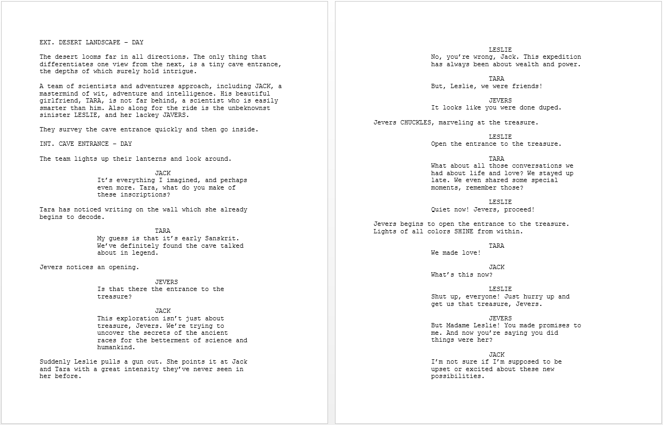
A Motion Picture Script Sample

Slide 5
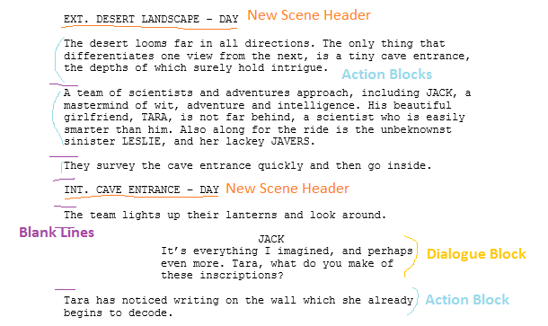
Script Breakdown

Slide 6
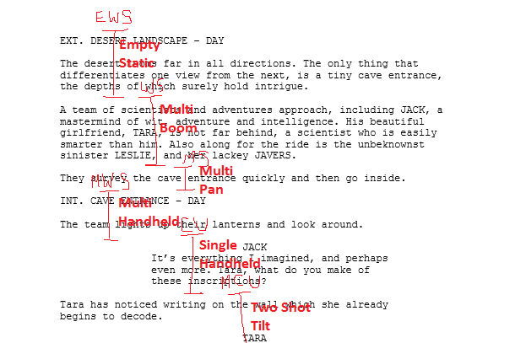
Lined Script

Slide 7
The Four Target Features
Our output will be similar to the lined script on the previous slide, except done with variables instead of drawn lines
Each line will have four target features:
  Cut
  ShotType
  CleanType
  Motion
Think of a cut on a line as the beginning and/or end of one the vertical lines

Slide 8
Target Feature Legend
Cut | ShotType | CleanType | Motion
NoCut Cut | ECU – Extreme Close Up CU – Close Up MCU – Medium Close Up MS – Medium Shot MWS – Medium Wide Shot WS – Wide Shot VWS – Very Wide Shot EWS – Extreme Wide Shot None Other | Single – 1 person SingleOTS – Single over the shoulder Two shot – 2 people Multi – more than 2 people MultiOTS – multiple over the shoulder Empty – nobody there | Static – camera doesn’t move Loose – camera moving a little Tilt – tilting up and down Pan – panning side to side Zoom – lens in and out Dolly – camera moves Steadicam – camera carried Crane – camera booms up/down Aerial – camera in air Handheld – held in hands DutchTilt – side rotate DollyZoom – zoom and dolly Circle – circler around Other

Slide 9
The Parser
Reads a raw but properly formatted script and translates it into a data structure usable by the other programs
Who uses the Parser:
  The Liner Tool
  The Lister Tool
Creates a data structure called AllData which contains:
  Script data structure
  Dataline structure for storing shot list information

Slide 10
The First Program: The Parser
The Parser reads the raw script line by line and identifies each line:
  New Scene
    i.e. EXT. ELM STREET – NIGHT, INT. BEDROOM - DAY
  Blank Line
    Line with nothing other than spaces
  Dialogue
    Block that starts with an all uppercase character name
  Action
    Anything else
This information is used to create the Script data structure

Slide 11
The Parser
The script data structure:
  Contains script objects, scenes, and scene objects
  script objects are data structures that can be things like characters or props which appear in more than one scene
  scene objects are only in one scene such as dialogue and action blocks
    With the notable exception of the blank line scene object which appears everywhere
  A scene in the data structure sense has references to all the script objects and scene objects that appear in that scene, along with other useful information such as the scene number and the scene header info

Slide 12
The Parser
The Dataline structure:
  Used for storing the shot list information for the whole script
  Each line of script has its own line data which has:
    The line of the script as a string
    Space for the four target features:
      A boolean for cut or no cut on that line
      An enum for shot type
      An enum for clean type
      An enum for motion type
    Booleans for whether characters appear in the shot
  The Parser only fills in the line of script string; the rest are just set initially to the default values

Slide 13
The Liner Tool
A GUI Interface
Dual Purpose:
  Line script, i.e., Add shot data to a script
  View an already lined script
Uses the Parser to process a script
Outputs an AllData file in the form of a JSON or a zip file. (The zip file is a zipped JSON)

Slide 14
The Liner Tool
Primary use of Liner Tool is to line scripts, that is to mark the shots on the script
Lining is named after practice of drawing vertical lines on a script to mark shots. Although, in our program, shots are marked by selecting the beginning and ending of a shot, by selecting if there are cuts on a line. A cut on a line marks the end of one shot and the beginning of a new
We want to be able to line scripts in order to create training sets for using later

Slide 15
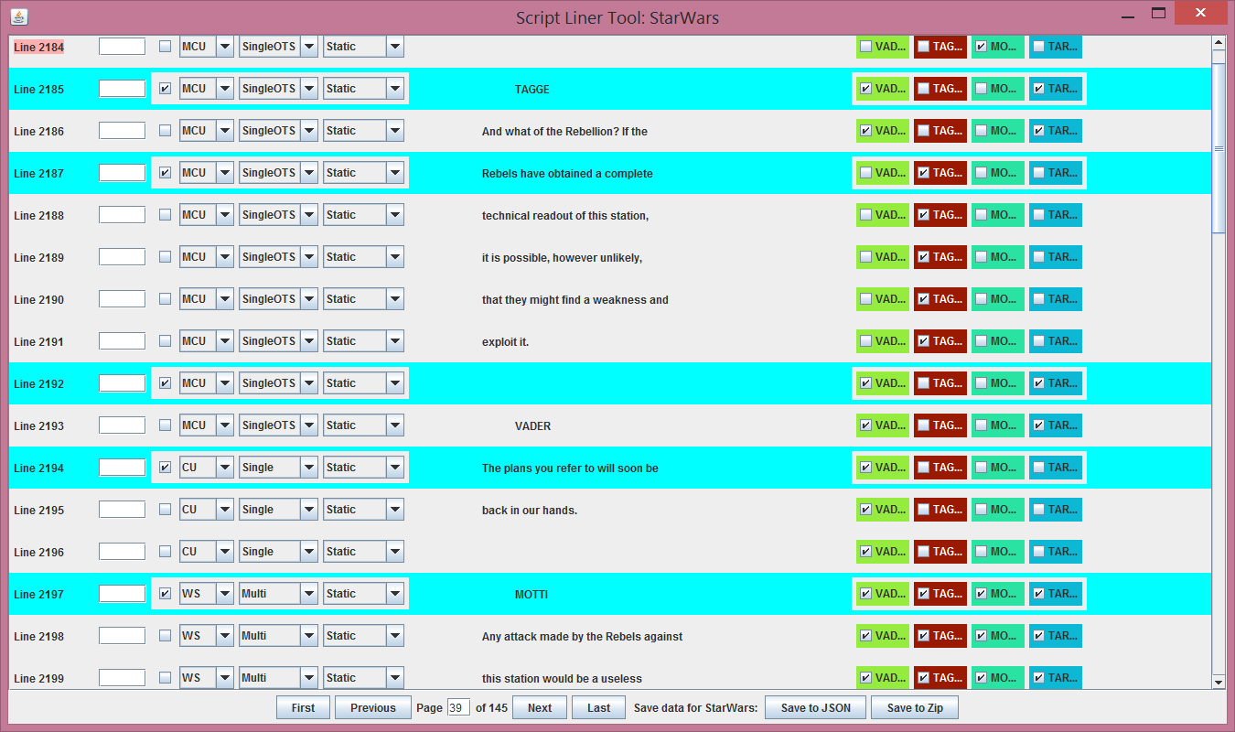
The Liner Tool

Slide 16
The Liner Tool
Lining the script involves going line by line and selecting from the options for each line:
  Cut: cut or no cut
  ShotType: Extreme Wide Shot, Wide Shot, Medium Shot, Close Up, etc.
  CleanType: Single, Two shot, Multi, empty, etc.
  Motion: Static, Pan, Tilt, Dolly, etc.
  Selecting whether a character appears in the current shot.
It is worth noting that ShotType, CleanType, etc. can change from line to line regardless of whether a cut took place
When all of these options have been picked for each line, the script is considered to be lined

Slide 17
The Liner Tool
Lining a script can take a while so the Liner tool was refactored many times to make it more convenient
  Hot keys were added
  Navigation of the script was made as simple as possible with use of either button or hot keys
  Multiple lines of data can be changed at the same time
  Choices can be copied from one line to another
  Lines with cuts or changes are highlighted in different colors
  Each character is given a unique color
  A space was added for entering timecode for convenience
  Hovering mouse over objects gives more details
  Progress can be saved and restored at any time

Slide 18
Training Sets
The Lister tool gets its data from Training Sets
In our case, a training set, is a film script that has been lined with the Liner tool
In its pure form, the Lister tool is interested in shot probabilities
We chose to line our scripts based on the actual films. In this way, we are collecting the data from the real film
  i.e., If a cut happens on screen, the cut check box is selected next to the line where the cut happened. The appropriate shot type, etc. is selected
Training sets could also be created without viewing the actual film, but just by using a human’s intuition to mark shots

Slide 19
Training Sets
Ideally, we would’ve wanted a hundred or even a thousand different lined scripts
This would’ve provided both more robust data, but also more possible selections
For example, we can customize our output by carefully selecting our input. Say we want our program to line a comedy, we would want to populate our vector with Training Sets of comedies
With more scripts, we could even go finer grain than that

Slide 20
Training Sets
Unfortunately, lining scripts according to actual movies is both difficult and time consuming
Lining a single standard script, in practice took between 16 and 20 hours
My time, combined with the time others graciously donated to me, I was able to get 11 different scripts lined, plus another lined for testing purposes, which is an adequate number for our experiments

Slide 21
The Vector Populator Tool
The Vector Populator tool actually takes the training sets, and pulls out the probability data
This data is then stored in a vector file for use by the Lister tool
The vector file is additive, so not only can it be created with any number of Training Sets, but more Training Sets can be added to the same file later
Different vector files can be created from different training sets to change the kind of output the Lister Tool will deliver

Slide 22
Before Explaining the Vector Populator Tool…
Let’s have a refresher course on the Naïve Bayes algorithm, which is critical to understand before understanding how the vectors become populated.
The Naïve Bayes algorithm takes the probabilities from the vector and applies them to the inputted script.
The very basic idea is that given the data from each line of the unlined script, along with the probabilities, we want to find which option has the highest probability.
The option with the highest probability is the one that is picked.

Slide 23
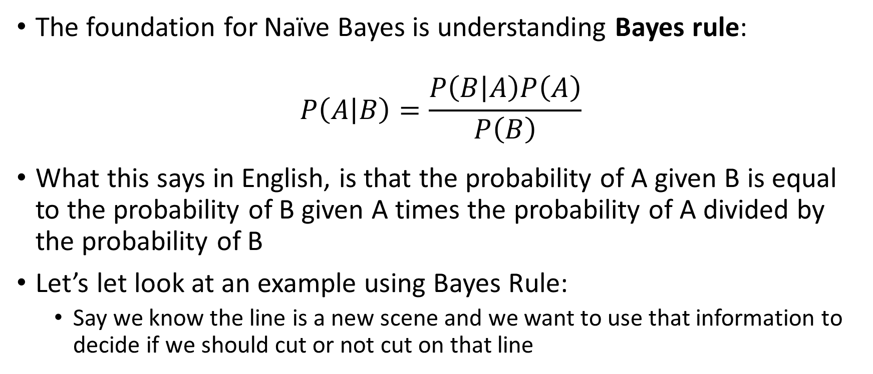
Bayes Rule
The foundation for Naïve Bayes is understanding Bayes rule:
$$P\left(A | B\right)=\frac{P\left(B | A\right)P\left(A\right)}{P\left(B\right)}$$
What this says in English, is that the probability of A given B is equal to the probability of B given A times the probability of A divided by the probability of B
Let’s let look at an example using Bayes Rule:
  Say we know the line is a new scene and we want to use that information to decide if we should cut or not cut on that line

Slide 24
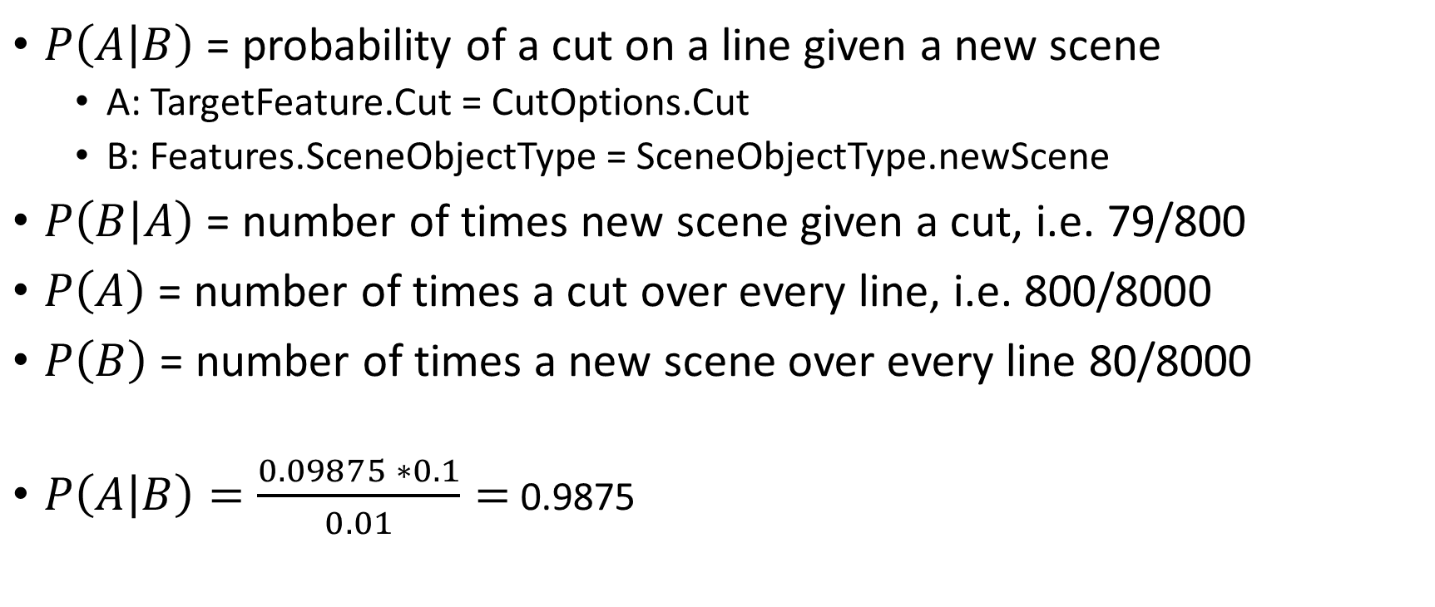
Example
$P\left(A | B\right)$ = probability of a cut on a line given a new scene
  A: TargetFeature.Cut = CutOptions.Cut
  B: Features.SceneObjectType = SceneObjectType.newScene
$P\left(B | A\right)$ = number of times new scene given a cut, i.e. 79/800
$P\left(A\right)$ = number of times a cut over every line, i.e. 800/8000
$P\left(B\right)$ = number of times a new scene over every line 80/8000
$P\left(A | B\right)=\frac{0.09875 ∗0.1}{0.01}=$ 0.9875

Slide 25
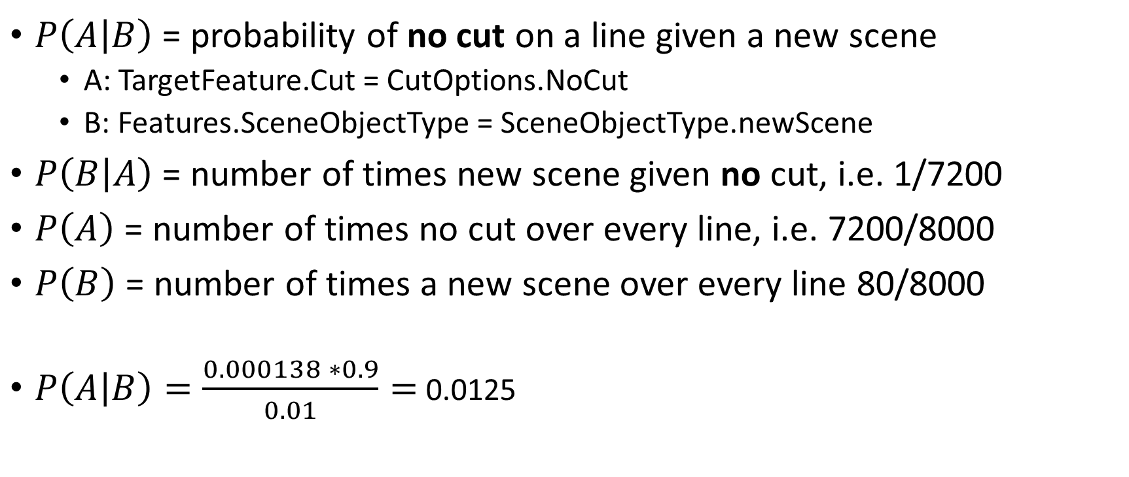
Example
$P\left(A | B\right)$ = probability of no cut on a line given a new scene
  A: TargetFeature.Cut = CutOptions.NoCut
  B: Features.SceneObjectType = SceneObjectType.newScene
$P\left(B | A\right)$ = number of times new scene given no cut, i.e. 1/7200
$P\left(A\right)$ = number of times no cut over every line, i.e. 7200/8000
$P\left(B\right)$ = number of times a new scene over every line 80/8000
$P\left(A | B\right)=\frac{0.000138 ∗0.9}{0.01}=$ 0.0125

Slide 26
Example
Probability of cut given new scene = 0.9875
Probability of no cut given new scene = 0.0125
0.9875 > 0.0125 so we pick the cut option
This is basically the Naïve Bayes algorithm, although instead of just applying one feature, like Features.SceneObjectType, we want to apply many features in the calculation for deciding cut

Slide 27
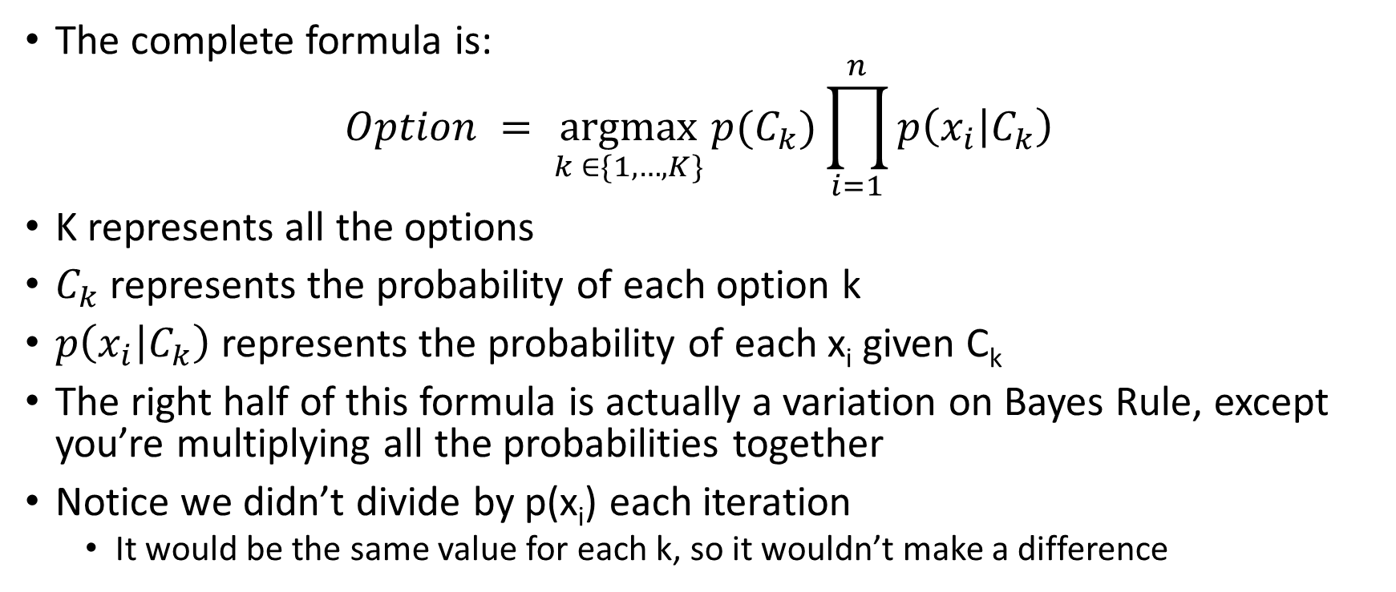
Naïve Bayes
The complete formula is:
$$Option = \underset{k ∈\{1, …, K\}}{argmax}{p(C_{k})\prod_{i=1}^{n}{p\left(x_{i} | C_{k}\right)}}$$
K represents all the options
$C_{k}$ represents the probability of each option k
$p\left(x_{i} | C_{k}\right)$ represents the probability of each x_{i} given C_{k}
The right half of this formula is actually a variation on Bayes Rule, except you’re multiplying all the probabilities together
Notice we didn’t divide by p(x_{i}) each iteration
  It would be the same value for each k, so it wouldn’t make a difference

Slide 28
Naïve Bayes
What Naïve Bayes does is calculate the probability of each option given all the selections of the features
All the probabilities of each feature are multiplied together to come up with the final probability for each option
Then the probabilities of all the options are compared and the one with the max probability is used

Slide 29
The Vector
The vector stores all of the probabilities. They are extracted from the training set by the Vector Populator tool
Each target feature has its own vector, but the four vectors corresponding to the four target features are all stored in one JSON file
A vector looks like this:
  CutVector.feature[f].selection[selected].option[picked].count
Each selection represents a Feature (like SceneObjectType), one of which is selected (like SceneObjectType.NewScene)
The option represents the Target Feature
Example:
  CutVector.feature[Features.sceneObjectType].selection[SceneObjectType.NewScene].option[TargetFeature.Cut].count would represent the number of times there was a cut when there was a new scene
  That number divided by the total number of cuts would give the probability of a new scene given a cut

Slide 30
The Vector Populator again
The Vector Populator goes through a lined script (training set), line by line, uses the picks for the Target Features, extracts the selection for the Features given the content of the script and appropriately increases the counts within the vector
Each line of script actually has many Features which can be extracted and used to create a stronger vector file. One of the goals of this project has been to come up with a well balanced Feature set

Slide 31
The Feature Set
Features can be anything that can be extracted from the script.
I have come up with two main types of feature:
  pure:
    A feature that can be calculated regardless of options picked
    i.e., SceneObjectType, LengthOfScene
  non-pure:
    A feature that is based on options picked on previous lines
    i.e., LinesSinceCut, LastShotType
It’s fine to use pure features in any calculation of any option, but we must be careful how we use non-pure features

Slide 32
Features
Pure | Non-Pure
sceneObjectType linesSinceObjectChange linesSinceNewScene intExt scriptObjectsInScene actionBlocksInScene dialogueBlocksInScene sceneLength | cut shotType cleanType Motions linesSinceCut linesSinceShotTypeChange lastShotTypeNoCut lastShotTypeWhenCut linesSinceCleanChange lastCleanType linesSinceMotionChange lastMotionType tiltCount zoomCount panCount | dialogueCountInShot uniqueDialogueCountInShot actionCountInShot lineCountInShot

Slide 33
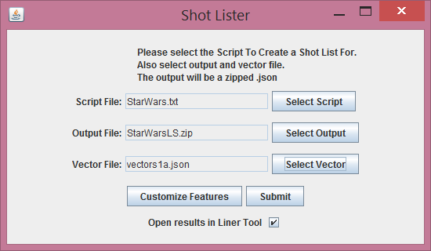
The Lister Tool
Takes a raw script as input
Allows naming of output file
Requires vector file
Also allows changing of Feature Settings

Slide 34
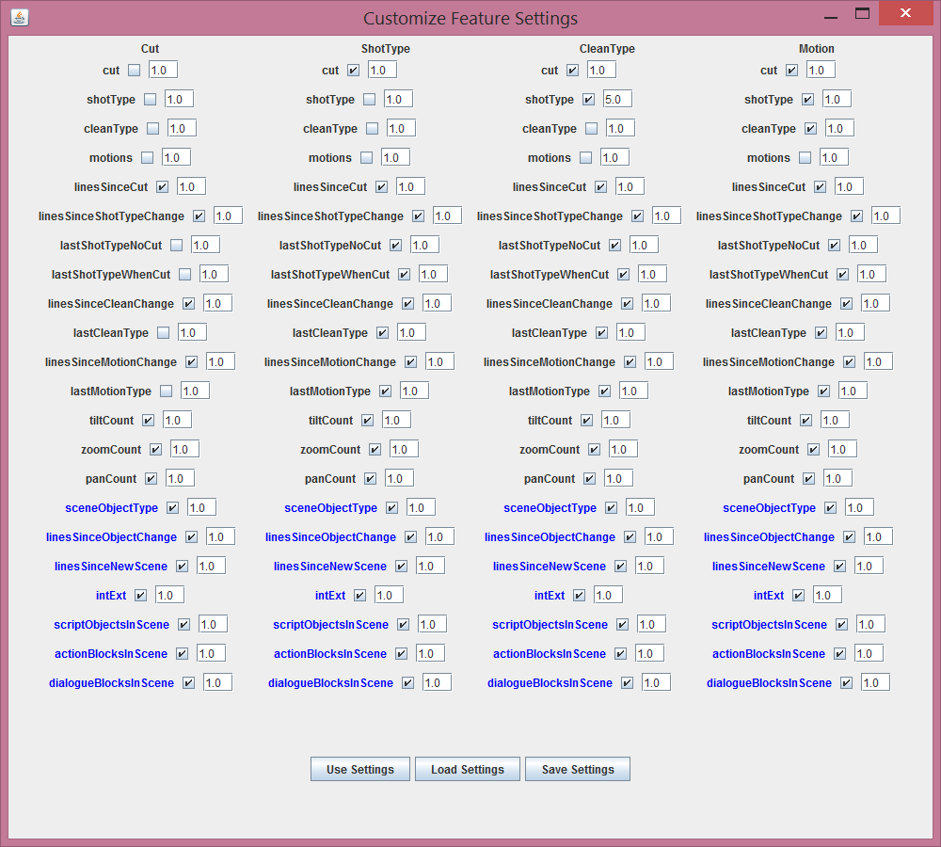
Feature Settings
Features can be turned on/off
Features can be weighted
  Weighting is done with exponents
Settings can be saved/loaded

Slide 35
The Lister
Takes raw scripts and calls parser to convert to AllData
Goes through the converted script line by line and applies Naïve Bayes algorithm to each target feature using the inputted vector file
The option picked for each target feature is applied to the AllData
The file is converted to JSON and outputted to a zip file
The zip file can be opened in the Liner tool to display the results
The output of the lister tool is the same file structure as the output of the liner tool. Thus, it is the same as a training set

Slide 36
Comparison
Comparing the output of the lister tool to a training set can be done in one of two ways:
  The Comparer Tool
    Programmatically compares two files and gives their difference
    Ultimately doesn’t provide very good data
  The Human Judge Tool
    Outputs samples from two or more files into a convenient to look at file which humans can judge
    If humans prefer the lister output as much as the training set or even more, the output is considered good

Slide 37
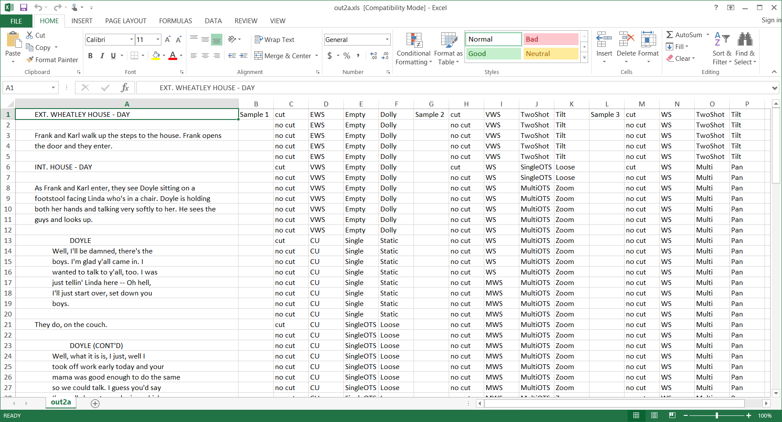

Slide 38
Experiments
Basic: Lister output vs. Training Set
Control Sample: Training Set vs. Human lined vs. Lister output
Training Set used as input of same script
Feed Lister output in as input
Many training sets vs. few training sets
Comparing different scripts by same director

Slide 39
Results
Experiments Round 1
  13 people participated
  Fleiss Kappa score: 0.2647 “fair agreement”
  Human lined script preferred: 111/156 = 71.1538462%
Experiments Round 2
  9 people participated
  Fleiss Kappa score: 0.1915 “slight agreement”
  Human lined script preferred: 72/108 = 66.6667%
Some refinements were done between the experiments

Slide 40
Refinement
The feature settings were tweaked some, disabling certain features from certain target features
Some features were given heavier weight
The biggest refinement came from separating the target features and doing a complete line by line pass of the script for each target feature
  The biggest benefit this provided was being able to see where a shot began and ended, thus provide more data to the next target features

Slide 41
Conclusion
The project output doesn’t pick perfect output but it does do reasonable output, providing a good starting place for would-be human shot list creators
Having more training sets would’ve definitely provided more customization
Having many training sets in a vector doesn’t necessarily provide better output than a few or just one training set
The Liner tool is a great tool for humans to create shot lists

Slide 42
Time to demo the software!

