Slide 1


DATA 225
Database Systems for Analytics
Access the Remote School Database Server
Fall Semester 2023
Department of Applied Data Science
San Jose State University
Instructor: Ron Mak
www.cs.sjsu.edu/~mak

Slide 2
We Have a Shared Database Server!
The server’s hostname is
IES-ADS-ClassDB.sjsu.edu
This is an internal SJSU server, so it is accessible only if you are on campus.
Therefore, to access it off campus (such as from your home), you need to be on SJSU’s virtual private network (VPN) which will put you virtually on campus.
  See the next slide!

Slide 3
Install VPN
For instructions on how to download and install Cisco’s VPN client software: https://www.sjsu.edu/it/services/network/internet-access/vpn.php
  For GROUP, you should select “Student-SSO” (single sign-on)
  You will be prompted for two-factor identification.
I installed VPN years ago as a faculty member.
I hope the installation as a student goes well.

Slide 4
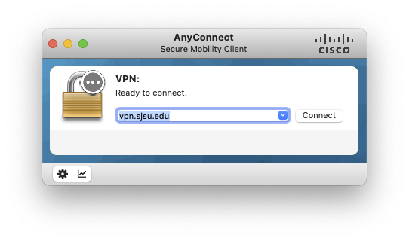
Connect to VPN
After you’ve successfully installed the VPN client, start it and connect:

Slide 5
When You’re Connected via VPN
You will be able to access the internal SJSU server IES-ADS-ClassDB.sjsu.edu
(and other internal university servers).
Because now your local machine is virtually on campus, you might no longer be able to access devices on your home network, such as printers, until you disconnect from VPN.

Slide 6
Team Project Databases
I created a database and a user for each team:
  bytes_db, bytes_user
  datadynamos_db, datadynamos_user
  dbwizards_db, dbwizards_user
  dfks_db, dfks_user
  invictus_db, invictus_user
  nobug_db, nobug_user
  rairdata_db, rairdata_user
  sqlweavers_db, sqlweavers_user
  starspartans_db, starspartans_user
  techorcas_db, techorcas_user
  visionary_db, visionary_user
I will email each team its user password.

Slide 7
Team Project Databases, cont’d
As a placeholder, I loaded the school database tables into each team’s database.
After you confirm that you can connect and see the tables, you can drop them.
You can use MySQL Workbench or Python code to create and load your own tables.

Slide 8
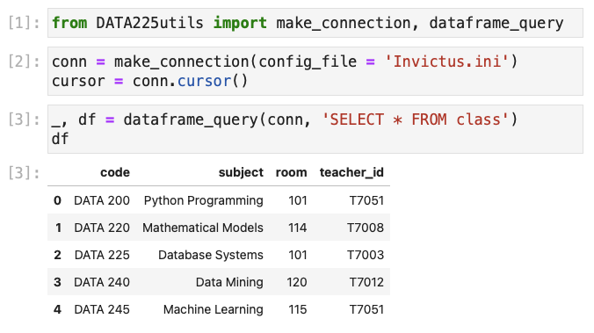
Python Connection to Your Team Database
Example (Team Invictus):
Invictus.ini
[mysql]
host = IES-ADS-ClassDB.sjsu.edu
database = invictus_db
user = invictus_user
password = Invictus team’s user password

Slide 9
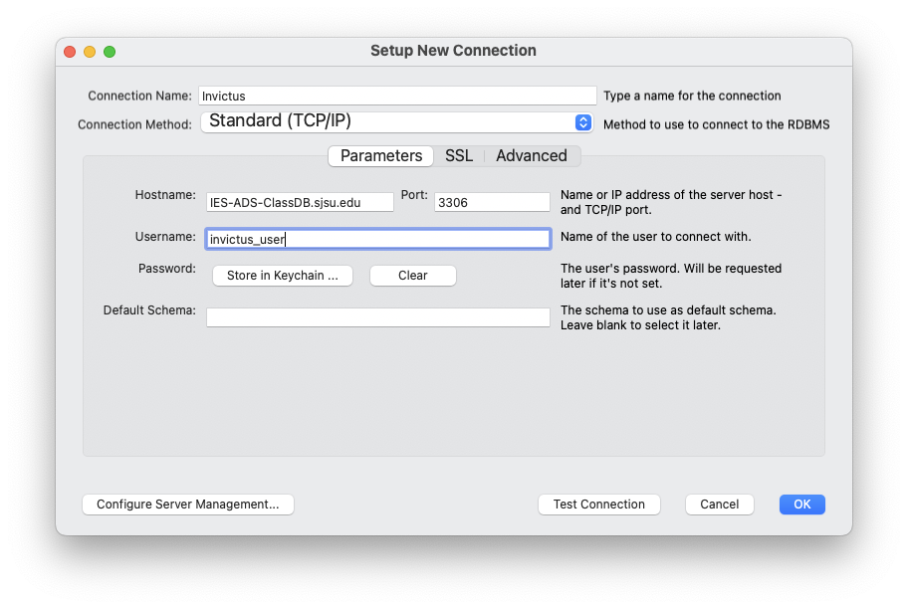
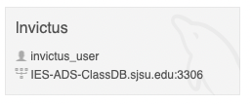
Create a MySQL Workbench Connection
You should also be able create a new connection in MySQL Workbench.
  Example: Team Invictus

Slide 10
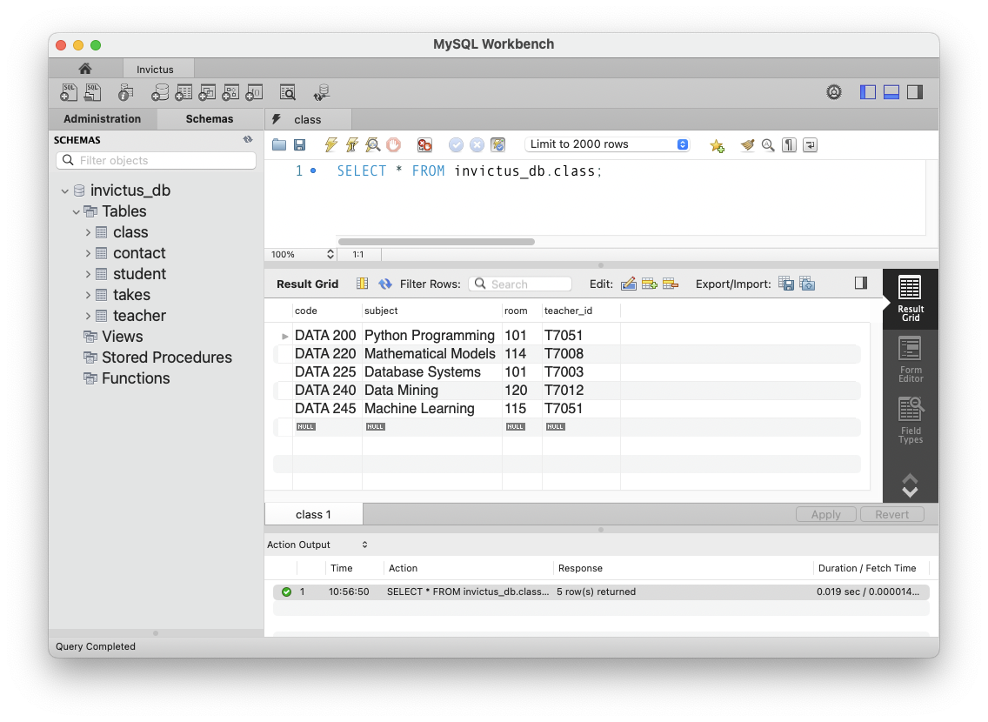
MySQL Workbench Connection, cont’d

Slide 11
Team Project Databases, cont’d
You should only be able to see
your team’s database on the server.
  You can create new users for your database.
  But you can’t create new databases.
  Let me know if your team needs a new database
  on the server.
Later, each team will also get a data warehouse on the server for data analysis.

