Slide 1


DATA 225
Database Systems for Analytics
November 27 Class Meeting
Department of Applied Data Science
San Jose State University
Fall 2023
Instructor: Ron Mak
www.cs.sjsu.edu/~mak

Slide 2
This Evening
Checkpoint 3 exam
Break
Miscellaneous topics
  Query optimization
  Security and public key cryptography
  Data virtualization
  Distributed databases
  Cloud computing

Slide 3
Query Processing
Query parser
  Checks the SQL query for syntactic and semantic correctness.
  Translates the query into an internal format.
  Verifies that all integrity rules are obeyed.
Query rewriter
  Automatically optimizes the query based upon
  the current state of the database.
  Evaluates execution plans based on their costs.
Query executor

Slide 4

Query Optimization Basics
Filter factor (FF)
  Associated with a query predicate
    Examples: country = 'US', gender = 'M'
  Fraction of rows expected to satisfy the predicate
    Chance that a particular row will be selected
Table cardinality (TC)
  Number of rows in the table
Query cardinality (QC)
  Expected number of rows selected by the query
$$QC=TC × {FF}_{1} ×{ FF}_{2 }×⋯ ×{ FF}_{n}$$

Slide 5

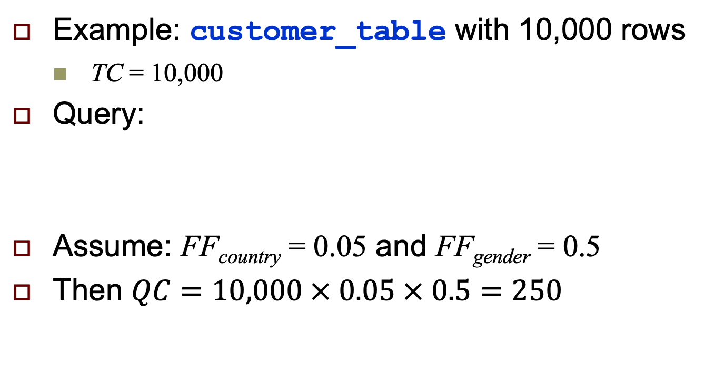
Query Optimization Basics, cont’d
$$QC=TC × {FF}_{1} ×{ FF}_{2 }×⋯ ×{ FF}_{n}$$
Example: customer_table with 10,000 rows
  TC = 10,000
Query:
Assume: FF_{country} = 0.05 and FF_{gender} = 0.5
Then $QC=10,000 × 0.05 × 0.5=250$
SELECT customer_id
FROM customer_table
WHERE country = 'US'
AND gender = 'M'
Lacking statistical data,
estimate FF_{i} = 1/NV_{i}
where NVi = the number
of different values for the
i^{th} attribute.

Slide 6
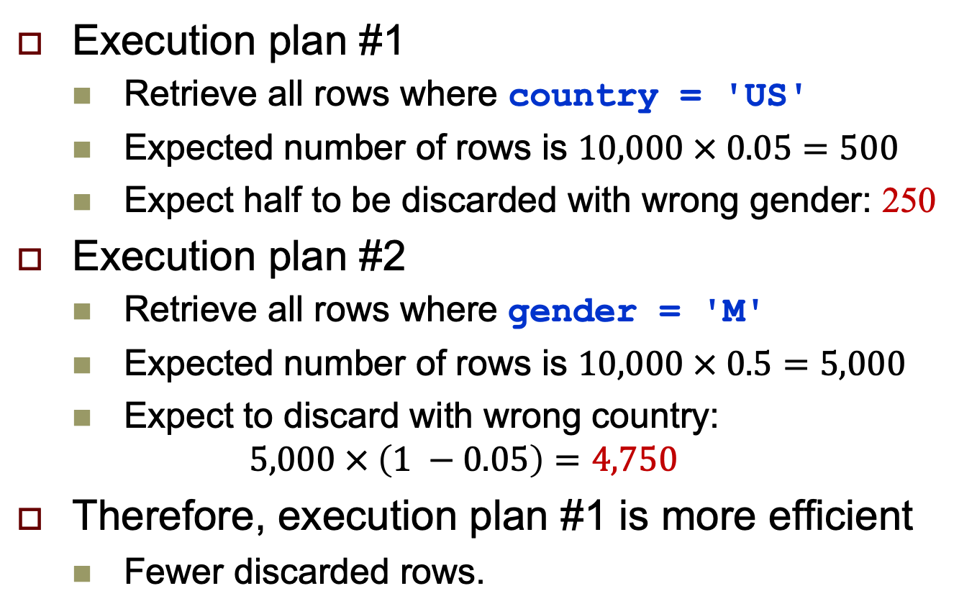
Query Optimization Basics, cont’d
Execution plan #1
  Retrieve all rows where country = 'US'
  Expected number of rows is $10,000 × 0.05=500$
  Expect half to be discarded with wrong gender: 250
Execution plan #2
  Retrieve all rows where gender = 'M'
  Expected number of rows is $10,000 × 0.5=5,000$
  Expect to discard with wrong country:
  $5,000 × \left(1 −0.05\right)=4,750$
Therefore, execution plan #1 is more efficient
  Fewer discarded rows.

Slide 7



Security
Sending data such as email messages
to each other via the Internet …
… is like sending postcards
via the U.S. mail system.
Anyone can read the
message along the way!
“We plan to manufacture 7 million widgets next quarter.”
Jill
John
Slides presented to
high school teachers
as an introduction
to data security.

Slide 8

Security, cont’d
“We plan to manufacture 7 million widgets next quarter.”
Jill
John
Bart
How can we keep the nefarious Bart
from reading confidential messages that
Jill and John are sending each other?

Slide 9
The Shared Secret
Jill needs to send a message containing the confidential data 7 to John.
John and Jill can agree ahead of time to a shared secret – the number 12.
Then Jill can encrypt the data by adding 12
to the confidential data 7.
John decrypts the data by subtracting 12.
19
John
Shared
secret 12
Jill
Shared
secret 12

Slide 10
The Shared Secret, cont’d
19
John
Shared
secret 12
Jill
Shared
secret 12
X
Bart
Because Bart doesn’t know the shared secret 12, he won’t be able to decrypt the message and obtain the confidential data 7.

Slide 11
The Shared Secret, cont’d
19
John
Shared
secret 12
Jill
Shared
secret 12
But this shared secret solution has problems.
  Jill and John must arrange beforehand
  to share the secret 12.
  What if Jill doesn’t already know John?
  What if Jill wants to send the confidential data
  to all her vice presidents at the same time?
How can Jill and all her recipients share a secret?

Slide 12
Public Key Cryptography, cont’d
How can Jill and her recipients share a secret number in order to encrypt the confidential data?
A security scheme called public key cryptography was invented just for this purpose.
In this simplified introduction, let’s pretend
that multiplication is a one-way operation.
  Once you’ve multiplied two numbers, say 4x5=20,
  you can’t recover the original numbers by dividing.
  In other words, you can’t do 20÷4=5 or 20÷5=4

Slide 13
Public Key Cryptography, cont’d
Jill chooses a private key.
  Let’s suppose Jill chooses 10.
Each person to whom she wants to send confidential data also chooses a private key.
  Let’s suppose John chooses 8.
Private
key 10
Jill
John
Private
key 8

Slide 14
Public Key Cryptography, cont’d
Private
key 10
Jill
John
Private
key 8
Public
key 5
Bart
Now Jill announces a public key.
  Let’s suppose the public key is 5.
Everyone can see the public key.
  Including the nefarious Bart.

Slide 15
Public Key Cryptography, cont’d
Jill’s
public-private
key 50
John’s
public-private
key 40
Private
key 10
Jill
John
Private
key 8
Public
key 5
Now Jill can create her public-private key.
  Multiply the public key by her private key: 5x10=50.
John creates his public-private key.
  Multiply the public key by his private key: 5x8=40.

Slide 16
Public Key Cryptography, cont’d
Jill’s
public-private
key 50
John’s
public-private
key 40
Private
key 10
Jill
John
Private
key 8
Public
key 5
Remember that we’re pretending that multiplication is a one-way operation.
  We cannot discover Jill’s private key 10 by dividing her public-private key 50 by the public key 5.
  We cannot discover John’s private key 8 by dividing his public-private key 40 by the public key 5.

Slide 17
Public Key Cryptography, cont’d
Jill’s
public-private
key 50
John’s
public-private
key 40
Private
key 10
Jill
John
Private
key 8
Public
key 5
What is the goal of all this?
  To create a shared secret between Jill and John.
Jill multiplies John’s public-private key by her private key: 40x10=400
John multiplies Jill’s public-private key by his private key: 50x8=400

Slide 18
Public Key Cryptography, cont’d
Shared
secret 400
Jill’s
public-private
key 50
John’s
public-private
key 40
Shared
secret 400
Private
key 10
Jill
John
Private
key 8
Public
key 5
407
Now Jill and John have a shared secret 400.
Jill can encrypt the confidential data 7
by adding the shared secret 400 to obtain 407.
John can decrypt the confidential data 7
by subtracting the shared secret 400 from 407.

Slide 19
Public Key Cryptography, cont’d
407
John
Shared
secret 400
Jill
Shared
secret 400
X
Bart
Bart can’t decrypt the 407 because he
doesn’t know the shared secret 400.

Slide 20
Public Key Cryptography, cont’d
Public key encryption works
with multiple recipients.
Jill needs to send confidential data
to both John and his
twin brother Mark.
Each picks a private key.
Mark
Private
key 2
Private
key 10
Jill
John
Private
key 8

Slide 21
Public Key Cryptography, cont’d
Jill announces the public key 5, and everyone generates his or her public-private key.
  Jill: 5x10=50
  John: 5x8=40
  Mark: 5x2=10
Mark’s
public-private
key 10
Mark
Private
key 2
Public
key 5
Jill’s
public-private
key 50
John’s
public-private
key 40
Private
key 10
Jill
John
Private
key 8

Slide 22
Public Key Cryptography, cont’d
Jill will have a shared secret with each recipient.
  Jill and John will share 400 between them, as before.
  Jill and Mark will have a different shared secret.
    Jill: Multiply Mark’s
    public-private key by
    her private key:
    10x10=100.
    Mark: Multiply Jill’s
    public-private key by
    his private key:
    50x2=100
Mark’s
public-private
key 10
Shared secret
with Jill: 100
Mark
Private
key 2
Public
key 5
Shared secret
with Mark: 100
Jill’s
public-private
key 50
John’s
public-private
key 40
Shared secret
with Jill: 400
Shared secret
with John: 400
Private
key 10
Jill
John
Private
key 8

Slide 23
Public Key Cryptography, cont’d
Jill sends to each recipient.
  Bart can’t decrypt the messages to recover the confidential data 7 because he doesn’t know
  the shared secrets.
Shared secret
with Jill: 100
Mark
107
Shared secret
with John: 400
407
Shared secret
with Jill: 400
Jill
John
Shared secret
with Mark: 100
X
Bart

Slide 24
Cryptography in the Real World
Of course, in the real world, we can’t use simple operations like multiplication and addition to generate keys and to encrypt data.
  Multiplication and addition are
  not one-way operations.
Real-world encryption uses very large
prime numbers and modulo arithmetic.
  Not even the most powerful supercomputer
  can undo such operations.

Slide 25
The Diffie-Hellman Protocol
Public key cryptography is a key exchange protocol first published by Whitfield Diffie
and Martin Hellman in 1976.
  It was actually invented earlier in 1970 by the
  British government, but it was classified.
Whenever you visit a secure website, you are using the Diffie-Hellman protocol or a variant.
  A secure website has a URL that
  starts with https: instead of http:

Slide 26
Data Virtualization
An approach to data management that allows an application to retrieve and manipulate data without requiring technical details about the data, such as how it is formatted or where it is physically located.
An agile data integration approach that organizations use to gain more insight from their data, respond faster to ever changing analytics and BI needs and save 50-75% over data replication and consolidation.
https://en.wikipedia.org/wiki/Data_virtualization
http://www.compositesw.com/data-virtualization/

Slide 27
Data Virtualization, cont’d
Differs from traditional ETL.
  The original data remains in place.
  A real-time process accesses the data sources.
Reduces the risk of data errors.
Reduces the workload of extracting, transforming, and loading data that may never be used by an application.
Provides applications a “virtual view” of the data.
  Applications can treat the disparate and heterogeneous data as a single relational database.

Slide 28
Data Virtualization Functionality
Abstraction
  Abstract away the technical aspects of stored data,
  such as location, storage structure, API,
  access language, and storage technology.
Virtualized data access
  Connect to different data sources and make them accessible from a common logical data access point.
Transformation
  Transform, improve quality, reformat, etc.
  source data for consumer use.
https://en.wikipedia.org/wiki/Data_virtualization

Slide 29
Data Virtualization Functionality, cont’d
Data federation
  Combine result sets from across
  multiple source systems.
Data delivery
  Publish result sets as views and/or data services executed by client applications or users when requested.
https://en.wikipedia.org/wiki/Data_virtualization

Slide 30
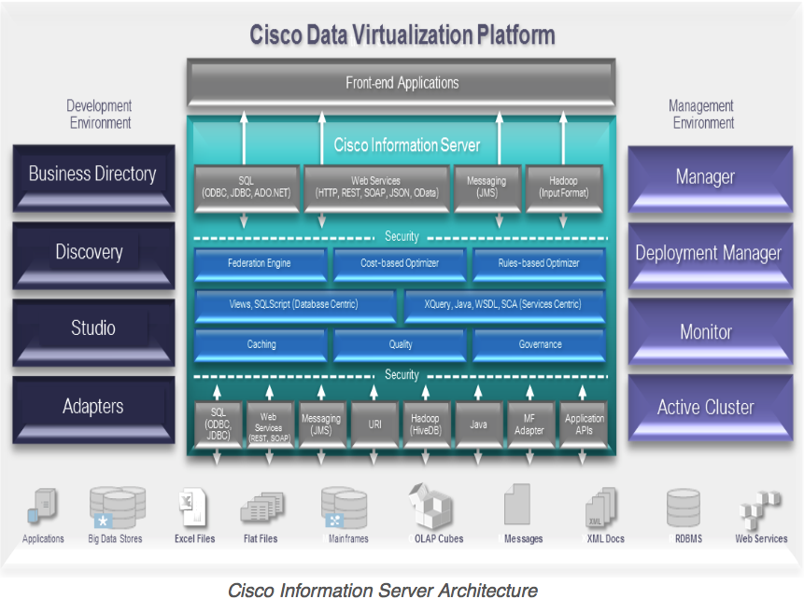
Cisco Information Server (CIS)
The Cisco Information Server (CIS) forms the core of the Cisco Data Virtualization Platform.
http://www.compositesw.com/data-virtualization/

Slide 31
Distributed Databases
Distributed database system (DDBS)
  Distribute the database among separate computers.
Shared data.
Reflect the organizational structures
that are naturally distributed.

Slide 32
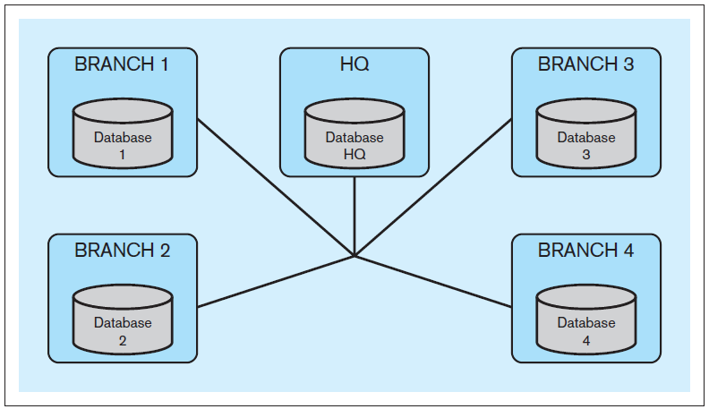
Distributed Databases, cont’d
Example: Bank headquarters and branches.
  Each branch maintains data about its customers.
  Each branch can access data from other branches.
  Each branch can access administrative HQ data.
  HQ can access branch data.
Database Systems
by Jukić, Vrbsky, & Nestorov
Pearson 2014
ISBN 978-0-13-257567-6

Slide 33
Distributed Databases, cont’d
Computers that run the DDBS do not share processing or storage devices.
The computers are connected by a network.
  The computers can reside in the same building
  or they may be located in different continents.
Key property: distribution transparency

Slide 34
Distribution Transparency
End users of the DDBS should
not be concerned about the
distributed nature of the system.
End users of the DDBS should not know
if the data they are accessing is stored locally
or remotely at a different geographic location.
End users can use the DDBS in the same way as if the data were not distributed.

Slide 35
Homogeneous vs. Heterogeneous
Homogeneous DDBS
  The same database management system
  runs on all computers.
  Example: All Oracle or all DB2
Heterogeneous DDBS
  Different DBMS’s run on different computers.
  Legacy systems
  Company merger

Slide 36
DDBS Performance Improvements
Users can access different parts of the database simultaneously.
  Without interfering with each other.
Most frequently accessed data at a particular location can be stored locally.
  Decreased access time.
  Fewer queries per computer.
Increased reliability.
  Replicated data.

Slide 37
DDBS Complexities
A DDBS is more complex
than a non-distributed database.
Additional functions required:
  Keep track of the locations of data and replicas.
  Determine which copy to use for queries.
  Know which queries are local and which are remote.
  Combine results of local and remote queries.
  Make sure data remains consistent after updates.

Slide 38
Database Fragmentation
Different strategies to distribute data in a DDBS:
  horizontal fragmentation
  vertical fragmentation
  mixed fragmentation

Slide 39
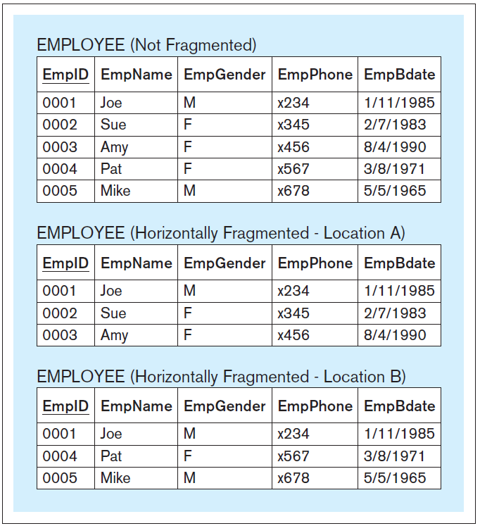
Horizontal Fragmentation
Store subsets of the rows of a table
at different locations.
Standard query:
SELECT * FROM employee_location_A
UNION
SELECT * FROM employee_location_B;
Transparent DDBS query:
SELECT * FROM employee
Database Systems
by Jukić, Vrbsky, & Nestorov
Pearson 2014
ISBN 978-0-13-257567-6

Slide 40
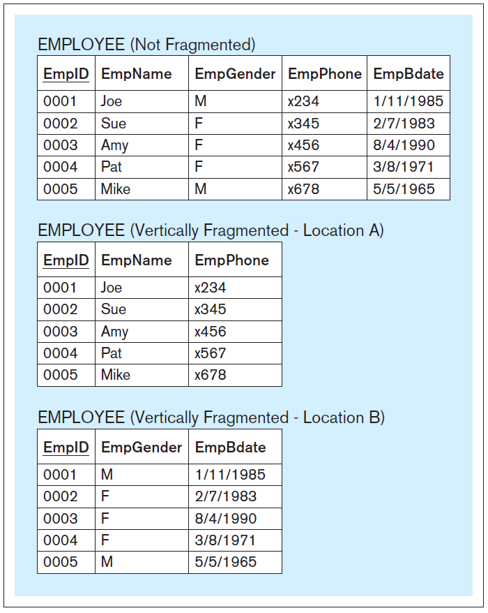
Vertical Fragmentation
Store subsets of the columns of a table
at different locations.
Standard query:
SELECT a.empid, a.empname,
b.empgender, a.empphone,
b.empbdate
FROM employee_location_a a,
employee_location_b b
WHERE a.empid = b.empid;
Transparent DDBS query:
SELECT * FROM employee
Database Systems
by Jukić, Vrbsky, & Nestorov
Pearson 2014
ISBN 978-0-13-257567-6

Slide 41
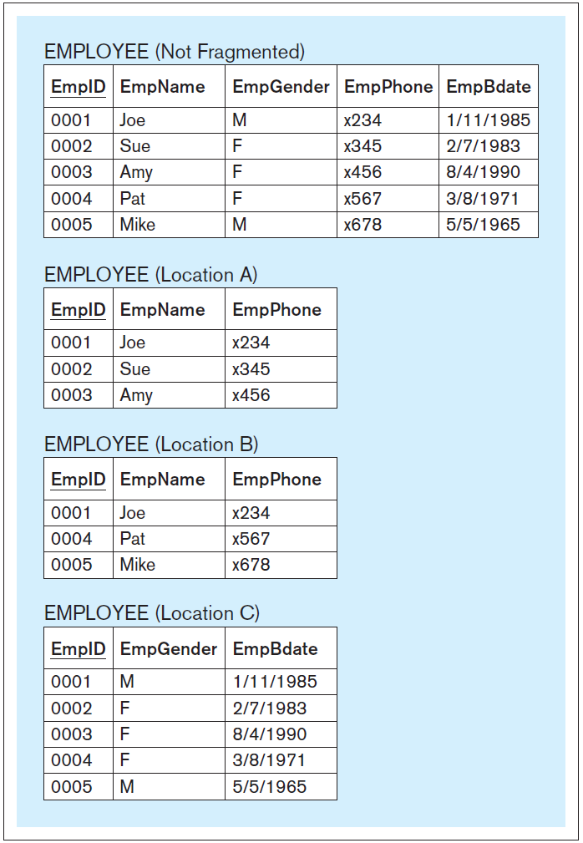
Mixed Fragmentation
A combination of horizontal
and vertical fragmentation.
Standard query:
SELECT a.empid, a.empname,
c.empgender, a.empphone,
c.empbdate
FROM employee_location_a a,
employee_location_c c
WHERE a.empid = c.empid
UNION
SELECT b.empid, b.empname,
c.empgender, b.empphone,
c.empbdate
FROM employee_location_b b,
employee_location_c c
WHERE b.empid = c.empid;
Transparent DDBS query:
SELECT * FROM employee
Database Systems
by Jukić, Vrbsky, & Nestorov
Pearson 2014
ISBN 978-0-13-257567-6

Slide 42
Databases and Cloud Computing
Data storage, management, and
processing services delivered in the “cloud”.
  Hosted by an Internet Service Provider (ISP).
Create databases in the ISP’s storage.
  The ISP provides backup and recovery services.
Connect to and access database data
via the Internet.
Computing resources on demand.
  Users increase or decrease resources as needed.

Slide 43
Advantages of Cloud Computing
Can be cost-effective for an organization.
  No computer hardware and software investment.
  Reduced or no IT support staff.
Elasticity
  On-demand access to computing resources
  Scale up or down based on dynamic workloads
  Pay-per-use model
Distributed computing
  Multiple data centers geographically distributed
  Highly parallelized computing.

Slide 44
Advantages of Cloud Computing, cont’d
Virtualization
  Multiple users can use the same computing resource simultaneously.
  A single server can emulate different physical machines and run different operating systems.
Reliability and availability
  Replicated processes and data can transparently and quickly take over from a failed machine.

Slide 45
Problems of Cloud Computing
Security and privacy risks
  Store an organization’s data off premises
  in a third-party vendor’s servers.
  Must trust the cloud host.
Government regulations
  Distributed data can be stored on servers
  that are located in foreign countries.
  Different laws regarding government access to data.

Slide 46
Categories of Cloud Services
Infrastructure as a Service (IaaS)
Platform as a Service (PaaS)
Software as a Service (SaaS)
Database as a Service (DaaS)

Slide 47
Infrastructure as a Service (IaaS)
Provide hardware as standardized services
over the network.
Customer rent resources.
  server space
  network equipment
  processing cycles
  storage space

Slide 48
Platform as a Service (PaaS)
Provide all the resources a customer needs
to build applications.
Platform consists of:
  operating system
  middleware
  application software
  development environment
Interact with the platform via an interface.
  The platform scales itself according to
  the customer’s needs.

Slide 49
Software as a Service (SaaS)
A software application offered
as an on-demand service.
The application is hosted by the ISP and operated by customers over the Internet.
Multitenant
  Multiple clients simultaneously use a single instance of the application that is running in the cloud.

Slide 50
Database as a Service (DaaS)
Database management in the cloud.
  A specialized version of SaaS.
Cloud-based databases solve some key difficulties of large-scale data processing.
  Automatically scale up and down
  based on dynamic workloads.
Well-suited for analytical databases.
  Few or no updates.
  Harder for operational databases due to
  update complexities and performance penalties.

