Slide 1


DATA 225
Database Systems for Analytics
November 13 Class Meeting
Department of Applied Data Science
San Jose State University
Fall 2023
Instructor: Ron Mak
www.cs.sjsu.edu/~mak

Slide 2
This Evening
Factless fact table
OLAP operations
  drill up, drill down
  slice, dice
  pivot
Conformed dimensions
BI tools
GROUP BY ... WITH ROLLUP
Break

Slide 3
This Evening, cont’d
Time-series analysis
  Moving averages
  Exponential smoothing
Executive dashboard
Assignment #10

Slide 4
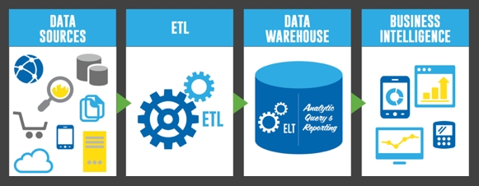
Extract, Transform, and Load (ETL)
http://uploads.webflow.com/54e3cc87305a0f0a0665f71f/5537351f5f1065d401cde83c_etl-elt-architecture.jpg

Slide 5
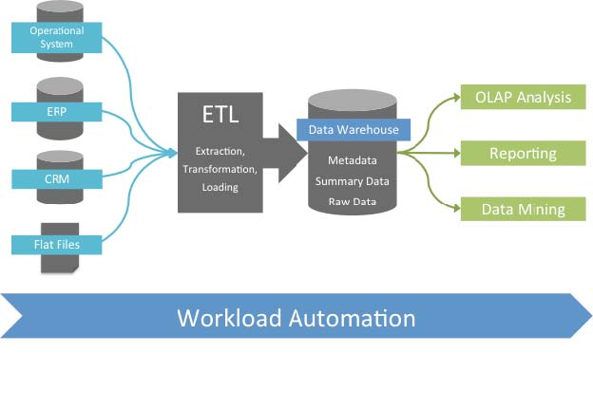
Extract, Transform, and Load (ETL), cont’d
http://www.stonebranch.com/common/images/etl-tipping-point.jpg

Slide 6
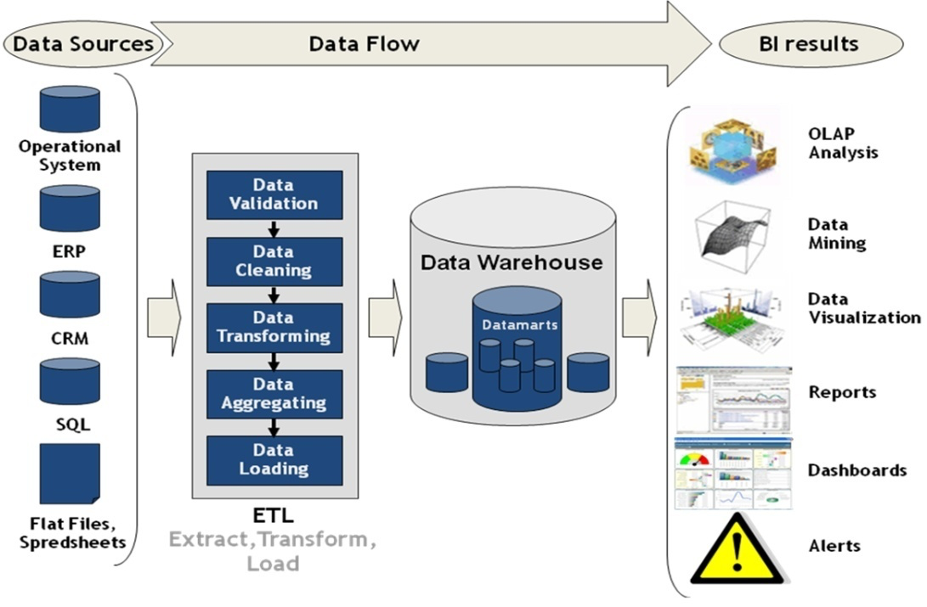
Extract, Transform, and Load (ETL), cont’d
http://superdevelop.com/wp-content/themes/shopperpress/thumbs/ETL.jpeg

Slide 7
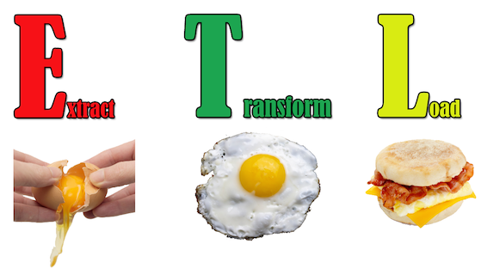
Extract, Transform, and Load (ETL), cont’d
http://edpflager.com/wp-content/uploads/2014/05/ETL.png

Slide 8
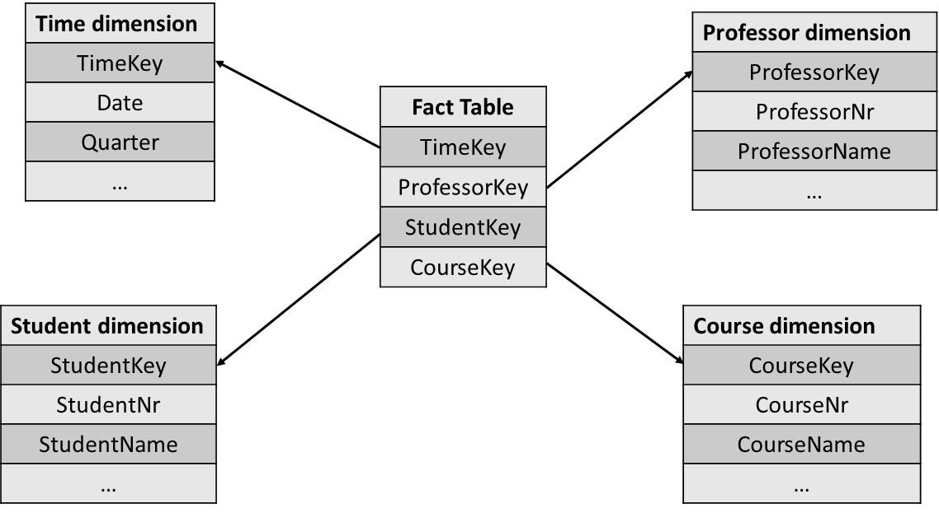
Factless Fact Table
Contains only foreign keys and no measures.
  Example:
  Example queries:
    Which professor teaches the highest number of courses?
    What is the average number of students who attend a course?
    Which course has the highest number of students?
Principles of Database Management
by Lemahieu, vanden Broucke, Baesens
Cambridge University Press, 2018
ISBN 978-1-107-18612-5

Slide 9
Online Transaction Processing (OLTP)
Online: The computer responds immediately
or very quickly.
  online ≠ Internet
OLTP
  online transaction processing
  operational database = OLTP system
Update and query operational data.
Present data
  Generate reports

Slide 10
Online Analytical Processing (OLAP)
OLAP
  online analytical processing
  Query data from data warehouses and/or
  data marts to analyze and present data.
OLAP tools support decision making.
OLAP tools are read only.

Slide 11
OLAP Operations
drill up and drill down
slice and dice
pivot

Slide 12
OLAP Drill Up and Drill Down
Drill through dimension hierarchies.
  Examples:
    Location: country → state → region → city → store
    Time: year → quarter → month → week → day → hour
Drill up
  AKA roll up
  Make the data granularity coarser.
  Aggregate the data.
Drill down
  Make the data granularity finer.

Slide 13
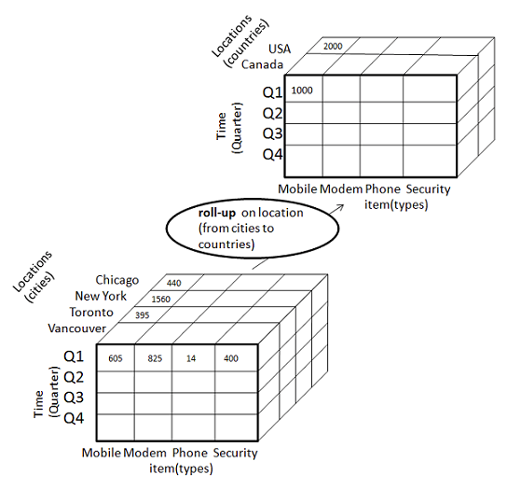
OLAP Drill Up and Drill Down, cont’d
http://www.tutorialspoint.com/dwh/dwh_olap.htm

Slide 14
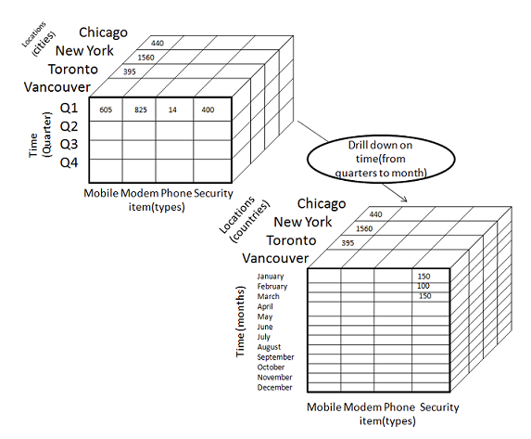
OLAP Drill Up and Drill Down, cont’d
http://www.tutorialspoint.com/dwh/dwh_olap.htm

Slide 15
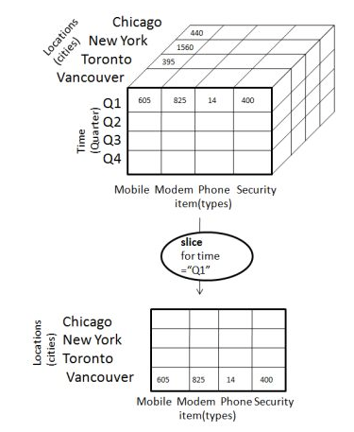
Slice and Dice
Slice: Select one value of a dimension attribute.
http://www.tutorialspoint.com/dwh/dwh_olap.htm

Slide 16
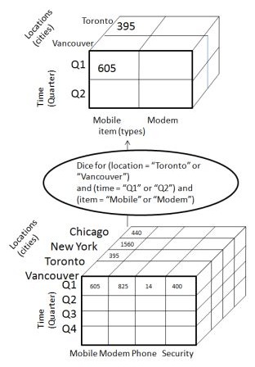
Slice and Dice
Dice: Select attribute values from two or more dimensions.
http://www.tutorialspoint.com/dwh/dwh_olap.htm

Slide 17
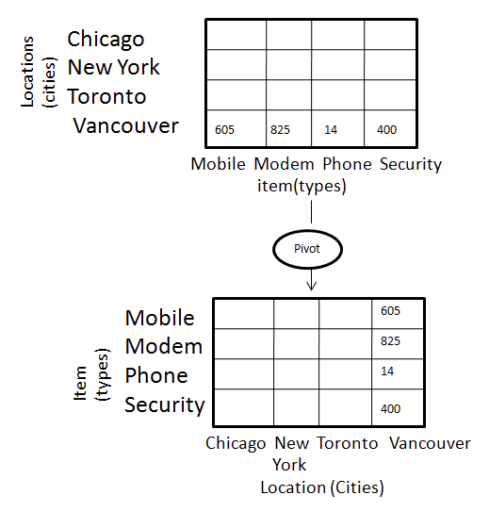
Pivot
Pivot: Reorganize query results by rotation.
http://www.tutorialspoint.com/dwh/dwh_olap.htm

Slide 18
ROLAP
OLAP: Online Analytical Processing
ROLAP: Relational OLAP
  dimensional model
  star schema
    dimension tables
    fact tables
ROLAP warehouses consist of multiple relational tables
  Kimball approach: dimensional models

Slide 19
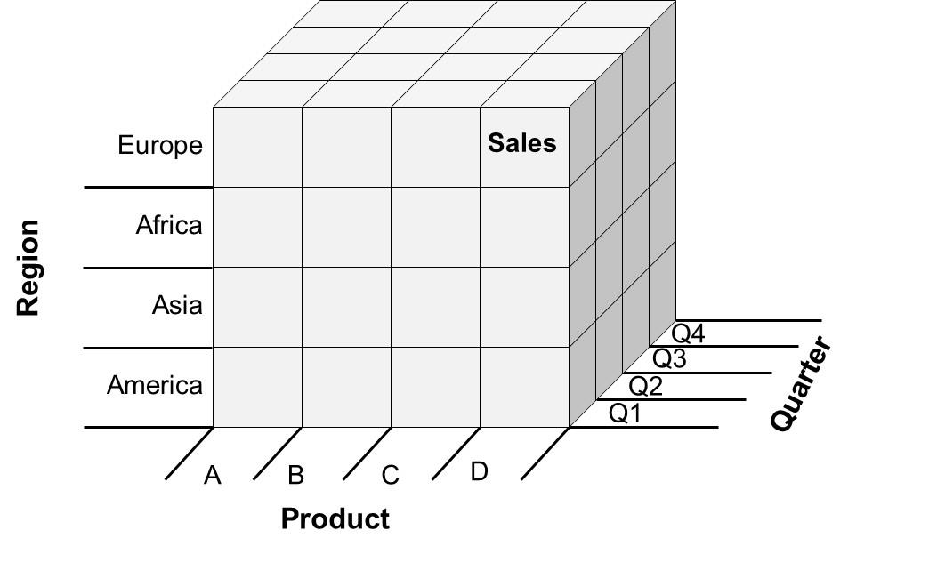
MOLAP
MOLAP: multidimensional OLAP
  Conceptually, a multidimensional data cube
Principles of Database Management
by Lemahieu, vanden Broucke, Baesens
Cambridge University Press, 2018
ISBN 978-1-107-18612-5

Slide 20
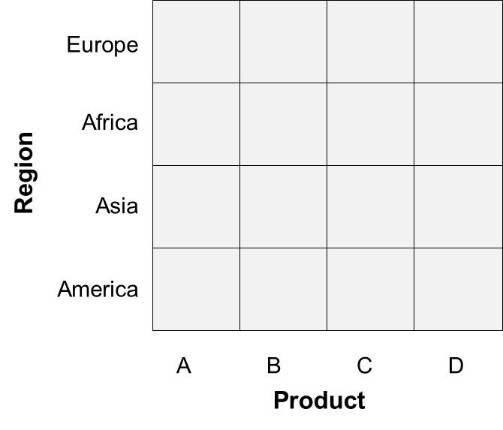
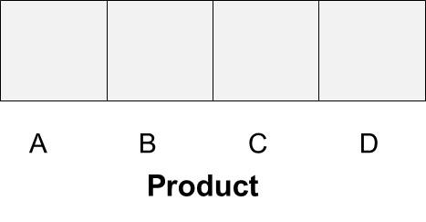
More Views of OLAP Operations
Drill up (rollup) and drill down
  Drill up/down along a dimension requires a hierarchy.
  Examples:
    calendar: decade ➔ year ➔ quarter ➔ month ➔ day ➔ hour
    location: continent ➔ country ➔ state ➔ county ➔ city ➔ street
Principles of Database Management
by Lemahieu, vanden Broucke, Baesens
Cambridge University Press, 2018
ISBN 978-1-107-18612-5

Slide 21
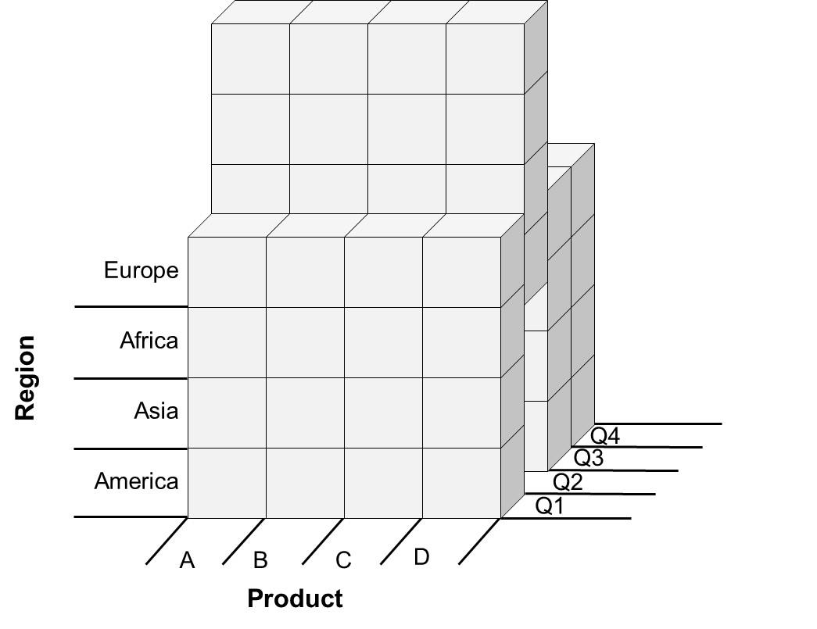
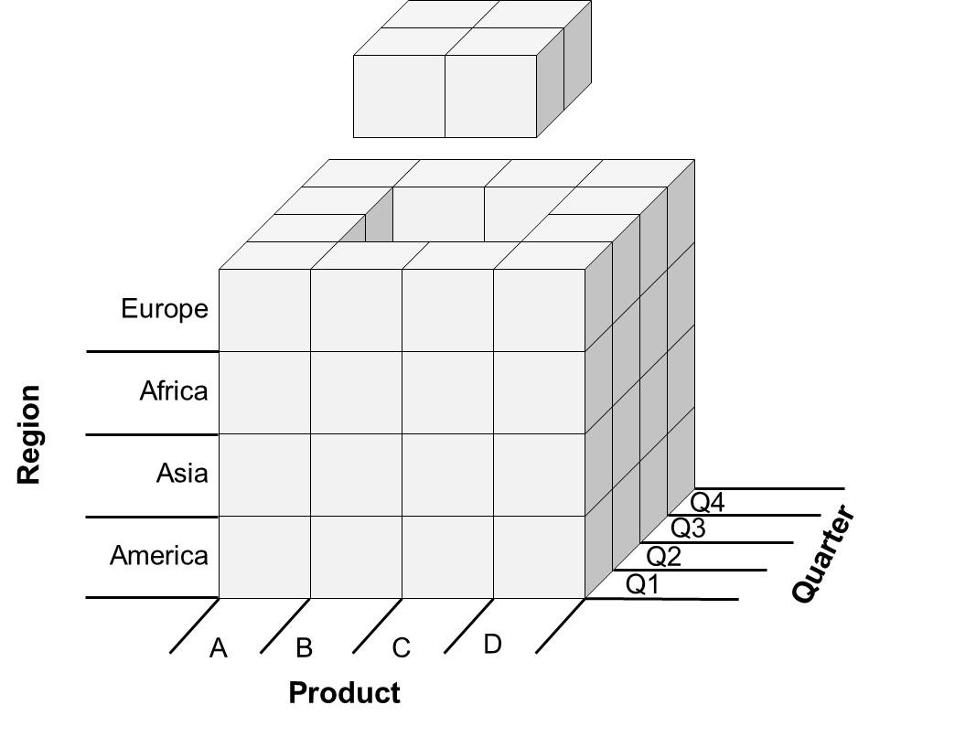
More Views of OLAP Operations, cont’d
Slice and dice
Principles of Database Management
by Lemahieu, vanden Broucke, Baesens
Cambridge University Press, 2018
ISBN 978-1-107-18612-5

Slide 22
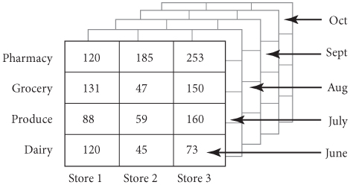
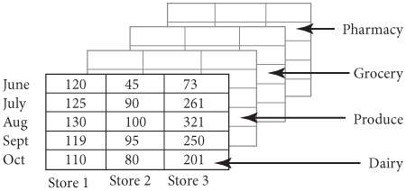
More Views of OLAP Operations, cont’d
Pivot
Database Illuminated, 3rd edition
by Catherine Ricardo & Susan Urban
Jones & Bartlett Learning,, 2017
ISBN 978-1-284-05694-5

Slide 23
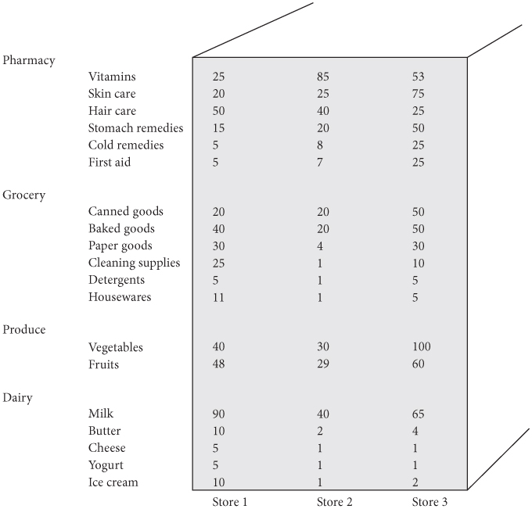
More Views of OLAP Operations, cont’d
Drill-down on
sales of a
department
showing the month of June
Database Illuminated, 3rd edition
by Catherine Ricardo & Susan Urban
Jones & Bartlett Learning,, 2017
ISBN 978-1-284-05694-5

Slide 24
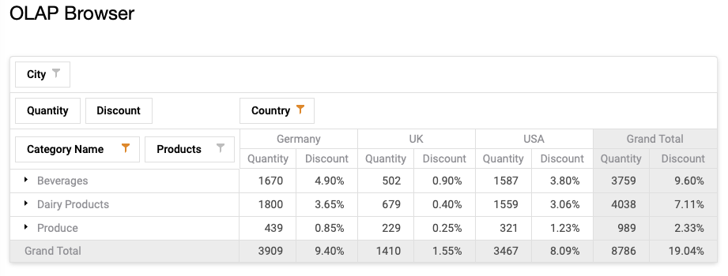
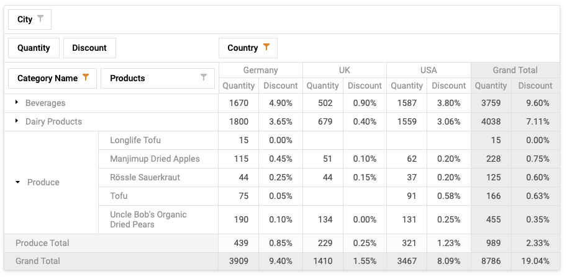
More Views of OLAP Operations, cont’d
Drill down on
Produce
Drill up
(rollup) on
Produce
https://demos.devexpress.com/aspxpivotgriddemos/OLAP/Browser.aspx
Demo

Slide 25
Implementing OLAP Operations
Straightforward to do with SQL only:
  drill up and down
  slice and dice
May also need Python code:
  pivot

Slide 26
Conformed Dimensions
When multiple star schemas share a common set of dimensions, the dimensions are called conformed dimensions.
Conformed dimensions enable analyses to span multiple star schemas, where the schemas share a common view of the world.
  For example, all the schemas must share
  a common view of what a customer is.
  Drill across: A OLAP operation that
  spans multiple star schemas.

Slide 27
OLAP/BI Tools
  Users can query fact and dimension tables
  by using simple point-and-click query-building applications.
  Based on user actions, the tool generates and executes the SQL code on the data warehouse or data mart.
  SQL code to drill up or down, slice or dice, or pivot.
Example OLAP/BI tools
  IBM Cognos, Oracle BI, TIBCO Spotfire, Tableau

Slide 28
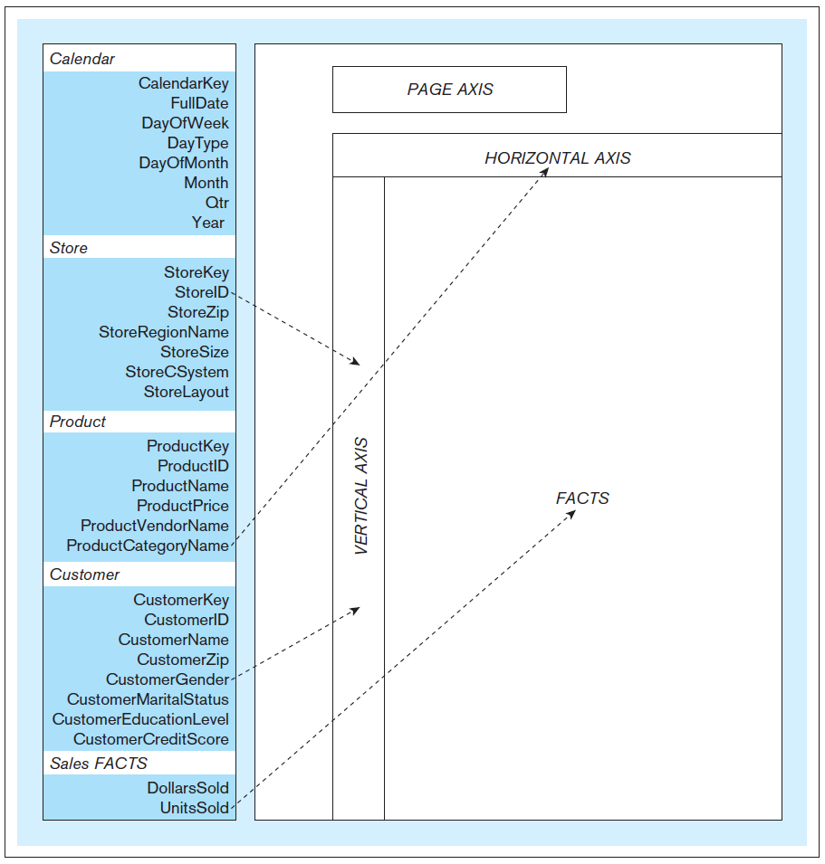
OLAP/BI Tools, cont’d
Typical OLAP
tool layout
Database Systems
by Jukić, Vrbsky, & Nestorov
Pearson 2014
ISBN 978-0-13-257567-6

Slide 29
Online OLAP/BI Tool Demos
Telerik OLAP and KPIs Support: http://demos.telerik.com/aspnet-ajax/pivotgrid/examples/olap/defaultcs.aspx
DevExpress OLAP Browser: https://demos.devexpress.com/aspxpivotgriddemos/OLAP/Browser.aspx
Business Intelligence Tools: http://www.softwareadvice.com/bi/?more=true#more

Slide 30
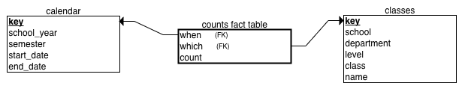
SQL ROLLUP for Drill Up/Down Subtotals
MySQL has GROUP BY ... WITH ROLLUP for drilling up and down hierarchical dimensions to calculate subtotals and a grand total.
In our example, the counts fact table has a measure which is a count of students, and the dimension tables calendar and classes are both hierarchical.
Students-star.ipynb
Students-rollup.ipynb

Slide 31
Break

Slide 32
Time-Series Analysis
Time-series analysis is a common application
of regression.
  Use the time dimension of a dimensional model.
  Record data at regular intervals of time.
  The data values are a function of the time.
  Calculate and plot trends of data values over time.
Different time-series trends:
  Least-squares line
  Moving average
  Exponentially smoothed

Slide 33
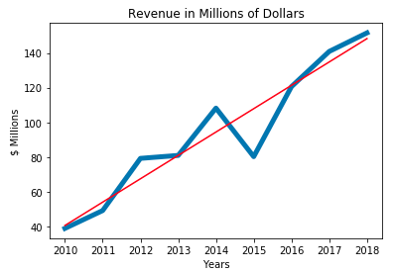
Linear Trend Over Time
A straightforward application of the
least squares regression line.
  You already know
  how to compute the
  the slope and
  y-intercept in SQL.

Slide 34
Moving Averages
The moving average of y data values over the
x values that represent the time intervals:
  Each y_{ma} value of the moving average corresponding to the current x time value is the average of the current y value and the previous n-1 of the y values.
  There can be no y_{ma} moving average values corresponding to the first n-1 of the x values.
Higher values of n generate moving average plots that “smooth out” the data more.

Slide 35
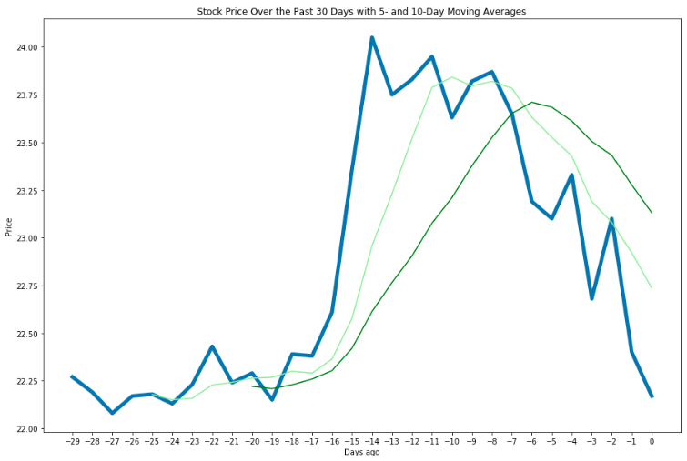
Moving Averages, cont’d
n = 5
n = 10

Slide 36
SQL Support for Moving Averages
Example:
  3-day moving average of stock prices
  Uses SQL windowing
No average for
the first 2 days.
SELECT days_ago, price,
CASE WHEN ROW_NUMBER() OVER (ORDER BY days_ago) >= 3
THEN AVG(price) OVER (ORDER BY days_ago
ROWS BETWEEN 2 PRECEDING
AND CURRENT ROW)
ELSE NULL
END AS {header}
FROM recent_prices
ORDER BY days_ago
Average of the preceding
2 prices and the current price.
MovingAverage.ipynb

Slide 37
Exponential Smoothing
Exponential smoothing is a special form of moving average that weighs the most recent values of y differently than the earlier y values.
The smoothing is based on the value of the smoothing constant α, a fraction between
0 and 1.
The first value y_{es} of the exponentially smoothed average is simply the value of y calculated from the first value of x, the first time interval.

Slide 38
Exponential Smoothing, cont’d
Moving forward in time, for each subsequent value of x, the value of y_{es} is α times the current corresponding value of y plus 1 – α times the previous value of y_{es}.
  Therefore, if α < 0.5, the current value of y has less influence on the smoothed curve than earlier values. This dampens current fluctuations.
Smaller values of α generate more stable values of y_{es}. Larger values of α enable quicker reaction to current changes in values of y.

Slide 39
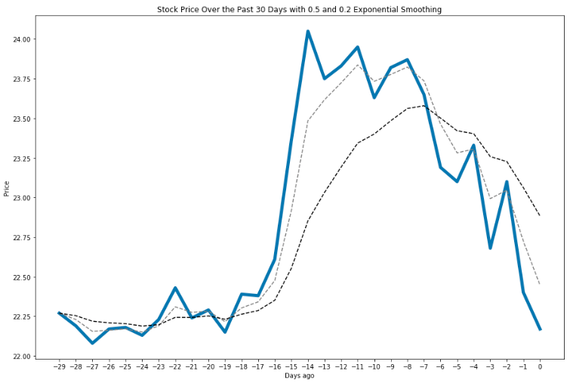
Exponential Smoothing, cont’d
α = 0.5
α = 0.2
If α < 0.5, the current value of y
has less influence on the
smoothed curve than earlier values.
This dampens current fluctuations.

Slide 40
SQL Support for Exponential Smoothing
Example:
  Exponential smoothing of stock prices with α = 0.2
  Uses user-defined variable @smoothed that is initially NULL
ExponentialSmoothing.ipynb
SELECT days_ago, price,
@smoothed := (0.2*price
+ (1-0.2)*(IF (@smoothed IS NULL, price, @smoothed)))
AS smoothed
FROM recent_prices
ORDER BY days_ago

Slide 41
Executive Dashboard
An executive dashboard is a good way to display important analysis results.
  Situational awareness: A decision maker sees at a glance what’s current and important.
Therefore, a major window of a GUI-based application can be an executive dashboard.

Slide 42
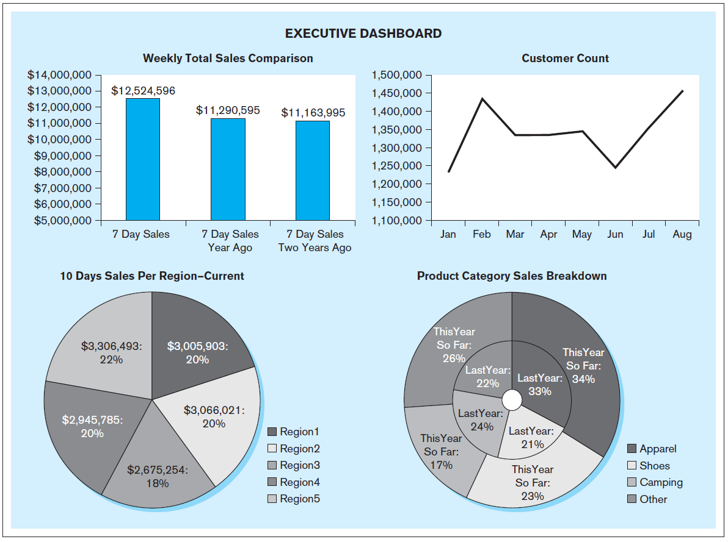
Executive Dashboard, cont’d
Database Systems
by Jukić, Vrbsky, & Nestorov
Pearson 2014
ISBN 978-0-13-257567-6

Slide 43
Assignment #10
Team assignment.
Perform OLAP and rollup operations on your
dimensional model from Assignment #7.
For each of the following operations, write and execute SQL queries using your sample data:
  drill up
  drill down
  slice
  dice

Slide 44
Assignment #10, cont’d
For each OLAP operation, show the query,
and “before” and “after” query output in a dataframe.
  Example: Do a query that shows quarterly results. Then for a drill down, do a query that shows monthly results. For a drill up, do a query that aggregates and shows yearly results.
Use any dimensions.

Slide 45
Assignment #10, cont’d
Perform an SQL query using a
GROUP BY ... WITH ROLLUP operation and display the results in a dataframe.
  You can simply display the dataframe with the None cells.
Submit a Python notebook into Canvas:
  SQL queries and cells containing the results.
  Please use your databases on the shared server.
Due Monday, May 1

