Slide 1


DATA 225
Database Systems for Analytics
October 30 Class Meeting
Department of Applied Data Science
San Jose State University
Fall 2023
Instructor: Ron Mak
www.cs.sjsu.edu/~mak

Slide 2
This Evening
Checkpoint Exam #2
Break
Operational vs. analytical databases
Application-oriented vs. subject-oriented
Data warehouse
  data warehouse components
  business intelligence (BI)
Dimensional modeling
  star schema

Slide 3
The Data Deluge
90% of all the data ever created
was created in the past two years.
2.5 quintillion bytes of data per day
is being created.
  2.5 x 10¹⁸
  That’s a lot of data!
80% of the data is “dark data”
  i.e., unstructured data

Slide 4
A Transformation
collect values
Data
Often together
simply called “data”
add metadata
Information
add context
Knowledge
add insight
Wisdom

Slide 5
Operational Data
Support a company’s day-to-day operations.
  A company can have multiple
  operational data sources.
Contains operational information.
  AKA transactional information.
Example operational data:
  sales transactions
  ATM withdrawals
  results from ongoing scientific experiments

Slide 6
Analytical Data
Collected for decision support and data analysis.
Example analytical information:
  patterns of ATM usage during the day
  sales trends over the past year
  common results from experimental practices
Analytical information is based on
operational information.
  Extracted from the operational databases.
  Possibly augmented by third-party data sources.

Slide 7
Operational vs. Analytical Data
Create a data warehouse as a separate analytical database.
Don’t slow down the performance of the operational database by also making it
support analytical operations.
It’s often impossible to structure a single database that is optimal for both operational and analytical operations.

Slide 8
Time Horizon
Operational data
  Shorter time horizon: typically 60 to 90 days.
    Archive data after 60 to 90 days.
  Frequent queries and updates by multiple users.
    Small amounts of data retrieved from each query.
  Don’t penalize the performance of typical queries
  for the sake of an occasional atypical query.
Analytical data
  Look for patterns and trends over many years.
  Specialized queries by a few data analysts.
    Possibly large amounts of data from each query.

Slide 9
Level of Data Detail
Operational data
  Detailed data about each transaction.
  Summarized data are not stored but are
  derived attributes calculated with formulas.
  Summary data is subject to frequent changes.
Analytical data
  Summarized data is physically stored.
  Summarized data is often precomputed.
  Summarized data is historical and unchanging.

Slide 10
Data Time Representation
Operational data
  Contains the current state of affairs.
  Frequently updated.
Analytical data
  Current situation plus snapshots of the past.
  Snapshots are calculated once
  and physically stored for repeated use.

Slide 11
Data Amounts and Query Frequency
Operational data
  Frequent queries by more users.
  Small amounts of data per query.
Analytical data
  Fewer queries by fewer users.
  Can have large amounts of data per query.
Difficult to optimize for both:
  Frequent queries + small amounts of data
  Less frequent queries + large amounts of data

Slide 12
Data Updates
Operational data
  Regularly updated by end users.
  Insert, modify, and delete data.
Analytical data
  End users can only retrieve data.
  Updates by end users not allowed.

Slide 13
Data Redundancy
Operational data
  Goal is to reduce data redundancy.
  Eliminate update anomalies.
Analytical data
  Updates by end users are not allowed.
  No danger of update anomalies.
  Eliminating data redundancies is not as critical.

Slide 14
Data Audience
Operational data
  Support day-to-day operations.
  Used by all types of employees, customers, etc.
  for various tactical purposes.
Analytical data
  Used by a narrower set of users
  for decision-making purposes.

Slide 15
Data Orientation
Operational data
  Application-oriented
  Created to support an application that serves
  one or more business operations and processes.
  Enable the efficient functioning of the application
  that it supports.
Analytical data
  Subject-oriented
  Created for the analysis of one or more business subject areas such as sales, returns, cost, profit, etc.

Slide 16
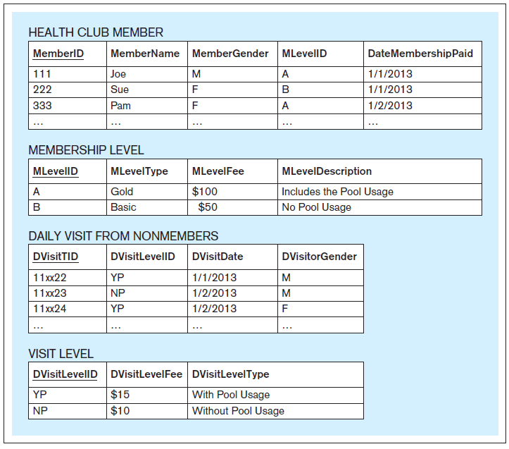
An Application-Oriented Operational Database
Support the
Visits and Payments application
of a health club.
Database Systems
by Jukić, Vrbsky, & Nestorov
Pearson 2014
ISBN 978-0-13-257567-6

Slide 17
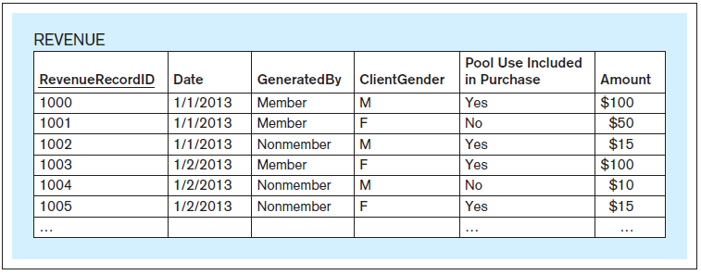
A Subject-Oriented Analytical Database
Support the analysis of the
subject of revenue
for a health club.
The data comes from
the operational database.
Database Systems
by Jukić, Vrbsky, & Nestorov
Pearson 2014
ISBN 978-0-13-257567-6

Slide 18
Operational vs. Analytical Data, cont’d
Operational Data | Analytical Data
Data Makeup
Typical time horizon: days/months | Typical time horizon: years
Detailed | Summarized (and/or detailed)
Current | Values over time (snapshots)
Technical Differences
Small amounts used in a process | Large amounts used in a process
High frequency of access | Low/Modest frequency of access
Can be updated | Read (and append) only
Non-redundant | Redundancy not an issue
Functional Differences
Used by all types of employees for tactical purposes | Used by fewer employees for decision making
Application oriented | Subject oriented

Slide 19
What is a Data Warehouse?
The data warehouse is a structured repository of integrated, subject-oriented, enterprise-wide, historical, and time-variant data.
The purpose of the data warehouse is
the retrieval of analytical information.
A data warehouse can store both detailed
and summarized data.

Slide 20
Structured Repository
The data warehouse is a structured repository of integrated, subject-oriented, enterprise-wide, historical, and time-variant data.
A data warehouse is a database that contains analytically useful information.
Any database is a structured repository.

Slide 21
Integrated
The data warehouse is a structured repository of integrated, subject-oriented, enterprise-wide, historical, and time-variant data.
The data warehouse integrates analytically useful data from existing operational databases in the organization.
Copy the data from the operational databases into the data warehouse.

Slide 22
Subject-Oriented
The data warehouse is a structured repository of integrated, subject-oriented, enterprise-wide, historical, and time-variant data.
Operational database
  Support a specific business operation.
Data warehouse
  Analyze specific business subject areas.

Slide 23
Enterprise-Wide
The data warehouse is a structured repository of integrated, subject-oriented, enterprise-wide, historical, and time-variant data.
The data warehouse provides an
enterprise-wide view of analytical data.
Example subject: Cost
  Bring into the data warehouse all
  analytically useful cost data.
  Possibly from individual operational databases at different business locations.

Slide 24
Historical
The data warehouse is a structured repository of integrated, subject-oriented, enterprise-wide, historical, and time-variant data.
The data warehouse has a longer time horizon than in operational databases.
  Operational database: typically, 60-90 days
  Data warehouse: typically, multiple years

Slide 25
Time-Variant
The data warehouse is a structured repository of integrated, subject-oriented, enterprise-wide, historical, and time-variant data.
The data warehouse contains slices or snapshots of data from different periods of time across its time horizon.
Example: Analyze and compare the cost for the first quarter of last year vs. the cost for the first quarter from two years ago.

Slide 26
Retrieval of Analytical Data
The data warehouse is a structured repository of integrated, subject-oriented, enterprise-wide, historical, and time-variant data.
Periodically load data from the operational databases into the data warehouse.
  Automatically append the new data
  to the existing data.
Data that has been loaded into the
data warehouse is not subject to changes.
  Users can only retrieve from a data warehouse.
  Nonvolatile, static, read-only data warehouse.

Slide 27
Detailed and/or Summarized Data
Detailed data
  AKA atomic data, transaction-level data
    Example: An ATM transaction
Summarized data
  Each record represents calculations based on multiple instances of transaction-level data.
    Example: The total amount of ATM withdrawals
    during one month for one account.
  Coarser level of detail than transaction data.
  A data warehouse that contains the data at the
  finest level of detail is the most powerful.

Slide 28
Data Warehouse Components
Source systems
Extract-transform-load (ETL) infrastructure
Data warehouse
Front-end applications
  Business Intelligence (BI) applications

Slide 29
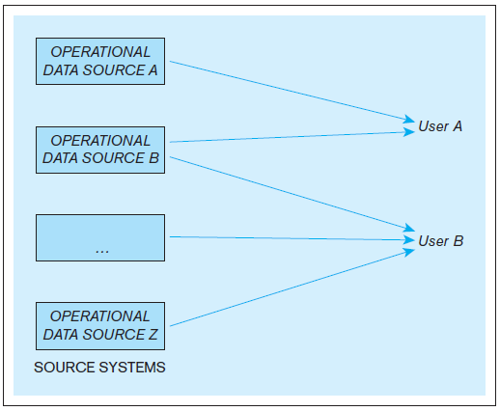
Data Warehouse Components, cont’d
Example: An organization where users use multiple operational data stores for daily operational purposes.
Database Systems
by Jukić, Vrbsky, & Nestorov
Pearson 2014
ISBN 978-0-13-257567-6

Slide 30
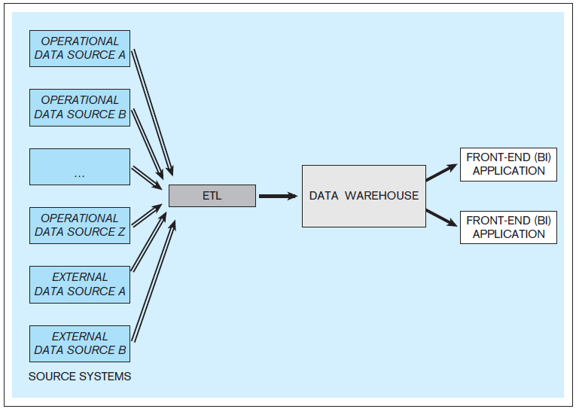
Data Warehouse Components, cont’d
Example: A data warehouse with multiple internal and external data sources.
Database Systems
by Jukić, Vrbsky, & Nestorov
Pearson 2014
ISBN 978-0-13-257567-6

Slide 31
Source Systems
Operational databases and other operational data repositories that provide analytically useful information for the data warehouse.
Therefore, each such operational data store
has two purposes:
  The original operational purpose.
  A source for the data warehouse.
Both internal and external data sources.
  Example external: third-party market research data

Slide 32
Extract-Transform-Load (ETL)
Extract analytically useful data from the operational data sources.
Transform the source data
  Make it conform to the structure of the
  subject-oriented data warehouse.
  Ensure data quality through processes such as
  data cleansing and scrubbing.
Load the transformed and quality-assured data into the target data warehouse.

Slide 33
Data Warehouse
Typically, an ETL operation occurs periodically for the target data warehouse.
  Common: Perform ETL nightly.
Active data warehouse: retrieval of data from the operational data sources is continuous.

Slide 34
Business Intelligence (BI)
A technology-driven process to analyze data and present actionable knowledge to help corporate executives, business managers and other end users make more informed business decisions.
Tools, applications and methodologies to collect data, prepare it for analysis, query the data, and create reports, dashboards, and other data visualizations.

Slide 35
Business Intelligence (BI) Applications
Front-end applications that allow users who are analysts to access the data and functions
of the data warehouse.

Slide 36
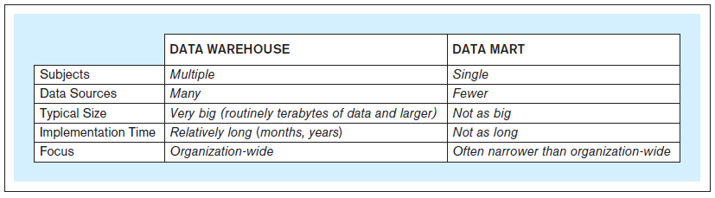
Data Marts
Same principles as a data warehouse.
More limited scope: one subject only.
Not necessarily an enterprise-wide focus.
Database Systems
by Jukić, Vrbsky, & Nestorov
Pearson 2014
ISBN 978-0-13-257567-6

Slide 37
Independent Data Marts
Standalone
Created the same way as a data warehouse.
Have their own data sources
and ETL infrastructure.

Slide 38
Dependent Data Marts
Does not have its own data sources.
Data comes from the data warehouse.
Provide users with a subset of the data.
  User get only the data they need or want
  or allowed to have access to.

Slide 39
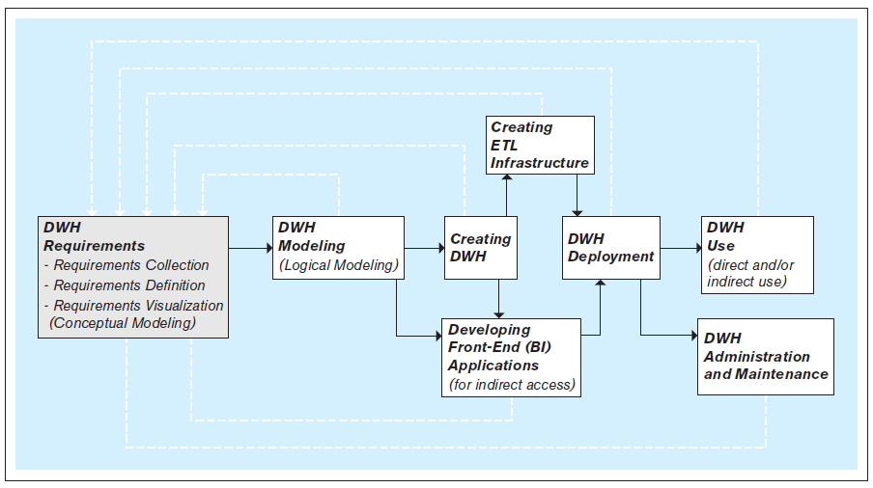
Steps to Create a Data Warehouse
An iterative process!
Database Systems
by Jukić, Vrbsky, & Nestorov
Pearson 2014
ISBN 978-0-13-257567-6

Slide 40
Create the ETL Infrastructure
The ETL infrastructure must reconcile all the differences between the multiple operational sources and the target data warehouse.
Decide how to bring in information without creating misleading duplicates.
Creating the ETL infrastructure is often
the most time- and resource-consuming part
of developing a data warehouse.

Slide 41
Develop the BI Applications
Front-end BI applications enable users to analyze the data in the data warehouse.
Typical business intelligence functions:
  Query the data.
  Perform ad hoc analyses on the fly.
  Generate reports and graphs.
  Control a dashboard, often in real time.
  Create data visualizations.
  Advanced: data mining.

Slide 42
Develop the BI Applications, cont’d
The primary goal of BI is to provide useful
business insights and actionable knowledge
for the decision makers.

Slide 43
Dimensional Modeling
A type of data model used for data warehouses and data marts.
  Subject-oriented analytical databases
The dimensional model is commonly based on the relational data model.
Two types of tables:
  dimension tables
  fact tables

Slide 44
Star Schema
A dimensional relational schema contains dimension tables and fact tables.
  Often called a star schema.
Each dimension table contains
  a primary key
  attributes that are used for the analysis
  of the measures in the fact tables
Each fact table contains
  fact-measure attributes
  foreign keys to the dimension tables

Slide 45
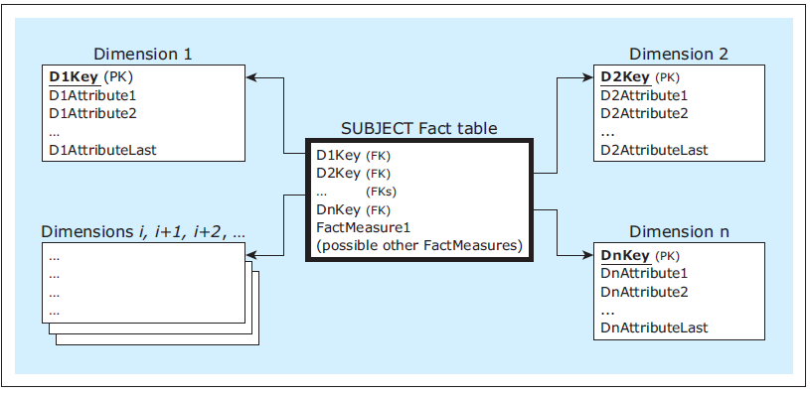
Star Schema, cont’d
A dimensional model
Database Systems
by Jukić, Vrbsky, & Nestorov
Pearson 2014
ISBN 978-0-13-257567-6

Slide 46
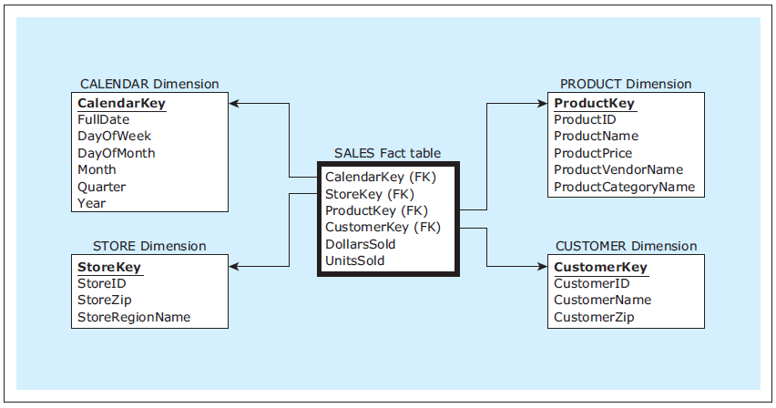
Dimensional Model Example
Nearly every star schema includes
a date- or time-related dimension.
Dimensional
model
Database Systems
by Jukić, Vrbsky, & Nestorov
Pearson 2014
ISBN 978-0-13-257567-6

