Slide 1


DATA 225
Database Systems for Analytics
Checkpoint 1 Solutions
Department of Applied Data Science
San Jose State University
Fall 2023
Instructor: Ron Mak
www.cs.sjsu.edu/~mak

Slide 2
Database Requirements
Design a database to maintain data about popular singer Tayloe Smith’s concerts.
Information that you need to include (be sure you’ll be able to do the query of Question #3):
  The title of each song that she wrote, and year she wrote it.
  The names of her concert venues (such as arena names) and their locations (city and state). A venue can hold multiple concerts on different dates.
  The venue and date (year, month, and day) of each concert.
  The title of each song and its starting time (hour and minute) that Tayloe performed (sang) during a concert. She might perform a song more than once during a concert.
  The name of each of her fans (“smithees”) who attended her concerts and then posted reviews of her performances, and the fan’s medium (an integer code representing social media, web, newspaper, etc.).
  The fan’s rating (an integer value) of Tayloe’s performance of a song during a concert. A fan can rate multiple performances of the same song during the same or different concerts. A performance can have any number of ratings.

Slide 3
Question #1
Use ERDPlus to create an ER diagram for your Tayloe Smith database.
  Give reasonable names to the entities, attributes, and relationships.
  Include the cardinalities of the relationships.
  Use ERDPlus’s features to indicate any other necessary characteristics of your diagram.
35 points

Slide 4
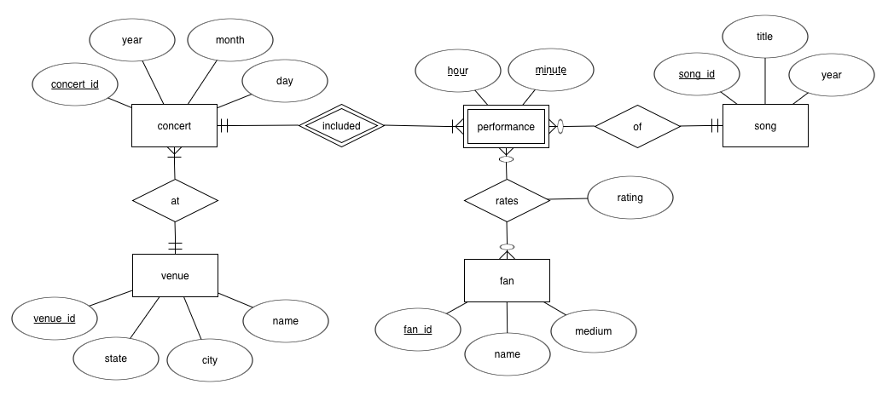
Question #1 Solution
Each concert includes multiple performances.
Each performance is included by one venue.
This is a one-to-many relationship.
Each performance is the singing of a song.
A song can be performed zero or more times.
This is a one-to-many relationship.
A venue can hold multiple concerts.
A concert is held at one venue.
This a one-to-many relationship.
Since performance is a weak entity, besides its partial keys hour and minute, it needs the concert_id of its owner entity concert to uniquely identify each of its records.
An alternative to making performance a weak entity is to give the entity its own regular unique attribute.
A fan at a concert can review zero or more performances of songs.
A performance can be reviewed by zero or more fans.
This is a many-to-many relationship.

Slide 5
Question #2
Use ERDPlus to automatically map your ER diagram to a relational schema. Edit the results of the mapping, as necessary. Move the components to minimize crossing lines.
You do not need to populate the tables.
25 points

Slide 6
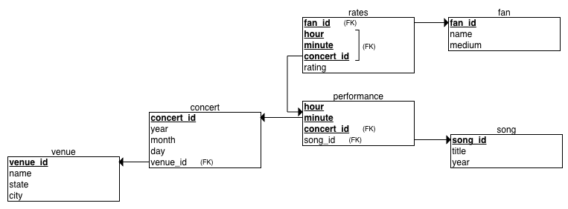
Question #2 Solution
The automatic mapping generated rates as the linking table for the many-to-many relationship between the fan and performance entities.
Table rates has a composite primary key consisting of the foreign keys fan_id, concert_id, hour, and minute.

Slide 7
Question #3
Write an SQL query to answer: Which fans attended Tayloe’s concerts at Levi’s Stadium and reviewed her performances? For each fan who posted reviews, display the fan’s id and name, which concerts the fan attended, the song titles and starting times of the performances the fan reviewed, and the rating the fan gave each performance. Sort the results first by the fan’s name and then by the concert.
SELECT fan.fan_id, fan.name, concert.concert_id, song.title,
performance.hour, performance.minute, rates.rating
FROM fan, venue, concert, performance, song, rates
WHERE venue.name = "Levi's Stadium"
AND venue.venue_id = concert.venue_id
AND concert.concert_id = rates.concert_id
AND concert.concert_id = performance.concert_id
AND performance.hour = rates.hour
AND performance.minute = rates.minute
AND rates.fan_id = fan.fan_id
AND performance.song_id = song.song_id
ORDER BY fan.name, concert.concert_id
30 points

Slide 8
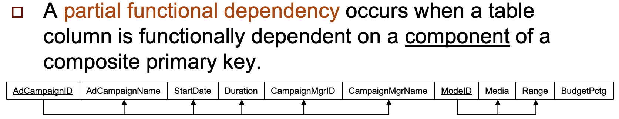
Question #4
In no more than 50 words, explain what you need do to resolve any partial functional dependencies when you normalize a relational table with a single-column primary key.
You need to do nothing. Partial functional dependencies can only occur if a relational table has a composite primary key.
10 points
Sept.18
Slide #36

