Slide 1


DATA 220
Mathematical Methods for Data Analysis
May 13 Class Meeting
Department of Applied Data Science
San Jose State University
Spring 2021
Instructor: Ron Mak
www.cs.sjsu.edu/~mak

Slide 2
Assignment #12 Solutions

Slide 3

Eigenvalues and Eigenvectors
The eigenvalue problem is one of the most important in linear algebra.
Given a square n-by-n matrix A, can we find
nonzero vectors x (eigenvectors) such that each
x is a scalar multiple of an λ (eigenvalue) of A?
eigenvalue
$$Ax=λx$$
eigenvector

Slide 4
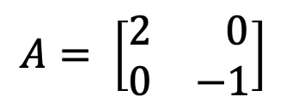
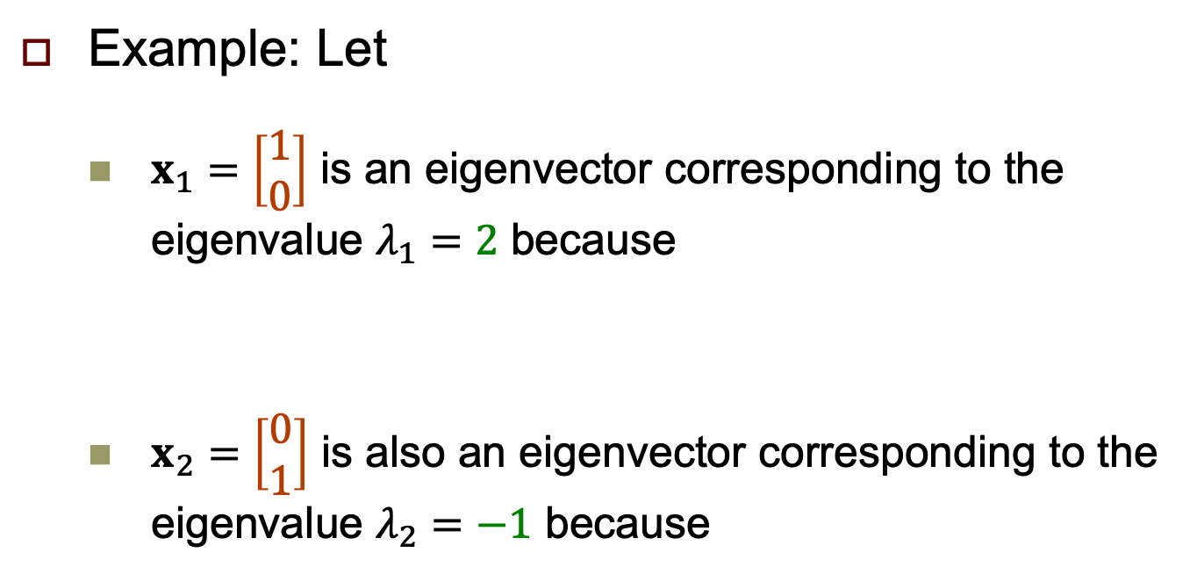
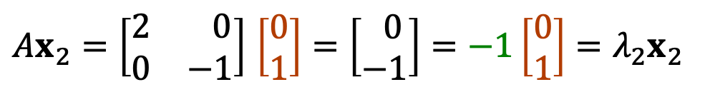
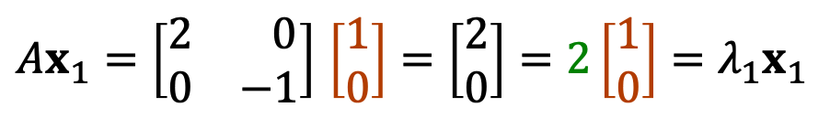
Eigenvalues and Eigenvectors, cont’d
$$A= \left[\begin{matrix}2 & 0 \\ 0 & −1\end{matrix}\right]$$
Example: Let
  $x_{1}=\left[\begin{matrix}1 \\ 0\end{matrix}\right]$ is an eigenvector corresponding to the eigenvalue $λ_{1}=2$ because
  $x_{2}=\left[\begin{matrix}0 \\ 1\end{matrix}\right]$ is also an eigenvector corresponding to the eigenvalue $λ_{2}=−1$ because
$Ax_{1}=\left[\begin{matrix}2 & 0 \\ 0 & −1\end{matrix}\right]$ $\left[\begin{matrix}1 \\ 0\end{matrix}\right]=\left[\begin{matrix}2 \\ 0\end{matrix}\right]=2\left[\begin{matrix}1 \\ 0\end{matrix}\right]=λ_{1}x_{1}$
$Ax_{2}=\left[\begin{matrix}2 & 0 \\ 0 & −1\end{matrix}\right]$ $\left[\begin{matrix}0 \\ 1\end{matrix}\right]=\left[\begin{matrix} 0 \\ −1\end{matrix}\right]=−1\left[\begin{aligned}0 \\ 1\end{aligned}\right]=λ_{2}x_{2}$

Slide 5
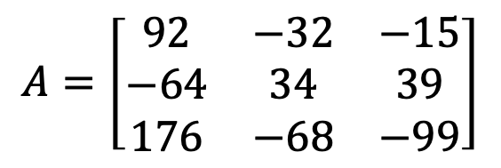

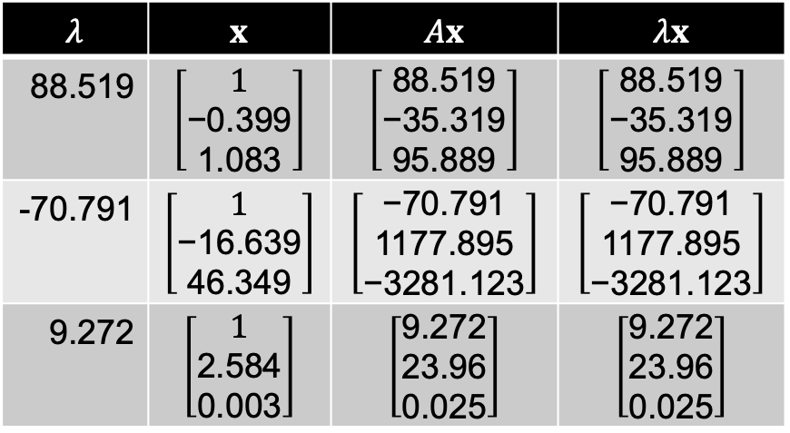
Eigenvalues and Eigenvectors, cont’d
$$A=\left[\begin{matrix}92 & −32 & −15 \\ −64 & 34 & 39 \\ 176 & −68 & −99\end{matrix}\right]$$
Example: Let
  Matrix A has several eigenvectors x
  and corresponding eigenvalues $λ$:
$$λ$$ | $$x$$ | $$Ax$$ | $$λx$$
88.519 | $$\left[\begin{aligned}1 \\ \text{−0.399} \\ \text{1.083}\end{aligned}\right]$$ | $$\left[\begin{aligned}\text{88.519} \\ \text{−35.319} \\ \text{95.889}\end{aligned}\right]$$ | $$\left[\begin{aligned}\text{88.519} \\ \text{−35.319} \\ \text{95.889}\end{aligned}\right]$$
-70.791 | $$\left[\begin{aligned}1 \\ \text{−16.639} \\ \text{46.349}\end{aligned}\right]$$ | $$\left[\begin{aligned}\text{−70.791} \\ \text{1177.895} \\ \text{−3281.123}\end{aligned}\right]$$ | $$\left[\begin{aligned}\text{−70.791} \\ \text{1177.895} \\ \text{−3281.123}\end{aligned}\right]$$
9.272 | $$\left[\begin{aligned}1 \\ \text{2.584} \\ \text{0.003}\end{aligned}\right]$$ | $$\left[\begin{aligned}\text{9.272} \\ \text{23.96} \\ \text{0.025}\end{aligned}\right]$$ | $$\left[\begin{aligned}\text{9.272} \\ \text{23.96} \\ \text{0.025}\end{aligned}\right]$$

Slide 6

Eigenvalues and Eigenvectors, cont’d
A Markov steady state is an eigenvector with a corresponding eigenvalue: $P\overline{X}=\overline{X}$
  The eigenvalue $λ$ = 1
  The eigenvector is $\overline{X}$.

Slide 7
Uses of Eigenvalues and Eigenvectors
Eigenvalues and eigenvectors are used to “decompose” a matrix into its constituent parts in order to simplify complex operations.
  “eigendecomposition”
A major example of its use is in performing principal component analysis (PCA) .
  We used PCA to reduce the four features of the
  Iris dataset down to two features so we could draw
  a 2-D graph that showed the clusters.

Slide 8
Uses of Eigenvalues and Eigenvectors, cont’d
Applications in machine learning:
  https://machinelearningmastery.com/introduction-to-eigendecomposition-eigenvalues-and-eigenvectors/
  https://medium.com/@jonathan_hui/machine-learning-linear-algebra-eigenvalue-and-eigenvector-f8d0493564c9
  https://towardsdatascience.com/the-essence-of-eigenvalues-and-eigenvectors-in-machine-learning-f28c4727f56f
Other applications:
  https://www.cpp.edu/~manasab/eigenvalue.pdf

Slide 9
Geometric Interpretations
VectorPlots.ipynb
%matplotlib inline
import matplotlib.pyplot as plt
def plot_vectors(vecs, xlim, ylim):
"""
Plot set of vectors.
@parm vecs [array-like] Coordinates of the vectors to plot.
Each vector is in an array. For instance:
[[1, 3], [2, 2]] can be used to plot 2 vectors.
@return matplotlib.figure.Figure of the vectors
"""
plt.figure()
plt.axvline(x=0, color='#A9A9A9', zorder=0)
plt.axhline(y=0, color='#A9A9A9', zorder=0)
plt.xlim(xlim[0], xlim[1])
plt.ylim(ylim[0], ylim[1])
vector_colors = ['#1190FF', '#FF9A13', '#000000'] # blue, orange, black
for i in range(len(vecs)):
x = np.concatenate([[0,0], vecs[i].flatten()])
plt.quiver([x[0]], [x[1]], [x[2]], [x[3]],
angles='xy', scale_units='xy', scale=1,
color=vector_colors[i])

Slide 10
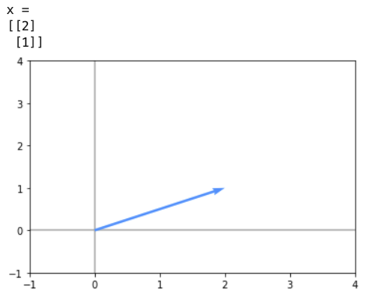
Geometric Interpretations, cont’d
x = np.array([[2],
[1]])
print('x =')
print(x)
plot_vectors([x],
xlim=(-1, 4), ylim=(-1, 4))
x

Slide 11
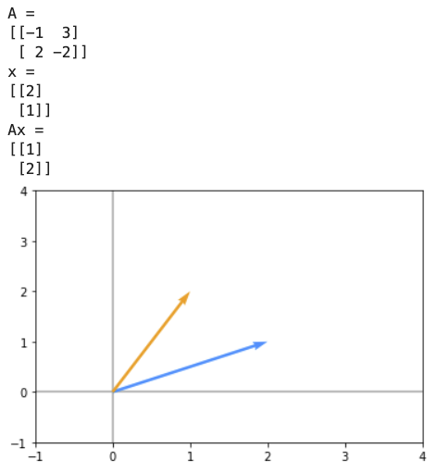
Geometric Interpretations, cont’d
A = np.array([[-1, 3],
[ 2, -2]])
x = np.array([[2],
[1]])
Ax = A@x
print('A =')
print(A)
print('x =')
print(x)
print('Ax =')
print(Ax)
plot_vectors([x, Ax],
xlim=(-1, 4), ylim=(-1, 4))
Ax
x
Matrix A transforms vector x
into vector Ax. This is called a
linear transformation or a
linear mapping defined by Ax.

Slide 12
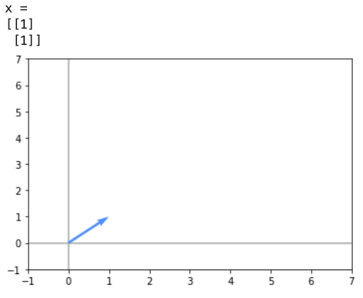
Geometric Interpretations, cont’d
x = np.array([[1],
[1]])
print('x =')
print(x)
plot_vectors([x],
xlim=(-1, 7),
ylim=(-1, 7))
x

Slide 13
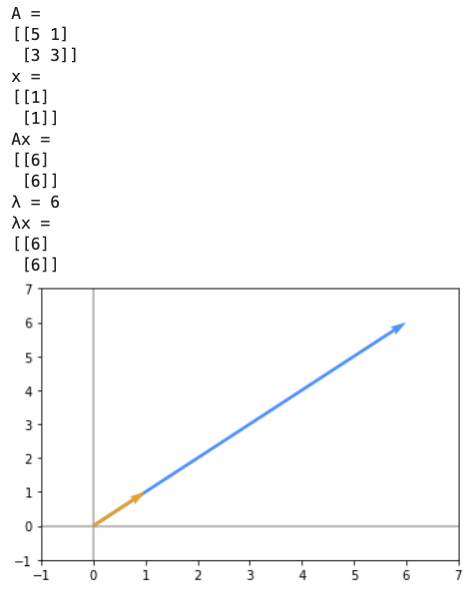



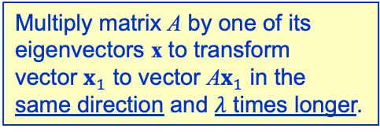
Geometric Interpretations, cont’d
A = np.array([[5, 1],
[3, 3]])
x = np.array([[1],
[1]])
λ = 6
Ax = A@x
λx = λ*x
print('A =')
print(A)
print('x =')
print(x)
print('Ax =')
print(A@x)
print(f'λ = {λ}')
print('λx =')
print(λx)
plot_vectors([Ax, x],
xlim=(-1, 7),
ylim=(-1, 7))
$$A=\left[\begin{matrix}5 & 1 \\ 3 & 3\end{matrix}\right]$$
Eigenvalue $λ_{1}=6$
Eigenvector $x_{1}= \left[\begin{matrix}1 \\ 1\end{matrix}\right]$
Multiply matrix A by one of its
eigenvectors x to transform
vector $x_{1}$ to vector A$x_{1}$ in the
same direction and $λ$ times longer.
A$x_{1}$
$$x_{1}$$

Slide 14
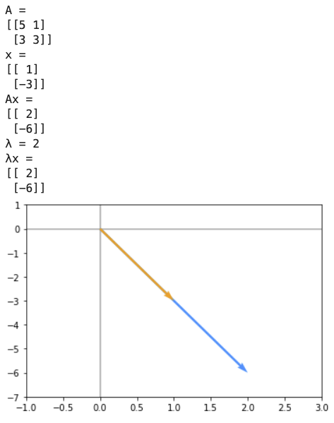



Geometric Interpretations, cont’d
A = np.array([[5, 1],
[3, 3]])
x = np.array([[ 1],
[-3]])
λ = 2
Ax = A@x
λx = λ*x
print('A =')
print(A)
print('x =')
print(x)
print('Ax =')
print(A@x)
print(f'λ = {λ}')
print('λx =')
print(λx)
plot_vectors([Ax, x],
xlim=(-1, 3),
ylim=(-7, 1))))
$$A=\left[\begin{matrix}5 & 1 \\ 3 & 3\end{matrix}\right]$$
Eigenvalue $λ_{2}=2$
Eigenvector $x_{2}= \left[\begin{matrix} 1 \\ −3\end{matrix}\right]$
$$x_{2}$$
A$x_{2}$

Slide 15
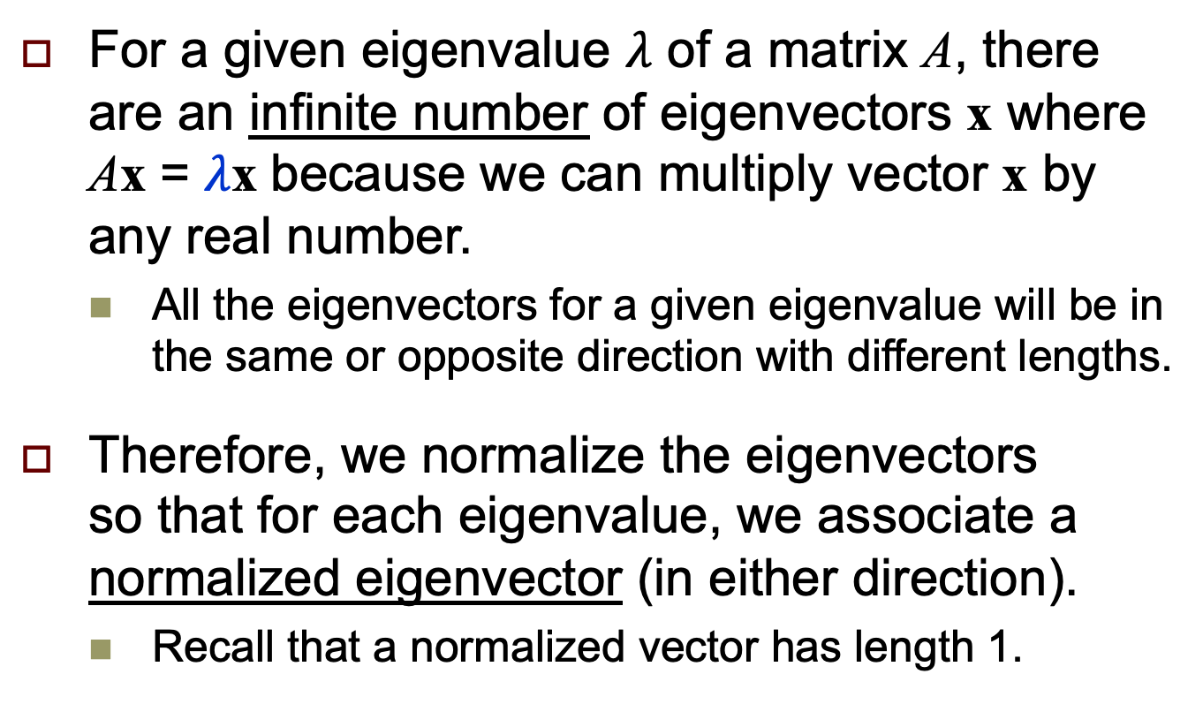
Normalized Eigenvectors
For a given eigenvalue $λ$ of a matrix A, there are an infinite number of eigenvectors x where Ax = $λ$x because we can multiply vector x by any real number.
  All the eigenvectors for a given eigenvalue will be in the same or opposite direction with different lengths.
Therefore, we normalize the eigenvectors
so that for each eigenvalue, we associate a normalized eigenvector (in either direction).
  Recall that a normalized vector has length 1.

Slide 16
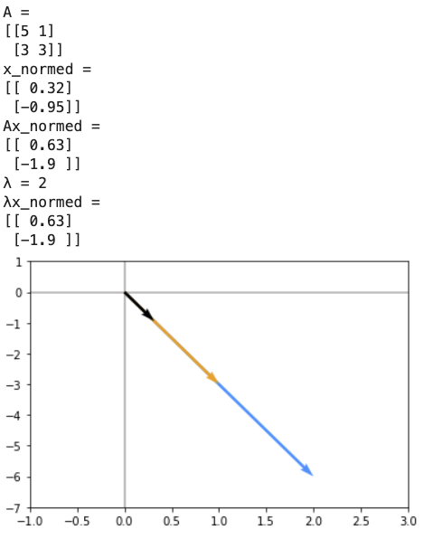
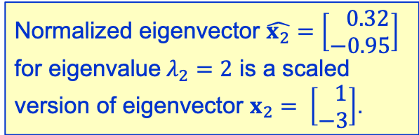

Geometric Interpretations, cont’d
%precision 2
from numpy.linalg import norm
A = np.array([[5, 1],
[3, 3]])
x = np.array([[ 1],
[-3]])
x_normed = x/norm(x)
λ = 2
Ax_normed = A@x_normed
λx_normed = λ*x_normed
print('A =')
print(A)
print('x_normed =')
print(x_normed)
print('Ax_normed =')
print(A@x_normed)
print(f'λ = {λ}')
print('λx_normed =')
print(λx_normed)
plot_vectors([Ax, x, x_normed],
xlim=(-1, 3),
ylim=(-7, 1))
Normalized eigenvector $\hat{x_{2}}=\left[\begin{matrix} 0.32 \\ −0.95\end{matrix}\right]$ for eigenvalue$λ_{2}=2$ is a scaled version of eigenvector $x_{2}= \left[\begin{matrix} 1 \\ −3\end{matrix}\right]$.
$$\hat{x_{2}}$$
x₂
Ax₂

Slide 17
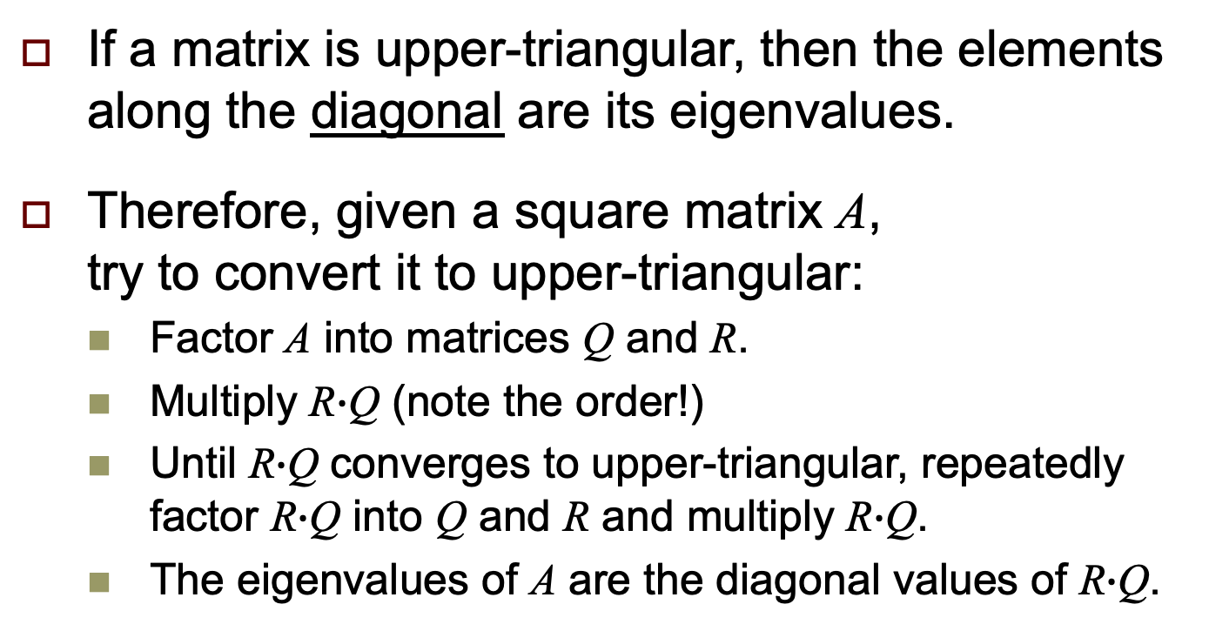
Compute Eigenvalues
If a matrix is upper-triangular, then the elements along the diagonal are its eigenvalues.
Therefore, given a square matrix A,
try to convert it to upper-triangular:
  Factor A into matrices Q and R.
  Multiply R$∙$Q (note the order!)
  Until R$∙$Q converges to upper-triangular, repeatedly factor R$∙$Q into Q and R and multiply R$∙$Q.
  The eigenvalues of A are the diagonal values of R$∙$Q.
This may require many factorings and matrix multiplications.
Rounding errors will increase with the number of iterations.

Slide 18
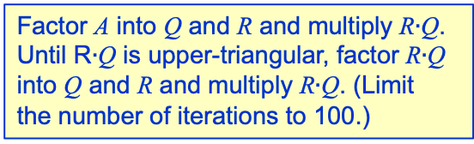
Compute Eigenvalues, cont’d
TestEigenFactorization1.ipynb
def is_upper_triangular(RQ):
for i in range(1, len(A)):
for j in range(i):
if abs(RQ[i][j]) > 0.0001:
return False
return True
Check whether the values under
the diagonal are zero (within the
given tolerance).
def factorize(A):
RQ = A
for n in range(101):
if is_upper_triangular(RQ):
break
Q,R = np.linalg.qr(RQ)
RQ = R@Q
print(f'After iteration {n+1}:')
print(RQ)
print()
return n, RQ
Factor A into Q and R and multiply R$∙$Q.
Until R$∙$Q is upper-triangular, factor R$∙$Q
into Q and R and multiply R$∙$Q. (Limit
the number of iterations to 100.)

Slide 19
Compute Eigenvalues, cont’d
def find_eigenvalues(A):
size = len(A)
eigenvalues = np.zeros(size)
n, RQ = factorize(A)
for i in range(size):
eigenvalues[i] = RQ[i][i]
return n, RQ, eigenvalues
The eigenvalues of A are the
diagonal elements of matrix RQ.

Slide 20
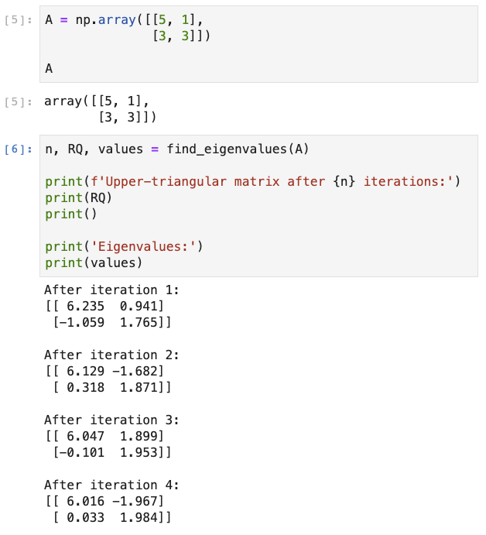
Compute Eigenvalues, cont’d

Slide 21
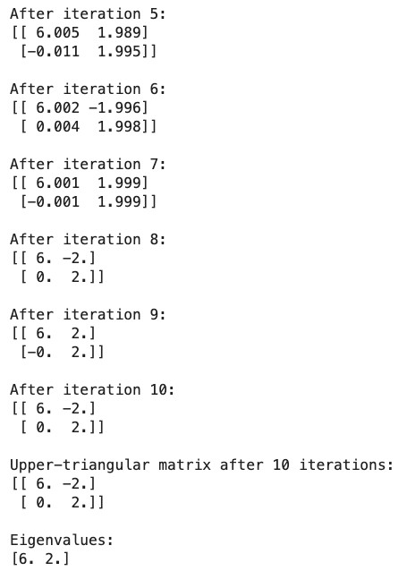
Compute Eigenvalues, cont’d

Slide 22

Compute Eigenvectors from Eigenvalues
Given the eigenvalue $λ$ of a matrix A, we can find the corresponding eigenvector x by solving a set of simultaneous linear equations since we know that Ax = $λ$x.

Slide 23
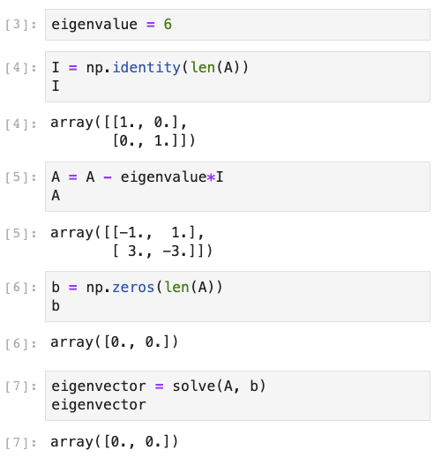


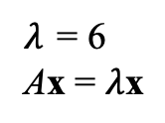

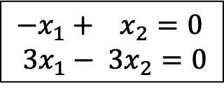
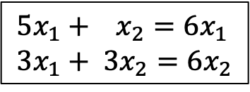
Compute Eigenvectors, cont’d
Example:
A = np.array([[5, 1],
[3, 3]])
$λ$ = 6
Ax = $λ$x
$$x=\left[\begin{aligned}x_{1} \\ x_{2}\end{aligned}\right]$$
$$5x_{1}+ x_{2}=6x_{1} \\ 3x_{1}+ {3x}_{2}=6x_{2}$$
$$Ax=6x$$
$$−x_{1}+ x_{2}=0 \\ 3x_{1}− {3x}_{2}=0$$
$$Ax−6Ix=0$$
TestEigenFactorization2.ipynb

Slide 24
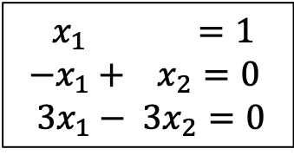
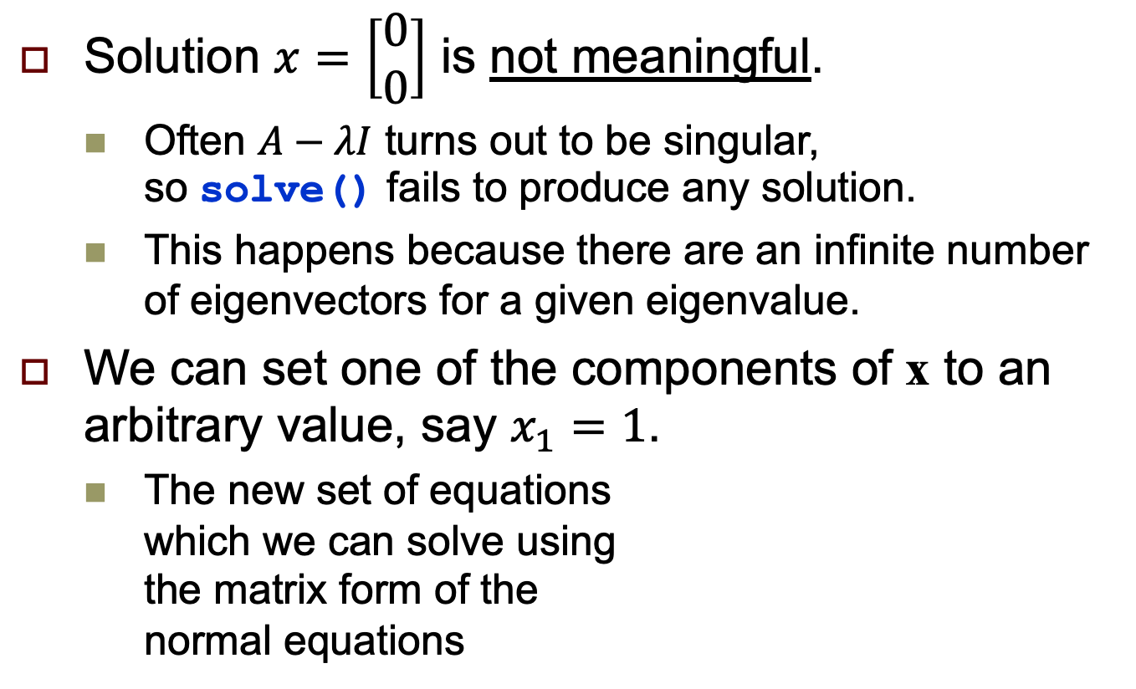

Compute Eigenvectors, cont’d
Solution $x=\left[\begin{aligned}0 \\ 0\end{aligned}\right]$ is not meaningful.
  Often $A−λI$ turns out to be singular,
  so solve() fails to produce any solution.
  This happens because there are an infinite number of eigenvectors for a given eigenvalue.
We can set one of the components of x to an arbitrary value, say $x_{1}=1$.
  The new set of equations
  which we can solve using
  the matrix form of the
  normal equations
$${ x}_{1} =1 \\ −x_{1}+ x_{2}=0 \\ 3x_{1}− {3x}_{2}=0$$
$$x={\left(A^{T}A\right)}^{−1}A^{T}b$$

Slide 25
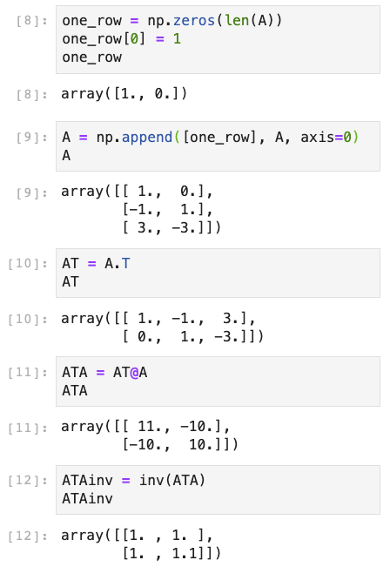
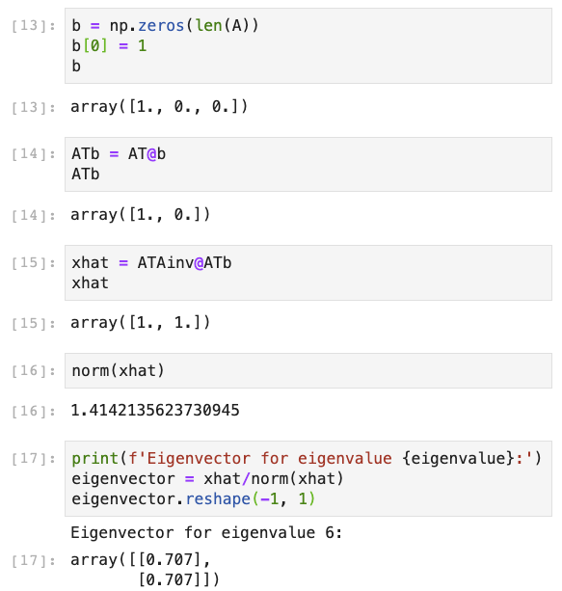
Compute Eigenvectors, cont’d

Slide 26
A Python Eigen Module
We can create a Python module.
Given a square matrix A:
  Convert A to upper-triangular.
  The eigenvalues of A are on the diagonal.
  Use the matrix form of the normal equations
  to solve for the eigenvector corresponding
  to each eigenvalue.
See:
EigenFactorization.py
TestEigenFactorization3.ipynb

Slide 27
The Python eig() Function
The eig() function in module numpy.linalg computes eigenvalues and eigenvectors.
TestEigenFactorization3.ipynb
import numpy as np
from numpy.linalg import eig
def test_eig(A):
values, vectors = eig(A)
print('Eigenvalues:')
print(values)
print()
print('Eigenvectors:')
print(vectors)
verify(values, vectors)

Slide 28
The Python eig() Function, cont’d
from EigenFactorization import find_eigenvalues, find_eigenvectors
def test_factorization(A, x_index=math.nan, tolerance=0.0001):
n, RQ, values = find_eigenvalues(A, tolerance)
print(f'Upper-triangular matrix after {n} iterations:')
print(RQ)
print()
print('Eigenvalues:')
print(values)
print()
print('Eigenvectors:')
vectors = find_eigenvectors(A, values, x_index)
print(vectors)
verify(values, vectors)

Slide 29
The Python eig() Function, cont’d
def verify(values, vectors):
for i in range(len(values)):
value = values[i]
vector = vectors[:, i]
print()
print(f'norm({vector}) = {norm(vector):.3f}')
print(f'Av = {A@vector}')
print(f'𝜆v = {value*vector}')

Slide 30
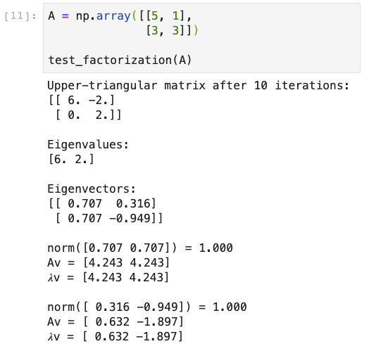
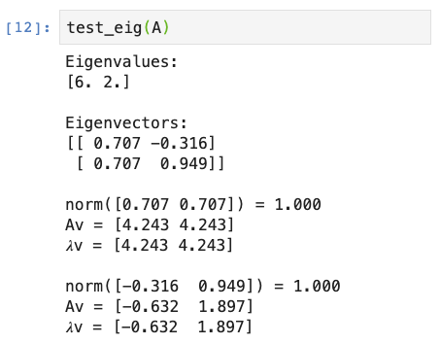
The Python eig() Function, cont’d
The eigenvectors
are the columns.
The eigenvectors
are the columns.

Slide 31
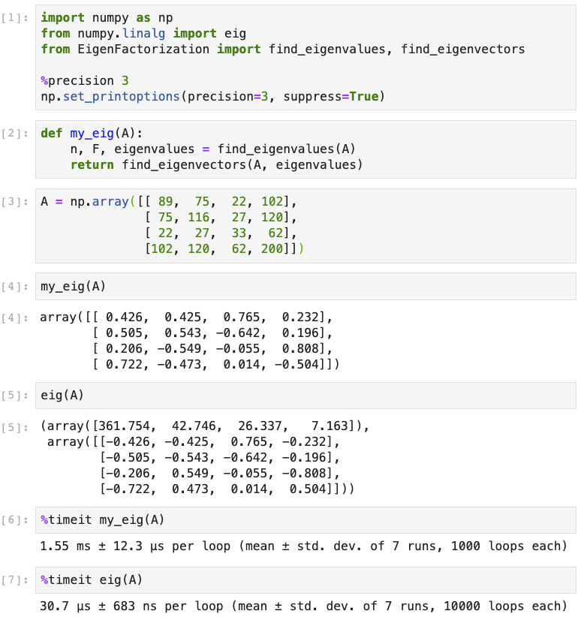
The Python eig() Function, cont’d
50 times faster

Slide 32
Matrix Powers
Repeated matrix multiplication to compute a matrix such as A^{n} is both time-consuming and prone to roundoff errors.
We can use eigenvectors to solve problems such as A^{n} x = b.
  Example: Recall the Markov chain problem:
Switch probability matrix:
Proportion of customers
currently in each store:
To store:
A
B
None
P = np.array([[0.70, 0.15, 0.15],
[0.20, 0.80, 0.15],
[0.10, 0.05, 0.70]])
X = np.array([[0.15],
[0.20],
[0.65]])
A
B
None
From store: A B None

Slide 33
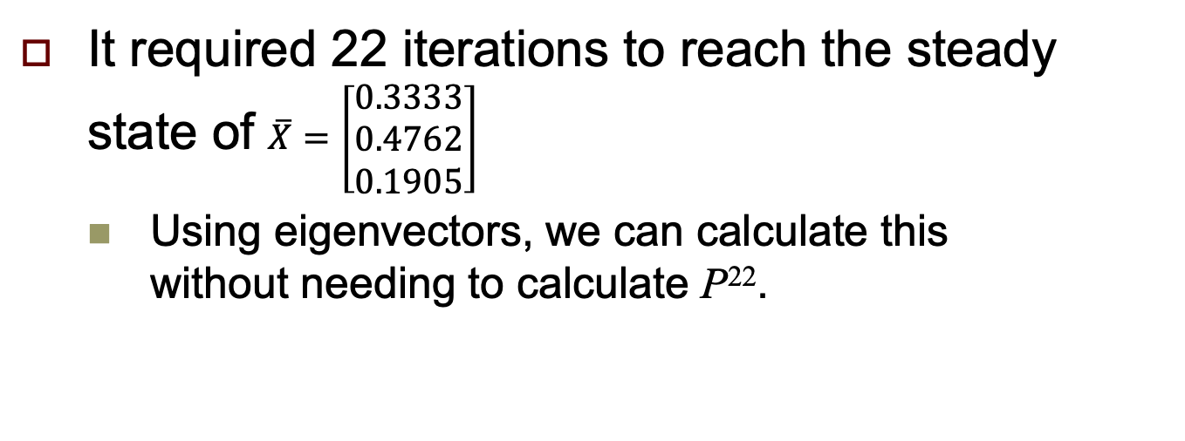
Matrix Powers, cont’d
Switch probability matrix:
Proportion of customers
currently in each store:
To store:
A
B
None
P = np.array([[0.70, 0.15, 0.15],
[0.20, 0.80, 0.15],
[0.10, 0.05, 0.70]])
X = np.array([[0.15],
[0.20],
[0.65]])
A
B
None
From store: A B None
It required 22 iterations to reach the steady state of $\overline{X}=\left[\begin{aligned}\text{0.3333} \\ 0.4762 \\ 0.1905\end{aligned}\right]$
  Using eigenvectors, we can calculate this
  without needing to calculate P²².

Slide 34
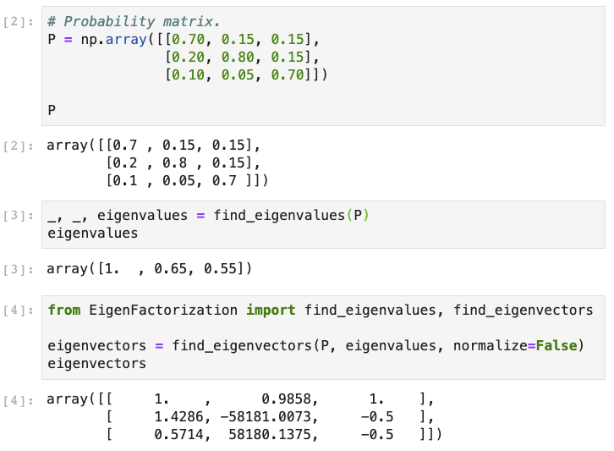
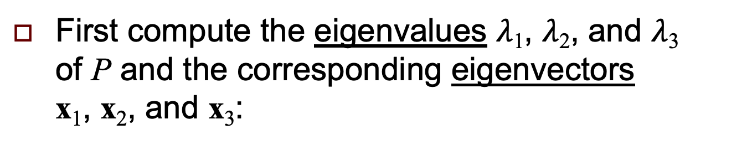
Matrix Powers, cont’d
First compute the eigenvalues $λ$₁, $λ$₂, and $λ$₃
of P and the corresponding eigenvectors
x₁, x₂, and x₃:

Slide 35
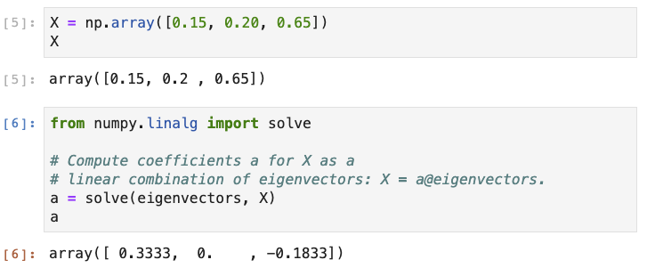
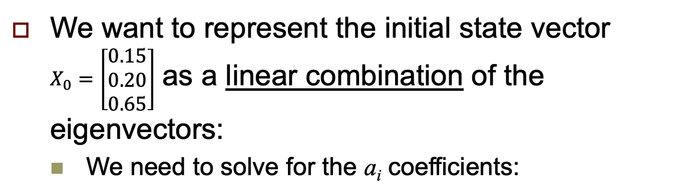

Matrix Powers, cont’d
We want to represent the initial state vector
$X_{0}=\left[\begin{aligned}0.15 \\ 0.20 \\ 0.65\end{aligned}\right]$ as a linear combination of the eigenvectors:
  We need to solve for the a_{i} coefficients:
$X_{0}=a_{1}x_{1}+a_{2}x_{2}+$ $a_{3}x_{3}$

Slide 36
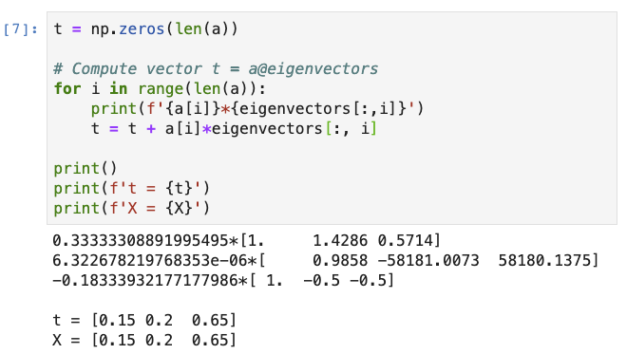
Matrix Powers, cont’d
Check:

Slide 37
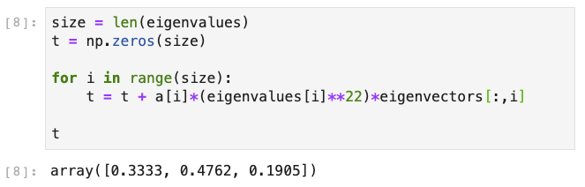
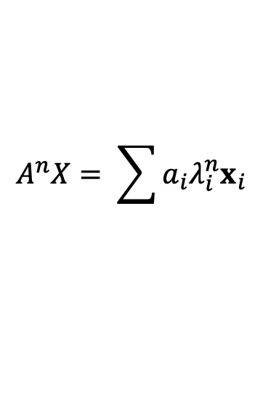
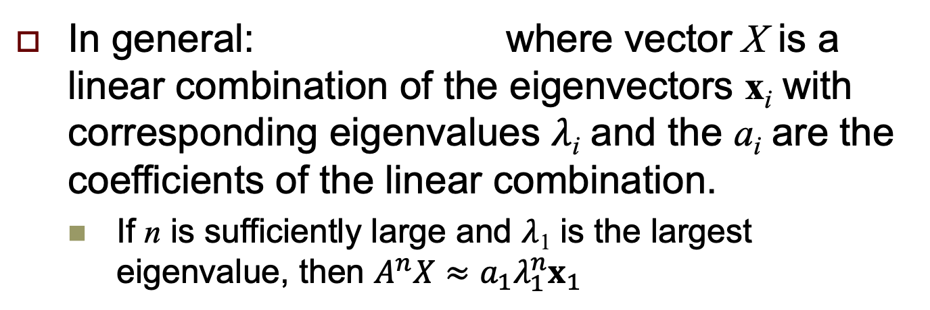
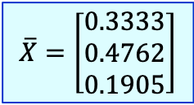
Matrix Powers, cont’d
$${\overline{X}=P}^{22}X_{0}=a_{1}\left(λ_{1}^{22}x_{1}\right)+ a_{2}\left(λ_{2}^{22}x_{2}\right)+ a_{3}\left(λ_{3}^{22}x_{3}\right)$$
$$\overline{X}=\left[\begin{aligned}\text{0.3333} \\ 0.4762 \\ 0.1905\end{aligned}\right]$$
$$A^{n}X= \sum{a_{i}{λ_{i}^{n}x}_{i}}$$
In general: where vector X is a linear combination of the eigenvectors x_{i} with corresponding eigenvalues $λ$_{i} and the a_{i} are the coefficients of the linear combination.
  If n is sufficiently large and $λ$₁ is the largest eigenvalue, then $A^{n}X≈a_{1}λ_{1}^{n}x_{1}$

Slide 38
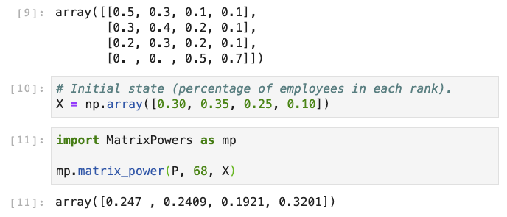
Matrix Powers, cont’d
From Assignment #12:

Slide 39
Matrix Powers, cont’d
MatrixPowers.ipynb
import numpy as np
from numpy.linalg import eig, solve
def matrix_power(A, n, x):
eigenvalues, eigenvectors = eig(A)
# Vector x will be a linear combination of
# the eigenvectors: x = sum(a[i]@eigenvectors[i])
a = solve(eigenvectors, x)
size = len(eigenvalues)
y = np.zeros(size)
# Compute vector y = (A**n)@x
for i in range(size):
y = y + a[i]*(eigenvalues[i]**n)*eigenvectors[:, i]
return y

Slide 40
Break
7:35

Slide 41
Optimization
The three pillars that support data science:
Data science
Statistics
Linear
algebra
Optimization

Slide 42
Optimization, cont’d
The components of an optimization problem:
  Objective function: f (x, y) with one or more variables
  Decision variables: x, y
  Constraints: a ≤ x ≤ b and c ≤ y ≤ d
  (there may be no constraints)
Problem: Find values of the decision variables that maximize (or minimize) the value of the objective function.
  Convert a maximization problem into a minimization problem (or vice versa) by using the negative of the objective function: -f (x, y)

Slide 43
Machine Learning Optimization
In ML, we want to create a model that performs well and gives accurate predictions of a parameter for a given dataset.
The cost function is the discrepancy between the true value of an estimated parameter and what the model predicted.
  We want to minimize the cost function.
  The decision variables are the hyperparameters
  of the model.
  Adjust the hyperparameters to minimize the function.

Slide 44
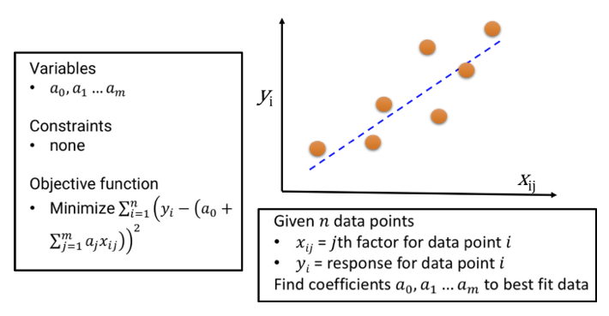
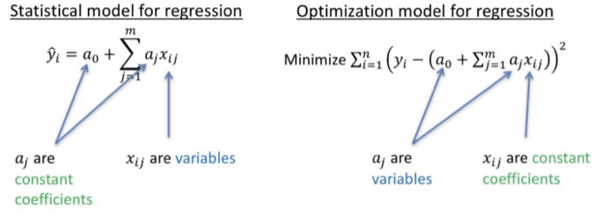
Example: Linear Regression
https://towardsdatascience.com/a-quick-overview-of-optimization-models-for-machine-learning-and-statistics-38e3a7d13138

Slide 45
The Nelder-Mead Algorithm
To minimize function f(x), start with a point x₀.
Move a certain distance (learning rate) to point x₁.
  If f(x₁) < f(x₀), you’re going in the right direction and continue in the same direction to point x₂, etc.
  You can increase the distance you go at each step.
If you overshoot the minimum value of f, you’ve gone too far, so change direction and go a shorter distance to get to the next point.
  Continue with smaller and smaller learning rates with each change in direction until you converge onto the minimum value.

Slide 46
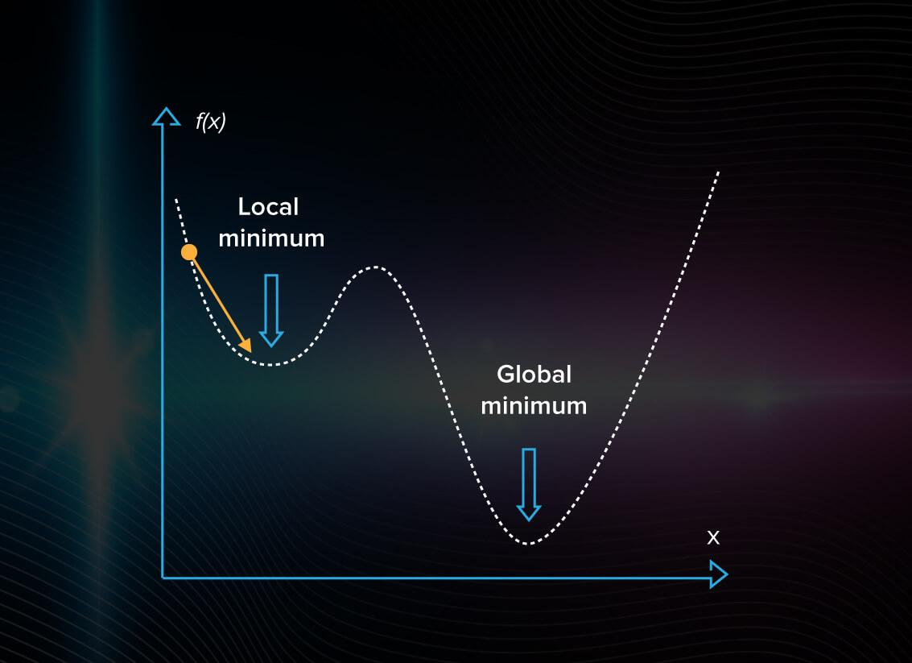
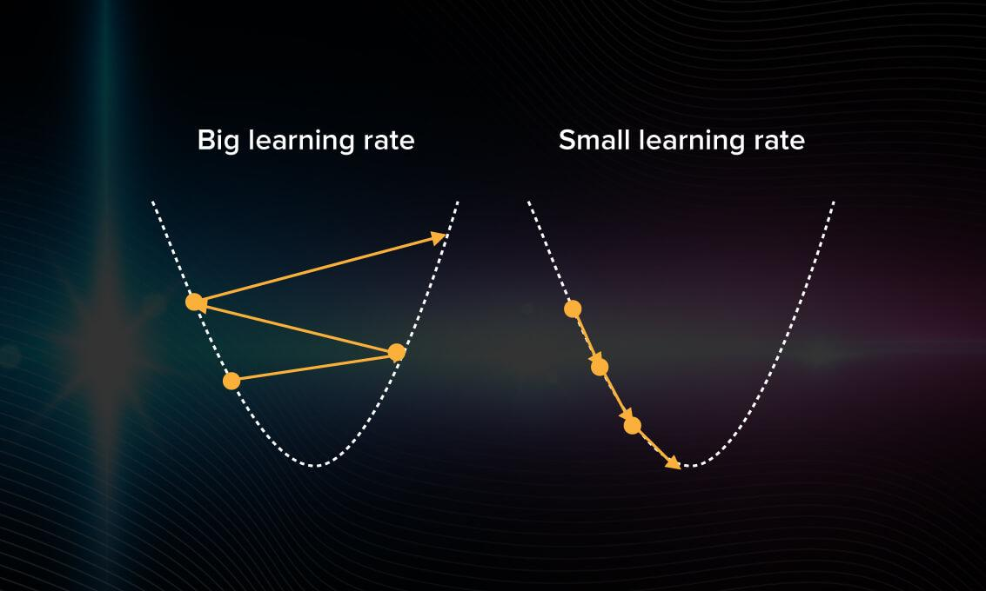
The Nelder-Mead Algorithm, cont’d
Problem: The function
may have several
local minima, and the
algorithm fails to find
the global minimum.
https://serokell.io/blog/ml-optimization

Slide 47
The Nelder-Mead Algorithm, cont’d
Animated interactive examples
with f(x) and f(x, y): https://www.benfrederickson.com/numerical-optimization/

Slide 48
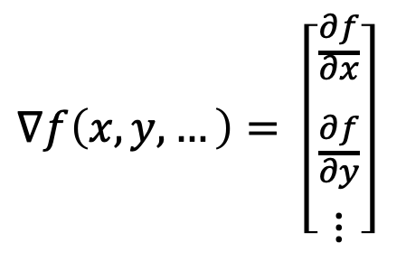
Gradients
A popular class of optimization algorithms for ML uses gradients.
  Gradient descent for minimization problems.
For math majors: The gradient of a
scalar-valued multivariable function
f (x,y,…), denoted by ∇f, is a vector
of its partial derivatives:
$∇f\left(x,y, …\right)= \left[\begin{aligned}\frac{∂f}{\begin{aligned}∂x \\ \\ \end{aligned}} \\ \frac{∂f}{\begin{aligned}∂y \\ \end{aligned}} \\ ⋮\end{aligned}\right]$
The gradient symbol ∇
is called “del” or “nabla”.

Slide 49
Gradients, cont’d
Intuitively, at a given point (x₀, y₀, ...),
∇f (x₀, y₀, ...) tells you which direction to go
to increase (for a maximization problem)
or decrease (for a minimization problem)
the value of f most rapidly.
Go in that direction a certain distance to reach point (x₁, y₁, ...), and then calculate ∇f (x₁, y₁, ...) to determine which direction to go next to reach the next point.
  If you went too far, you must change direction and possibly decrease the learning rate each time.

Slide 50

Gradients, cont’d
At any point, the gradient points in the direction of the steepest ascent (for a maximization problem).
https://www.khanacademy.org/math/multivariable-calculus/multivariable-derivatives/partial-derivative-and-gradient-articles/a/the-gradient

Slide 51
Gradient Descent
Animated interactive examples of gradient descent and other algorithms : https://www.benfrederickson.com/numerical-optimization/

Slide 52
Optimization with Python
Package scipy.optimize contains several commonly used optimization algorithms.
  See https://docs.scipy.org/doc/scipy/reference/tutorial/optimize.html#global-optimization
  Python examples:
LeastSquaresOptimization.ipynb
from scipy.optimize import least_squares
GlobalOptimization.ipynb
from scipy import optimize
from scipy.optimize import OptimizeResult

Slide 53
Logistic Regression
Use a logistic regression model if the dependent variable has only two possible values.
Example:
  The Titanic dataset included what class ticket each passenger had and whether or not that passenger survived (”yes” or “no”).
  Train a logistic model to predict, based on the passenger’s ticket class, whether or not that passenger survived.

Slide 54

Logistic Regression, cont’d
LogisticRegression.ipynb

Slide 55

Logistic Regression, cont’d

Slide 56

Logistic Regression, cont’d

Slide 57


The Sigmoid Function
Logistic regression is a classification algorithm that classifies data points into one of two categories.
It uses the sigmoid function as
a probability density function.
For a given data point, if the
probability is less than 0.5,
the data point is put into one
of the categories. Otherwise,
it goes into the other category.
$$f(z)=\frac{1}{1+e^{−z}}$$

