Slide 1


DATA 220
Mathematical Methods for Data Analysis
April 22 Class Meeting
Department of Applied Data Science
San Jose State University
Spring 2021
Instructor: Ron Mak
www.cs.sjsu.edu/~mak

Slide 2
Assignment #10
Statistics Problem Set

Slide 3
What is Linear Algebra
A branch of mathematics that deals with
linear equations and their representations
as vectors and matrices.
An important math skill for machine learning.
  Fit a model to a dataset
  Data classification
  Linear regression
  Principal component analysis
  Recommender systems
  Image data processing
  Deep learning

Slide 4
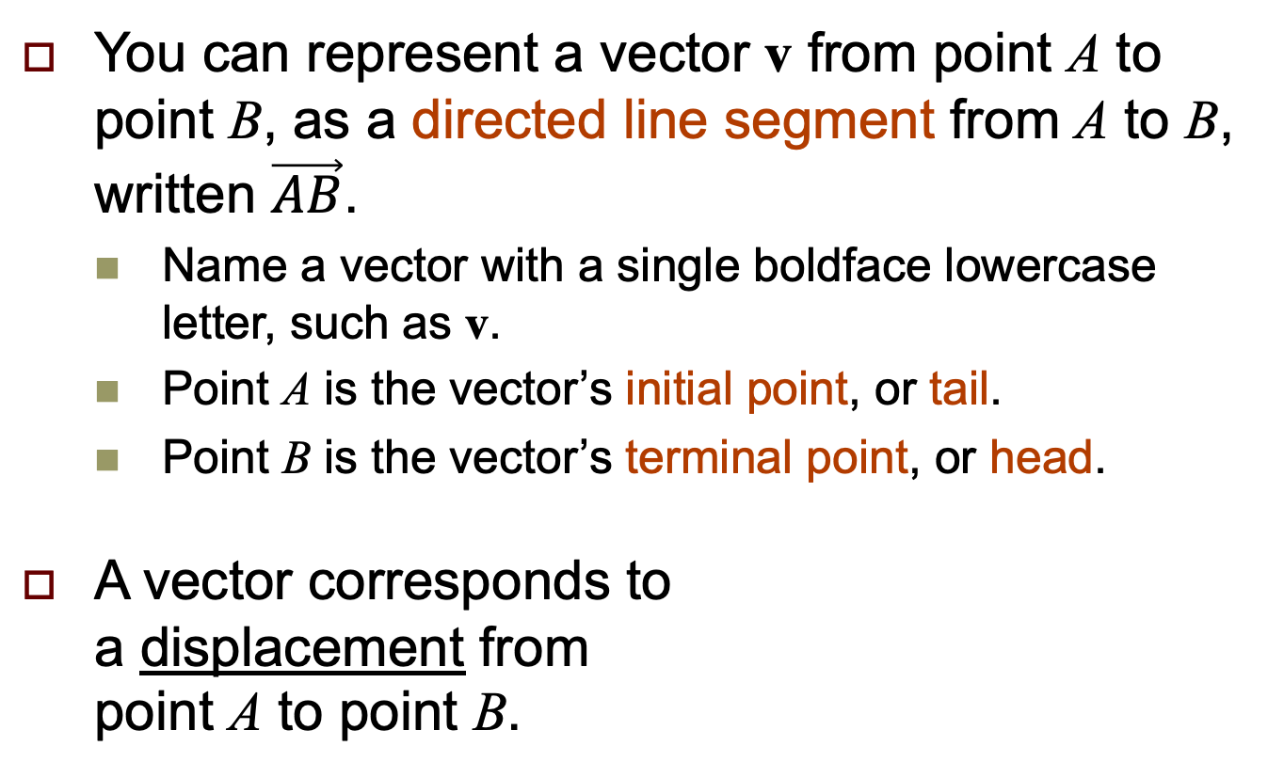
Vectors
You can represent a vector v from point A to point B, as a directed line segment from A to B, written $\vec{AB}$.
  Name a vector with a single boldface lowercase letter, such as v.
  Point A is the vector’s initial point, or tail.
  Point B is the vector’s terminal point, or head.
A vector corresponds to
a displacement from
point A to point B.
v
B
A

Slide 5
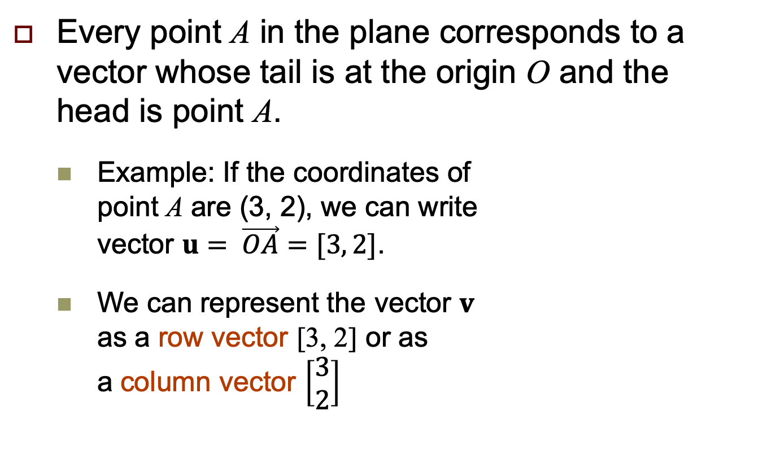
Vectors, cont’d
Every point A in the plane corresponds to a vector whose tail is at the origin O and the
head is point A.
  Example: If the coordinates of
  point A are (3, 2), we can write
  vector $u= \vec{OA}=[3, 2]$.
  We can represent the vector $v$
  as a row vector [3, 2] or as
  a column vector $\left[\begin{aligned}3 \\ 2\end{aligned}\right]$
A
2
u
O
3

Slide 6
Vector Arithmetic
Suppose vector u = [3, 2] and vector v = [1, -1].
  Then u + v = [3, 2] + [1, -1] = [3 + 1, 2 - 1] = [4, 1]
  Add the corresponding components:
  3 + 1 = 4 and 2 - 1 = 1
  Note that u + v = v + u.
v
u
u + v
O
v
u

Slide 7
Scalar Multiplication of a Vector
Scalar multiplication
  To multiply a vector by a constant, multiply each component of the vector by the constant.
  Example: If u = [3, 2] , then 2u = [6, 4]

Slide 8
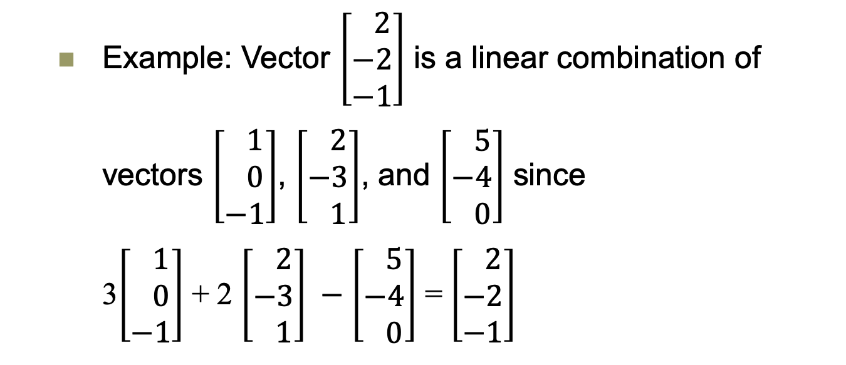
Linear Combination
A vector v is a linear combination of vectors
v₁, v₂, ..., v_{k} if there are scalars c₁, c₂, ..., c_{k}
such that v = c₁v₁ + c₂v₂ + ... + c_{k}v_{k}.
  Example: Vector $\left[\begin{aligned} 2 \\ −2 \\ −1\end{aligned}\right]$ is a linear combination of
  vectors $\left[\begin{aligned} 1 \\ 0 \\ −1\end{aligned}\right]$, $\left[\begin{aligned} 2 \\ −3 \\ 1\end{aligned}\right]$, and $\left[\begin{aligned} 5 \\ −4 \\ 0\end{aligned}\right]$ since
  3$\left[\begin{aligned} 1 \\ 0 \\ −1\end{aligned}\right]$ + 2 $\left[\begin{aligned} 2 \\ −3 \\ 1\end{aligned}\right] −$ $\left[\begin{aligned} 5 \\ −4 \\ 0\end{aligned}\right]$ = $\left[\begin{aligned} 2 \\ −2 \\ −1\end{aligned}\right]$

Slide 9
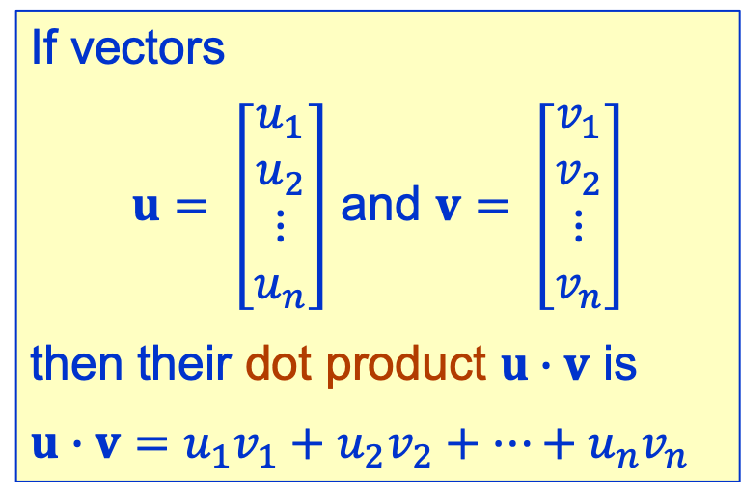
Dot Product
If vectors
$u= \left[\begin{aligned}u_{1} \\ u_{2} \\ ⋮ \\ u_{n}\end{aligned}\right]$ and $v= \left[\begin{aligned}v_{1} \\ v_{2} \\ ⋮ \\ v_{n}\end{aligned}\right]$
then their dot product $u∙v$ is
$$u∙v=u_{1}v_{1}+u_{2}v_{2}+⋯+u_{n}v_{n}$$

Slide 10
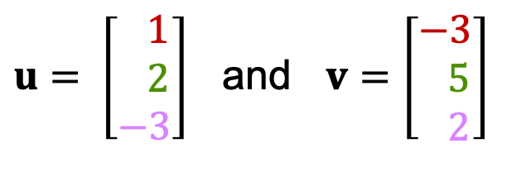

Dot Product, cont’d
Example: Let
then $u∙v=1∙\left(−3\right)+2∙5+\left(−3\right)∙2=1$
Note that a dot product is a scalar.
$u= \left[\begin{aligned} 1 \\ 2 \\ −3\end{aligned}\right]$ and $v=\left[\begin{aligned}−3 \\ 5 \\ 2\end{aligned}\right]$

Slide 11
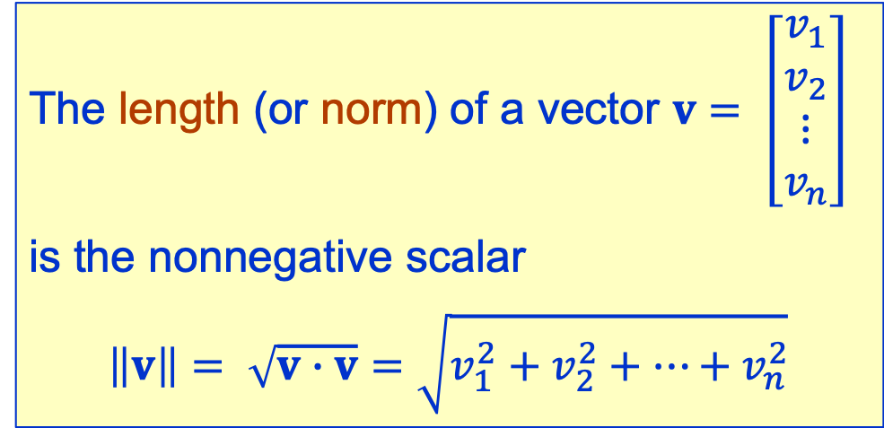

Length or Norm
The length (or norm) of a vector $v= \left[\begin{aligned}v_{1} \\ v_{2} \\ ⋮ \\ v_{n}\end{aligned}\right]$
is the nonnegative scalar
$$\left\|v\right\|= \sqrt{v∙v}=\sqrt{v_{1}^{2}+v_{2}^{2}+⋯+v_{n}^{2}}$$
  Example: $\left\|[2, 3]\right\|=\sqrt{2^{2}+3^{2}}=\sqrt{13}$

Slide 12
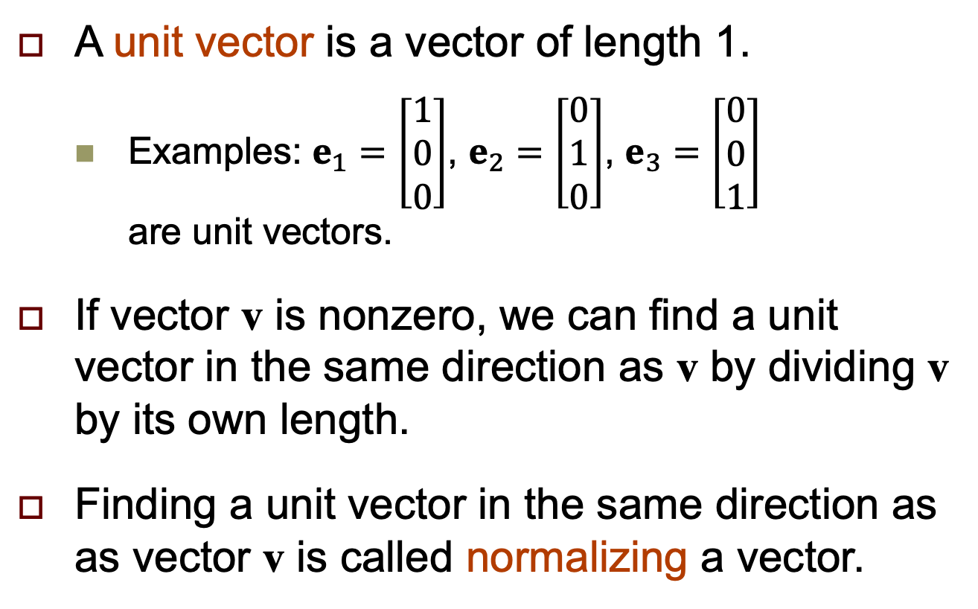
Normalize a Vector
A unit vector is a vector of length 1.
  Examples: $e_{1}=\left[\begin{aligned}1 \\ 0 \\ 0\end{aligned}\right]$, $e_{2}=\left[\begin{aligned}0 \\ 1 \\ 0\end{aligned}\right]$, $e_{3}=\left[\begin{aligned}0 \\ 0 \\ 1\end{aligned}\right]$
  are unit vectors.
If vector v is nonzero, we can find a unit vector in the same direction as v by dividing v by its own length.
Finding a unit vector in the same direction as as vector v is called normalizing a vector.

Slide 13
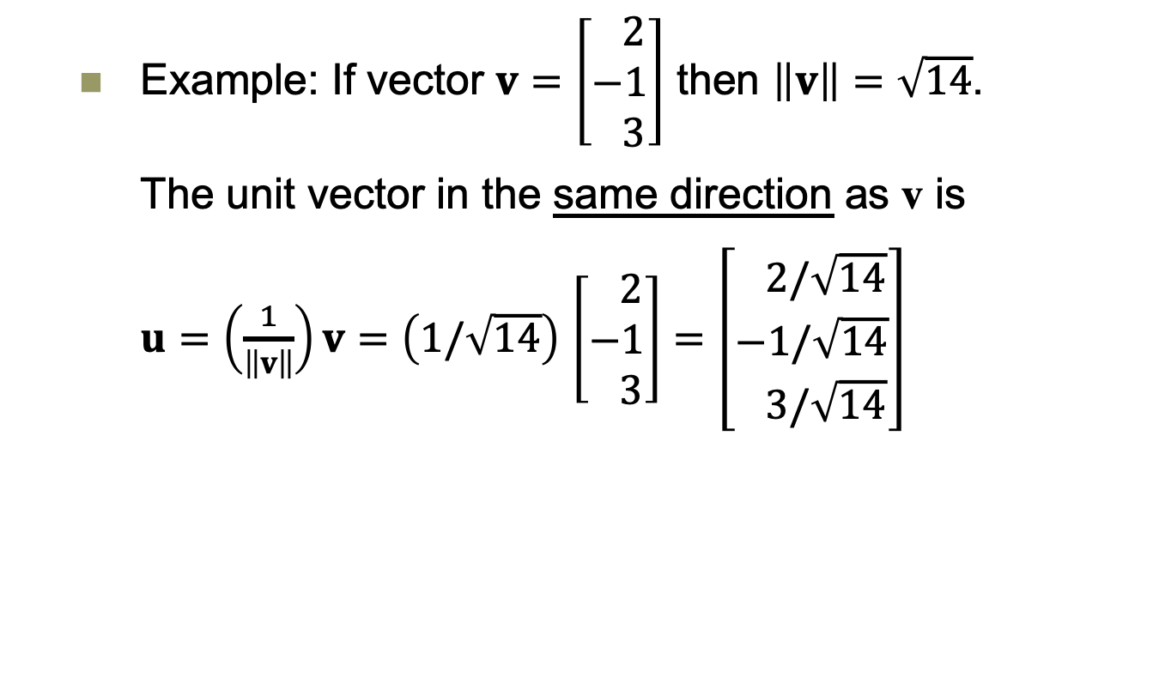
Normalize a Vector
  Example: If vector $v=\left[\begin{aligned} 2 \\ −1 \\ 3\end{aligned}\right]$ then $\left\|v\right\|=\sqrt{14}$.
  The unit vector in the same direction as v is
  $u=\left(\frac{1}{\left\|v\right\|}\right)v=\left(1/\sqrt{14}\right)$ $\left[\begin{aligned} 2 \\ −1 \\ 3\end{aligned}\right]=$ $\left[\begin{aligned} 2/\sqrt{14} \\ −1/\sqrt{14} \\ 3/\sqrt{14}\end{aligned}\right]$

Slide 14
Vectors and NumPy
If we represent vectors by NumPy arrays, then we can perform vector arithmetic directly.
Vector addition
Vectors.ipynb
import numpy as np
u = np.array([3, 2])
v = np.array([1, -1])
print(f'u = {u}')
print(f'v = {v}')
print(f'u + v = {u + v}')
u = [3 2]
v = [1 -1]
u + v = [4 1]

Slide 15
Vectors and NumPy, cont’d
Scalar multiplication
u = np.array([3, 2])
print(f' u = {u}')
print(f'2u = {2*u}')
u = [3 2]
2u = [6 4]

Slide 16
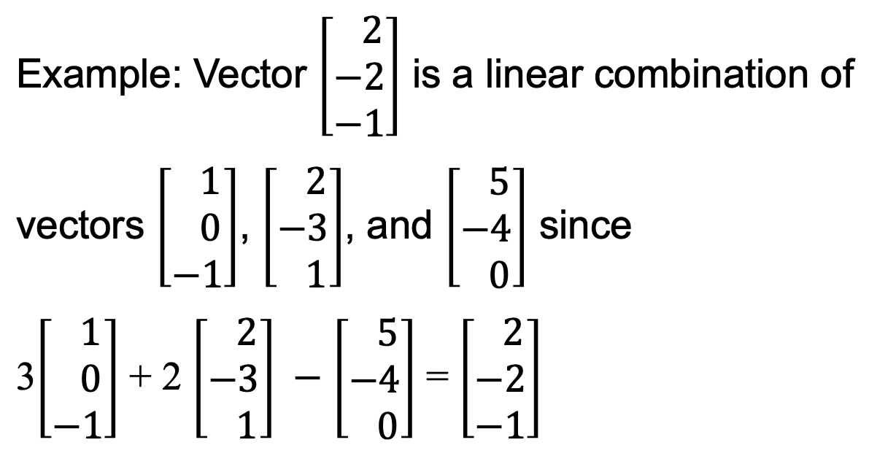
Vectors and NumPy, cont’d
Linear combination
v1 = np.array([1, 0, -1])
v2 = np.array([2, -3, 1])
v3 = np.array([5, -4, 0])
print(f'v1 = {v1}')
print(f'v2 = {v2}')
print(f'v3 = {v3}')
print()
print(f'3v1 + 2v2 - v3 = {3*v1 + 2*v2 - v3}')
v1 = [ 1 0 -1]
v2 = [ 2 -3 1]
v3 = [ 5 -4 0]
3v1 + 2v2 - v3 = [ 2 -2 -1]

Slide 17
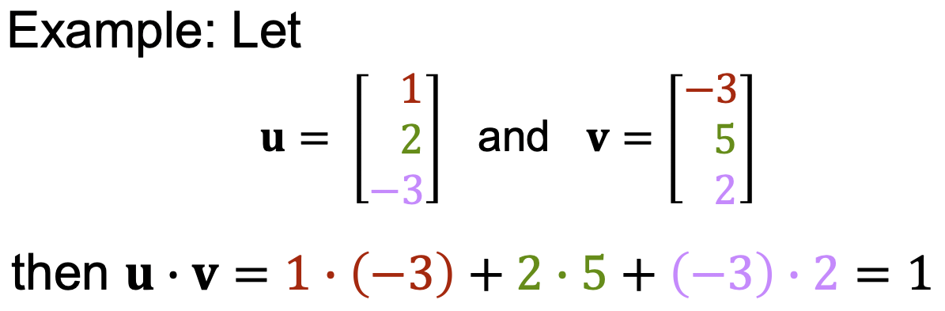
Vectors and NumPy, cont’d
Dot product
u = np.array([ 1, 2, -3])
v = np.array([-3, 5, 2])
print(f'u = {u}')
print(f'v = {v}')
print()
print(f'u.dot(v) = {u.dot(v)}')
print(f'u@v = {u@v}')
u = [ 1 2 -3]
v = [-3 5 2]
u.dot(v) = 1
u@v = 1

Slide 18
Vectors and NumPy, cont’d
Length (norm)
from numpy.linalg import norm
v = np.array([2, -1, 3])
print(f'v = {v}')
print(f'norm(v) = {norm(v)}')
v = [ 2 -1 3]
norm(v) = 3.7416573867739413

Slide 19
Vectors and NumPy, cont’d
Normalize a vector
v = np.array([2, -1, 3])
u = (1/norm(v))*v
print(f' v = {v}')
print(f' u = {u}')
print(f'norm(u) = {norm(u)}')
v = [ 2 -1 3]
u = [ 0.53452248 -0.26726124 0.80178373]
norm(u) = 1.0

Slide 20
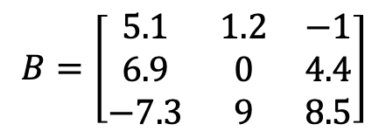
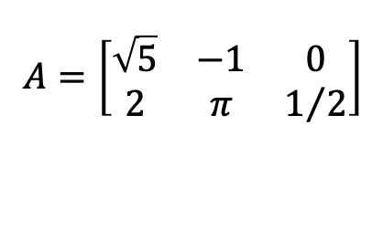
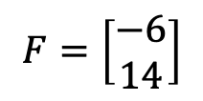


Matrices
A matrix is a two-dimensional array of values.
  Name a matrix with an uppercase italic letter,
  such as A.
  Examples:
NumPy allows us to do matrix arithmetic.
$$A=\left[\begin{matrix}\sqrt{5} & −1 & 0 \\ 2 & π & 1/2\end{matrix}\right]$$
$$C=\left[7\right]$$
$$E=\left[\begin{matrix}1 & 12 & 5\end{matrix}\right]$$
$$B=\left[\begin{matrix}5.1 & 1.2 & −1 \\ 6.9 & 0 & 4.4 \\ −7.3 & 9 & 8.5\end{matrix}\right]$$
$$F=\left[\begin{matrix}−6 \\ 14\end{matrix}\right]$$

Slide 21
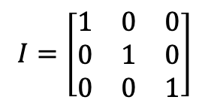
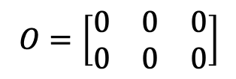
Special Matrices
A zero matrix has all zeros as elements.
  Example:
An identity matrix is a square matrix with
ones along the diagonal and zeros elsewhere.
  Example:
$$O=\left[\begin{matrix}0 & 0 & 0 \\ 0 & 0 & 0\end{matrix}\right]$$
$$I=\left[\begin{matrix}1 & 0 & 0 \\ 0 & 1 & 0 \\ 0 & 0 & 1\end{matrix}\right]$$

Slide 22
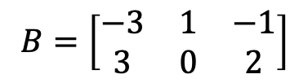
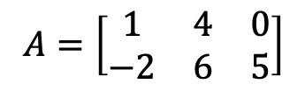
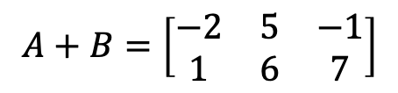
Matrix Arithmetic
Addition
  You can only add matrices that have the same shape (same numbers of rows and columns).
  The sum matrix will have the same shape.
  Add the matrices element-by-element.
  Example:
  For all matrices, A + B = B + A
  and A + O = O + A = A
$$A=\left[\begin{matrix}1 & 4 & 0 \\ −2 & 6 & 5\end{matrix}\right]$$
$$B=\left[\begin{matrix}−3 & 1 & −1 \\ 3 & 0 & 2\end{matrix}\right]$$
$$A+B=\left[\begin{matrix}−2 & 5 & −1 \\ 1 & 6 & 7\end{matrix}\right]$$

Slide 23
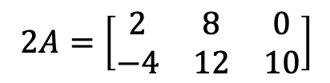
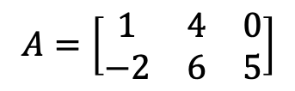
Matrix Arithmetic, cont’d
Scalar multiplication
  To multiply a matrix by a constant, multiply each element of the matrix by the constant.
  Example:
$$A=\left[\begin{matrix}1 & 4 & 0 \\ −2 & 6 & 5\end{matrix}\right]$$
$$2A=\left[\begin{matrix}2 & 8 & 0 \\ −4 & 12 & 10\end{matrix}\right]$$

Slide 24
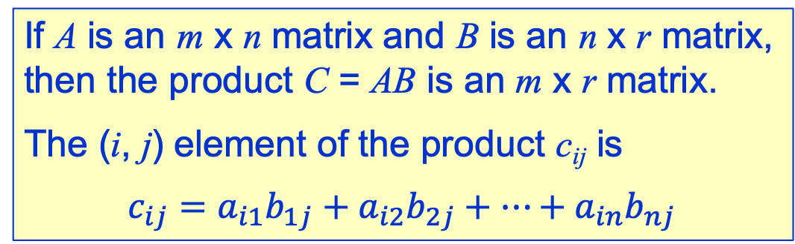
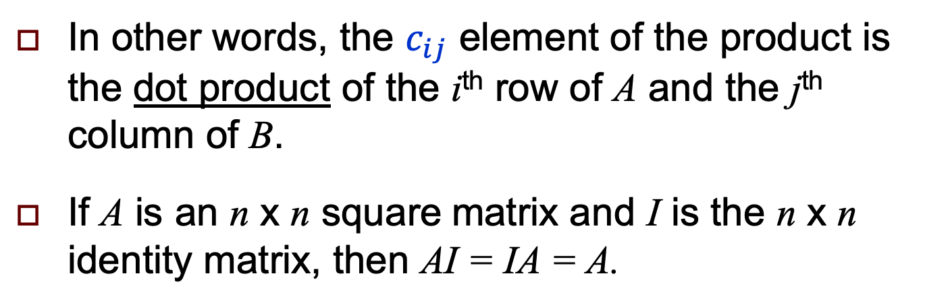
Matrix Multiplication
If A is an m x n matrix and B is an n x r matrix,
then the product C = AB is an m x r matrix.
The (i, j) element of the product c_{ij} is
$$c_{ij}=a_{i1}b_{1j}+a_{i2}b_{2j}+⋯+a_{in}b_{nj}$$
In other words, the $c_{ij}$ element of the product is the dot product of the i^{th} row of A and the j^{th} column of B.
If A is an n x n square matrix and I is the n x n identity matrix, then AI = IA = A.

Slide 25
Example: Matrix Multiplication
Ann and Bert each shop for fruit, but for different numbers of each fruit. There are two fruit stores with different prices. How much would each person spend if they shopped at these two stores?
  Numbers of fruit
  Fruit prices
 | Apples | Grapefruit | Oranges
Ann | 6 | 3 | 10
Bert | 4 | 8 | 5
 | Store A | Store B
Apples | $0.10 | $0.15
Grapefruit | $0.40 | $0.30
Oranges | $0.10 | $0.20

Slide 26
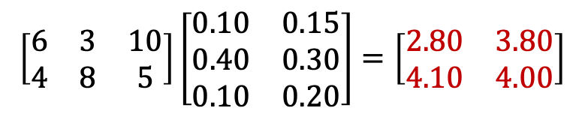
Example: Matrix Multiplication, cont’d
 | Apples | Grapefruit | Oranges
Ann | 6 | 3 | 10
Bert | 4 | 8 | 5
 | Store A | Store B
Apples | $0.10 | $0.15
Grapefruit | $0.40 | $0.30
Oranges | $0.10 | $0.20
Ann at Store A:
Ann at Store B:
Bert at Store A:
Bert at Store B:
Equivalent to:
6(0.10) + 3(0.40) + 10(0.10) = $2.80
6(0.15) + 3(0.30) + 10(0.20) = $3.80
4(0.10) + 8(0.40) + 5(0.10) = $4.10
4(0.15) + 8(0.30) + 5(0.20) = $4.00
$$\left[\begin{matrix}6 & 3 & 10 \\ 4 & 8 & 5\end{matrix}\right]\left[\begin{matrix}0.10 & 0.15 \\ 0.40 & 0.30 \\ 0.10 & 0.20\end{matrix}\right]=\left[\begin{matrix}2.80 & 3.80 \\ 4.10 & 4.00\end{matrix}\right]$$

Slide 27
Inverse of a Matrix
An n x n square matrix A is invertible (or nonsingular)
if there exists an n x n matrix B such that AB = BA = I,
the n x n identity matrix. Then B is the multiplicative
inverse of A, written A⁻¹.
A matrix that does not have an inverse is noninvertible
(or singular).
We will leave until later how to determine whether or not a matrix has an inverse.
We will use Python functions to calculate the inverse of a matrix if it exists.

Slide 28
Matrices and NumPy
Matrices.ipynb
Zero
Identity
import numpy as np
print('np.zeros([3, 3]):')
print(np.zeros([3, 3]))
np.zeros([3, 3]):
[[0. 0. 0.]
[0. 0. 0.]
[0. 0. 0.]]
print('np.identity(3):')
print(np.identity(3))
np.identity(3):
[[1. 0. 0.]
[0. 1. 0.]
[0. 0. 1.]]

Slide 29
Matrices and NumPy, cont’d
Matrix addition
A = np.array([[ 1, 4, 0],
[-2, 6, 5]])
O = np.zeros([2, 3])
print('A:')
print(A)
print()
print('A + O:')
print(A + O)
print()
print('O + A:')
print(O + A)
A:
[[ 1 4 0]
[-2 6 5]]
A + O:
[[ 1. 4. 0.]
[-2. 6. 5.]]
O + A:
[[ 1. 4. 0.]
[-2. 6. 5.]]

Slide 30
Matrices and NumPy, cont’d
Matrix addition, cont’d
A = np.array([[ 1, 4, 0],
[-2, 6, 5]])
B = np.array([[-3, 1, -1],
[3, 0, 2]])
print('A:')
print(A)
print()
print('B:')
print(B)
print()
print('A + B:')
print(A + B)
print()
print('B + A:')
print(B + A)
A:
[[ 1 4 0]
[-2 6 5]]
B:
[[-3 1 -1]
[ 3 0 2]]
A + B:
[[-2 5 -1]
[ 1 6 7]]
B + A:
[[-2 5 -1]
[ 1 6 7]]

Slide 31
Matrices and NumPy, cont’d
Scalar multiplication
A = np.array([[ 1, 4, 0],
[-2, 6, 5]])
print('A:')
print(A)
print()
print('2*A:')
print(2*A)
A:
[[ 1 4 0]
[-2 6 5]]
2*A:
[[ 2 8 0]
[-4 12 10]]

Slide 32
Matrices and NumPy, cont’d
Matrix multiplication
A = np.array([[1, 2, 3],
[4, 5, 6],
[7, 8, 9]])
I = np.identity(3)
print('A:')
print(A)
print()
print('A@I:')
print(A@I)
print()
print('I@A:')
print(I@A)
A:
[[1 2 3]
[4 5 6]
[7 8 9]]
A@I:
[[1. 2. 3.]
[4. 5. 6.]
[7. 8. 9.]]
I@A:
[[1. 2. 3.]
[4. 5. 6.]
[7. 8. 9.]]

Slide 33
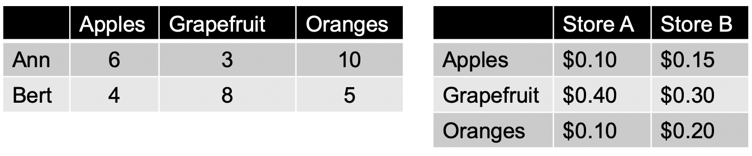
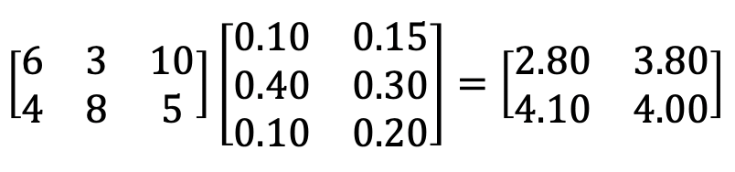
Matrices and NumPy, cont’d
Matrix multiplication, cont’d
F = np.array([[6, 3, 10],
[4, 8, 5]])
S = np.array([[0.10, 0.15],
[0.40, 0.30],
[0.10, 0.20]])
print('Fruits numbers F:')
print(F)
print()
print('Store prices S:')
print(S)
print()
print('Total costs F@S:')
print(F@S)
Fruits numbers F:
[[ 6 3 10]
[ 4 8 5]]
Store prices S:
[[0.1 0.15]
[0.4 0.3 ]
[0.1 0.2 ]]
Total costs F@S:
[[2.8 3.8]
[4.1 4. ]]
F@S is the same as F.dot(S)

Slide 34
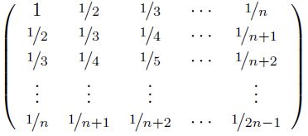
Matrices and NumPy, cont’d
Matrix inverse
Hilbert matrix
from numpy.linalg import inv
%precision 3
H = np.array([[1/(i + j - 1)
for j in range(1, 6)]
for i in range(1, 6)])
print('H:')
print(H)
print()
print('inv(H)')
print(inv(H))
print()
print('H@inv(H):')
print(H@inv(H))
print()
print('inv(H)@H:')
print(inv(H)@H)
print()
print('inv(inv(H)):')
print(inv(inv(H)))
H =
H =
[[1. 0.5 0.333 0.25 0.2 ]
[0.5 0.333 0.25 0.2 0.167]
[0.333 0.25 0.2 0.167 0.143]
[0.25 0.2 0.167 0.143 0.125]
[0.2 0.167 0.143 0.125 0.111]]
Matrices.ipynb

Slide 35
Matrices and NumPy, cont’d
Matrix inverse, cont’d
inv(H) =
[[ 2.500e+01 -3.000e+02 1.050e+03 -1.400e+03 6.300e+02]
[-3.000e+02 4.800e+03 -1.890e+04 2.688e+04 -1.260e+04]
[ 1.050e+03 -1.890e+04 7.938e+04 -1.176e+05 5.670e+04]
[-1.400e+03 2.688e+04 -1.176e+05 1.792e+05 -8.820e+04]
[ 6.300e+02 -1.260e+04 5.670e+04 -8.820e+04 4.410e+04]]
H@inv(H) =
[[ 1.000e+00 -5.037e-13 1.357e-12 4.760e-13 -2.380e-13]
[ 1.312e-14 1.000e+00 -5.246e-13 -1.003e-12 -7.112e-13]
[ 1.531e-14 -2.899e-13 1.000e+00 1.219e-12 4.298e-13]
[ 0.000e+00 -2.274e-13 0.000e+00 1.000e+00 0.000e+00]
[-7.278e-16 2.719e-14 -3.497e-13 1.150e-12 1.000e+00]]
inv(H)@H =
[[ 1.000e+00 -1.764e-13 -1.187e-13 -9.948e-14 -8.441e-14]
[ 4.058e-13 1.000e+00 3.598e-13 4.547e-13 3.304e-13]
[-4.464e-12 -3.556e-12 1.000e+00 -9.095e-13 -1.158e-12]
[ 2.659e-12 1.422e-12 6.994e-13 1.000e+00 3.419e-13]
[-2.380e-13 1.108e-12 -4.796e-13 0.000e+00 1.000e+00]]

Slide 36
Matrices and NumPy, cont’d
Matrix inverse, cont’d
inv(inv(H)) =
[[1. 0.5 0.333 0.25 0.2 ]
[0.5 0.333 0.25 0.2 0.167]
[0.333 0.25 0.2 0.167 0.143]
[0.25 0.2 0.167 0.143 0.125]
[0.2 0.167 0.143 0.125 0.111]]
H =
[[1. 0.5 0.333 0.25 0.2 ]
[0.5 0.333 0.25 0.2 0.167]
[0.333 0.25 0.2 0.167 0.143]
[0.25 0.2 0.167 0.143 0.125]
[0.2 0.167 0.143 0.125 0.111]]

Slide 37
More Vector and Matrix Facts
Hilbert matrices
  See
Miscellaneous facts
  Matrix transpose
  QR factorization
  See:
Hilbert.ipynb
LinearAlgebra.ipynb

Slide 38
Break

Slide 39
Graphic Transformation Matrix
A good example of the use of matrices is the graphic transformation matrix.
In 3-D computer graphics, an object on the screen can be subjected to:
  translation: move from one location to another
  scaling: grow and shrink in size
  rotation: rotate about the x-, y-, or z-axis
    Assume the z-axis is perpendicular to the screen: positive towards the viewer and negative away from the viewer

Slide 40
Graphic Transformation Matrix, cont’d
Translation:
Scaling:

Slide 41
Graphic Transformation Matrix, cont’d
Rotation about the x-axis:

Slide 42
Graphic Transformation Matrix, cont’d
Rotation about the y-axis:

Slide 43
Graphic Transformation Matrix, cont’d
Rotation about the z-axis:

Slide 44
Graphic Transformation Matrix, cont’d
To animate (translate, scale, rotate, etc.)
an object on the screen:
  The object consists of a set of vertices and
  lines connecting the vertices.
  Each vertex has x, y, and z coordinates.
  Multiply all the corresponding transformation matrices together — in the order that we want to apply them — to form the concatenated transformation matrix.
  Multiply each vertex of the object by the concatenated transformation matrix.
TransformationMatrix.ipynb

Slide 45
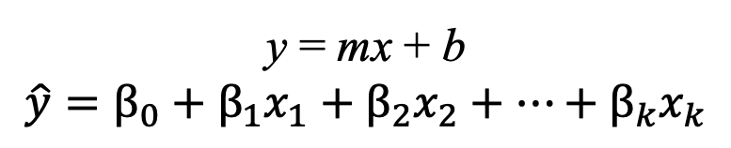
Linear Equations
A linear equation is one where the variables have “simple” forms.
  No exponents (other than the implied 1)
  The graph is always a straight line.
You have already seen examples from
linear regression:
y = mx + b
$$\hat{y}=β_{0}+β_{1}x_{1}+β_{2}x_{2}+⋯+β_{k}x_{k}$$

Slide 46

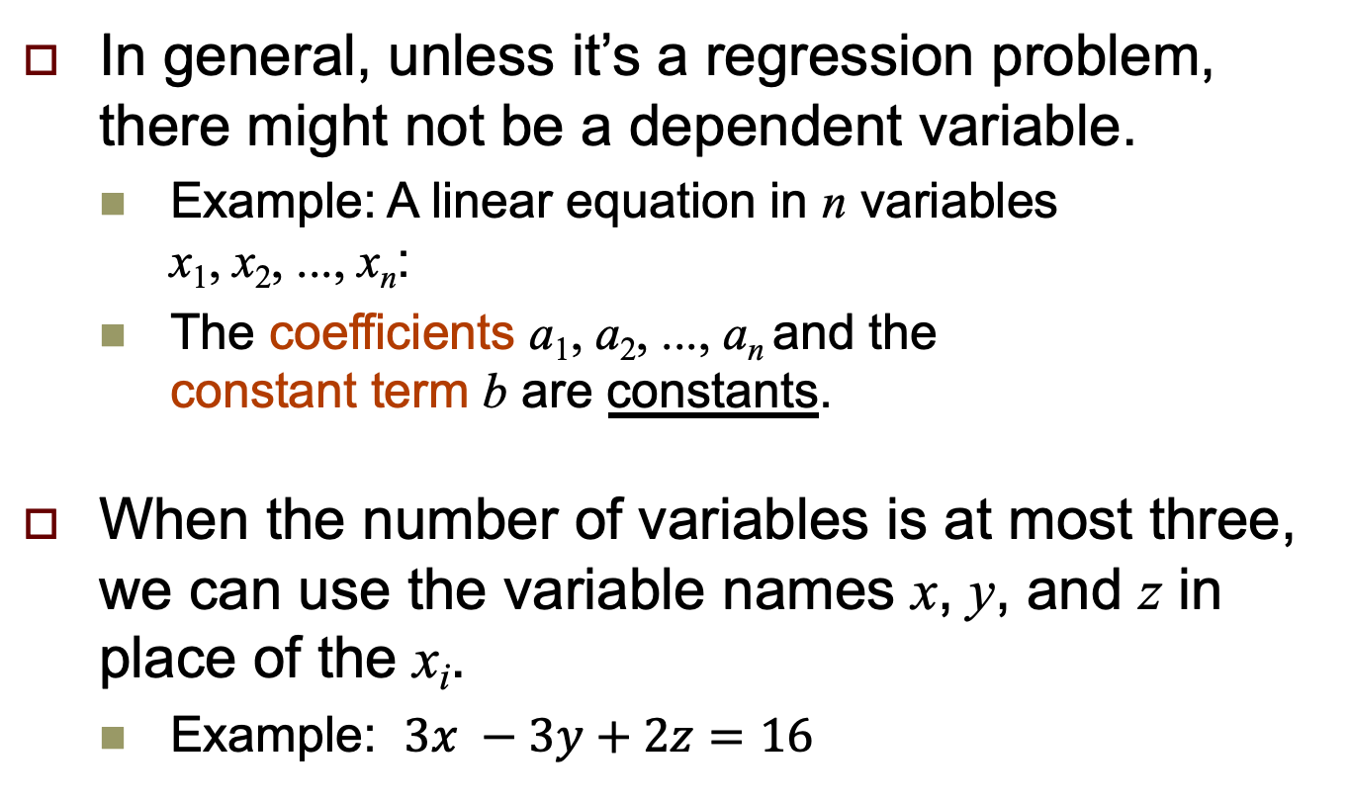
Linear Equations, cont’d
In general, unless it’s a regression problem, there might not be a dependent variable.
  Example: A linear equation in n variables
  x₁, x₂, ..., x_{n}:
  The coefficients a₁, a₂, ..., a_{n} and the
  constant term b are constants.
When the number of variables is at most three, we can use the variable names x, y, and z in place of the x_{i}.
  Example: $3x −3y+2z=16$
$$a_{1}x_{1}+a_{2}x_{2}+⋯+a_{n}x_{n}=b$$

Slide 47
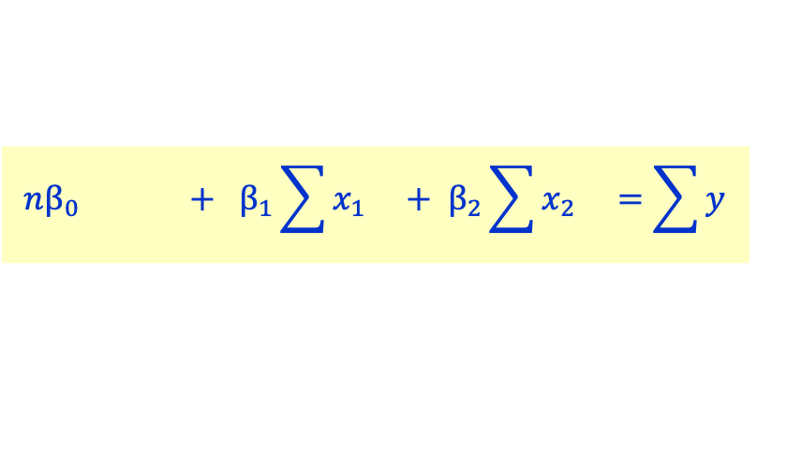
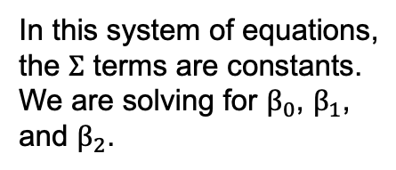
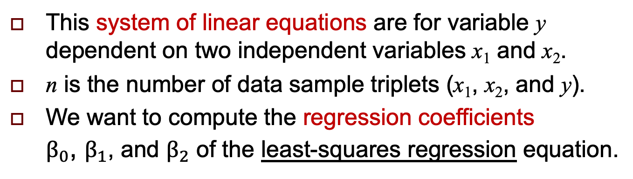

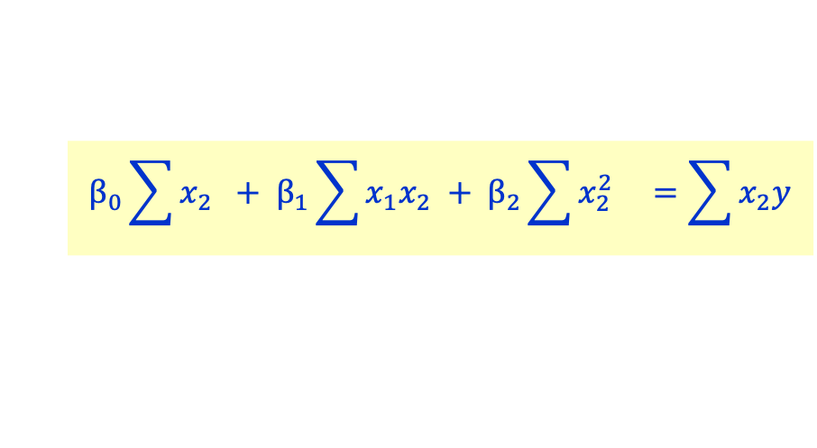
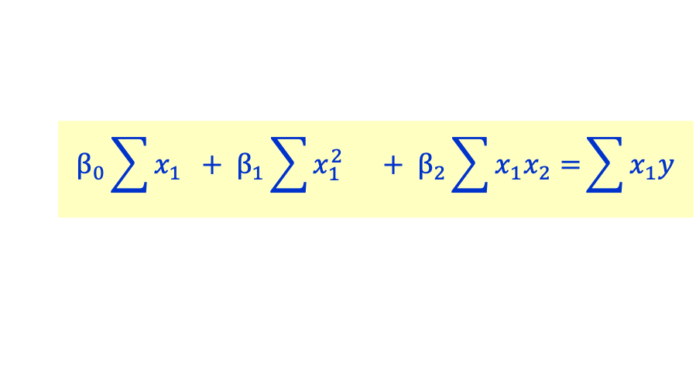
Normal Equations for Multiple Linear Regression
$$nβ_{0} + β_{1}\sum{x_{1} + β_{2}\sum{x_{2} =\sum{y}}}$$
In this system of equations,
the $Σ$ terms are constants.
We are solving for $β_{0}$, $β_{1}$,
and $β_{2}$.
$$β_{0}\sum{x_{1}} + β_{1}\sum{x_{1}^{2} + β_{2}\sum{x_{1}x_{2}=}}\sum{x_{1}y}$$
$$β_{0}\sum{x_{2}} + β_{1}\sum{x_{1}x_{2} + β_{2}\sum{x_{2}^{2} =\sum{x_{2}y}}}$$
This system of linear equations are for variable y dependent on two independent variables x₁ and x₂.
n is the number of data sample triplets (x₁, x₂, and y).
We want to compute the regression coefficients
$β_{0}$, $β_{1}$, and $β_{2}$ of the least-squares regression equation.
$$\hat{y}=β_{0}+β_{1}x_{1}+β_{2}x_{2}$$

Slide 48
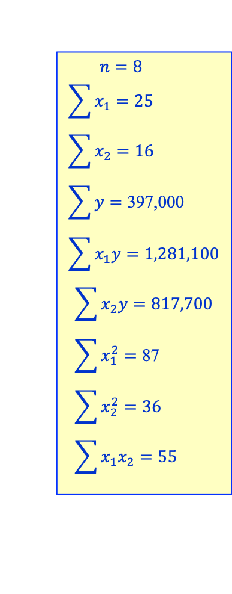
Multiple Regression Example: Home Prices
The following table of homes for sale
(obviously not in California):
$$n=8 \\ \sum{x_{1}=25} \\ \sum{x_{2}=16} \\ \sum{y=\text{397}\text{,}\text{000}} \\ \sum{x_{1}y}=1,281,100$$
$$\sum{x_{2}y}=817,700 \\ \sum{x_{1}^{2}=\text{87}} \\ \sum{x_{2}^{2}=\text{36}} \\ \sum{x_{1}x_{2}=\text{55}}$$
Number of bedrooms x₁ | Number of bathrooms x₂ | $ Price y
3 | 2 | 48,800
2 | 1 | 44,300
4 | 3 | 53,800
2 | 1 | 44,200
3 | 2 | 49,700
2 | 2 | 44,900
5 | 3 | 58,400
4 | 2 | 52,900

Slide 49
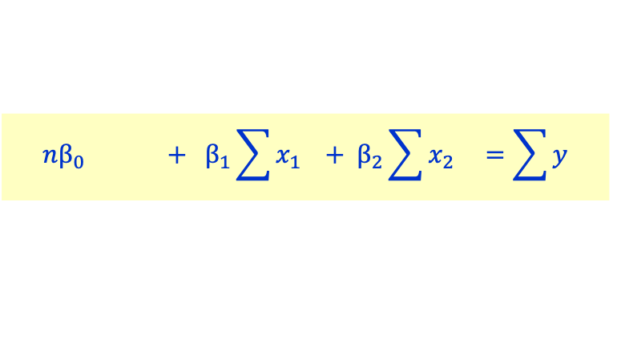
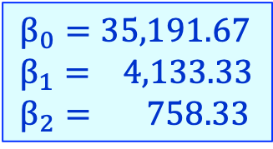

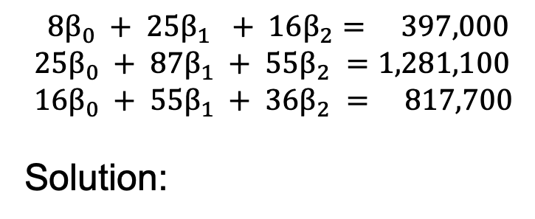

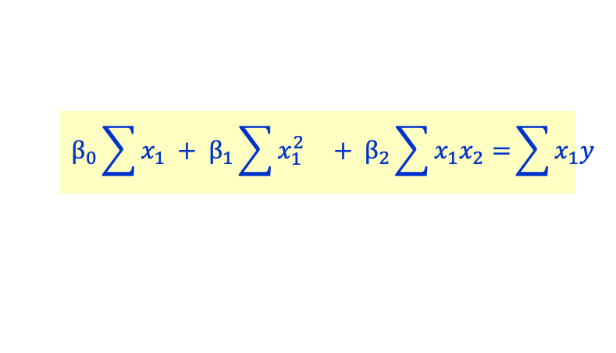
Example: Home Prices, cont’d
$$n=8 \\ \sum{x_{1}=25} \\ \sum{x_{2}=16} \\ \sum{y=\text{397}\text{,}\text{000}} \\ \sum{x_{1}y}=1,281,100$$
$$\sum{x_{2}y}=817,700 \\ \sum{x_{1}^{2}=\text{87}} \\ \sum{x_{2}^{2}=\text{36}} \\ \sum{x_{1}x_{2}=\text{55}}$$
$$nβ_{0} + β_{1}\sum{x_{1} + β_{2}\sum{x_{2} =\sum{y}}}$$
$$β_{0}\sum{x_{1}} + β_{1}\sum{x_{1}^{2} + β_{2}\sum{x_{1}x_{2}=}}\sum{x_{1}y}$$
$$β_{0}\sum{x_{2}} + β_{1}\sum{x_{1}x_{2} + β_{2}\sum{x_{2}^{2} =\sum{x_{2}y}}}$$
$$8β_{0} + 25β_{1} + 16β_{2}= 397,000 \\ 25β_{0} + 87β_{1} + 55β_{2} =1,281,100 \\ 16β_{0} + 55β_{1} + 36β_{2} = 817,700$$
Solution:
$$β_{0}=35,191.67 \\ β_{1}= 4,133.33 \\ β_{2}= 758.33$$
HomePricesSolve.ipynb

Slide 50


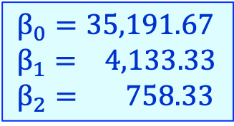
Example: Home Prices, cont’d
$$β_{0}=35,191.67 \\ β_{1}= 4,133.33 \\ β_{2}= 758.33$$
$$\hat{y}={ β}_{0} + { β}_{1}x_{1}+ β_{2}x_{2}$$
$$=35,191.67\text{ + }4,133.33x_{1}+758.33x_{2}$$
Estimated house price for
x₁ = 2 bedrooms and x₂ = 1 bathrooms:
Estimated house price for
x₁ = 5 bedrooms and x₂ = 3 bathrooms:
$35,191.67$ +$4,133.33\left(2\right)+758.33\left(1\right)=\$44,216.67$
$35,191.67$ +$4,133.33\left(5\right)+758.33\left(3\right)=\$58,133.33$

Slide 51
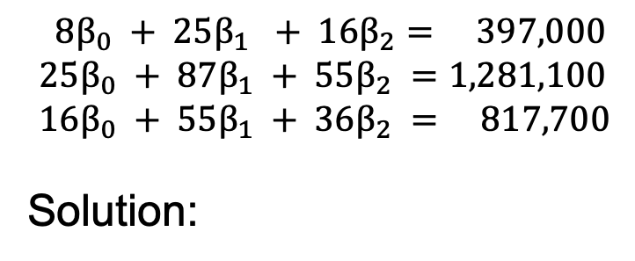

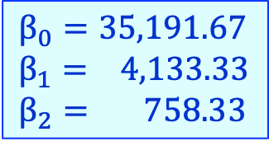
Solve a System of Linear Equations
How to solve a system of linear equations?
Solving means to find a common set of values for the $β_{i}$variables that correctly fit each equation.
$$8β_{0} + 25β_{1} + 16β_{2}= 397,000 \\ 25β_{0} + 87β_{1} + 55β_{2} =1,281,100 \\ 16β_{0} + 55β_{1} + 36β_{2} = 817,700$$
Solution:
$$β_{0}=35,191.67 \\ β_{1}= 4,133.33 \\ β_{2}= 758.33$$

Slide 52
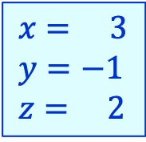
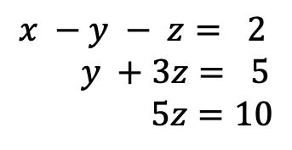
Solve a System of Linear Equations, cont’d
Here’s an easy system to solve:
Because it’s in the handy upper triangular form,
we can use back substitution.
  From equation c, calculate z = 10/5 = 2.
  Then use the value of z in equation b:
  y + 3z = y + 3(2) = y + 6 = 5, so y = 5 – 6 = –1.
  Finally, use the values of y and z in equation a:
  x – y – z = x – (–1) – 2 = x – 1 = 2, so x = 2 + 1 = 3.
$$x −y − z= 2 \\ y +3z= 5 \\ 5z=10$$
a
$$x= 3 \\ y=−1 \\ z= 2$$
b
c

Slide 53
Equivalent Systems
Our goal is to get a system of linear equations into triangular form.
We can perform the following operations on a system to obtain an equivalent system:
Two systems are equivalent if they have
the same solution set.
  Interchange two equations.
  Multiply an equation by a nonzero constant.
  Add a multiple of one equation to another equation.

Slide 54
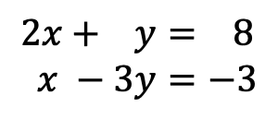
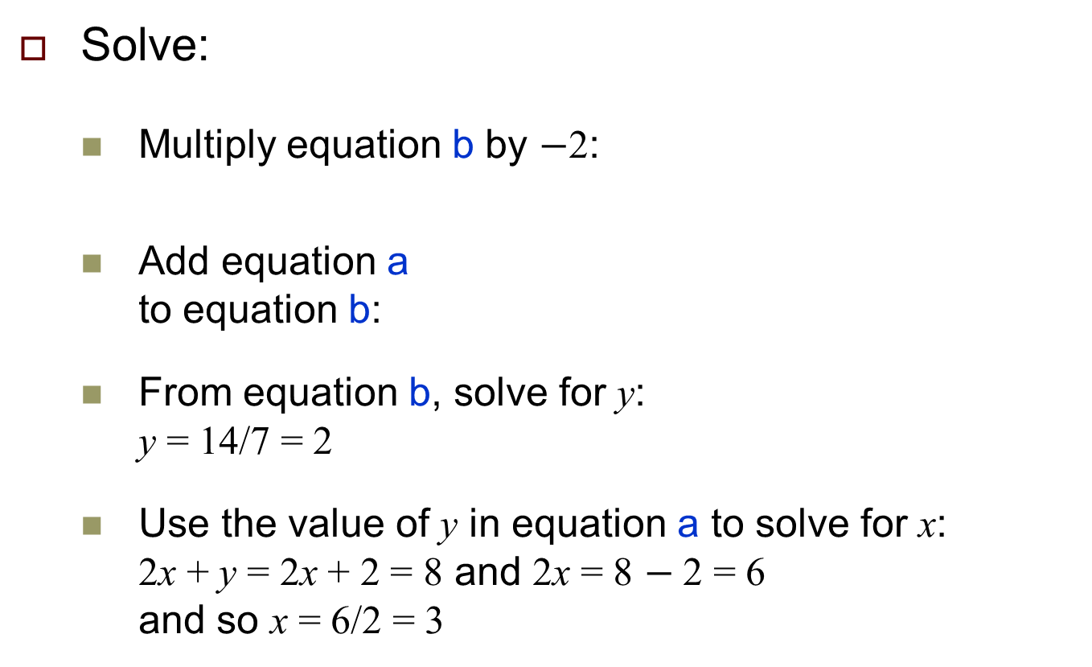


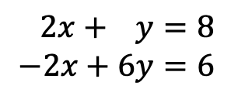
Solve a System of Linear Equations, cont’d
Solve:
  Multiply equation b by $−$2:
  Add equation a
  to equation b:
  From equation b, solve for y:
  y = 14/7 = 2
  Use the value of y in equation a to solve for x:
  2x + y = 2x + 2 = 8 and 2x = 8 $−$2 = 6
  and so x = 6/2 = 3
$$2x+ y= 8 \\ x −3y=−3$$
a
$$x=3 \\ y=2$$
b
$$2x+ y=8 \\ −2x+6y=6$$
a
b
$$2x+ y= 8 \\ 7y=14$$
a
b

Slide 55



Graphical Solution
We can visualize the solution of a system of linear equations with two unknowns x and y.
  Rewrite equation a as $y=−2x+8$
  and equation b as $y= \frac{1}{3}x+1$
  Plot both equations:
  The solution is the intersection at (x, y) = (3, 2).
$$2x+ y= 8 \\ x −3y=−3$$
a
b
In this system of equations,
y is not dependent on x.

Slide 56


Consistent and Inconsistent Systems
A system of linear equations with real coefficients has either
A unique solution
Infinitely many solutions
No solution
A system of linear equations is consistent if it has at least
one solution. It is inconsistent if it has no solutions.
Unique solution
Infinitely many solutions
No solutions
LinearEquationPlots.ipynb

Slide 57

Ill-Conditioned Systems
A system of linear equations is ill-conditioned if small changes in the coefficients result in large changes in the solution.
  Otherwise, the system is well-conditioned.
  Example: Graph of an ill-conditioned system.
  A tiny wiggle in either or
  both lines will greatly
  change where the two
  lines cross.
Java Number Cruncher:
The Java Programmer’s Guide to Numerical Computing
by Ronald Mak
Prentice Hall, 2003
ISBN 0-13-046041-9

Slide 58


Augmented Matrix
We can solve a system of linear equations with an augmented matrix.
  Example: Solve
  Begin by eliminating x from equations b and c.
$$x − y− z= 2 \\ 3x −3y+2z=16 \\ 2x − y + z= 9$$
a
$$\left[\begin{matrix}1 & −1 & −1 \\ 3 & −3 & 2 \\ 2 & −1 & 1\end{matrix} \begin{matrix} 2 \\ 16 \\ 9\end{matrix}\right]$$
b
c

Slide 59






Solve with an Augmented Matrix
$$x − y− z= 2 \\ 3x −3y+2z=16 \\ 2x − y + z= 9$$
a
$$\left[\begin{matrix}1 & −1 & −1 \\ 3 & −3 & 2 \\ 2 & −1 & 1\end{matrix} \begin{matrix} 2 \\ 16 \\ 9\end{matrix}\right]$$
b
c
Subtract 3 times equation a
from equation b:
Subtract 3 times the first row
from the second row:
$$x − y− z= 2 \\ 5z=10 \\ 2x − y + z= 9$$
a
$$\left[\begin{matrix}1 & −1 & −1 \\ 0 & 0 & 5 \\ 2 & −1 & 1\end{matrix} \begin{matrix} 2 \\ 10 \\ 9\end{matrix}\right]$$
b
c
Subtract 2 times equation a
from equation c:
Subtract 2 times the first row
from the third row:
$$x − y− z= 2 \\ 5z=10 \\ y + 3z= 5$$
a
$$\left[\begin{matrix}1 & −1 & −1 \\ 0 & 0 & 5 \\ 0 & 1 & 3\end{matrix} \begin{matrix} 2 \\ 10 \\ 5\end{matrix}\right]$$
b
c

Slide 60




Solve with an Augmented Matrix, cont’d
$$x − y− z= 2 \\ 5z=10 \\ y + 3z= 5$$
a
$$\left[\begin{matrix}1 & −1 & −1 \\ 0 & 0 & 5 \\ 0 & 1 & 3\end{matrix} \begin{matrix} 2 \\ 10 \\ 5\end{matrix}\right]$$
b
c
Interchange the second
and third rows:
Interchange equations b and c:
$$x − y− z = 2 \\ y + 3z= 5 \\ 5z=10$$
a
$$\left[\begin{matrix}1 & −1 & −1 \\ 0 & 1 & 3 \\ 0 & 0 & 5\end{matrix} \begin{matrix} 2 \\ 5 \\ 10\end{matrix}\right]$$
b
c
  Now as before, we can solve for x, y, and z using back substitution.

Slide 61

Row Echelon Form
$$\left[\begin{matrix}1 & −1 & −1 \\ 0 & 1 & 3 \\ 0 & 0 & 5\end{matrix} \begin{matrix} 2 \\ 5 \\ 10\end{matrix}\right]$$
A matrix is in row echelon form if:
Any rows consisting entirely of zeros are at the bottom.
In each nonzero row, the first nonzero entry (called the
leading entry) is in a column to the left of any leading
entries below it.
The rank of a matrix is the number of nonzero rows
in its row echelon form.

Slide 62
Gaussian Elimination
A system of linear equations is ready to be solved by back substitution if the corresponding augmented matrix is in row echelon form.
Gaussian elimination: The process of reducing a matrix to its row echelon form in order to solve a system of linear equations.
  Gauss-Jordan elimination puts a matrix into reduced row echelon form: It’s in row echelon form and each leading entry is a 1 (called a leading 1), and each column containing a leading 1 has zeros elsewhere.

Slide 63






Solution to the Home Prices System
$$8β_{0} + 25β_{1} + 16β_{2}= 397,000 \\ 25β_{0} + 87β_{1} + 55β_{2} =1,281,100 \\ 16β_{0} + 55β_{1} + 36β_{2} = 817,700$$
$$\left[\begin{matrix}8 & 25 & 16 \\ 25 & 87 & 55 \\ 16 & 55 & 36\end{matrix} \begin{matrix} 397,000 \\ 1,281,100 \\ 817,700\end{matrix}\right]$$
Eliminate $β_{0}$ from row 3:
row 3 = row 3 – 2*row 1:
HomePricesSolve.ipynb
$$\left[\begin{matrix}8 & 25 & 16 \\ 25 & 87 & 55 \\ 0 & 5 & 4\end{matrix} \begin{matrix} 397,000 \\ 1,281,100 \\ \text{23}\text{,}\text{700}\end{matrix}\right]$$
Eliminate $β_{0}$ from row 2:
row 2 = 25*row 1 – 8*row 2:
$$\left[\begin{matrix}8 & 25 & 16 \\ 0 & −71 & −40 \\ 0 & 5 & 4\end{matrix} \begin{matrix} 397,000 \\ −\text{323}\text{,}\text{800} \\ \text{23}\text{,}\text{700}\end{matrix}\right]$$

Slide 64





Solution to the Home Prices System, cont’d
$$\left[\begin{matrix}8 & 25 & 16 \\ 0 & −71 & −40 \\ 0 & 5 & 4\end{matrix} \begin{matrix} 397,000 \\ −\text{323}\text{.}\text{800} \\ \text{23}\text{,}\text{700}\end{matrix}\right]$$
Eliminate $β_{1}$ from row 3:
row 3 = 5*row 2 + 71*row 3:
$$\left[\begin{matrix}8 & 25 & 16 \\ 0 & −71 & −40 \\ 0 & 0 & 84\end{matrix} \begin{matrix} 397,000 \\ −\text{323}\text{,}\text{800} \\ \text{63}\text{,}\text{700}\end{matrix}\right]$$
The matrix is now in echelon form.
Solve by back substitution:
$β_{2}$ = $\text{63,700}$/84 = 758.33
$β_{1}$ = (323,800 - 40*β₂)/71 = 4,133.33
$β_{0}$ = (397,000 - 25*β₁ - 16*β₂)/8 = 35,191.67
$$β_{0}=35,191.67 \\ β_{1}= 4,133.33 \\ β_{2}= 758.33$$

Slide 65
Solution to the Home Prices System, cont’d
Solving a system of linear equations by hand
is a real pain!
Fortunately, Python has a numpy function:
np.linalg.solve().

Slide 66


Solution Using Python
$$\left[\begin{matrix}8 & 25 & 16 \\ 25 & 87 & 55 \\ 16 & 55 & 36\end{matrix} \begin{matrix} 397,000 \\ 1,281,100 \\ 817,700\end{matrix}\right]$$
$β_{2}$ = $\text{63,700}$/84 = 758.33
$β_{1}$ = (323,800 - 40*β₂)/71 = 4,133.33
$β_{0}$ = (397,000 - 25*β₁ - 16*β₂)/8 = 35,191.67
HomePricesSolve.ipynb
import numpy as np
A = np.array([[ 8, 25, 16],
[25, 87, 55],
[16, 55, 36]])
b = np.array([397_000, 1_281_100, 817_700])
solution = np.linalg.solve(A, b)
print(f'β0 = {solution[0]:9,.2f}')
print(f'β1 = {solution[1]:9,.2f}')
print(f'β2 = {solution[2]:9,.2f}')
β0 = 35,191.67
β1 = 4,133.33
β2 = 758.33

