Slide 1


DATA 220
Mathematical Methods for Data Analysis
April 8 Class Meeting
Department of Applied Data Science
San Jose State University
Spring 2021
Instructor: Ron Mak
www.cs.sjsu.edu/~mak

Slide 2
Python Regression Analysis Functions
Python has functions for doing
linear regression analysis.
  Load data into a Pandas dataframe.
  Perform regression analysis using SciPy.
  Create a scatter plot with a linear regression line using Seaborn.
  The regression line is surrounded by a shaded area representing the 95% confidence interval.

Slide 3
Example: New York City Temperatures
Visit the website of the National Oceanic and Atmospheric Administration (NOAA) to obtain the average January temperatures for New York City from 1895 through 2021.
  https://www.ncdc.noaa.gov/cag/
Clean and transform the data.
Create a scatter plot of the temperatures.
Generate a regression line with a
95% confidence interval.
Predict the average January 2022 temperature.

Slide 4
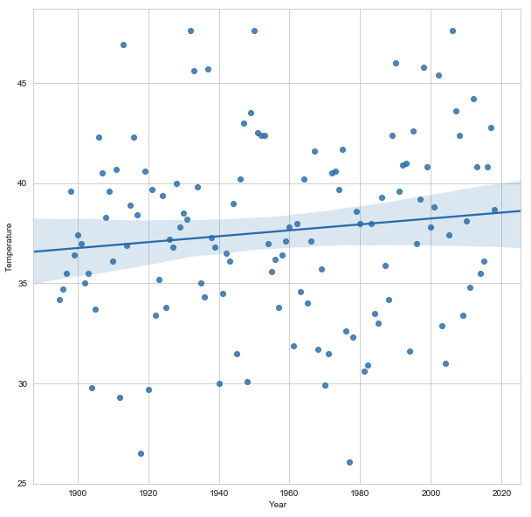
Example: New York City Temperatures, cont’d
NYCTemps.ipynb
slope = 0.0148, intercept = 8.6950
The predicted temperature in year 2022 is 38.89

Slide 5
Statistical Applications in Data Analytics
A very brief introduction only!
  using Python libraries
Time series analysis
Multiple linear regression

Slide 6
Statistical Applications in Data Analytics, cont’d
Supervised machine learning
  training and testing
  underfitting and overfitting
  time series and multiple linear regression using ML
  classification algorithms
Unsupervised machine learning
  dimensionality reduction
  clustering algorithms
  principle component analysis

Slide 7
Time-Series Analysis
Time-series analysis is a common application
of regression.
  Record data at regular intervals of time.
  The data values are a function of the time.
  Calculate and plot trends of data values over time.
Different time-series trends:
  Least-squares line
  Moving average
  Exponentially smoothed

Slide 8
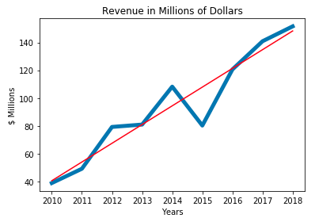
Linear Trend Over Time
A straightforward application of the
least squares regression line.
TimeSeries.ipynb

Slide 9
Moving Averages
The moving average of y data values over the
x values that represent the time intervals:
  Each y_{ma} value of the moving average corresponding to the current x time value is the average of the current y value and the previous n-1 of the y values.
  Keep a buffer of the last n of the y values. Throw out the oldest y value when you append the newest value.
  There can be no y_{ma} moving average values corresponding to the first n-1 of the x values.
Higher values of n generate moving average plots that “smooth out” the data more.

Slide 10
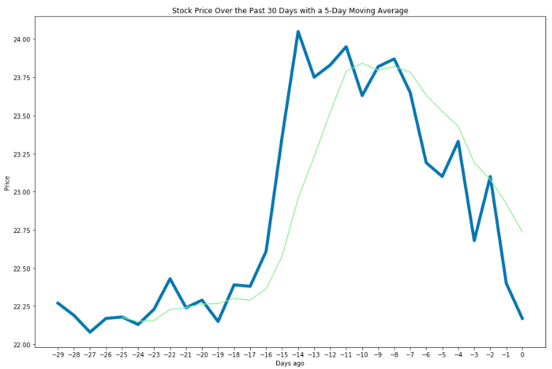
Moving Averages, cont’d
TimeSeries.ipynb
n = 5

Slide 11
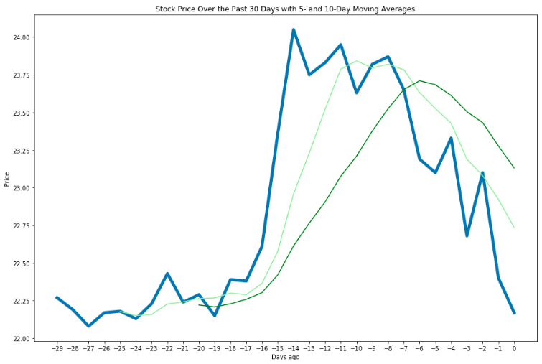
Moving Averages, cont’d
TimeSeries.ipynb
n = 10
n = 5

Slide 12
Exponential Smoothing
Exponential smoothing is a special form of moving average that weighs the most recent values of y differently than the earlier y values.
The smoothing is based on the value of the smoothing constant α, a fraction between
0 and 1.
The first value y_{es} of the exponentially smoothed average is simply the value of y calculated from the first value of x, the first time interval.

Slide 13
Exponential Smoothing, cont’d
Moving forward in time, for each subsequent value of x, the value of y_{es} is α times the corresponding value of y plus 1 – α times the previous value of y_{es}.
  Therefore, if α < 0.5, the current value of y has less influence on the smoothed curve than earlier values. This dampens current fluctuations.
Smaller values of α generate more stable values of y_{es}. Larger values of α enable quicker reaction to current changes in values of y.

Slide 14
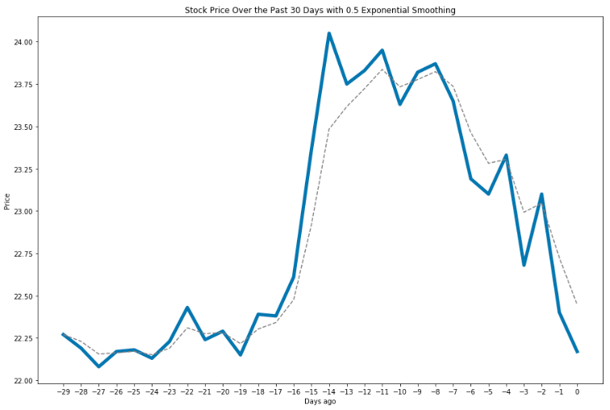
Exponential Smoothing, cont’d
TimeSeries.ipynb
α = 0.5

Slide 15
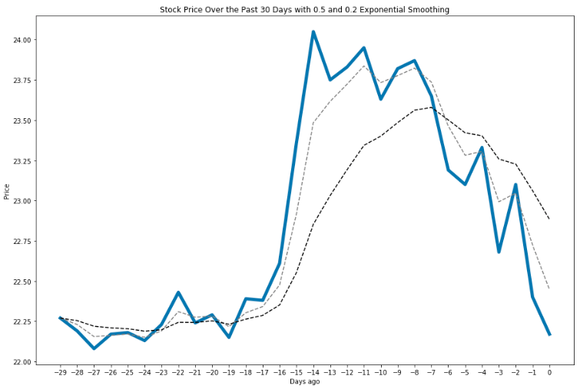
Exponential Smoothing, cont’d
TimeSeries.ipynb
α = 0.5
α = 0.2
If α < 0.5, the current value of y
has less influence on the
smoothed curve than earlier values.
This dampens current fluctuations.

Slide 16
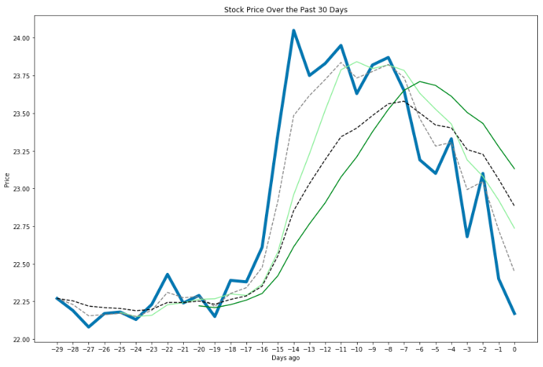
Averages Compared
TimeSeries.ipynb

Slide 17
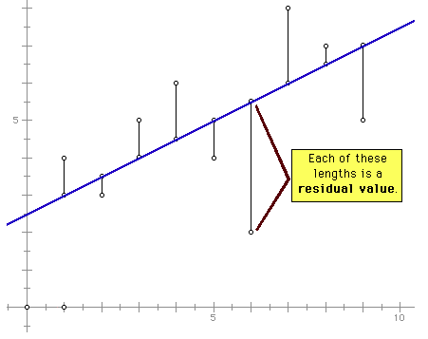
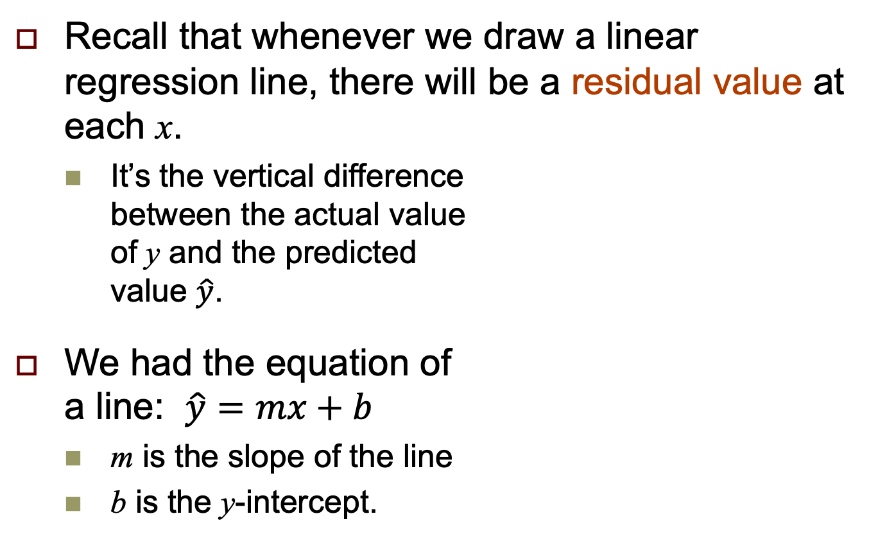
Another Perspective on Linear Regression
Recall that whenever we draw a linear regression line, there will be a residual value at each x.
  It’s the vertical difference
  between the actual value
  of y and the predicted
  value $\hat{y}$.
We had the equation of
a line: $\hat{y}=mx+b$
  m is the slope of the line
  b is the y-intercept.

Slide 18

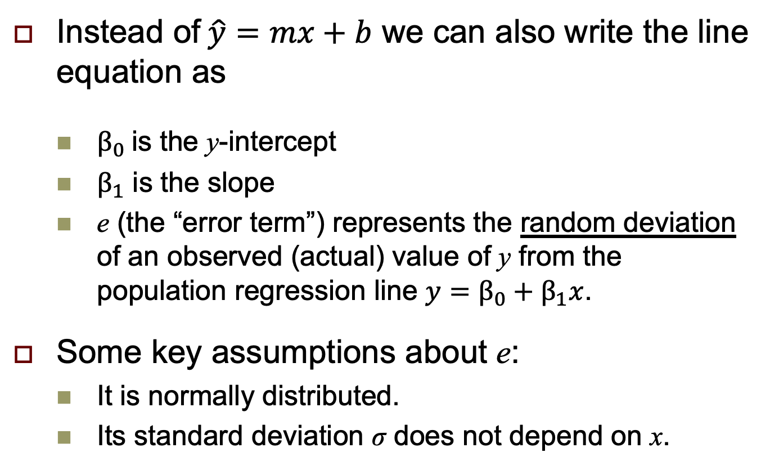
Another Perspective, cont’d
Instead of$\hat{y}=mx+b$ we can also write the line equation as
  $β_{0} \text{is} \text{the} \text{y}\text{-}\text{intercept}$
  $β_{1}$ is the slope
  e (the “error term”) represents the random deviation of an observed (actual) value of y from the population regression line $y=β_{0}+β_{1}x$.
Some key assumptions about e:
  It is normally distributed.
  Its standard deviation σ does not depend on x.
$$y=β_{0}+β_{1}x+e$$

Slide 19
Another Perspective, cont’d
At each value of x, the value of e is normally distributed.
  The mean of e
  is 0.
  e has the same
  standard
  deviation σ all
  along the line.
  σ = the standard
  deviation of y.
http://proc-x.com/2015/09/plot-the-conditional-distribution-of-the-response-in-a-linear-regression-model/

Slide 20
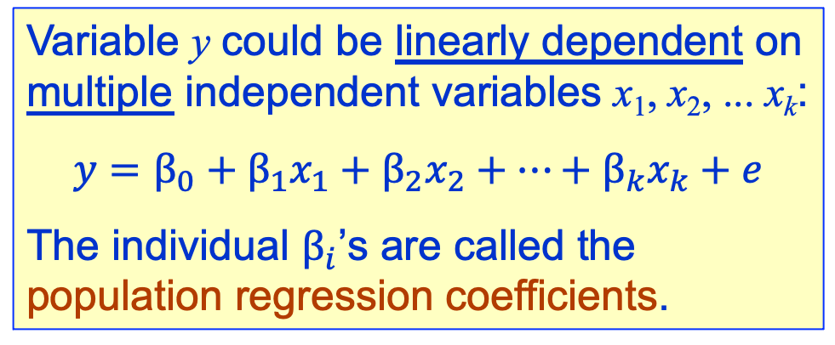
Multiple Linear Regression
Variable y could be linearly dependent on
multiple independent variables x₁, x₂, ... x_{k}:
$$y=β_{0}+β_{1}x_{1}+β_{2}x_{2}+⋯+β_{k}x_{k}+e$$
The individual $β_{i}$’s are called the
population regression coefficients.
In the above formula, each of the independent variables x₁, x₂, ... x_{k} represents a list of n random values.

Slide 21

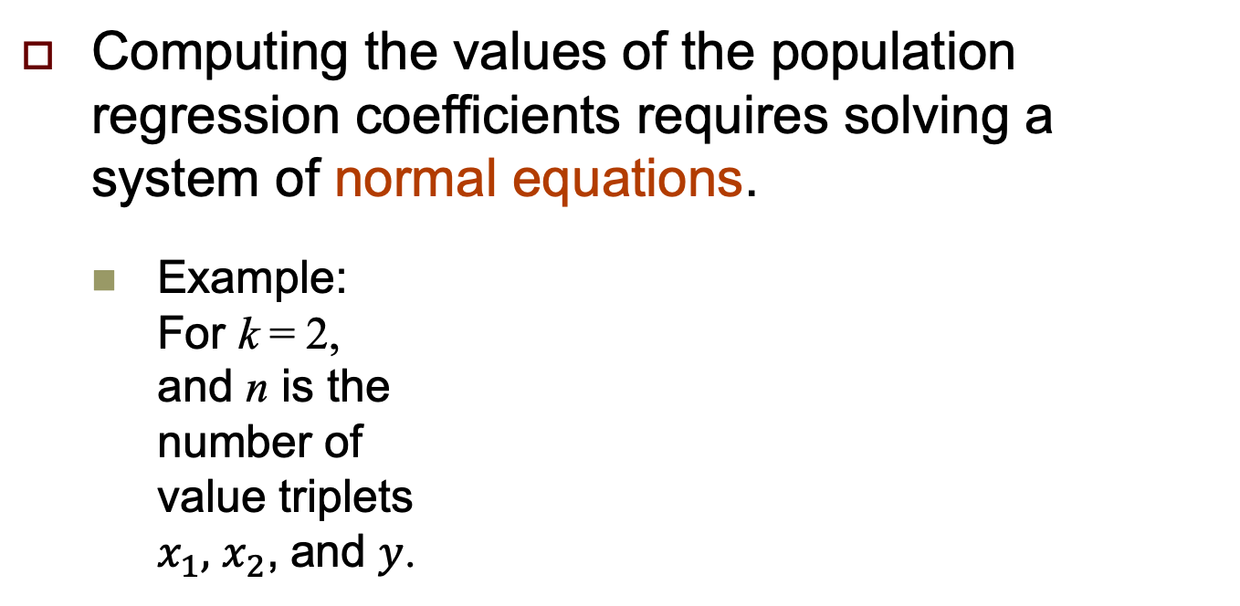
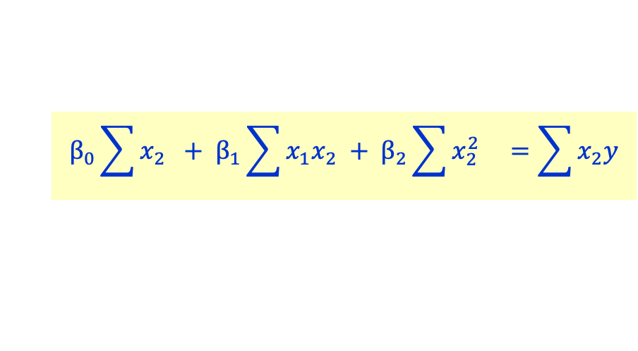
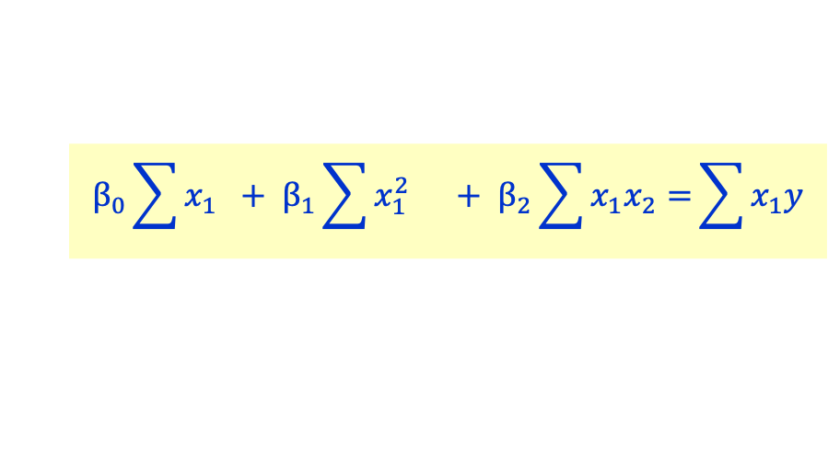
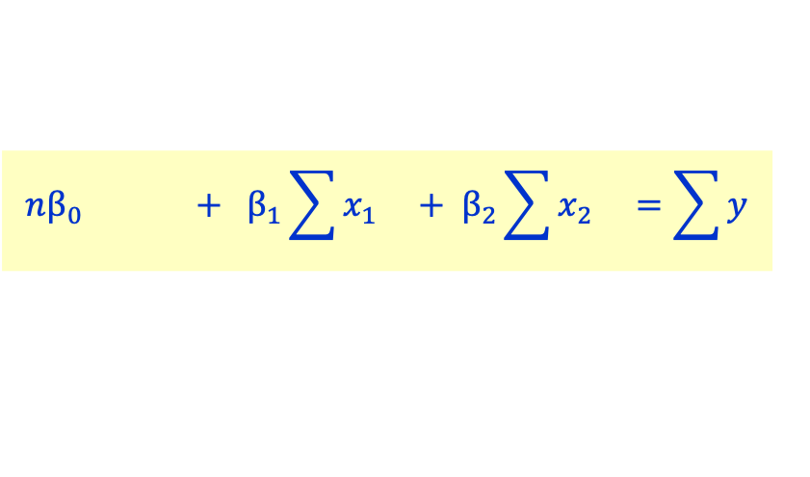
Normal Equations
$$y=β_{0}+β_{1}x_{1}+β_{2}x_{2}+⋯+β_{k}x_{k}+e$$
Computing the values of the population regression coefficients requires solving a system of normal equations.
  Example:
  For k = 2,
  and n is the
  number of
  value triplets
  $x_{1},$ $x_{2}$, and $y$.
$$nβ_{0} + β_{1}\sum{x_{1} + β_{2}\sum{x_{2} =\sum{y}}}$$
$$β_{0}\sum{x_{1}} + β_{1}\sum{x_{1}^{2} + β_{2}\sum{x_{1}x_{2}=}}\sum{x_{1}y}$$
$$β_{0}\sum{x_{2}} + β_{1}\sum{x_{1}x_{2} + β_{2}\sum{x_{2}^{2} =\sum{x_{2}y}}}$$

Slide 22
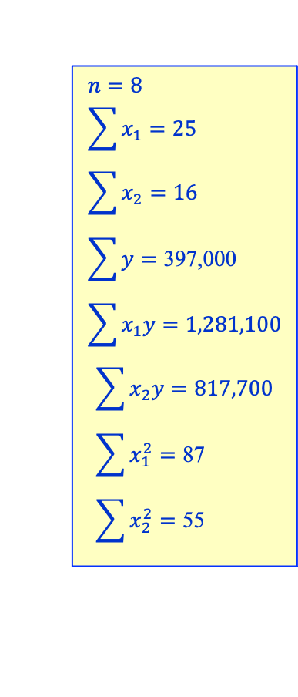
Multiple Regression Example: Home Prices
The following table of homes for sale
(obviously not in California):
$$n=8 \\ \sum{x_{1}=25} \\ \sum{x_{2}=16} \\ \sum{y=\text{397}\text{,}\text{000}} \\ \sum{x_{1}y}=1,281,100$$
$$\sum{x_{2}y}=817,700 \\ \sum{x_{1}^{2}=\text{87}} \\ \sum{x_{2}^{2}=\text{55}}$$
Number of bedrooms x₁ | Number of bathrooms x₂ | $ Price y
3 | 2 | 48,800
2 | 1 | 44,300
4 | 3 | 53,800
2 | 1 | 44,200
3 | 2 | 49,700
2 | 2 | 44,900
5 | 3 | 58,400
4 | 2 | 52,900

Slide 23
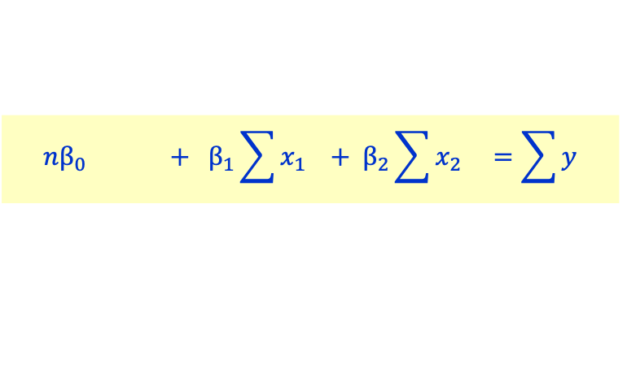
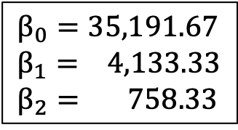
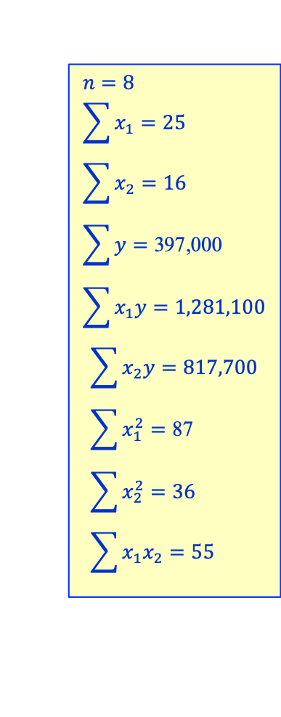
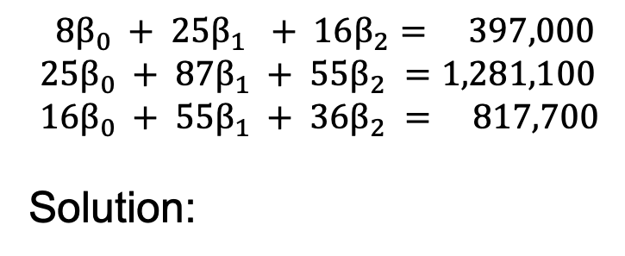

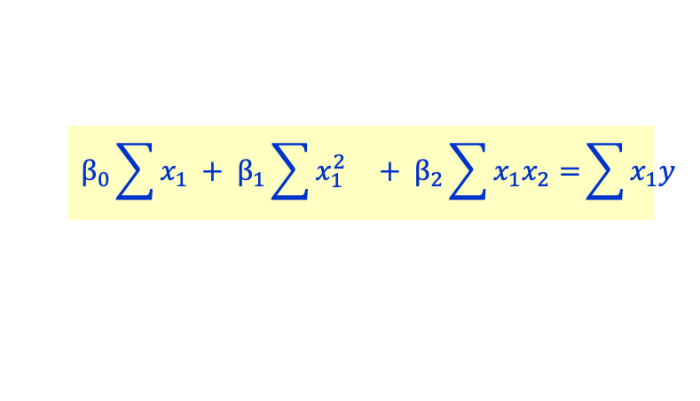
Example: Home Prices, cont’d
$$n=8 \\ \sum{x_{1}=25} \\ \sum{x_{2}=16} \\ \sum{y=\text{397}\text{,}\text{000}} \\ \sum{x_{1}y}=1,281,100$$
$$\sum{x_{2}y}=817,700 \\ \sum{x_{1}^{2}=\text{87}} \\ \sum{x_{2}^{2}=\text{36}} \\ \sum{x_{1}x_{2}=\text{55}}$$
$$nβ_{0} + β_{1}\sum{x_{1} + β_{2}\sum{x_{2} =\sum{y}}}$$
$$β_{0}\sum{x_{1}} + β_{1}\sum{x_{1}^{2} + β_{2}\sum{x_{1}x_{2}=}}\sum{x_{1}y}$$
$$β_{0}\sum{x_{2}} + β_{1}\sum{x_{1}x_{2} + β_{2}\sum{x_{2}^{2} =\sum{x_{2}y}}}$$
$$8β_{0} + 25β_{1} + 16β_{2}= 397,000 \\ 25β_{0} + 87β_{1} + 55β_{2} =1,281,100 \\ 16β_{0} + 55β_{1} + 36β_{2} = 817,700$$
Solution:
$$β_{0}=35,191.67 \\ β_{1}= 4,133.33 \\ β_{2}= 758.33$$
HomePrices.ipynb

Slide 24


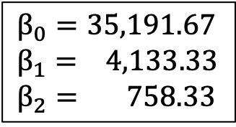

Example: Home Prices, cont’d
$$β_{0}=35,191.67 \\ β_{1}= 4,133.33 \\ β_{2}= 758.33$$
$$\hat{y}=β_{0} + β_{1}x_{1} + β_{2}x_{2}$$
$= 35,191.67$ +$4,133.33x_{1} +758.33x_{2}$
It’s $\hat{y}$ because we left off the e error term.
Estimated house price for
x₁ = 2 bedrooms and x₂ = 1 bathrooms:
Estimated house price for
x₁ = 5 bedrooms and x₂ = 3 bathrooms:
$35,191.67$ +$4,133.33\left(2\right)+758.33\left(1\right)=\$44,216.67$
$35,191.67$ +$4,133.33\left(5\right)+758.33\left(3\right)=\$58,133.33$

Slide 25
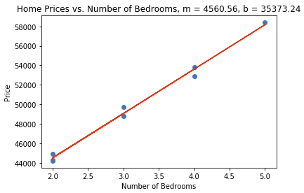
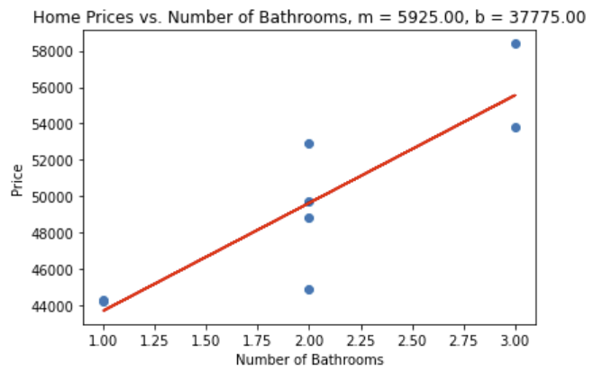
Example: Home Prices, cont’d
HomePrices.ipynb

Slide 26
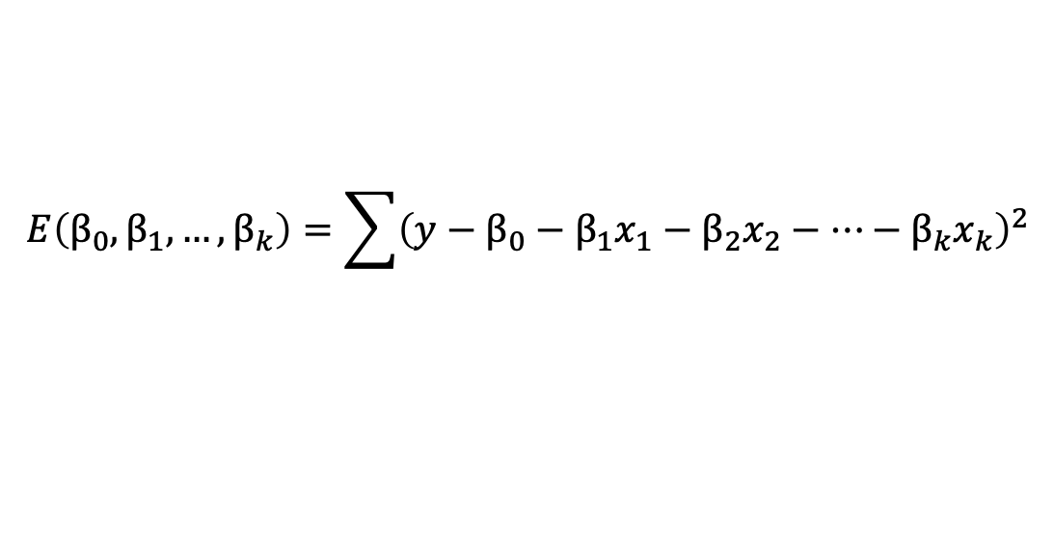
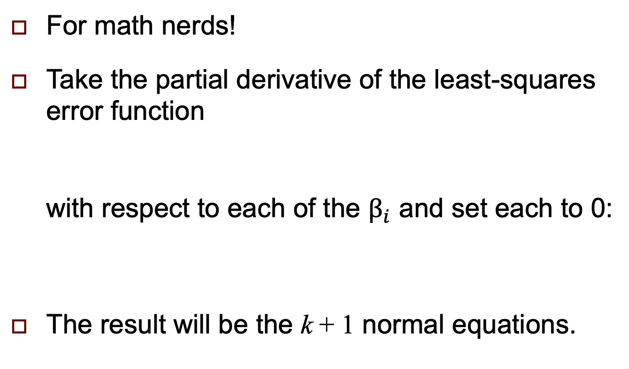
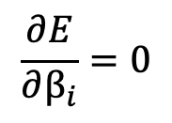
Derivation of the Normal Equations
For math nerds!
Take the partial derivative of the least-squares error function
with respect to each of the $β_{i}$ and set each to 0:
The result will be the k + 1 normal equations.
$$E\left(β_{0},β_{1},…,β_{k}\right)=\sum{{\left(y−β_{0}−β_{1}x_{1}−β_{2}x_{2}−⋯−β_{k}x_{k}\right)}^{2}}$$
$$\frac{∂E}{∂β_{i}}=0$$
for i = 0, 1, ..., k

Slide 27
Break
15 minutes

Slide 28
Introduction to Machine Learning
An exciting and promising subfield of
artificial intelligence (AI).
  Use large datasets.
  Rather than program expertise into applications, instead program applications to learn from data.
  Create powerful models to quickly analyze data, extract insights, and make predictions.
Use Python’s popular Scikit-Learn library to develop machine learning models.
  Use Scikit-Learn to train a model on a subset of the data and then test the model on the rest of the data.

Slide 29
Supervised Machine Learning
Work with labeled data.
  Example: Train a computer vision application to recognize photos of dogs and cats by showing it many photos correctly labeled “dog” or “cat”. If the resulting model is successful, the application will be able to recognize unlabeled photos of dogs and cats that it had not seen before.
Two types of supervised machine learning.
  classification
  regression

Slide 30
Unsupervised Machine Learning
Work with unlabeled data.
  Example: An online bookseller records large amounts of unlabeled book purchase data and notice that people who buy certain books often buy other books on the same or similar topics. Unsupervised machine learning supports the development of a recommendation system.
Clustering algorithms
  Example: k-means clustering to find similarities in unlabeled data.
  Use dimensionality reduction to compress a large feature set.

Slide 31
Datasets for Machine Learning
Scikit-learn comes with bundled datasets.
  See https://scikit-learn.org/stable/datasets/
More datasets are available at OpenML.
  See https://www.openml.org

Slide 32
Steps for Doing Machine Learning
Acquire and load the data.
Explore the data with Pandas and visualization.
Clean and transform the data as necessary.
  Scikit-Learn requires numeric data.
Split the data for training and testing.
Create the machine learning model.
Train and test the model.
Tune the model and evaluate its accuracy.
Use the model to make predictions on live data that the model hasn’t seen before.

Slide 33
Example: Time Series Analysis via ML
We’ll use the same NY City January temperatures dataset as before.
  We’ll use a machine learning approach
  to linear regression.
We’ll use the
sklearn.model_selection.train_test_split function to split the data for training and testing.
We’ll use the
sklearn.linear_model.LinearRegression
class to perform regression analysis.

Slide 34
Example: Time Series Analysis via ML, cont’d
Clean, transform, and load the data into a Pandas dataframe, as before.
Train the ML model using a training set
from the data and then test the model
using the (remaining) testing set.
  Use the train_test_split function from the sklearn.model_selection module.
Use scikit-learn estimators (ML algorithms).
  We’ll use the LinearRegression estimator.

Slide 35
Split Data for Training and Testing
from sklearn.model_selection import train_test_split
X_train, X_test, y_train, y_test =
train_test_split(nyc.Year.values.reshape(-1, 1),
nyc.Temperature.values,
random_state=11)
The function shuffles the data and then splits it:
  X_train, X_test: sample values split into two sets
  y_train, y_test: target values split into two sets
print(f'Shape of training set = {X_train.shape}')
print(f'Shape of testing set = {X_test.shape}')
Size of training set = (95, 1)
Size of testing set = (32, 1)

Slide 36
Split Data for Training and Testing, cont’d
from sklearn.model_selection import train_test_split
X_train, X_test, y_train, y_test =
train_test_split(nyc.Year.values.reshape(-1, 1),
nyc.Temperature.values,
random_state=11)
Scikit-learn estimators require their training and testing data to be two-dimensional arrays.
  The reshape function converts the one-dimensional array of nyc.Year.values into a two-dimensional array where each row consists of one column.
  The -1 tells reshape to infer the number of rows from the length of the data.

Slide 37
Train the Estimator
Train the LinearRegression estimator:
  The slope is an array for the general case of multivariate regression.
from sklearn.linear_model import LinearRegression
linear_regression = LinearRegression()
linear_regression.fit(X=X_train, y=y_train)
print(f'regression coefficient (slope) = {linear_regression.coef_}')
print(f' intercept = {linear_regression.intercept_}')
regression coefficient (slope) = [0.03061817]
intercept = -23.15950296932693

Slide 38
Test the Model
Test the model using the set of test data:
predicted = linear_regression.predict(X_test)
expected = y_test
for p, e in zip(predicted[::5], expected[::5]):
print(f'predicted: {p:.2f}, expected: {e:.2f}, difference: {p - e:.2f}')
predicted: 36.42, expected: 39.30, difference: -2.88
predicted: 34.92, expected: 34.30, difference: 0.62
predicted: 37.25, expected: 39.60, difference: -2.35
predicted: 35.14, expected: 28.10, difference: 7.04
predicted: 35.35, expected: 40.00, difference: -4.65
predicted: 37.22, expected: 39.50, difference: -2.28
predicted: 34.86, expected: 33.20, difference: 1.66
predicted: 38.02, expected: 45.80, difference: -7.78
predicted: 38.41, expected: 34.80, difference: 3.61
predicted: 36.64, expected: 41.20, difference: -4.56
. . .

Slide 39
Make Predictions
“Deploy” the model by using it to predict:
def predict_temperature(linear_regression, year):
m = linear_regression.coef_
b = linear_regression.intercept_
x = year
y_hat = m*x + b
return y_hat[0]
year = 2020
temp = predict_temperature(linear_regression, year)
print(f'The predicted temperature in year {year} is {temp:.2f}')
The predicted temperature in year 2021 is 38.75

Slide 40
Seaborn Scatter Plot
Use Seaborn to create a scatter plot.
Add a regression line.
import numpy as np
import matplotlib.pyplot as plt
import seaborn as sns
sns.set_style('whitegrid')
plt.figure(figsize=(10, 10))
axes = sns.scatterplot(data=nyc, x='Year', y='Temperature',
hue='Temperature', palette='winter',
legend=False)
axes.set_ylim(25, 50)
x = np.array([min(nyc.Year.values), max(nyc.Year.values)])
y = x*linear_regression.coef_ + linear_regression.intercept_
line = plt.plot(x, y)

Slide 41
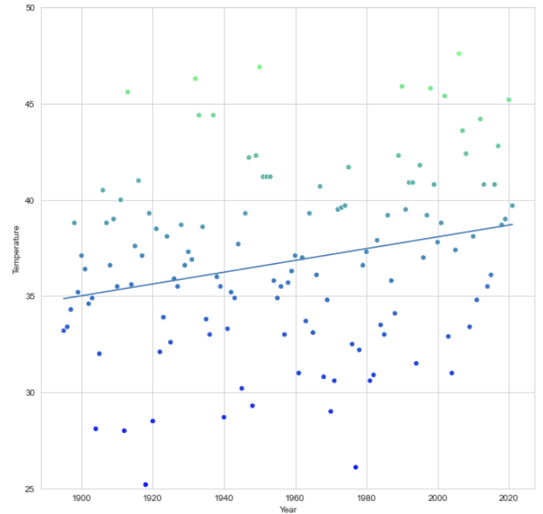
Seaborn Scatter Plot, cont’d
The temperature
determines the
hues of the dots.

Slide 42
Example: Multiple Regression via ML
Use the California Housing dataset.
  Derived from the 1990 U.S. census.
  20,640 samples, one per block
Attributes (x_{i} values for each block):
  median income in $10,000s (max value 5)
  median house age in years (max value 52)
  average number of rooms
  average number of bedrooms
  block population
  average house occupancy
  block house latitude
  block house longitude
Target (y values): median house value per sample, in $10,000s

Slide 43
Example: Multiple Regression via ML, cont’d
Split the data for training and testing:
CaliforniaHousing.ipynb
from sklearn.model_selection import train_test_split
X_train, X_test, y_train, y_test = \
train_test_split(california.data, california.target, random_state=11)
print(f'Shape of training set = {X_train.shape}')
print(f'Shape of testing set = {X_test.shape}')
Shape of training set = (15480, 8)
Shape of testing set = (5160, 8)

Slide 44
Example: Multiple Regression via ML, cont’d
Train the model:
from sklearn.linear_model import LinearRegression
linear_regression = LinearRegression()
linear_regression.fit(X=X_train, y=y_train)
for i, name in enumerate(california.feature_names):
print(f'{name:>11}: {linear_regression.coef_[i]:24.20f}')
print()
print(f'y-intercept: {linear_regression.intercept_:23.20f}')
MedInc: 0.43770302153822177038
HouseAge: 0.00921683456579792774
AveRooms: -0.10732526637361011757
AveBedrms: 0.61171330739181228875
Population: -0.00000575682200929482
AveOccup: -0.00338456646571639458
Latitude: -0.41948186096490608366
Longitude: -0.43377133498740105821
y-intercept: -36.88295065605546341203
Why are some
coefficients
negative?
What can you
say about the
population?

Slide 45
Example: Multiple Regression via ML, cont’d
Test the model:
import math
from sklearn import metrics
predicted = linear_regression.predict(X_test)
expected = y_test
r2 = metrics.r2_score(expected, predicted)
r = math.sqrt(r2)
print(f'coefficient of determination = {r2:.1f}')
print(f' correlation coefficient = {r:.1f}')
coefficient of determination = 0.6
correlation coefficient = 0.8
Strong linear correlation

Slide 46
Example: Multiple Regression via ML, cont’d
Visualize the expected vs. predicted prices:
df = pd.DataFrame()
df['Expected'] = pd.Series(expected)
df['Predicted'] = pd.Series(predicted)
figure = plt.figure(figsize=(15, 10))
axes = sns.scatterplot(data=df, x='Expected', y='Predicted',
hue='Predicted', palette='cool',
legend=False)
start = min(expected.min(), predicted.min())
end = max(expected.max(), predicted.max())
axes.set_xlim(start, end)
axes.set_ylim(start, end)
line = plt.plot([start, end], [start, end], 'k--')

Slide 47
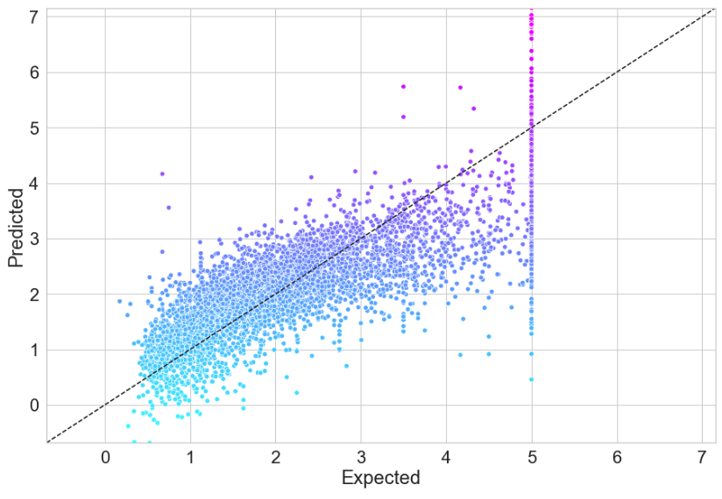
Example: Multiple Regression via ML, cont’d

Slide 48
Underfitting and Overfitting
Two common problems that can prevent
a machine learning model from making accurate predictions.
Underfitting
  The model is too simple to make predictions,
  based on its training data.
  Attempt to use a linear model when the data
  is in fact non-linear.

Slide 49
Underfitting and Overfitting, cont’d
Overfitting
  The model is too complex.
  The model has too many independent variables.
  The model memorizes its training data.
  The model works only if the new data
  looks exactly like its training data.
  The model doesn’t work with new data
  that is unlike the training data.

Slide 50
Lab Assignment #8: Multiple Regression
Identify a suitable dataset for
multiple regression analysis.
  Clean, transform, and load.
Analysis
  Verify that the dependent variable is linearly related to the independent variables.
  Use NumPy, Pandas, SciPy, Scikit-Learn, etc. to perform the analysis.
Use Matplotlib, Seaborn, etc. to create graphs.

Slide 51
Lab Assignment #8, cont’d
You should perform at least the analyses and generate similar graphs as the California Housing example given in class.
  CaliforniaHousing.ipynb

Slide 52
Datasets Bundled with Scikit-Learn
Datasets bundled with scikit-learn
“Toy” datasets Boston house prices Iris plants Diabetes Optical recognition of handwritten digits Linnerrud Wine recognition Breast cancer Wisconsin (diagnostic) | Real-world datasets Olivetti faces 20 newsgroups text Labeled Faces in the Wild face recognition Forest cover types RCV1 Kddcup 99 California Housing
See: https://scikit-learn.org/stable/datasets/
and: https://www.openml.org
Python for Programmers
by Paul Deitel and Harvey Deitel
Pearson, 2019
ISBN 9780135231364

