Slide 1


DATA 201
Database Technologies for Data Analytics
April 10 Class Meeting
Department of Applied Data Science
San Jose State University
Spring 2025
Instructor: Ron Mak
www.cs.sjsu.edu/~mak

Slide 2
This Evening
Five solutions for the linear regression problem.
Clean data prior to analysis
  What to do about outliers
An estimation problem
Replace missing or corrupt values
with averages or linear regression values
  using client-side Python
It’s time to do
data analysis!

Slide 3
This Evening, cont’d
Break
Replace missing or corrupt values
with linear regression values
  using server-side SQL
Multiple regression with client-side Python
and server-side SQL
  two and three independent variables
Team project description

Slide 4
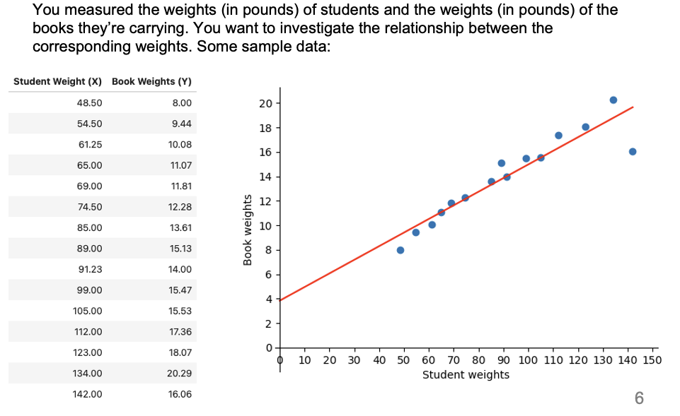
Data Analytics Problem
Can you now solve this waiver exam problem?

Slide 5
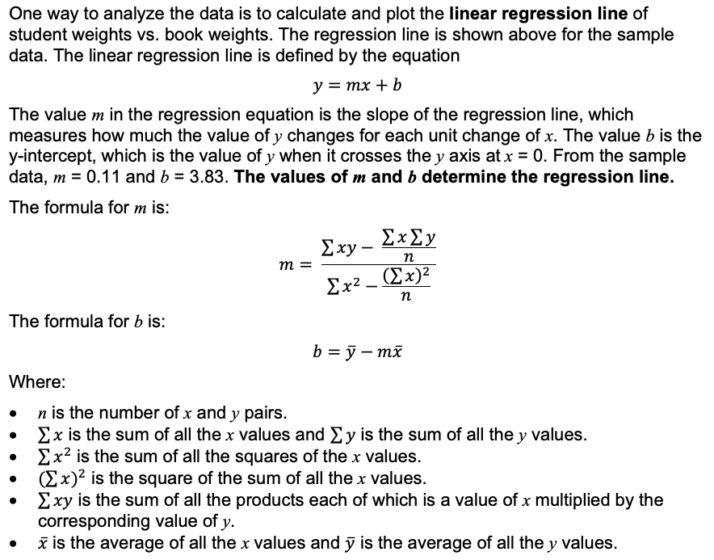
Data Analytics Problem, cont’d

Slide 6
Data Analytics Problem, cont’d
If the database table contains millions of records, you do not want to download all the records to the client side and in order to use a Python program to calculate the slope m and the y-intercept b.
  Much network traffic and latencies.
  Keep the data on the database server.
Do all the math in SQL on the database server.
  Then in your clientside Python program, query for and download only the values of m and b.

Slide 7
Five Solutions for Linear Regression
Five ways in SQL to calculate linear regression
coefficients m and b on the database server.
  CTEs
  Views
  Nested subqueries
  User-defined variables
  Stored procedures
LinearRegression-solution.ipynb

Slide 8
What Do Data Scientists Do?
Surveys show that data scientists spend an average of 80% of their time acquiring, cleaning, transforming, and loading data.
  ETL (extract, transform, and load).
  “Data wrangling”
  The remaining time for analyzing the data?
How do we structure the data in a database
to facilitate data analysis?
  What if it’s “Big Data” and we want to do
  data mining?

Slide 9
Cleaning the Data
Missing or corrupted data values
  Throw out records containing missing
  or corrupted data.
  Replace the missing or corrupted data.
  Will these tactics bias your data analysis?
Outliers
  What values are outliers?
  Throw out or replace the outliers?
  How do we know the outlier values aren’t
  statistically significant?

Slide 10
Cleaning the Data, cont’d
Irrelevant data
  Ignore data that is not pertinent to your analysis.
  Be wary of unexpected correlations between the “irrelevant” data and the data you want to analyze.
Resolution
  Data that is not at the scale that you need.
  Example: Daily data but you need hourly data.
Format
  You need to reformat your data to work with your analysis procedures.

Slide 11
What are Outliers?
What data values to consider outliers depends on the application.
  Example: A person’s age is negative
  or over 125 years.
Throwing out or replacing an outlier may cause you to miss something important in your data!
  You can treat an outlier like a missing value
  and replace it.

Slide 12
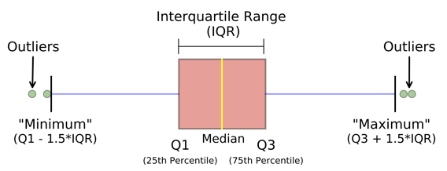
What are Outliers? cont’d
A statistical definition of outliers:
Reminder: The interquartile range (IQR) of a dataset are the values within the second (Q2) and third (Q3) quartiles
  Middle values that include 25 – 75% of the values.

Slide 13
Replace Missing or Corrupted Data Values
Some data records may have missing or corrupted field values.
  You don’t want to throw out those records entirely because other fields of the records contain important values. (Are your tables normalized?)
How can you replace the bad field values in ways that allow you to analyze all the data and won’t bias your analysis?
  Replace with average values. Which averages?
  Use regression to replace with approximate values.

Slide 14
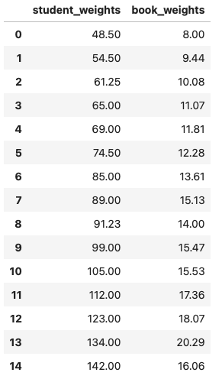
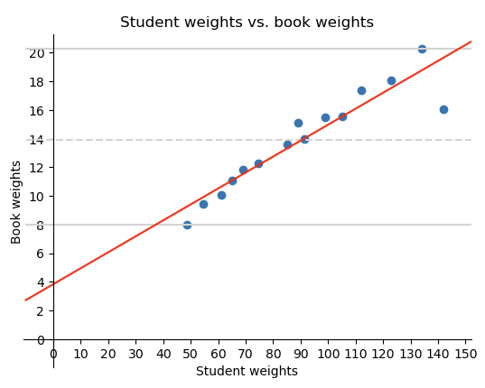

Linearly Correlated Data
We determined that the weight of a student and the weight of the books that the student can carry are linearly correlated.

Slide 15
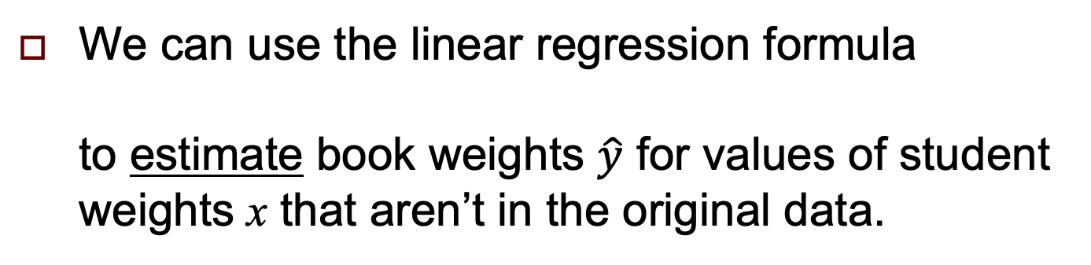
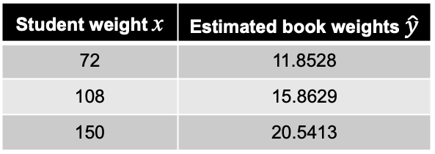
An Estimation Problem
We can use the linear regression formula
to estimate book weights $\hat{y}$ for values of student weights x that aren’t in the original data.
We had calculated m = 0.1113 and b = 3.8327
Student weight x | Estimated book weights $\hat{y}$
72 | 11.8528
108 | 15.8629
150 | 20.5413

Slide 16
Missing Weights
Suppose we have rows with a missing student or books weight.
  You don’t want to throw out the “bad” rows.
What values can you use to replace the missing values and still make good estimates?
  Replace each missing student weight with the average of the “good” student weights and replace each missing books weight with the average of the “good” book weights.
  Replace each missing value with an estimate computed from a regression of the “good” values.

Slide 17
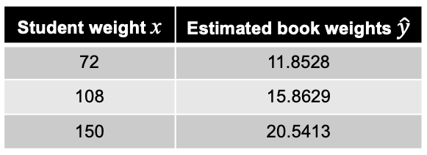
Missing Data, cont’d
baseline
Use the estimated values
from the full data as the
baseline estimates.
Which is better?
  Replace missing values with averages of the “good” values, compute book weight estimates, and compare them to the baseline estimates.
  Replace missing values with regression values from the “good” values, compute book weight estimates, and compare them to the baseline estimates.
MissingWeightsPython.ipynb

Slide 18
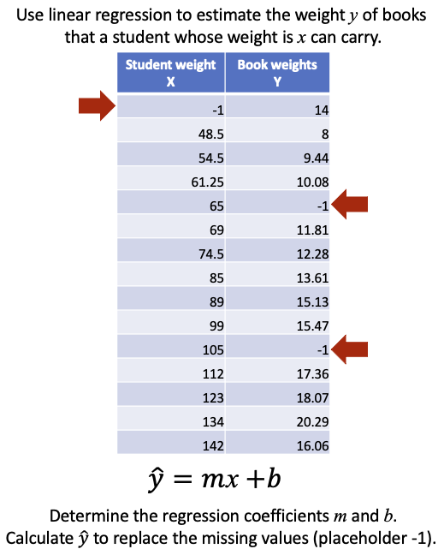
Linear Regression Analysis
If the “good” data points are linear,
use linear regression analysis to compute replacement values for the missing or corrupted values.

Slide 19
Break

Slide 20
Recall: Client-Server Architecture
Local machine
localhost
network
MySQL
database server
Python
database
application
"""
SELECT *
FROM teacher
"""
Databases
results
"""
SELECT *
FROM teacher
"""
Port 3306
MySQL
Workbench
"""
SELECT *
FROM teacher
"""
results
results
Terminal
running
mysql
client app
"""
SELECT *
FROM teacher
"""
results
Web apps
"""
SELECT *
FROM teacher
"""
Web
Browser
Apache
web server
results
Remote machine
IES-ADS-ClassDB.sjsu.edu

Slide 21
Client Side vs. Server Side
We want to reduce network traffic and latencies between the client and the server.
Therefore, it is undesirable to download table rows from the database server in order to clean data or calculate regression coefficients
on the client side.
  Especially if the table contains many rows (Big Data).
Use SQL code to do the work in the database server and download only the results.

Slide 22
Recall: SQL IF Function
Syntax and semantics of the SQL IF function.
  Do not confuse with the IF statement used in stored procedures and functions.
Evaluate the conditional_expression
Then the value of the IF function is
  value_if_true if the condition evaluates to true
  value_if_false otherwise
IF ( conditional_expression, value_if_true, value_if_false )

Slide 23
Clean Dirty Data with SQL
Instead of doing it with Python code on the client side, we can clean a dirty table in SQL using regression estimates in the database server.
  Example: Use stored procedures.
MissingWeightsLoad.ipynb
MissingWeightsProcs.ipynb

Slide 24

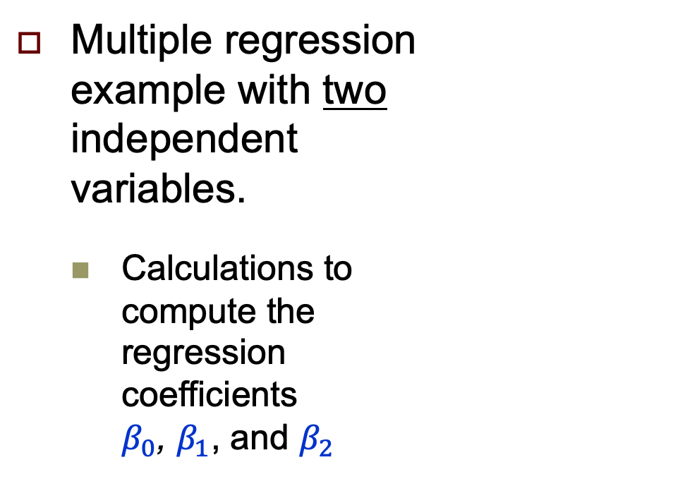
Multiple Linear Regression: Two Independents
Multiple regression
example with two
independent
variables.
  Calculations to
  compute the
  regression
  coefficients
  $β_{0}$, $β_{1}$, and $β_{2}$
Number of bedrooms x₁ | Number of bathrooms x₂ | $ Price y
3 | 2 | 48,800
2 | 1 | 44,300
4 | 3 | 53,800
2 | 1 | 44,200
3 | 2 | 49,700
2 | 2 | 44,900
5 | 3 | 58,400
4 | 2 | 52,900
HomePricesSklearn.ipynb
HomePricesSQL.ipynb

Slide 25
Linear Regression with sklearn.linear_model
The Python code used sklearn.linear_model:
Function linear_regression.fit() uses matrix arithmetic to calculate the coefficients.
  See https://online.stat.psu.edu/stat462/node/132/
from sklearn.linear_model import LinearRegression
X = np.array([X1, X2]).T
linear_regression = LinearRegression()
linear_regression.fit(X, Y)
β0 = linear_regression.intercept_
β1 = linear_regression.coef_[0]
β2 = linear_regression.coef_[1]

Slide 26
Linear Regression with Matrices
Decompose sklearn.linear_model and use matrices and vectors:
  matrix homes
  matrix base
  vector univariate_regression
  matrix residuals
  vector multiple_regression_2
    This vector will contain the regression coefficients
    β₀, β₁, and β₂:
HomePricesMatrix.ipynb

Slide 27
Multiple Linear Regression with SQL
To perform multiple linear regression with two independent variables on the database server, we can recreate the Python matrix operations
in SQL.
HomePricesSQL.ipynb

Slide 28
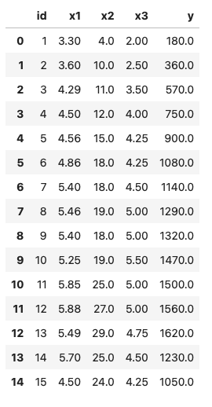
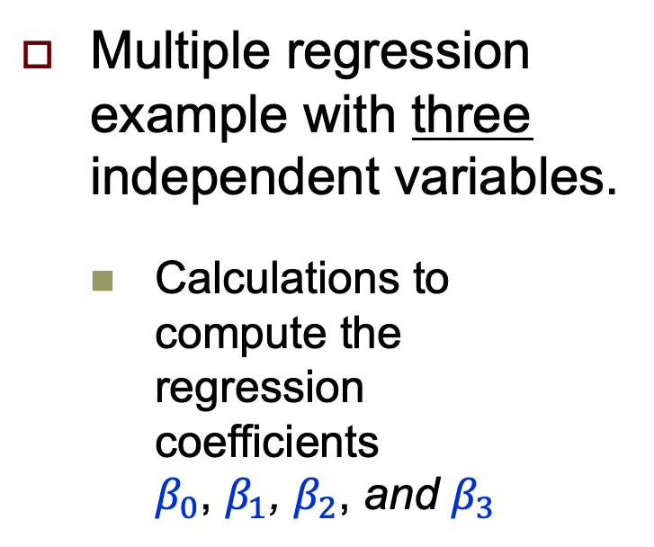

Multiple Linear Regression: Three Independents
Multiple regression
example with three
independent variables.
  Calculations to
  compute the
  regression
  coefficients
  $β_{0}$, $β_{1}$, $β_{2}$, and $β_{3}$
ThreeIndependentsSklearn.ipynb
ThreeIndependentsSQL.ipynb
$$\hat{y}=β_{0}+β_{1}x_{1}+β_{2}x_{2}+β_{3}x_{3}$$

Slide 29
Next Several Weeks
Operational vs. analytical databases
How to structure a relational database to facilitate data analysis.
  dimensional modeling
  fact tables and dimension tables
  star schema
Online analytical processing (OLAP)
Data warehouse

Slide 30
Team Database Projects
Each project team produces:
  Operational database
  + GUI-based Python application
  Analytical database
  + GUI-based Python application
Demonstrate how well you can apply what you learned during the semester.
  Not all technologies have to be used.
Live demos
  Evaluated by the class via Canvas surveys
Analytical databases to be covered over the next few weeks.

Slide 31
Team Database Projects, cont’d
Data for the operational database
  Actual commerce or experimental data
  Dataset(s) downloaded from the web
  Artificially generated data (e.g., mockeroo)
The frontend GUI-based Python application for the operational database should demonstrate user queries and updates and display their results.

Slide 32
Team Database Projects, cont’d
Data for the analytical database
  Extracted from the operational database.
  ETL from external sources.
The frontend GUI-based Python application for the analytical database should demonstrate analytical operations and display their results.
Analytical databases to be covered over the next few weeks.

Slide 33
Team Database Projects, cont’d
Python code (notebook or standalone)
  Use the shared school server (provide access info)
Written report (10 – 20 pages)
  What is the application?
  Describe your operational and analytical databases.
  What data did you use, and where did you get it?
  Include:
    ER diagram
    Relational and star schemas
    Operational and analytical queries
    User scenarios with screen shots
Star schemas and analytical queries to be covered over the next few weeks.

