Slide 1


DATA 201
Database Technologies for Data Analytics
March 27 Class Meeting
Department of Applied Data Science
San Jose State University
Spring 2025
Instructor: Ron Mak
www.cs.sjsu.edu/~mak

Slide 2
This Evening
Go over Checkpoint Exam #2 solutions
Transactions
ACID properties
Break
Concurrency and locking
Data loss and recovery
Reliability and RAID
Data analytics problem (from the waiver exam)

Slide 3
Transaction Management
Protect the database during transactions.
Concurrency control
  Allow simultaneous use of the database
  without users interfering with one another.
Recovery
  Restore the database to
  a correct state after a failure.

Slide 4
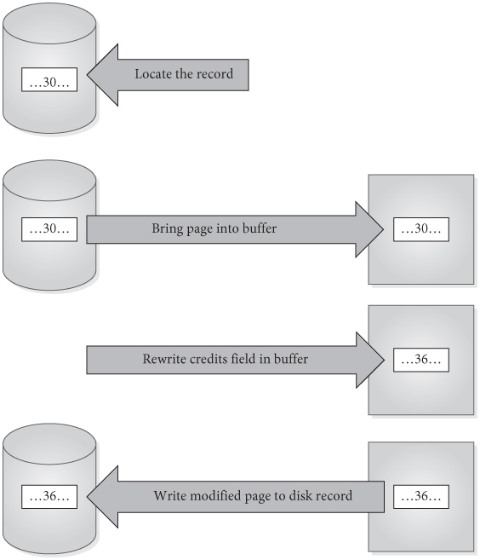
Simple Update of One Record
Locate the record to be updated.
Bring the page into the buffer
Write the update to the buffer.
Write the modified page out to disk.
Databases Illuminated, 3rd ed.
by Ricardo & Urban
Jones & Bartlett Learning, 2017
ISBN 978-1-284-05694-5

Slide 5
The Need to Commit
From Python, using the mysql.connector:
  If you update a table (such as an insertion)
  and then query its contents, you will see the
  updated contents.
  But what you see is the buffer contents and
  not the physical table contents.
  You must issue a commit command to push the buffer contents to the physical table.
    Either use the SQL COMMIT command or the connector object’s commit() function.
CommitTest.ipynb

Slide 6
Steps in a Transaction
More complicated transactions may involve several updates.
A modified buffer page might not be written to disk immediately after the transaction completes.
We should assume there is a delay before the actual disk write is done.

Slide 7
Basic Ideas About Transactions
Transaction: a logical unit of work that takes the database from one consistent state to another.
Transactions can terminate successfully
and commit.
Transactions can terminate unsuccessfully
and be aborted.
Aborted transactions must be rolled back (undone) if they changed the database.
Committed transactions cannot be rolled back.

Slide 8
ACID Properties of Transactions
Atomicity
Consistency
Isolation
Durability

Slide 9
ACID Properties of Transactions: Atomicity
The entire set of database update operations
are all carried out, or none are.
  Guarantee that multiple operations that alter tables can be treated as one indivisible unit of work.
The DBMS must roll back a transaction
if it changed the database but was not able
to complete successfully.
The rollback process uses the database server’s log of the transaction writes.

Slide 10
ACID Properties of Transactions: Consistency
Applications are responsible for ensuring that each transaction, if executed individually,
leaves the database in a consistent state.
  Example inconsistency: During a transfer of $100 from Account A to Account B, subtract $100 from Account A but fail to add $100 to Account B.
The DBMS’s concurrency control subsystem ensures this for multiple transactions.
  Multiple users can be updating the database
  at the same time.

Slide 11
ACID Properties of Transactions: Isolation
When transactions execute simultaneously,
the DBMS ensures that the final effect is
as if the transactions were executed serially (i.e., in isolation).
Interleaved transactions should not interfere, nor present intermediate results to one another, before having reached a committed state.

Slide 12
ACID Properties of Transactions: Durability
The effect of any committed transaction
is recorded in the database.
  Even if the system crashes before all its writes
  are made to the database.
The DBMS’s recovery subsystem guarantees durability.

Slide 13
Transaction Support in MySQL
MySQL is normally in autocommit mode.
  In both MySQL Workbench and the commandline mysql application, each statement is committed
  as soon as it has executed.
  Each statement is its own transaction.
MySQL Connector/Python turns autocommit off by default.
  Use the autocommit keyword to turn it on or off.
conn = MySQLConnection( ... autocommit=True ... )

Slide 14
Transaction Support in MySQL, cont’d
To perform an explicit transaction, turn off
auto-commit with START TRANSACTION.
After performing operations that are part of
the transaction, ROLLBACK or COMMIT the transaction.

Slide 15
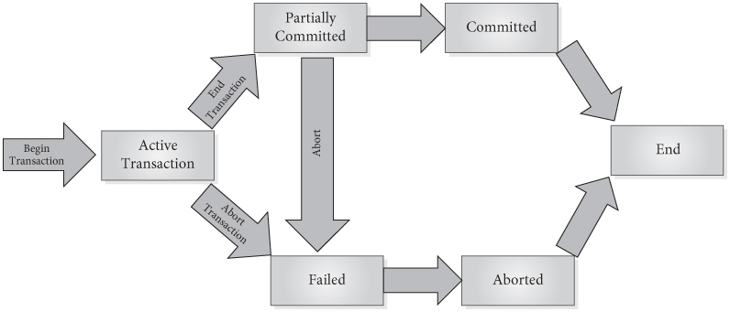
Transaction Support in MySQL, cont’d
Examples:
Transactions-commands.ipynb
Transactions-methods.ipynb
Databases Illuminated, 3rd ed.
by Ricardo & Urban
Jones & Bartlett Learning, 2017
ISBN 978-1-284-05694-5

Slide 16
Break

Slide 17
Concurrency Problems
Concurrency control is needed when transactions are permitted to execute simultaneously, if at least one performs
an update.
Potential problems due to a lack of
concurrency control:
  Lost update
  Uncommitted update
  Inconsistent analysis

Slide 18
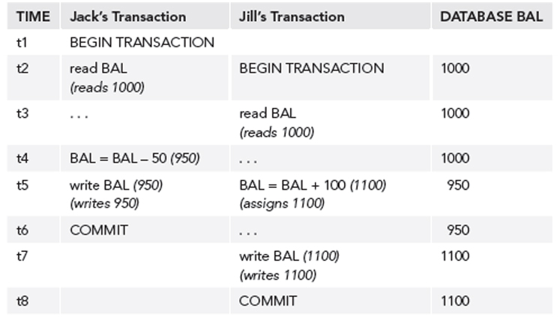
Lost Update Problem
Jack’s update is lost.
Databases Illuminated, 3rd ed.
by Ricardo & Urban
Jones & Bartlett Learning, 2017
ISBN 978-1-284-05694-5

Slide 19
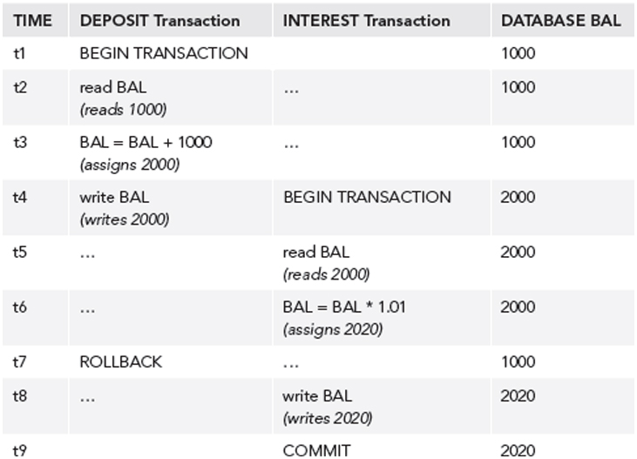
Uncommitted Update Problem
The rollback invalidates
data used by the other.
Databases Illuminated, 3rd ed.
by Ricardo & Urban
Jones & Bartlett Learning, 2017
ISBN 978-1-284-05694-5

Slide 20
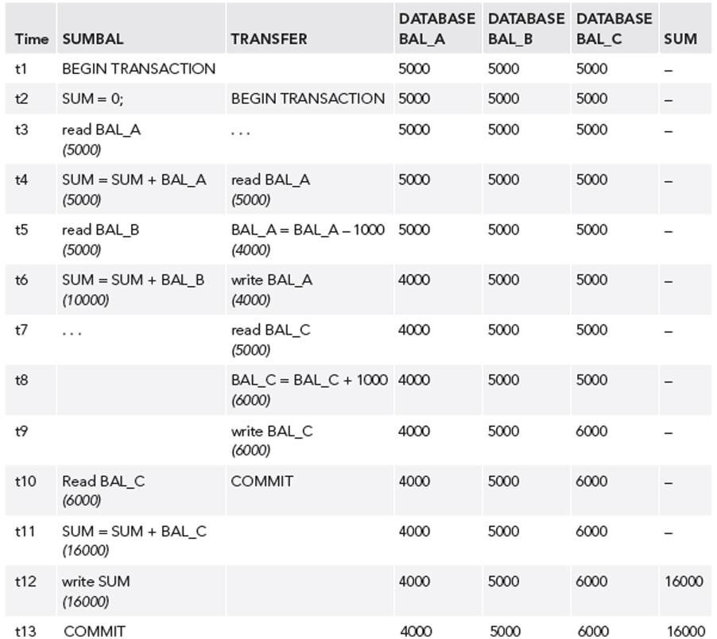
Inconsistent Analysis Problem
SUMBAL
Compute the sum
of all three balances.
TRANSFER
Move $1000 from
BAL_A to BAL_C.
Transaction SUMBAL
reads several values
to sum them.
But meanwhile,
transaction TRANSFER
updates those values.
Databases Illuminated, 3rd ed.
by Ricardo & Urban
Jones & Bartlett Learning, 2017
ISBN 978-1-284-05694-5

Slide 21
Non-Repeatable Read Problem
The first transaction reads an item.
The second transaction writes
a new value for the item.
  The first transaction rereads the item
  and gets a different value.

Slide 22
Phantom Data Problem
The transaction T1 reads a set of rows.
The transaction T2 inserts a row.
  The transaction T1 reads the rows again
  and sees the new row.

Slide 23
Transaction Conflicts
If two transactions are only reading data items, they do not conflict, and execution order is not important.
If two transactions operate on completely separate data items, they do not conflict,
and execution order is not important.
If one transaction writes to a data item and another transaction either reads or writes
to the same data item, then execution
order is important.

Slide 24
Transaction Conflicts, cont’d
Therefore, two operations conflict
only if all of these are true:
  They belong to different transactions.
  They access the same data item.
  At least one of them writes to the item.

Slide 25
Locking
A transaction can ask the DBMS to place
locks on database objects to prevent another transaction from modifying the objects.
Locking and unlocking can be made implicitly by the DBMS when a transaction begins and commits, respectively.
  The transaction manager interacts with the
  lock manager.
Explicit locking: SQL LOCK TABLES and
UNLOCK TABLES commands.

Slide 26
Locking, cont’d
Transactions may be made to wait
until locks are released before their
lock requests can be granted.
Objects of various sizes (database, table, page, record, data item) can be locked.
  Size determines the granularity of the lock.

Slide 27
Shared and Exclusive Locks
A transaction must acquire a lock on any item
that it needs to read or write.
Shared lock
  Multiple transactions can read but not update the item, if no other transaction has an exclusive lock on the item.
Exclusive lock
  A single transaction can both read and update the item, if no other transaction has a shared or exclusive lock on the item.

Slide 28
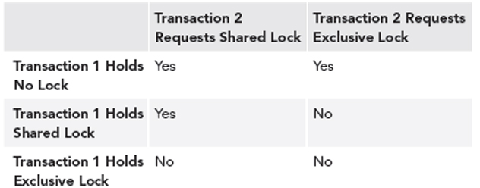
Lock Compatibility
Databases Illuminated, 3rd ed.
by Ricardo & Urban
Jones & Bartlett Learning, 2017
ISBN 978-1-284-05694-5

Slide 29
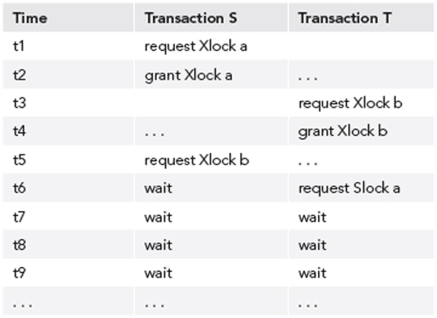
Deadlocks
Two transactions are each waiting for locks
held by the other to be released.
Databases Illuminated, 3rd ed.
by Ricardo & Urban
Jones & Bartlett Learning, 2017
ISBN 978-1-284-05694-5

Slide 30
Two-Phase Locking Protocol
Guarantees serializability.
Every transaction acquires all its locks before releasing any, but not necessarily all at once.
A transaction has two phases:
  Growing phase: The transaction obtains locks.
  Shrinking phase: The transaction releases locks.
Once it enters its shrinking phase, a transaction cannot obtain a new lock.

Slide 31
Two-Phase Locking Protocol, cont’d
Recall:
Jack’s update is lost.
Databases Illuminated, 3rd ed.
by Ricardo & Urban
Jones & Bartlett Learning, 2017
ISBN 978-1-284-05694-5

Slide 32
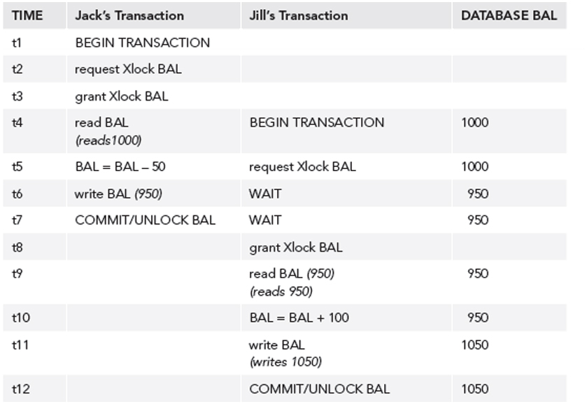
Two-Phase Locking Protocol, cont’d
After application of two-phase locking:
Databases Illuminated, 3rd ed.
by Ricardo & Urban
Jones & Bartlett Learning, 2017
ISBN 978-1-284-05694-5

Slide 33
Optimistic Techniques
AKA validation techniques.
Assume that conflicts will be rare.
Transactions proceed as if there were no concurrency problems.
Before a transaction commits, perform a check to determine whether a conflict has occurred.
  If there is a conflict, must roll back the transaction.
  Assume rollback will be rare.
  Rollback is the price to be paid for eliminating locks.
Allow more concurrency, since no locking.

Slide 34
Need for Recovery
Many different types of failures can affect database processing:
  Natural physical disasters
  Sabotage
  Carelessness
  Disk malfunctions that result in loss of stored data.
  System crashes due to hardware malfunctions that result in loss of main and cache memory
  System software errors that result in abnormal termination or damage to the DBMS
  Application software errors

Slide 35
Possible Effects of Failure
Loss of main memory,
including database buffers.
Loss of the disk copy of the database.
Failure to write data safely to disk.
The DBMS recovery subsystem uses techniques that minimize these effects.

Slide 36
Recovery Manager
DBMS subsystem responsible for ensuring atomicity and durability for transactions in the event of failure.
Atomicity: Perform all or none of a transaction.
  All the effects of committed transactions must reach the database, and that the effects of any uncommitted transactions must be undone.
Durability: Effects of a committed transaction are permanent.
  All effects must survive loss of main memory, loss of disk storage, and failure to write safely to disk.

Slide 37
Failure to Write
Write modified pages first to the local disk
and then to the mirror or remote disk.
  The output is considered done
  after both writes are complete.
If a data transfer error is detected,
examine both copies.
  If they are identical, the data is correct.
  If one has an error condition, use the other copy to replace the faulty data.
  If neither has an error condition but they have different values, undo the writes.

Slide 38
System Failure
If system failure occurs:
  Database buffers are lost.
  Disk copy of the database survives, but it may be incorrect due to partial transactions.
A transaction can commit once its writes are made to the database buffers.
Updates made to buffers are not automatically written to disk, even for committed transactions.

Slide 39
System Failure, cont’d
There may be a delay between a commit and actual disk writing.
If the system fails during this delay, we must ensure that these updates reach the disk copy of the database.

Slide 40
Recovery Log
Contains records of each transaction showing:
  the start of a transaction
  the write operations of a transaction
  the end of a transaction
If system fails, the log is examined:
  what transactions to redo
  what transactions to undo
Redo: Redo writes,
not re-execute the transaction.
Undo: Roll back writes.

Slide 41
Deferred Update Protocol
The DBMS does all database writes in the log, and it does not write to the database until the transaction is ready to commit.
The log protects against system failures.
Use log records to perform the updates to the database buffers.
  Later, these updated pages will be written to disk.
If the transaction aborts, ignore the log records.

Slide 42
Checkpoints
After a failure, we may not know how far back in the log to search for redo of transactions.
Limit log searching by using checkpoints.
  Scheduled at predetermined intervals.
Checkpoint operations
  Write modified blocks in the database buffers to disk.
  Write a checkpoint record to the log that contains the names of all the transactions that are active at the time of the checkpoint.
  Write all log records now in main memory out to disk.
Managed internally by the MySQL server.
See: https://dev.mysql.com/doc/refman/8.0/en/innodb-checkpoints.html

Slide 43
Loss of Disk Data
Do frequent backups.
In case of disk failure, the backup can be brought up to date using a log of transactions.
Good practices:
  mirrored disks
  RAID storage
  remote live backup site
How can we minimize data loss from disk failures?

Slide 44
RAID
Redundant Array of Independent Disks
  formerly: Redundant Array of Inexpensive Disks
A data storage virtualization technology.
Combine multiple physical disk drive components into one or more logical units.
Provide data redundancy or
performance improvement, or both.

Slide 45
RAID, cont’d
The term “RAID” was invented by David Patterson, Garth Gibson, and Randy Katz.
  U.C. Berkeley, 1987
Claim: An array of inexpensive disk drives could beat the performance of the top mainframe disk drive at the time.
  Distribute the data across the array of disk drives.
  The inexpensive disk drives were developed
  for the growing personal computer market.

Slide 46
MTTF
Large disk arrays are highly vulnerable
to disk failures.
An array of 100 disks is 100 times
more likely to fail than a single disk.
  Example: An MTTF (mean time to failure) of
  50,000 hours for a single disk implies an MTTF of 500 hours for a disk array with 100 disks.

Slide 47
Reliability and Availability
Reliability
  How well a system can work
  without any component failures.
Availability
  How well a system a system can work
  despite any failures of its components.
Configure a disk array for redundancy.
  The reliability of the array can far exceed
  that of any large single drive.
  Provide fault tolerance.

Slide 48
Reliability and Availability, cont’d
With a single hard disk,
high costs of a disk failure.
Time required to:
  Obtain and install a replacement disk.
  Reinstall the operating system.
  Restore files from backup tapes.
  Repeat all the data entry performed
  since the last backup was made.

Slide 49
Reliability and Availability, cont’d
With a disk array and redundancy,
the system can stay up and running:
  Despite a disk failure.
  While installing a replacement disk.
  While restoring data.

Slide 50
Parallel Access
If the RAID hardware and software can perform true parallel accesses on multiple drives,
there will be a performance improvement
over a single disk.

Slide 51
Cost-Effective RAID
For an optimal cost-effective RAID implementation, simultaneously:
  Maximize the number of disks
  accessed in parallel.
  Minimize the amount of disk space
  used for redundant data.
  Minimize the overhead required
  to achieve the above goals.

Slide 52
Data Striping
Data striping improves performance.
Transparently distribute data
over multiple disks.
Make the multiple disks appear
as a single fast, large disk.

Slide 53
Data Striping, cont’d
Improve aggregate I/O performance by allowing multiple I/O’s to be serviced in parallel.
Multiple, independent requests can be serviced in parallel by separate disks.
  Decrease the queueing time seen by I/O requests.
Single, multiple block requests can be serviced by multiple disks acting in coordination.
  Increase the effective transfer rate of a single request.
  The performance benefits increase
  with the number of disks in the array.

Slide 54
Data Redundancy
Use redundancy to overcome the decreased reliability of an array of multiple disks.
Select a method to compute
the redundant information.
  Most use parity.

Slide 55
Data Redundancy, cont’d
How to distribute redundant information?
Concentrate the redundant information
on a small number of disks.
Distribute redundant information uniformly
across all the disks.
  Avoid “hot spots” and load balancing problems.

Slide 56
RAID Levels
There are several data distribution schemes,
called RAID levels.
RAID levels and their associated data formats are standardized by
the Storage Network
Industry Association
(SNIA).
  Common RAID
  Disk Drive Format
  (DDF) standard.
http://www.ace-data.com/storage-consolidation/

Slide 57
RAID Level 0 (Disk Striping)
Minimum two disks.
No fault tolerance.
  Lose data if a disk fails.
  Do not use if data is mission critical.
Blocks striped.
  Excellent performance.
No redundancy.
  No mirror or parity.
http://www.maxtronic.com/index.php/techenical-briefs/raid-tutorial

Slide 58
RAID Level 1 (Disk Mirroring)
Minimum two disks.
Very high reliability.
Continued data availability.
No improvement in data access speed.
Low capacity.
Blocks mirrored.
  Good performance.
  100% redundancy.
http://www.maxtronic.com/index.php/techenical-briefs/raid-tutorial

Slide 59
RAID Level 3 (Striping, Dedicated Parity)
Minimum three disks.
Good for applications that require a single I/O stream with a high data transfer rate.
  Large blocks of sequential data must be transferred quickly.
  Examples: graphical imaging processors, CAD/CAM files
Dedicated parity disk.
http://www.maxtronic.com/index.php/techenical-briefs/raid-tutorial

Slide 60
RAID Level 5 (Striping, Distributed Parity)
Minimum three disks.
Good for applications that are heavily read-oriented.
Writes will be slow.
  Use memory caching
  to improve write performance.
Must read all other disks to recover data from a failed disk.
Parity distributed.
  Good redundancy.
http://www.maxtronic.com/index.php/techenical-briefs/raid-tutorial

Slide 61
RAID Level 6 (Striping, Double Distributed Parity)
Minimum four disks.
Can handle two disks failing.
Complex to implement.
Overhead of double parity calculations.
Blocks striped.
Double distributed parity (P+Q).
http://www.maxtronic.com/index.php/techenical-briefs/raid-tutorial

Slide 62
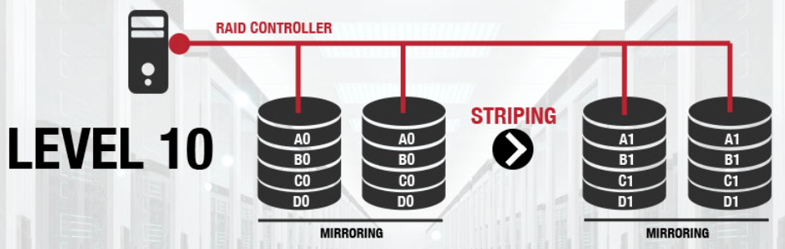
RAID Level 10 (Striped Mirrors)
Combines RAID Level 0 (disk striping) and RAID Level 1 (disk mirroring).
  RAID 1+0
  “Stripe of mirrors”
Requires at least four disks.
Excellent performance (striping) and redundancy (mirroring).
Recover from a failed disk by reading its mirror.
Best option if you can afford all the disks.

Slide 63
Hardware RAID
Dedicated hardware RAID controllers or cards.
+ Performance
  No CPU cycles to manage the underlying disks.
  Extensive caching.
+ Less complexity
  The operating system does not need to understand RAID and can treat the disk array as a single device.
+ Availability
  Available at system boot time.

Slide 64
Hardware RAID, cont’d
- Vendor lock-in
  Proprietary firmware on the RAID hardware.
  Must replace a failed component with an identical
  or a compatible model.
- Cost
  High-end RAID hardware is expensive.

Slide 65
Software RAID
+ Flexibility
  Managed within the operating system.
  Easy to configure from available storage
  without reconfiguring hardware.
+ Open source
  Open-source RAID software available for Linux.
  Easy to port to other systems.
  No specialty hardware costs.

Slide 66
Software RAID, cont’d
- Implementation-specific
  Tied to a specific software implementation of RAID.
  Data formats may not be compatible.
- Performance overhead
  Adds additional overhead.
  Uses CPU cycles and memory.

Slide 67
Disk Recovery
Drive capacity has grown at a much faster rate than transfer speed.
But error rates have only fallen a little
in comparison.
Larger-capacity drives may take hours
if not days to rebuild.
  During which time other drives may fail.

Slide 68
MTBF and MTTR
MTTF is the mean time for a disk to fail.
MTTR is the mean time to repair a failed disk.
MTBF is an individual drive’s mean time between failure
  The total amount of time that elapses
  between one failure and the next.
  Equals the sum of MTTF and MTTR.
  MTBF has increased historically over time.
  But it has not kept up with disks’
  increased storage capacity.

Slide 69
MTBF and MTTR, cont’d
http://blog.fosketts.net/2011/07/06/defining-failure-mttr-mttf-mtbf/

Slide 70
Backups Still Needed!
RAID does not protect from
multiple disk failures.
  While one disk is offline for any reason,
  the disk array is not fully redundant.
RAID does not protect from
non-disk related failures:
  hardware errors
  software errors
  human errors

Slide 71
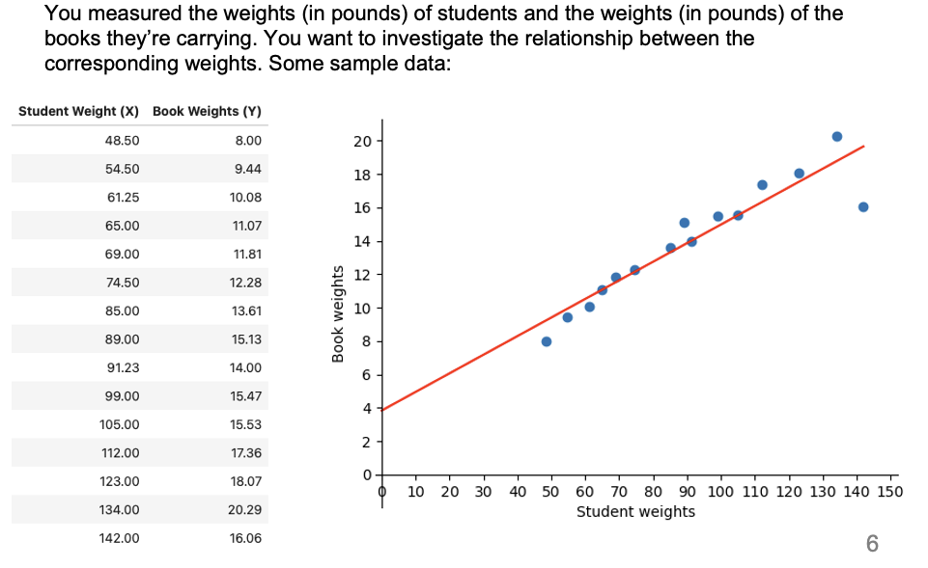
Data Analytics Problem
Can you now solve this waiver exam problem?

Slide 72
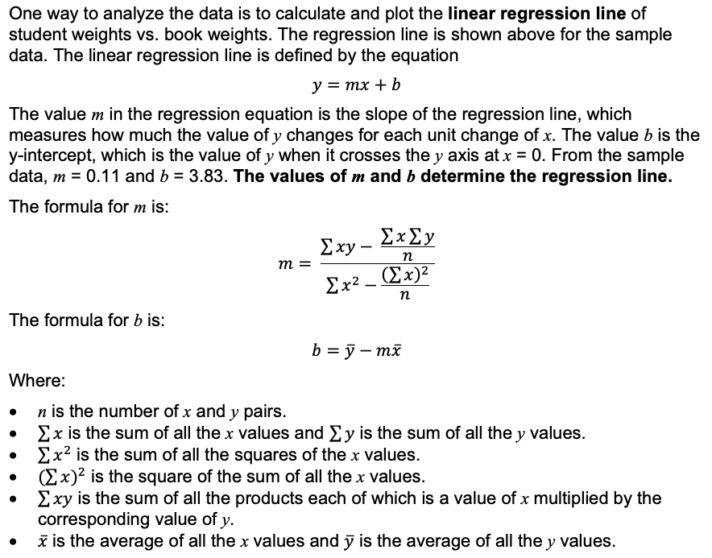
Data Analytics Problem, cont’d

Slide 73
Data Analytics Problem, cont’d
If the database table contains millions of records, you do not want to download all the records to the client side and in order to use a Python program to calculate the slope m and the y-intercept b.
  Much network traffic and latencies.
  Keep the data on the database server.
Do all the math in SQL on the database server.
  Then in your clientside Python program, query for and download only the values of m and b.

Slide 74

Data Analytics Problem, cont’d
Write SQL code to compute on the database server the values of the m and b from the data in table weights.
  You may use the SQL functions SUM and AVG.
  Do not use any built-in regression functions.
  There are at least five ways to solve this. You should be able to do at least three of the ways.
Show how to query the slope
and y-intercept values.
StudentBookWeights.ipynb

