Slide 1


DATA 201
Database Technologies for Data Analytics
March 13 Class Meeting
Department of Applied Data Science
San Jose State University
Spring 2025
Instructor: Ron Mak
www.cs.sjsu.edu/~mak

Slide 2
This Evening
SQL practice
Northwind database (northwind)
  Hostname: IES-ADS-ClassDB.sjsu.edu
  Username: your team username
  Password: your team password
  NOTE: On the remote server, you will not be able to alter tables, update rows, or create views.
  Create the database on your local machine for full access rights:
  https://www.cs.sjsu.edu/~mak/DATA201/notebooks/0313/northwind.sql

Slide 3
Reminder: Unofficial Field Trip
Computer History Museum in Mt. View
  http://www.computerhistory.org/
  Provide your own transportation to the museum.
Saturday, March 15, 11:30 AM
  Special free admission for my students.
    Meet in the front lobby for your free pass.
  Stay as long as you like, until closing time
  Do a self-guided tour of the Revolution exhibit.
  Experience a fully restored IBM 1401 mainframe computer from the early 1960s in operation.

Slide 4
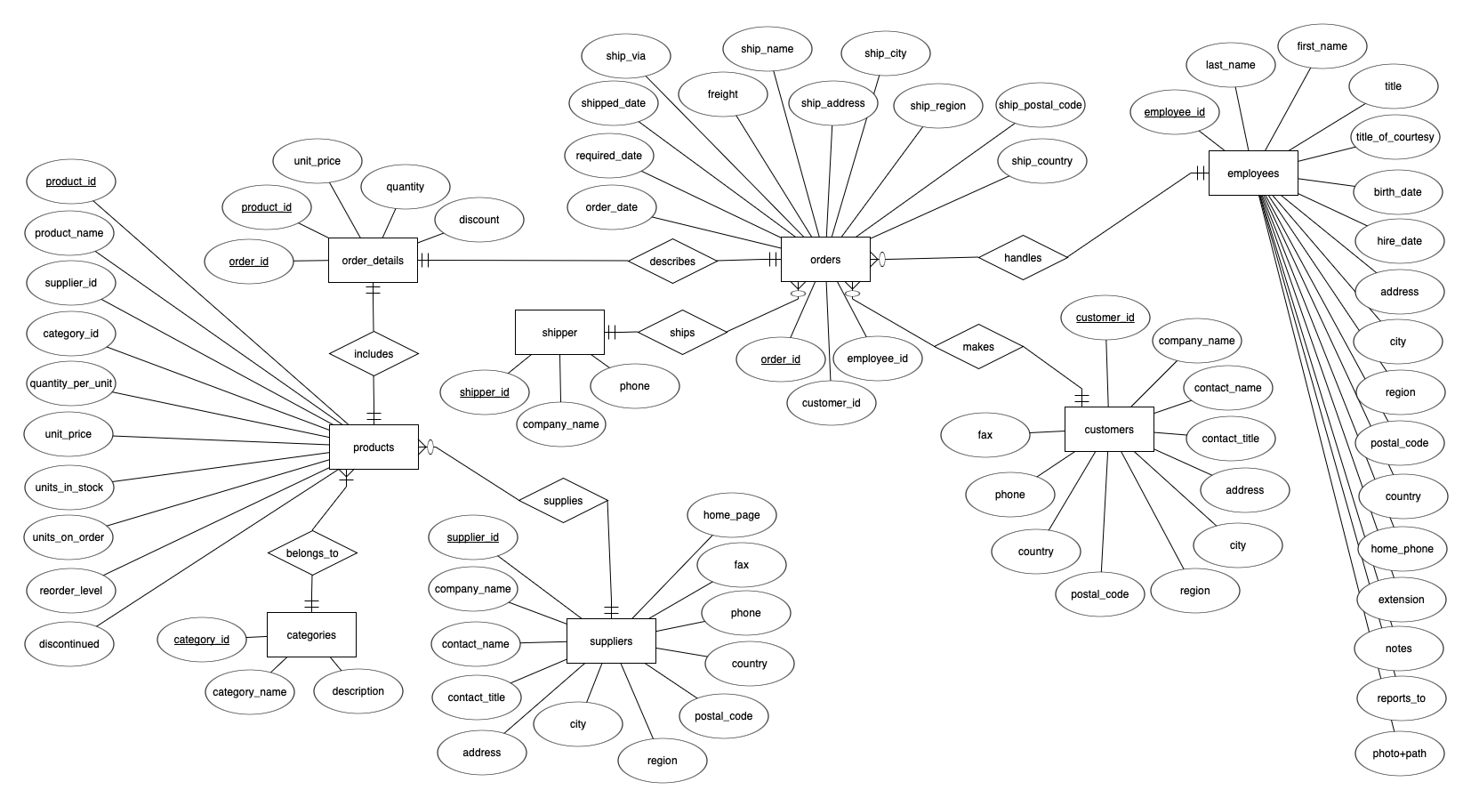
Northwind ERD

Slide 5
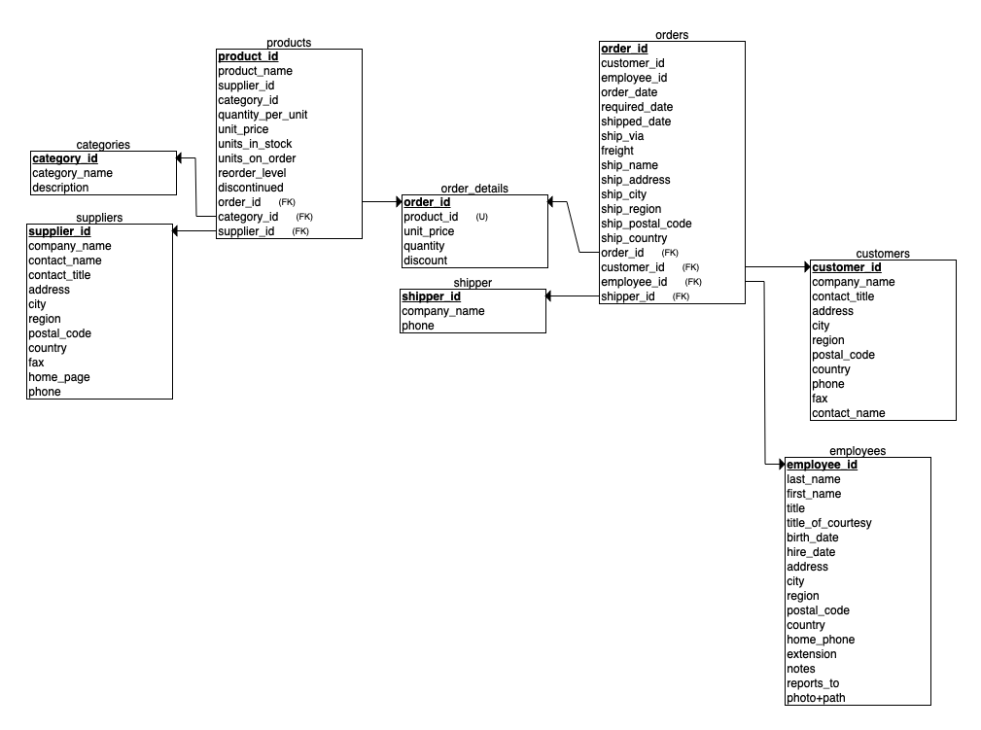
Northwind Relational Schema

Slide 6
Single-Table Queries
The following queries each involves only a single table.

Slide 7
Query 1
Display the product ID and name for those products whose name includes “queso”.
+------------+---------------------------+
| product_id | product_name |
+------------+---------------------------+
| 11 | Queso Cabrales |
| 12 | Queso Manchego La Pastora |
+------------+---------------------------+
2 rows in set (0.00 sec)

Slide 8
Query 2
Display all orders from any Latin American country.
+----------+-------------+--------------+
| order_id | customer_id | ship_country |
+----------+-------------+--------------+
| 10250 | HANAR | Brazil |
| 10253 | HANAR | Brazil |
| 10256 | WELLI | Brazil |
| 10257 | HILAA | Venezuela |
| 10259 | CENTC | Mexico |
| 10261 | QUEDE | Brazil |
...
| 11071 | LILAS | Venezuela |
| 11073 | PERIC | Mexico |
+----------+-------------+--------------+
173 rows in set (0.00 sec)

Slide 9
Query 3
For each line item in order details, display the order ID, product ID, unit price, quantity, and total price (= unit price * quantity). Format the monetary amounts.
+----------+------------+------------+----------+-------------+
| order_id | product_id | unit_price | quantity | total_price |
+----------+------------+------------+----------+-------------+
| 10248 | 11 | $14.00 | 12 | $168.00 |
| 10248 | 42 | $9.80 | 10 | $98.00 |
| 10248 | 72 | $34.80 | 5 | $174.00 |
| 10249 | 14 | $18.60 | 9 | $167.40 |
| 10249 | 51 | $42.40 | 40 | $1,696.00 |
...
| 11077 | 75 | $7.75 | 4 | $31.00 |
| 11077 | 77 | $13.00 | 2 | $26.00 |
+----------+------------+------------+----------+-------------+
2155 rows in set (0.00 sec)

Slide 10
Query 4
When was the first order?
+---------------------+
| first_order |
+---------------------+
| 2014-07-04 08:00:00 |
+---------------------+
1 row in set (0.00 sec)

Slide 11
Query 5
Northwind has customers in which countries and how many in each country? Sort the results alphabetically.
+-------------+-------+
| country | count |
+-------------+-------+
| Argentina | 3 |
| Austria | 2 |
| Belgium | 2 |
| Brazil | 9 |
| Canada | 3 |
| Denmark | 2 |
| Finland | 2 |
| France | 11 |
| Germany | 11 |
| Ireland | 1 |
| Italy | 3 |
| Mexico | 5 |
| Norway | 1 |
| Poland | 1 |
| Portugal | 2 |
| Spain | 5 |
| Sweden | 2 |
| Switzerland | 2 |
| UK | 7 |
| USA | 13 |
| Venezuela | 4 |
+-------------+-------+
21 rows in set (0.00 sec)

Slide 12
Query 6
What is the count of customers in each city? Show the country, city, and count. Sort by count in descending order and then alphabetically by country and city in ascending order.
+-------------+-----------------+-----------------+
| country | city | total_customers |
+-------------+-----------------+-----------------+
| UK | London | 6 |
| Mexico | México D.F. | 5 |
| Brazil | Sao Paulo | 4 |
| Argentina | Buenos Aires | 3 |
| Brazil | Rio de Janeiro | 3 |
| Spain | Madrid | 3 |
| France | Nantes | 2 |
| France | Paris | 2 |
| Portugal | Lisboa | 2 |
| USA | Portland | 2 |
| Austria | Graz | 1 |
| Austria | Salzburg | 1 |
| Belgium | Bruxelles | 1 |
| Belgium | Charleroi | 1 |
| Brazil | Campinas | 1 |
| Brazil | Resende | 1 |
| Canada | Montréal | 1 |
| Canada | Tsawassen | 1 |
| Canada | Vancouver | 1 |
...
| Venezuela | I. de Margarita | 1 |
| Venezuela | San Cristóbal | 1 |
+-------------+-----------------+-----------------+
69 rows in set (0.00 sec)

Slide 13
Query 7
Display each customer’s ID, company name, and region. Sort alphabetically by region. Customers who have no recorded region should be sorted at the bottom by customer ID.
+-------------+--------------------------------------+---------------+
| customer_id | company_name | region |
+-------------+--------------------------------------+---------------+
| OLDWO | Old World Delicatessen | AK |
| BOTTM | Bottom-Dollar Markets | BC |
| LAUGB | Laughing Bacchus Wine Cellars | BC |
| LETSS | Let's Stop N Shop | CA |
| HUNGO | Hungry Owl All-Night Grocers | Co. Cork |
| GROSR | GROSELLA-Restaurante | DF |
| SAVEA | Save-a-lot Markets | ID |
| ISLAT | Island Trading | Isle of Wight |
| LILAS | LILA-Supermercado | Lara |
| THECR | The Cracker Box | MT |
| RATTC | Rattlesnake Canyon Grocery | NM |
| LINOD | LINO-Delicateses | Nueva Esparta |
...
| TOMSP | Toms Spezialitäten | NULL |
| TORTU | Tortuga Restaurante | NULL |
| VAFFE | Vaffeljernet | NULL |
| VICTE | Victuailles en stock | NULL |
| VINET | Vins et alcools Chevalier | NULL |
| WANDK | Die Wandernde Kuh | NULL |
| WARTH | Wartian Herkku | NULL |
| WILMK | Wilman Kala | NULL |
| WOLZA | Wolski Zajazd | NULL |
+-------------+--------------------------------------+---------------+
91 rows in set (0.00 sec)

Slide 14
Query 8
In the year 2015, which three countries had the highest average freight charges? Sort the three in descending order.
+--------------+-----------------+
| ship_country | average_freight |
+--------------+-----------------+
| Austria | 178.364285714 |
| Switzerland | 117.177500000 |
| France | 113.991025641 |
+--------------+-----------------+
3 rows in set (0.00 sec)

Slide 15
Query 9
Randomly pick 5 customers for a survey. Show the customer ID and company name. There should be a different set of customers picked each time.
+-------------+-------------------+
| customer_id | company_name |
+-------------+-------------------+
| CHOPS | Chop-suey Chinese |
| WARTH | Wartian Herkku |
| BONAP | Bon app' |
| QUEE | Queen Cozinha |
| WANDK | Die Wandernde Kuh |
+-------------+-------------------+
5 rows in set (0.00 sec)

Slide 16
Query 10
Randomly pick around 10% of the customers for a survey. Show the customer ID and company name. There should be a different set of customers picked each time.
+-------------+--------------------------------------+
| customer_id | company_name |
+-------------+--------------------------------------+
| LAUGB | Laughing Bacchus Wine Cellars |
| VICTE | Victuailles en stock |
| ERNSH | Ernst Handel |
| FRANK | Frankenversand |
| FISSA | FISSA Fabrica Inter. Salchichas S.A. |
| COMMI | Comércio Mineiro |
| WELLI | Wellington Importadora |
| SPECD | Spécialités du monde |
| SEVES | Seven Seas Imports |
| OCEA | Océano Atlántico Ltda. |
+-------------+--------------------------------------+
10 rows in set (0.00 sec)

Slide 17
Multi-Table Queries
The following queries each requires joins.

Slide 18
Query 11
Who were the high-value customers in 2016 who made at least one order with a total amount (quantity times unit price) of $10,000 or more? Show customer ID, company name, order ID, and total order amount. Sort in descending order of amount.
+-------------+------------------------------+----------+--------------------+
| customer_id | company_name | order_id | total_order_amount |
+-------------+------------------------------+----------+--------------------+
| QUICK | QUICK-Stop | 10865 | $17,250.00 |
| SAVEA | Save-a-lot Markets | 11030 | $16,321.90 |
| HANAR | Hanari Carnes | 10981 | $15,810.00 |
| KOENE | Königlich Essen | 10817 | $11,490.70 |
| RATTC | Rattlesnake Canyon Grocery | 10889 | $11,380.00 |
| HUNGO | Hungry Owl All-Night Grocers | 10897 | $10,835.24 |
+-------------+------------------------------+----------+--------------------+
6 rows in set (0.01 sec)

Slide 19
Query 12
Display the customer ID, company name, ship country, and the order date and time of any rush orders within 15 hours before Christmas 2015. Format the date and time.
+-------------+-----------------+--------------+-------------------------+
| customer_id | company_name | ship_country | timestamp |
+-------------+-----------------+--------------+-------------------------+
| ERNSH | Ernst Handel | Austria | Dec 24, 2015 @ 11:00 AM |
| AROUT | Around the Horn | UK | Dec 24, 2015 @ 09:00 PM |
+-------------+-----------------+--------------+-------------------------+
2 rows in set (0.00 sec)

Slide 20
Query 13
Which customers have never placed an order?
+-------------+
| customer_id |
+-------------+
| FISSA |
| PARIS |
+-------------+
2 rows in set (0.00 sec)

Slide 21
Query 14
What is the total number of orders handled by each employee?
+-------------+-----------+------------+--------------+
| employee_id | last_name | first_name | total_orders |
+-------------+-----------+------------+--------------+
| 1 | Davolio | Nancy | 123 |
| 2 | Fuller | Andrew | 96 |
| 3 | Leverling | Janet | 127 |
| 4 | Peacock | Margaret | 156 |
| 5 | Buchanan | Steven | 42 |
| 6 | Suyama | Michael | 67 |
| 7 | King | Robert | 72 |
| 8 | Callahan | Laura | 104 |
| 9 | Dodsworth | Anne | 43 |
+-------------+-----------+------------+--------------+
9 rows in set (0.00 sec)

Slide 22
Query 15
What is the total number of late orders handled by each employee? An order is late if its shipped date is not before its required date.
+-------------+-----------+------------+-------------+
| employee_id | last_name | first_name | late_orders |
+-------------+-----------+------------+-------------+
| 1 | Davolio | Nancy | 3 |
| 2 | Fuller | Andrew | 4 |
| 3 | Leverling | Janet | 5 |
| 4 | Peacock | Margaret | 10 |
| 6 | Suyama | Michael | 3 |
| 7 | King | Robert | 4 |
| 8 | Callahan | Laura | 5 |
| 9 | Dodsworth | Anne | 5 |
+-------------+-----------+------------+-------------+
8 rows in set (0.00 sec)

Slide 23
Query 16
For each employee, display the total number of orders and the number of late orders handled by that employee.
+-------------+-----------+------------+--------------+-------------+
| employee_id | last_name | first_name | total_orders | late_orders |
+-------------+-----------+------------+--------------+-------------+
| 1 | Davolio | Nancy | 123 | 3 |
| 2 | Fuller | Andrew | 96 | 4 |
| 3 | Leverling | Janet | 127 | 5 |
| 4 | Peacock | Margaret | 156 | 10 |
| 5 | Buchanan | Steven | 42 | 0 |
| 6 | Suyama | Michael | 67 | 3 |
| 7 | King | Robert | 72 | 4 |
| 8 | Callahan | Laura | 104 | 5 |
| 9 | Dodsworth | Anne | 43 | 5 |
+-------------+-----------+------------+--------------+-------------+
9 rows in set (0.00 sec)

Slide 24
Query 17
Rate each customer by the total value of the customer’s orders (the sum of quantity*price) during 2016. A customer is
    “Very high” if the total value exceeds $10,000
    “High” if the total value is $5,000 to $10,000
    “Medium” if the total value is $1,000 to $5,000
    otherwise “Low”.
+-------------+------------------------------------+------------+-----------+
| customer_id | company_name | total | rating |
+-------------+------------------------------------+------------+-----------+
| ALFKI | Alfreds Futterkiste | $2,302.20 | Medium |
| ANATR | Ana Trujillo Emparedados y helados | $514.40 | Low |
| ANTO | Antonio Moreno Taquería | $660.00 | Low |
| AROUT | Around the Horn | $5,838.50 | High |
| BERGS | Berglunds snabbköp | $8,110.55 | High |
| BLAUS | Blauer See Delikatessen | $2,160.00 | Medium |
...
| WOLZA | Wolski Zajazd | $1,865.10 | Medium |
+-------------+------------------------------------+------------+-----------+
81 rows in set (0.00 sec)

Slide 25
Query 18
Due to an accounting error, some orders of quantities 60 or more were entered more than once with different product IDs but with the same quantity. Display the order ID, product ID, and quantity of the erroneous entries.
+----------+------------+----------+
| order_id | product_id | quantity |
+----------+------------+----------+
| 10263 | 16 | 60 |
| 10263 | 30 | 60 |
| 10263 | 24 | 65 |
| 10263 | 74 | 65 |
| 10658 | 40 | 70 |
| 10658 | 77 | 70 |
| 10990 | 21 | 65 |
| 10990 | 55 | 65 |
| 11030 | 2 | 100 |
| 11030 | 59 | 100 |
+----------+------------+----------+
10 rows in set (0.00 sec)

