Slide 1


DATA 200
Computational Programming for Analytics
February 1 Class Meeting
Department of Applied Data Science
San Jose State University
Spring 2024
Instructor: Ron Mak
www.cs.sjsu.edu/~mak

Slide 2
This Evening
What is Python and its role in data analytics
Installing Python software
Ways to run Python code
Introduction to Python programming
Example Python programs:
Example Jupyter notebooks:
Daily quiz
RollDieDynamic.py
FindMin.py
02_02.ipynb
02_03.ipynb
02_04.ipynb
02_05.ipynb
02_06.ipynb
02_07.ipynb
02_08.ipynb
02_09.ipynb

Slide 3
What is Python?
Currently the world’s most popular programming language in general use,
and especially for educational and scientific computing.
  https://www.tiobe.com/tiobe-index/
  First released in 1991.
Open source, free, and widely available.
Many libraries available for data science, AI, finance, web programming, etc.
Easy to learn?

Slide 4
Python’s Role in Data Analytics
All phases use
Python programming!
Understand the application:
What do we want to learn?
What must be decided?
DATA 228
DATA 270
DATA 200
Exploratory data
analysis (EDA)
Identify the data sources
80%
Data wrangling:
Prepare and understand
the data
Extract, transform,
and load data (ETL)
DATA 220
DATA 225
Perform statistical analysis,
produce tables,
charts, and graphs
DATA 230
Artificial
intelligence (AI)
Perform advanced analysis:
machine learning,
data mining, deep
learning, natural
language processing, etc.
DATA 240
Discover insights
in the data
DATA 245
DATA 255

Slide 5
Ways to Run Python Code
The Python code we’ll work with in this class comes in two forms.
As a standalone Python program in a text file.
  File suffix is .py
  Example: RollDieDynamic.py
  Run ipython in a terminal/prompt window.
    Windows: Get from the Start menu.
    Do not run as administrator.
ipython RollDieDynamic.py 100 100

Slide 6
Ways to Run Python Code, cont’d
As a Jupyter notebook.
  File suffix is .ipynb
  Example: AgeHistogram.ipynb
  cd to the directory/folder containing the notebooks
  Run in a terminal/prompt window.
    Windows: Get from the Start menu.
    Do not run as administrator.
jupyter lab

Slide 7
Jupyter Notebook
An electronic version of a lab notebook.
  Runs in a web browser.
  Ideal for sharing data, algorithms, and results.
Contains text and Python code in cells.
  You can execute the code within the notebook.
  The results appear in new output cells.
jupyter lab runs IPython hidden in the background.

Slide 8
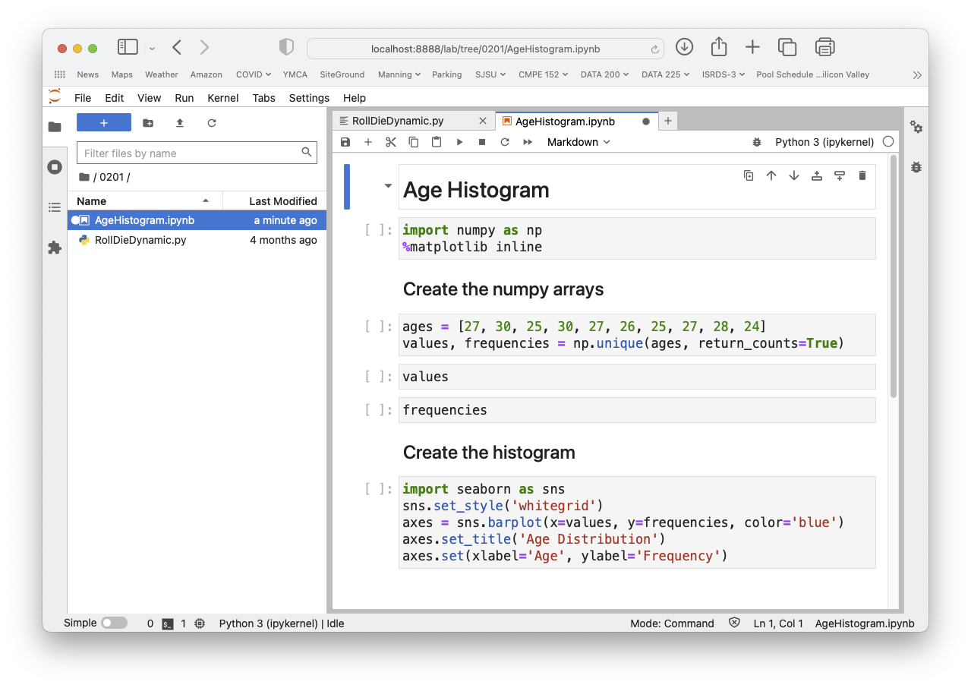
Jupyter Notebook, cont’d

Slide 9
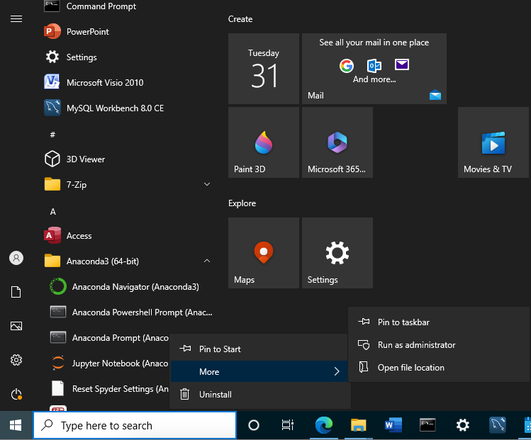
Break: Install Python Software
Anaconda: https://www.anaconda.com
MacOS/Linux: Open a terminal window.
Windows:
  Click on the bottom
  “Window” icon
  Open Anaconda3
  Right-click the menu item
  Anaconda Prompt
  More ➔
  Run as administrator

Slide 10
Break: Install Python Software, cont’d
In the terminal/prompt window, update Anaconda’s installed packages to their
latest versions:
conda update conda
conda update --all

