Slide 1


CS 46B: Introduction to Data Structures
August 4 Class Meeting
Department of Computer Science
San Jose State University
Summer 2015
Instructor: Ron Mak
www.cs.sjsu.edu/~mak

Slide 2
Homework #10
Generate a Huffman tree using the characters from the input file GettysburgAddress.txt and their frequencies.
Use HuffmanTree.java that you can download from your textbook’s website: http://bcs.wiley.com/he-bcs/Books?action=index&itemId=1118431111&bcsId=7872

Slide 3
Homework #10, cont’d
Write a new class HuffmanGettysburg that has at least the following methods:
  Method makeFrequencyMap() reads the input file and returns a frequency map that maps each character in the file to its frequency.
  Method computeCharacterCount() iterates over the frequency map and returns the total number of characters in the input file.
private static Map<Character, Integer> makeFrequencyMap(Scanner in)
private static int computeCharacterCount(Map<Character, Integer> map)

Slide 4
Homework #10, cont’d
  Method printHuffmanCodes() uses both the frequency map and the encoding map (obtained from the Huffman tree) to print a table of the characters in the input file, one character per row in sorted order.
    For each character, print the character, its frequency, and its Huffman code.
    The method should also return the total bit length of the file if all the characters are encoded using their Huffman codes.
private static int printHuffmanCodes(
Map<Character, Integer> frequencyMap,
Map<Character, String> encodingMap)

Slide 5
Homework #10, cont’d
The main() method should:
  Create a file Scanner for the input text file GettysburgAddress.txt.
    The input file is already loaded into Codecheck.
  Create a Huffman tree and its encoding map.
  Call the preceding methods appropriately.

Slide 6
Homework #10, cont’d
The main() method should (cont’d):
  Print the total number of characters and the total number of bits required to encode the file using UTF-8 encoding (the way text files are normally encoded).
  Print the total number of bits required to encode all the input file’s characters using their Huffman codes.
  Print the percentage reduction in bit length of the input file from using the UTF-8 code to using the Huffman code.

Slide 7
Homework #10, cont’d
Note that you are not expected to actually encode the input file using Huffman coding.
  Just calculate how many bits it would take
  to do the encoding.
Codecheck URL: http://codecheck.it/codecheck/files/1508010323ehsg28urjg6q8sjsian3rrpmi
Canvas: Homework 10 Final (there is no draft)
Due: Wednesday, August 5 at 11:59 PM

Slide 8
1459 total characters
11672 total UTF-8 bits
Character Frequency Code
\n 25 101010
space 244 111
, 23 100001
- 8 11001011
. 10 1010000
B 1 0010010000
F 1 0010010011
G 1 0010010001
I 3 001001011
N 1 0010010010
T 2 1100101001
W 2 001001010
a 102 1011
b 13 1010001
c 31 110011
d 58 11010
e 165 011
f 26 101011
g 27 110001
h 80 0101
i 65 11011
k 3 110010101
l 42 00101
m 13 1100100
n 76 0011
o 93 1001
p 15 001000
q 1 1100101000
r 79 0100
s 44 10001
t 124 000
u 21 100000
v 24 101001
w 26 110000
y 10 0010011
6200 total Huffman-encoded bits
46.9% reduction
Expected
output:

Slide 9
Tree Traversal
In a tree traversal, you “visit” (process)
all the nodes of a tree in a particular order.
Three common orders:
  inorder traversal
  preorder traversal
  postorder traversal
Related:
  depth-first search
  breadth-first search

Slide 10
Inorder Traversal
Used to traverse a binary tree.
Visit the root node in between
visiting the left child and the right child.
If the binary tree is a binary search tree, an inorder traversal visits the nodes in sorted order.
  Why?

Slide 11
Inorder Traversal, cont’d
Use recursion:
  Visit the left child (if any).
  Visit the root.
  Visit the right child (if any).
The base case is visiting a leaf node.
  Each child is a subtree which is closer to a leaf node.

Slide 12
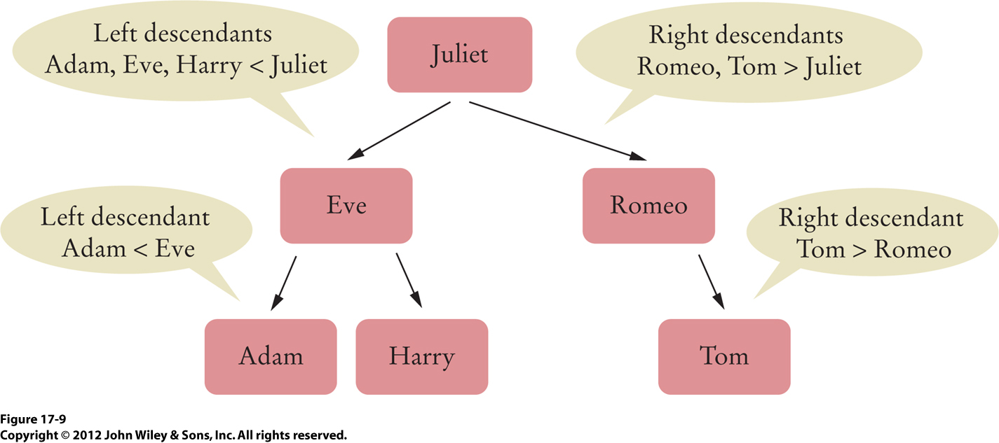
Inorder Traversal, cont’d
Suppose visiting a node means printing its data:
An inorder traversal of this BST yields:
  Adam Eve Harry Juliet Romeo Tom

Slide 13
Preorder Traversal
Visit the root before visiting the children.
  Visit the children in order.
Works for any tree, not just binary trees.
For a binary tree:
  Visit the root.
  Visit the left child (if any).
  Visit the right child (if any).
Use recursion!

Slide 14
Preorder Traversal, cont’d
A preorder traversal of this BST yields:
  Juliet Eve Adam Harry Romeo Tom

Slide 15
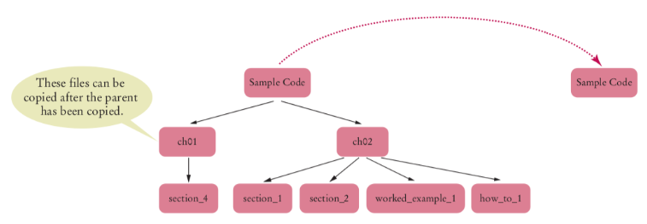
Preorder Traversal, cont’d
Do a preorder traversal to
copy a directory tree.
  Why preorder?

Slide 16
Postorder Traversal
Visit the root after visiting the children.
  Visit the children in order.
Works for any tree, not just binary trees.
For a binary tree:
  Visit the left child (if any).
  Visit the right child (if any).
  Visit the root.
Use recursion!

Slide 17
Postorder Traversal, cont’d
A postorder traversal of this BST yields:
  Adam Harry Eve Tom Romeo Juliet

Slide 18
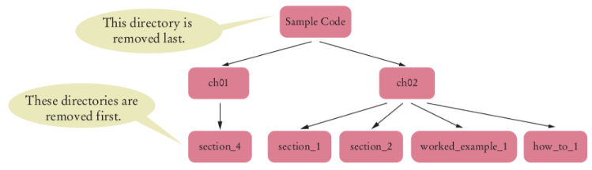
Postorder Traversal, cont’d
Do a postorder traversal to
remove all directories from a tree.
  Why postorder?

Slide 19
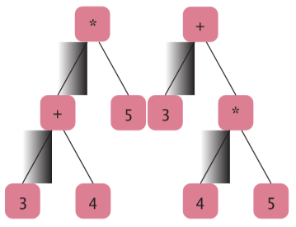
Postorder Traversal, cont’d
Postorder traversals of expression trees:
“Reverse Polish” notation
  3 4 + 5 *
  3 4 5 * +

Slide 20
The Visitor Interface
Create an interface that says you will visit nodes:
public interface Visitor
{
void visit(Object data);
}
private static void preorder(Node n, Visitor v)
{
if (n == null) return;
v.visit(n.data);
for (Node c : n.children) preorder(c, v);
}
public void preorder(Visitor v)
{
preorder(root, v);
}

Slide 21
The Visitor Interface, cont’d
public static void main(String[] args)
{
BinarySearchTree bst = . . .;
class ShortNameCounter implements Visitor
{
public int counter = 0;
public void visit(Object data)
{
if (data.toString().length() <= 5) counter++;
}
}
ShortNameCounter v = new ShortNameCounter();
bst.preorder(v);
System.out.println("Short names: " + v.counter);
}

Slide 22
Depth-First Search
A depth-first search goes deeply into a tree and then backtracks when it reaches the leaves.
  Stop when you reach a goal (such as finding a value).
An iterative, non-recursive algorithm,
that uses a stack:
Push the root node on a stack.
While the stack is not empty:
Pop the stack; let n be the popped node.
Process n.
Push the children of n on the stack, starting with the last one.

Slide 23
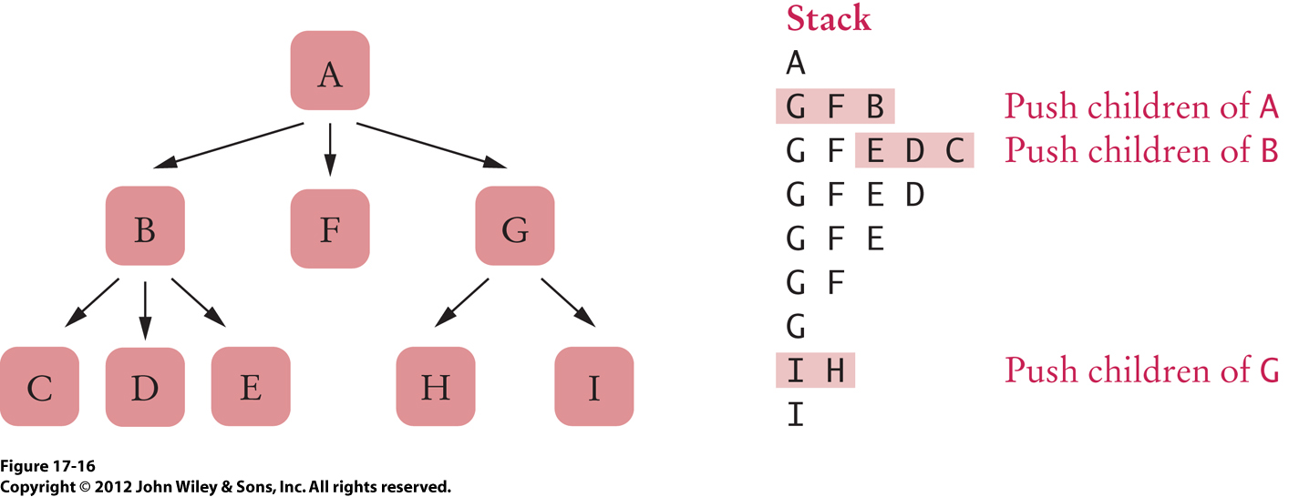
Depth-First Search, cont’d
Push the root node on a stack.
While the stack is not empty:
Pop the stack; let n be the popped node.
Process n.
Push the children of n on the stack, starting with the last one.

Slide 24
You’re Lost in a Maze
You have a bag of bread crumbs.
As you go down each path,
you drop bread crumbs to mark your path.
Whenever you come to a dead end, you retrace your path by following your bread crumbs.
You continue retracing your path (backtracking) until you come to an intersection with an unmarked path.
You go down the unmarked path.
Why is this a
depth-first search?

Slide 25
Breadth-First Search
Visit all the tree nodes at the same level
before going on to the next level.
  Stop when you reach a goal (such as finding a value).
An iterative, non-recursive algorithm,
that uses a queue:
Add the root node to a queue.
While the queue is not empty:
Remove from the queue; let n be the removed node.
Process n.
Add the children of n to the queue, starting with the first one.

Slide 26
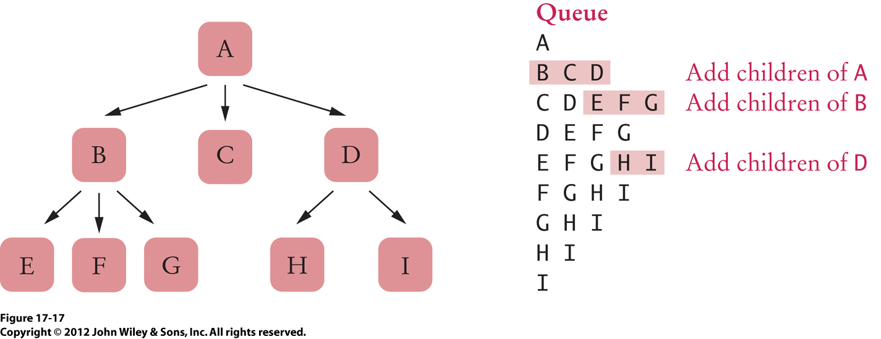
Breadth-First Search, cont’d
Add the root node to a queue.
While the queue is not empty:
Remove from the queue; let n be the removed node.
Process n.
Add the children of n to the queue, starting with the first one.

Slide 27
Find a Lost Child in a Large Building
Start in the room where the child was last seen.
Search each room adjacent to the first room.
  Put a tag on the door to mark a room
  you’ve already searched.
Then search each room adjacent to
the rooms you’ve already searched.
Repeatedly search all the rooms adjacent to rooms you’ve already searched before moving farther out from the first room.
Why is this a
breadth-first search?

Slide 28
Tree Iterators
You can create a tree iterator that implements a depth-first search, a breadth-first search, or
one of the tree traversals.
Example:
Note that the iterator itself does not visit nodes.
  The user of the iterator is responsible for processing the node data returned by the iterator.
TreeSet<String> t = . . .
Iterator<String> iter = t.iterator();
String first = iter.next();
String second = iter.next();

Slide 29
Breadth-First Tree Iterator
class BreadthFirstIterator
{
private Queue<Node> q;
public BreadthFirstIterator(Node root)
{
q = new LinkedList<Node>();
if (root != null) q.add(root);
}
public boolean hasNext() { return q.size() > 0; }
public Object next()
{
Node n = q.remove();
for (Node c : n.children) q.add(c);
return n.data;
}
}

Slide 30
Break

Slide 31
Review for the Final
The final exam will be on Thursday.
  Same time, same place.
Same format as the two midterms.
  It will cover the entire semester.
  With emphasis on the latter third.
See the lecture notes of June 18 and July 9 for reviews of the first two-thirds of the semester.

Slide 32
Review for the Final, cont’d
Java Collections framework
  linked lists
  sets
  maps
  stacks
  queues
  priority queues

Slide 33
Review for the Final, cont’d
Linked list implementation
  add, remove, set elements
  singly- and doubly-lined lists
  uni-directional and bi-directional iterators
Array list implementation
  internal array
Stack implementation
Queue implementation
  circular arrays

Slide 34
Review for the Final, cont’d
Hash table implementation
  hash codes
  collision resolution
  separate chaining
  linear and quadratic probing
  iterator
  load factor

Slide 35
Review for the Final, cont’d
Tree implementation
  binary tree
  decision tree
Huffman tree
  Huffman codes
  encoding map
Binary search tree
  search
  insert
  remove

Slide 36
Review for the Final, cont’d
Tree traversals
  inorder
  preorder
  postorder
Depth-first search
Bread-first search

