Slide 1


CS 46B: Introduction to Data Structures
July 30 Class Meeting
Department of Computer Science
San Jose State University
Summer 2015
Instructor: Ron Mak
www.cs.sjsu.edu/~mak

Slide 2
Quizzes for August 4
Quiz 24 August 4 Worked Example 17.1
Quiz 25 August 4 17.4

Slide 3
Homework #9: Iterative Solution
public void reverse()
{
if (first == null) {
throw new NoSuchElementException();
}
Node p1 = first;
Node p2 = p1.next;
// Loop to reverse the links.
while (p2 != null) {
Node p3 = p2.next;
p2.next = p1;
p1 = p2;
p2 = p3;
}
first.next = null; // old first is now the list end
first = p1; // set first to head of reversed list
}

Slide 4
Homework #9: Recursive Solution
private Node reverse(Node p1)
{
if ((p1 == null) || (p1.next == null)) return p1; // base case
else {
Node p2 = p1.next; // one element shorter
Node p3 = reverse(p2);
p2.next = p1; // append first element to reversed list
p1.next = null;
return p3; // head of reversed list
}
}

Slide 5
Binary Tree
Each node has at most 2 children.
  Order is significant.
  Which child should be the left child.
  Which child should be the right child.
Many important applications!

Slide 6
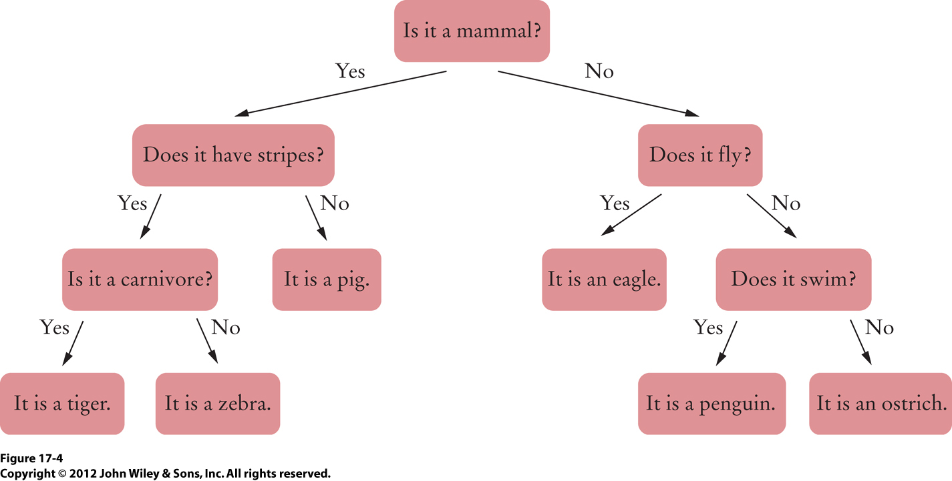
Binary Tree Example
Decision tree
  Left child: Yes
  Right child: No
This tree happens to be full:
Each node is either a leaf
or it has two children.

Slide 7
Binary Tree Implementation
public class BinaryTree
{
private Node root;
public BinaryTree() { root = null; } // An empty tree
public BinaryTree (Object rootData, BinaryTree left,
BinaryTree right)
{
root = new Node();
root.data = rootData;
root.left = left.root;
root.right = right.root;
}
class Node
{
public Object data;
public Node left;
public Node right;
}
. . .
}

Slide 8
Example Binary Tree: Huffman Tree
Goal: Reduce the number of bits
to transmit a message.
  Invented by David A. Huffman in 1952.
Idea: Use fewer bits to encode message characters that appear more frequently.
Normally, each message character is encoded
by a fixed number of bits.
  Examples: 7-bit ASCII code
  8-bit UTF-8 code

Slide 9
Huffman Encoding
Use a full binary tree to determine
character encodings.
  Each node is either a leaf or has two children.
Each character is a leaf node.
In the path from the root to a character:
  Each left link is a 0 bit
  Each right link is a 1 bit
No character code is a prefix
of another character.

Slide 10
Huffman Encoding, cont’d
Use frequency
as the weight.
Always merge the two trees
with the lowest weights.
Data Structures and Algorithms in Java, 3rd ed.
by Mark Allen Weiss
Pearson Education, Inc., 2012
ISBN 0-13-257627-9

Slide 11
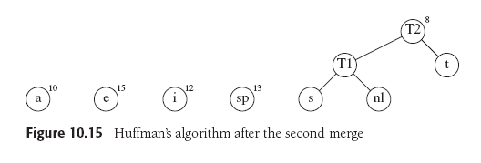
Huffman Encoding, cont’d
Always merge the two trees
with the lowest weights.
Data Structures and Algorithms in Java, 3rd ed.
by Mark Allen Weiss
Pearson Education, Inc., 2012
ISBN 0-13-257627-9

Slide 12
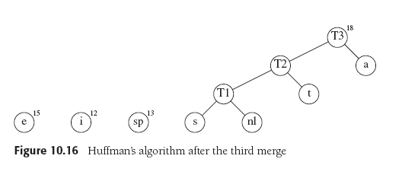
Huffman Encoding, cont’d
Always merge the two trees
with the lowest weights.
Data Structures and Algorithms in Java, 3rd ed.
by Mark Allen Weiss
Pearson Education, Inc., 2012
ISBN 0-13-257627-9

Slide 13
Huffman Encoding, cont’d
Always merge the two trees
with the lowest weights.
Data Structures and Algorithms in Java, 3rd ed.
by Mark Allen Weiss
Pearson Education, Inc., 2012
ISBN 0-13-257627-9

Slide 14
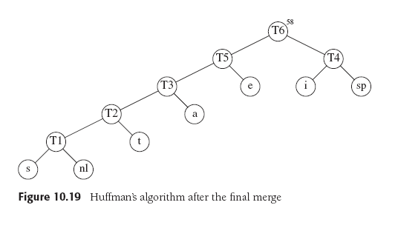
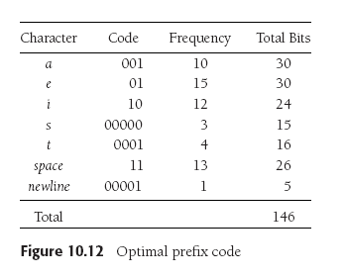
Huffman Encoding, cont’d
Always merge the two trees
with the lowest weights.
Data Structures and Algorithms in Java, 3rd ed.
by Mark Allen Weiss
Pearson Education, Inc., 2012
ISBN 0-13-257627-9
Decode: 000000010001100010001011110000100001
000000010001100010001011110000100001
s a t i a t e☐ i t \n

Slide 15
Building a Huffman Tree
Be sure to read Worked Example 17.1
Download and study the Java code for the Worked Example.
See http://bcs.wiley.com/he-bcs/Books?action=index&itemId=1118431111&bcsId=7872

Slide 16
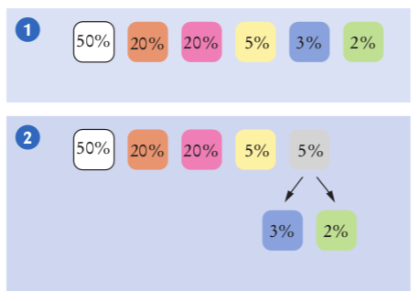
Another Huffman Tree Building Example

Slide 17
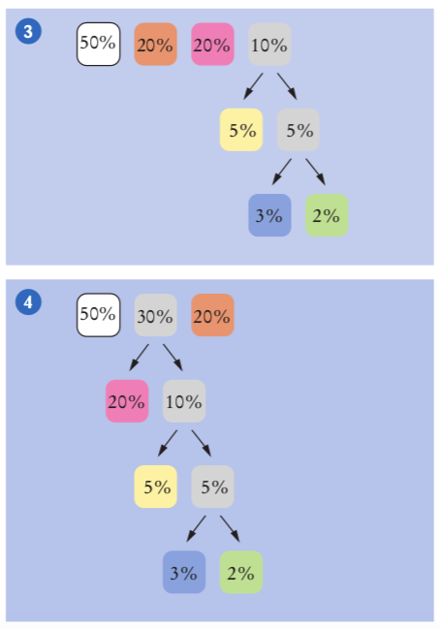
Another Example, cont’d

Slide 18
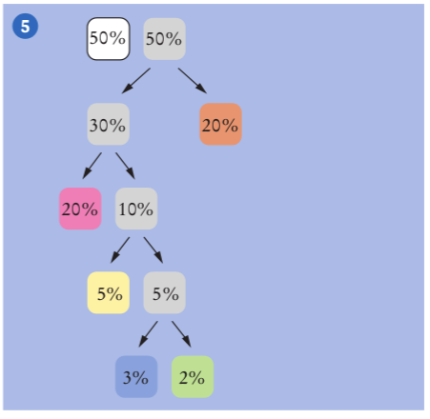
Another Example, cont’d

Slide 19
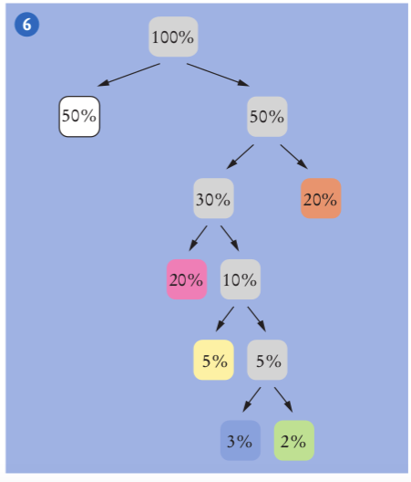
Another Example, cont’d

Slide 20
Building a Huffman Tree, cont’d
Since building a Huffman tree involves
always merging two binary trees with
the lowest frequencies (weights),
use a priority queue to store tree nodes.
As long as there are two nodes left
in the queue, remove two nodes:
  Make the two nodes the children of a new node whose frequency is the sum of the two nodes’ frequencies.
  Add the parent node to the priority queue.

Slide 21
Huffman Tree Node
class Node implements Comparable<Node>
{
public char character;
public int frequency;
public Node left;
public Node right;
public int compareTo(Node other)
{
return frequency - other.frequency;
}
}
An inner class.
Implement Comparable so we can
put the nodes in a priority queue.

Slide 22
Huffman Tree Constructor
The tree constructor receives a
Map<Character, Integer>
containing the frequencies.
  Each character maps to its frequency.
public HuffmanTree(Map<Character, Integer> frequencies)
{
PriorityQueue<Node> nodes = new PriorityQueue<Node>();
for (char ch : frequencies.keySet()) {
Node newNode = new Node();
newNode.character = ch;
newNode.frequency = frequencies.get(ch);
nodes.add(newNode);
}
...
}
Fill the
priority queue.

Slide 23
Huffman Tree Constructor, cont’d
public HuffmanTree(Map<Character, Integer> frequencies)
{
...
while (nodes.size() > 1) {
Node smallest = nodes.remove();
Node nextSmallest = nodes.remove();
Node newNode = new Node();
newNode.frequency = smallest.frequency +
nextSmallest.frequency;
newNode.left = smallest;
newNode.right = nextSmallest;
nodes.add(newNode);
}
root = nodes.remove();
}
Build the
Huffman tree.

Slide 24
Encoding Map
We don’t want to search the Huffman tree each time we have a character to encode.
A more efficient way is to use a map.
  Key: the character
  Value: its Huffman encoding
Recursive method fillEncodingMap()
of inner class Node builds the map.

Slide 25
Encoding Map, cont’d
class Node implements Comparable<Node>
{
...
public void fillEncodingMap(Map<Character, String> map,
String prefix)
{
if (left == null) { // it's a leaf
map.put(character, prefix);
}
else {
left.fillEncodingMap(map, prefix + "0");
right.fillEncodingMap(map, prefix + "1");
}
}
}

Slide 26
Encoding Map, cont’d
The encoding map is created by starting at the Huffman tree root with an empty prefix.
public Map<Character, String> getEncodingMap()
{
Map<Character, String> map = new HashMap<Character, String>();
if (root != null) {
root.fillEncodingMap(map, "");
}
return map;
}

Slide 27
Aloha Demo
public static void main(String[] args)
{
Map<Character, Integer> frequencyMap =
new HashMap<Character, Integer>();
frequencyMap.put('A', 2089);
frequencyMap.put('E', 576);
frequencyMap.put('H', 357);
frequencyMap.put('I', 671);
frequencyMap.put('K', 849);
frequencyMap.put('L', 354);
frequencyMap.put('M', 259);
frequencyMap.put('N', 660);
frequencyMap.put('O', 844);
frequencyMap.put('P', 239);
frequencyMap.put('U', 472);
frequencyMap.put('W', 74);
frequencyMap.put('\'', 541);
HuffmanTree tree = new HuffmanTree(frequencyMap);
...
}

Slide 28
Aloha Demo, cont’d
public static void main(String[] args)
{
...
Map<Character, String> encodingMap = tree.getEncodingMap();
String encoded = encode("ALOHA", encodingMap);
System.out.println(encoded);
String decoded = tree.decode(encoded);
System.out.println(decoded);
}
Demo

Slide 29
Aloha Demo, cont’d
Encode a string of text
into a string of 1’s and 0’s.
public static String encode(String toEncode,
Map<Character, String> encodingMap)
{
String result = "";
for (int i = 0; i < toEncode.length(); i++) {
char ch = toEncode.charAt(i);
result = result + encodingMap.get(ch);
}
return result;
}

Slide 30
Homework #10
Last one!
More details forthcoming, but here’s an outline.
Read GettysburgAddress.txt.
Compute the frequency of each character.
Use Huffman’s algorithm to generate
a code for each character.
What is the space savings if you were to encode the contents of GettysburgAddress.txt?
  Original bit count vs. Huffman-encoded bit count.

Slide 31
Break

Slide 32
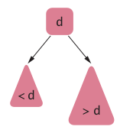
Binary Search Tree
A binary search tree (BST) has these properties
for each of its nodes:
  All the values in the node’s left subtree are
  less than the value of the node itself.
  All the values in the node’s
  right subtree are greater than
  the value of the node itself.

Slide 33
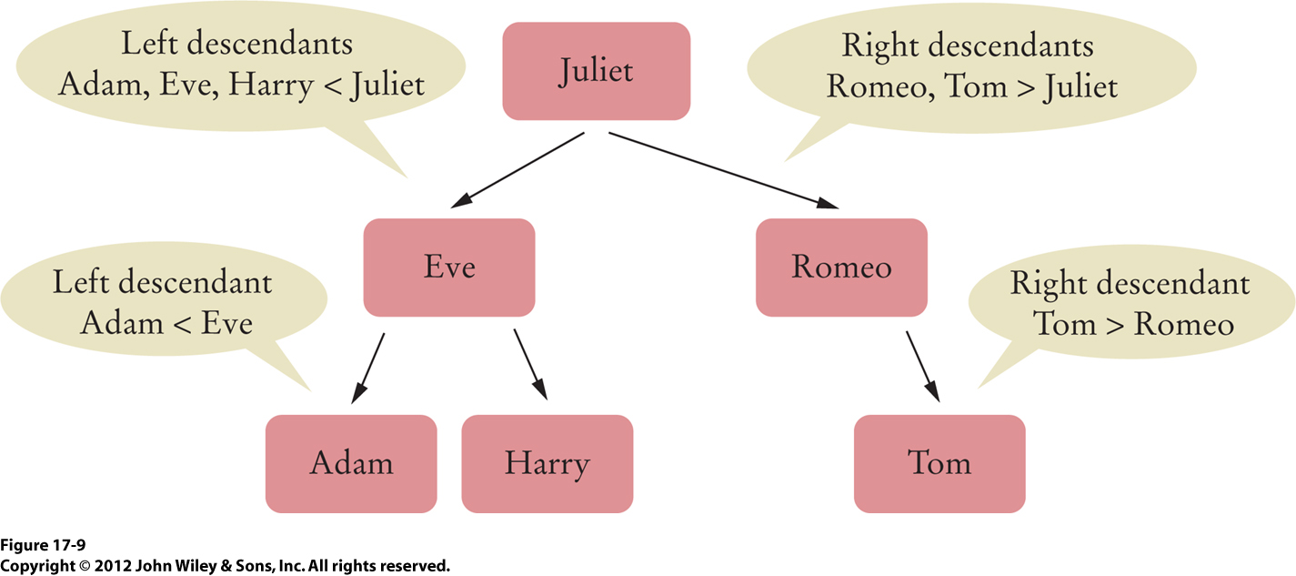
Binary Search Tree, cont’d

Slide 34
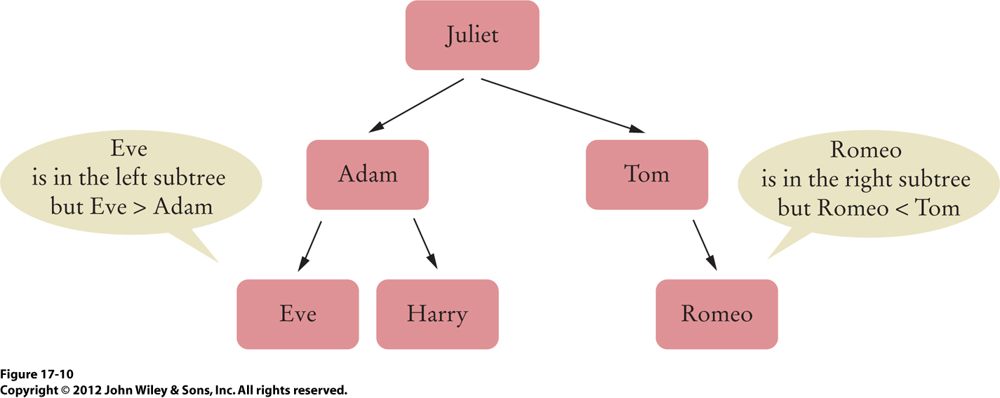
Not a Binary Search Tree

Slide 35
Search a Binary Search Tree
Does a binary search tree contain
a target value?
Search recursively starting at the root node:
  If the target value is less than the node’s value,
  then search the node’s left subtree.
  If the target value is greater than the node’s value,
  then search the node’s right subtree.
  If the values are equal, then yes,
  the target value is contained in the tree.
  If you “run off the bottom” of the tree, then no,
  the target value is not contained in the tree.

Slide 36
Insert into a Binary Search Tree
To insert a target value into the tree:
  Proceed as if you are checking
  whether the tree contains the target value.
As you’re recursively examining left and right subtrees, if you encounter a null link (either a left link or a right link), then that’s where the new value should be inserted.
  Create a new node containing the target value
  and replace the null link with a link to the new node.
  So the new node is attached to the last-visited node.

Slide 37
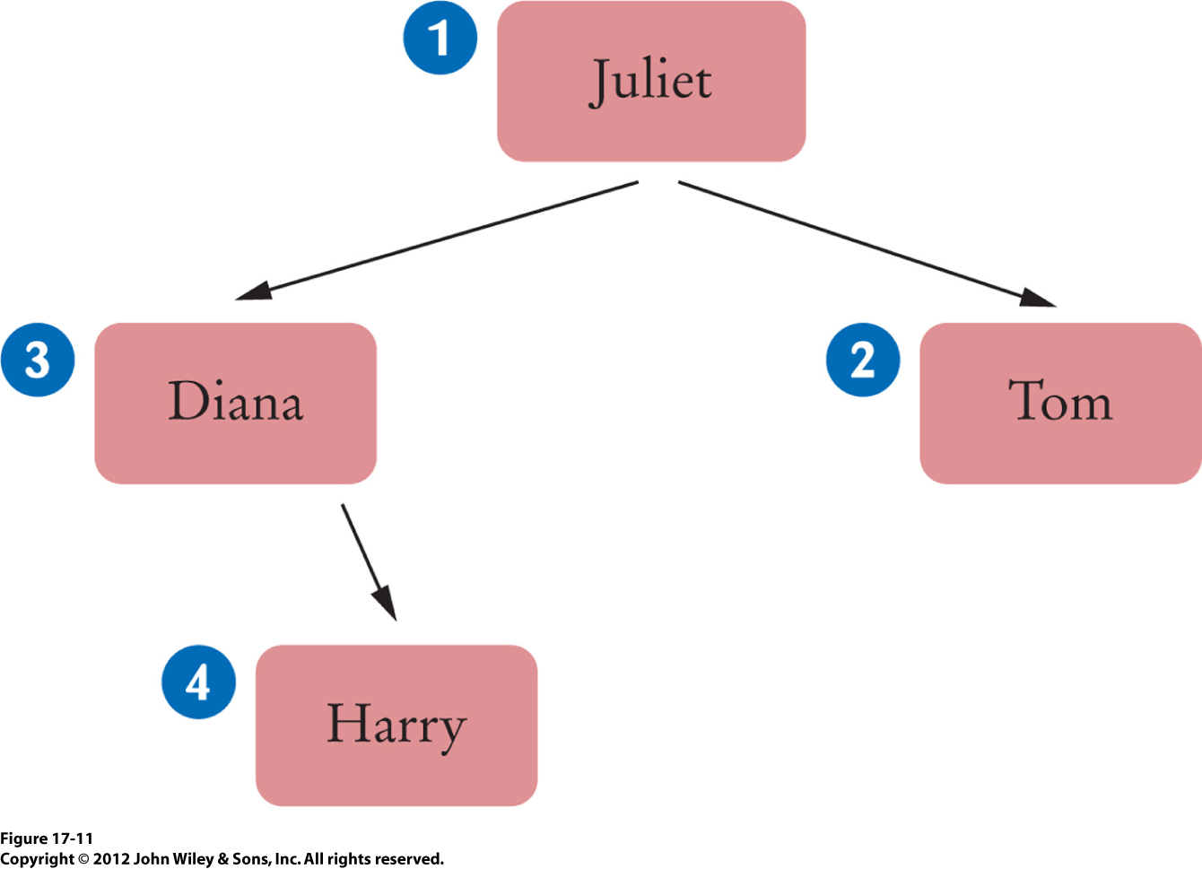
Insert into a Binary Search Tree, cont’d
Example:
BinarySearchTree tree = new BinarySearchTree();
tree.add("Juliet"); // 1
tree.add("Tom"); // 2
tree.add("Diana"); // 3
tree.add("Harry"); // 4

Slide 38
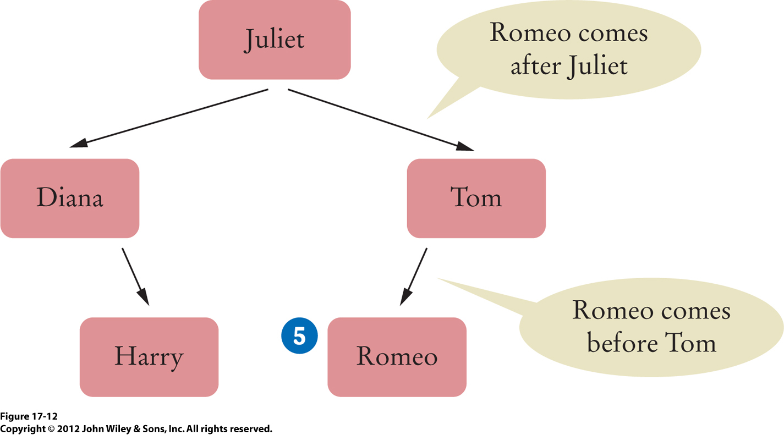
Insert into a Binary Search Tree, cont’d
Now add Romeo.

Slide 39
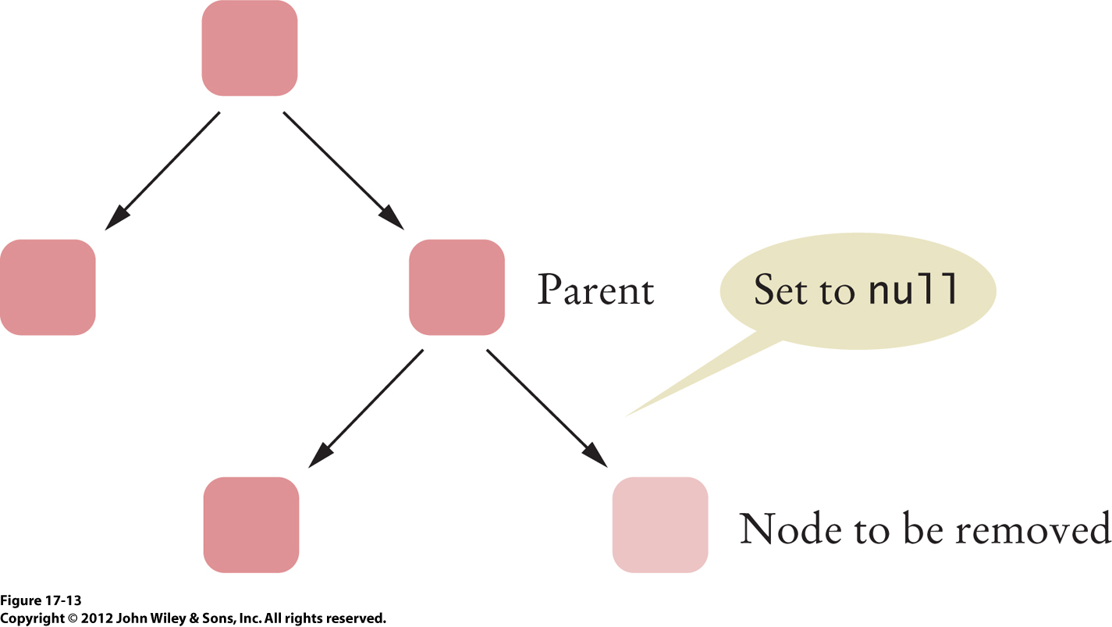
Remove from a Binary Tree
Simple case: The node has no children.

Slide 40
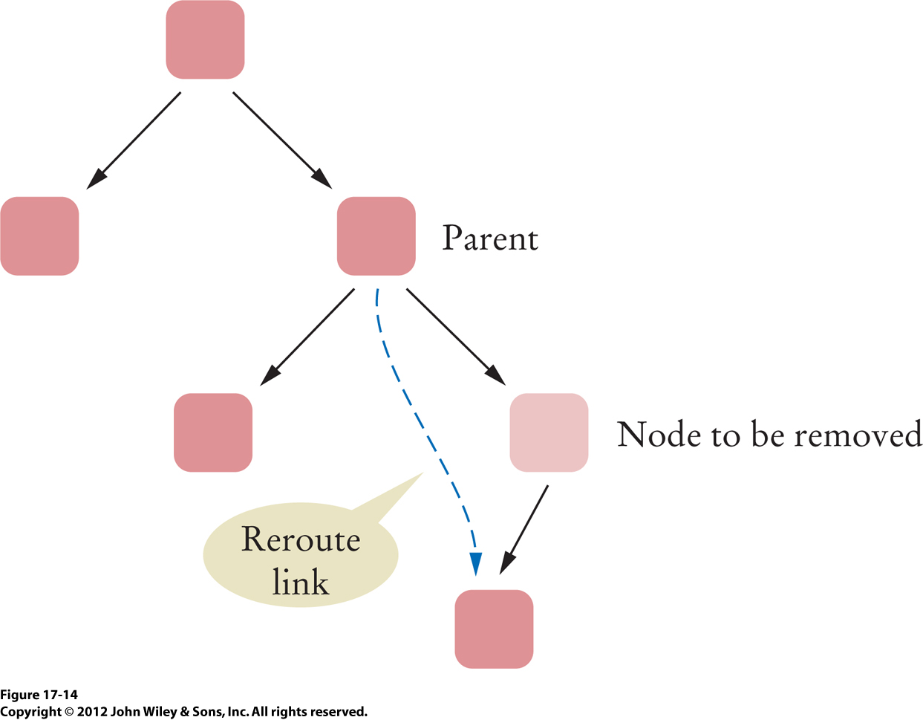
Remove from a Binary Tree, cont’d
The node has one child:

Slide 41
Remove from a Binary Tree, cont’d
The node has two children.
  This is the complicated case!
How do we restructure the tree so that
the order of the node values is preserved?

Slide 42
Remove from a Binary Tree, cont’d
Recall what happens you remove a list node.
  Assume that the list is sorted.
  If we delete target node 5, which node takes its place?
  The replacement node is the node that is
  immediately after the target node in the sorted order.
0
1
2
3
4
5
6
7
8
9
0
1
2
3
4
6
7
8
9

Slide 43
Remove from a Binary Tree, cont’d
A somewhat convoluted way to do this:
  Replace the target node’s value with
  the successor node’s value.
  Then remove the successor node,
  which is now “empty”.
0
1
2
3
4
5
6
7
8
9
0
1
2
3
4
6
7
8
9
0
1
2
3
4
6
7
8
9

Slide 44
Remove from a Binary Tree, cont’d
0
1
2
3
4
5
6
7
8
9
0
1
2
3
4
6
7
8
9
0
1
2
3
4
6
7
8
9
The same convoluted process happens when you remove a node from a binary search tree.
  The successor node is the node that is immediately after the deleted node in the sorted order.
  Replace the target node’s value with
  the successor node’s value.
  Remove the successor node, which is now “empty”.

Slide 45
Remove from a Binary Tree, cont’d
If you have a target node in a binary search tree, where is the node that is its immediate successor in the sort order?
  The successor’s value is ≥ than the target value.
  It must be the minimum value in the right subtree.
General idea:
  Replace the value in the target node
  with the value of the successor node.
    The successor node is now “empty”.
  Recursively delete the successor node.

Slide 46
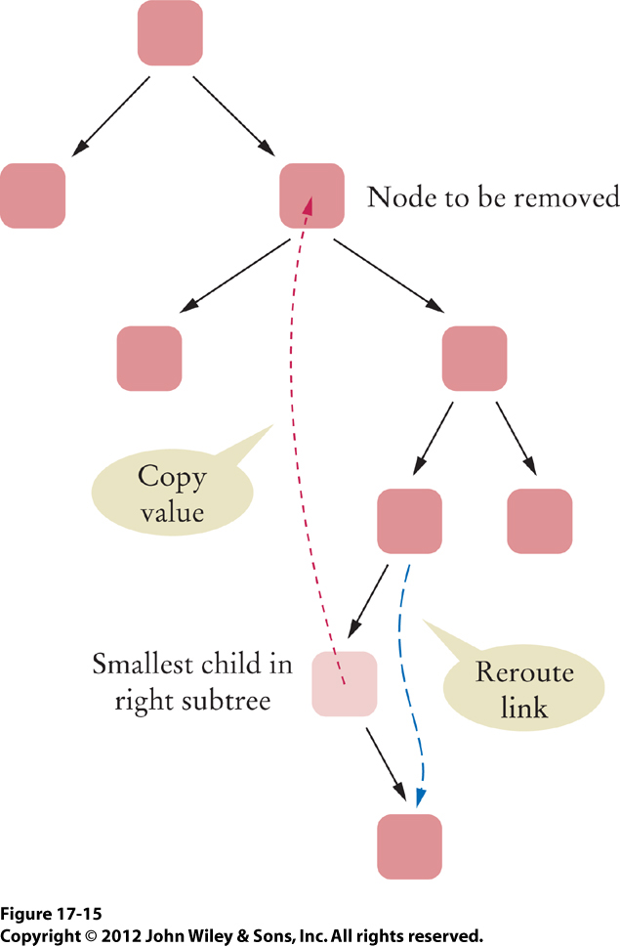
Remove from a Binary Tree, cont’d
Removing the successor node (the smallest child in the right subtree) is easy.
It is either a leaf node.
Or it has one right child.
  Why can’t it have
  a left child?

