Slide 1


CS 46B: Introduction to Data Structures
July 23 Class Meeting
Department of Computer Science
San Jose State University
Summer 2015
Instructor: Ron Mak
www.cs.sjsu.edu/~mak

Slide 2
Quizzes for July 23
Quiz 20 July 28 16.4

Slide 3
Homework #9
Reverse the elements of a singly-linked list using an iterative method and a recursive method.
Example
  Original list: [A B C D]
  Reversed list: [D C B A]
You must reverse the linked list in place.
  You may not copy the elements to an array
  or an array list.

Slide 4
Homework #9, cont’d
You are given a linked list class AbbreviatedLinkedList that has a private inner Node class, a private field first, and a public method addFirst().
You will add the iterative reverse() method:
You will add the recursive reverse() method:
  Parameter p refers to the starting node of the list where reversal is to begin.
public void reverse()
private Node reverse(Node p)

Slide 5
Homework #9, cont’d
There is a public driver method for the recursive reverse() method:
There is no iterator class.
Sample output:
public void reverseRecursive()
{
first = reverse(first);
}
Original list: [A B C D]
Iteratively reversed: [D C B A]
Original list: [A B C D]
Recursively reversed: [D C B A]

Slide 6
Homework #9, cont’d
Draft: Iterative version only.
  Codecheck: http://codecheck.it/codecheck/files/15072108363747y0fo08ar6knsd11a5wjak
  Canvas: Homework 9 Draft
  Due: Friday, July 24 at 11:59 PM
Final: Replace your iterative method
with your recursive method.
  Codecheck: http://codecheck.it/codecheck/files/1507210846ccvdhl3kluu0qfmolsx1y2h1i
  Canvas: Homework 9 Final
  Due: Monday, July 27 at 11:59 PM

Slide 7
Use a Linked List Iterator
Applications that use a linked list must
create an iterator for the linked list.
Use the iterator to:
  Traverse the elements of the list.
  Add and remove elements from the list
  (except for the first element).
  Set an element of the list.

Slide 8
Use a Linked List Iterator, cont’d
Advantages
  Applications that use the linked list don’t directly manipulate the elements’ next reference.
  Hide the list implementation from applications.
Disadvantages
  More complex linked list implementation code.
  Applications must deal with yet another object.

Slide 9
Direct Linked List Manipulation
Don’t use an iterator.
  Applications that use the linked list directly manipulates the elements’ next reference.
Advantages
  Simpler linked list implementation code.
Disadvantages
  Applications are aware of how
  the linked list is implemented.
  Application code is less safe.

Slide 10
Direct Linked List Manipulation, cont’d
public class LinkedListNoIterator
{
public Node first;
public static class Node
{
public Object data;
public Node next;
}
...
}

Slide 11
Direct Linked List Manipulation, cont’d
public static void main(String[] args)
{
LinkedListNoIterator list = new LinkedListNoIterator();
add(list, new String[] {"C", "S", "4", "6", "B"});
print(list);
System.out.println("\nRemove B");
Node prev = getPrevious(list, "B");
prev.next = prev.next.next;
print(list);
System.out.println("\nAdd 1");
prev = getPrevious(list, "4");
Node one = new Node();
one.data = "1";
one.next = prev.next;
prev.next = one;
print(list);
}

Slide 12
Direct Linked List Manipulation, cont’d
private static void add(LinkedListNoIterator list, Object elmts[])
{
for (int i = elmts.length-1; i >= 0; i--) list.addFirst(elmts[i]);
}
private static void print(LinkedListNoIterator list)
{
System.out.print("List: ");
for (Node p = list.first; p != null; p = p.next) {
System.out.print(p.data + " ");
}
System.out.println();
}
private static Node getPrevious(LinkedListNoIterator list, Object elmt)
{
for (Node p = list.first; p.next != null; p = p.next) {
if (elmt.equals(p.next.data)) return p;
}
return null;
}

Slide 13
Recursive Linked List Reversal
What is the base case?
Given a list to reverse:
  What is closer to the base case?
  If you recursively reverse the shorter list,
  what should you do with the first element?
A
B
C
D
A
B
C
D
A
B
C
D

Slide 14
Arrays
The most basic data structure.
Array of primitives:
Array of objects:
Easy to access an element.
  Just use an index!
double values[] = new double[20];
Employee workers[] = new Employee[50];
values[14] = Math.PI;
workers[42] = new Employee();

Slide 15
Disadvantages of Arrays
To allocate an array, you have to know
its size in advance.
What happens if you don’t allocate
enough elements?
  Or you allocated too many elements?
Can you easily insert an element into an array?
  Or remove an element?
double values[] = new double[20];
Employee workers[] = new Employee[50];

Slide 16
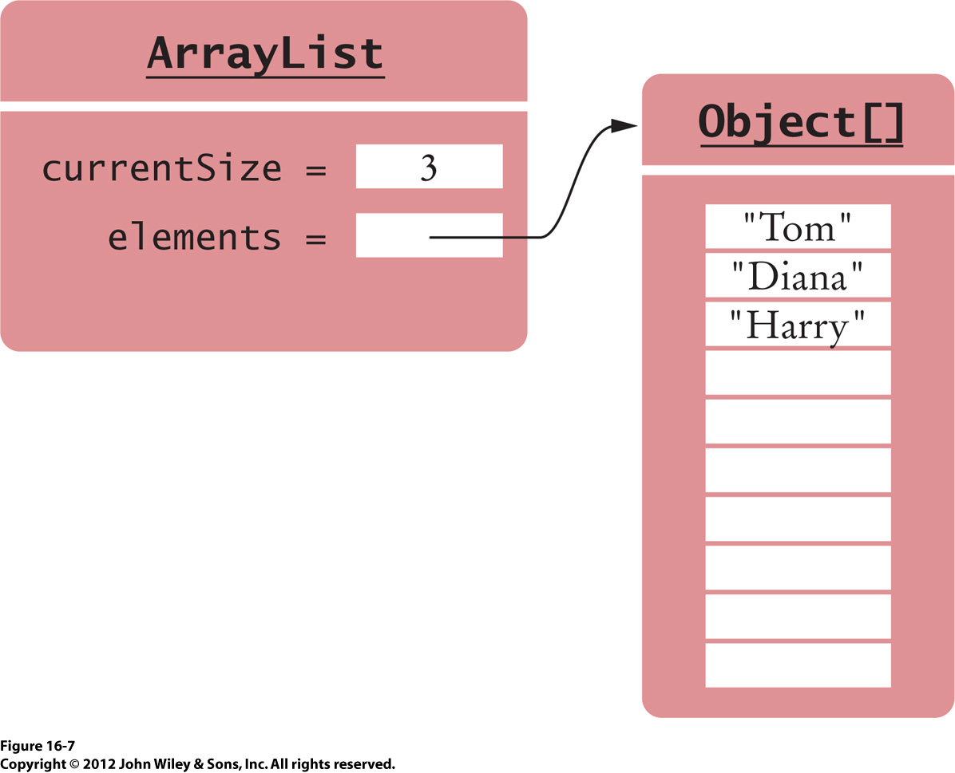
Array List Implementation
An array list overcomes some of the disadvantages of a plain array.
An array list
has a reference
to a plain
internal array.
It also keeps track of the
internal array’s current size.

Slide 17
Array List Element Remove and Insert
If you remove an element, the array list will move each of the following elements up
to fill in the hole.
  It copies each element to the previous position.
If you insert (add) an element at a particular position, the array list will move each of the following elements down to make a hole
for the new element.
  It copies each element to the next position.

Slide 18
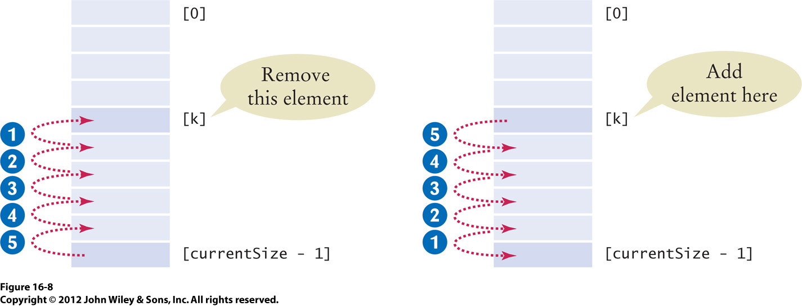
Array List Element Remove and Insert, cont’d

Slide 19
Array List Grows the Internal Array
If its internal array is full and you add a new element, the array list will grow the internal array.
  Allocate a new internal array that’s twice the size.
  Copy all the elements from the old array to the new.
  This is an O(n) operation.

Slide 20
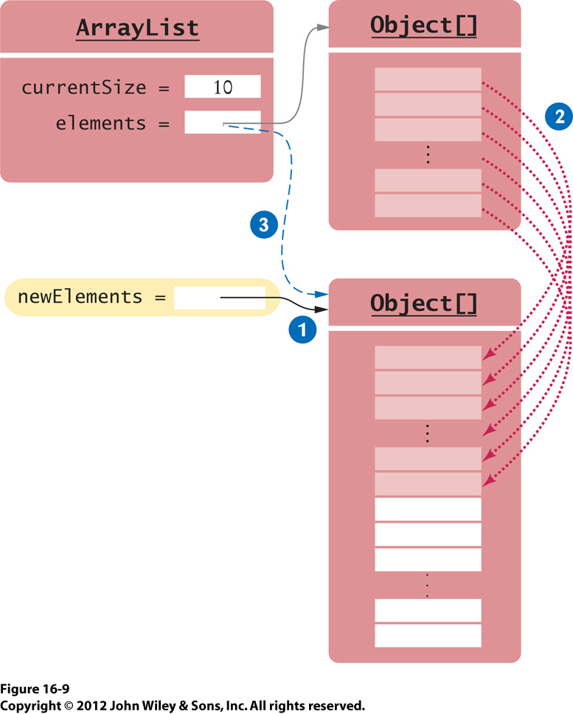
Array List Grows the Internal Array, cont’d
Since the new internal array is twice the size of the old one, the array list should have to grow the array not very often.
  Therefore, adding an element is an O(1)+ operation.
  Amortize growing the array over all add operations.

Slide 21
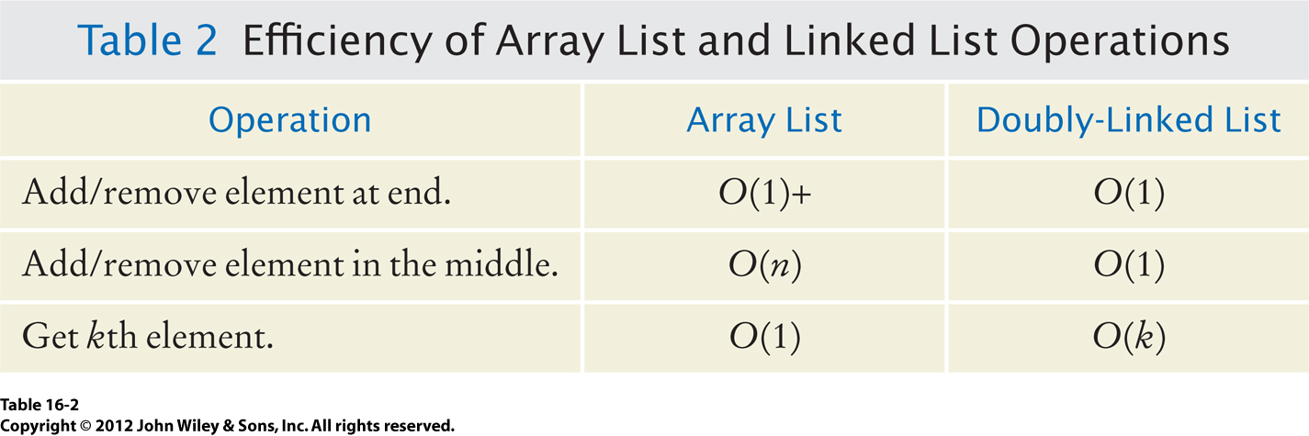
Array List vs. Linked List
O(1)+ because the time to grow the array is amortized over all add operations.
  We can also shrink the array
  after a remove operation.

Slide 22
Break

Slide 23
Stack Implementation
We can implement a stack using a linked list
or an array list.
Which end of the linked list or array list to use for push and pop operations?

Slide 24
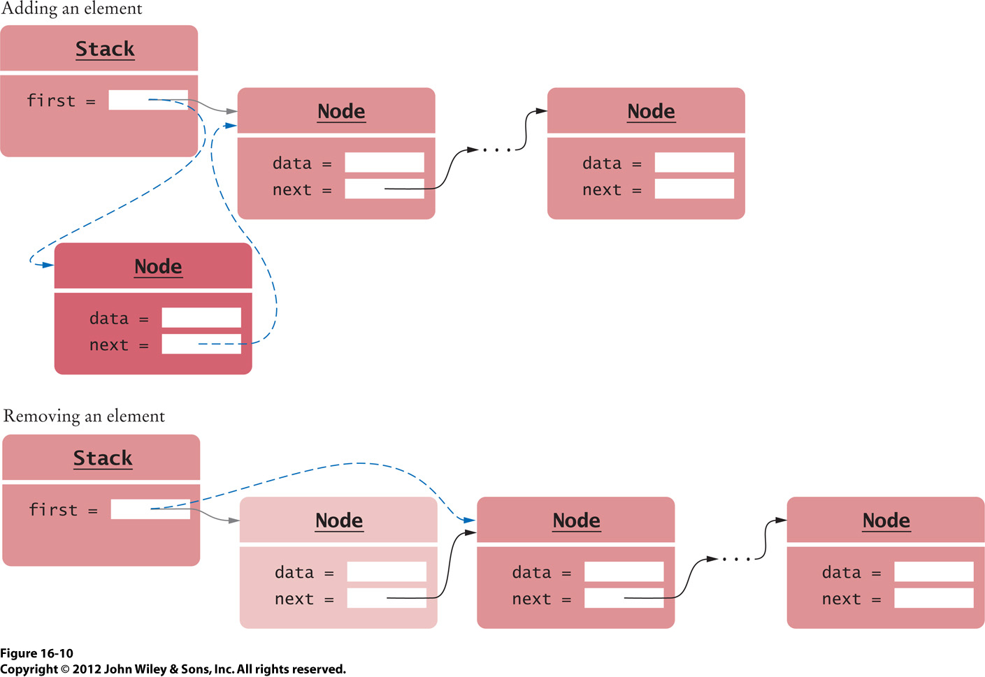
Stack as a Linked List
Which end to push and pop?

Slide 25
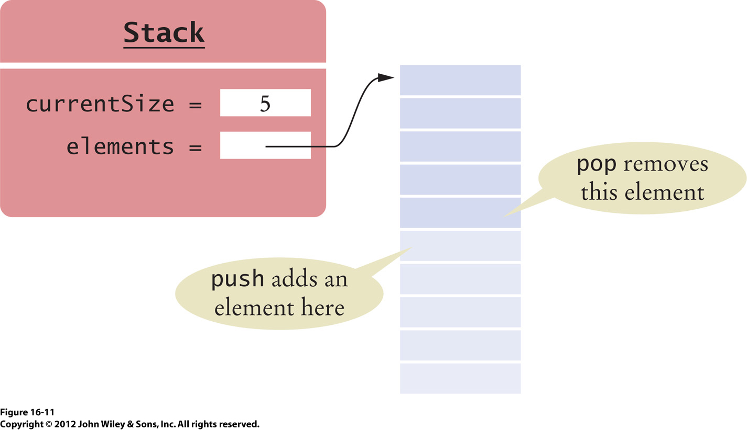
Stack as an Array List
Which end to push and pop?
Why this end?

Slide 26
Queue Implementation
We can implement a queue using a linked list
or an array.
Which end of the linked list or array to use
for add and remove operations?

Slide 27
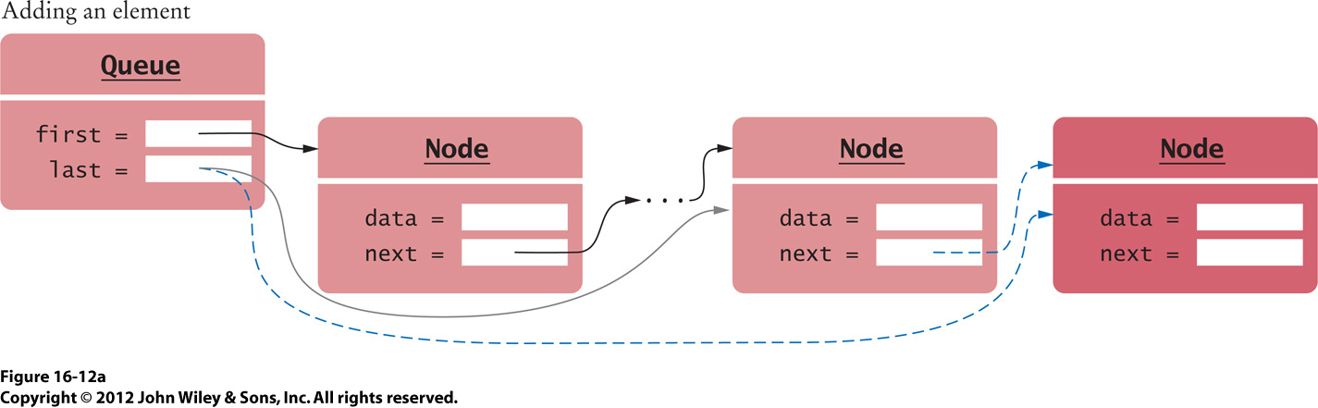
Queue as a Linked List
Which end to add an element?
Why this end?

Slide 28
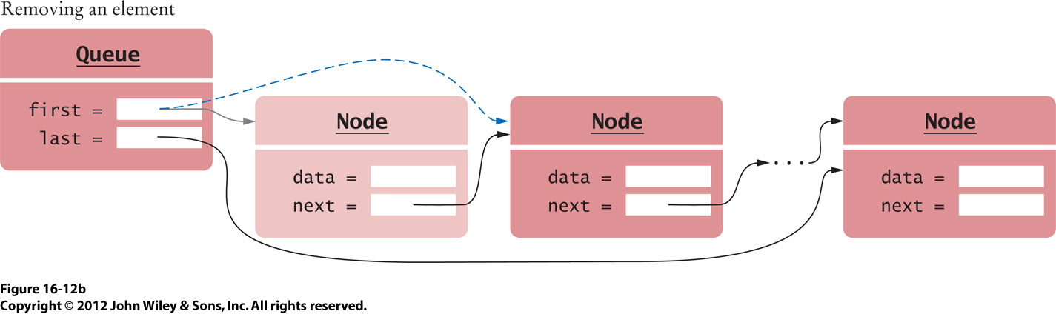
Queue as a Linked List, cont’d
Which end to remove an element?
Why this end?

Slide 29
Queue as an Array
We can also implement a queue using
a plain array.
But then there’s a problem with the
remove operation.
  Removing an element from the middle of an array
  is an O(n) operation.
We can overcome this problem by using a circular array.
  AKA circular buffer

Slide 30
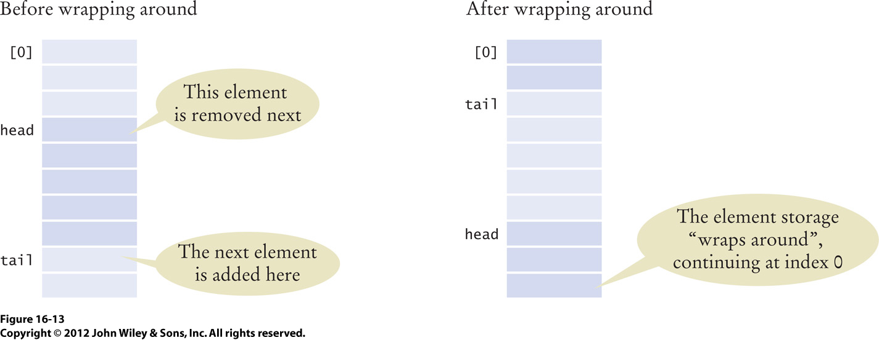
Queue as a Circular Array
Index variables head and tail
chase each other around the array.

Slide 31
Queue as a Circular Array, cont’d
What does it mean when the tail catches up with the head, i.e., head == tail?

Slide 32
Queue as a Circular Array, cont’d
When head == tail, the queue is empty.
Or the queue is full.

Slide 33
Queue as a Circular Array, cont’d
Therefore, we also need to keep track of the count of elements in the queue.
  If full, we can grow the array.

Slide 34
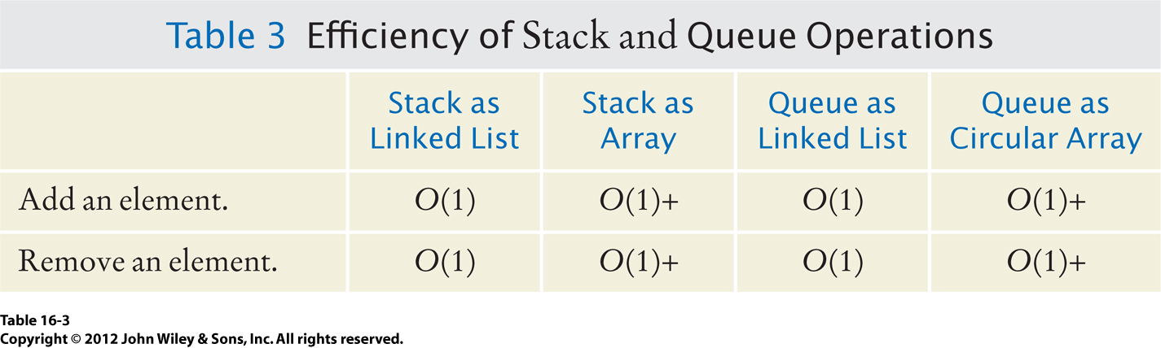
Stack and Queue Efficiency

