Slide 1


CS 46B: Introduction to Data Structures
July 21 Class Meeting
Department of Computer Science
San Jose State University
Summer 2015
Instructor: Ron Mak
www.cs.sjsu.edu/~mak

Slide 2
Quizzes for July 23
Quiz 19 July 23 16.3

Slide 3
Homework #8 Solution
Requirements
  Print all the unique words in GettysburgAddress.txt in alphabetical order.
  Use classes from the Java Collections framework.
Which classes to use?
  unique: Some kind of set,
  either HashSet or TreeSet.
  alphabetical order: TreeSet
A set does not admit
duplicate entries.
A TreeSet stores its entries
in sorted order.

Slide 4
Homework #8 Solution, cont’d
Read the words into a TreeSet object:
private static final String FILE_NAME =
"GettysburgAddress.txt";
in = new Scanner(new File(FILE_NAME));
in.useDelimiter("[^A-Za-z]");
TreeSet<String> words = new TreeSet<String>();
while (in.hasNext()) {
String word = in.next().toLowerCase();
if (word.length() > 0) words.add(word);
}
If the word is already in the set,
the add operation is ignored.

Slide 5
Homework #8 Solution, cont’d
Now print the words in the set.
  They’re in order because it’s a TreeSet.
private static final int WORDS_PER_LINE = 8;
int counter = 0;
for (String word : words) {
System.out.print(word);
if (++counter < WORDS_PER_LINE) System.out.print(" ");
else {
counter = 0;
System.out.println();
}
}
Demo

Slide 6
Linked List Implementation
To understand better the LinkedList class
in the Java Collections framework,
let’s implement a simplified version.
We will also implement an iterator class.

Slide 7
A Node Class
A linked list is made up of nodes,
so we’ll need a Node class.
  It will be an inner class of the LinkedList class.
public class LinkedList
{
...
class Node
{
public Object data;
public Node next;
}
...
}

Slide 8
The Linked List Class
We want to keep a reference to the
first node of the linked list.
  Initialize first to null in the constructor
  to signify an empty list.
A getter method getFirst() returns the data
in the first node.

Slide 9
The Linked List Class, cont’d
public class LinkedList
{
private Node first;
public LinkedList()
{
first = null;
}
public Object getFirst()
{
if (first == null) {
throw new NoSuchElementException();
}
return first.data;
}
...
}

Slide 10
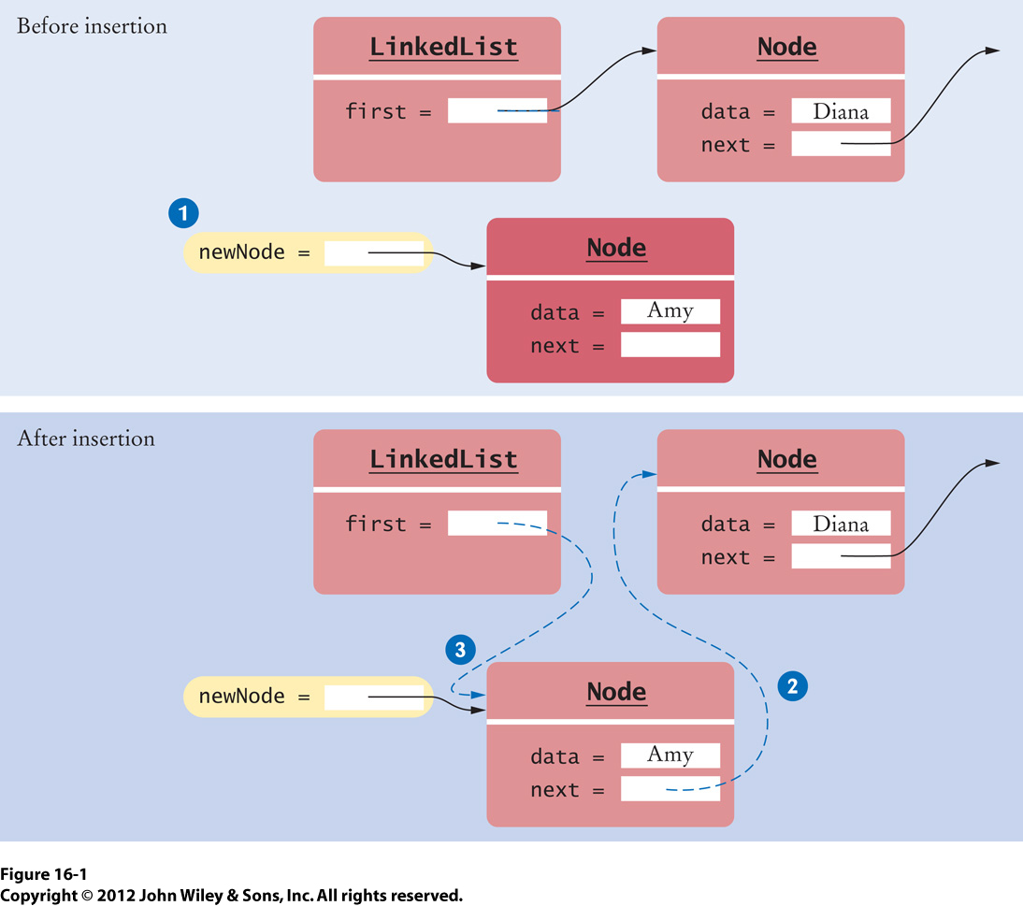
Add the First Element
public void addFirst(Object element)
{
Node newNode = new Node();
newNode.data = element;
newNode.next = first;
first = newNode;
}

Slide 11
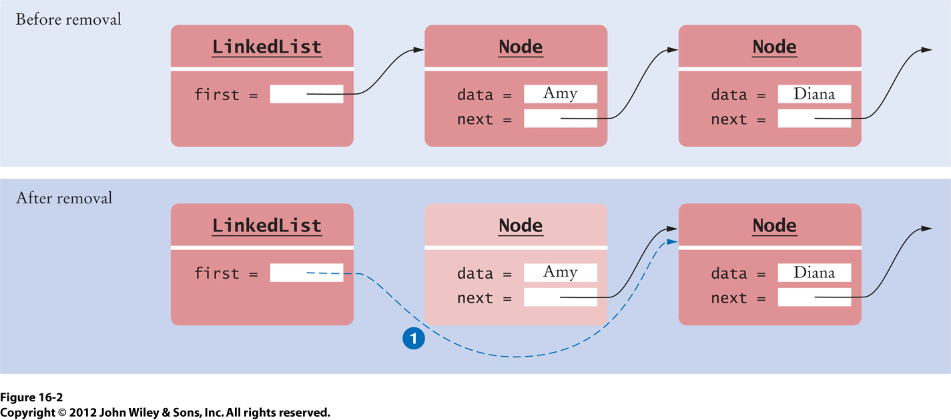
Remove the First Element
public Object removeFirst()
{
if (first == null) {
throw new NoSuchElementException();
}
Object element = first.data;
first = first.next;
return element;
}

Slide 12
The Iterator Class
Another inner class of our linked list class.
We will implement five methods only:
  next()
  hasNext()
  add()
  remove()
  set()

Slide 13
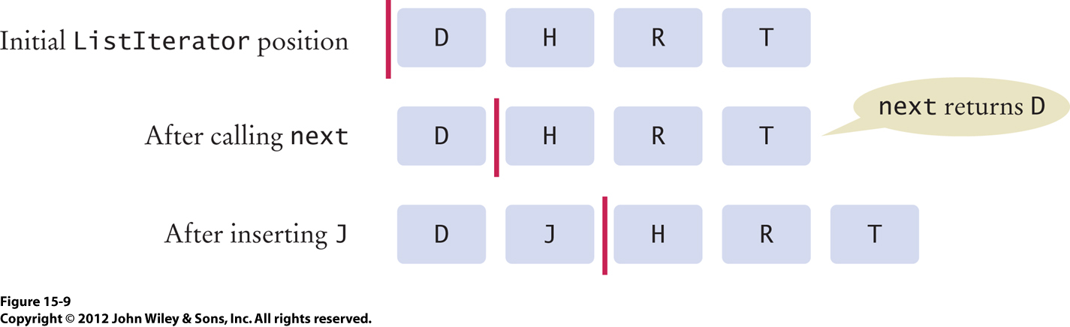
The Iterator Class, cont’d
Remember to think of an iterator as a
cursor between elements.

Slide 14
The Iterator Class, cont’d
public class LinkedList
{
...
public ListIterator listIterator()
{
return new LinkedListIterator();
}
...
class LinkedListIterator implements ListIterator
{
private Node position;
private Node previous;
private boolean isAfterNext;
public LinkedListIterator()
{
position = null;
previous = null;
isAfterNext = false;
}
...
}
}
position refers to the
currently visited node
previous refers to the
last node before that
isAfterNext keeps track of when
the next() method has been called

Slide 15
Advance the Iterator
public Object next()
{
if (!hasNext()) {
throw new NoSuchElementException();
}
previous = position; // Remember for remove
isAfterNext = true;
if (position == null) {
position = first;
}
else {
position = position.next;
}
return position.data;
}
It’s the first element.
It’s the next element.

Slide 16
Advance the Iterator, cont’d
public boolean hasNext()
{
if (position == null) {
return first != null;
}
else {
return position.next != null;
}
}
Check the first element.
Is there a next element?

Slide 17
Remove an Element
Use the iterator to remove an element
from the middle of the linked list.
Remember that a list iterator removes
the last element that it visited.
  Therefore, you must first call next()
  to visit an element.
  That element is the one that’s removed.

Slide 18
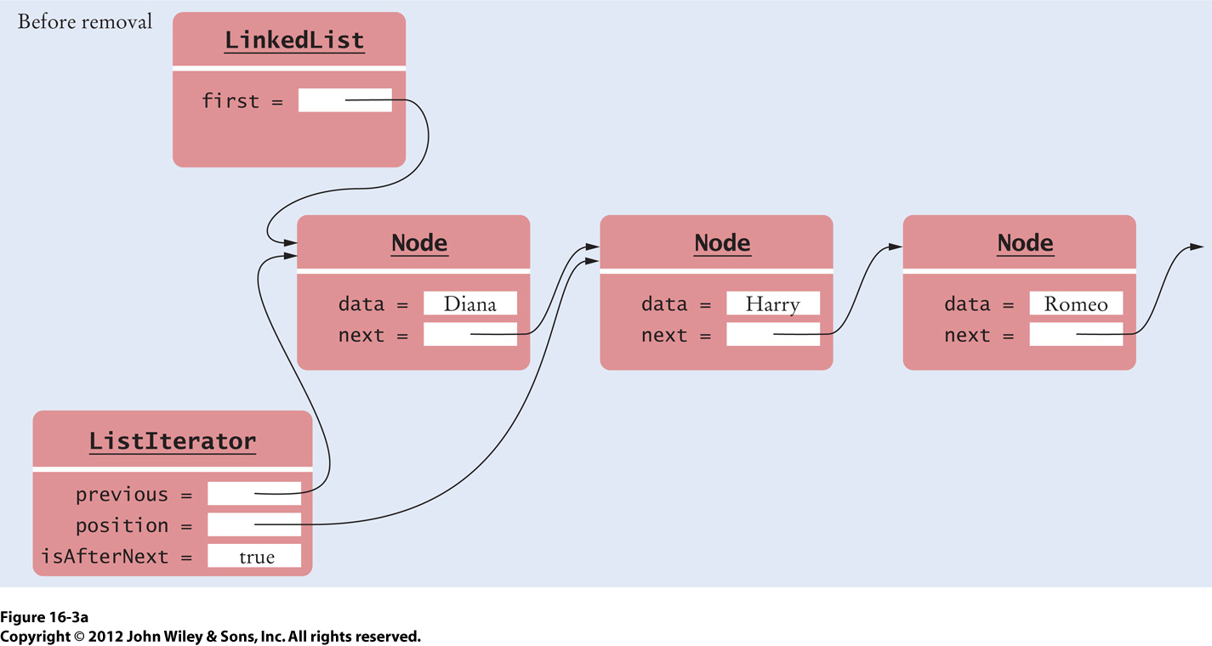
Remove an Element, cont’d
We’re going to
remove this node.

Slide 19
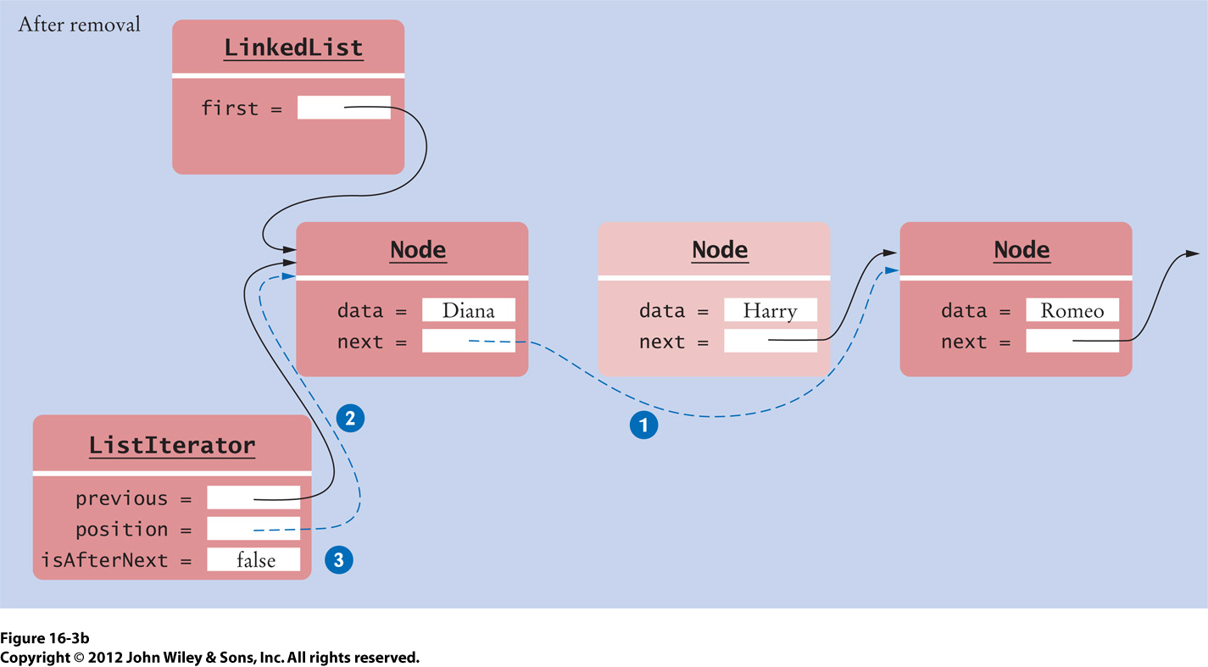
Remove an Element, cont’d
Why can’t we call
remove() again?

Slide 20
Remove an Element, cont’d
public void remove()
{
if (!isAfterNext) {
throw new IllegalStateException();
}
if (position == first) {
removeFirst();
}
else {
previous.next = position.next;
}
position = previous;
isAfterNext = false;
}

Slide 21
Add an Element
Use the iterator to add (insert) an element
to the middle of the linked list.
  You add an element before the cursor.
  Afterward, the cursor is after the added element.

Slide 22
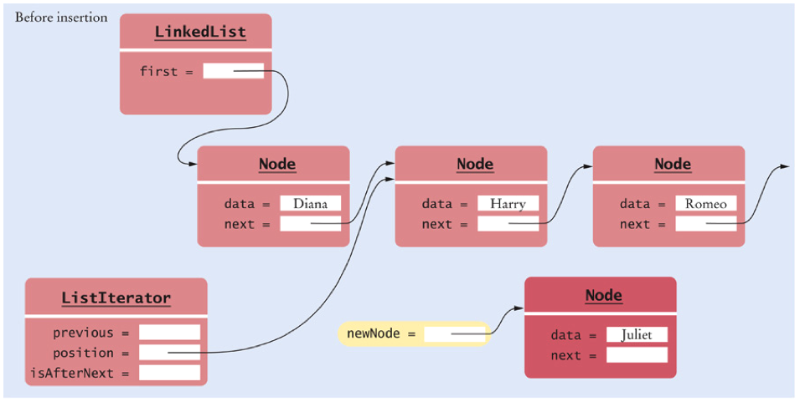
Add an Element, cont’d

Slide 23
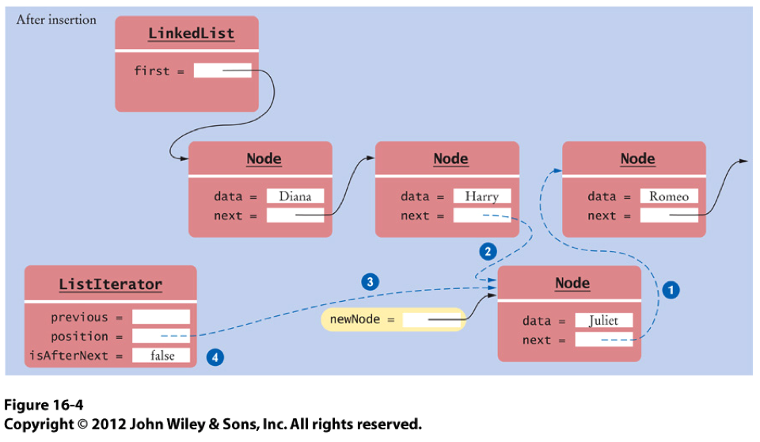
Add an Element, cont’d

Slide 24
Add an Element, cont’d
public void add(Object element)
{
if (position == null) {
addFirst(element);
position = first;
}
else {
Node newNode = new Node();
newNode.data = element;
newNode.next = position.next;
position.next = newNode;
position = newNode;
}
isAfterNext = false;
}

Slide 25
Set a Value
Use the iterator to set or change
an element value of the linked list.
  Set the value of the element just visited.
  Therefore, you must first call next()
  to visit an element.
  That’s the element whose value will be set.

Slide 26
Set a Value, cont’d
public void set(Object element)
{
if (!isAfterNext) {
throw new IllegalStateException();
}
position.data = element;
}

Slide 27
Break

Slide 28
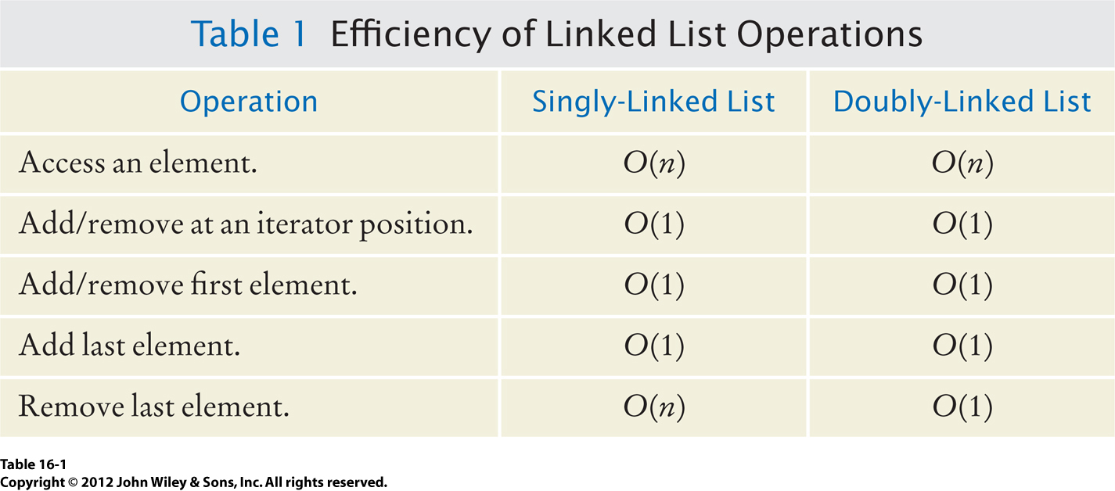
Efficiency of Linked List Operations

Slide 29
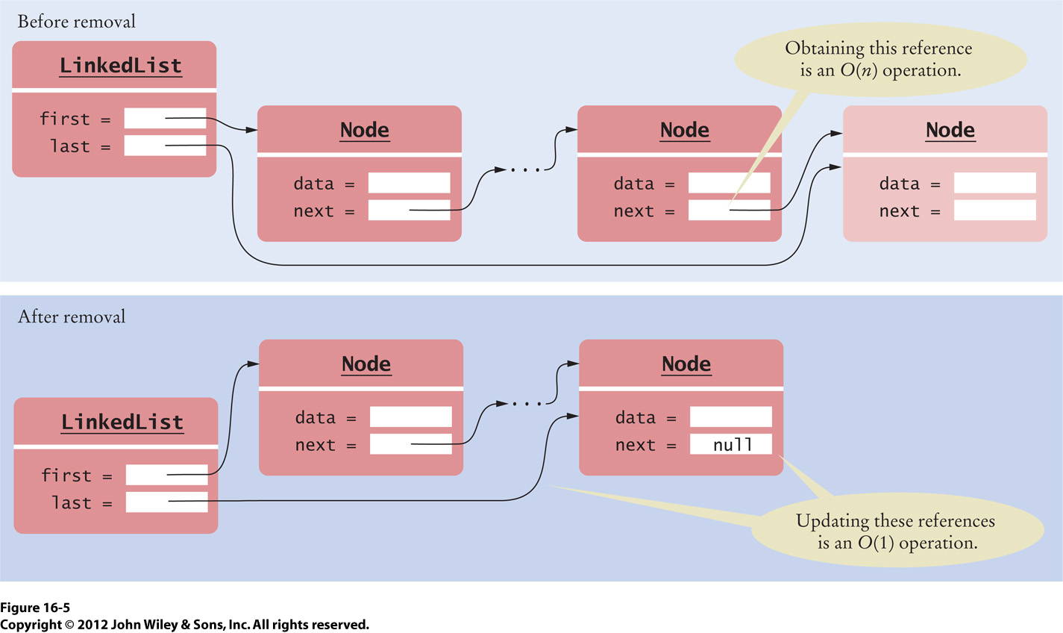
Remove the Last Element

Slide 30
A Doubly Linked List
Each node now refers to both
the next node and the previous node.
public class LinkedList
{
private Node first;
private Node last;
...
class Node
{
public Object data;
public Node next;
public Node previous;
}
...
}

Slide 31
Add the First Element
public void addFirst(Object element)
{
Node newNode = new Node();
newNode.data = element;
newNode.next = first;
newNode.previous = null;
if (first == null) {
last = newNode;
}
else {
first.previous = newNode;
}
first = newNode;
}
We just added the
very first element.

Slide 32
Remove the First Element
public Object removeFirst()
{
if (first == null) {
throw new NoSuchElementException();
}
Object element = first.data;
first = first.next;
if (first == null) {
last = null;
}
else {
first.previous = null;
}
return element;
}
The list is now empty.

Slide 33
Add the Last Element
public void addLast(Object element)
{
Node newNode = new Node();
newNode.data = element;
newNode.next = null;
newNode.previous = last;
if (last == null) {
first = newNode;
}
else {
last.next = newNode;
}
last = newNode;
}
We just added the
very first element.

Slide 34
Remove the Last Element
public Object removeLast()
{
if (last == null) {
throw new NoSuchElementException();
}
Object element = last.data;
last = last.previous;
if (last == null) {
first = null;
}
else {
last.next = null;
}
return element;
}
The list is now empty.

Slide 35
A Bidirectional Iterator
In a doubly-linked list, the iterator can move forward and backward.
Method previous() returns the element
after the cursor position.
LinkedList lst = new LinkedList();
lst.addLast("A");
lst.addLast("B");
lst.addLast("C");
ListIterator iter = lst.listIterator();
// The iterator is before the first element |ABC
iter.next(); // Returns “A”; the iterator is after the first element A|BC
iter.next(); // Returns “B”; the iterator is after the second element AB|C
iter.previous(); // Returns “B”; the iterator is after the first element A|BC

Slide 36
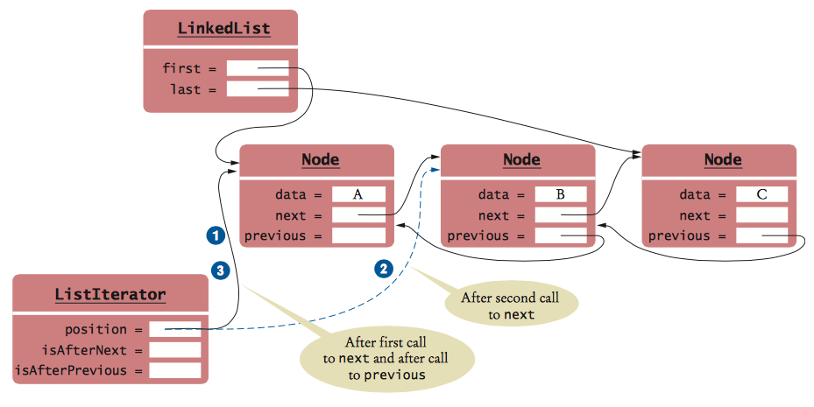
A Bidirectional Iterator, cont’d
ListIterator iter = lst.listIterator();
// The iterator is before the first element |ABC
iter.next(); // Returns “A”; the iterator is after the first element A|BC
iter.next(); // Returns “B”; the iterator is after the second element AB|C
iter.previous(); // Returns “B”; the iterator is after the first element A|BC

Slide 37
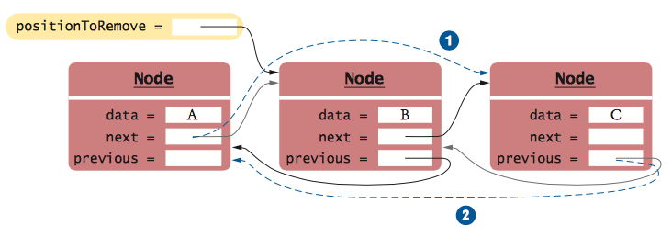
Remove an Element

Slide 38
Homework #9
Reverse the elements of a singly-linked list using an iterative method and a recursive method.
Example
  Original list: [A B C D]
  Reversed list: [D C B A]
You must reverse the linked list in place.
  You may not copy the elements to an array
  or an array list.

Slide 39
Homework #9, cont’d
You are given a linked list class AbbreviatedLinkedList that has a private inner Node class, a private field first, and a public method addFirst().
You will add the iterative reverse() method:
You will add the recursive reverse() method:
  Parameter p refers to the starting node of the list where reversal is to begin.
public void reverse()
private Node reverse(Node p)

Slide 40
Homework #9, cont’d
There is a public driver method for the recursive reverse() method:
There is no iterator class.
Sample output:
public void reverseRecursive()
{
first = reverse(first);
}
Original list: [A B C D]
Iteratively reversed: [D C B A]
Original list: [A B C D]
Recursively reversed: [D C B A]

Slide 41
Homework #9, cont’d
Draft: Iterative version only.
  Codecheck: http://codecheck.it/codecheck/files/15072108363747y0fo08ar6knsd11a5wjak
  Canvas: Homework 9 Draft
  Due: Friday, July 24 at 11:59 PM
Final: Replace your iterative method
with your recursive method.
  Codecheck: http://codecheck.it/codecheck/files/1507210846ccvdhl3kluu0qfmolsx1y2h1i
  Canvas: Homework 9 Final
  Due: Monday, July 27 at 11:59 PM

