Slide 1


CS 46B: Introduction to Data Structures
July 16 Class Meeting
Department of Computer Science
San Jose State University
Summer 2015
Instructor: Ron Mak
www.cs.sjsu.edu/~mak

Slide 2
Quizzes for July 21
Quiz 16 July 21 16.1
Quiz 17 July 21 16.1 Worked Example
Quiz 18 July 21 16.2

Slide 3

Pluto and Its Moon Charon

Slide 4

Pluto

Slide 5

Pluto Closeup

Slide 6
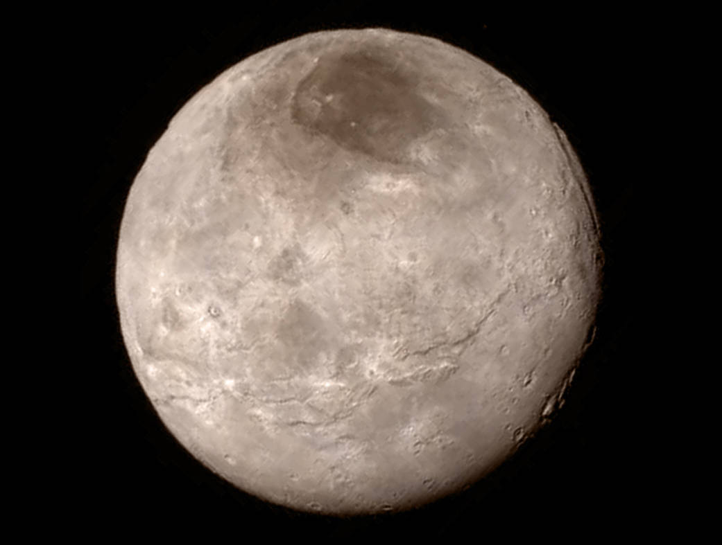
Pluto’s Moon Charon

Slide 7
Midterm Solution: Question 1
public class EveryOtherCharacter
{
private static String everyOther(String str)
{
switch (str.length()) {
case 0: return "";
case 1: return str;
default: return str.substring(0, 1) +
everyOther(str.substring(2));
}
}
...
}

Slide 8
Midterm Solution: Question 2
public class EveryOtherDigit
{
private static long everyOther(long value)
{
if (value < 10) return value;
else {
long last = value%10;
return 10*everyOther(value/100) + last;
}
}
...
}

Slide 9
Midterm Solution: Question 3
public class WordTranslator
{
private static String translate(String word, int index,
ArrayList<String> english,
ArrayList<String> french)
{
if (index == english.size()) return "???";
else if (word.equalsIgnoreCase(english.get(index))) {
return french.get(index);
}
else return translate(word, ++index, english, french);
}
...
}

Slide 10
Midterm Solution: Question 4
public class SentenceTranslator
{
...
private static String translate(Scanner text,
ArrayList<String> english,
ArrayList<String> french)
{
if (!text.hasNext()) return "";
else {
String word = text.next();
return translate(word, english, french) + " " +
translate(text, english, french);
}
}
...
}

Slide 11
Midterm Solution: Question 5
private static LinkedList<Integer> merge(LinkedList<Integer> first,
LinkedList<Integer> second)
{
LinkedList<Integer> list = new LinkedList<Integer>();
while ((first.size() > 0) && (second.size() > 0)) {
if (first.getFirst() < second.getFirst()) {
list.add(first.getFirst());
first.remove();
}
else {
list.add(second.getFirst());
second.remove();
}
}
if (first.size() > 0) list.addAll(first);
if (second.size() > 0) list.addAll(second);
return list;
}
Merge from the first list.
Merge from the second list.
Merge the
leftovers.

Slide 12
Midterm Solution: Question 6
int[] a = { 4, 14, 16, 16, 18, 26, 29, 32, 47, 50,
54, 61, 63, 64, 79, 83, 86, 88, 92, 97};
Looking for 86:
Looking for 42:
a[ 9]=50
a[14]=79
a[17]=88
a[15]=83
a[16]=86
a[9]=50
a[4]=18
a[6]=29
a[7]=32
a[8]=47

Slide 13
Midterm Solution: Question 7
Partitioning:
[17, 69, 23, 27, 52, 38, 2, 42, 91, 80]
Pivot = 52
[17, 69, 23, 27, 80, 38, 2, 42, 91, 52]
i = 1, j = 7, swapped 42 and 69:
[17, 42, 23, 27, 80, 38, 2, 69, 91, 52]
i = 4, j = 6, swapped 2 and 80:
[17, 42, 23, 27, 2, 38, 80, 69, 91, 52]
Partitioned: pivot = 52, pivot index = 6
[17, 42, 23, 27, 2, 38, 52, 69, 91, 80]

Slide 14
Break

Slide 15
The Java Collections Framework
A built-in set of interfaces and classes
that you can use in your programs
to organize multiple data objects.
  Different ways to store the objects in memory.
  Different ways to access and manipulate the objects.
You put the objects into a collection.
  Example collection type: ArrayList

Slide 16
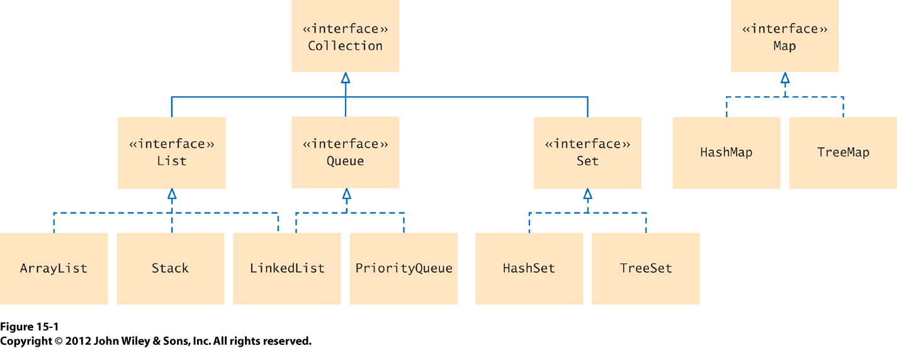
Collections Interfaces and Classes

Slide 17
Sets
A set is an unordered collection.
  No duplicates admitted.
Its elements are stored in a way that’s
optimized for efficiency.
  Not necessarily in the order that you entered them.
There are two implementations of
the standard Set interface.
  HashSet
  TreeSet

Slide 18

HashSet
Based on hash tables.
Use to group elements into smaller collections that share the same characteristic.
Books grouped
by color.

Slide 19

TreeSet
Based on binary search trees.
Use to store elements in sorted order.
  The element objects must be Comparable.
  Or, you must supply a Comparator object.
Books sorted
by height.

Slide 20
Constructing Sets
Set<String> names = new HashSet<String>();
Set<String> names = new TreeSet<String>();
Set<String> names = new TreeSet<String>(myComparator);
Or use the “diamond” with newer Java versions.
Set<String> names = new HashSet<>();
Set<String> names = new TreeSet<>();
Set<String> names = new TreeSet<>(myComparator);

Slide 21
Working with Sets
Add to a set of names (strings):
  No duplicates.
  If you add an element that’s already in the set,
  the add operation is ignored.
Remove from a set of names:
  If you try to remove an element that’s not in the set,
  the remove operation is ignored.
names.add("Juliet");
names.remove("Juliet");

Slide 22
Working with Sets, cont’d
Is an element in the set?
Iterate through the elements of a set:
Or, use the “for each” loop:
if (names.contains("Juliet") ...
Iterator<String> iter = names.iterator();
while (iter.hasNext()) {
String name = iter.next();
...
}
for (String name : names) {
...
}

Slide 23
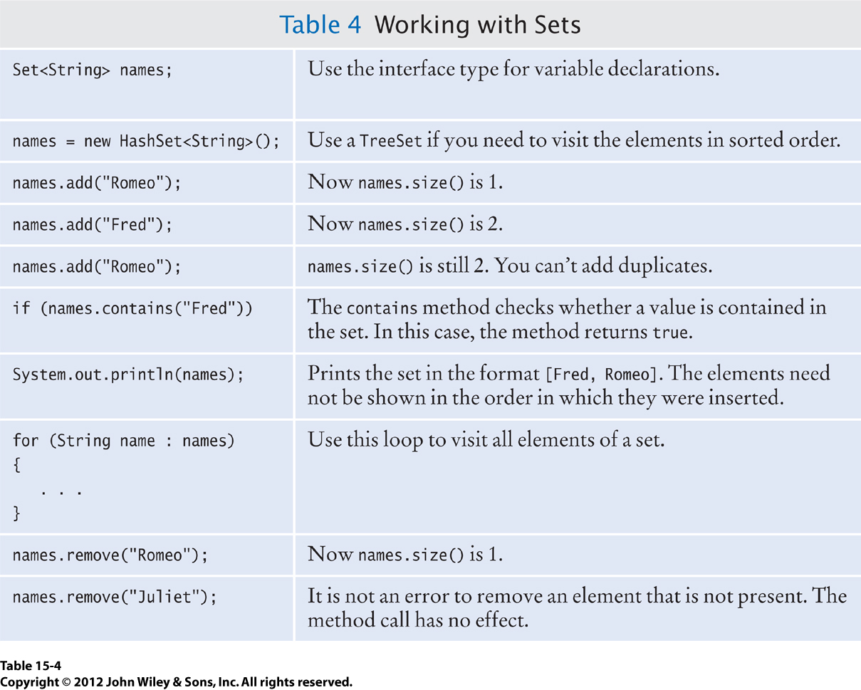
Working with Sets, cont’d

Slide 24
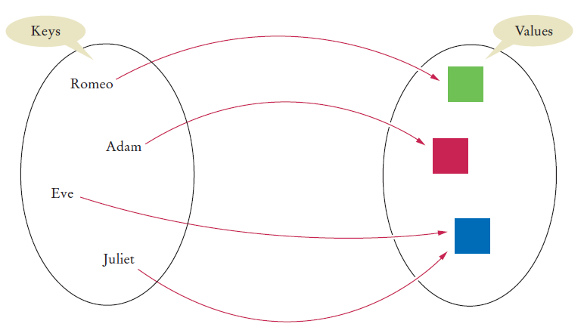
Maps
Associate elements from a key set
with elements from a value collection.
Two implementations of the Map interface:
  HashMap
  TreeMap

Slide 25
Working with Maps
Construct a map:
Add an association:
Update (change) an existing association:
Get an association:
Remove an association:
Map<String, Color> favoriteColors = new HashMap<String, Color>();
favoriteColors.put("Juliet", Color.RED);
favoriteColors.put("Juliet", Color.BLUE);
Returns null if the
association doesn’t exist.
favoriteColors.get("Juliet");
favoriteColors.remove("Juliet");

Slide 26
Working with Maps, cont’d
To enumerate (list) all the keys in a map:
  Method keySet() returns the set of keys.
  Then iterate over the keys.
If the map is a TreeMap, then keySet() will iterate over the keys in sorted order.
Set<String> keys = favoriteColors.keySet();
for (String key : keys) {
Color value = favoriteColors.get(key);
...
}

Slide 27
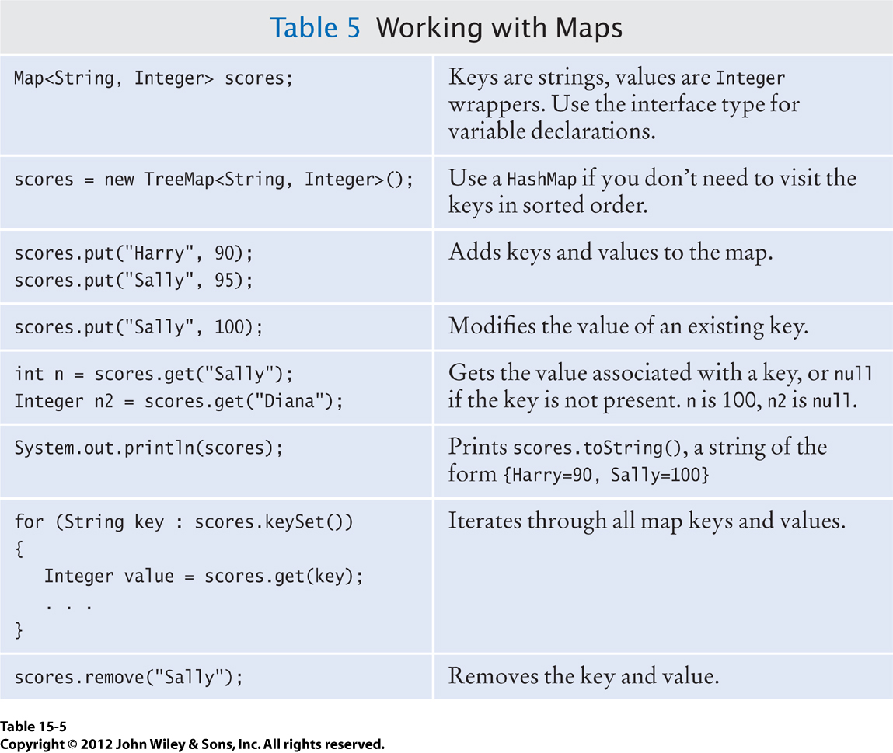
Working with Maps, cont’d

Slide 28
Stacks
Enter (“push”) an element only at one end
(the “top”) of the stack.
Remove (“pop”) an element only from
the same end of the stack.
Last in, first out (LIFO).
Stack<String> stk = new Stack<String>();
stk.push("I");
stk.push("love");
stk.push("Java");
while (stk.size() > 0) {
System.out.println(stk.pop());
}
What is printed?

Slide 29
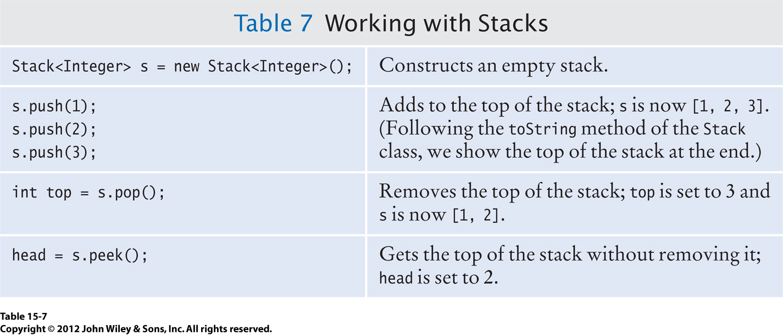
Working with Stacks

Slide 30
Queues
Enter elements only at one end
(the “tail”) of the queue.
Remove elements only from the other end
(the “head”) of the queue.
First in, first out (FIFO)
Queue<String> q= new Queue<String>();
q.add("I");
q.add("love");
q.add("Java");
while (q.size() > 0) {
System.out.println(q.remove());
}
What is printed?

Slide 31
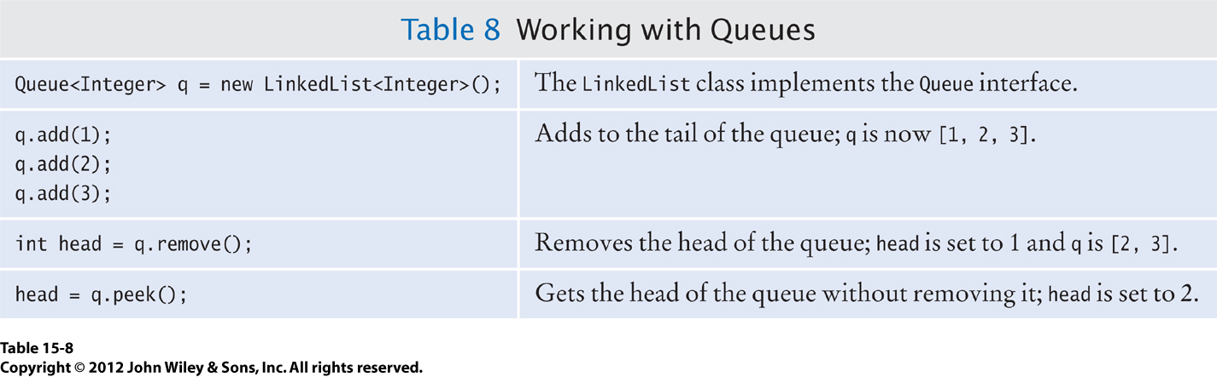
Working with Queues

Slide 32
Priority Queues
Add element to a priority queue in any order, but assign a priority to each element.
Remove elements in priority order.
  Customary to assign low values to the most urgent priorities; thus, priority 1 would be the most urgent.
Each remove operation extracts the minimum element from the priority queue.
  Element objects must be Comparable.
  If two elements have the same priority,
  the priority queue breaks ties arbitrarily.

Slide 33
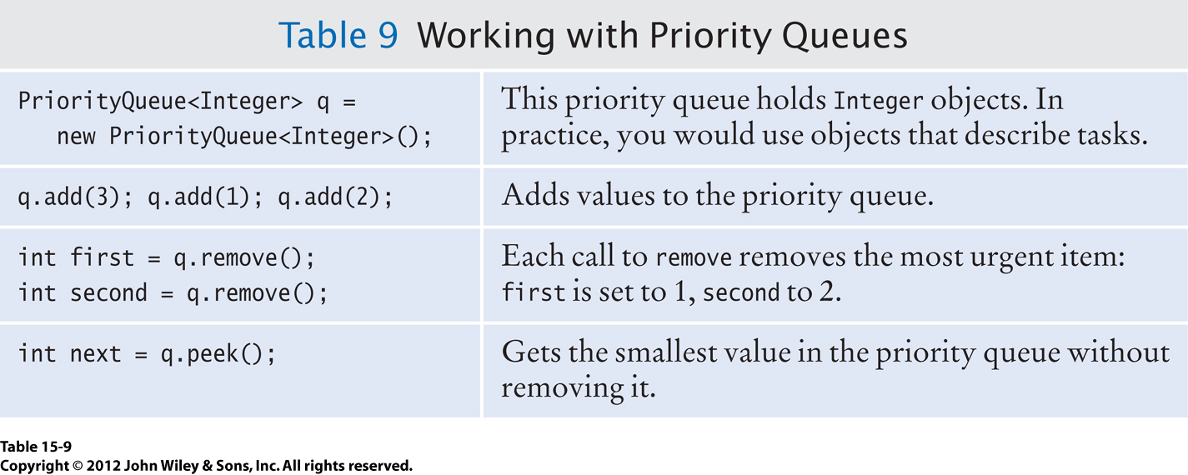
Working with Priority Queues

Slide 34
Homework 8 Final
For this assignment, you must use one or more classes from the Java Collections framework.
Read the text file GettysburgAddress.txt.
  http://www.cs.sjsu.edu/~mak/CS46B/assignments/8/GettysburgAddress.txt
Print all the unique words in the file in alphabetical order.
  Case insensitive: But and but are the same word.
  Print the words in lower case, 8 words per line, separated by a single space.

Slide 35
Homework 8 Final, cont’d
Your code should be as efficient as possible.
  Make best use of the collections framework.
  Avoid writing code that you don’t have to write.
20 points. This homework has no draft.
Codecheck URL: http://codecheck.it/codecheck/files/15071607148den21njqu0ri0g193w4y5ket
Canvas: Homework 8 Final
Due Monday, July 20 at 11:59 PM.

