Slide 1
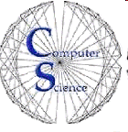

CS 46B: Introduction to Data Structures
July 14 Class Meeting
Department of Computer Science
San Jose State University
Summer 2015
Instructor: Ron Mak
www.cs.sjsu.edu/~mak

Slide 2
Quizzes for July 16
Quiz 14 July 16 15.3 – 15.4
Quiz 15 July 15 15.5 – 15.6

