Slide 1


CS 46B: Introduction to Data Structures
July 9 Class Meeting
Department of Computer Science
San Jose State University
Summer 2015
Instructor: Ron Mak
www.cs.sjsu.edu/~mak

Slide 2
The Java Collections Framework
A built-in set of interfaces and classes
that you can use in your programs
to organize multiple data objects.
  Different ways to store the objects in memory.
  Different ways to access and manipulate the objects.
You put the objects into a collection.
  Example collection type: ArrayList

Slide 3
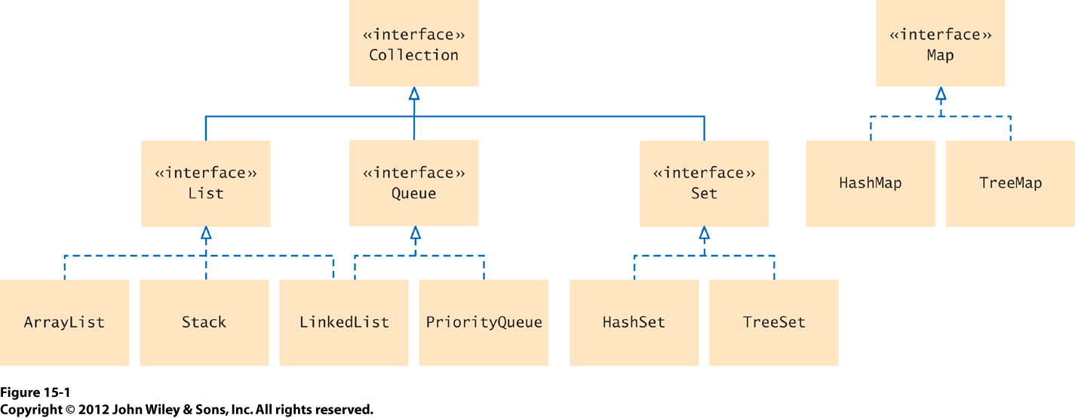
Collections Interfaces and Classes

Slide 4
List
A list is an ordered collection of objects.
  Order does not necessarily mean sorted.
Once you’ve established an order, you can access the objects of a list one after another.
You can also access any object in a list
directly via an index.
  Examples: 1st object, 42nd object, 5th object, etc.

Slide 5

List, cont’d
A list of books:
ArrayList, Stack,
and LinkedList
implement the
List interface.
List methods include:
  get() and set()
  add() and remove()
  size(), clear(), and isEmpty()

Slide 6

Stack
Stack is a subclass of List
  Therefore, it is an ordered collection of objects.
Add objects to a stack or
remove objects only at
one end of the stack only.
  This end is commonly called
  the “top” of the stack.
  Call method push()
  to add an object to a stack.
  Call method pop() to remove an object.

Slide 7
Stack, cont’d
Why does the term “last in, first out” (LIFO) describe a stack?

Slide 8

Queue
Add objects only at one end of a queue,
called its “tail”.
Remove objects only at the other end,
called the “head” of the queue.
head
tail

Slide 9

Queue, cont’d
Why does the term “first in, first out” (FIFO) describe a queue?

Slide 10

Set
A set is an unordered collection
of unique objects.
  You don’t care about the order of the objects.
  You don’t want any duplicate objects.
A set of books:
Some methods:
  add(), remove()
  size(), isEmpty()
  contains()

Slide 11
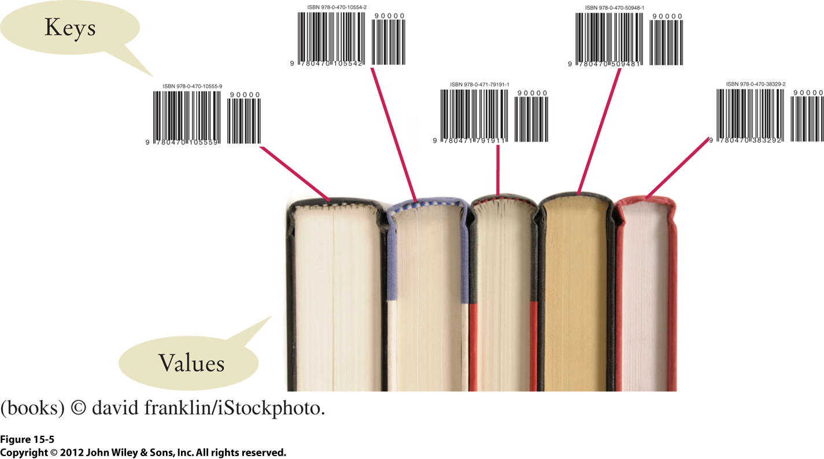
Map
A map is a collection in which you use a key
to access a value in the map.
  It maps a key to its value.
  A map stores the keys, values,
  and the associations between them.
Mapping bar codes (keys)
to books (values).

Slide 12
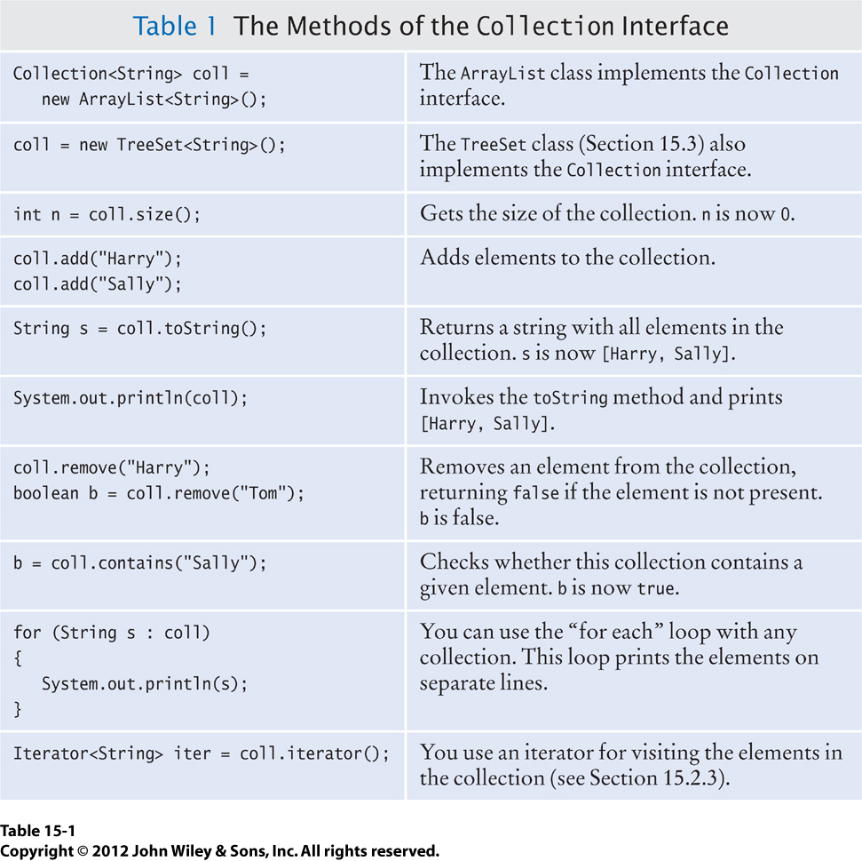
Common Collector Methods

Slide 13
LinkedList
Like the ArrayList class, the LinkedList class implements the List interface.
  LinkedList also implements the Queue interface.
Therefore, it has the same methods:
  get() and set()
  add() and remove()
  size(), clear(), and isEmpty()

Slide 14
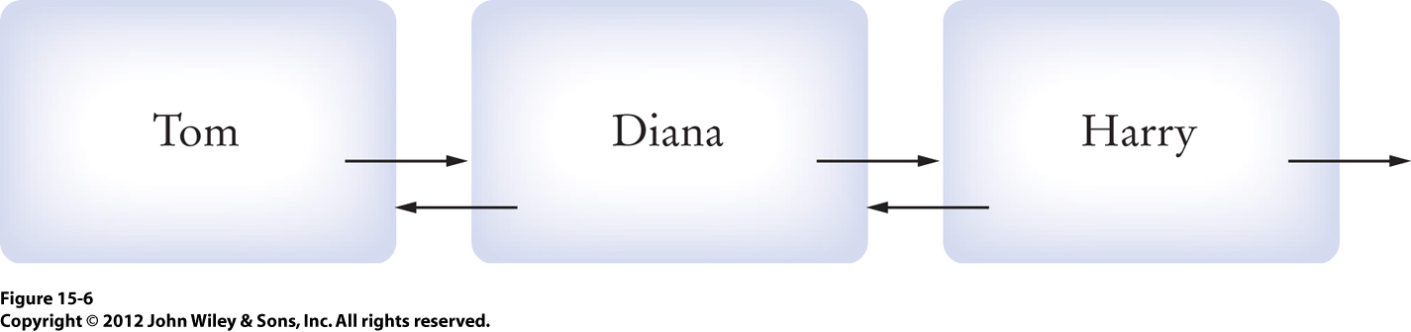
LinkedList, cont’d
A linked list is a sequence of nodes.
Each node contains:
  A data value.
  A reference to the next node in the sequence.
    The reference is null if it’s the last node.
  A reference to the previous node in the sequence.
    The reference is null if it’s the first node.

Slide 15
Linked List, cont’d
Unlike an array list, you cannot directly access the i^{th} node of a linked list.
  You start with the head of the list and then
  “chase” (follow) references (“links” or “pointers”)
  to the next node until you get the the i^{th} node.
  Or, you can start with the tail of the list
  and then chase links to the previous node
  until you get to the i^{th} node.
If the list is long, it can take a while
to get to the node you want.

Slide 16
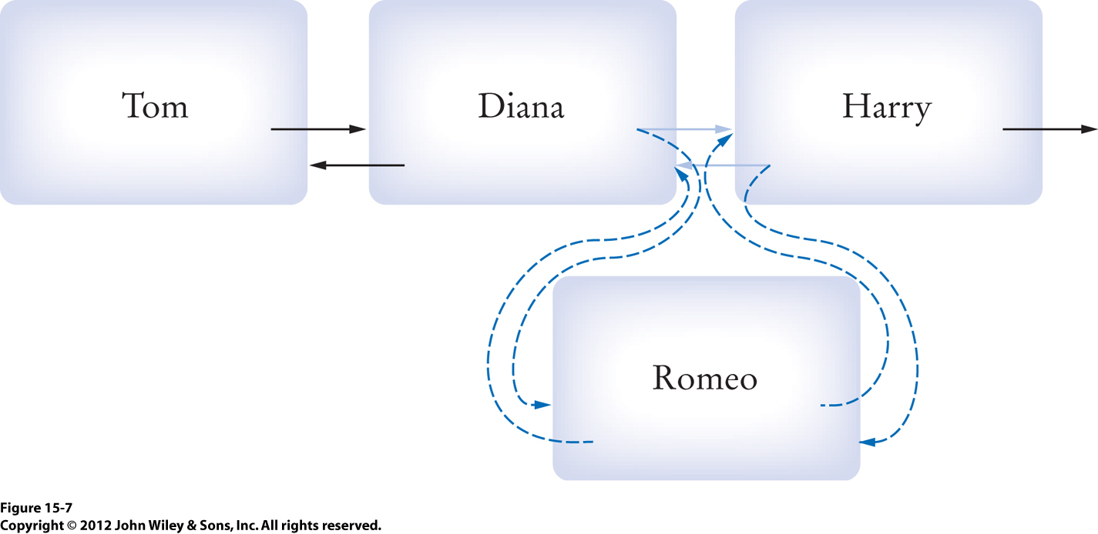
LinkedList, cont’d
Adding a node into a linked list can be very fast.
  You need to update only the references
  of the node’s new neighbors.
  Example: Add Romeo between Diana and Harry.
But getting to the node
containing “Diana”
may take a while.

Slide 17
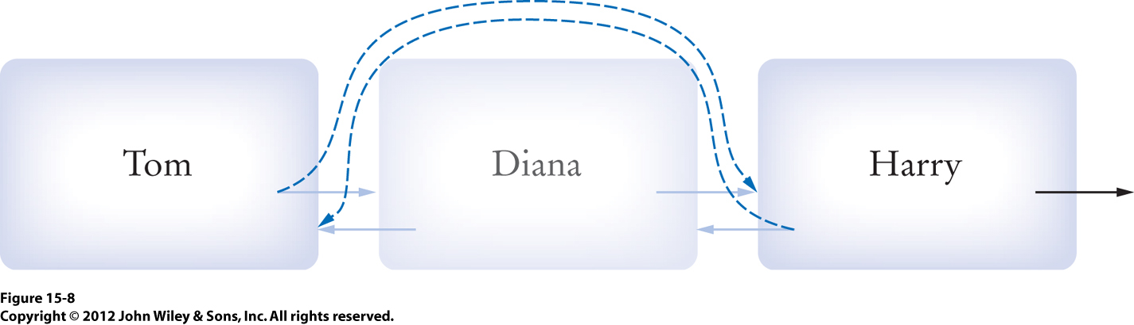
LinkedList, cont’d
Similarly, removing a node from a linked list
can be very fast.
But getting to the node
containing “Diana”
may take a while.

Slide 18
LinkedList, cont’d
By the way, adding and removing an object from an array list can be very slow.
  Why?

Slide 19
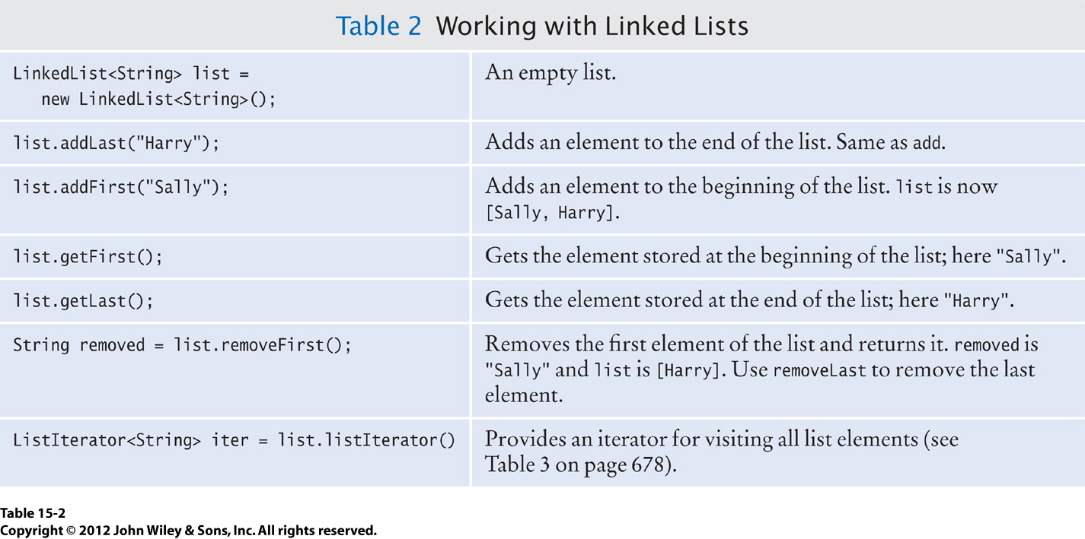
The LinkedList Class
The LinkedList class
of the collections framework:

Slide 20
ListIterator
The get() method of a linked list
can be very slow.
  Imagine a linked list L of a million nodes.
  Your program calls L.get(500000)
  How many links do you have to chase
  from the head of the list to access the node?
A list iterator keeps track of a position in a list.
  A list’s iterator allows you to efficiently
  access each node of the list in succession.

Slide 21
ListIterator, cont’d
Suppose you have a linked list named workers of Employee objects:
  Then iter enables you to access each object
  in turn, starting with the first one in the list:
LinkedList<Employee> workers = ... ;
ListIterator<Employee> iter = workers.listIterator();
while (iter.hasNext()) {
Employee w = iter.next();
...
}

Slide 22
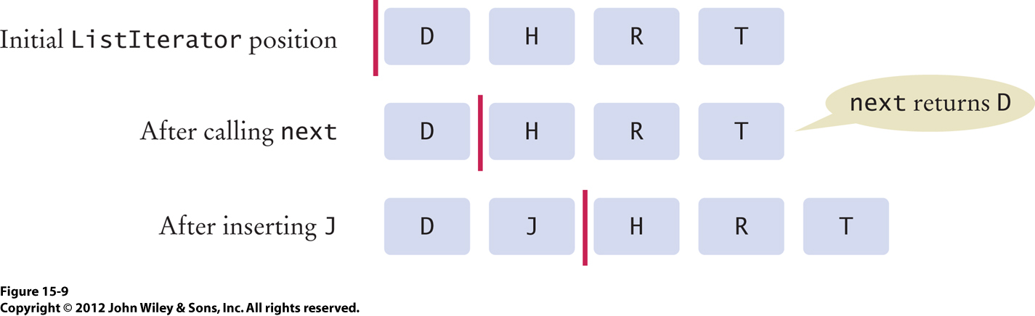
ListIterator, cont’d
You can think of an iterator as a “cursor” between list nodes:
You insert (add) before the cursor and so then the cursor is after the inserted node.

Slide 23
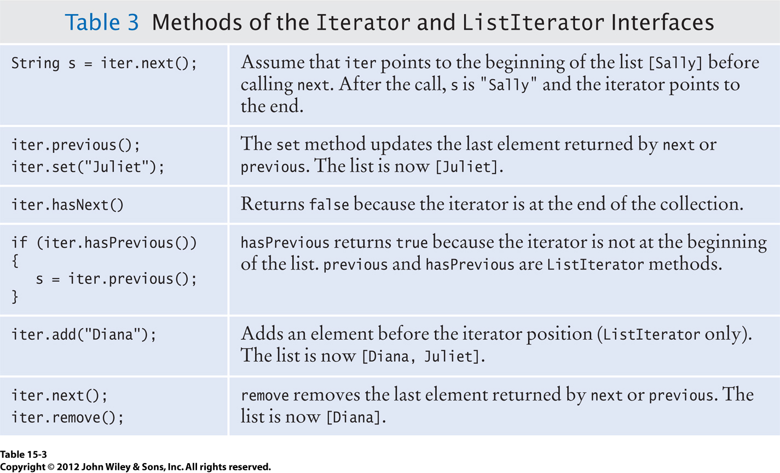
List ListIterator, cont’d

Slide 24
ListIterator, cont’d
To use an iterator to remove a list node:
  Call the iterator’s next() or previous() method to access a node.
  Then call the iterator’s remove() method
  to remove the node just accessed.
Do not:
  Call remove() more than once
  after calling next() or previous().
  Call remove() right after calling add().
Demo

Slide 25
Clicker Question July 9 #1
What is the contents of letters
after this sequence of instructions?
List<String> letters = new LinkedList<>();
letters.add("F");
letters.add("R");
letters.add("E");
letters.add("D");
ListIterator<String> iter = letters.iterator();
iter.next();
iter.next();
iter.remove();
iter.next();
iter.add("X");
a. [F, R, E, X]
b. [F, E, X, D]
c. [F, E, R, X]
d. Something else

Slide 26
Break

Slide 27
Review for Midterm #2
Similar to Midterm #1
Open book, laptop, Internet
Use Codecheck and submit to Canvas
1 hour 55 minutes

Slide 28
Review for Midterm #2
Recursion
  Solve the base case
  Look for a simpler but similar problem
  that’s closer to the base case whose
  solution will help solve the overall problem.
  Solve the simpler problem recursively.
Mutual recursion

Slide 29
Review for Midterm #2, cont’d
Sorting
  selection sort
  merge sort
  quicksort
Partitioning strategy
  pivot element
Performance analysis
  Proof that merge sort is O(N log N)
  growth order

Slide 30
Review for Midterm #2, cont’d
Arrays.sort() and Collections.sort()
Searching
  binary search (recursive and non-recursive)
Parameterized Comparable and Comparator interfaces
Collections framework
  List interface
  linked list
  linked list iterator

