Slide 1


CS 46B: Introduction to Data Structures
July 7 Class Meeting
Department of Computer Science
San Jose State University
Summer 2015
Instructor: Ron Mak
www.cs.sjsu.edu/~mak

Slide 2
Sorting Animations
https://www.cs.usfca.edu/~galles/visualization/ComparisonSort.html
http://www.sorting-algorithms.com

Slide 3
Quizzes for July 9
Quiz 13 July 9 15.1 – 15.2

Slide 4
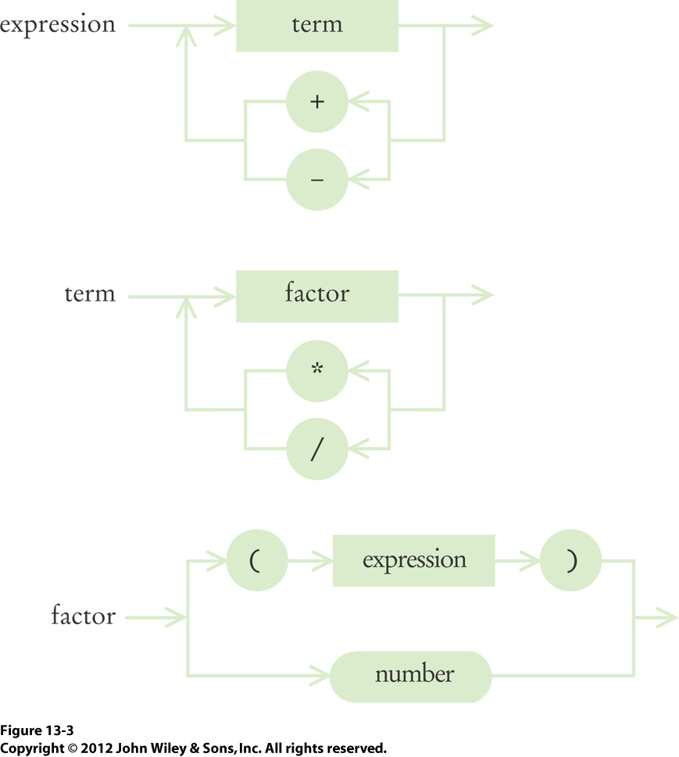
Homework #6 Solution
Three mutually recursive methods:
  getTermValue()
  getFactorValue()
  getExpressionValue()
Which one should handle the modulo % operator?

Slide 5
Homework #6 Solution, cont’d
The % modulo operator binds as tightly
(has the same precedence level) as * and /
Therefore, method getTermValue()
should also handle %

Slide 6
Homework #6 Solution, cont’d
public int getTermValue()
{
int value = getFactorValue();
boolean done = false;
while (!done) {
String next = tokenizer.peekToken();
if ("*".equals(next) || "/".equals(next) || "%".equals(next)) {
tokenizer.nextToken();
int value2 = getFactorValue();
if ("*".equals(next)) {
value = value*value2;
}
else if ("/".equals(next)) {
value = value/value2;
}
else {
value = value%value2;
}
}
else {
done = true;
}
}
return value;
}

Slide 7
Homework #6 Solution, cont’d
The ^ power operator binds the most tightly
of all the operators.
  It has the highest precedence level.
How should we handle the modulo ^ operator?

Slide 8
Homework #6 Solution, cont’d
Because the ^ power operator has
higher precedence than * / and %,
it needs its own method.

Slide 9
Homework #6 Solution, cont’d
public int getPowerValue()
{
int value = getFactorValue();
boolean done = false;
while (!done) {
String next = tokenizer.peekToken();
if ("^".equals(next)) {
tokenizer.nextToken();
int value2 = getFactorValue();
value = (int) Math.pow((double) value,
(double) value2);
}
else {
done = true;
}
}
return value;
}

Slide 10
Homework #6 Solution, cont’d
Who calls method getPowerValue()?
Method getPowerValue() calls method getFactorValue().
Therefore, method getTermValue()
calls method getPowerValue().

Slide 11
Homework #6 Solution, cont’d
public int getTermValue()
{
int value = getPowerValue();
boolean done = false;
while (!done) {
String next = tokenizer.peekToken();
if ("*".equals(next) || "/".equals(next) || "%".equals(next)) {
tokenizer.nextToken();
int value2 = getPowerValue();
if ("*".equals(next)) {
value = value*value2;
}
else if ("/".equals(next)) {
value = value/value2;
}
else {
value = value%value2;
}
}
else {
done = true;
}
}
return value;
}

Slide 12
Homework #7: Quicksort
Recall that quicksort works by selecting a pivot value from an array range, and it uses the pivot value to partition the range into two subranges.
  The first subrange will contain all the values
  less than the pivot value.
  The second subrange will contain all the values greater than the pivot value.
Then it recursively sort both partitions.

Slide 13



Homework #7: Quicksort, cont’d
That’s what the textbook’s quicksort does:
  First partition:
  Then recursively sort each partition:

Slide 14
Homework #7: Quicksort
A slightly more elegant version of partitioning places the pivot value between the two partitions.
When you do this, the pivot value is placed into its “final resting place”.
  It will not move again during subsequent
  sorting operations.

Slide 15
Data Structures and Algorithms in Java, 3rd ed.
by Mark Allen Weiss
Pearson Education, Inc., 2012

Slide 16
Homework #7-Draft: Quicksort
For the draft, you are provided a partitioning method that places the pivot value into position.
Add more print statements to trace how:
  Index variables i and j march towards each other.
  Elements are swapped along the way.

Slide 17
Homework #7-Draft: Quicksort
Partitioning:
[50, 63, 29, 14, 86, 16, 79, 16, 26, 61, 47, 64, 83, 18, 97, 92, 32, 54, 4, 88]
Pivot = 50
[88, 63, 29, 14, 86, 16, 79, 16, 26, 61, 47, 64, 83, 18, 97, 92, 32, 54, 4, 50]
i = 0, j = 18, swapped 4 and 88:
[4, 63, 29, 14, 86, 16, 79, 16, 26, 61, 47, 64, 83, 18, 97, 92, 32, 54, 88, 50]
i = 1, j = 16, swapped 32 and 63:
[4, 32, 29, 14, 86, 16, 79, 16, 26, 61, 47, 64, 83, 18, 97, 92, 63, 54, 88, 50]
i = 4, j = 13, swapped 18 and 86:
[4, 32, 29, 14, 18, 16, 79, 16, 26, 61, 47, 64, 83, 86, 97, 92, 63, 54, 88, 50]
i = 6, j = 10, swapped 47 and 79:
[4, 32, 29, 14, 18, 16, 47, 16, 26, 61, 79, 64, 83, 86, 97, 92, 63, 54, 88, 50]
Partitioned: pivot = 50, pivot index = 9
[4, 32, 29, 14, 18, 16, 47, 16, 26, 50, 79, 64, 83, 86, 97, 92, 63, 54, 88, 61]

Slide 18
Homework #7-Draft: Quicksort
You are provided a quicksort method.
Use your tracer partitioning method.
Add more print statements to trace each recursive call to sort().
  For each recursive call, print the from and to index values for the start and end of the range to sort.

Slide 19
Homework #7-Draft: Quicksort
Original array:
[50, 63, 29, 14, 86, 16, 79, 16, 26, 61, 47, 64, 83, 18, 97, 92, 32, 54, 4, 88]
SORTING: from = 0, to = 19
Partitioning:
[50, 63, 29, 14, 86, 16, 79, 16, 26, 61, 47, 64, 83, 18, 97, 92, 32, 54, 4, 88]
Pivot = 50
[88, 63, 29, 14, 86, 16, 79, 16, 26, 61, 47, 64, 83, 18, 97, 92, 32, 54, 4, 50]
i = 0, j = 18, swapped 4 and 88:
[4, 63, 29, 14, 86, 16, 79, 16, 26, 61, 47, 64, 83, 18, 97, 92, 32, 54, 88, 50]
i = 1, j = 16, swapped 32 and 63:
[4, 32, 29, 14, 86, 16, 79, 16, 26, 61, 47, 64, 83, 18, 97, 92, 63, 54, 88, 50]
i = 4, j = 13, swapped 18 and 86:
[4, 32, 29, 14, 18, 16, 79, 16, 26, 61, 47, 64, 83, 86, 97, 92, 63, 54, 88, 50]
i = 6, j = 10, swapped 47 and 79:
[4, 32, 29, 14, 18, 16, 47, 16, 26, 61, 79, 64, 83, 86, 97, 92, 63, 54, 88, 50]
Partitioned: pivot = 50, pivot index = 9
[4, 32, 29, 14, 18, 16, 47, 16, 26, 50, 79, 64, 83, 86, 97, 92, 63, 54, 88, 61]

Slide 20
Homework #7-Draft: Quicksort
SORTING: from = 0, to = 8
Partitioning:
[4, 32, 29, 14, 18, 16, 47, 16, 26, 50, 79, 64, 83, 86, 97, 92, 63, 54, 88, 61]
Pivot = 4
[26, 32, 29, 14, 18, 16, 47, 16, 4, 50, 79, 64, 83, 86, 97, 92, 63, 54, 88, 61]
Partitioned: pivot = 4, pivot index = 0
[4, 32, 29, 14, 18, 16, 47, 16, 26, 50, 79, 64, 83, 86, 97, 92, 63, 54, 88, 61]
SORTING: from = 0, to = -1
SORTING: from = 1, to = 8
Partitioning:
[4, 32, 29, 14, 18, 16, 47, 16, 26, 50, 79, 64, 83, 86, 97, 92, 63, 54, 88, 61]
Pivot = 32
[4, 26, 29, 14, 18, 16, 47, 16, 32, 50, 79, 64, 83, 86, 97, 92, 63, 54, 88, 61]
i = 6, j = 7, swapped 16 and 47:
[4, 26, 29, 14, 18, 16, 16, 47, 32, 50, 79, 64, 83, 86, 97, 92, 63, 54, 88, 61]
Partitioned: pivot = 32, pivot index = 7
[4, 26, 29, 14, 18, 16, 16, 32, 47, 50, 79, 64, 83, 86, 97, 92, 63, 54, 88, 61]
Note how pivot values don’t move after they’ve been placed into their final positions.

Slide 21
Homework #7-Draft: Quicksort
...
SORTING: from = 15, to = 16
Partitioning:
[4, 14, 16, 16, 18, 26, 29, 32, 47, 50, 54, 61, 63, 64, 79, 83, 86, 88, 92, 97]
Pivot = 83
[4, 14, 16, 16, 18, 26, 29, 32, 47, 50, 54, 61, 63, 64, 79, 86, 83, 88, 92, 97]
Partitioned: pivot = 83, pivot index = 15
[4, 14, 16, 16, 18, 26, 29, 32, 47, 50, 54, 61, 63, 64, 79, 83, 86, 88, 92, 97]
SORTING: from = 15, to = 14
SORTING: from = 16, to = 16
SORTING: from = 18, to = 17
SORTING: from = 19, to = 19
Sorted array:
[4, 14, 16, 16, 18, 26, 29, 32, 47, 50, 54, 61, 63, 64, 79, 83, 86, 88, 92, 97]

Slide 22
Homework #7-Final: Quicksort
For the final version, use quicksort to sort an array list of names.
  You are provided a text file of the names of
  U.S. presidents.
Sort the presidents by their last names.
  If two presidents have the same last name,
  sort those names by their first names.
  If two presidents have the same first and last names, sort their names by their middle names.
    Example: George Bush should come before George W. Bush.

Slide 23
Linear Search
Search for item in an array of n elements.
  The array is not sorted in any way.
What choices do we have?
  Look at all the elements one at a time.
  Example: To search in 1000 elements,
  it takes on average 500 steps.
Therefore: O(n)

Slide 24
Binary Search
Now assume the array is sorted.
  Smallest value to largest value.
First check the middle element.
Is the target value you’re looking for
smaller than the middle element?
  If so, search the first half of the array.
Is the target value you’re looking for
larger than the middle element?
  If so, search the second half of the array.

Slide 25
Binary Search, cont’d
The binary search keeps cutting in half
the part of the array it’s searching.
  Next search either the first half or the second half.
  Eventually, you’ll either find the target value,
  or conclude that the value is not in the array.
Therefore, O(log₂ n)
  To search 1000 elements, it takes < 10 steps.
  Note: In computer science,
  logarithms are by default base 2.

Slide 26
Recursive Binary Search
Binary search can be done recursively:
public static int search(int[] a, int low, int high, int value)
{
if (low <= high) {
int mid = (low + high)/2;
if (value == a[mid]) {
return mid;
}
else if (value < a[mid]) {
return search(a, low, mid-1, value);
}
else {
return search(a, mid+1, high, value);
}
}
else {
return -1;
}
}
Get the midpoint of the subrange.
Found the target value?
Search the first half.
Search the second half.
The target value is not in the subrange.

Slide 27
Non-Recursive Binary Search
It’s easy to write binary search non-recursively:
public static int search(int[] a, int low, int high, int value)
{
while (low <= high) {
int mid = (low + high)/2;
if (value == a[mid]) {
return mid;
}
else if (value < a[mid]) {
high = mid-1;
}
else {
low = mid+1;
}
}
return -1;
}
Get the midpoint of the subrange.
Found the target value?
Search the first half next.
Search the second half next.
The target value is not in the array.

Slide 28
Break

Slide 29
Sorting and Searching in the Real World
So far, we’ve done sorting and searching
with arrays of numeric values.
Revelation #1: In a real application, we may need to sort and search different object types.
  Example: Sort employee objects.
Revelation #2: Java has built-in sorting and searching routines.
  You don’t have to write them yourself!

Slide 30
Built-in Sort Routines
Arrays.sort() will sort an array of objects.
  Example:
Collections.sort() will sort
an array list of objects.
  Example:
Employee workers[] = ... ;
Arrays.sort(workers);
ArrayList<Employee> workers = ... ;
Collections.sort(workers);

Slide 31
Built-in Sort Routines, cont’d
But how do Arrays.sort() and Collections.sort() know
how to compare your objects?
  How does it know that object A is less than,
  equal to, or greater than object B?
Your objects must be Comparable objects.
  They must be instances of a class that implements the Comparable interface.
Arrays.sort() and Collections.sort() call the objects’ compareTo() methods

Slide 32
Arrays.sort()
We saw Arrays.sort() on the midterm:
import java.util.Arrays;
public class Name implements Comparable
{
private String name;
private String first;
private String last;
...
public int compareTo(Object other)
{
Name otherName = (Name) other;
return this.last.compareTo(otherName.last);
}
public static void main(String args[])
{
Name names[] = { ... };
Arrays.sort(names);
for (Name name : names) System.out.println(name.getName());
}
}
Use the String class’s
compareTo() method.

Slide 33
Collections.sort()
Collections.sort() sorts an array list:
import java.util.ArrayList;
import java.util.Collections;
public class Name implements Comparable
{
...
public int compareTo(Object other)
{
Name otherName = (Name) other;
return this.last.compareTo(otherName.last);
}
public static void main(String args[])
{
ArrayList<Name> names = new ArrayList<Name>();
names.add(new Name("George Washington"));
names.add(new Name("Abraham Lincoln"));
...
Collections.sort(names);
for (Name name : names) System.out.println(name.getName());
}
}

Slide 34
Comparable as a Parameterized Interface
Just like ArrayList<Name>, we can give Comparable a type parameter.
So instead of:
public int compareTo(Object other)
{
Name otherName = (Name) other;
return this.name.length() - otherName.name.length();
}
Type cast required!

Slide 35
Comparable as a Parameterized Interface
We can eliminate the type cast in the compareTo() method:
public class Name implements Comparable<Name>
{
...
public int compareTo(Name otherName)
{
return this.last.compareTo(otherName.last);
}
...
}
No type cast!

Slide 36
Sorting Challenges
Suppose you want to sort objects that
don’t belong to a class that implements
the Comparable interface.
  You don’t have access to the code to modify it.
Or, you are developing an application where
an array or array list of objects needs to be sorted in different ways.

Slide 37
The Comparator Interface
Use the Comparator interface to create a comparator object whose sole responsibility is to compare two objects of the same type.
  The objects don’t have to belong to a class that implements the Comparable interface.
You can create different Comparator objects each of which compares in a different way.
  Tip: You can use inner classes that implement the Comparator interface.

Slide 38
The Comparator Interface, cont’d
import java.util.Arrays;
import java.util.Comparator;
public class Name
{
private String name;
private String first;
private String last;
...
private static class LastNamesComparator
implements Comparator<Name>
{
public int compare(Name name1, Name name2)
{
return name1.last.compareTo(name2.last);
}
}

Slide 39
The Comparator Interface, cont’d
private static class ReverseLastNamesComparator
implements Comparator<Name>
{
public int compare(Name name1, Name name2)
{
return -name1.last.compareTo(name2.last);
}
}
private static class NameLengthsComparator
implements Comparator<Name>
{
public int compare(Name name1, Name name2)
{
return name1.name.length() - name2.name.length();
}
}

Slide 40
The Comparator Interface, cont’d
public static void main(String args[])
{
Name names[] = {
new Name("George Washington"),
new Name("Abraham Lincoln"),
...
};
System.out.println("Sorted by last names:\n");
Arrays.sort(names, new LastNamesComparator());
for (Name name : names) System.out.println(name.getName());
System.out.println("\nReverse sorted by last names:\n");
Arrays.sort(names, new ReverseLastNamesComparator());
for (Name name : names) System.out.println(name.getName());
System.out.println("\nSorted by name lengths:\n");
Arrays.sort(names, new NameLengthsComparator());
for (Name name : names) System.out.println(name.getName());
}
}
Demo

Slide 41
Measuring Algorithm Performance
How can we measure the performance
of an algorithm?
  How much time does it take to run?
  How many operations does it perform?
We want to be able to estimate an algorithm’s performance without actually running it.
  It may be too expensive to run.

Slide 42
Growth Order
We want to know an algorithm’s growth order.
  How does its performance change relative to the number N of objects it has to work with?
  If we increase N, how does its run time
  or number of operations grow?
We use big-Oh notation to indicate growth order.
  O(N)
  O(N²)
  O(N log N)

Slide 43
Growth Order, cont’d
Before choosing an algorithm to handle
N items, make sure you understand the algorithm’s growth order as N increases.
The running time of an O(N), O(log N), or
O(N log N) algorithm grows much more slowly
than an O(N²) algorithm.
See http://www.ccs.neu.edu/home/jaa/CS7800.12F/Information/Handouts/order.html

Slide 44
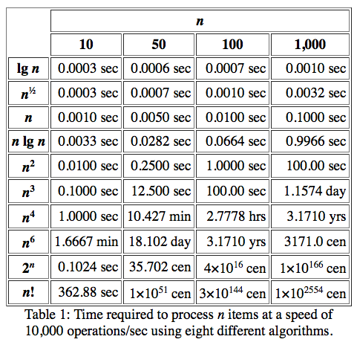
Growth Order, cont’d
Ten orders of growth
http://www.ccs.neu.edu/home/jaa/CS7800.12F/Information/Handouts/order.html

Slide 45
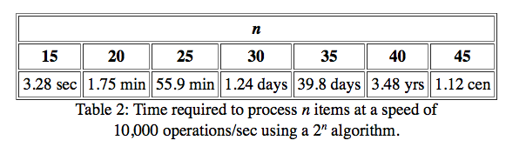
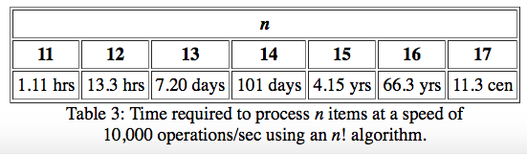
Growth Order, cont’d
The explosive growth of 2^{n}
The Explosive Growth of n!
http://www.ccs.neu.edu/home/jaa/CS7800.12F/Information/Handouts/order.html

Slide 46
Growth Order, cont’d
Linear time: O(N)
  The algorithm makes one pass over the N elements and performs a “simple” operation per element.
  Example: Searching a list.
Quadratic time: O(N²)
  The algorithm makes one pass over the N elements and performs up to N operations per element.
  Example: selection sort
Logarithmic time: O(log N) or O(N log N)
  The algorithm uses a “divide and conquer” strategy.
  Examples: merge sort, quicksort, binary search

