Slide 1


CS 46B: Introduction to Data Structures
July 2 Class Meeting
Department of Computer Science
San Jose State University
Summer 2015
Instructor: Ron Mak
www.cs.sjsu.edu/~mak

Slide 2
Quizzes for July 7
Quiz 12 July 7 14.6-14.8

Slide 3
This Friday’s Lab
School is closed on Friday, July 3 for holiday.
Therefore, do the following labs on your own:
  Lab 2
  Lab 10
See the lab instructor Thong Nguyen’s message in Canvas.

Slide 4





Selection Sort
Find the smallest and swap it
with the first element.
Find the next smallest. It is
already in the correct place.
Find the next smallest and
swap it with first element of
unsorted portion.
Repeat.
When the unsorted portion
is of length 1, we are done.

Slide 5
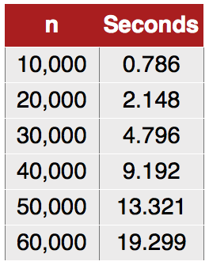
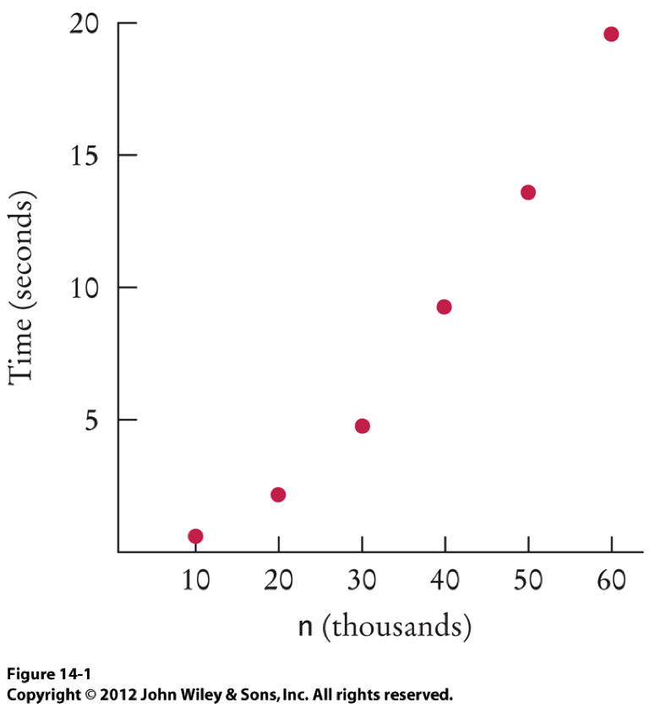
Selection Sort Performance
How long does it take the selection sort algorithm to sort an array of n elements?
Doubling n
increases the
sorting time
about four times.

Slide 6
Selection Sort Performance, cont’d
The number of visits is of the order n²
The number of visits is “order n²”: O(n²)
Multiplying the number of elements in an array by 2 multiplies the processing time by 4

Slide 7
Merge Sort
To sort an array recursively:
Base case
  An array with only one element: Do nothing.
A simpler but similar case:
  A smaller array, such as one that is half the size.
After sorting both halves, merge them back together as the whole sorted array.
Dramatically faster than selection sort!

Slide 8

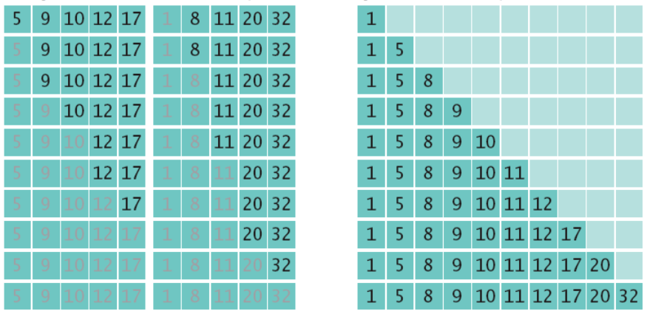
Merge Sort, cont’d
Divide the array into two halves
and sort each half.
Merge the two sorted halves
into a single sorted array.

Slide 9
Merge Sort, cont’d
public static void sort(int[] a)
{
if (a.length <= 1) return;
int[] first = new int[a.length/2];
int[] second = new int[a.length - first.length];
for (int i = 0; i < first.length; i++) {
first[i] = a[i];
}
for (int i = 0; i < second.length; i++) {
second[i] = a[first.length + i];
}
sort(first);
sort(second);
merge(first, second, a);
}
Base case
First half of the array.
Second half.
Recursively sort
each half.
Merge the sorted halves
back into a single sorted array.

Slide 10
Merge Sort, cont’d
private static void merge(int[] first, int[] second, int[] a)
{
int iFirst = 0; // Next element to consider in the first array
int iSecond = 0; // Next element to consider in the second array
int j = 0; // Next open position in a
while (iFirst < first.length && iSecond < second.length) {
if (first[iFirst] < second[iSecond]) {
a[j] = first[iFirst];
iFirst++;
}
else {
a[j] = second[iSecond];
iSecond++;
}
j++;
}
...
Merge an element from the first array.
Merge an element from the second array.

Slide 11
Merge Sort, cont’d
...
while (iFirst < first.length) {
a[j] = first[iFirst];
iFirst++;
j++;
}
while (iSecond < second.length) {
a[j] = second[iSecond];
iSecond++;
j++;
}
}
Merge remaining elements
from the first array.
Only one of these
two while loops will
execute.
Merge remaining elements
from the second array.

Slide 12
Clicker Question July 2 #1
Look at the first while loop of the merge() method. Which of the following is true when the loop is complete?
  All elements of first have been added to array a
  All elements of second have been added to array a
  All elements of first or second have been added to array a
  Both first and second contain some elements that haven't been added to array a

Slide 13
Merge Sort, cont’d
public class MergeSortDemo
{
public static void main(String[] args)
{
int[] a = ArrayUtil.randomIntArray(20, 100);
System.out.println(Arrays.toString(a));
MergeSorter.sort(a);
System.out.println(Arrays.toString(a));
}
}
Demo

Slide 14
Merge Sort vs. Selection Sort
Recall that the time it takes to sort n elements using selection sort is O(n²).
We can prove that the time it takes to
sort n elements using merge sort is O(n log₂ n).
n log₂ n grows much more slowly than n².
For large arrays, you want to do merge sort
rather than selection sort.

Slide 15
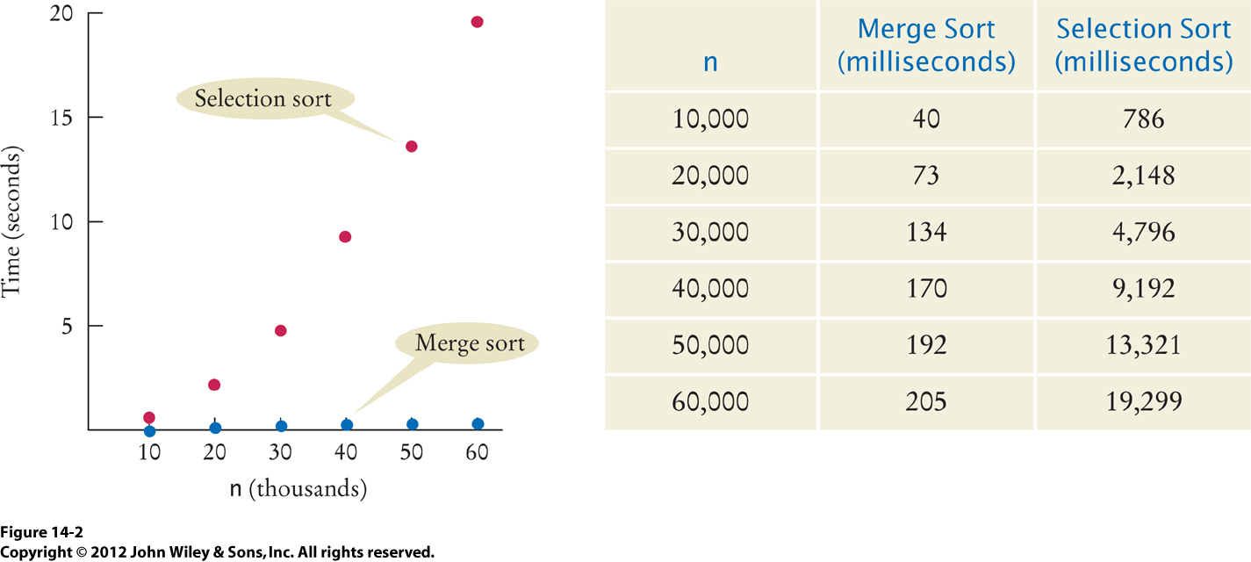
Merge Sort vs. Selection Sort, cont’d

Slide 16
Proof that Merge Sort is O(n log₂ n)
Assume that the array size n is a power of 2:
How many visits?
  2n: to create the two subarrays
  3n: 3 to merge each element
  5n total
Therefore:

Slide 17
Proof that Merge Sort is O(n log₂ n), cont’d
(a)
Evaluate T(n/2):
Substitute into (a):
Evaluate T(n/4):
Substitute into (b):
(b)

Slide 18
Proof that Merge Sort is O(n log₂ n), cont’d
In general for arbitrary powers of 2:
We assumed that so for k = m,
  Because ,

Slide 19
Proof that Merge Sort is O(n log₂ n), cont’d
➔ O(n log₂ n)

Slide 20
Break

Slide 21
Quicksort
Divide and conquer, like merge sort.
Better than merge sort, because there is
no copying into temporary arrays to sort
and then merge.

Slide 22



Quicksort, cont’d
First partition the range:
Then recursively sort each partition.
  Sort in place – no temporary arrays needed.

Slide 23
Quicksort, cont’d
public static void sort(int[] a, int from, int to)
{
if (from >= to) return; // base case
int p = partition(a, from, to);
sort(a, from, p);
sort(a, p+1, to);
}

Slide 24
Quicksort Partitioning Strategy
The basic idea of partitioning a range:
Pick a pivot in the range.
Partition the range into groups:
  numbers less than the pivot value
  numbers greater than the pivot value

Slide 25
Quicksort Partitioning Strategy, cont’d
Once we’ve picked a pivot within a range:
  We must push values in the range that are
  less than the pivot to the left.
  We must push values in the range that are
  greater than the pivot to the right.
The pivot value then will have (unsorted) lesser values before it, and (unsorted) greater values after it.
Insight: The pivot will already be in its proper position, so sorting operations will not move it.

Slide 26
Data Structures and Algorithms in Java, 3rd ed.
by Mark Allen Weiss
Pearson Education, Inc., 2012

Slide 27
How to Partition
Given a range, pick an element to be the pivot.
  Various strategies: The simplest is to pick the first element of the range to be the pivot.
Create two index variables, i and j.
  i starts at the left end of the range.
  j starts at the right end of the range.

Slide 28
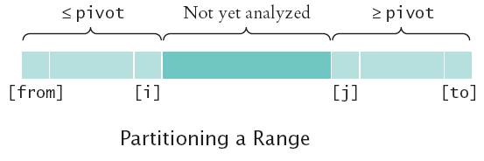
How to Partition
Keep incrementing i while a[i] < pivot
Keep decrementing j while a[j] > pivot

Slide 29
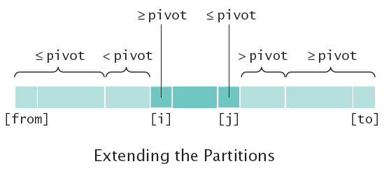
How to Partition, cont’d
When both i and j can’t go any further:
  a[i] > pivot
  a[j] < pivot
Swap a[i] and a[j]

Slide 30
How to Partition, cont’d
Resume moving i and j towards each other
as long as i < j
When you’re done moving i and j,
the range will be partitioned.

Slide 31
How to Partition, cont’d
private static int partition(int[] a, int from, int to)
{
int pivot = a[from];
int i = from - 1;
int j = to + 1;
while (i < j) {
i++;
while (a[i] < pivot) {
i++;
}
j--;
while (a[j] > pivot) {
j--;
}
if (i < j) {
ArrayUtil.swap(a, i, j);
}
}
return j;
}
Move i to the right.
Move j to the left.
Swap.
Index of the pivot.
Demo

Slide 32
Sorting Animations
https://www.cs.usfca.edu/~galles/visualization/ComparisonSort.html
http://www.sorting-algorithms.com

