Slide 1


CS 46B: Introduction to Data Structures
June 30 Class Meeting
Department of Computer Science
San Jose State University
Summer 2015
Instructor: Ron Mak
www.cs.sjsu.edu/~mak

Slide 2
Quizzes for July 2
Quiz 10 July 2 14.1-14.3
Quiz 11 July 2 14.4-14.5 + Special Topic 14.3

Slide 3
Homework 4-Final: A Solution
Aggregations:
  A Company object aggregates
  multiple Department objects.
  Each Department object aggregates
  one Manager object.
  Each Employee object aggregates an Address object which is inherited by a Manager or Worker.
private ArrayList<Department> departments = new ArrayList<Department>();
private Manager manager;
private Address address;

Slide 4
Homework 4-Final: A Solution
  Each Manager object aggregates
  multiple Worker objects.
private ArrayList<Worker> workers = new ArrayList<Worker>();

Slide 5
Homework 4-Final: A Solution
Starting with the company’s department,
loop over the aggregated objects.
private void printReport(Company company)
{
...
for (Department dept : company.getDepartments()) {
Manager mgr = dept.getManager();
...
for (Worker wrkr : mgr.getWorkers()) {
...
}
}
}
Print headers.
Loop over the
departments.
Print the manager and address.
Loop over each
manager’s worker.
Print each worker and address.

Slide 6
Homework 5: Recursive Read File
Base case:
  An empty file, or at end of file: Stop.
Simpler but similar case:
  A file that’s one line shorter.
  Therefore, read a line and make a recursive call to read the rest of the file.

Slide 7
Homework 5: Recursive All Same
Base case:
  A string of length 0 or 1: Return true.
Simpler but similar case:
  A string that’s shorter.
  Compare the first two characters of the string and make a recursive call on the rest of the string.

Slide 8
Homework 5: Recursive Count
Base case:
  An empty string: Return 0.
Simpler but similar case:
  A shorter string.
  Check and count the first character, and add to a recursive call on the rest of the string.

Slide 9
Homework 5: Recursive Append
Base case:
  The second list is empty: Return the first list.
Simpler but similar case:
  The second list is shorter.
  Remove the first element of the second list.
    OR: Remove the last element of the second list.
  Append the removed element to the end of the result of a recursive call to append the (shorter) second list to the first list.

Slide 10
Mutual Recursion
A set of cooperating methods
that call each other recursively.
A calculator for arithmetic expressions.
  Precedence rules: operators * and / bind more tightly than operators + and -
    * and / have higher precedence than + and -
  Parentheses can group subexpressions
    The most deeply nested subexpressions
    are evaluated first.

Slide 11
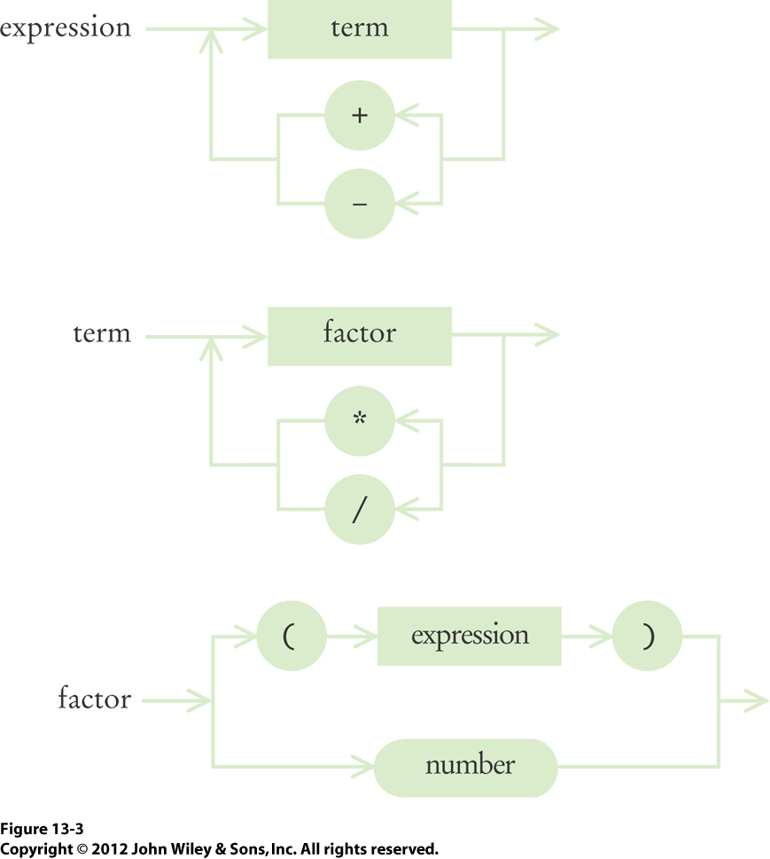
Syntax Diagrams

Slide 12
Arithmetic Expressions
3+4*5
(3+4)*5
An expression is broken down into a
sequence of terms, separated by + or -
Each term is broken down into a
sequence of factors, separated by * or /
Each factor is either a parenthesized expression or a number.
The syntax trees represent which
operations should be carried out first.

Slide 13
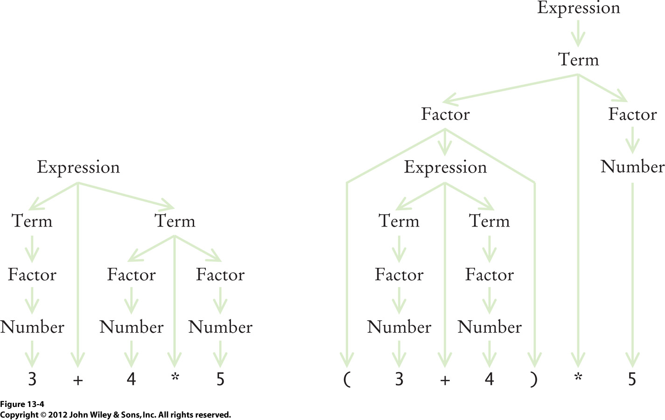
Syntax Trees

Slide 14
Clicker Question June 29 #1
Why do we need both terms and factors in the syntax diagram?
  Factors are combined by multiplicative operators
  (* and /), terms are combined by additive operators (+, -).
  Terms are combined by multiplicative operators
  (* and /), factors are combined by additive operators (+, -).
  We need both so that multiplication can bind more strongly than addition.
  We need both so that we can have mutual recursion.

Slide 15
Mutually Recursive Methods
Consider methods
  getExpressionValue()
  getTermValue()
  getFactorValue()
  Method getFactorValue() recursively calls method getExpressionValue()

Slide 16
Expression
public int getExpressionValue()
{
int value = getTermValue();
boolean done = false;
while (!done) {
String next = tokenizer.peekToken();
if ("+".equals(next) || "-".equals(next)) {
tokenizer.nextToken(); // Discard "+" or "-"
int value2 = getTermValue();
if ("+".equals(next)) value = value + value2;
else value = value - value2;
}
else {
done = true;
}
}
return value;
}

Slide 17
Term
public int getTermValue()
{
int value = getFactorValue();
boolean done = false;
while (!done) {
String next = tokenizer.peekToken();
if ("*".equals(next) || "/".equals(next)) {
tokenizer.nextToken() ; // Discard "*" or "/"
int value2 = getFactorValue();
if ("*".equals(next)) value = value*value2;
else value = value/value2;
}
else {
done = true;
}
}
return value;
}

Slide 18
Factor
public int getFactorValue()
{
int value;
String next = tokenizer.peekToken();
if ("(".equals(next)) {
tokenizer.nextToken(); // Discard "(”
value = getExpressionValue();
tokenizer.nextToken(); // Discard ")”
}
else {
value = Integer.parseInt(tokenizer.nextToken());
}
return value;
}

Slide 19
Clicker Question June 29 #2
What happens if you try to parse
the illegal expression 3+4*)5?
Specifically, which method throws an exception?
  getExpressionValue()
  getTermValue()
  getFactorValue()
  main()

Slide 20
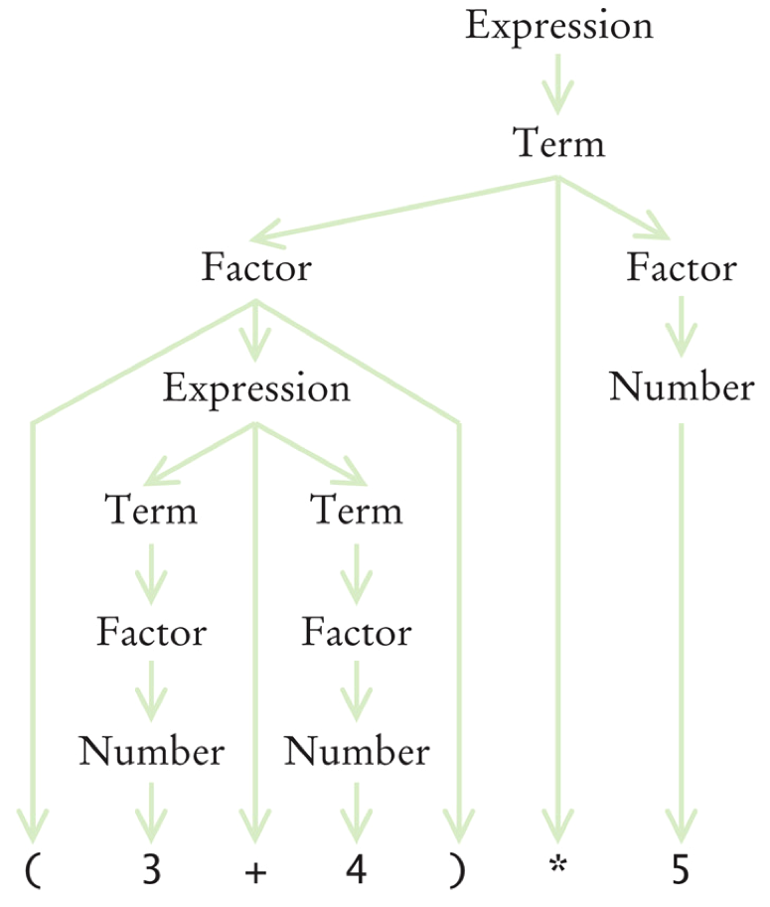
Syntax Tree of (3 + 4)*5

Slide 21
Trace of (3 + 4)*5
getExpressionValue() calls getTermValue()
  getTermValue() calls getFactorValue()
    getFactorValue() consumes the ( input
    getFactorValue() calls getExpressionValue()
      getExpressionValue() returns eventually with the value of 7,
      having consumed 3 + 4. This is the recursive call.
    getFactorValue() consumes the ) input
    getFactorValue() returns 7
  getTermValue() consumes the inputs * and 5
  and returns 35
getExpressionValue() returns 35

Slide 22
Clicker Question June 29 #3
Why does the expression parser use
mutual recursion?
  To compute the value of an arithmetic expression more efficiently than with a loop.
  To make * and / bind stronger than + and -
  To handle both operators such as * and / and numbers such as 2 and 3
  To handle parenthesized expressions,
  such as 2+3*(4+5)

Slide 23
Break

Slide 24
Homework #6 Final (No Draft)
Modify Evaluator.java to handle:
  The % modulo operator, which should bind as tightly (have the same precedence level) as * and /
    Example: 19%4 = 3
  The ^ power operator, which should bind the most tightly of all the operators (have the highest precedence level).
    Example: 2^5 = 32
    Tip: Look up Math.pow()

Slide 25
Homework #6 Final, cont’d
Codecheck URL: http://codecheck.it/codecheck/files/15063004458msne7gm8q5xfc266nmdvknb5
  Ignore the system error message about the unknown pseudo-comment ARGS
Canvas: Homework 6 Final
Due Monday, July 6 at 11:59 PM

Slide 26





Selection Sort
Find the smallest and swap it
with the first element.
Find the next smallest. It is
already in the correct place.
Find the next smallest and
swap it with first element of
unsorted portion.
Repeat.
When the unsorted portion
is of length 1, we are done.

Slide 27
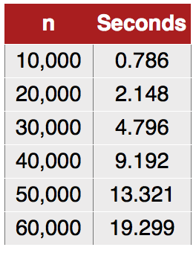
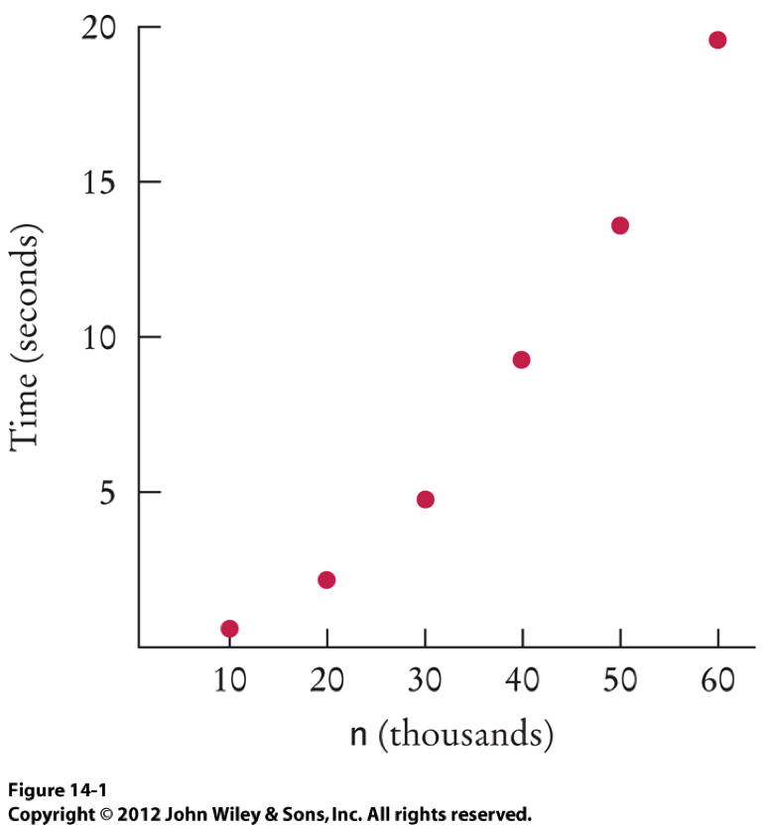
Selection Sort Performance
How long does it take the selection sort algorithm to sort an array of n elements?
Doubling n
increases the
sorting time
about four times.

Slide 28
Measure Selection Sort Performance
We want to know how the sorting times increase as the array size n increases.
Actual times, of course, depend on CPU speed.
A CPU-neutral way to measure selection sort performance is not to count milliseconds but to count how many times the array elements are visited.

Slide 29
Count Element Visits
To find the smallest value:
  visit n elements
  + 2 visits for the swap
To find the next smallest value:
  visit (n - 1) elements
  + 2 visits for the swap
The last term:
  visit 2 elements
  + 2 visits for the swap

Slide 30
Analyze Selection Sort Performance
The number of visits:
  T(n) = n + 2 + (n - 1) + 2 + (n - 2) + 2 + . . .+ (1)2 + 2
  = 2 + … + (n-1) + n + 2(n-1)
  = because
  =
Ignore which is small compared to
Also ignore the which will cancel out
when comparing ratios.

Slide 31
Analyze Selection Sort Performance, cont’d
The number of visits is of the order n²
The number of visits is “order n²”: O(n²)
To convert to big-Oh notation:
  Locate the fastest-growing term
  Ignore any constant coefficient
Multiplying the number of elements in an array by 2 multiplies the processing time by 4
➔ O(n²)

Slide 32
Big-Oh Isn’t Just for Sorting
Find the largest number in an array
  Set variable largestSoFar to a[0]: 1 visit
  Compare largestSoFar with a[1]: 1 visit
  Compare largestSoFar with a[2]: 1 visit
  ...
  Compare largestSoFar with a[n-1]: 1 visit
Total: n visits
Finding largest number is O(n)

Slide 33

Find the Most Frequent Element
Find the most frequent element.
An algorithm:
  Count how many times 8 occurs: n visits
  Count how many times 7 occurs: n visits
  Repeat for each element.
  Each count is O(n).
  There are n elements, so O(n²) for all.
  Find the largest count: O(n)
  All together: O(n²) + O(n) = O(n²)

Slide 34
Find the Most Frequent Element, cont’d
Another algorithm?
  What if we sorted the array first?
  Then identical values are next to each other.
  Only one pass to find the most frequent element.
What if we used selection sort to do the sorting?

Slide 35
Merge Sort
Uses recursion to sort.
Divide an array in half.
Recursively sort each half.
  Sort each half the same way, by dividing it in half.
  Eventually, a half will contain only one element.
Merge the two sorted halves.
Dramatically faster than selection sort!

Slide 36

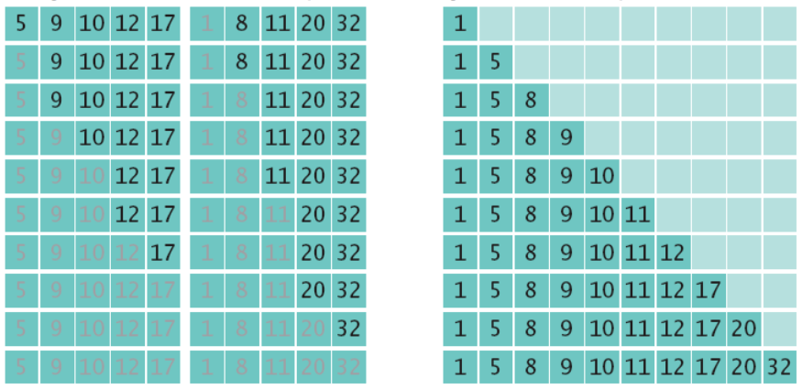
Merge Sort, cont’d
Divide the array into two halves
and sort each half.
Merge the two sorted halves
into a single sorted array.

Slide 37
Merge Sort, cont’d
public void sort(int a[])
{
if (a.length <= 1) return; // base case
int first[] = new int[a.length/2];
int second[] = new int[a.length - first.length];
// Copy the first half of a into array first,
// the second half of a into array second
...
sort(first);
sort(second);
merge(first, second);
}

