Slide 1


CS 46B: Introduction to Data Structures
June 16 Class Meeting
Department of Computer Science
San Jose State University
Summer 2015
Instructor: Ron Mak
www.cs.sjsu.edu/~mak

Slide 2
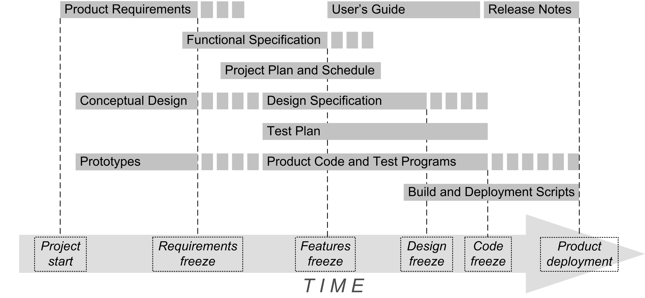
Application Development Big Picture

Slide 3
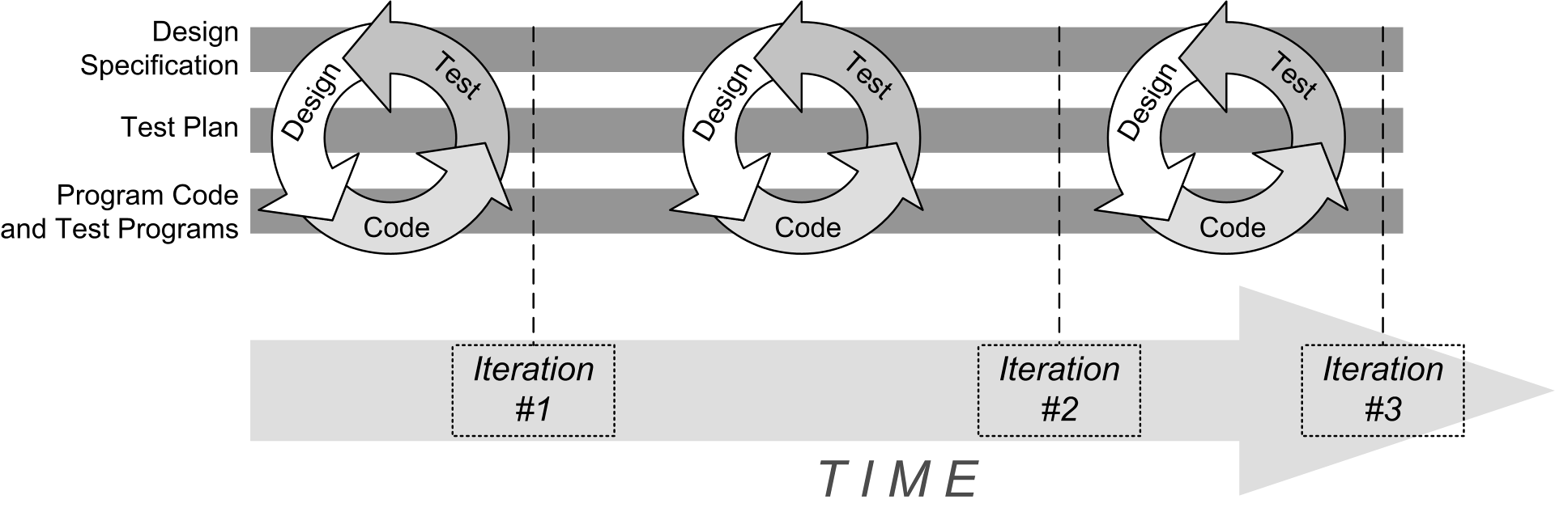
Iterative Development

Slide 4

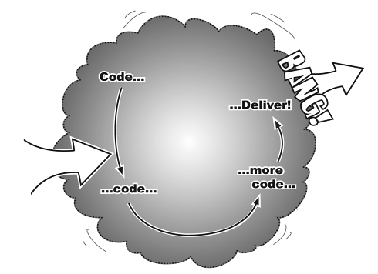
Incremental Development
Goal
Start
Each iteration adds functionality to
code that already works.
No Big Bang!
Head First Object-Oriented Analysis & Design
by Brett McLaughlin & Gary Pollice
O’Reilly, 2006.

Slide 5
UML Diagrams
A picture is worth a thousand words!
It is much easier to extract information
from a graphical notation than reading
a textual document.
Show your design in graphical UML diagrams.
  UML: Unified Modeling Language
There are several different types
of UML diagrams.
  We’ll use simple class diagrams for now.

Slide 6
UML Class Diagram
A class diagram can have
up to three compartments:
Class Name
Attributes : types
Methods(parms : types) : return type

Slide 7
Example UML Class Diagram
Example:
Mailbox
newMessages : ArrayList<Message> savedMessages : ArrayList<Message>
add(msg : Message) : boolean getCurrentMessage() : Message
For now, our simple class diagrams will only show the class names.
We won’t show attributes and methods yet.

Slide 8
UML Class Diagram: Relationships
 | Dependency
 | Aggregation
 | Inheritance
 | Composition
 | Association
 | Direct association
 | Interface implementation
Relationships among classes using arrows.

Slide 9
UML Class Diagram: Inheritance
An “is a” relationship
Use an open triangle at the superclass.
Example
  A dog is a mammal
Mammal
Dog

Slide 10
UML Class Diagram: Multiplicities
Sign | Meaning
* | Zero or more
1..* | One or more
0..1 | Zero or one
1 | Exactly one
Multiplicity in a “has a” relationship.

Slide 11
UML Class Diagram: Aggregation
A “has a” relationship.
The contained object can have an existence
independent of its container.
Example
  A mailbox has a set of messages.
  A message can exist without a mailbox.
  Therefore, a mailbox aggregates messages.
1
*
Mailbox
Message

Slide 12
UML Class Diagram: Composition
A “has a” relationship.
The contained object cannot (logically) have
an existence independent of its container.
Example
  A mailbox has a message queue.
  The message queue cannot
  (logically) exist without a mailbox.
  Therefore, a mailbox composes a message queue.
Mailbox
1
1
MessageQueue

Slide 13
UML Class Diagram: Interface Implementation
An “is a” relationship
Use an open triangle at the interface
and a dashed line.
Example
  A dog is a biter
<<interface>>
Biter
Dog

Slide 14
No Surprises!
Good software design has few, if any, surprises.
Surprises can lead to serious
programming errors.

Slide 15
How Good is Your Class Design?
Who is the user of a class that you write?
  Other programmers
  Perhaps you yourself, later!
Class designer priorities
  Efficient algorithm
  Convenient coding
  etc.
Class user priorities
  Easy to use
  Don’t have to understand the implementation
  etc.

Slide 16
How Good is Your Class Design?
Is there a “conflict of interest” if you’re both
the class designer and the class user?
Can you make the right engineering tradeoffs?

Slide 17
In-Class Exercise: UML Class Diagram
Draw UML class diagrams that
capture all of these facts:
  A university has several departments.
  Each department has a department chair.
  Each department teaches several courses.
  Two of the departments are computer science (CS)
  and computer engineering (CMPE).
  The computer science department teaches the courses
  CS 101, CS 102, and CS 103.
  The computer engineering department teaches the courses CMPE 101 and CMPE 102.
  CS 102, CS 103, and CMPE 102 are also online.
  Each course has a professor, a number of students,
  and possibly a graduate student T.A.
  People have home addresses.
No attributes or
methods are required
in these diagrams.

Slide 18
An Exercise Solution
University
Address
1..n
Department
Chair
Person
1..n
Course
Professor
1..n
Student
CS 101
Computer
Science
CS 102
0..1
TA
CS 103
«interface»
Online
«interface»
Graduate
Computer
Engineering
CMPE 101
CMPE 102

Slide 19
Break

Slide 20
Quick Review for the Midterm
Midterm #1 next Tuesday, June 23.
Closed book and laptop.
It will include all topics we’ve covered so far.
  Chapter readings
  Lectures
  Homework
Written exam (old fashioned pen and paper)
  Short answer
  Program snippets

Slide 21
Quick Review for the Midterm, cont’d
Classes
  superclass, subclass, inheritance,
  polymorphism
  type casts and instanceof
Object class
  toString() and equals() methods

Slide 22
Quick Review for the Midterm, cont’d
Interfaces
  why?
  Comparable interface
  interface constants
  marker interfaces
Scanner class
  hasNext(), next()
  hasNextLine(), nextLine()
  hasNextInt(), nextInt()
  useDelimiter()

Slide 23
Quick Review for the Midterm, cont’d
PrintWriter class
I/O errors
  FileNotFoundException
Exception handling
  checked and unchecked exceptions
  try-catch statement
  throwing an exception
  custom exception classes
  finally clause

Slide 24
Quick Review for the Midterm, cont’d
Object-oriented design
  what makes software good
  iterative and incremental development
  sources and classification of classes
  CRC technique
  dependency and aggregation
  UML class diagrams

