Slide 1


CS 46B: Introduction to Data Structures
June 11 Class Meeting
Department of Computer Science
San Jose State University
Summer 2015
Instructor: Ron Mak
www.cs.sjsu.edu/~mak

Slide 2
What Scanner Considers to be a Word
Java considers a word to be any consecutive sequence of characters that is not “white space”.
  White space includes any spaces, tabs,
  and newline characters.
So if the input file contains instead
the output will be
Mary had 12 little #%@&!! lambs.
Mary
had
12
little
#%@&!!
lambs.
Using the default delimiters
(the whitespace characters).

Slide 3
What Scanner Considers to be a Word, cont’d
Mary had 12 little #%@&!! lambs.
in.useDelimiter("[^A-Za-z]+");
Mary
had
little
lambs

Slide 4
What Scanner Considers to be a Word, cont’d
in.reset();
while (in.hasNext()) {
if (in.hasNextInt()) {
System.out.printf(" int: %d\n", in.nextInt());
}
else {
System.out.printf("word: %s\n", in.next());
}
}
Mary had 12 little #%@&!! lambs.
word: Mary
word: had
int: 12
word: little
word: #%@&!!
word: lambs.

Slide 5
Homework #3
Print a detail report with rolled-up sums.
Input will be a CSV (comma-separated values) text file generated from an Excel spreadsheet.
  The first line of the file contains column headers.
  The subsequent detail lines each contains
  how many widgets an employee made.
STATE,PLANT,DEPT,EMPID,NAME,COUNT
12,34,56,789,George Carter,4
12,34,56,799,Mary Clinton,6
12,34,57,639,Alfred Lincoln,8
12,40,57,710,Kim Kennedy,8
...

Slide 6
Homework #3, cont’d
STATE,PLANT,DEPT,EMPID,NAME,COUNT
12,34,56,789,George Carter,4
12,34,56,799,Mary Clinton,6
12,34,57,639,Alfred Lincoln,8
12,40,57,710,Kim Kennedy,8
...
Each detail line contains:
  State code
  Plant code
  Department code
  Employee ID
  Employee name
  Count of widgets made by the employee

Slide 7
Homework #3, cont’d
STATE,PLANT,DEPT,EMPID,NAME,COUNT
12,34,56,789,George Carter,4
12,34,56,799,Mary Clinton,6
12,34,57,639,Alfred Lincoln,8
12,40,57,710,Kim Kennedy,8
...
  Each plant’s department codes
  are separate from another
  plant’s department codes.
A state contains one or more plants.
A plant contains one or more departments.
A department has one or more employees.
Detail lines are sorted first by state code, then by plant code, then by department code, then by employee ID.

Slide 8
Homework #3, cont’d
A detail report contains the information
from all the input detail lines.
The report totals for each department the number of widgets made by the employees
of that department.
It totals for each plant the number of widgets made by the departments of that plant.
It totals for each state the number of widgets made by the plants of that state.
It computes the grand total number of widgets.

Slide 9
Homework #3, cont’d
Draft: Due Saturday, June 13 at 11:59 PM
  Just print the headers and the contents
  of each detail line.
  URL: http://codecheck.it/codecheck/files/150611070629f45sczkm70ffwuedde6p8ed
Final: Due Monday, June 15 at 11:59 PM
  Print the detail report with the multilevel totals.
  URL: http://codecheck.it/codecheck/files/1506120526avo37t7yjlh6dyh21xjloss7e
Canvas:
Homework 3 Draft
Canvas:
Homework 3 Final

Slide 10
Homework #3, cont’d
Input file widgets.csv: http://www.cs.sjsu.edu/~mak/CS46B/assignments/3/widgets.csv
STATE,PLANT,DEPT,EMPID,NAME,COUNT
12,34,56,789,George Carter,4
12,34,56,799,Mary Clinton,6
12,34,57,639,Alfred Lincoln,8
12,40,57,710,Kim Kennedy,8
12,40,57,990,Jina Johnson,6
12,40,75,426,Ruby Roosevelt,10
12,40,75,551,John Washington,7
33,22,11,297,Hilda Hoover,10
33,22,11,428,Ted Truman,11
33,22,11,808,Nora Nixon,3
33,22,14,629,Mabel Bush,9
33,27,19,321,Chris Adams,5
The Excel spreadsheet:
http://www.cs.sjsu.edu/~mak/CS46B/assignments/3/widgets.xlsx

Slide 11
Homework #3, cont’d
Draft output: http://www.cs.sjsu.edu/~mak/CS46B/assignments/3/draft.out
STATE PLANT DEPT EMPID COUNT NAME
12 34 56 789 4 George Carter
12 34 56 799 6 Mary Clinton
12 34 57 639 8 Alfred Lincoln
12 40 57 710 8 Kim Kennedy
12 40 57 990 6 Jina Johnson
12 40 75 426 10 Ruby Roosevelt
12 40 75 551 7 John Washington
33 22 11 297 10 Hilda Hoover
33 22 11 428 11 Ted Truman
33 22 11 808 3 Nora Nixon
33 22 14 629 9 Mabel Bush
33 27 19 321 5 Chris Adams
The output should be
written to a file named
widgets.out.

Slide 12
Homework #3, cont’d
STATE PLANT DEPT EMPID COUNT NAME
12 34 56 789 4 George Carter
12 34 56 799 6 Mary Clinton
10 TOTAL FOR DEPT 56 *
12 34 57 639 8 Alfred Lincoln
8 TOTAL FOR DEPT 57 *
18 TOTAL FOR PLANT 34 **
12 40 57 710 8 Kim Kennedy
12 40 57 990 6 Jina Johnson
14 TOTAL FOR DEPT 57 *
12 40 75 426 10 Ruby Roosevelt
12 40 75 551 7 John Washington
17 TOTAL FOR DEPT 75 *
31 TOTAL FOR PLANT 40 **
49 TOTAL FOR STATE 12 ***
33 22 11 297 10 Hilda Hoover
33 22 11 428 11 Ted Truman
33 22 11 808 3 Nora Nixon
24 TOTAL FOR DEPT 11 *
33 22 14 629 9 Mabel Bush
9 TOTAL FOR DEPT 14 *
33 TOTAL FOR PLANT 22 **
33 27 19 321 5 Chris Adams
5 TOTAL FOR DEPT 19 *
5 TOTAL FOR PLANT 27 **
38 TOTAL FOR STATE 33 ***
87 GRAND TOTAL ****
Final output: http://www.cs.sjsu.edu/~mak/CS46B/assignments/3/final.out
  What logic do we need to generate
  this detail report
  with the different levels of totals?

Slide 13
Break

Slide 14
Introduction to Exception Handling
Java exception handling is a flexible means of transferring runtime control:
  From the point an exception (error) is detected
  To special code to handle (deal with) the error.
try {
/* code that can cause an exception, such as
an attempt to read a nonexistent file. */
}
catch (FileNotFoundException ex) {
/* code to handle the exception,
such as writing an error message. */
}

Slide 15
Introduction to Exception Handling, cont’d
try {
...
}
catch (SomeException ex) {
...
}
The exception variable ex
contains useful information about
the exception that just occurred.
When a statement inside a try block causes an exception, your program immediately branches to the catch block.
After executing the catch block, your program continues to the next statement.
  It does not resume executing the try block.

Slide 16
FileNotFoundException Handler Example
public int countLines()
{
int count = 0;
Scanner in = null;
try {
in = new Scanner(inputFile);
while (in.hasNextLine()) {
in.nextLine();
++count;
}
}
catch (FileNotFoundException ex) {
ex.printStackTrace();
}
return count;
}

Slide 17
The finally Clause
Add a finally block to a try-catch statement for code that should be executed after the try block, whether or not an exception occurred.
try {
in = new Scanner(inputFile);
...
}
catch (FileNotFoundException ex) {
ex.printStackTrace();
}
finally {
if (in != null) in.close();
}
No matter whether the try block executed normally,
or an exception occurred and the catch block executed,
we will always close the input file.

Slide 18
Clicker Question June 11 #1
public void read(String filename)
{
Scanner in = null;
try
{
in = new Scanner(new File(filename));
process(in);
}
catch (IOException ex) { println("I/O Error"); }
finally { in.close(); }
}
The file doesn’t exist! What happens?
  The message "I/O error" is printed.
  A FileNotFoundException is thrown to the caller of read().
  A NullPointerException is thrown to the caller of read().
  The read() method returns without printing anything
  and without throwing an exception.

Slide 19
Throw an Exception
When an exception occurs, we say that
the code throws an exception.
When an I/O error occurs, such as an attempt to read a nonexistent file, the Scanner code will throw a FileNotFoundException.
Java has an hierarchy of built-in exceptions that it can throw for a variety of runtime errors.

Slide 20
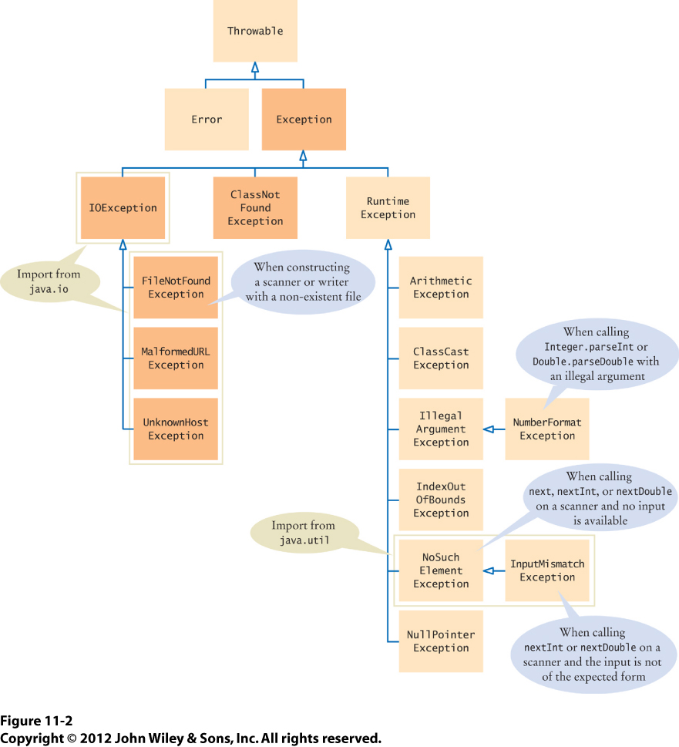
Exceptions Hierarchy

Slide 21
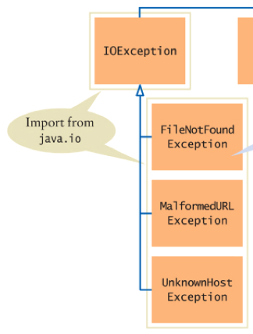
Catch an Exception
Your catch clause will not only catch
the specified exception, but also
any of the exception’s subclasses.
  Catch any IOException,
  including FileNotFoundException.
try {
in = new Scanner(inputFile);
...
}
catch (IOException ex) {
ex.printStackTrace();
}

Slide 22
Catch Multiple Exceptions
You can catch multiple exceptions.
try {
in = new Scanner(inputFile);
...
}
catch (FileNotFoundException ex) {
... ;
}
catch (NullPointerException ex) {
... ;
}
catch (Exception ex) {
... ;
}
When an exception occurs,
the catch clauses are
checked in the order
that they are specified.
Specify Exception last as a catch-all since
it’s the root of the exception hierarchy.

Slide 23
Clicker Question June 11 #2
try {
process(filename)
}
catch (FileNotFoundException ex) { println("File not found"); }
catch (IOException ex) { println("I/O error"); }
catch (RuntimeException ex) { println("Something went wrong"); }
An EOFException occurs during the call
to method process(). What is printed?
  "File not found"
  "I/O error"
  "Something went wrong"

Slide 24
If You Don’t Catch an Exception
If a method can potentially throw an exception, but the “dangerous” code is not in a try-catch, then the method must warn any caller that
it can throw that exception.
Then the caller must either catch the exception,
or it must in turn warn its caller that the exception can be thrown.
public void myMethod(File f) throws FileNotFoundException
{
Scanner in = new Scanner(f);
...
}

Slide 25
Explicitly Throw an Exception
Your program can explicitly throw an exception:
Explicitly throw an exception whenever your program logic detects an application-specific error has occurred.
throw new IllegalArgumentException("Amount exceeds balance.");

Slide 26
Custom Exceptions
You can even define an application-specific subclass of the Exception class.
  Example: You’re writing a banking application.
public class InsufficientFundsException
extends IllegalArgumentException
{
public InsufficientFundsException() {}
public InsufficientFundsException(String message)
{
super(message);
}
}
throw new InsufficientFundsException();

Slide 27
Checked vs. Unchecked Exceptions
Descendants of RuntimeException are for errors caused by your code.
  Unchecked exceptions
All other exceptions are for errors caused by external reasons beyond your control.
  Checked exceptions

Slide 28
Checked vs. Unchecked Exceptions, cont’d
Your program must either handle a checked exception with a try-catch statement,
or a method must warn its callers with a
throws clause in its header.
  Otherwise, your program will not compile.
Because unchecked exceptions are caused
by your program logic, it is up to you to decide whether or not to handle them.
  No try-catch statement or throws clause required.

Slide 29
Clicker Question June 11 #3
When you call a[i] on an array, your code might throw an ArrayIndexOutOfBoundsException.
What is the reason you don’t have to tag methods with
throws ArrayIndexOutOfBoundsException?
  ArrayIndexOutOfBoundsException
  is a checked exception.
  ArrayIndexOutOfBoundsException
  is checked at compile time.
  Your program could have checked whether i is valid.
  The code could have also thrown a NullPointerException (if a is null).

