Slide 1


CS 174: Web Programming
November 25 Class Meeting
Department of Computer Science
San Jose State University
Fall 2015
Instructor: Ron Mak
www.cs.sjsu.edu/~mak

Slide 2
Next Week’s Presentations
15-minute demos.
Explain what the app does.
Show the app in operation.
Describe what technologies you used.

Slide 3
Next Week’s Presentations: Section 2
Team | Day
Anonymous | M
Awesome | M
Bits & Bytes | W
Brute Force | M
Chi | W
CTRL-A | M
Sparkly Bubbles | W
The JAVS | W

Slide 4
Next Week’s Presentations: Section 4
Team | Day
Algorithmics | M
BCGK | W
Creative Coders | W
Spot Checkers | M
Super Designers | M
Team 76 | W
The Hacking Bad | W
Zettabyte | M

Slide 5

A Good Book on Web Usability

Slide 6
Definitions of Usability
Useful
  Does it do something people need done?
Learnable
  Can people figure out how to use it?
Memorable
  Do they have to relearn it each time they use it?
Effective
  Does it get the job done?

Slide 7
Definitions of Usability, cont’d
Efficient
  Does it do it with a reasonable amount
  of time and effort?
Desirable
  Do people want it?
Delightful
  Is using it enjoyable, or even fun?
“A person of average (or even below average) ability and experience
can figure out how to use the thing to accomplish something without
it being more trouble than it’s worth.”
Don’t Make Me Think, Revisited
by Steve Krug
New Riders, 2014

Slide 8
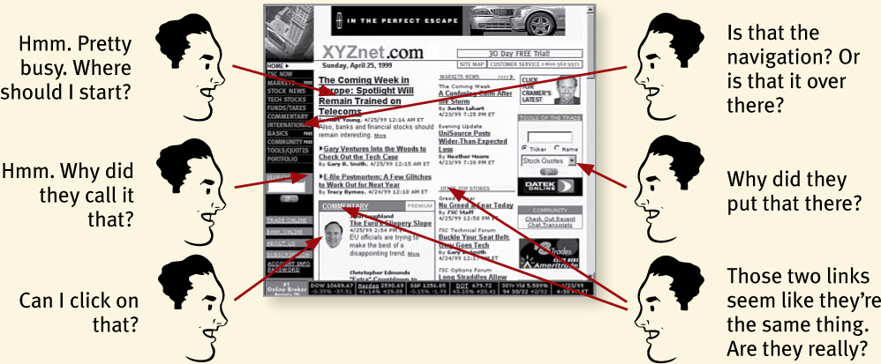
Don’t Make Me Think
You don’t want users to have to
think about your page.
Don’t Make Me Think, Revisited
by Steve Krug
New Riders, 2014

Slide 9
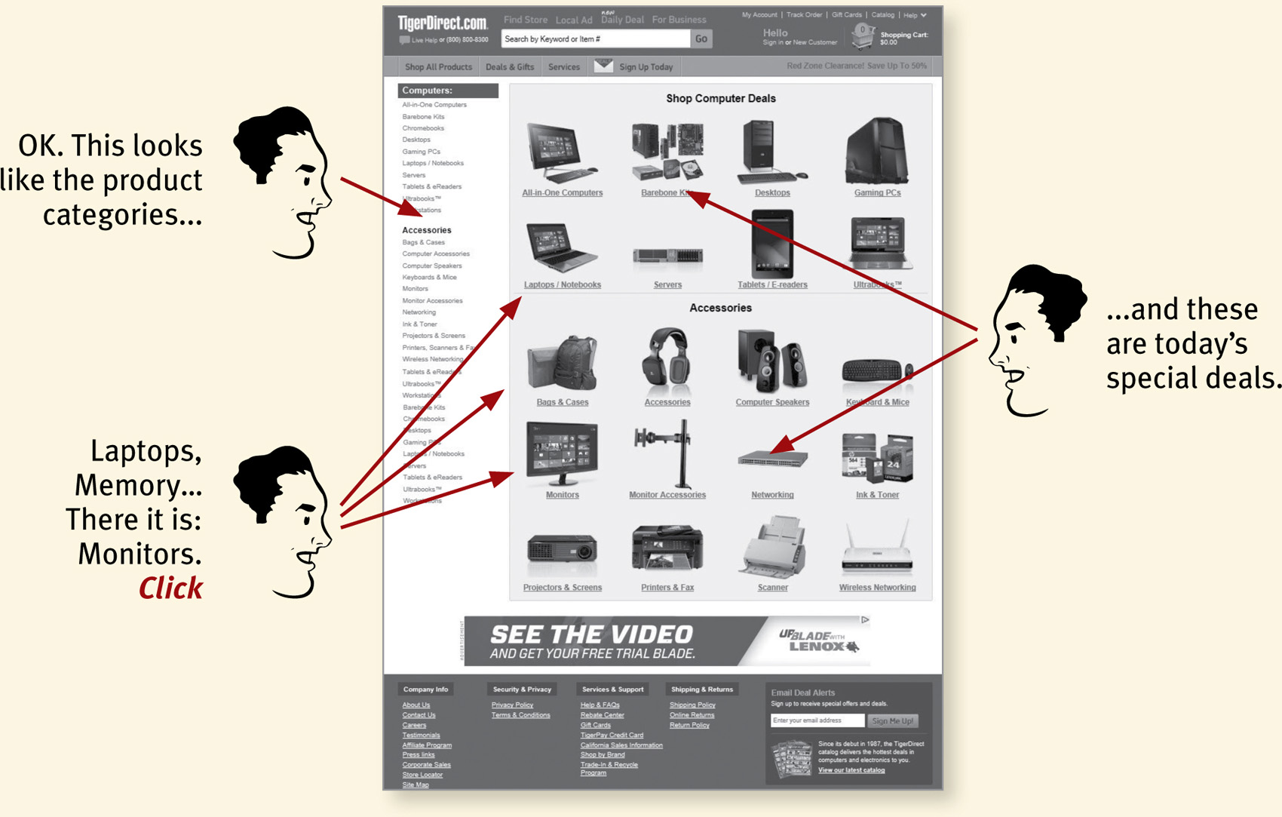
Don’t Make Me Think, cont’d
Things should be immediately obvious.
Don’t Make Me Think, Revisited
by Steve Krug
New Riders, 2014

Slide 10
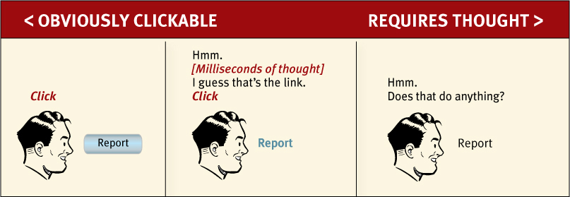
Don’t Make Me Think, cont’d
What is clickable?
Don’t Make Me Think, Revisited
by Steve Krug
New Riders, 2014

Slide 11
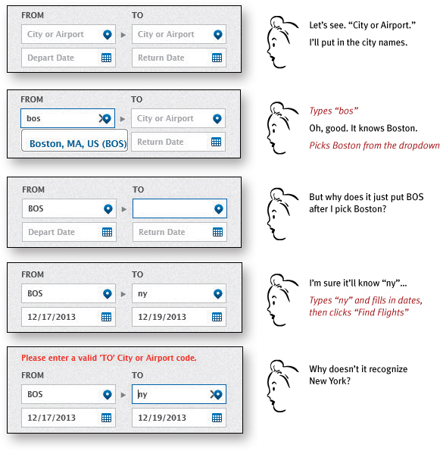
Don’t Make Me Think, cont’d
Booking a flight
Don’t Make Me Think, Revisited
by Steve Krug
New Riders, 2014

Slide 12
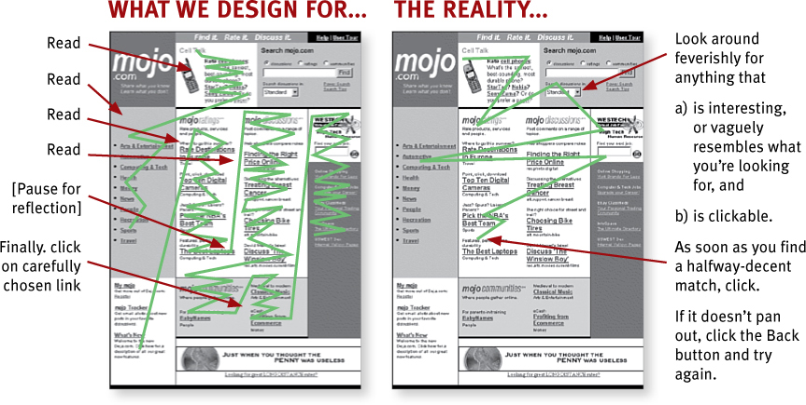
Users Don’t Read Pages
Users scan web pages.
Don’t Make Me Think, Revisited
by Steve Krug
New Riders, 2014

Slide 13
Users Scan Web Pages
Users use the web to get something done.
Users know they don’t have to read everything.
Scanning is a basic skill.
Therefore, it must be easy to find
the key components of a web page.
Format pages to facilitate scanning.

Slide 14
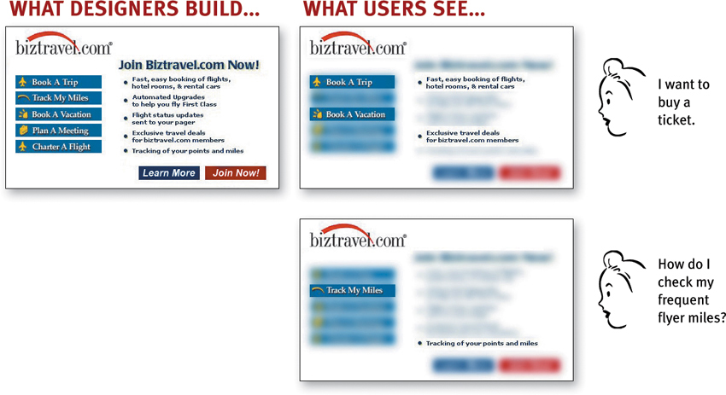
Users Scan Web Pages, cont’d
Don’t Make Me Think, Revisited
by Steve Krug
New Riders, 2014

Slide 15
Users “Satisfice”
Users don’t make optimal choices when looking for desired items on web pages.
Instead, users “satisfice” – they make the first reasonable choice.
  satisfice = a made-up word that combines
  “satisfy” + “suffice”

Slide 16


Follow Conventions
Don’t Make Me Think, Revisited
by Steve Krug
New Riders, 2014

Slide 17
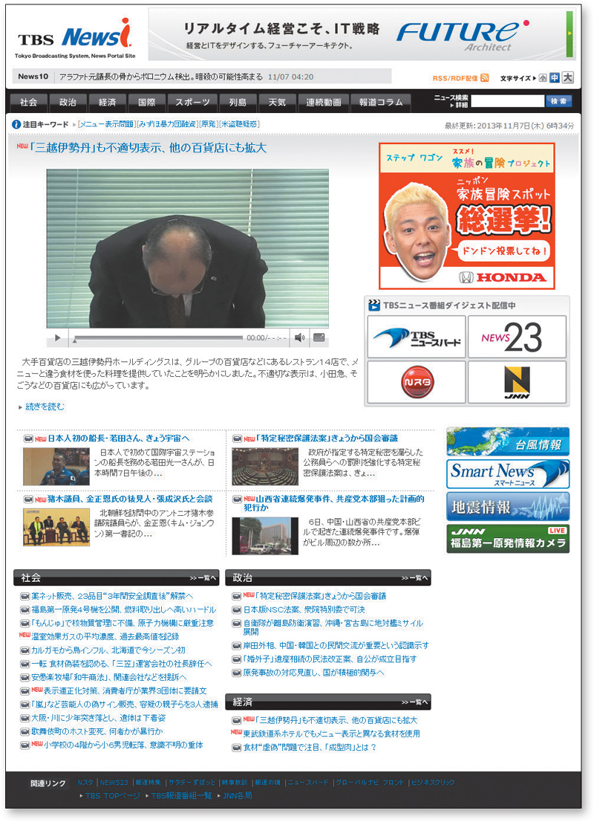
Follow Conventions, cont’d
Even if you don’t read Japanese, you can figure out what’s on this page.
Don’t Make Me Think, Revisited
by Steve Krug
New Riders, 2014

Slide 18
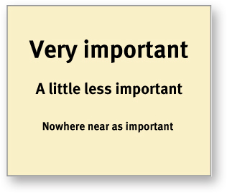
Create Effective Visual Hierarchies
The more important something is,
the more prominent it should be.
Don’t Make Me Think, Revisited
by Steve Krug
New Riders, 2014

Slide 19
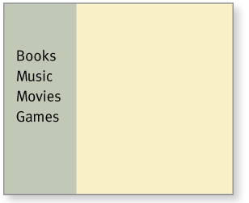
Create Effective Visual Hierarchies, cont’d
Things that are related logically
should be related visually.
Don’t Make Me Think, Revisited
by Steve Krug
New Riders, 2014

Slide 20
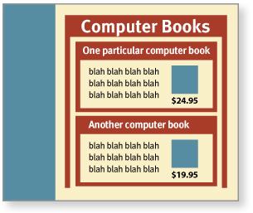
Create Effective Visual Hierarchies, cont’d
Use nesting to show what is part of what.
Don’t Make Me Think, Revisited
by Steve Krug
New Riders, 2014

Slide 21
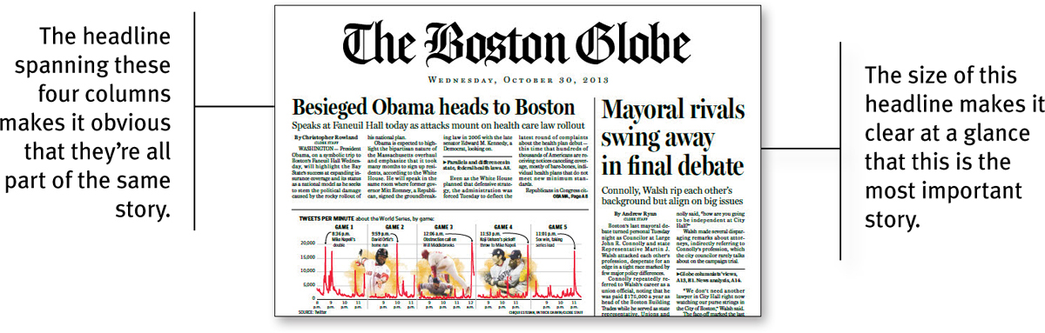
Create Effective Visual Hierarchies, cont’d
Don’t Make Me Think, Revisited
by Steve Krug
New Riders, 2014

Slide 22
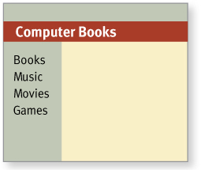
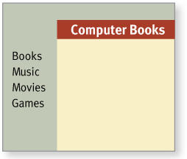
Create Effective Visual Hierarchies, cont’d
Break pages into clearly defined areas.
Wrong
Right
Don’t Make Me Think, Revisited
by Steve Krug
New Riders, 2014

Slide 23
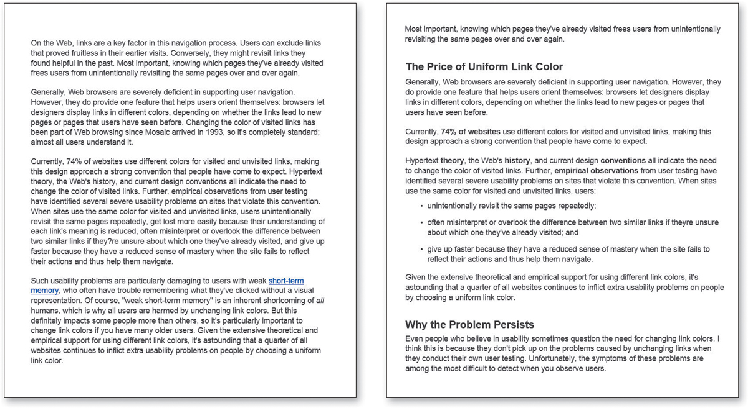
Format Text to Support Scanning
Which would you rather scan?
Don’t Make Me Think, Revisited
by Steve Krug
New Riders, 2014

Slide 24
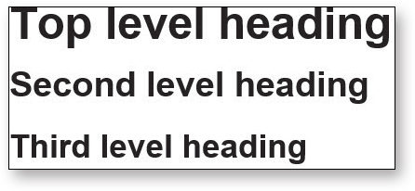
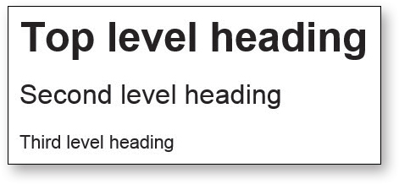
Format Text to Support Scanning, cont’d
Use headings that are well differentiated.
Bad
Better
Don’t Make Me Think, Revisited
by Steve Krug
New Riders, 2014

Slide 25
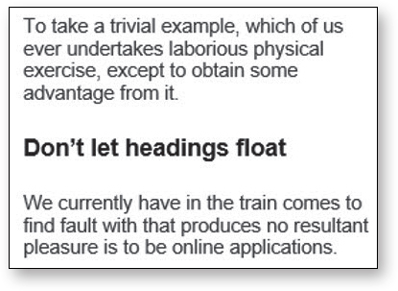
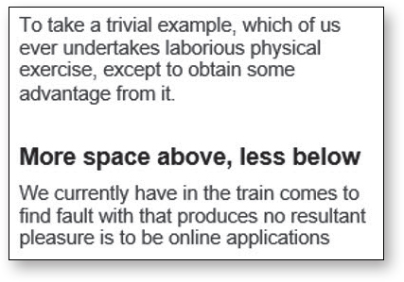
Format Text to Support Scanning, cont’d
Don’t let headings “float”.
Don’t Make Me Think, Revisited
by Steve Krug
New Riders, 2014

Slide 26
Following the “Scent of Information”
Users don’t mind clicking a lot to find
desired information on a website as long as:
  Each click is painless.
  They have continued confidence that they’re
  on the right track to finding their information “prey”.

Slide 27
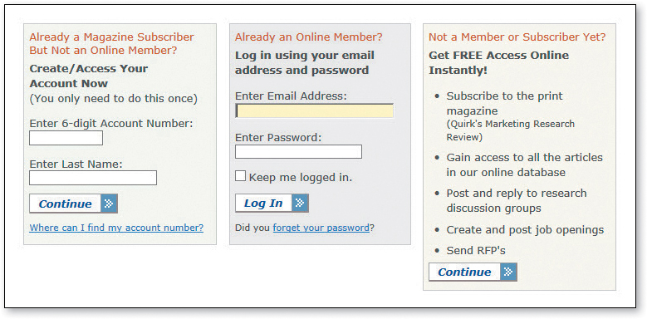
Avoid Showing Confusing Options
A confused user may decide it’s not worth it.
Don’t Make Me Think, Revisited
by Steve Krug
New Riders, 2014

Slide 28
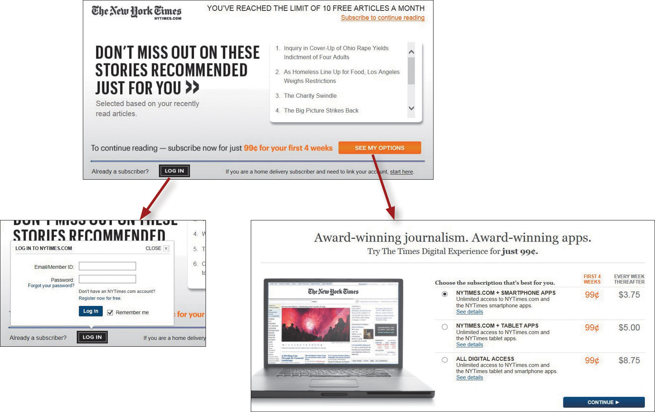
Avoid Showing Confusing Options, cont’d
Display only relevant options.
Don’t Make Me Think, Revisited
by Steve Krug
New Riders, 2014

Slide 29
The Home Page
What is the big picture?
What is this website about?
Users must be able to answer these questions within the first few seconds.
The first few seconds a user spends
on a new website are critical.
  You must quickly get the main point across.

Slide 30
The Home Page, cont’d
Not every visitor to your website
will start with the home page.
The user may actually start with some
internal page after following a link.
Therefore, make it easy to return
to the home page from every page.

Slide 31
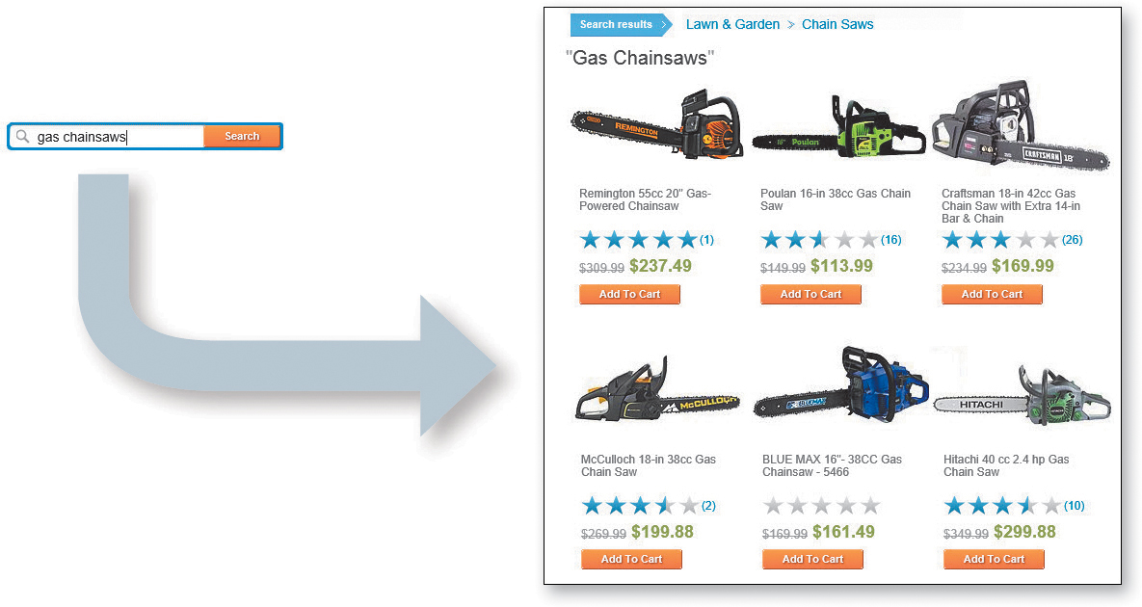
Web Navigation
“Search-dominant” users look for a search box as soon as they enter a site.
  In a physical store, they immediately look for a clerk.
Don’t Make Me Think, Revisited
by Steve Krug
New Riders, 2014

Slide 32


Web Navigation, cont’d
“Link-dominant” users want to browse first.
  They search only after running out of links
  or they’ve gotten sufficiently frustrated.
Don’t Make Me Think, Revisited
by Steve Krug
New Riders, 2014

Slide 33
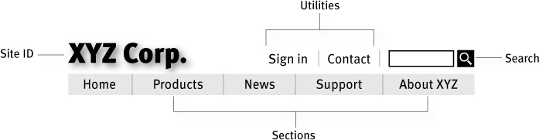
Persistent Navigation
The set of navigation elements that
appear on every page of a site.
  AKA global navigation
Don’t Make Me Think, Revisited
by Steve Krug
New Riders, 2014

Slide 34
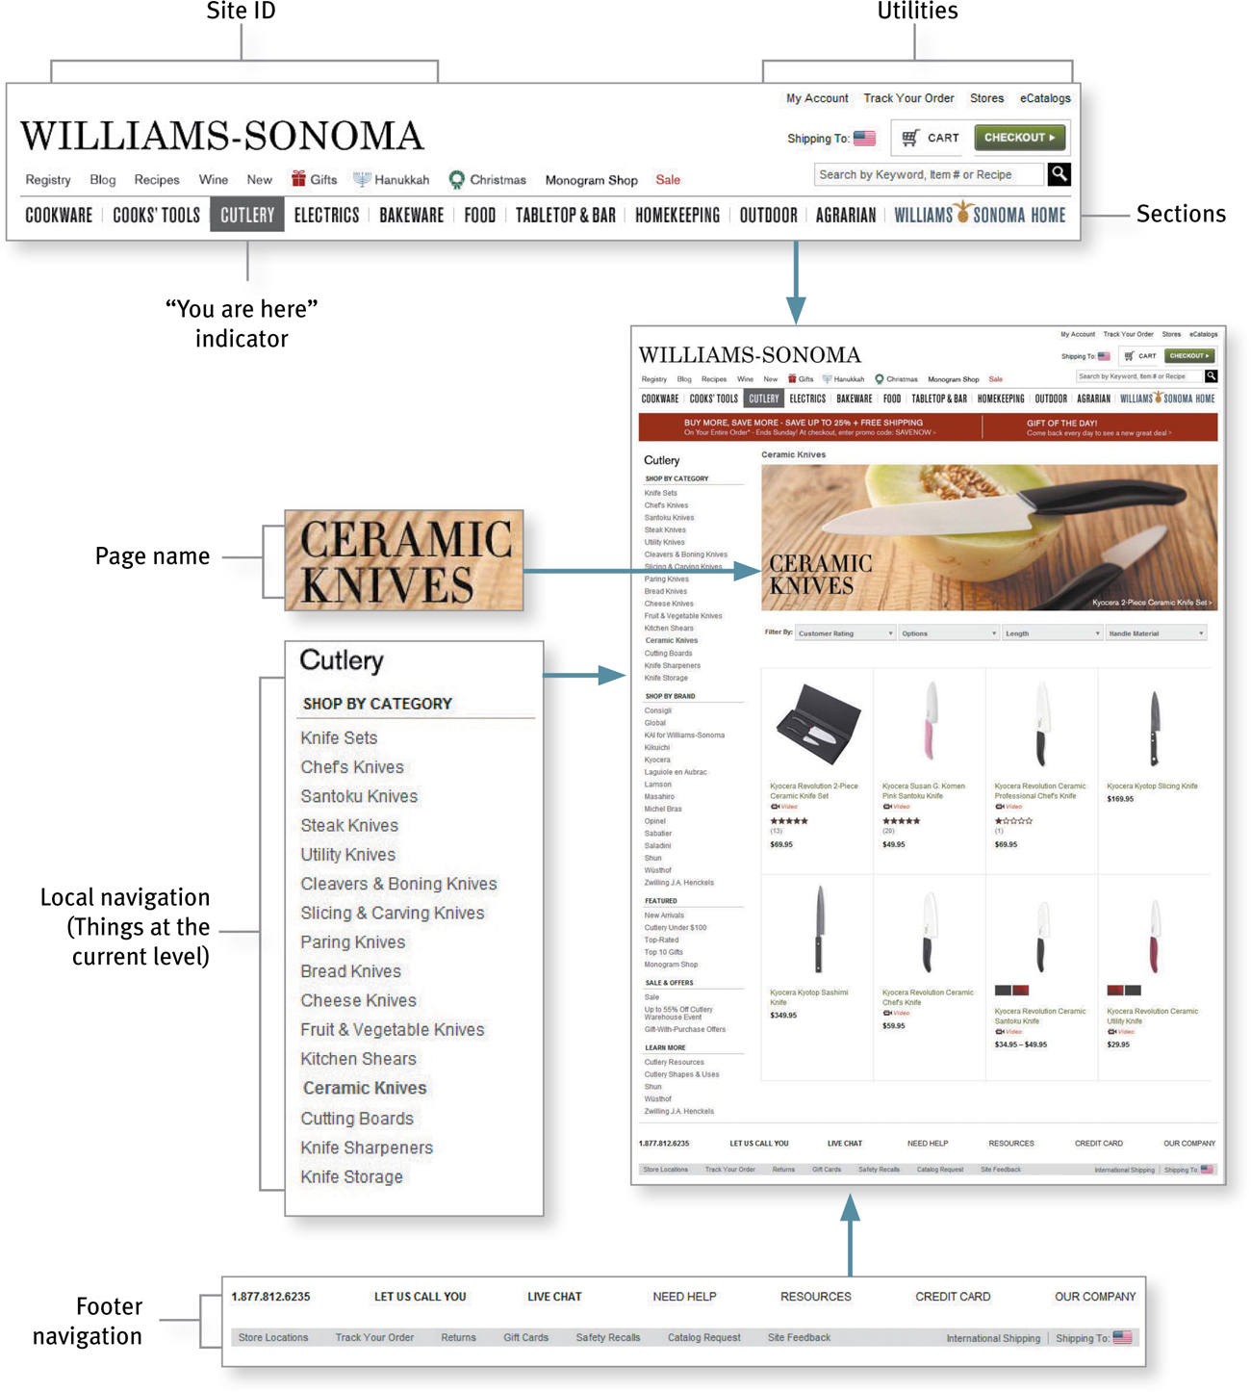
Web Navigation Conventions
Don’t Make Me Think, Revisited
by Steve Krug
New Riders, 2014

Slide 35
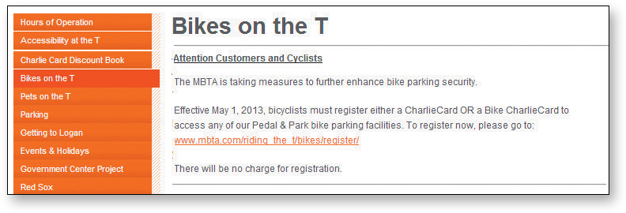
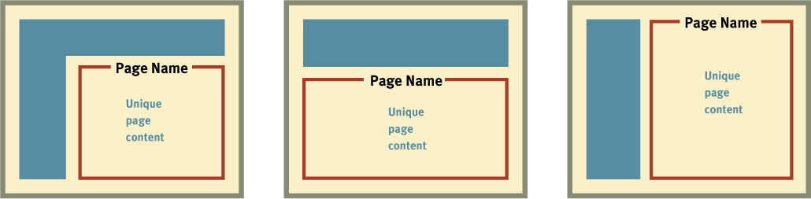
Give Every Page a Name
The page name should be prominent.
Don’t Make Me Think, Revisited
by Steve Krug
New Riders, 2014

Slide 36
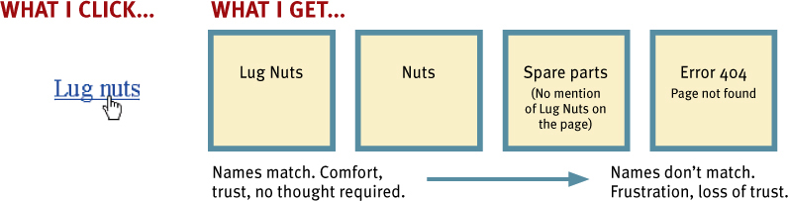
Use Page Names Consistently
Don’t Make Me Think, Revisited
by Steve Krug
New Riders, 2014

Slide 37
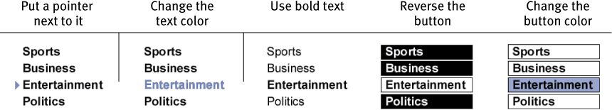
“You are Here”
Make the current location stand out.
Don’t Make Me Think, Revisited
by Steve Krug
New Riders, 2014

Slide 38
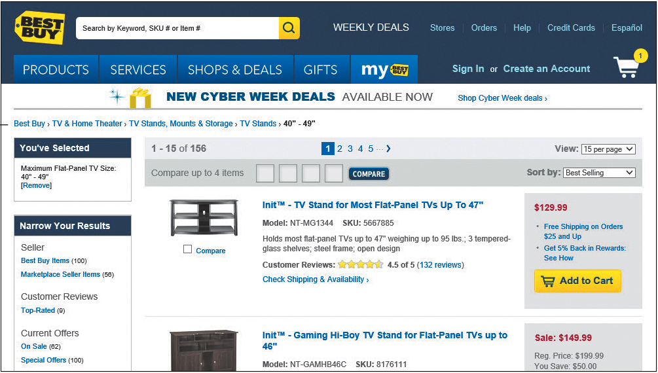
“You are Here”, cont’d
“Breadcrumbs” show you where you are
and how you got there.
Don’t Make Me Think, Revisited
by Steve Krug
New Riders, 2014

Slide 39
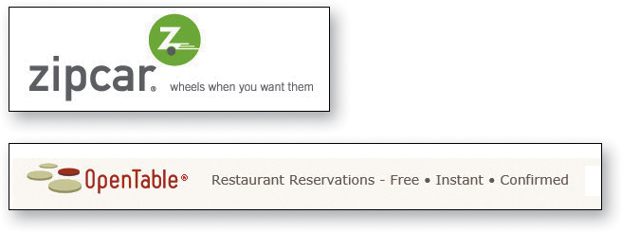
Website Taglines
Good taglines are clear and informative and explain exactly what your website or your organization does.
Don’t Make Me Think, Revisited
by Steve Krug
New Riders, 2014

Slide 40

Website Taglines, cont’d
Good taglines are just long enough,
but not too long.
  Six to eight words seem long enough to convey
  a full thought, but short enough to absorb easily.
Don’t Make Me Think, Revisited
by Steve Krug
New Riders, 2014

Slide 41
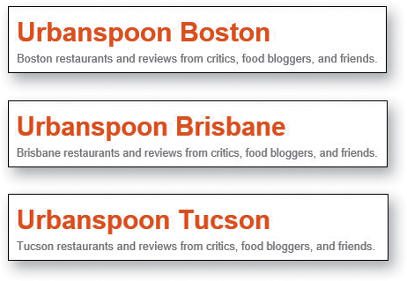
Website Taglines, cont’d
Good taglines convey differentiation
and a clear benefit.
  A really good
  tagline is one
  that no one
  else in the
  world could
  use except you.
Don’t Make Me Think, Revisited
by Steve Krug
New Riders, 2014

Slide 42

Website Taglines, cont’d
Bad taglines sound generic.
Don’t Make Me Think, Revisited
by Steve Krug
New Riders, 2014

Slide 43

Website Taglines, cont’d
Good taglines are personable, lively,
and sometimes clever.
  Clever is good, but only if the cleverness helps convey—not obscure—the benefit.
Don’t Make Me Think, Revisited
by Steve Krug
New Riders, 2014

