Slide 1


CS 174: Web Programming
November 2 Class Meeting
Department of Computer Science
San Jose State University
Fall 2015
Instructor: Ron Mak
www.cs.sjsu.edu/~mak

Slide 2
More AJAX with jQuery
When using AJAX, an HTML page
does not explicitly need to have a form.
  A JavaScript function creates a “virtual form”
  to pass data to a PHP page on the web server.
The PHP page only needs to generate a snippet of HTML instead of an entire page.
  Simpler PHP code.
  Less data transmission over the network.

Slide 3
More AJAX with jQuery, cont’d
JavaScript and jQuery directly manage the request to the web server and the response.
  Rather than letting it happen automatically
  via the web browser - web server cycle.
More control by the programmer!

Slide 4
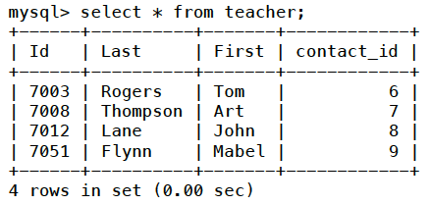
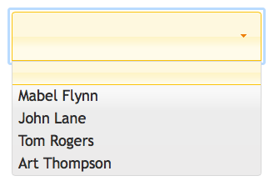
Dynamically Populated Menu
Use AJAX to obtain results from a database
to dynamically populate a drop-down menu:

Slide 5
Dynamically Populated Menu, cont’d
<body>
<h1 class="ui-state-default">Teacher's Students</h1>
<h2>
Students of &nbsp;
<select id="teachermenu"></select>
</h2>
<div id="output"></div>
</body>
school/studentsof4.html

Slide 6
Dynamically Populated Menu, cont’d
school/studentsof4.js
$(init);
function init()
{
$("#teachermenu").selectmenu();
$("#teachermenu").on("selectmenuchange", showStudents);
$.get("teachers.php", null, loadMenu);
}
function loadMenu(data, status)
{
$("#teachermenu").html(data);
}

Slide 7
Dynamically Populated Menu, cont’d
class Teacher
{
private $id;
private $first;
private $last;
public function getId() { return $this->id; }
public function getFirst() { return $this->first; }
public function getLast() { return $this->last; }
}
...
$con = new PDO("mysql:host=localhost;dbname=school",
"root", "sesame");
$con->setAttribute(PDO::ATTR_ERRMODE,
PDO::ERRMODE_EXCEPTION);
school/teachers.php

Slide 8
Dynamically Populated Menu, cont’d
$query = "SELECT id, first, last FROM teacher ORDER BY last";
$ps = $con->prepare($query);
$ps->execute();
$ps->setFetchMode(PDO::FETCH_CLASS, "Teacher");
// Construct menu options. Start with a blank option.
print "<option value=0>$full</option>";
while ($teacher = $ps->fetch()) {
$id = $teacher->getId();
$first = $teacher->getFirst();
$last = $teacher->getLast();
$full = $first . " " . $last;
print "<option value='$id'>$full</option>";
}
school/teachers.php

Slide 9
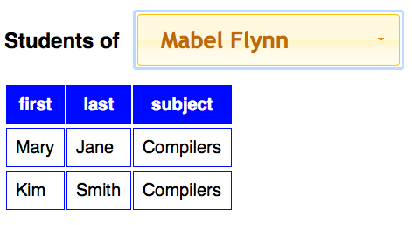
Dynamically Created Table
Use AJAX to obtain results from a database
to dynamically create a table:

Slide 10
Dynamically Created Table, cont’d
<body>
<h1 class="ui-state-default">Teacher's Students</h1>
<h2>
Students of &nbsp;
<select id="teachermenu"></select>
</h2>
<div id="output"></div>
</body>
school/studentsof4.html
function init()
{
$("#teachermenu").selectmenu();
$("#teachermenu").on("selectmenuchange", showStudents);
$.get("teachers.php", null, loadMenu);
}
school/studentsof4.js

Slide 11
Dynamically Created Table, cont’d
function showStudents(event, ui)
{
teacherId = $("#teachermenu").val();
$.post("students.php", {"id": teacherId}, loadTable);
}
function loadTable(data, status)
{
$("#output").html(data);
}
studentsof4.js

Slide 12
Dynamically Created Table, cont’d
school/students.php
class StudentSubject
{
private $first;
private $last;
private $subject;
public function getFirst() { return $this->first; }
public function getLast() { return $this->last; }
public function getSubject() { return $this->subject; }
}
$teacherId = filter_input(INPUT_POST, 'id');
if ($teacherId == 0) return;

Slide 13
Dynamically Created Table, cont’d
$con = new PDO("mysql:host=localhost;dbname=school",
"root", "sesame");
$con->setAttribute(PDO::ATTR_ERRMODE,
PDO::ERRMODE_EXCEPTION);
// Prepared statement query.
$query = "SELECT student.first, student.last, subject ".
"FROM student, class, student_class ".
"WHERE teacher_id = :teacher_id ".
"AND code = class_code ".
"AND student.id = student_id ".
"ORDER BY subject, student.last";
$ps = $con->prepare($query);
$ps->bindParam(':teacher_id', $teacherId);
$ps->execute();
createTable($ps);
school/students.php

Slide 14
Dynamically Created Table, cont’d
school/students.php
function createTable(PDOStatement $ps)
{
print "<table>\n";
createHeaderRow($ps);
$ps->execute();
$ps->setFetchMode(PDO::FETCH_CLASS, "StudentSubject");
// Construct the data rows.
while ($ss = $ps->fetch()) {
print "<tr>\n";
createDataRow($ss);
print "</tr>\n";
}
print "</table>\n";
}

Slide 15
Dynamically Created Table, cont’d
function createHeaderRow(PDOStatement $ps)
{
$row = $ps->fetch(PDO::FETCH_ASSOC);
print "<tr>\n";
foreach ($row as $field => $value) {
print "<th>$field</th>\n";
}
print "</tr>\n";
}
function createDataRow(StudentSubject $ss)
{
print "<tr>\n";
print "<td>" . $ss->getFirst() . "</td>\n";
print "<td>" . $ss->getLast() . "</td>\n";
print "<td>" . $ss->getSubject() . "</td>\n";
print "</tr>\n";
}
school/students.php

Slide 16
load() Instead of $.get()
Instead of:
Shorter:
school/studentsof4.js
function init()
{
$("#teachermenu").selectmenu();
$("#teachermenu").on("selectmenuchange", showStudents);
$.get("teachers.php", null, loadMenu);
}
function loadMenu(data, status)
{
$("#teachermenu").html(data);
}
school/studentsof5.js
function init()
{
$("#teachermenu").selectmenu().load("teachers.php");
$("#teachermenu").on("selectmenuchange", showStudents);
}

Slide 17
load() Instead of $.post()
Instead of:
Shorter:
school/studentsof4.js
function showStudents(event, ui)
{
teacherId = $("#teachermenu").val();
$.post("students.php", {"id": teacherId}, loadTable);
}
function loadTable(data, status)
{
$("#output").html(data);
}
school/studentsof5.js
function showStudents(event, ui)
{
teacherId = $("#teachermenu").val();
$("#output").load("students.php", {"id": teacherId});
}

Slide 18
Cookies
Normally, each connection you make to the
web server via a URL is a separate transaction.
The web server has no memory
of your previous transactions.
One way for the web server to remember information from one transaction to another is by using cookies.

Slide 19
Cookies, cont’d
A cookie is a small packet of data
created by the web application.
  A cookie can hold at most about 4 KB of data.
The web server sends the cookie
to your web browser.
  The browser stores the cookie in its cookie folder.
The next time you connect to the web app,
the browser sends the cookie data along with any form data.
  The web application thereby “recalls” information from the previous transaction.

Slide 20
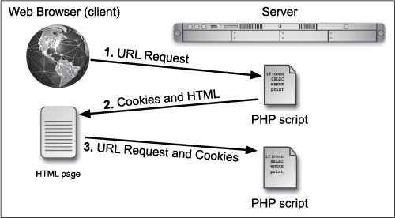
Cookies, cont’d
Each newly created cookie contains a unique session id to distinguish it from other cookies.
PHP and MySQL for
Dynamic Web Sites, 4th ed.
by Larry Ullman
Peachpit Press, 2012
ISBN 978-0-321-78407-0

Slide 21
Cookies, cont’d
session/cookie.php
<?php
$counter = 0;
if (isset($_COOKIE['counter'])) {
$counter = $_COOKIE['counter'] + 1;
}
setCookie('counter', $counter);
?>
<!DOCTYPE html>
<html lang="en-US">
<head>
<meta charset="UTF-8">
<title>Cookie Counter</title>
</head>
<body>
<?php
echo "<h1>Cookie Counter: $counter</h1>\n";
?>
</body>
</html>
Is there a cookie?
Send a cookie.
Send cookies before
sending any text
to the web browser.

Slide 22
Deleting Cookies
To delete a cookie, call setCookie()
with only the name parameter but no value.
  Example:
setCookie('counter');

Slide 23
Problems with Cookies
Small amount of data
  Only at most 4 KB.
Insecure
  The cookie data is kept by the web browser.
Sometimes disallowed
  Some browsers may have cookies turned off.

Slide 24
Sessions
Similar functionality to cookies.
More data can be stored.
More secure: Data is stored on the web server.
Also assigns a unique session id to each user.
  Sessions use cookies.
  But sessions can also work without cookies.

Slide 25
Sessions, cont’d
<?php
session_start();
?>
<!DOCTYPE html>
<html lang="en-US">
<head>
<meta charset="UTF-8">
<title>Session Counter</title>
</head>
<body>
<?php
$counter = 0;
if (isset($_SESSION['counter'])) {
$counter = $_SESSION['counter'] + 1;
}
$_SESSION['counter'] = $counter;
echo "<h1>Session Counter: $counter</h1>";
?>
</body>
</html>
Start the session before
sending any text
to the web browser.
sessaion/session.php

Slide 26
Deleting Sessions
Delete a session variable:
Delete all session variables:
Delete the session:
unset($_SESSION['counter']);
$_SESSION = array();
session_start();
set_cookie('PHPSESSID');

