Slide 1


CS 174: Web Programming
October 28 Class Meeting
Department of Computer Science
San Jose State University
Fall 2015
Instructor: Ron Mak
www.cs.sjsu.edu/~mak

Slide 2
The jQuery User Interface Toolkit
The jQuery User Interface Toolkit is built
on top of the jQuery library.
New cross-platform UI features:
  UI elements: scrollbars
    tabs, date pickers, etc.
  Advanced user interaction
    drag and drop
    resize objects
  Theme templates
    control your application’s look and feel
  Icon library

Slide 3
The jQuery User Interface Toolkit, cont’d
Build a modern application.
  That just happens to run inside a web browser.
  Add visual effects.
Open source
  Download from http://jqueryui.com

Slide 4
Themes
A jQuery theme is a visual rule set.
  Defines a particular look and feel.
  Implemented by a complex CSS document
  that you can download and link to your web pages.
Visit the jQuery Theme Roller at
http://jqueryui.com/themeroller/
  Widgets (tool objects) of jQuery UI.
  Select and download themes.
  Modify themes or create new themes.

Slide 5
Drag an Object
Call a jQuery object’s draggable() function
to an object to enable it to be dragged with a mouse.

Slide 6
Drag an Object, cont’d
<head>
<title>Drag</title>
<meta charset= "UTF-8" />
<script type="text/javascript"
src="js/jquery.js">
</script>
<script type="text/javascript"
src="js/jquery-ui-lightness/jquery-ui.min.js">
</script>
<script type="text/javascript"
src="js/drag.js">
</script>
</head>
<body>
<h1>Drag Demo</h1>
<div id="dragMe">
<img src="images/Bristol.png" width="200" />
</div>
</body>
drag.html
drag.js
$(init);
function init()
{
$("#dragMe").draggable();
}

Slide 7
UI Icons
Each UI Toolkit download includes an images folder that contains the icon files.
To insert an icon, create a span
where icon-name is obtained from the
Theme Roller.
  Hover the mouse over the desired icon
  to see its name.
<span class="ui-icon icon-name"></span>

Slide 8
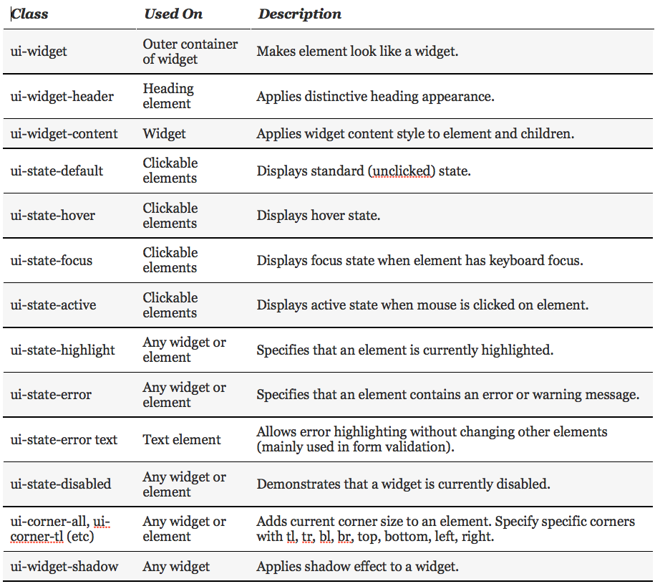
jQuery UI Toolkit Classes for CSS

Slide 9
Resize an Object
Call a jQuery object’s resizable() function
to an object to enable it to be resized with a mouse.
Add the following jQuery UI classes
to the object:
  ui-widget
  ui-widget-content
  ui-corner-all

Slide 10
Resize an Object, cont’d
<head>
<meta http-equiv="content-type"
content="text/xml; charset=utf-8" />
<link rel = "stylesheet"
type = "text/css"
href = "css/jquery-ui-lightness/jquery-ui.min.css" />
<link rel = "stylesheet"
type = "text/css"
href = "css/resize.css" />
<script type = "text/javascript"
src = "js/jquery.js">
</script>
<script type = "text/javascript"
src = "js/jquery-ui-lightness/jquery-ui.min.js">
</script>
<script type = "text/javascript"
src="js/resize.js">
</script>
<title>resize.html</title>
</head>
resize.html

Slide 11
Resize an Object, cont’d
<body>
<h1>Resize Demo</h1>
<div id = "resizeMe">
<h2>
<span class = "ui-icon ui-icon-heart"></span>
Resize me
<span class = "ui-icon ui-icon-star"></span>
</h2>
<p>
Drag a corner or side to resize.
</p>
</div>
</body>
resize.html

Slide 12
Resize an Object, cont’d
resize.js
$(init);
function init()
{
$("#resizeMe").resizable();
$("div").addClass("ui-widget")
.addClass("ui-widget-content")
.addClass("ui-corner-all");
$(":header").addClass("ui-widget-header")
.addClass("ui-corner-all");
}

Slide 13
Drag and Drop an Object
Call a jQuery object’s droppable() function
to an object to enable it to be a drop target.
Use the bind() function to bind drop-in
and drop-out events to the object.
  Attach a callback function to each event.
UI variable ui-draggable refers to the object that triggered the drop-in callback function.

Slide 14
Drag and Drop an Object, cont’d
dragdrop.html
<body>
<h1>Drag and Drop Demo</h1>
<div class="dragMe">
DRAG ME
</div>
<div id="target">
DROP HERE
</div>
</body>
</html>

Slide 15
Drag and Drop an Object, cont’d
dragdrop.js
$(init);
function init()
{
cloneDragMe();
$(".dragMe").draggable();
$("#target").droppable();
$("#target").bind("drop", highlightTarget);
$("#target").bind("dropout", resetTarget);
}

Slide 16
Drag and Drop an Object, cont’d
dragdrop.js
function highlightTarget(event, ui)
{
$("#target").addClass("ui-state-highlight")
.html("Dropped ")
.append(ui.draggable.text());
}
function resetTarget(event, ui)
{
$("#target").removeClass("ui-state-highlight")
.html("Drop on me");
}

Slide 17
Drag and Drop an Object, cont’d
dragdrop.js
function cloneDragMe()
{
for (i = 1; i <= 4; i++){
zValue = 101 + i;
yPos = 80 + 20*i + "px";
$("div:first").clone()
.insertAfter("div:last")
.css("top", yPos)
.css("zIndex", zValue)
.append(" #" + i);
}
}

Slide 18
jQuery UI Widgets
Popular jQuery UI widgets include:
  accordion
  tabs
  date picker
  slider
  selectable elements
  sortable lists
  dialog boxes

Slide 19
Accordion Widget
Create an outer div to be the accordion widget.
Create a heading for each collapsible element of the accordion widget.
  The headings are contained in the outer div.
  Make all the headings at the same level.
Follow each heading with an inner div to contain the contents of the collapsible element.

Slide 20
Accordion Widget, cont’d
<body>
<h1>Accordion Demo</h1>
<div id="accordion">
<h2>CS 149 Operating Systems</h2>
<div>
<p>
Fundamentals: Contiguous and non-contiguous
...
</p>
<p>
<strong>Prerequisite:</strong> CS 146 or SE 146
(with a grade of "C-" or better).
</p>
</div>
<h2>CS 153 Compiler Design</h2>
<div> ... </div>
...
</div>
</body>
accordion.html

Slide 21
Accordion Widget, cont’d
accordion.js
$(init);
function init()
{
$("#accordion").accordion();
}

Slide 22
Tabs Widget
Create an outer div to be the tabs widget.
The first element contained in the div must be an ordered or unordered list to serve as the tabs directory.
Each list item is a local link to an inner div
that contains the tab contents.

Slide 23
Tabs Widget, cont’d
tabs.html
<body>
<h1 class="ui-state-default">Tabs Demo</h1>
<div id="tabs">
<ul>
<li><a href="#CS149">CS 149</a></li>
<li><a href="#CS153">CS 153</a></li>
<li><a href="#CS174">CS 174</a></li>
<li><a href="#CS235">CS 235</a></li>
</ul>
<div id="CS149">
...
</div>
<div id="CS153">
...
</div>
...
</div>
</body>
$(init);
function init()
{
$("#tabs").tabs();
}
tabs.js

Slide 24
AJAX Tabs
Use AJAX to obtain the contents of a tab.
Specify the file to be loaded from the server
as a link in the corresponding item in the
tabs directory list.

Slide 25
AJAX Tabs, cont’d
ajaxtabs.html
<body>
<h1 class="ui-state-default">AJAX Tabs Demo</h1>
<div id="tabs">
<ul>
<li><a href="courses/CS149.html">CS 149</a></li>
<li><a href="courses/CS153.html">CS 153</a></li>
<li><a href="courses/CS174.html">CS 174</a></li>
<li><a href="courses/CS235.html">CS 235</a></li>
</ul>
</div>
</body>

Slide 26
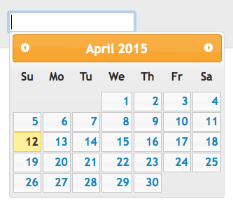
Date Picker Widget
<input type="text" id="datePicker" />
$("#datePicker").datepicker();

Slide 27
Slider Widget
<div id="slider"></div>
<div id="slideOutput">0</div>
$("#slider").slider().bind("slide", reportSlider);
...
function reportSlider()
{
var sliderVal = $("#slider").slider("value");
$("#slideOutput").html(sliderVal);
}

Slide 28

Selectable Widget
<ul id="selectable">
<li>alpha</li>
<li>beta</li>
<li>gamma</li>
<li>delta</li>
</ul>
$("#selectable").selectable();

Slide 29


Sortable Widget
<ul id="sortable">
<li>alpha</li>
<li>beta</li>
<li>gamma</li>
<li>delta</li>
</ul>
$("#sortable").sortable();

Slide 30
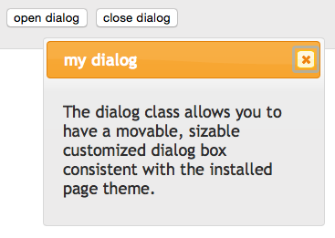
Dialog Widget
<div id="dialog" title="my dialog">
<p>
The dialog class allows you
to have a movable sizable
customized dialog box
consistent the installed
page theme.
</p>
</div>
<input type="button"
value="open dialog"
onclick="openDialog()" />
<input type="button"
value="close dialog"
onclick="closeDialog()" />

Slide 31
Dialog Widget, cont’d
$("#dialog").dialog();
$("#dialog").dialog("close");
...
function openDialog()
{
$("#dialog").dialog("open");
}
function closeDialog()
{
$("#dialog").dialog("close");
}

Slide 32
Assignment #6
Add jQuery and jQuery UI widgets
to your web application.
  Use a jQuery Theme.
  Up to 10 points extra credit if you
  create (or modify) a theme.
Turn in the usual zip file containing source files, database dump, and screen shots.
Due Friday, Nov. 6.

