Slide 1


CS 174: Web Programming
October 14 Class Meeting
Department of Computer Science
San Jose State University
Fall 2015
Instructor: Ron Mak
www.cs.sjsu.edu/~mak

Slide 2
Hidden HTML Form Input Fields
So far, a data submitted by an HTML form
have been explicitly entered by the user.
  text fields
  checkboxes
  radio button
  select menus
A “hidden” input field:
  Send data from an HTML form to the server
  in a way that is not displayed by the web page.
<input type="hidden" id="unseen" value="some value" />

Slide 3
Receiving Client Data by the Server
Send data to the server using get or post.
  Corresponding ways for PHP code
  on the server to receive the data:
Older ways to receive data is via the
PHP superglobals:
  $_REQUEST combines $_GET and $_POST.
$first = filter_input(INPUT_GET, "firstName");
$language = filter_input(INPUT_POST, "language");
$first = $_GET("firstName");
$language = $_POST("language");
$direction = $_REQUEST("direction");

Slide 4
PHP Input Filtering
An optional third parameter specifies either a sanitizing filter or a validation filter.
  Example:
A sanitizing filter strips off certain characters.
A validating filter checks the input for validity.
if (!filter_input(INPUT_GET, "email", FILTER_VALIDATE_EMAIL)) {
echo("Email is not valid");
}
else {
echo("Email is valid");
}

Slide 5
PHP Input Filtering, cont’d
http://www.w3schools.com/php/php_ref_filter.asp
Filter constant | ID | Description
FILTER_VALIDATE_BOOLEAN | 258 | Validates a boolean
FILTER_VALIDATE_EMAIL | 274 | Validates an e-mail address
FILTER_VALIDATE_FLOAT | 259 | Validates a float
FILTER_VALIDATE_INT | 257 | Validates an integer
FILTER_VALIDATE_IP | 275 | Validates an IP address
FILTER_VALIDATE_REGEXP | 272 | Validates a regular expression
FILTER_VALIDATE_URL | 273 | Validates a URL
FILTER_SANITIZE_EMAIL | 517 | Removes all illegal characters from an e-mail address
FILTER_SANITIZE_ENCODED | 514 | Removes/Encodes special characters
FILTER_SANITIZE_MAGIC_QUOTES | 521 | Apply addslashes()
FILTER_SANITIZE_NUMBER_FLOAT | 520 | Remove all characters, except digits, +- and optionally .,eE
FILTER_SANITIZE_NUMBER_INT | 519 | Removes all characters except digits and + -
FILTER_SANITIZE_SPECIAL_CHARS | 515 | Removes special characters
FILTER_SANITIZE_STRING | 513 | Removes tags/special characters from a string
FILTER_SANITIZE_STRIPPED | 513 | Alias of FILTER_SANITIZE_STRING
FILTER_SANITIZE_URL | 518 | Removes all illegal character from s URL
FILTER_UNSAFE_RAW | 516 | Do nothing, optionally strip/encode special characters
FILTER_CALLBACK | 1024 | Call a user-defined function to filter data
Default

Slide 6
PHP is Object-Oriented
The object-oriented features and syntax
of PHP resemble those of Java:
  classes and objects
  abstract classes
  inheritance
  interfaces
PHP also has traits.
  Add functionality to a class without inheritance.

Slide 7
PHP Classes
oo/Pet.php
class Pet
{
public $name;
function __construct($pet_name)
{
$this->name = $pet_name;
}
function eat() { /* ... */ }
function sleep() { /* ... */ }
function play() { /* ... */ }
}
The constructor
is always named
__construct
(two underscores).

Slide 8
PHP Inheritance
As with Java, a PHP class can inherit
from at most one superclass.
class Cat extends Pet
{
function play()
{
parent::play();
}
}
Scope resolution
operator ::
oo/Pet.php

Slide 9
PHP Objects
$cat = new Cat('Eliza');
$pet = new Pet('Norska');
$cat->eat();
$pet->sleep();
// Delete the objects
unset($cat, $pet);
oo/Pet.php

Slide 10
PHP Abstract Classes
abstract class Shape
{
abstract public function getArea();
abstract public function getPerimeter();
}
oo/Shape.php
require('Shape.php');
class Triangle extends Shape
{
private $_sides = array();
private $_perimeter = NULL;
function __construct($s0 = 0, $s1 = 0, $s2 = 0)
{
/* ... */
}
public function getArea() { /* ... */ }
public function getPerimeter() { /* ... */ }
}
oo/Triangle.php

Slide 11
PHP Interfaces
interface Crud
{
public function create($data);
public function read();
public function update($data);
public function delete();
}
oo/Crud.php
require('Crud.php');
class User implements Crud
{
/* ... */
function create($data) { /* ... */ }
function read() { /* ... */ }
function update($data) { /* ... */ }
public function delete() { /* ... */ }
}
oo/User.php

Slide 12
PHP Traits
Traits add functionality to a class
without class inheritance.
  They help overcome some of the
  restrictions of single inheritance.
A class can use several traits.
Several classes can share traits.

Slide 13
PHP Traits, cont’d
trait Debug
{
public function dumpObject()
{
$class = get_class($this);
$attributes = get_object_vars($this);
$methods = get_class_methods($this);
echo "<h2>Information about the $class object</h2>";
echo '<h3>Attributes</h3><ul>';
foreach ($attributes as $k => $v) {
echo "<li>$k: $v</li>";
}
echo '</li></ul>';
echo '<h3>Methods</h3><ul>';
foreach ($methods as $v) {
echo "<li>$v</li>";
}
echo '</li></ul>';
}
}
oo/Debug.php

Slide 14
PHP Traits, cont’d
oo/Rectangle.php
require('Shape.php');
require('Debug.php');
class Rectangle extends Shape
{
use Debug;
public $width;
public $height;
function __construct($w, $h)
{
$width = $w;
$height = $h;
}
function getArea() { return $width * $height; }
function getPerimeter() { return 2*($width + $height); }
}

Slide 15
PHP Traits, cont’d
oo/traittest.php
require('Rectangle.php');
$r = new Rectangle(42, 37);
$r->dumpObject();
Demo

Slide 16
Sample Midterm Question #1
Write the HTML and JavaScript code to allow a user to input a credit card number and then validate and reformat the number. The user must enter the card number with spaces such as 1234 5678 9012 3456 and the web page should submit the number without spaces. Pop up an alert that displays the reformatted number that is being submitted, or the alert should display an error message if the user entered the number in the wrong format.

Slide 17
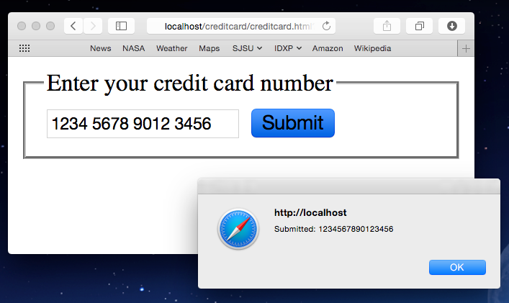
Sample Midterm Question #1, cont’d

Slide 18
Solution to Question #1
<body>
<form action = "" onsubmit = "validate()">
<fieldset>
<legend>Enter your credit card number</legend>
<input type = "text"
value = ""
id = "ccNumber" />
<input type = "submit" />
</fieldset>
</form>
</body>

Slide 19
Solution to Question #1, cont’d
function validate()
{
ccNumber = document.getElementById("ccNumber");
ccn = ccNumber.value;
ccnRE = /(\d{4}) (\d{4}) (\d{4}) (\d{4})/;
if (!ccn.match(ccnRE)){
alert("Invalid credit card number format.");
return false;
}
else {
ccn = ccn.replace(ccnRE, "$1$2$3$4");
ccNumber.value = ccn;
alert("Submitted: " + ccNumber.value);
return true;
}
}

Slide 20
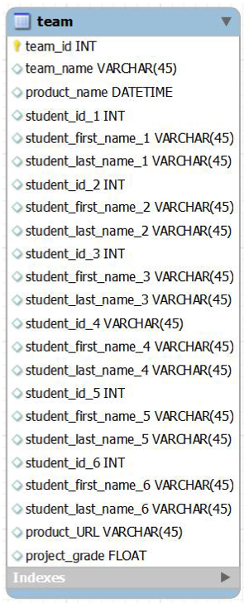
Sample Midterm Question #2
Normalize this table to 2NF.
Represent your normalized tables with a simple generic diagram or with a crow’s feet ER diagram. Show the field names, but you can leave off the data types. Identify the primary and foreign keys with (PK) and (FK), respectively, next to the field names. Indicate which table each foreign key refers to.

Slide 21
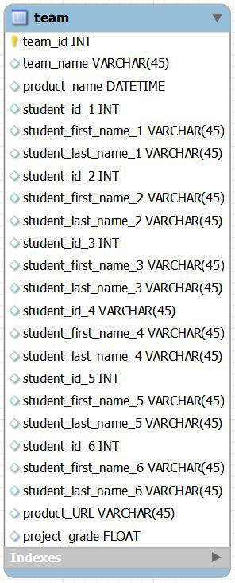
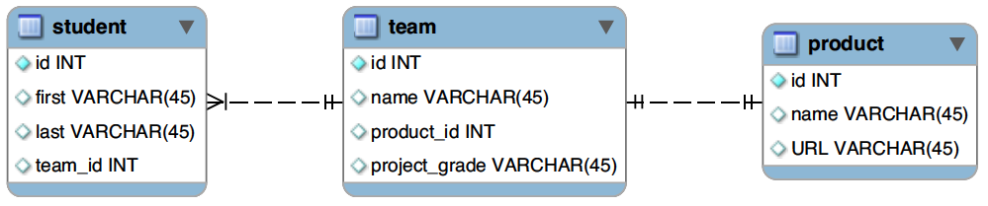
Solution to Question #2
(FK)
(FK)

Slide 22
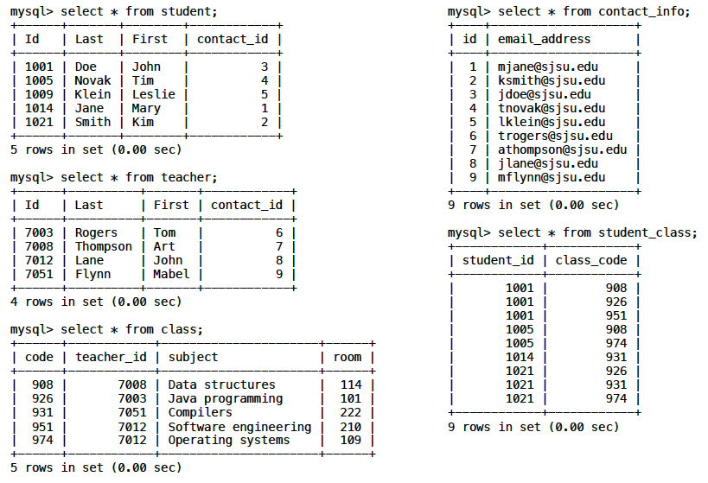
Sample Midterm Question #3
Write an SQL statement that makes this query:
Who are all the teachers of student John Doe
and what are the corresponding subjects?

Slide 23
Solution to Question #3
mysql> SELECT teacher.first, teacher.last, subject
-> FROM student, teacher, class, student_class
-> WHERE student.first = 'John' AND student.last = 'Doe'
-> AND student.id = student_id AND class.code = class_code
-> AND teacher.id = class.teacher_id
-> ;
+-------+----------+----------------------+
| first | last | subject |
+-------+----------+----------------------+
| Tom | Rogers | Java programming |
| Art | Thompson | Data structures |
| John | Lane | Software engineering |
+-------+----------+----------------------+
3 rows in set (0.02 sec)

Slide 24
Sample Midterm Question #4
Write the PHP statements that include a prepared statement to make the same query for any student when given the student’s first and last name, and then return the result set as an associative array. You may assume that variable $con already contains the connection to the database, and that variables $first and $last contain the name of a student.

Slide 25
Solution to Question #4
$query = "SELECT teacher.first, teacher.last, subject " .
"FROM student, teacher, class, student_class " .
"WHERE student.first = :first " .
"AND student.last = :last " .
"AND student.id = student_id " .
"AND class.code = class_code " .
"AND teacher.id = class.teacher_id";
$ps = $con->prepare($query);
$ps->bindParam(':first', $first);
$ps->bindParam(':last', $last);
$ps->execute();
$ps->setFetchMode(PDO::FETCH_ASSOC);

