Slide 1


CS 174: Web Programming
October 5 Class Meeting
Department of Computer Science
San Jose State University
Fall 2015
Instructor: Ron Mak
www.cs.sjsu.edu/~mak

Slide 2
The HTML5 Canvas Object
HTML5 introduces the drawing canvas.
The <canvas> tag provides a
graphics context.
A rich set of drawing operations.
  Execute using JavaScript.
  Replaces the needed for Flash or Java.
  Used by many game developers.
Universally supported by modern browsers.

Slide 3
Simple Canvas Demo
<canvas id = "canvas"
width = "200"
height = "200">
<p>Your browser does not support the canvas tag.</p>
</canvas>
canvas/simple.html
function draw()
{
var canvas = document.getElementById("canvas");
var con = canvas.getContext('2d');
con.strokeStyle = "black";
con.strokeRect(0, 0, 200, 200);
con.fillStyle = "red";
con.fillRect(40, 140, 150, 50);
}
Demo

Slide 4
Canvas Basics
Two main canvas drawing operations:
  stroke: draw a line
  fill: fill in a shape
Specify strokestyle and fillstyle.
Basic shapes: lines, rectangles, arcs, text
Create paths to draw complex shapes.
Draw images.
Alter pixels.

Slide 5
Ways to Specify Colors
By name: red, silver, gray, etc.
RGB with integers 0-255 or percentages:
rgb(10, 250, 100) or
rgb(100%, 100%, 0%)
RGBA with alpha transparency.
HSL and HSLA
RGB with six-digit hex values: #FF0000 is red, #FFFF00 is yellow.
RGB with three-digit hex values: #F00 is red, #FF0 is yellow.

Slide 6
Gradients
Fill a shape with a gradient.
Linear gradient or radial gradient.
Color stop: Specifies a color to add to a gradient and a position along the gradient.
  Position 0 through 1
  0 = beginning of the gradient
  1 = end of the gradient

Slide 7
Gradients, cont’d
<canvas id = "linear"
height = "200"
width = "200">
<p>Canvas not supported!</p>
</canvas>
<canvas id = "radial"
height = "200"
width = "200">
<p>Canvas not supported!</p>
</canvas>
canvas/gradients.html

Slide 8
Gradients, cont’d
function draw()
{
var linear = document.getElementById("linear");
var radial = document.getElementById("radial");
// Linear gradient
var con = linear.getContext("2d");
lGrad = con.createLinearGradient(0, 0, 100, 200);
lGrad.addColorStop(0, "#FF0000");
lGrad.addColorStop(0.5, "#00FF00");
lGrad.addColorStop(1, "#0000FF");
con.fillStyle = lGrad;
con.fillRect(0, 0, 200, 200);
...
}
canvas/gradients.html

Slide 9
Gradients, cont’d
function draw()
{
...
// Radial gradient
con = radial.getContext("2d");
rGrad = con.createRadialGradient(50, 50, 0, 100, 100, 125);
rGrad.addColorStop(0, "#FF0000");
rGrad.addColorStop(0.5, "#00FF00");
rGrad.addColorStop(1, "#0000FF");
con.fillStyle = rGrad;
con.fillRect(0, 0, 200, 200);
}
canvas/gradients.html

Slide 10
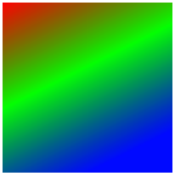
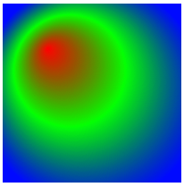
Gradients, cont’d
createLinearGradient(0, 0, 100, 200)
starting position
ending position
radius of
inner circle
radius of
outer circle
createRadialGradient(50, 50, 0, 100, 100, 125)
center position
of inner circle
center position
of outer circle

Slide 11
Rectangle Operations
strokeRect(x, y, w, h)
  Draw the outline of a rectangle with the upper left corner at position x, y and width w and height h.
  Use the current strokeStyle and lineWidth.
fillRect(x, y, w, h)
  Draw a filled-in rectangle.
  Fill with the current fillStyle.
clearRect(x, y, w, h)
  Erase a rectangle by filling in with the
  current background color.

Slide 12
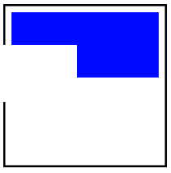
Rectangle Operations, cont’d
<canvas id = "canvas"
height = "200"
width = "200" >
<p>Canvas not supported</p>
</canvas>
canvas/rectangles.html
function draw()
{
var canvas = document.getElementById("canvas");
var con = canvas.getContext("2d");
con.fillStyle = "blue";
con.strokeStyle = "black";
con.lineWidth = "5";
con.strokeRect(0, 0, 200, 200);
con.fillRect(10, 10, 180, 80);
con.clearRect(0, 50, 90, 70);
}

Slide 13
Drawing Text
fillText(string, x, y)
Display the characters of string
at offset x and baseline at y.
strokeText(string, x, y)
Display the outline of the characters of string.
<canvas id = "canvas"
height = "200"
width = "200" >
<p>Canvas not supported</p>
</canvas>

Slide 14
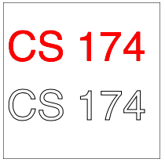
Drawing Text, cont’d
canvas/text.html
function draw()
{
var canvas = document.getElementById("canvas");
var con = canvas.getContext("2d");
con.strokeStyle = "black";
con.strokeRect(0, 0, 200, 200);
con.font = "40pt sans-serif";
con.fillStyle = "red";
con.fillText("CS 174", 5, 75);
con.strokeText("CS 174", 5, 150);
}

Slide 15
Shadows
Add a shadow to any object
you draw on the canvas.
Canvas shadow attributes:
  shadowOffsetX, shadowOffsetY
  How much to move the shadow along
  the x and y axes.
  shadowColor
  Default is black.
  shadowBlur
  0: crisp and sharp
  5: softer and lighter

Slide 16

Shadows, cont’d
function draw()
{
var canvas = document.getElementById("canvas");
var con = canvas.getContext("2d");
con.strokeStyle = "black";
con.strokeRect(0, 0, 200, 200);
con.shadowOffsetX = 3;
con.shadowOffsetY = 3;
con.shadowColor = "gray";
con.shadowBlur = 5;
con.font = "40pt sans-serif";
con.fillStyle = "red";
con.fillText("CS 174", 5, 100);
}
canvas/shadow.html

Slide 17
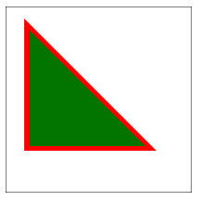
Paths
A path records
“pen motion”.
function draw()
{
...
con.strokeStyle = "red";
con.fillStyle = "green";
con.lineWidth = "10";
con.beginPath();
con.moveTo(25, 25);
con.lineTo(150, 150);
con.lineTo(25, 150);
con.lineTo(25, 100);
con.closePath();
con.stroke();
con.fill();
}
canvas/path.html

Slide 18
Line Attributes
strokeStyle
lineWidth
  in pixels
lineJoin
  miter: sharp corners
  round: rounded corners
  bevel: squared-off corners
lineCap
  round: rounded edges
  butt: squared-off edges cut off exactly at line width
  square: like butt but with a small added length

Slide 19
Line Attributes, cont’d
Line joins:
canvas/lines.html
con.lineJoin = "round"
con.strokeStyle = "red";
con.beginPath();
con.moveTo(20, 50);
con.lineTo(30, 20);
con.lineTo(40, 50);
con.stroke();
con.closePath();
con.lineJoin = "bevel"
con.strokeStyle = "blue";
con.beginPath();
con.moveTo(60, 50);
con.lineTo(70, 20);
con.lineTo(80, 50);
con.stroke();
con.closePath();
con.lineJoin = "miter";
con.strokeStyle = "green"
con.beginPath();
con.moveTo(100, 50);
con.lineTo(110, 20);
con.lineTo(120, 50);
con.stroke();
con.closePath();

Slide 20
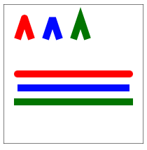
Line Attributes, cont’d
Line caps:
con.lineCap = "round";
con.strokeStyle = "red"
con.beginPath();
con.moveTo(20, 100);
con.lineTo(180, 100);
con.stroke();
con.closePath();
con.lineCap = "butt";
con.strokeStyle = "blue"
con.beginPath();
con.moveTo(20, 120);
con.lineTo(180, 120);
con.stroke();
con.closePath();
canvas/lines.html
con.lineCap = "square";
con.strokeStyle = "green"
con.beginPath();
con.moveTo(20, 140);
con.lineTo(180, 140);
con.stroke();
con.closePath();

Slide 21
Arcs and Circles
starting and ending angles
in radians
radius
arc(70, 30, 50, 0, Math.PI, false)
center position
drawing direction
true: counter-clockwise
false: clockwise
Compass | Radians
East | 0
South | Math.PI/2
West | Math.PI
North | 3*Math.PI/2

Slide 22
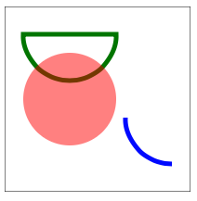
Arcs and Circles, cont’d
// Stroked closed half-circle
con.strokeStyle = "green";
con.lineWidth = "5";
con.beginPath();
con.arc(70, 30, 50, 0, Math.PI, false);
con.closePath();
con.stroke();
// Filled full circle
con.fillStyle = "rgba(255, 0, 0, 0.5)";
con.beginPath();
con.arc(70, 100, 50, 0, 2*Math.PI, true);
con.closePath();
con.fill();
// Stroked quarter arc
con.strokeStyle = "blue";
con.beginPath();
con.arc(180, 120, 50, Math.PI/2, Math.PI, false);
con.stroke();
con.closePath();
canvas/arcs.html

Slide 23
Quadratic Curve
Curve with starting and ending points.
A control point affects the shape of the curve.
quadraticCurveTo(100, 10, 190, 190)
control point
position
ending point
position

Slide 24
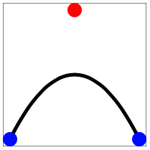
Quadratic Curve, cont’d
con.beginPath();
con.moveTo(10,190);
con.quadraticCurveTo(100, 10, 190, 190);
con.stroke();
con.closePath();
// Blue dots: start and end points.
drawDot(10, 190, "blue");
drawDot(190, 190, "blue");
// Red dot: control point.
drawDot(100, 10, "red");
canvas/quadratic.html
function drawDot(x, y, color)
{
con.fillStyle = color;
con.beginPath();
con.arc(x, y, 10, 0, 2*Math.PI, true);
con.fill();
con.closePath();
}

Slide 25
Bézier Curve
Similar to the quadratic curve,
but with two control points.
bezierCurveTo(100, 10, 100, 190, 190, 190)
control point #1
position
control point #2
position
ending point
position

Slide 26
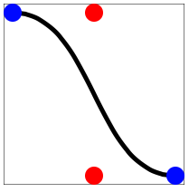
Bézier Curve, cont’d
canvas/bezier.html
con.beginPath();
con.moveTo(10,10);
con.bezierCurveTo(100, 10, 100, 190, 190, 190);
con.stroke();
con.closePath();
// Blue dots: start and end points.
drawDot(10, 10, "blue");
drawDot(190, 190, "blue");
// Red dots: control points.
drawDot(100, 10, "red");
drawDot(100, 190, "red");

Slide 27
Drawing an Image
Draw the entire image:
Draw part of the image:
destination
position
drawImage(image, 10, 10, 180, 135)
destination
width and height
image upper left
corner position
destination
position
drawImage(image, 150, 70, 190, 120, 10, 10, 180, 110)
image width
and height
destination
width and height

Slide 28
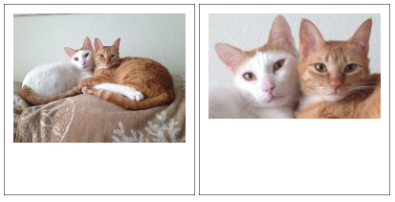
Drawing an Image, cont’d
var image = new Image();
image.src = "images/RonCats.jpg";
...
con.drawImage(image, 10, 10, 180, 135);
...
con.drawImage(image, 150, 70, 190, 120, 10, 10, 180, 110);
canvas/images.html

Slide 29
Altering Pixels
An image is displayed in a canvas
as an array of pixels.
Each pixel takes up four elements of the array, R, G, B, and A, each value can be 0 – 255.
Convert an image to imageData
to get the array of RGBA values.
You can then alter each value.

Slide 30
Altering Pixels, cont’d
var imageData = con.getImageData(10, 10, 180, 135);
for (var row = 0; row < 135; row++) {
for (var col = 0; col < 180; col++) {
var index = 4*(col + row*imageData.width);
var r = imageData.data[index];
var g = imageData.data[index+1];
var b = imageData.data[index+2];
var a = imageData.data[index+3];
g = r;
b = r;
imageData.data[index] = r;
imageData.data[index+1] = g;
imageData.data[index+2] = b;
imageData.data[index+3] = a;
}
}
con.putImageData(imageData, 10, 10);
Get the image data
from the canvas.
Separate each pixel
into R, G, B, and A
Alter each pixel.
canvas/pixels.html
Set the altered pixel
back into the image data.
Put the altered image data
back into the canvas.

Slide 31
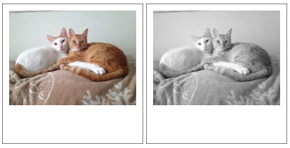
Altering Pixels, cont’d

Slide 32
Assignment #4
Add JavaScript to your web application.
  Client-side input validation
  Greater interactivity
Extra credit (after this week’s lectures)
  +5 points: JavaScript drawing on an HTML5 canvas.
  +5 points: JavaScript animation
Turn in the usual zip file containing source files, database dump, and screen shots.
Due Wednesday, October 14.

