Slide 1


CS 174: Web Programming
September 28 Class Meeting
Department of Computer Science
San Jose State University
Fall 2015
Instructor: Ron Mak
www.cs.sjsu.edu/~mak

Slide 2
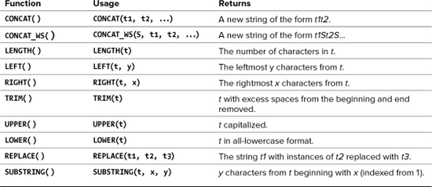
MySQL Text Functions
Also:
  One-way encryption
  Returns a 40-character string.
SHA1(string)
PHP and MySQL for
Dynamic Web Sites, 4th ed.
by Larry Ullman
Peachpit Press, 2012
ISBN 978-0-321-78407-0

Slide 3
MySQL Text Functions, cont’d
mysql> select concat(first, ' ', last)
-> from people;
+--------------------------+
| concat(first, ' ', last) |
+--------------------------+
| Charles Jones |
| Mary Adams |
| Susan Miller |
| Roger Brown |
| Leslie Adamson |
+--------------------------+
5 rows in set (0.00 sec)
mysql> select concat(first, ' ', last) as name
-> from people;
+----------------+
| name |
+----------------+
| Charles Jones |
| Mary Adams |
| Susan Miller |
| Roger Brown |
| Leslie Adamson |
+----------------+
5 rows in set (0.00 sec)
alias

Slide 4
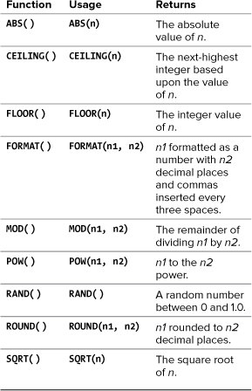
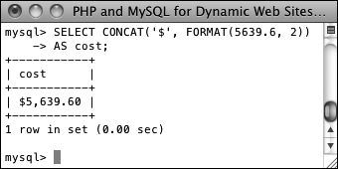
MySQL Numeric Functions
SELECT CONCAT('$', FORMAT(5639.6, 2))
AS cost;
PHP and MySQL for
Dynamic Web Sites, 4th ed.
by Larry Ullman
Peachpit Press, 2012
ISBN 978-0-321-78407-0

Slide 5
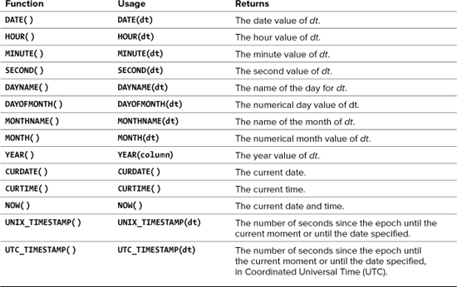
MySQL Date and Time Functions
No arguments.
PHP and MySQL for
Dynamic Web Sites, 4th ed.
by Larry Ullman
Peachpit Press, 2012
ISBN 978-0-321-78407-0

Slide 6
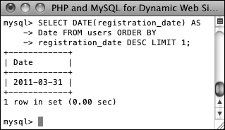
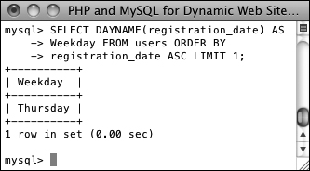
MySQL Date and Time Functions, cont’d
Data types that store both a date and time:
DATETIME and TIMESTAMP
Data type that stores just the date: DATE
Data type that stores just the year: YEAR
PHP and MySQL for
Dynamic Web Sites, 4th ed.
by Larry Ullman
Peachpit Press, 2012
ISBN 978-0-321-78407-0
SELECT DATE(registration_date)
AS Date FROM users ORDER BY
registration_date DESC LIMIT 1;
SELECT DAYNAME(registration_date)
AS Weekday FROM users ORDER BY
registration_date ASC LIMIT 1;

Slide 7
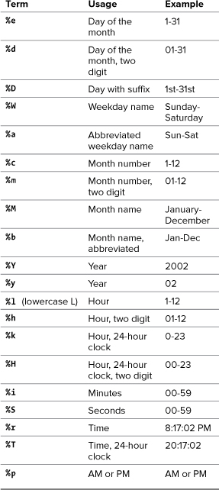
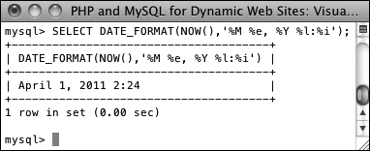
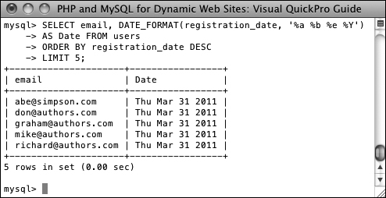
Formatting the Date and Time
Return the current date and time as Month DD, YYYY - HH:MM :
PHP and MySQL for
Dynamic Web Sites, 4th ed.
by Larry Ullman
Peachpit Press, 2012
ISBN 978-0-321-78407-0
Select the email address and date registered,
ordered by date registered, formatting the date as
Weekday (abbreviated) Month (abbreviated) Day Year,
for the last five registered users:

Slide 8
OK, Back to the Client Side
Don’t get dizzy!

Slide 9
The Document Object Model (DOM)
Your web browser represents the
contents of an HTML page internally
using the Document Object Model (DOM).

Slide 10
The DOM, cont’d
Several key objects of the DOM are
children of the special window object.
  Some important children of window:
Object | Represents | Notes
document | Current HTML page | Most commonly scripted object
location | Current page URL | Change location.href to move to another page
history | List of recently visited pages | Access to view previously visited pages
status | Browser status bar | Use to set a message in the status bar

Slide 11
Chrome and the DOM
Use the Chrome browser’s Developer Tools
to manually manipulate the DOM.
Load any web page into the Chrome browser.
  View ➔ Developer ➔ Developer Tools
  Console tab
Enter
  Chrome displays the valid choices in a
  drop-down menu after you type each period.
document.body.style.backgroundColor="yellow"
Note: CSS uses background-color but DOM uses backgroundColor.
Demo

Slide 12
Introduction to JavaScript
 | PHP | JavaScript
Where | Server side: web server | Client side: web browser
Syntax | Similar to C | Similar to Java
Purpose | Access user’s form input data Access back-end data stores Generate new HTML pages | Validate user’s form input data Provide interactivity Modify existing HTML pages
You can write JavaScript code
that directly manipulates the DOM.

Slide 13
Example JavaScript Code
js/backgroundcolor1.html
<!DOCTYPE html>
<html lang="en-US">
<head>
<meta charset="UTF-8">
<title>Background Color #1</title>
</head>
<body>
<form action="">
<fieldset>
<legend>Color buttons</legend>
<p>
<input type="button" value="Red"
onclick="document.body.style.backgroundColor='red'" />
<input type="button" value="Green"
onclick="document.body.style.backgroundColor='green'" />
<input type="button" value="Blue"
onclick="document.body.style.backgroundColor='blue'" />
</p>
</fieldset>
</form>
</body>
</html>
Button events
Event handlers
Demo

Slide 14
Example JavaScript Function
<!DOCTYPE html>
<html lang="en-US">
<head>
<meta charset="UTF-8">
<title>Background Color #2</title>
<script type="text/javascript">
function changeBGColor(color)
{
document.body.style.backgroundColor = color;
}
</script>
</head>
<body>
<form action="">
<fieldset>
<legend>Color buttons</legend>
<p>
<input type="button" value="Red"
onclick="changeBGColor('red')" />
<input type="button" value="Green"
onclick="changeBGColor('green')" />
<input type="button" value="Blue"
onclick="changeBGColor('blue')" />
</p>
</fieldset>
</form>
</body>
</html>
js/backgroundcolor2.html
Demo

Slide 15
JavaScript Variables
JavaScript variables are dynamically typed.
  The type of a variable’s value
  is determined at run time.
  What is the value of sum in each example?
var x = "1";
var y = "2";
var sum = x + y;
var x = 1;
var y = 2;
var sum = x + y;

Slide 16
Obtaining Text Input Field Values
<body>
<form action="">
<fieldset>
<legend>User input</legend>
<p>
<label>First number:</label>
<input id="first" type="text" />
</p>
<p>
<label>Second number:</label>
<input id="second" type="text" />
</p>
<p>
<input type="button" value="Add version 1"
onclick="add1()" />
<input type="button" value="Add version 2"
onclick="add2()" />
</p>
</fieldset>
</form>
</body>
js/adds1.html

Slide 17
Obtaining Text Input Field Values, cont’d
<head>
<meta charset="UTF-8">
<title>Add Versions #1</title>
<script type="text/javascript">
function add1()
{
var x = document.getElementById("first").value;
var y = document.getElementById("second").value;
var sum = x + y;
alert(x + " + " + y + " = " + sum);
}
function add2()
{
var x = parseInt(document.getElementById("first").value);
var y = parseInt(document.getElementById("second").value);
var sum = x + y;
alert(x + " + " + y + " = " + sum);
}
</script>
</head>
js/adds1.html
Demo

Slide 18
Modifying the DOM
<body>
<form action="">
<fieldset>
...
</fieldset>
</form>
<div id="outputDiv">
<p>Output will appear here.</p>
</div>
</body>
js/adds2.html

Slide 19
Modifying the DOM, cont’d
<head>
...
<script type="text/javascript">
function outputSum(x, y)
{
var sum = x + y;
document.getElementById("outputDiv").innerHTML =
"<p><strong>" +
x + " + " + y + " = " + sum +
"</strong></p>";
}
function add1()
{
var x = document.getElementById("first").value;
var y = document.getElementById("second").value;
outputSum(x, y);
}
...
</script>
</head>
js/adds2.html
Demo

Slide 20
Viewing Generated Source Code
Use JavaScript to modify the DOM
via an object’s innerHTML property.
  The browser’s View Source command
  shows the original unmodified HTML.
Use the browser’s Inspect Element command
instead to see the modified HTML.
Demo

Slide 21
Checkbox Values
<body>
<form action="">
<fieldset>
<legend>Select one or more colors</legend>
<p>
<input type="checkbox" id="cbred" value="Red" />
<label for="cbred">Red</label>
<input type="checkbox" id="cbgreen" value="Green" />
<label for="cbgreen">Green</label>
<input type="checkbox" id="cbblue" value="Blue" />
<label for="cbblue">Blue</label>
<input type="button" value="Show colors"
onclick="showColors()" />
</p>
</fieldset>
</form>
<div id="outputDiv">
<p>Output will appear here.</p>
</div>
js/checkbox.html

Slide 22
Checkbox Values, cont’d
<head>
...
<script type="text/javascript">
function showColors()
{
var cbred = document.getElementById("cbred");
var cbgreen = document.getElementById("cbgreen");
var cbblue = document.getElementById("cbblue");
var output = "<p><strong>You chose:";
if (cbred.checked) output += " Red";
if (cbgreen.checked) output += " Green";
if (cbblue.checked) output += " Blue";
output += "</strong></p>";
document.getElementById("outputDiv").innerHTML = output;
}
</script>
</head>
js/checkbox.html
Demo

Slide 23
Radio Button Values
<body>
<form action="">
<fieldset>
<legend>Select a color</legend>
<p>
<input type="radio" name="colors" id="cbred" value="Red" />
<label for="cbred">Red</label>
<input type="radio" name="colors" id="cbgreen" value="Green" />
<label for="cbgreen">Green</label>
<input type="radio" name="colors" id="cbblue" value="Blue" />
<label for="cbblue">Blue</label>
<input type="button" value="Show color"
onclick="showColor()" />
</p>
</fieldset>
</form>
<div id="outputDiv">
<p>Output will appear here.</p>
</div>
</body>
js/radio.html

Slide 24
Radio Button Values, cont’d
<head>
...
<script type="text/javascript">
function showColor()
{
var colors = document.getElementsByName("colors");
var output = "<p><strong>You chose:";
for (i = 0; i < colors.length; i++) {
if (colors[i].checked) {
output += " " + colors[i].value;
}
}
output += "</strong></p>";
document.getElementById("outputDiv").innerHTML = output;
}
</script>
</head>
js/radio.html
Demo

Slide 25
Select Menu Value
js/backgroundcolor3.html
<body>
<form action="">
<fieldset>
<legend>Select a color</legend>
<p>
<select id="colorChooser">
<option value="red">Red</option>
<option value="green">Green</option>
<option value="blue">Blue</option>
</select>
<input type="button" value="Change color"
onclick="changeBGColor()" />
</p>
</fieldset>
</form>
</body>

Slide 26
Select Menu Value, cont’d
<head>
...
<script type="text/javascript">
function changeBGColor()
{
var color = document.getElementById("colorChooser").value;
document.body.style.backgroundColor = color;
}
</script>
</head>
js/backgroundcolor3.html
Demo

Slide 27
Multiple Selection Values
<body>
<form action="">
<fieldset>
<legend>Select one or more colors</legend>
<p>
<select id="colorChooser"
size = "3" multiple="multiple">
<option value="red">Red</option>
<option value="green">Green</option>
<option value="blue">Blue</option>
</select>
<input type="button" value="Show colors"
onclick="showColors()" />
</p>
</fieldset>
</form>
<div id="outputDiv">
<p>Output will appear here.</p>
</div>
</body>
js/multisel.html

Slide 28
Multiple Selection Values, cont’d
<head>
...
<script type="text/javascript">
function showColors()
{
var chooser = document.getElementById("colorChooser");
var output = "<p><strong>You chose:";
for (i = 0; i < chooser.length; i++) {
if (chooser[i].selected) {
output += " " + chooser[i].value;
}
}
output += "</strong></p>";
document.getElementById("outputDiv").innerHTML = output;
}
</script>
</head>
js/multisel.html
Demo

