Slide 1


CS 174: Web Programming
September 23 Class Meeting
Department of Computer Science
San Jose State University
Fall 2015
Instructor: Ron Mak
www.cs.sjsu.edu/~mak

Slide 2
SQL to Create and Drop a Database
Create examples:
Drop examples:
CREATE DATABASE school3;
CREATE DATABASE IF NOT EXISTS school3;
DROP DATABASE school3;
DROP DATABASE IF EXISTS school3;

Slide 3
SQL to Create a Table
First we create a new database
and connect to it:
Create the Class table:
Code | Teacher_id | Subject | Room
908 | 7008 | Data structures | 114
926 | 7003 | Java programming | 101
931 | 7051 | Compilers | 222
951 | 7012 | Software engineering | 210
974 | 7012 | Operating systems | 109
CREATE DATABASE school3;
USE school3;
CREATE TABLE class
(
code INT PRIMARY KEY,
teacher_id INT NOT NULL,
subject VARCHAR(32) NOT NULL,
room INT NOT NULL
);

Slide 4
Database Record Insert, Update, and Delete
There are SQL statements to insert, update, and delete records.
  See the SQL tutorial.
  INSERT INTO teacher (id, last, first)
  VALUES (7088, 'Mak', 'Ron'),
  (7090, 'Wilson', 'Brian')
  UPDATE teacher
  SET first = 'Ronald'
  WHERE first = 'Ron'
  DELETE FROM teacher
  WHERE id = 7090
This can update
multiple records!

Slide 5
SQL to Add Rows
Add rows to
the Class table:
Code | Teacher_id | Subject | Room
908 | 7008 | Data structures | 114
926 | 7003 | Java programming | 101
931 | 7051 | Compilers | 222
951 | 7012 | Software engineering | 210
974 | 7012 | Operating systems | 109
INSERT INTO class (code, teacher_id, subject, room)
VALUES (908, 7008, 'Data structures', 114),
(926, 7003, 'Java programming', 101),
(931, 7051, 'Compilers', 222),
(951, 7012, 'Software engineering', 210),
(978, 7012, 'Operating systems', 109);

Slide 6
SQL Script create_school.sql
DROP DATABASE IF EXISTS school3;
CREATE DATABASE school3;
USE school3;
CREATE TABLE class
(
code INT PRIMARY KEY,
teacher_id INT NOT NULL,
subject VARCHAR(32) NOT NULL,
room INT NOT NULL,
);
INSERT INTO class (code, teacher_id, subject, room)
VALUES (908, 7008, 'Data structures', 114),
(926, 7003, 'Java programming', 101),
(931, 7051, 'Compilers', 222),
(951, 7012, 'Software engineering', 210),
  (978, 7012, 'Operating systems', 109);

Slide 7
SQL Script create_school.sql, cont’d
CREATE TABLE contact_info
(
id INT PRIMARY KEY,
email_address VARCHAR(32) NOT NULL
);
INSERT INTO contact_info (id, email_address)
VALUES (1, 'mjane@sjsu.edu'),
(2, 'ksmith@sjsu.edu'),
(3, 'jdoe@sjsu.edu'),
(4, 'tnovak@sjsu.edu'),
(5, 'lklein@sjsu.edu'),
(6, 'trogers@sjsu.edu'),
(7, 'athompson@sjsu.edu'),
(8, 'jlane@sjsu.edu'),
(9, 'mflynn@sjsu.edu');

Slide 8
SQL Script create_school.sql, cont’d
CREATE TABLE teacher
(
id INT PRIMARY KEY,
last VARCHAR(32) NOT NULL,
first VARCHAR(32) NOT NULL,
contact_id INT REFERENCES contact_info(id)
);
INSERT INTO teacher (id, last, first, contact_id)
VALUES (7003, 'Rogers', 'Tom', 6),
(7008, 'Thompson', 'Art', 7),
(7012, 'Lane', 'John’, 8),
(7051, 'Flynn', 'Mabel', 9);
Use the MySQL source command:
source create_school.sql

Slide 9
Entity-Relationship (ER) Diagrams
Data modeling diagrams are called
Entity-Relationship (ER) diagrams.
  Very similar in concept to UML diagrams.
  There are several styles of ER diagrams.
One style is crow’s feet diagrams.

Slide 10
One-to-Many Relationship
One (each) teacher teaches 0, 1,
or many classes.
many
one
Database cardinality is only
0, 1, or many (more than 1).
one
zero
Teacher
Class
minimum
maximum
Id | Last | First
7003 | Rogers | Tom
7008 | Thompson | Art
7012 | Lane | John
7051 | Flynn | Mabel
Code | Teacher_id | Subject | Room
908 | 7008 | Data structures | 114
926 | 7003 | Java programming | 101
931 | 7051 | Compilers | 222
951 | 7012 | Software engineering | 210
974 | 7012 | Operating systems | 109

Slide 11
Many-to-Many Relationship
Student_Class
A student has 0, 1 or many classes.
A class has 1 or many students.
Student
Key | Student_id | Class_code
1 | 1001 | 926
2 | 1001 | 951
3 | 1001 | 908
4 | 1005 | 974
5 | 1005 | 908
6 | 1014 | 931
7 | 1021 | 926
8 | 1021 | 974
9 | 1021 | 931
Student-Class
Class
Student
Class
Id | Last | First
1001 | Doe | John
1005 | Novak | Tim
1009 | Klein | Leslie
1014 | Jane | Mary
1021 | Smith | Kim
Code | Teacher_id | Subject | Room
908 | 7008 | Data structures | 114
926 | 7003 | Java programming | 101
931 | 7051 | Compilers | 222
951 | 7012 | Software engineering | 210
974 | 7012 | Operating systems | 109

Slide 12
Complete Entity Diagram
Class
code (PK)
teacher_id (FK)
subject
room
Class
Code | Teacher_id | Subject | Room
908 | 7008 | Data structures | 114
926 | 7003 | Java programming | 101
931 | 7051 | Compilers | 222
951 | 7012 | Software engineering | 210
974 | 7012 | Operating systems | 109

Slide 13
MySQL Workbench
Open-source version of some very expensive commercial database design and management tools (such as ERWin Data Modeler).
  Download from http://dev.mysql.com/downloads/
Features
  Manage databases and database connections.
  Edit, execute, and save SQL scripts.
  Forward- and reverse-engineering.
    Generate a crow’s feet ER diagram
    from an existing database.
    Manually create an ER diagram.
    Automatically generate a database from the diagram.

Slide 14
MySQL Workbench: ER Diagrams
MySQL Workbench can generate
a new ER diagram by “reverse engineering”
an existing database.
Demo: Generate a new ER diagram.

Slide 15
MySQL Workbench: ER Diagrams, cont’d
MySQL Workbench can generate
a new database by “forward engineering”
an ER diagram.
  Demo: Generate a new database.

Slide 16
PHP query() vs. exec()
Use PDO::query() to execute
an SQL SELECT statement.
  Returns a result set as a PDOStatement object.
$con = new PDO("mysql:host=localhost;dbname=school",
"root", "sesame");
$con->setAttribute(PDO::ATTR_ERRMODE,
PDO::ERRMODE_EXCEPTION);
$query = "SELECT * FROM teacher WHERE id = $id";
$data = $con->query($query);

Slide 17
PHP query() vs. exec(), cont’d
Use PDO::exec() to execute an
SQL INSERT, UPDATE, or DELETE statement.
  Returns the count of affected rows.
$con = new PDO("mysql:host=localhost;dbname=school",
"root", "sesame");
$con->setAttribute(PDO::ATTR_ERRMODE,
PDO::ERRMODE_EXCEPTION);
$query = "UPDATE teacher ".
"SET first = 'Ronald' ".
"WHERE first = 'Ron'";
$count = $con->exec($query);

Slide 18
Table Join with PHP
$first = filter_input(INPUT_GET, "firstName");
$last = filter_input(INPUT_GET, "lastName");
try {
$con = new PDO("mysql:host=localhost;dbname=school",
"root", "sesame");
$con->setAttribute(PDO::ATTR_ERRMODE,
PDO::ERRMODE_EXCEPTION);
$query = "SELECT student.first, student.last, subject ".
"FROM student, teacher, class, student_class ".
"WHERE teacher.last = '$last' ".
"AND teacher.first = '$first' ".
"AND teacher_id = teacher.id ".
"AND code = class_code ".
"AND student.id = student_id ".
"ORDER BY subject, student.last";
$data = $con->query($query);
$data->setFetchMode(PDO::FETCH_ASSOC);

Slide 19
SQL Injection Attack
A simple query with a teacher id:
$id = filter_input(INPUT_GET, "id");
try {
$con = new PDO("mysql:host=localhost;dbname=school",
"root", "sesame");
$con->setAttribute(PDO::ATTR_ERRMODE,
PDO::ERRMODE_EXCEPTION);
$query = "SELECT * FROM teacher WHERE id = $id";
$data = $con->query($query);
$data->setFetchMode(PDO::FETCH_ASSOC);
$data contains a result set as a PDOStatement object.

Slide 20
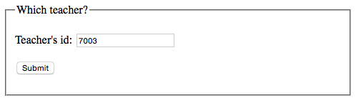
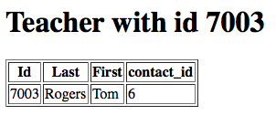
SQL Injection Attack, cont’d
Id | Last | First
7003 | Rogers | Tom
7008 | Thompson | Art
7012 | Lane | John
7051 | Flynn | Mabel

Slide 21
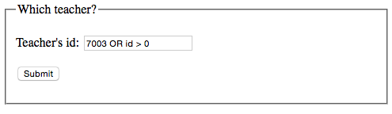
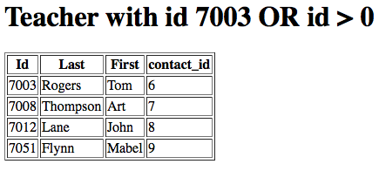
SQL Injection Attack, cont’d

Slide 22
Prepared Statement
$id = filter_input(INPUT_GET, "id");
try {
$con = new PDO("mysql:host=localhost;dbname=school",
"root", "sesame");
$con->setAttribute(PDO::ATTR_ERRMODE,
PDO::ERRMODE_EXCEPTION);
$query = "SELECT * FROM teacher WHERE id = :id";
$ps = $con->prepare($query);
$ps->execute(array(':id' => $id));
$data = $ps->fetchAll(PDO::FETCH_ASSOC);
$data contains an array.

Slide 23
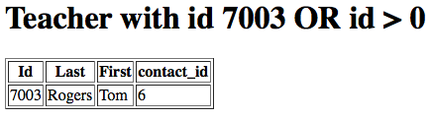
Prepared Statement, cont’d

Slide 24
Prepared Statement, cont’d
Never insert text from a user on the client side
directly into an SQL query on the server side.
A prepared statement provides some defense against SQL injection attacks.
A prepared statement is parsed
and compiled once.
  It can be reused.
  Performance improvement for queries
  made from inside PHP loops.

Slide 25
Table Join with a Prepared Statement
$con = new PDO("mysql:host=localhost;dbname=school",
"root", "sesame");
$con->setAttribute(PDO::ATTR_ERRMODE,
PDO::ERRMODE_EXCEPTION);
$query = "SELECT student.first, student.last, subject ".
"FROM student, teacher, class, student_class ".
"WHERE teacher.last = :last ".
"AND teacher.first = :first ".
"AND teacher_id = teacher.id ".
"AND code = class_code ".
"AND student.id = student_id ".
"ORDER BY subject, student.last";
$ps = $con->prepare($query);
$ps->execute(array(':first' => $first, ':last' => $last));
$data = $ps->fetchAll(PDO::FETCH_ASSOC);

Slide 26
Parameter Binding
Instead of:
Use parameter binding:
$ps->execute(array(':first' => $first, ':last' => $last));
$data = $ps->fetchAll(PDO::FETCH_ASSOC);
$ps->bindParam(':first', $first);
$ps->bindParam(':last', $last);
$ps->execute();
$data = $ps->fetchAll(PDO::FETCH_ASSOC);

Slide 27
Assignment #3
Add more database tables to your application.
  The tables should be in 2nd normal form.
Do joins.
Use PHP prepared statements.
Due Tuesday, Sept. 29.

Slide 28
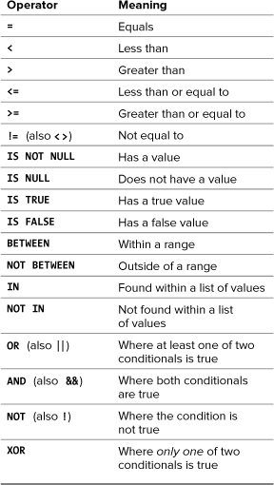
MySQL Conditional Operators
PHP and MySQL for
Dynamic Web Sites, 4th ed.
by Larry Ullman
Peachpit Press, 2012
ISBN 978-0-321-78407-0

Slide 29
LIKE and NOT LIKE
String comparisons using wildcard characters:
  _ matches any single character
  % matches any zero or more characters
mysql> select * from people;
+-----+---------+---------+--------+--------+
| id | first | last | gender | salary |
+-----+---------+---------+--------+--------+
| 101 | Charles | Jones | M | 100000 |
| 103 | Mary | Adams | F | 150000 |
| 105 | Susan | Miller | F | 50000 |
| 110 | Roger | Brown | M | 75000 |
| 112 | Leslie | Adamson | F | 105000 |
+-----+---------+---------+--------+--------+
5 rows in set (0.00 sec)
mysql> select * from people
-> where last like 'Adam%';
+-----+--------+---------+--------+--------+
| id | first | last | gender | salary |
+-----+--------+---------+--------+--------+
| 103 | Mary | Adams | F | 150000 |
| 112 | Leslie | Adamson | F | 105000 |
+-----+--------+---------+--------+--------+
2 rows in set (0.02 sec)

Slide 30
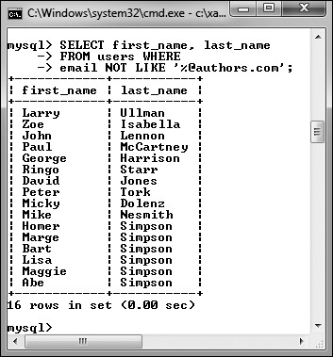
LIKE and NOT LIKE, cont’d
SELECT first_name, last_name
FROM users WHERE
email NOT LIKE '%@authors.com';
PHP and MySQL for
Dynamic Web Sites, 4th ed.
by Larry Ullman
Peachpit Press, 2012
ISBN 978-0-321-78407-0

Slide 31
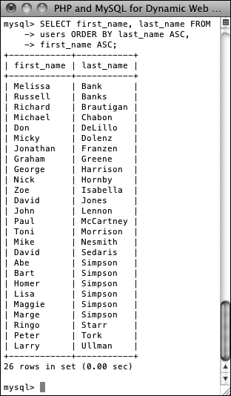
Sorting Query Results
Sort ascending (ASC) or descending (DESC).
  ASC is the default.
SELECT first_name, last_name
FROM users
ORDER BY last_name ASC,
first_name ASC;
PHP and MySQL for
Dynamic Web Sites, 4th ed.
by Larry Ullman
Peachpit Press, 2012
ISBN 978-0-321-78407-0

Slide 32
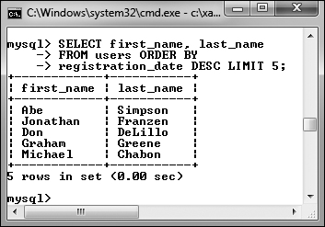
Limiting Query Results
SELECT first_name, last_name
FROM users ORDER BY
registration_date DESC
LIMIT 5;
Also:
  Return n records starting
  with the i^{th} record.
  Does not improve the query execution speed,
  since MySQL still has to match all the records.
  Reduces the number of returned records.
  Useful for “paging” the results.
LIMIT i, n
PHP and MySQL for
Dynamic Web Sites, 4th ed.
by Larry Ullman
Peachpit Press, 2012
ISBN 978-0-321-78407-0

