Slide 1


CS 174: Web Programming
September 16 Class Meeting
Department of Computer Science
San Jose State University
Fall 2015
Instructor: Ron Mak
www.cs.sjsu.edu/~mak

Slide 2
Acknowledgements
Today’s lecture is based on notes
by Robert Nicholson.

Slide 3
What is SEO?
Search Engine Optimization is the practice of tuning a web presence to generate traffic through placement in organic search results.
Organic search results: Listings on search engine results pages that appear because of their relevance to the search terms, as opposed to advertisements.
  Non-organic search results: Pay-per-click advertising.

Slide 4
Why SEO is Important
Almost all web businesses, and many brick-and-mortar businesses, depend on website traffic for their success.
For most websites, organic search results are the single largest traffic driver
  Search engines are the first source of information
  for most users.
  People use search engines multiple times every day.
  Relevant, targeted traffic: People who are looking for your product or service!

Slide 5
Alternatives to SEO
Paid Internet advertising
Social marketing
Traditional advertising and PR

Slide 6
Not for All Businesses
Appliance repair
  Perfect fit: People search when they need it
Mexican restaurant
  Some benefit: But relies more on “brand awareness”
Brain surgeon
  Little or no benefit: A referral-based business
Levitating salad bowls
  No benefit: Nobody is searching for them

Slide 7
SEO is Important for Web Developers
Technical and structural choices
can make SEO easier or harder.
Web developers are often expected
to be “one man shops”.
Entrepreneurial web developers need to understand the requirements for a successful web business.

Slide 8
The Big Secret of SEO
Search engine companies want to show
the best sites first.
Users want to visit (and share) good sites.
If you are designing your site for search engines, you’re missing the point.
Build the best site you can.
  Search engines (and users) will support you.

Slide 9
The Three R’s
Right subjects
  What are people searching for, and what do you want to tell them?
Relevant content
  Deliver the information users want, in a way that search engines understand
Rank
  Google Page Rank (PR) is a rough measure of
  your site’s visibility on the web, based largely on
  the number and quality of links to your site.

Slide 10
The Right Subject
Understand your business priorities.
  Image and messages
  Markets
  Most profitable products or services
Know what people are searching for.
  WordTracker.com
  Google Trends (formerly Google Insights)
  Google Keyword Planner

Slide 11
The Right Subject: Understand the Buy Cycle
Exploring and learning
  “Types of TV sets”
Comparison and evaluation
  “LCD LED Plasma TVs compared”
Find and purchase
  “Cheap Sony LED TV”
Each should be targeted separately
with different keywords and different content.

Slide 12
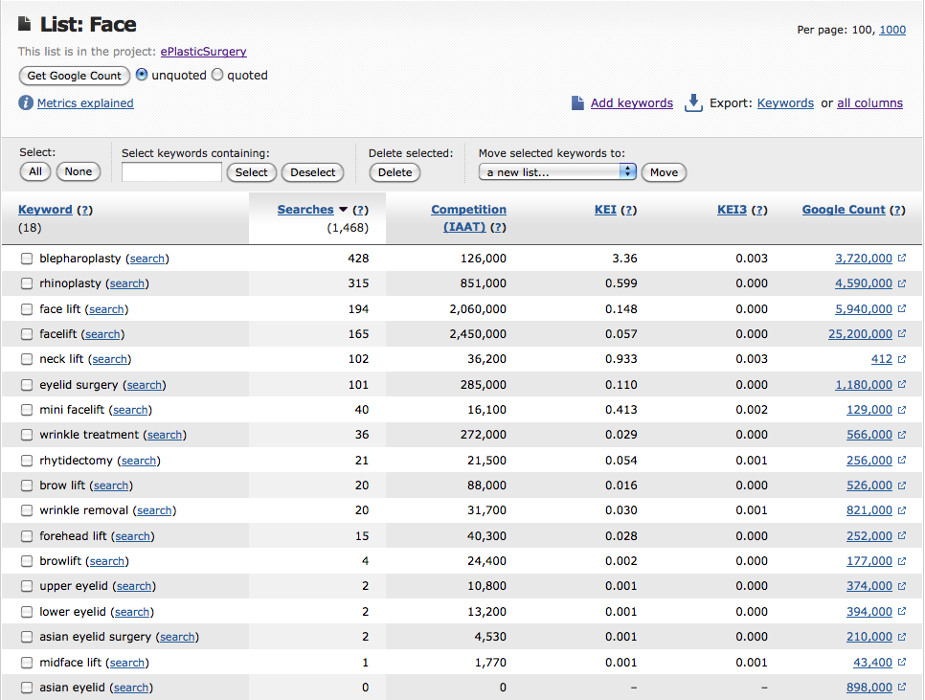
WordTracker.com

Slide 13
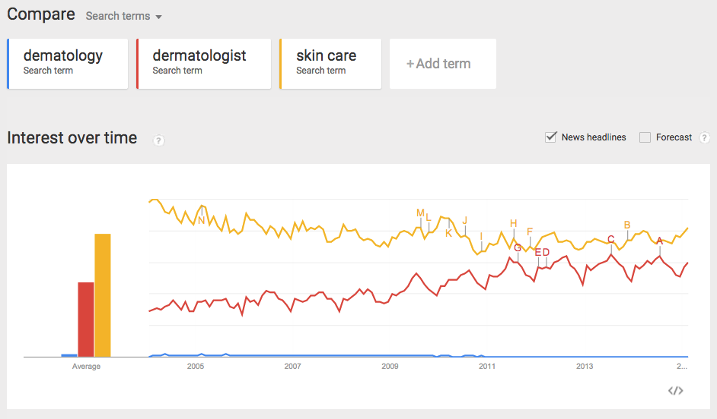
Google Trends

Slide 14
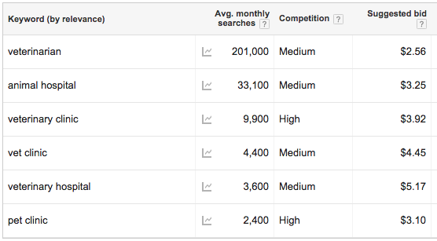
Google Keyword Planner

Slide 15
Relevant Content
Focused, content-rich pages for specific targets.
Incorporate keywords (and variants) in:
  Page filenames: keywords.html
  Page titles (first 60 characters): <title>
  Headings and subheads: <h1>, <h2>, <h3>
  Lead paragraph(s)
  Image captions and alt tags
  Unique page descriptions:
  <meta name="Description" … >
  (May also show up in search results.)

Slide 16
Make Content More Useful
Open Graph tags for social networks
  Supports Facebook sharing
Semantic tags
  <article>, <section>, <header>, etc.
  Allows search engines to intelligently respond
  to queries using your information.
Google Rich Snippets (Webmaster Tools)
Schema.org: Supported by Google and Bing
  Schemas for local businesses, products, etc.

Slide 17
Build Rank
Google PageRank is a rough metric.
  Site importance on a scale of 1 to 10
  Exponential scale (roughly base 7)
Based on links from high rank, relevant pages
Links from pages with high authority
  news sites, government sites, educational institutions
The fundamental premise of Google:
If a site is good, other sites will link to it.

Slide 18
Link Sources
Professional associations
Partners, suppliers
Satisfied clients
Rating and review sites
Press releases and news coverage
Local business directories
Industry-specific directories
Forums (take time to develop credibility)

Slide 19
Trade Content for Links
Provide high quality, original content in exchange for links.
  Example: CopyrightSafeguard.com
Guest blogging:
  “Six Copyright-for-Artists Facts You Need to Know”
  http://artprintissues.com/2014/12/six-copyright-artists-facts-need-know/

Slide 20
Trade Content for Links, cont’d
Guest article:
  “How Does Copyright Law Protect My Work?”
  http://www.lawyerratingz.com/article/7/How+Does+Copyright+Law+Protect+my+Work?
Interview:
  “Talking Internet Copyright with Bob Nicholson”
  http://twoartsygals.podomatic.com/entry/2015-01-28T17_55_06-08_00

Slide 21
Trade Content for Links, cont’d
Save your best content for your own site!

Slide 22
Things to Avoid
Paid links
Link exchanges
Article syndication
Comment spamming
Links TO or FROM “bad neighborhoods”
Nofollow links (add no rank)

Slide 23
Links to Your Competitors
Find links to your competitors with free or paid “back link checkers”:
  backlinkwatch.com
  moz.com
Check each site that links to your competitors.
  Request a link to your site if appropriate.
Besides specific links, look for
ideas for types of sites
that might link to yours.

Slide 24
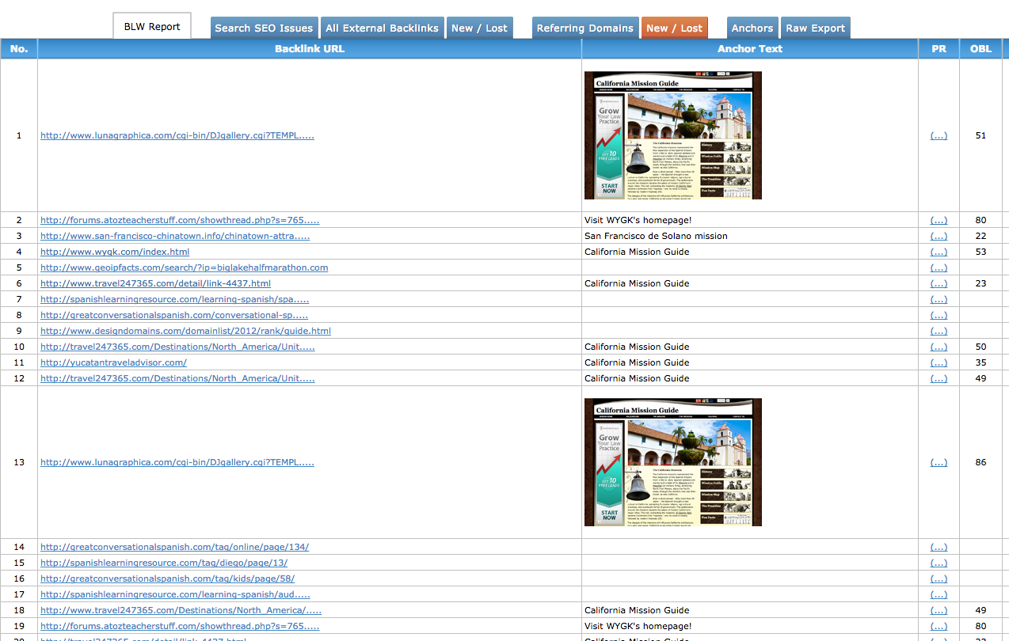
Backlinkwatch.com

Slide 25
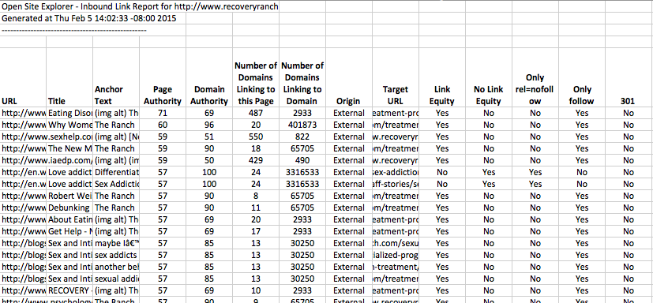
Moz.com

Slide 26
Help Relevance and Rank
Relevant link anchors text.
Good link:
  VOIP Phone Comparison
Not-so-good links:
  For VOIP Phone Comparison Click Here
  VOIP Phone Comparison at myVOIP.com
Google bombing (classic case example):
  Was George W Bush a miserable failure?

Slide 27
Additional Factors
Search engine results clicks
Google+page
Social “Likes”
Social shares
Download speed
Valid html
Semantic tags
Domain longevity
Update frequency
Link frequency

Slide 28
Analytical and Tracking Tools
Google Analytics
  Traffic statistics and analysis.
  Where visitors come from (geography and referrals), pages they view, time on site, browser & system stats, etc.
Google Webmaster Tools
  Organic search keywords and data, site issues, crawl data.
  Submit your sitemap

Slide 29
Analytical and Tracking Tools, cont’d
Bing Webmaster Tools
  Similar to Google Webmaster Tools.

Slide 30
SEO Tools
Majestic SEO
  Backlink checker and site explorer.
Moz Pro
  Keyword research, competitive site analysis, backlink checker, site explorer, campaign manager.
Raven Tools
  30+ tools that can help you with almost any aspect
  of SEO and digital marketing.

Slide 31
SEO Tools, cont’d
Advanced Web Ranking
  Rank tracking, link building analytics, social media monitoring, keyword research, competitor analysis, and website optimization.
SEMrush
  Competitor research tool that focuses on all aspects of search engine marketing, including SEO and paid search advertising.
SEO PowerSuit
  SEO software package that combines rank tracking, site auditing, and link building functions.

Slide 32
SEO Tools, cont’d
Ahrefs
  Site explorer, SEO report, backlinks report, domain comparison, and batch analysis.
Rage Software
  Keyword explorer, sitemap generator, site explorer, SERP rank tracker, competitive tracking.
Whitespark
  Link prospector, SERP rank tracker, review handout generator, offline conversion tracker, local citation finder.

Slide 33
SEO Tools, cont’d
BuzzStream
  Link-building, CRM, social media management.

Slide 34
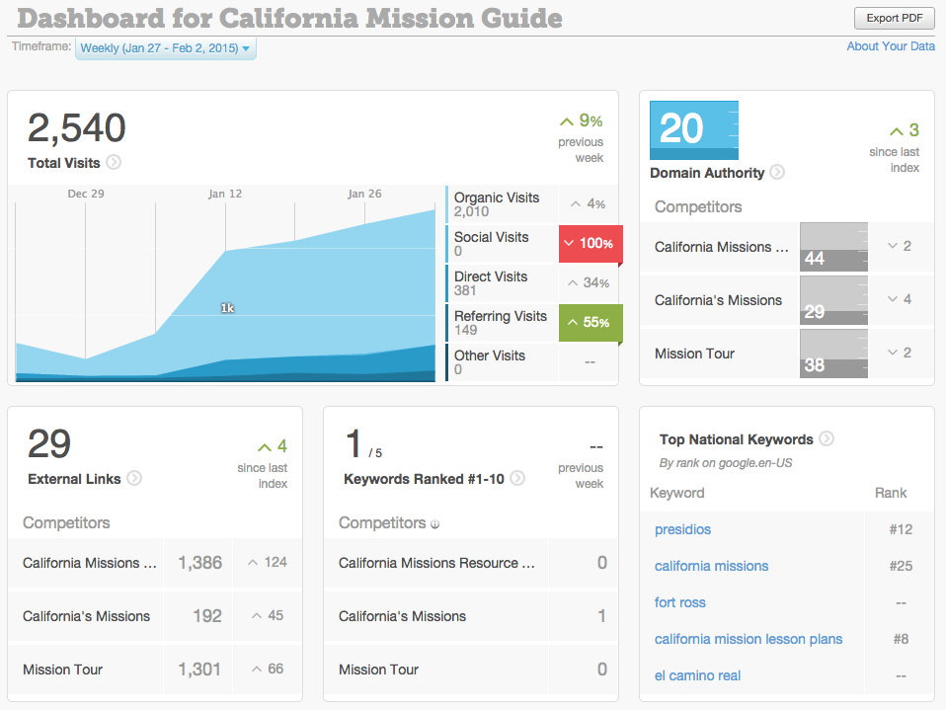
Moz Pro Dashboard

Slide 35
SEO Conclusion
SEO is essential to web success.
SEO requires an ongoing effort.
  Budget time
  Track efforts and results (tools or spreadsheets)
SEO requires knowledge, skill, and tools
The rules will continue to change.
Focus on creating a great site with lots of high quality content.

Slide 36
Working with Graphics Designers
Experiences and lessons learned.

Slide 37
Design is Important
Graphic design is critical to success.
  Especially in consumer applications,
You are not a graphic designer
  Designers spend years studying color theory,
  layout, typography, iconography, graphic development tools, etc.
Design fashions and styles change.

Slide 38
Trust Your Designer
Set individual preferences aside.
Choose a designer based on past work.
Make sure the designer understands
your requirements.
Tell the designer what you need.
  Provide wireframes and screen types.
  Provide unflattened Photoshop files, sized icons,
  font and color specifications, CSS files, etc.

Slide 39
Trust Your Designer
Get early designs and refine.
Incorporate graphic design in prototypes.
As far as possible, isolate design from code
  Examples: CSS, WordPress themes

