Slide 1


CS 174: Web Programming
September 14 Class Meeting
Department of Computer Science
San Jose State University
Fall 2015
Instructor: Ron Mak
www.cs.sjsu.edu/~mak

Slide 2
Good Tutorial Website
http://www.w3schools.com

Slide 3
HTML and CSS
HTML
  content
  organization
  semantics
Cascading Style Sheet (CSS)
  layout
  formatting

Slide 4
Formatting Text
Format text by setting font properties:
  family
  style
  weight
  size
  line height
  color
  spacing and indentation
  alignment
  transformations and variants

Slide 5
Font Family
Example:
Surround multi-word names with quotes.
Generic font families:
  serif
  sans-serif
  cursive
body {
font-family: Geneva;
}
h1,
h2 {
font-family: "Gill Sans";
}
  fantasy
  monospace

Slide 6
Font Family, cont’d
Specify alternate font families.
  In case a browser lacks a font family.
  Example:
Default font families shared by
Microsoft Windows and Mac OS X:
  Arial
  Comic Sans MS
  Courier New
h1 {
font-family: "Gill Sans", "Gill Sans MT", Calibri, sans-serif;
}
  New Times Roman
  Verdana

Slide 7
Font Style
Font styles are normal, italic,
or oblique (faux italic).
  Not all font families have true italic.
  Example:
h1: {
font-style: oblique;
}
p: {
font-style: italic;
}

Slide 8
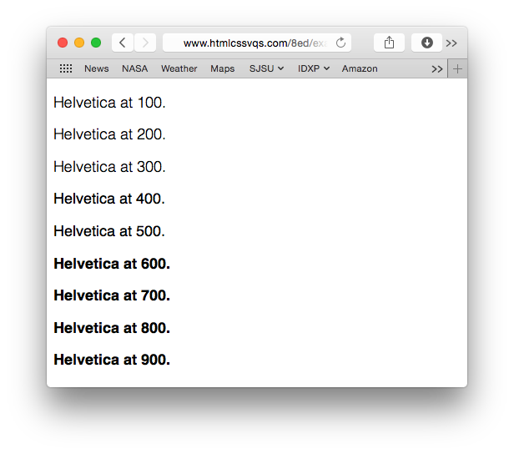
Font Weight
Font weights are normal, bold, bolder,
or lighter.
  Example:
  Also: 100, 200, 300,
  400, 500, 600, 700,
  800, or 900
.special {
font-weight: bold;
}

Slide 9
Font Size
Default sizes:
  xx-small
  x-small
  small
Specify font size with absolute or relative units.
Absolute units in pixels (px) or points (pt)
  Example:
  There is no space between the number and px or pt.
  medium
  large
  x-large
  xx-large
  smaller
  larger
h1 {
font-size: 35px;
}
Use points
for printing.

Slide 10
Font Size, cont’d
Relative units
  By percentage of the default size (usually 16px).
  By ratio of the parent element’s font size (em units).
  Examples:
body {
font-size: 100%; /* 16px */
}
h1 {
font-size: 2.1875em; /* 35px/16px */
}
h2 {
font-size: 1.75em; /* 28px/16px */
}
Establish the
baseline size.
In traditional typesetting,
an em unit is the width
of the letter m.

Slide 11
Line Height
Specify line height:
  as a multiple of the font size
  as a percentage of the font size
  in em, px, or pt units
  Example:
p {
line-height: 1.65; /* 15px x 1.65 = 24.75px */
}

Slide 12
Font Variants
Font variants are normal or small-caps.
  Example:
h2 {
font-variant: small-caps;
}

Slide 13
Combining Font Values
Use the font property to combine font values.
  Size, families, weight, variant, line height
  List the values in any order, separated by blanks.
You must specify the font size and font families.
  Size before families, only a blank after the size.
Specify line height immediately after
the font size, separated by a slash.
  Followed by a blank and the font families.
Example:
p {
font: italic small-caps bold .85em/1.2 Palatino, serif;
}

Slide 14

Line and Letter Spacing
Specify line spacing and letter spacing with absolute px units or relative em units.
  Example:
h2 {
font-family: "Gill Sans", "Gill Sans MT", Calibri, sans-serif;
font-weight: normal;
letter-spacing: 7px
}

Slide 15
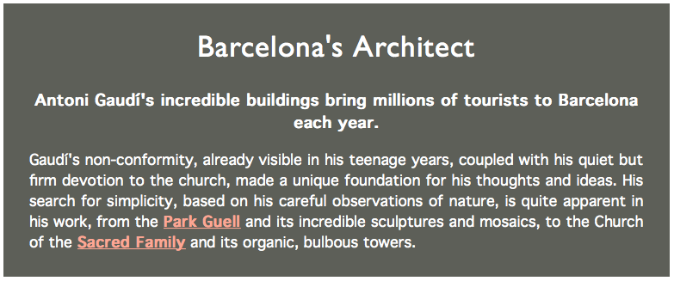
Text Alignment
Text alignments are left, right, center,
or justify.
  Example:
h1
{
text-align: center;
}
p {
text-align: justify;
}
.intro .subhead {
text-align: center;
}

Slide 16
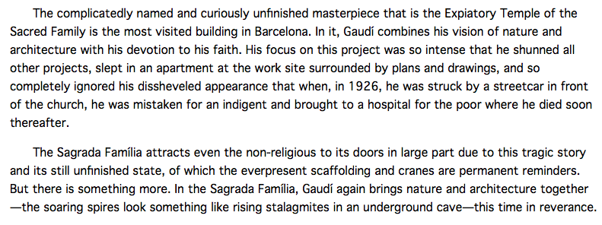
Text Indentation
Specify paragraph indentation with
absolute px units or relative em units.
  Example:
p {
text-indent: 2em;
}

Slide 17

Text Transformation
Text transformations are none, capitalize, uppercase, or lowercase.
  Example:
h1 {
text-transform: uppercase;
}

Slide 18
Controlling the Display of Elements
Each HTML element has a default
display property setting.
  Example: Paragraphs are display: block
  and emphasized text are display: inline
CSS rules can override the default display.
  Example:
em {
display: block;
}
The following is some
emphasized
text that displays as a block.

Slide 19
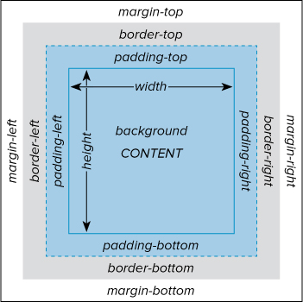
The Box Model
CSS treats every HTML element as if it were enclosed in an
invisible box:
  width
  height
  padding
  borders
  margins
Use absolute or
relative units,
or auto.

Slide 20
Borders
Set the values of each border:
  border-top, border-bottom
  border-left, border-right
  Or just border to set the values of all four borders
Also:
  border-color
  border-width
  border-style
    none, dotted, dashed, solid, double,
    groove, ridge, inset, outset
.about img {
border: 5px solid gray;
}
.nav-main {
border-top: 5px solid red;
border-bottom: 1px solid red;
}

Slide 21
Padding
Set the size of the padding on each side:
  padding-top, padding-bottom
  padding-left, padding-right
  Padding color is the background-color.

Slide 22
Padding, cont’d
Also:
  padding: size
  Applies to all sides
  padding: size_{tb}, size_{rl}
  size_{tb} applies to the top and bottom and
  size_{rl} applies to the right and left
  padding: size_{t}, size_{rl}, size_{b}
  size_{t} applies to the top, size_{b} applies to the bottom,
  and size_{rl} applies to the right and left
  padding: size_{t}, size_{r}, size_{b}, size_{l}
  in clockwise order
.about {
background-color: white;
padding: .3em .6em .3em;
}

Slide 23
Margins
Set margin sizes (similar to padding sizes):
  margin-top, margin-bottom
  margin-left, margin-right
Also:
  margin: size
  margin: size_{tb}, size_{rl}
  margin: size_{t}, size_{rl}, size_{b}
  margin: size_{t}, size_{r}, size_{b}, size_{l}
h1: {
margin-bottom: .4em;
}

Slide 24
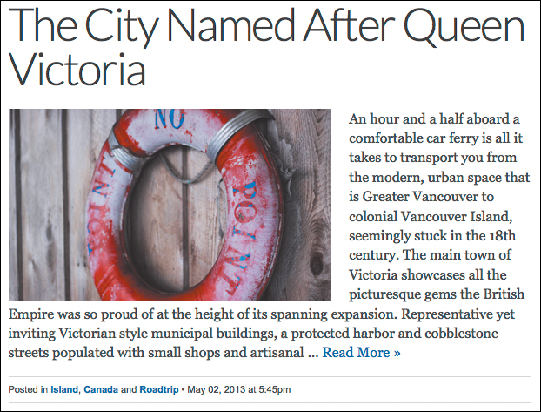
Floating Elements
An element can float among text or other elements by making that other content flow around it.
  float: left
  Put the element to the left of the other content.
  float: right
  float: none
.post-photo {
float: left;
margin-bottom: 2px;
margin-right: 22px;
}

Slide 25
Relative Positioning
Position an element relative
to its natural location.
  position: relative;
  Add any top, right, bottom, or left offsets.
Relative positioning does not affect
any surrounding elements.

Slide 26
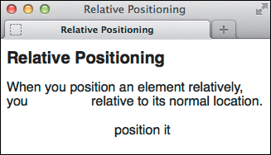
Relative Positioning, cont’d
  Example:
<h1>Relative Positioning</h1>
<p>When you position an element relatively, you
<span class="example">position it</span>
relative to its normal location.</p>
.example {
position: relative;
top: 35px;
left: 100px;
}

Slide 27
Absolute Positioning
Position an element absolutely by specifying its position with respect to the page body or to its nearest positioned ancestor element.
  position: absolute
  Add any top, right, bottom, or left positions
  in px, em, or percentage of the ancestor.
If elements overlap, specify a z-index value.
  Elements with higher z-index values overlap elements with lower values.
  Compare the z-index values only for elements
  in the same container.

Slide 28
Vertical Alignment
Use vertical-align to align an element:
  baseline
  Align the element’s baseline with its parent’s baseline.
  middle
  Align the middle of the element slightly above
  the parent’s baseline.
  sub
  Position the element as a subscript
  of the parent’s baseline.
  super
  Position the element as a superscript
  of the parent’s baseline.

Slide 29
HTML Container Elements
Semantic containers
  <header> … </header>
  <footer> … </footer>
  <main> … </main>
  <aside> … </aside>
  <nav> … </nav>
  <article> … </article>
  <section> … </section>
Generic containers
  <div> … </div>
  <span> … </span>
No inherent meaning. Used to apply styling.
Contain a block of content.
Contain a word or phrase.

Slide 30
ARIA Landmark Roles
WAI-ARIA
  Web Accessibility Initiative
  Accessible Rich Internet Application
Add ARIA roles to HTML elements
to guide HTML screen readers
for the visually impaired.
  Example:
<nav role="navigation"> … </nav>

Slide 31
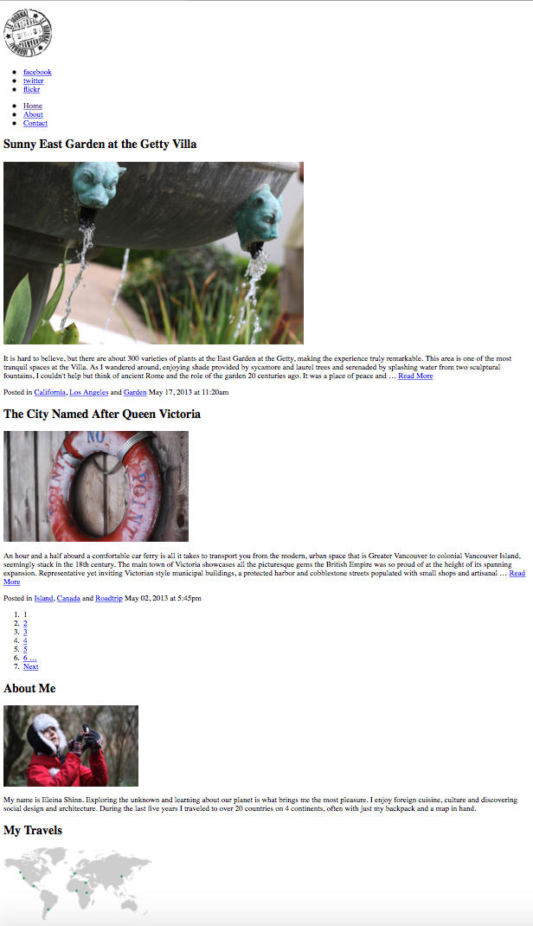
Page with No Styles
http://www.htmlcssvqs.com/8ed/examples/chapter-11/no-styles.html

Slide 32
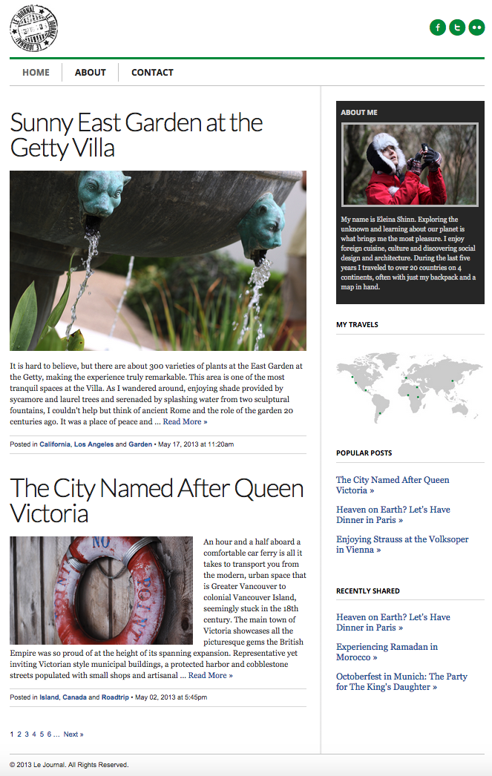
Page Layout
Header
Main
Sidebar
http://www.htmlcssvqs.com/8ed/examples/chapter-11/finished-page.html
Footer

Slide 33
Assignment #2
Use HTML container elements to structure
your HTML pages from Assignment #1.
  You can add more web pages and database tables.
Add one or more CSS pages to your application.
  Format your HTML elements.
  Lay out your HTML pages.
Zip file containing HTML, CSS, and PHP pages,
database dump, and screen shots.
Due Monday, September 21.

