Slide 1


CS 174: Web Programming
August 31 Class Meeting
Department of Computer Science
San Jose State University
Fall 2015
Instructor: Ron Mak
www.cs.sjsu.edu/~mak

Slide 2
Client-Server Web Apps
Client Side
Web Browser
Chrome
Firefox
Safari
Microsoft IE
Server Side
Web Server
Apache + PHP
HTTP request
HTTP response
HTTP request
  User’s form data
HTTP response
  Dynamically generated HTML page
Don’t be confused because for now,
both the client side (your browser)
and the server side (the Apache web server)
are running on the same computer (your laptop).

Slide 3
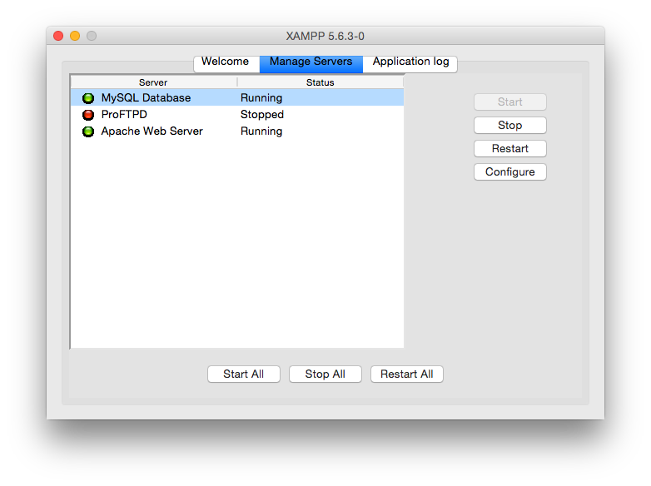
XAMPP Control Panel
Use the XAMPP control panel to start or stop:
  Apache Web Server
  MySQL Database Server
  FTP server

Slide 4
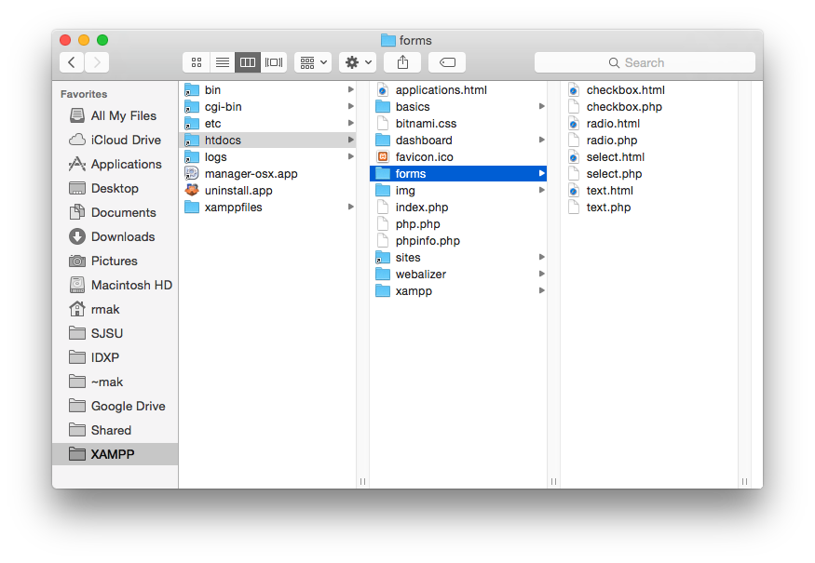
XAMPP Directory Structure
Folder htdocs is the root
of all the web pages
on your web server.
Some web servers name
the root folder public_html.

Slide 5
Serving Web Pages
The Apache web server serves web pages.
  Displayed on the client side by web browsers.
  Web pages can be static or dynamic.
Static web pages: .html
  HTML files that the web server reads from disk.
  A static page always displays the same content.
Dynamic web pages: .php
  Generated by PHP code running on the server.
  Contains dynamic content.

Slide 6
Form Data
A user can input data into an HTML form displayed on a client-side web browser.
When the user presses a Submit button, the browser sends to form data to a specified
PHP program running on the web server.
The PHP program can use the form data to
  Query the back-end database.
  Generate a new HTML page to send to the user’s client-side web browser.

Slide 7
Ways to Send Form Data
A browser sends form data to a PHP file on the server when the user presses the submit button.
  The action attribute of the <FORM> tab.
  Two methods to send form data: get and post.

Slide 8
Ways to Send Form Data, cont’d
Get method
  The form data is appended to the target URL.
  Good for small amounts of data.
  The data is visible:
Post method
  The data is sent via environment variables.
  Good for larger amounts of data.
  Slightly more secure than the get method.
http://localhost/forms/text.php?firstName=Ron&lastName=Mak

Slide 9
Three-Tier Web Application Architecture
Client-side web browser
Form data
Server-side web server
(.html .php
images, etc.)
Static (.html)
or
dynamically
generated (.php)
web pages
Queries
Back-end database server
(MySQL)
Data

Slide 10
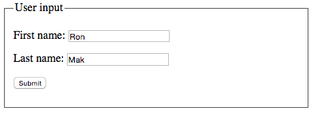
Text Input: HTML Page
<body>
<form action="text.php"
method="get">
<fieldset>
<legend>User input</legend>
<p>
<label>First name:</label>
<input name="firstName" type="text" />
</p>
<p>
<label>Last name:</label>
<input name="lastName" type="text" />
</p>
<p>
<input type="submit" value="Submit" />
</p>
</fieldset>
</form>
</body>
forms/text.html

Slide 11
Text Input: PHP Code
<!DOCTYPE html>
<html lang="en-US">
<head>
<meta charset="UTF-8">
<title>Text Greeting</title>
</head>
<body>
<p>
<?php
$first = filter_input(INPUT_GET, "firstName");
print "<h1>Hello, $first!</h1>";
?>
</p>
</body>
</html>
forms/text.php

Slide 12
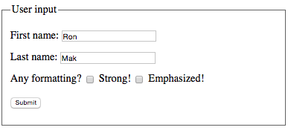
Checkbox Input: HTML Page
<body>
<form action="checkbox.php"
method="post">
<fieldset>
...
<p>
<label>Any formatting?</label>
<input type="checkbox"
name="strong"
value="strong" /> Strong!
<input type="checkbox"
name="em"
value="em" /> Emphasized!
</p>
...
</fieldset>
</form>
</body>
forms/checkbox.html

Slide 13
Checkbox Input: PHP Code
<body>
<p>
<?php
$first = filter_input(INPUT_POST, "firstName");
$output = "Hello, $first!";
if (filter_has_var(INPUT_POST, "strong")) {
$output = "<strong>$output</strong>";
}
if (filter_has_var(INPUT_POST, "em")) {
$output = "<em>$output</em>";
}
print $output;
?>
</p>
</body>
forms/checkbox.php

Slide 14
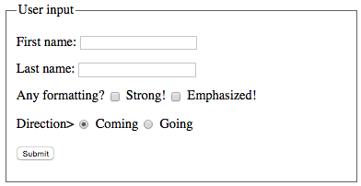
Radio Button Input: HTML Page
<body>
<form action="radio.php"
method="post">
<fieldset>
...
<p>
<label>Direction></label>
<input type="radio"
name="direction"
value="coming"
checked /> Coming
<input type="radio"
name="direction"
value="going" /> Going
</p>
...
</fieldset>
</form>
</body>
Every radio button
in the same group
must have the
same name
(e.g., direction).
forms/radio.html

Slide 15
Radio Button Input: PHP Code
<body>
<p>
<?php
$first = filter_input(INPUT_POST, "firstName");
$direction = filter_input(INPUT_POST, "direction");
if ($direction == "coming") {
$output = "Hello";
}
else if ($direction == "going") {
$output = "Good-bye";
}
else {
$output = "You are SO confused";
}
$output = $output.", $first!";
...
print $output;
?>
</p>
</body>
forms/radio.php

Slide 16
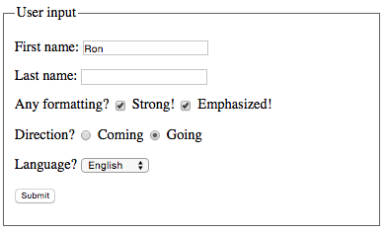
Select List Input: HTML Page
<body>
<form action="select.php"
method="post">
<fieldset>
...
<p>
<label>Language?</label>
<select name="language">
<option value="english" selected>English</option>
<option value="french">Français</option>
<option value="german">Deutsch</option>
</selct>
</p>
<p>
<input type="submit" value="Submit" />
</p>
</fieldset>
</form>
</body>
forms/select.html

Slide 17
Select List Input: PHP Code
<body>
<p>
<?php
$first = filter_input(INPUT_POST, "firstName");
$direction = filter_input(INPUT_POST, "direction");
$language = filter_input(INPUT_POST, "language");
$error = "You are SO confused";
if ($direction == "coming") {
switch ($language) {
case "english":
$output = "Hello";
break;
case "french":
$output = "Bonjour";
break;
case "german":
$output = "Guten tag";
break;
default:
$output = $error;
}
}
else if ($direction == "going") {
switch ($language) {
case "english":
$output = "Good-bye";
break;
case "french":
$output = "Au revoir";
break;
case "german":
$output = "Auf wiedersehen";
break;
default:
$output = $error;
}
}
else {
$output = $error;
}
...
?>
</p>
</body>
forms/select.php

Slide 18
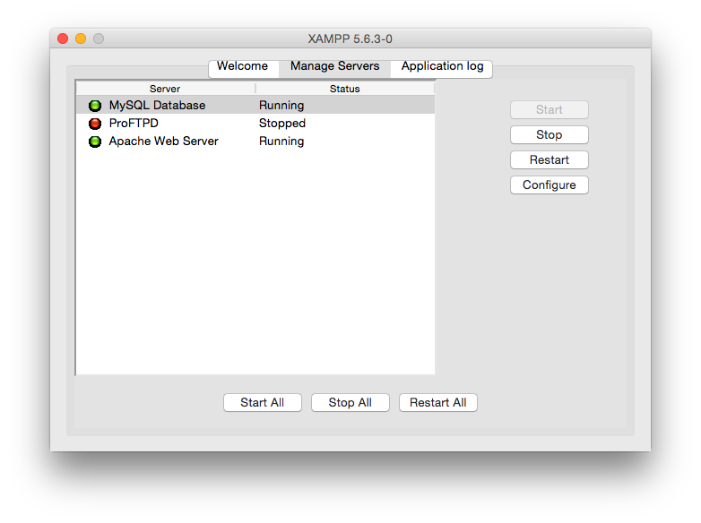
Start the MySQL Database Server

Slide 19

XAMPP Home Page
phpMyAdmin
is a PHP-based GUI interface
to the MySQL database server.

Slide 20
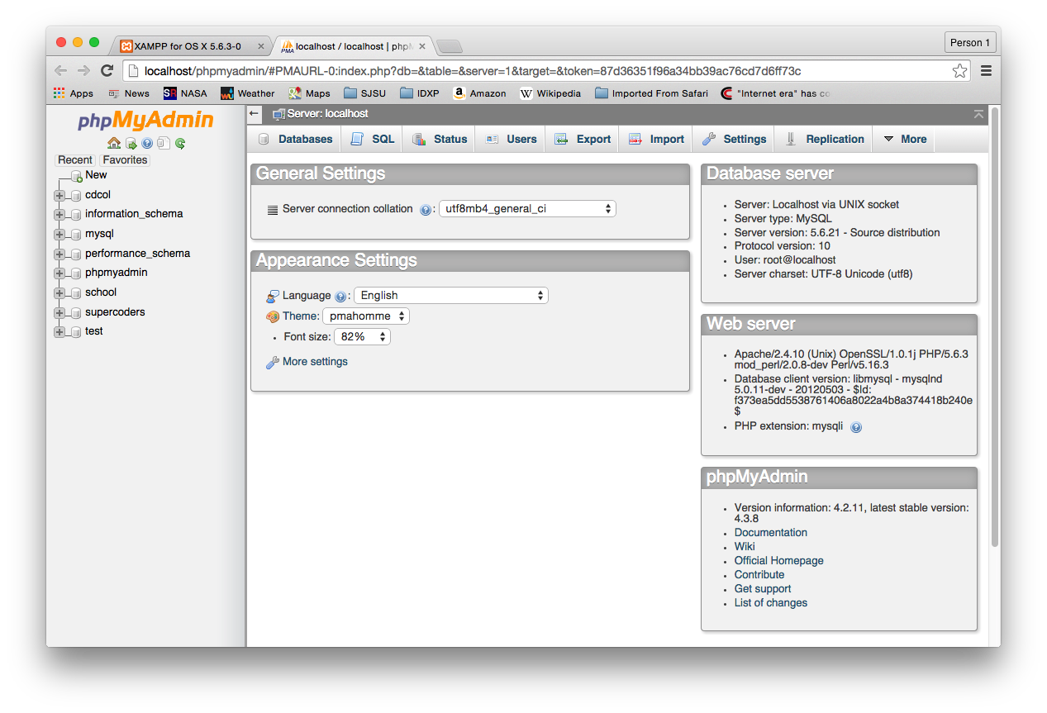
phpMyAdmin Home Page

Slide 21
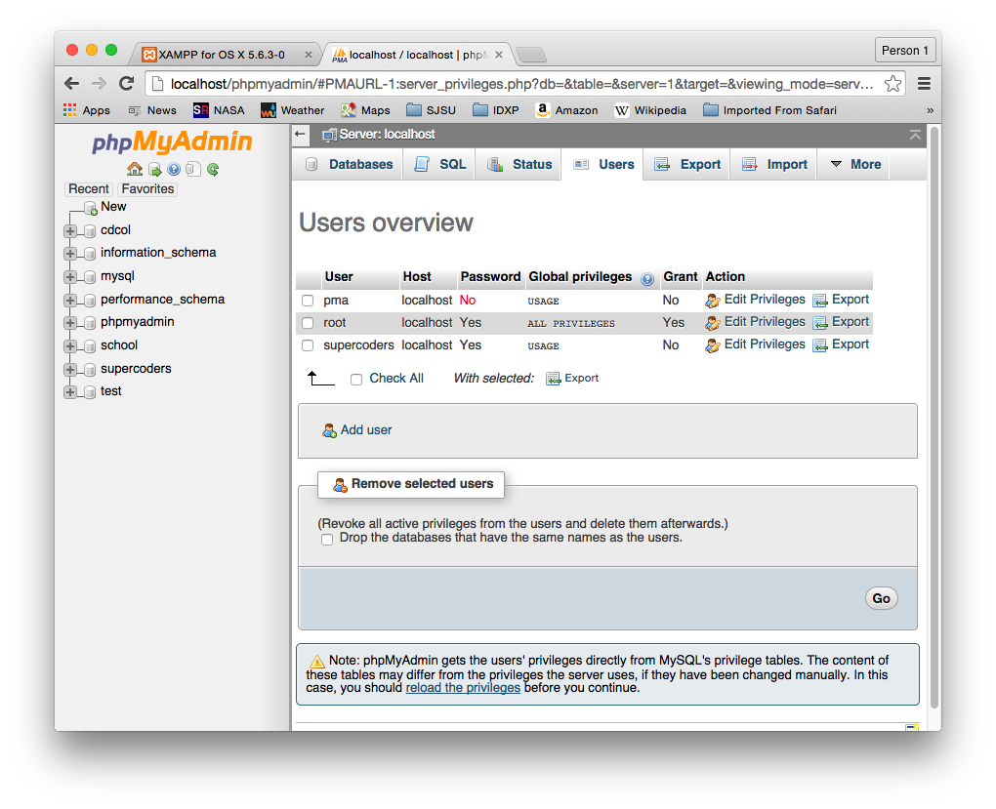
Database Server Root Password
By default, there is no root password.
Set the root password using phpMyAdmin.
Go to the
Users tab.
Edit the
root user
to change
its password.

Slide 22
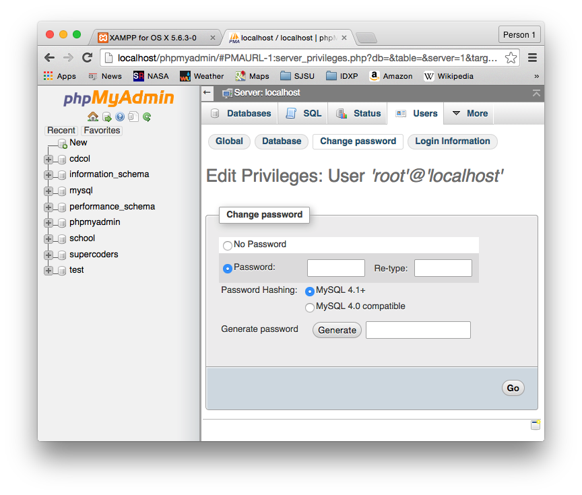
Database Server Root Password, cont’d

Slide 23
Enable phpMyAdmin to Connect
phpMyAdmin connects to the MySQL
database server as the root user.
Now you must tell phpMyAdmin
what the new root password is.
Edit the configuration file
XAMPP/xamppfiles/phpmyadmin/config.inc.php
  Edit the line
  $cfg['Servers'][$i]['password'] = 'root password';

Slide 24
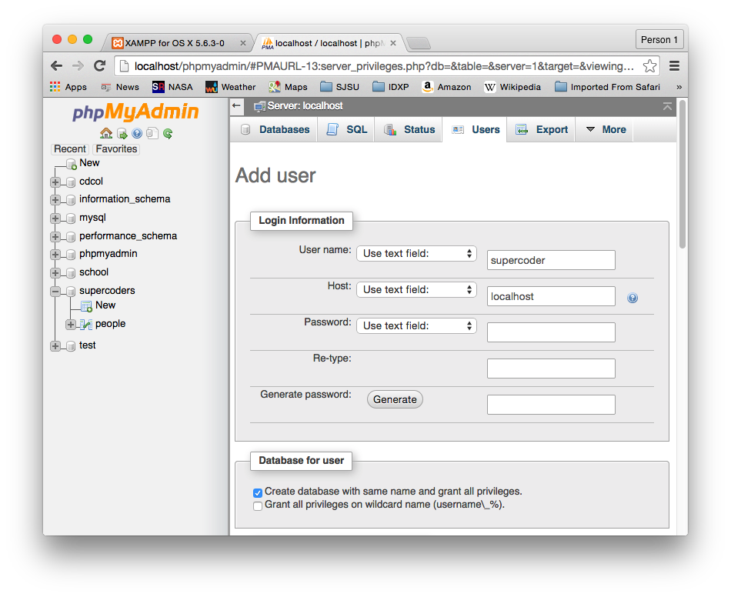
Add a New Database User
Name the user after yourself or your team.
  Click “Add user” on the Users tab.
  Use “localhost” for the host.
Tick the checkbox
to create a
database with
the same name.

Slide 25
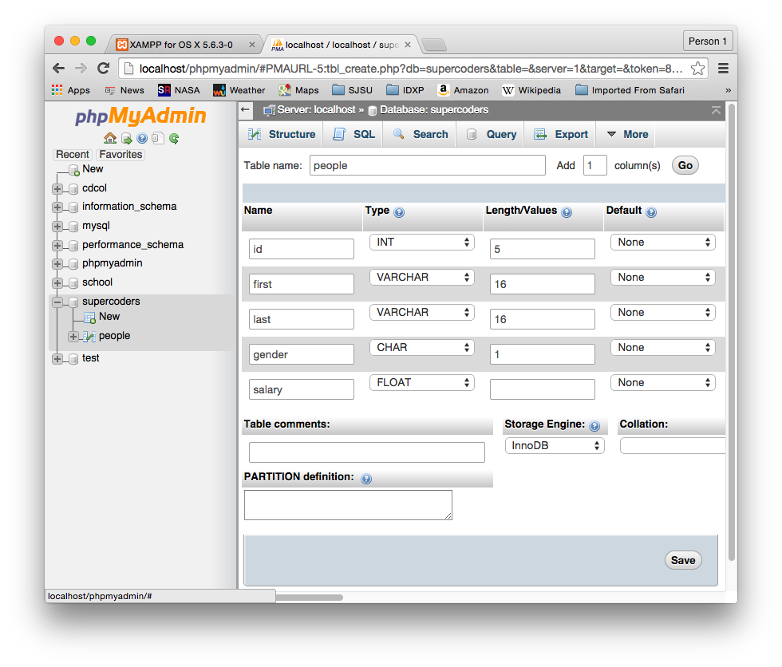
Create a Table in the New Database

Slide 26
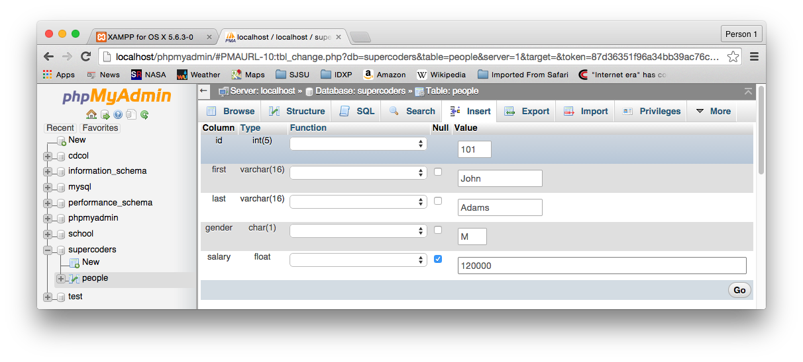
Insert Data into the Table

Slide 27
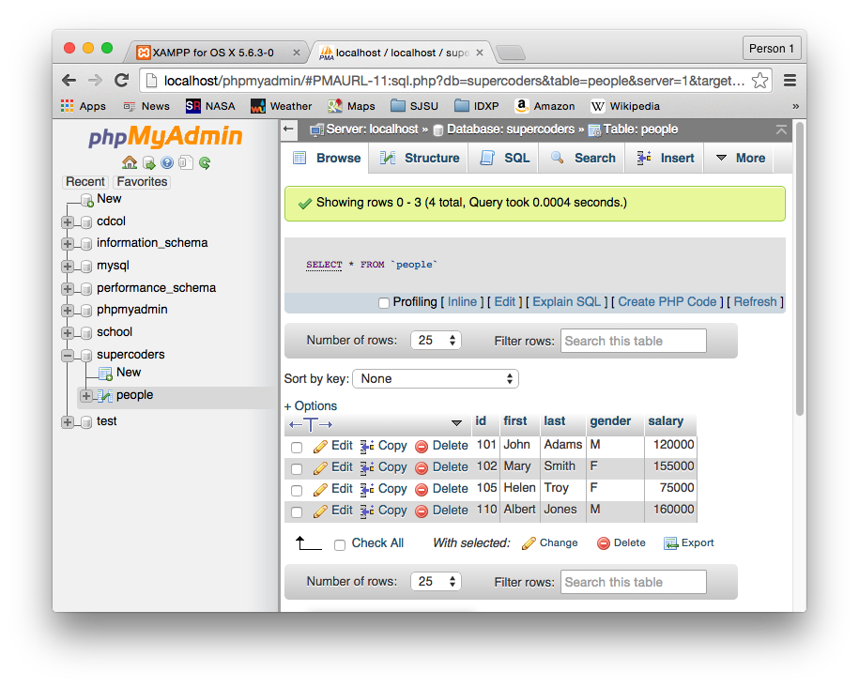
Browse the Table Contents

Slide 28
MySQL Command Line Interface
~: /Applications/XAMPP/xamppfiles/bin/mysql -u supercoders -p
Enter password:
mysql> show databases;
+--------------------+
| Database |
+--------------------+
| information_schema |
| supercoders |
+--------------------+
2 rows in set (0.00 sec)
mysql> use supercoders
Database changed
mysql> show tables;
+-----------------------+
| Tables_in_supercoders |
+-----------------------+
| people |
+-----------------------+
1 row in set (0.00 sec)

Slide 29
MySQL Command Line Interface, cont’d
mysql> select * from people;
+-----+--------+-------+--------+--------+
| id | first | last | gender | salary |
+-----+--------+-------+--------+--------+
| 101 | John | Adams | M | 120000 |
| 102 | Mary | Smith | F | 155000 |
| 105 | Helen | Troy | F | 75000 |
| 110 | Albert | Jones | M | 160000 |
+-----+--------+-------+--------+--------+
4 rows in set (0.00 sec)
mysql> select * from people
-> where first = 'Helen'
-> and last = 'Troy';
+-----+-------+------+--------+--------+
| id | first | last | gender | salary |
+-----+-------+------+--------+--------+
| 105 | Helen | Troy | F | 75000 |
+-----+-------+------+--------+--------+
1 row in set (0.00 sec)
mysql>

Slide 30
Simple End-to-End Web Application!
Client side
  An HTML form to submit a person’s
  first and last names.
Server side
  PHP code that uses the first and last names
  to query the people table in the back end database.
  Dynamically generate a new web page
  containing a table of the query results.
Back end
  A database table containing people data.
Demo

Slide 31
Default Web Page: index.html
<body>
<form action="queryDB.php"
method="get">
<fieldset>
<legend>User input</legend>
<p>
<label>First name:</label>
<input name="firstName" type="text" />
</p>
<p>
<label>Last name:</label>
<input name="lastName" type="text" />
</p>
<p>
<input type="submit" value="Submit" />
</p>
</fieldset>
</form>
</body>
people/index.html

Slide 32
PHP Page: queryDB.php
<body>
<h1>Query Results</h1>
<p>
<?php
$first = filter_input(INPUT_GET, "firstName");
$last = filter_input(INPUT_GET, "lastName");
try {
// Connect to the database.
$con = new PDO("mysql:host=localhost;dbname=supercoders",
"supercoders", "sesame");
$con->setAttribute(PDO::ATTR_ERRMODE,
PDO::ERRMODE_EXCEPTION);
...
}
catch(PDOException $ex) {
echo 'ERROR: '.$ex->getMessage();
}
?>
</p>
</body>
people/queryDB.php

Slide 33
PHP Page: queryDB.php, cont’d
try {
...
$query = "SELECT * FROM people";
// We're going to construct an HTML table.
print "<table border='1'>\n";
// Fetch the database field names.
$result = $con->query($query);
$row = $result->fetch(PDO::FETCH_ASSOC);
// Construct the header row of the HTML table.
print " <tr>\n";
foreach ($row as $field => $value) {
print " <th>$field</th>\n";
}
print " </tr>\n";
...
}
people/queryDB.html

Slide 34
PHP Page: queryDB.php, cont’d
try {
...
// Constrain the query if we got first and last names.
if ((strlen($first) > 0) && (strlen($last) > 0)) {
$query = "SELECT * FROM people ".
"WHERE first = '$first' ".
"AND last = '$last'";
}
// Fetch the matching database table rows.
$data = $con->query($query);
$data->setFetchMode(PDO::FETCH_ASSOC);
...
}
people/queryDB.html

Slide 35
PHP Page: queryDB.php, cont’d
try {
...
// Construct the HTML table row by row.
foreach ($data as $row) {
print " <tr>\n";
foreach ($row as $name => $value) {
print " <td>$value</td>\n";
}
print " </tr>\n";
}
print ” </table>\n"; ...
}
people/queryDB.html

Slide 36
Assignment #1
Construct a single MySQL database table
that contains some data.
  Your choice of fields and data values.
Create an HTML page containing various types of input (text, checkboxes, radio buttons, etc.).
Create a PHP page that makes different queries of the database table based on the form data.
Dynamically generate a web page that displays the query results.

Slide 37
Assignment #1, cont’d
Make screen shots of your web pages.
Create a “dump” of your database
with the mysqldump command
located in the XAMPP bin directory:
  Note: No space between –p and the password.
  Example:
  The output file create.sql will allow the graders
  to recreate your database table.
mysqldump –u username –ppassword dbname > create.sql
mysqldump -u supercoders -psesame supercoders > create.sql

Slide 38
Assignment #1, cont’d
Create a zip file named after your team
(e.g., supercoders.zip) containing:
  Your .html and .php files.
  Output from the mysqldump command.
  Screen shots of your web pages.
Email to ron.mak@sjsu.edu
  Subject line:
  CS 174-section Assignment #1 team name
  CC all team members.

Slide 39
Assignment #1, cont’d
This is a team assignment.
  One submission per team.
  Each team member receives the same score.
Due Tuesday, Sept. 8 at 11:59 PM.

