Slide 1



CS 160 and CMPE/SE 131
Software Engineering
May 3 Class Meeting
Department of Computer Science
Department of Computer Engineering
San José State University
Spring 2016
Instructor: Ron Mak
www.cs.sjsu.edu/~mak

Slide 2

Dr. Patricia Selinger
Co-inventor at IBM of the
first relational database system
during the 1970s.
Developed query optimization techniques.
IBM Fellow
CTO of Paradata, a data analytics startup.
Bio: https://www-03.ibm.com/ibm/history/witexhibit/wit_fellows_selinger.html
Tuesday, May 10 at 6:00 PM
Clark 222

Slide 3
Project Team Product Demos
Presentation schedule, CS 160-01
Tuesday, May 10
  Ruby Baby
  Softneers
  TBA
  Underground Railsroad
Thursday, May 12
  Big Trains
  Code-Ninjas
  Mak Survival Group
  Revy
15 minutes each

Slide 4
Project Team Product Demos, cont’d
Presentation schedule, CS 160-02
Tuesday, May 10
  Spartans on Rails
  SpartanSE
  The A Team
  The Directors
Thursday, May 12
  Face
  Green
  Hacking Bad
  Mak & Cheese
15 minutes each

Slide 5
Project Team Product Demos, cont’d
Presentation schedule, CMPE 131-01
Tuesday, May 10
  NoName4
  Piramides
  Rubber Ducks
  RubyLand
  Sour Patch Kids
  Unispace
Thursday, May 12
  ARMY
  Codiggers
  Cupid’s Minions
  Fabulous
  Gains
  JAMH
12 minutes each

Slide 6
The Rational Unified Process (RUP)
An iterative software development process framework.
  Created by Rational Software Corporation,
  now a division of IBM.
  Based on the Rational Approach developed
  during the 1980s and 1990s.
Very different development philosophy from Extreme Programming.
  More formal, prescriptive, and process-oriented.
  Better-suited to more traditional corporate cultures.

Slide 7
RUP: Essential Principles
Attack major risks early and continuously.
  Or they will attack you.
Ensure that you deliver value to your customer.
Stay focused on executable software.
Accommodate change early in the project.
Baseline an executable architecture early on.
Build your system with components.
Work together as a team.
Make quality a way of life.
  Not an afterthought.

Slide 8
RUP: Four Key Modeling Elements
Roles
  who
Activities
  how
Artifacts
  what
Workflows
  when

Slide 9
Rational Unified Process: Roles
Emphasis on roles.
  architect
  developer
  business analyst
  database designer
  technical writer
  tester
Each project team member can have
one or more roles.
Some roles can be filled by more than
one team member.

Slide 10
Rational Unified Process: Artifacts
Artifact: A piece of information produced, modified, or used by a process.

Slide 11
Rational Unified Process: Artifacts, cont’d
Model
  use case
  design
Document
  vision statement
  business case
Source code
Executable
  prototype

Slide 12
Rational Unified Process: Workflows
Workflow: A description of:
  The sequence of events that produce a result.
  The interaction between roles.
Discipline: A high-level workflow.
Express workflows using UML diagrams.
  sequence diagram
  collaboration diagram
  activity diagram

Slide 13
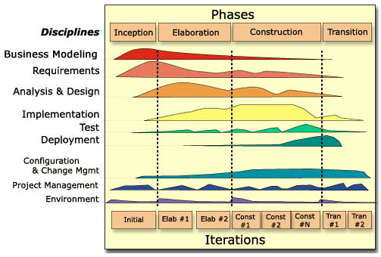
The Rational Unified Process: Disciplines
Not the phases of the waterfall model!

Slide 14
RUP: Inception Phase
Define the goals of the project.
Define the overall scope.
Define the high-level architecture.

Slide 15
RUP: Elaboration Phase
Iterations (each 2 to 6 weeks)
  Refine the scope.
  Define the overall architecture.
  Specify functionality and features.
  Create use cases.
  Build prototypes.

Slide 16
RUP: Construction Phase
Iterations (each 2 to 6 weeks)
  Design
  Develop
  Test

Slide 17
RUP: Transition Phase
Complete the documentation.
Release the product to the users.

