Slide 1



CS 160 and CMPE/SE 131
Software Engineering
April 19 Class Meeting
Department of Computer Science
Department of Computer Engineering
San José State University
Spring 2016
Instructor: Ron Mak
www.cs.sjsu.edu/~mak

Slide 2
Unofficial Field Trip
Computer History Museum in Mt. View
  http://www.computerhistory.org/
  Provide your own transportation to the museum.
Saturday, May 14, 11:30 – closing time
  Special free admission (for my students only).
  Experience a fully restored IBM 1401 mainframe computer from the early 1960s in operation.
  Do a self-guided tour of the Revolution exhibit.

Slide 3
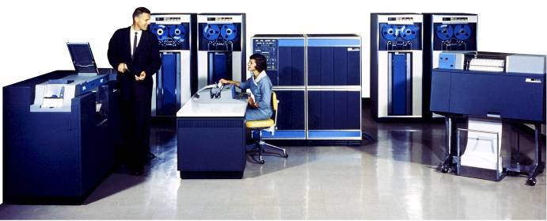
Unofficial Field Trip, cont’d
IBM 1401 computer, fully restored and operational.
  A small transistor-based mainframe computer.
  Extremely popular with small businesses
  in the late 1950s through the mid 1960s
    Maximum of 16K bytes of memory.
    800 card/minute card reader (wire brushes).
    600 line/minute line printer (impact).
    6 magnetic tape drives, no disk drives.

Slide 4
Unofficial Field Trip, cont’d
Information on the IBM 1401:
  General info: http://en.wikipedia.org/wiki/IBM_1401
  My summer seminar: http://www.cs.sjsu.edu/~mak/1401/
  Restoration: http://ed-thelen.org/1401Project/1401RestorationPage.html

Slide 5
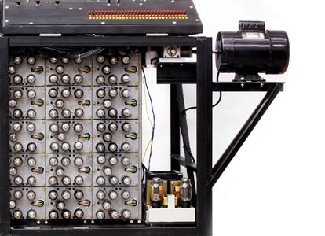
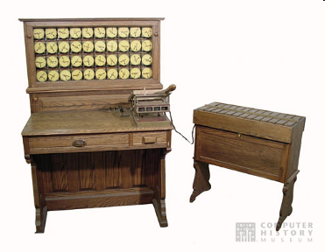
Unofficial Field Trip, cont’d
See the extensive Revolution exhibit!
  Walk through a timeline of the
  First 2000 Years of Computing History.
  Historic computer systems, data processing equipment,
  and other artifacts.
  Small theater presentations.
Hollerith
Census
Machine
Atanasoff-Berry
Computer

Slide 6
Unofficial Field Trip, cont’d
There may be extra credit if you participate in the visit to the Computer History Museum.
  If I find the time to put together a Canvas quiz.
Correct answers will be found among the museum exhibits and presentations.
  You will have to read the exhibit labels,
  listen to the audio, and watch the videos.
Each correct answer adds one point
to your midterm score.

Slide 7
Code Reviews
AKA code inspection
Different levels: personal, walkthrough, formal
Personal review
  You carefully examine your own code
  to find and fix as many bugs as possible.
Code walkthrough
  An informal process where you walk through your code’s behavior in front of your project colleagues.
Formal review

Slide 8
Formal Code Review
Three phases:
  Preparation
  Inspection meeting
  Repair and report
Preparation
  Kick-off meeting to ensure everyone understands what is being reviewed.
  Decide on participants’ roles.
  Reviewers study the material being inspected.

Slide 9
Formal Code Review, cont’d
Inspection meeting
  Reviewers discuss inspection findings
  with the developers.
  Assign resolution responsibilities.
Repair and report
  Developers fix bugs.
  Write and submit an inspection report.

Slide 10
Formal Code Review, cont’d
Planning
Verify materials meet review criteria.
Schedule introductory meeting.
Rework
Developer fixes bugs alone.
Schedule verification meeting.
Introductory meeting
Developer presents materials.
Moderator explains goals and rules.
Schedule inspection meeting.
Yes
More
bugs?
Inspection meeting
Group reviews materials.
Log bugs.
Recorder collects metrics.
No
Verification meeting
Reviewers verify bug fixes.
Any
bugs?
Yes
No
Done!

Slide 11
What to Review
Your source code, of course.
But also:
  design documentation
  project plans and schedules
  test plans
  deployment plans
  maintenance plans

Slide 12
What to Ask During a Code Review
What are the goals of the review?
  Reduce the number of bugs.
  Reduce support costs.
How will you collect metrics?
  Without a quantifiable measure of success,
  how do you know the review process is helping?
  Can you assign a dollar value to each measurable goal?

Slide 13
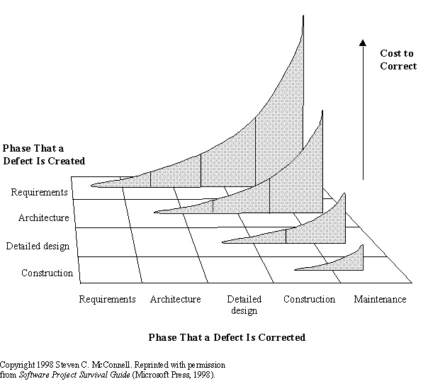
Why do Code Reviews?
Recall this diagram:
  The sooner you find and fix bugs,
  the less expensive it is.

Slide 14
Why do Code Reviews? cont’d
Recall:
change
complexity
collaboration
communication
coordination
Code reviews add collaboration,
communication, and coordination
to software development.
  Programmers want to work alone.
  Programmers unit test their own code,
  but another pair of eyes will catch more bugs.
An undetected defect can be extremely costly.
  One bug can result in the loss of market share.
A successfully implemented code review process can be a competitive advantage.

Slide 15
Benefits of Code Reviews
Direct benefits
  improved code quality
  fewer bugs
  improved communication about the code
  education of junior or newly hired programmers
Indirect benefits
  shorter development and test iterations
  reduced impact on technical support
  more customer satisfaction
  more maintainable code

Slide 16
Resistance to Code Reviews
Programmer egos
  Two classes of programmers:
  collaborators and isolationists
  Isolationists will thrash unproductively
  rather than admit to peers that they need help.
Perceived cost
  Too much trouble to prepare the materials.
  The entire procedure is too disruptive.
  Not worth the effort even if the code is improved.

Slide 17
Pros and Cons of Code Reviews
Synergy
  Pro: Teams find bugs that no individual would.
  Con: Find false-positives rather than real bugs.
Education
  Pro: Less experienced developers learn from pros.
  Con: Education by observation is less effective.
Deadline
  Pro: Reviews create schedules for the developers.
  Con: Too many meetings.

Slide 18
Pros and Cons of Code Reviews, cont’d
Competition
  Pro: Egos lead to personal incentives to do well.
  Con: Competition destroys teamwork.
Process
  Pro: Inspections require meetings.
  Con: Facts, not tradition, should determine process.
Studies have shown that more actual bugs are found while preparing for a code review than during the inspection meeting itself.
  Would it be better to improve the testing procedures?

Slide 19
Continuous Code Review
The Extreme Programming methodology advocates pair programming.
  Two developers at a single workstation.
One developer codes while the other watches.
  They can take turns.
Continuous free-form discussion
and code review.
But then both developers may be too close to the code to see it with a fresh perspective.

Slide 20
Productive Code Reviews
Object-oriented code can be difficult to review.
  In order to understand one class, you may need
  to look at other classes.
  Reviewers may end up wandering aimlessly
  and end up reading code that is off-topic.
Developers should prepare a “reading plan”.
  A checklist of what to look for in the code.
  Use cases that the code should implement correctly.

Slide 21
What to Look For in a Code Review
Documentation
  comments
  corner cases
  complex algorithms
  non-obvious or unusual behavior
  incomplete TODO items
Testing
  unit tests written

Slide 22
What to Look For in a Code Review, cont’d
Error handing
  defensive programming throughout
Thread safety
  handle multiple processes and threads
Performance
  good CPU and memory utilization
  no unnecessary optimizations

Slide 23
A Code Review War Story
What I found during an actual code review.
  When I was a Research Staff Member at an
  unnamed 100+ year old computer company
  commonly known by its three initials.
Cfront: The original C++ compiler in 1983
which translated C++ source code into C.
  Did not support exceptions.
“We’ve always done it this way.”
  “If we change now, the new code
  will be different from the old code.”

Slide 24
Next Week: (Semi) Formal Code Reviews
Each project team will lead a code review.
Preparation
  Each team provides some source code for an important algorithm or use case.
    Other than logging in or logging out.
    Should take at most 20 minutes to read the code.
  Reading plan
    Checklist (what to look for)
    High-level description of the algorithm or use case.
  Submit into Canvas: Code review material

Slide 25
Next Week: Code Reviews, cont’d
Inspection meetings
  CS 160 sections: 15 minutes each
  CmpE 131 sections: 12 minutes each

Slide 26
Code Review Inspection Meetings: CS 160-01
Tuesday, April 26
  Big Trains
  Code-Ninjas
  Mak Survival Group
  Revy
Thursday, April 28
  Ruby Baby
  Softneers
  TBA
  Underground Railsroad
Code and reading plan
due Friday, April 22.
Code and reading plan
due Sunday, April 24.

Slide 27
Code Review Inspection Meetings: CS 160-02
Tuesday, April 26
  Face
  Green
  Hacking Bad
  Mak & Cheese
Thursday, April 28
  Spartans on Rails
  SpartanSE
  The A Team
  The Directors
Code and reading plan
due Friday, April 22.
Code and reading plan
due Sunday, April 24.

Slide 28
Code Review Inspection Meetings: CmpE 131-01
Tuesday, April 26
  ARMY
  Codiggers
  Cupid’s Minions
  Fabulous
  Gains
  JAMH
Thursday, April 28
  NoName4
  Piramides
  Rubber Ducks
  RubyLand
  Sour Patch Kids
  Unispace
Code and reading plan
due Friday, April 22.
Code and reading plan
due Sunday, April 24.

Slide 29
Software Metrics
Quantitative measurements of a software project.
attribute
  something you can measure
  number of lines of code
  number of bugs
metric
  can be the same as an attribute
  can also be a calculated value
  number of bugs per thousand lines of code (KLOC)

Slide 30
What are Good Attributes and Metrics?
Simple
  The easier an attribute to understand, the better.
Measurable
  It’s not useful if you can’t measure it.
Relevant
  If it’s not a useful indicator, don’t bother measuring it.

Slide 31
What are Good Attributes and Metrics? cont’d
Objectivity
  Easier to get meaning results from objective data.
  Objective: The number of bugs.
  Subjective: Ease of use of the GUI.
Easily obtainable
  Gathering attribute data should not be a huge burden.

Slide 32
How to Use Metrics
Minimize a schedule.
Stay on schedule.
Reduce the number of bugs.
Predict the number of bugs that will arise.
Make bug fixing easier.
Assess ongoing quality.
Improve finished results.
Improve maintenance.
Detect risks such as schedule slips and adjust staffing and work effort to address them.

Slide 33
How to Use Metrics, cont’d
Provide regular feedback to the project team.
Signposts that point in the right direction.
  Not always harbingers of doom.
Not to appraise individuals
or the team as a whole.
  Do not use to chastise, or you will no longer get accurate metric data.
Do not obsess over a particular metric.
  Don’t create a problem where none exists.

Slide 34
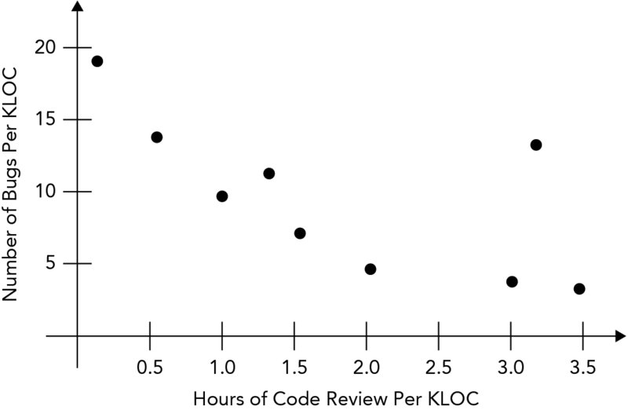
Process Metrics
Measure the development process.
Collect over a long period of time
over many projects.
Use to improve your development process.
Example:
  Spend 1.5 to 2 hours
  per KLOC in future
  projects.
  KLOC: thousand
  lines of code
Beginning Software Engineering
by Rod Stephens
Wrox, 2015

Slide 35
Project Metrics
Measure a specific project.
Use to set project goals.
  Example: Write ten use cases per day.

Slide 36
Objective Project Metrics
Cost and effort
  $$$
  person-hours
Defect rates
  number of bugs discovered over time
Lines of code
  average LOC per day, or per developer per day
Pages of documentation

Slide 37
Subjective Project Metrics
Sufficiency
  Satisfies all requirements.
Robustness
  Recovers from all anomalous events.
Flexibility
  Easily adaptable to changes.
Reusability
  Can be reused in related applications.

Slide 38
Subjective Project Metrics, cont’d
Efficiency
  Meets speed and resource requirements.
Reliability
  Achieves the required mean time between failures.
Scalability
  Is the basis for a version with greater scope.
Security
  Resists security breaches.

Slide 39
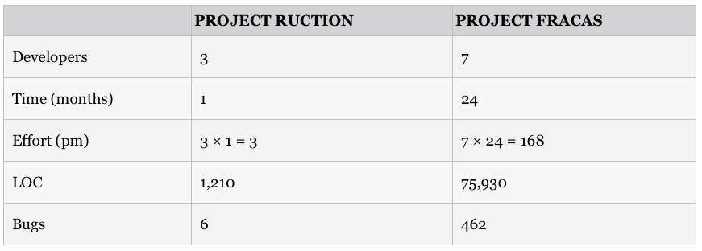
Metric Normalization
In which project were the developers
more productive?
Beginning Software Engineering
by Rod Stephens
Wrox, 2015

Slide 40
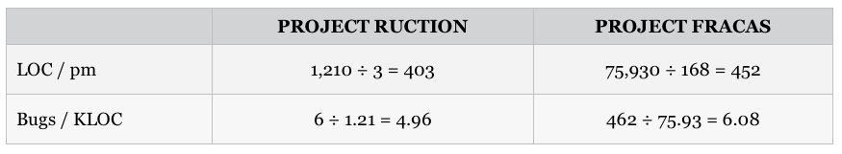
Size-Oriented Normalization
Divide each attribute value by the project size.
Project Fracas was more productive in terms of lines of code.
Project Ruction had less buggy code.
Beginning Software Engineering
by Rod Stephens
Wrox, 2015

Slide 41
Function Point Normalization
Calculate an FP number to measure
the application’s complexity.
  Measure a project from the user’s point of view.
  Count what an application does, not how it does it.
Function points
  inputs: how many times internal data is updated
  output: how many times output occurs
  inquiries: how many query/response actions
  internal files: number of logical files
  external files: number of files used that are managed by external programs (such as databases)

Slide 42
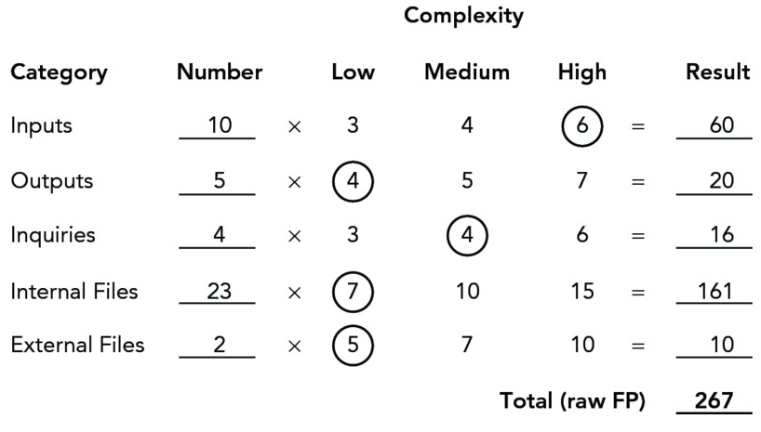
Function Point Normalization, cont’d
Multiply each FP metric by a complexity factor and sum up the products to get a total (raw) FP.
  Example:
Beginning Software Engineering
by Rod Stephens
Wrox, 2015

Slide 43
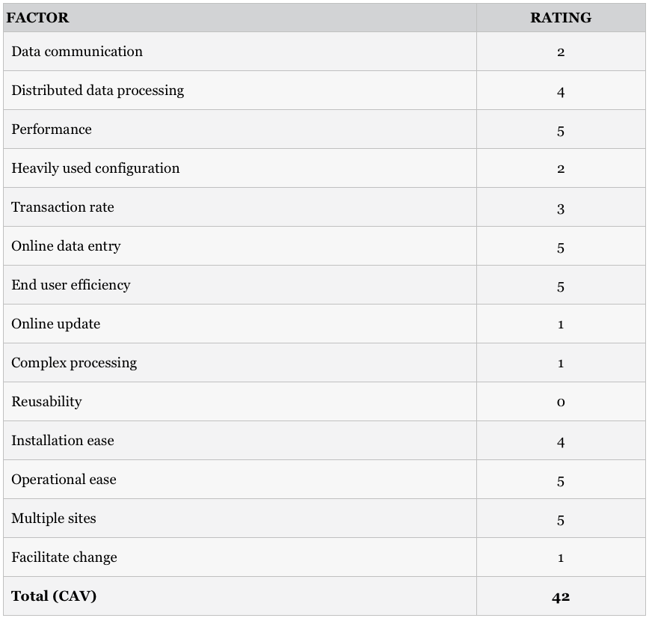
Function Point Normalization, cont’d
Calculate the complexity adjustment value (CAV)
  Example:
Importance | Rating
Irrelevant | 0
Minor | 1
Moderate | 2
Average | 3
Significant | 4
Essential | 5
Beginning Software Engineering
by Rod Stephens
Wrox, 2015

Slide 44
Function Point Normalization, cont’d
Calculate the final FP:
  Example: FP = 267 x (0.65 + 0.01 x 42) = 285.69
FP = (raw FP) x (0.65 + 0.01 x CAV)

