Slide 1



CS 160 and CMPE/SE 131
Software Engineering
April 14 Class Meeting
Department of Computer Science
Department of Computer Engineering
San José State University
Spring 2016
Instructor: Ron Mak
www.cs.sjsu.edu/~mak

Slide 2
Profiling
Collect statistics about your program execution.
How many times was each statement executed?
How long does your program spend
in each method?
How many bytes and how many objects
of each type does your program create?
Google “Rails profiling tools”

Slide 3

A Good Book on Web Usability

Slide 4
Definitions of Usability
Useful
  Does it do something people need done?
Learnable
  Can people figure out how to use it?
Memorable
  Do they have to relearn it each time they use it?
Effective
  Does it get the job done?

Slide 5
Definitions of Usability, cont’d
Efficient
  Does it do it with a reasonable amount
  of time and effort?
Desirable
  Do people want it?
Delightful
  Is using it enjoyable, or even fun?
“A person of average (or even below average) ability and experience
can figure out how to use the thing to accomplish something without
it being more trouble than it’s worth.”
Don’t Make Me Think, Revisited
by Steve Krug
New Riders, 2014

Slide 6
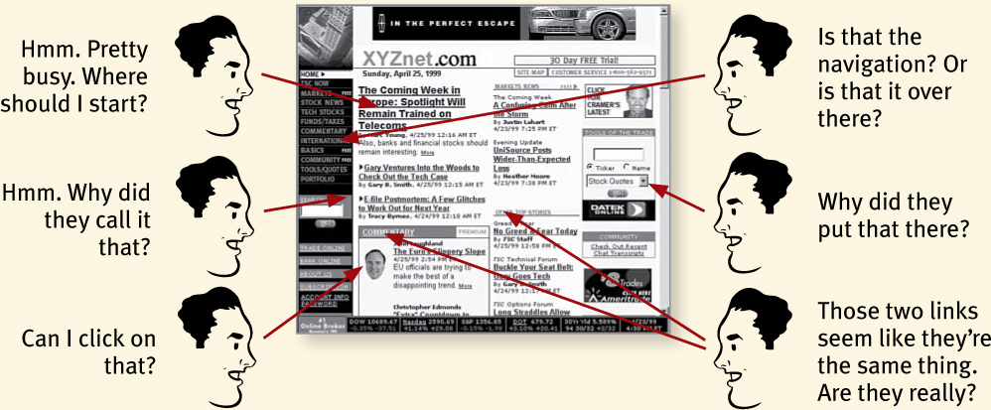
Don’t Make Me Think
You don’t want users to have to
think about your page.
Don’t Make Me Think, Revisited
by Steve Krug
New Riders, 2014

Slide 7
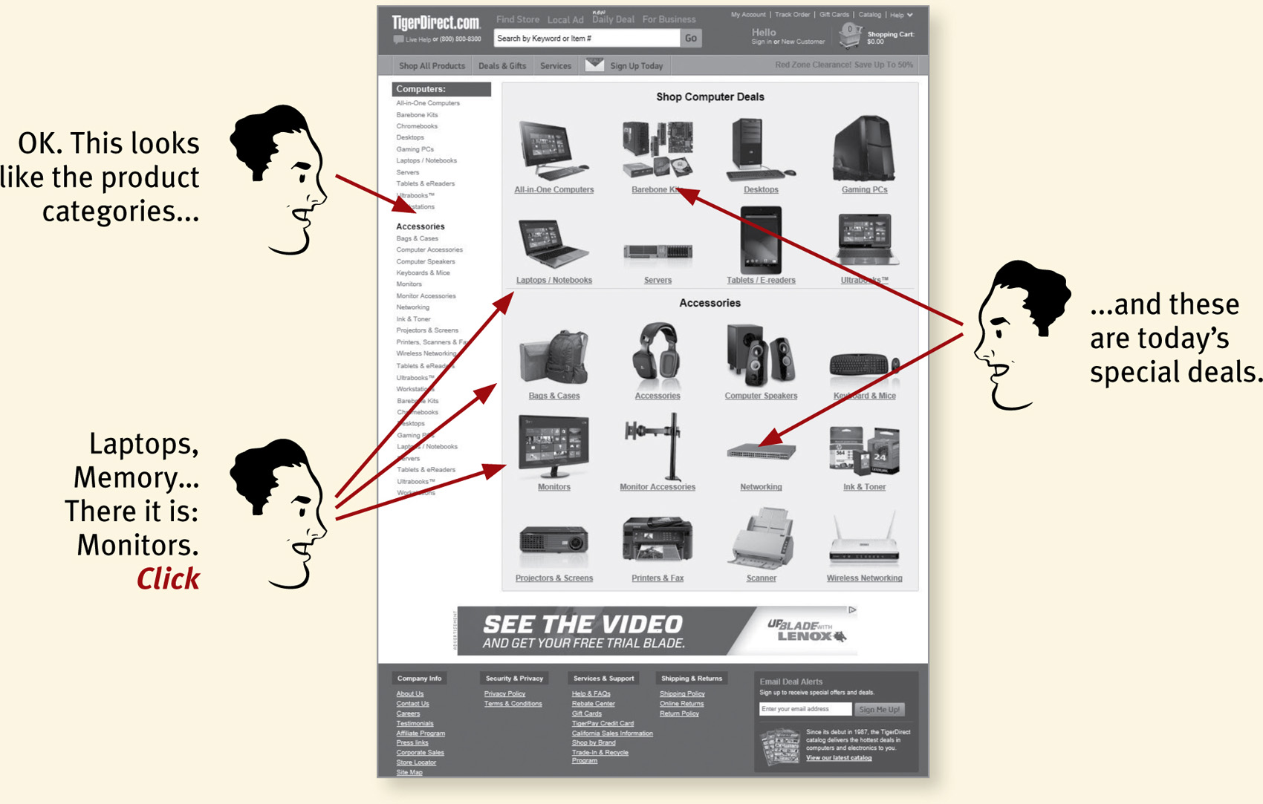
Don’t Make Me Think, cont’d
Things should be immediately obvious.
Don’t Make Me Think, Revisited
by Steve Krug
New Riders, 2014

Slide 8
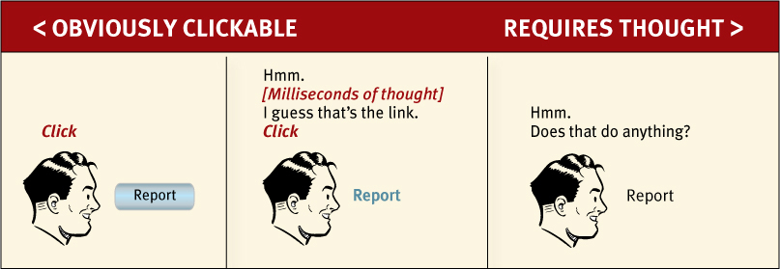
Don’t Make Me Think, cont’d
What is clickable?
Don’t Make Me Think, Revisited
by Steve Krug
New Riders, 2014

Slide 9
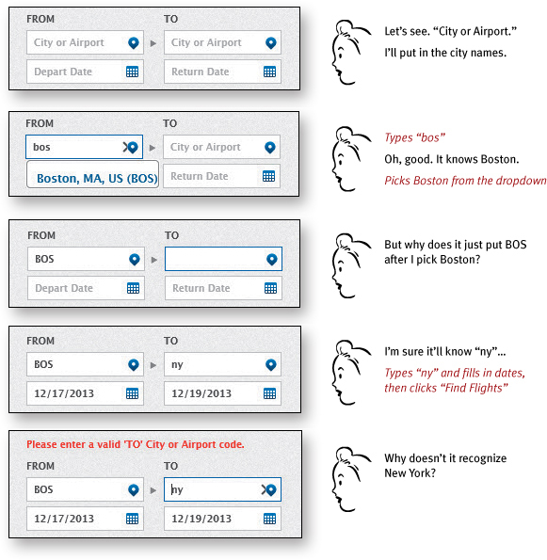
Don’t Make Me Think, cont’d
Booking a flight
Don’t Make Me Think, Revisited
by Steve Krug
New Riders, 2014

Slide 10
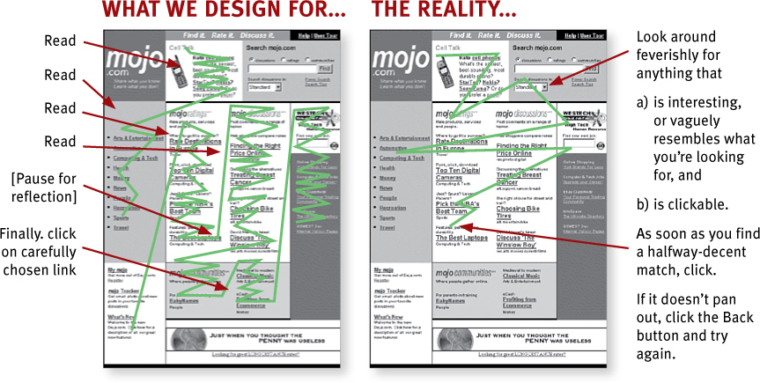
Users Don’t Read Pages
Users scan web pages.
Don’t Make Me Think, Revisited
by Steve Krug
New Riders, 2014

Slide 11
Users Scan Web Pages
Users use the web to get something done.
Users know they don’t have to read everything.
Scanning is a basic skill.
Therefore, it must be easy to find
the key components of a web page.
Format pages to facilitate scanning.

Slide 12
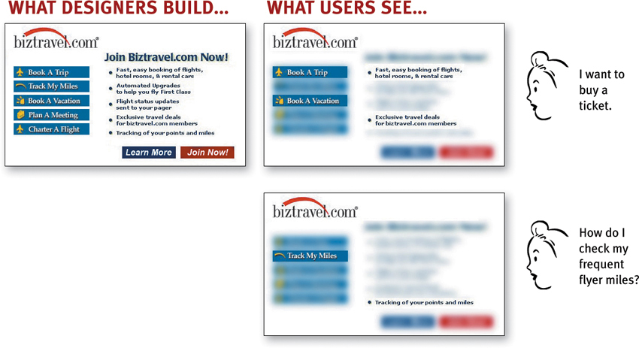
Users Scan Web Pages, cont’d
Don’t Make Me Think, Revisited
by Steve Krug
New Riders, 2014

Slide 13
Users “Satisfice”
Users don’t make optimal choices when looking for desired items on web pages.
Instead, users “satisfice” – they make the first reasonable choice.
  satisfice = a made-up word that combines
  “satisfy” + “suffice”

Slide 14


Follow Conventions
Don’t Make Me Think, Revisited
by Steve Krug
New Riders, 2014

Slide 15
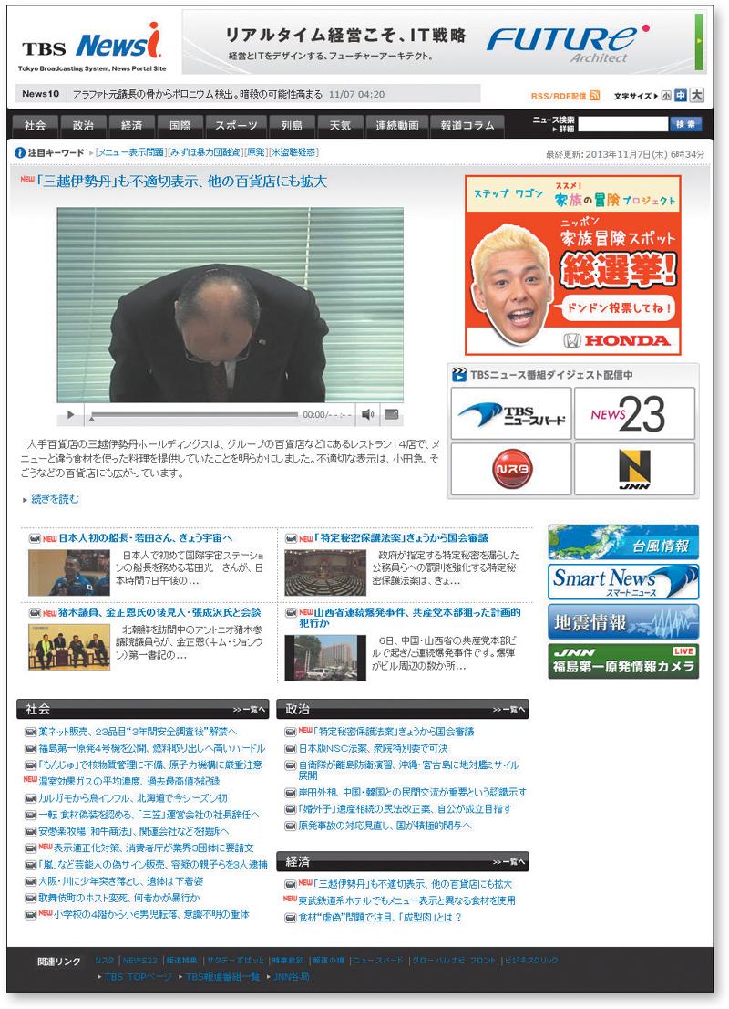
Follow Conventions, cont’d
Even if you don’t read Japanese, you can figure out what’s on this page.
Don’t Make Me Think, Revisited
by Steve Krug
New Riders, 2014

Slide 16
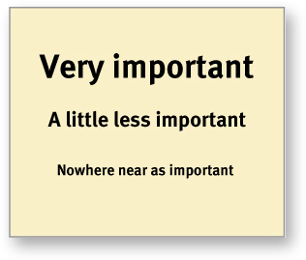
Create Effective Visual Hierarchies
The more important something is,
the more prominent it should be.
Don’t Make Me Think, Revisited
by Steve Krug
New Riders, 2014

Slide 17
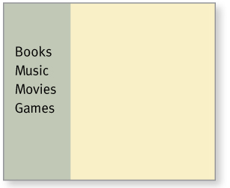
Create Effective Visual Hierarchies, cont’d
Things that are related logically
should be related visually.
Don’t Make Me Think, Revisited
by Steve Krug
New Riders, 2014

Slide 18
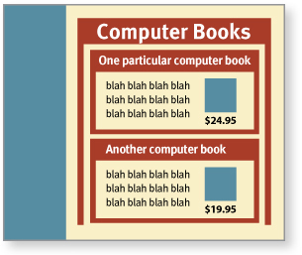
Create Effective Visual Hierarchies, cont’d
Use nesting to show what is part of what.
Don’t Make Me Think, Revisited
by Steve Krug
New Riders, 2014

Slide 19
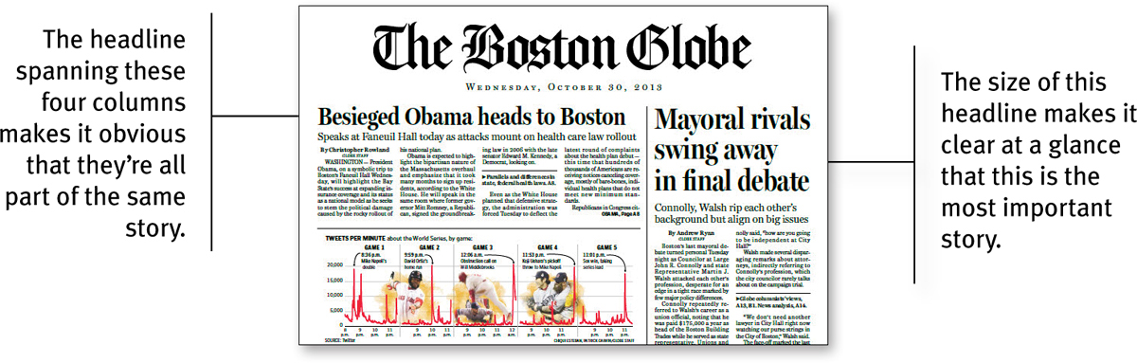
Create Effective Visual Hierarchies, cont’d
Don’t Make Me Think, Revisited
by Steve Krug
New Riders, 2014

Slide 20
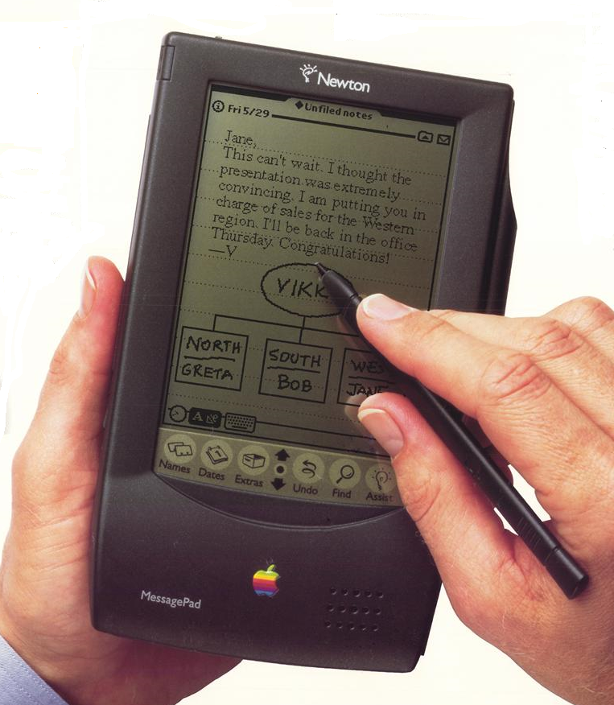
Usability Testing: The German Newton
The Apple Newton MessagePad was an “iPad” developed in the early 1990s.
  Besides the English version, there was a German and a Japanese version.
It was too far ahead of its time and was killed by Steve Jobs shortly after he returned to Apple.

Slide 21
Usability Testing: The German Newton, cont’d
A key feature of the Newton was its
handwriting recognition.
  Handschrifterkennung in the German version.
The Newton recognized successive words
in a sentence using an algorithm that
tracked the movement of the stylus.
  Not by optical pattern recognition.
Cultural differences between
Americans and Germans.

Slide 22
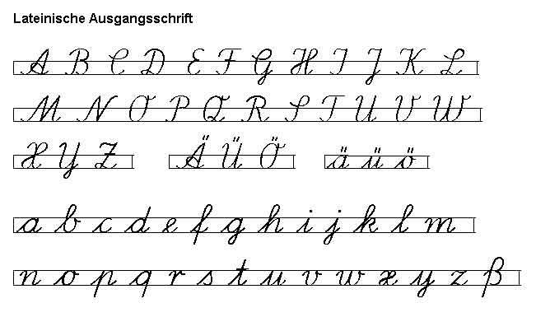
Usability Testing: The German Newton, cont’d
The way the Germans write their letters:
    In order to demo the German Newton, I had to buy a child’s handwriting book in order to learn to write like a German.

Slide 23
Usability Testing: The German Newton, cont’d
The way the Germans write words,
especially the (many) compound words
  Example: Geschäftsreise “business trip”).
Philosophical differences with regards to personal handwriting.
  Americans were willing to alter their handwriting in order to make the Newton recognize their words.
  The Germans, on the other hand …

Slide 24
Beta Testing: NASA Mars Rover Mission
Beta testing for the Collaborative Information Portal (CIP) software system.
NASA’s Jet Propulsion Laboratory (JPL) conducted several Operational Readiness Tests (ORTs) before the actual rovers landed.

Slide 25
Beta Testing: NASA Mars Rover Mission, cont’d
Operational Readiness Tests (ORTs)
A working rover was inside of a large “sandbox” in a separate warehouse building at JPL.
Mission control personnel communicated with and operated the sandbox rover as if it were actually on Mars.
A built-in delay simulated the signal travel time
between Earth and Mars.

Slide 26
Beta Testing: NASA Mars Rover Mission, cont’d
Mission scientists accessed and analyzed the data and images downloaded by the sandbox rover.
All mission software, including CIP, was intensely tested in this simulated environment.

Slide 27
System Testing
Test the entire application in its
operating environment.
  Part of beta testing.
  Rerun all regression tests
  Installation testing
  Performance testing
  Stress testing
  Usability testing

Slide 28
Acceptance Testing
Can be performed by the clients.
Signoff by stakeholders, clients, and customers.

Slide 29
When can you stop testing?
“Testing can prove the presence of bugs,
but never their absence.”
Stop testing when:
  All the regression tests pass.
  Testing finds only “acceptable” bugs.
    Put on the Known Bugs list.
    Have workarounds.
  When you’ve run out of time.

Slide 30
Test Plan
Part of the product design documentation.
Description of each functional, performance, and stress test case.
  Each test case should be traceable to a functional
  or nonfunctional requirement or to a use case.
How the unit tests will be generated.
Description of each regression test script.

Slide 31
Test Plan, cont’d
How to run each test:
  Input data
  Manual operations (text input, menu selection, button press, etc.)
  Expected output.
Acceptance criteria (success/failure).

Slide 32
Test Plan, cont’d
Integration testing procedure.
Description of each usability test.
  Who will be the guinea pigs?
Description of each system test.
  What are the beta test sites?
Description of each acceptance test.
  Signoff checklist

Slide 33
Example Functional Test Case
Name
  Compute Square Root
Purpose
  Test that the “Square Root Calculator” website can compute the square root of a value that is zero or positive.

Slide 34
Example Test Case Specification, cont’d
Manual operations
  Enter 0 or a valid positive number into the text field.
    The number may have a + sign and a single decimal point.
    The maximum value of the number can be 99999999
  Press the Submit button.
Expected results
  THE SQUARE ROOT OF number IS sqrt
  where number is the number entered into the text field and sqrt is the correct square root of the number.
Acceptance criteria
  The square root is accurate to within 8 significant digits.

Slide 35
Example Test Case Specification, cont’d
Manual operations
  Enter a negative number into the text field.
    The minimum value of the number can be -99999999
  Press the Submit button.
Expected results
  Message ERROR: number MUST BE POSITIVE
  where number is the number entered into the text.
Acceptance criteria
  The error message appears.
  Another number can be entered
  (the program did not crash).

Slide 36
Assignment #7
Write 10 functional test cases for your project.
Each test case should have:
  name
  purpose
  manual operations (including input)
  expected results
  acceptance criteria
Submit to Canvas: Assignment #7
Due Friday, April 22.
Repeat 3, 4, and 5
as often as necessary.

Slide 37
Test-Driven Development (TDD)
A programming practice originally from the Extreme Programming (XP) methodology but which is starting to catch on elsewhere.
Basic idea: Before adding a new feature to your application, first write a test case for it.
  A unit test.
  Of course, the test will fail, because you haven’t written the code for the feature yet.

Slide 38
Test-Driven Development (TDD), cont’d
Writing the test case first forces you to:
  Understand what the feature is supposed to do based on its requirements and use cases.
  Design a good API for the feature.
… before writing the code.

Slide 39
Test-Driven Development (TDD), cont’d
“Traditional” agile programming cycle:
DESIGN
CODE
TEST
COMMIT
TDD programming cycle:
DESIGN
TEST
CODE
COMMIT
Your goal as a developer:
  Make your code pass its test.

Slide 40
Logging
Add special logging statements
to your application.
  Generate output to a log file.
  Can be just simple print statements.
Each logging statement logs (writes) a message containing useful information about the application’s execution.
  “I am here.” – Execution reached this point.
  Status information at that point.
  The log file provides a history
  of the application’s execution.

Slide 41
Logging, cont’d
Logs are useful if a failure occurred.
  Status of the erroneous condition
  leading up to the failure.
  Status at the point (or just before)
  the failure occurred.
Turn logging off before deployment,
or leave it on.
  Perform “log mining” to glean useful information about how the application is used and how it’s behaving.

Slide 42
Log Example: Mars Rover Mission
2004-12-20 20:23:33,435 INFO : mjane: Streamer.putDataFile(/opt/bea/user_projects/cip/
conf/preferences/m.preferences)
2004-12-20 20:23:33,439 DEBUG: Begin upload of file '/opt/bea/user_projects/cip/conf/
preferences/sthompso.preferences'
2004-12-20 20:23:39,140 DEBUG: Completed upload of file '/opt/bea/user_projects/cip/conf/
preferences/sthompso.preferences': 35659 bytes
'/opt/bea/user_projects/cip/conf/global.properties': 13453 bytes
2004-12-20 20:28:57,516 INFO : jdoe: Streamer.getPreferences(user)
2004-12-20 20:29:29,721 INFO : jdoe: Streamer.getFileInfo()
2004-12-20 20:29:30,784 INFO : jdoe: Streamer.getFileInfo(/oss/merb/ops/ops/surface/
tactical/sol)
2004-12-21 19:17:43,320 INFO : jqpublic: Streamer.getDataFile(/global/nfs2/merb/ops/ops/
surface/tactical/sol/120/opgs/edr/jpeg/1P138831013ETH2809P2845L2M1.JPG)
2004-12-21 19:17:43,324 DEBUG: Begin download of file '/global/nfs2/merb/ops/ops/surface/
tactical/sol/120/opgs/edr/jpeg/1P138831013ETH2809P2845L2M1JPG'
2004-12-21 19:17:44,584 DEBUG: Completed download of file '/global/nfs2/merb/ops/ops/
surface/tactical/sol/120/opgs/edr/jpeg/1P138831013ETH2809P2845L2M1.JPG': 1876 bytes
Timestamp, user name, method name
Information about the uploaded
or downloaded file

Slide 43
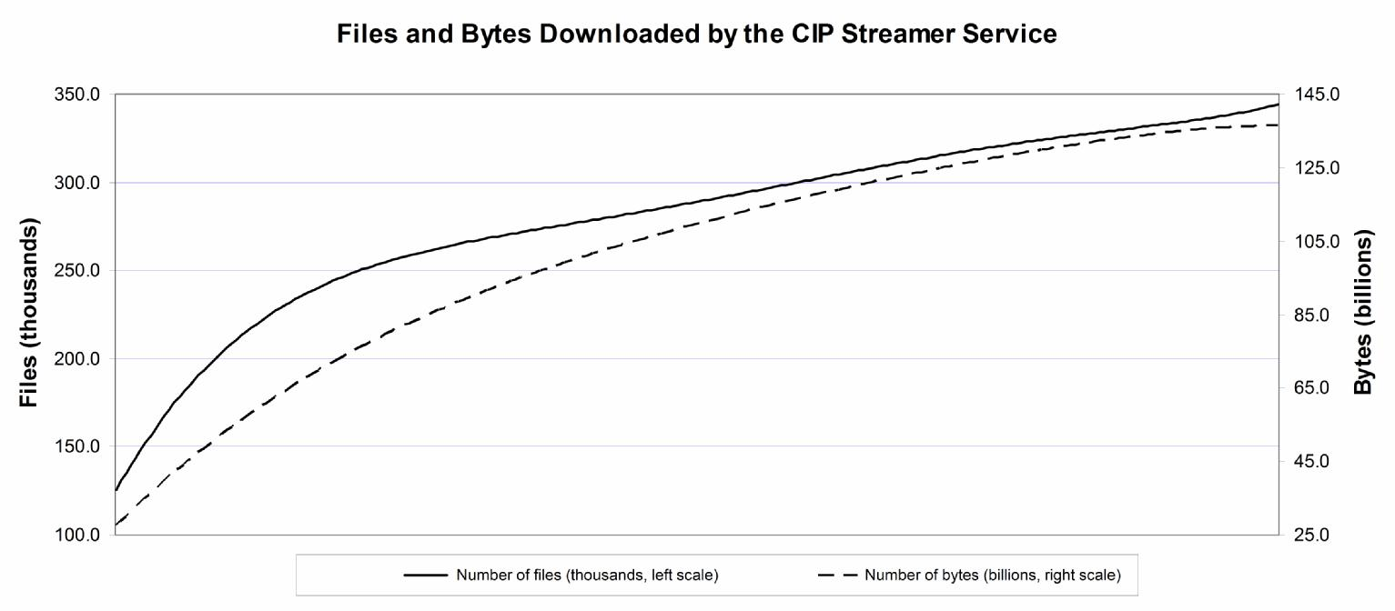
“Log Mining” Example: Mars Rover Mission

Slide 44
Rails Support for Logging and Debugging
Look in file log/development.log.
The Rails logger uses severity levels:
  :debug :info :warn :error :unknown
Set the desired severity level.
The logger adds to the log only those messages whose severity level is higher than the official severity level.
Learn to use Rail’s logger and debugger.
  See Chapter 13 of the Rails Crash Course book.

